Slide 1
Discrete Fourier Transform
  Ajit S. Bopardikar
  Conexant Systems Pvt. Ltd.
  Hyderabad

Slide 2
Overview
Introduction to the DFT: How to calculate DTFT at the discrete set of points?
Properties of DFT
Operations involving DFT

Slide 3
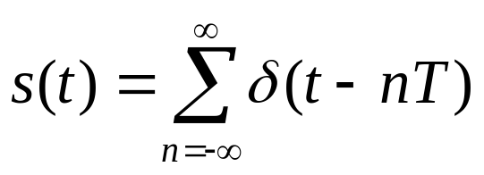
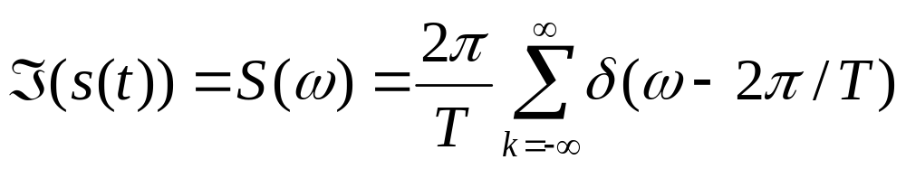
Remember
Convolution in time/space domain is multiplication in the frequency domain and vice versa
Fourier transform of an impulse train in time domain is another impulse train in the frequency domain

Slide 4
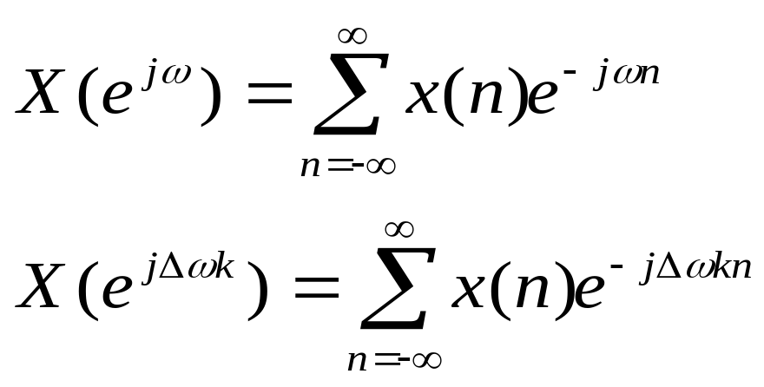

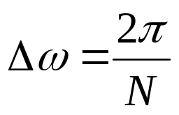
Sampling in Frequency
If we take N samples in the interval

Slide 5
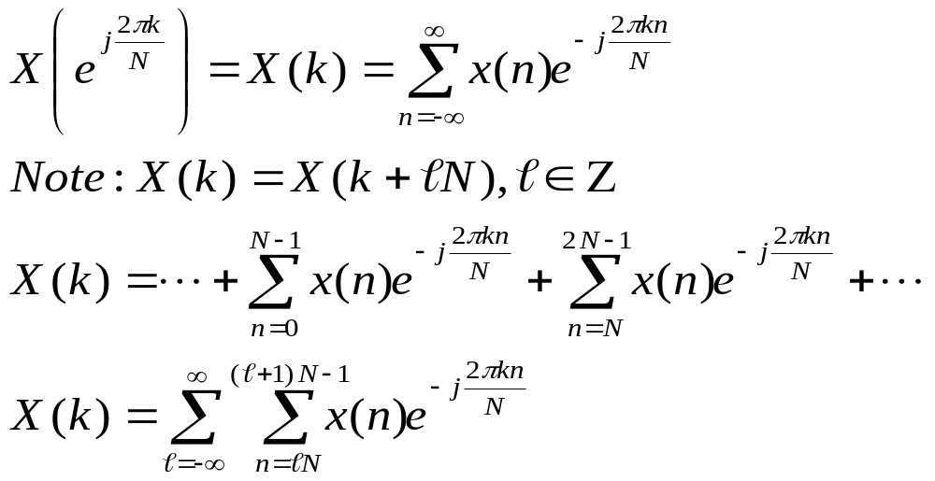
Sampling in Frequency

Slide 6
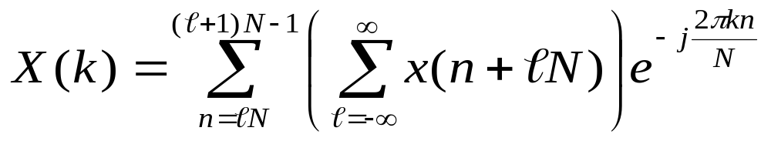

Sampling in Frequency
Change in variable gives
Input assumed to be a periodic signal with a period of N.
Periodic signal derived from input by adding versions of the input signal shifted by

Slide 7
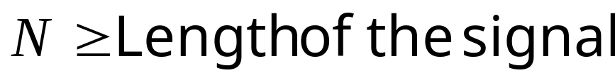
Sampling in Frequency
When do the frequency samples fully represent the signal?
  When the signal and its N-shifted versions do not overlap
  When there is no aliasing in the time/spatial domain
The equation is known as the forward DFT
In event of no aliasing, how do you get back the N signal samples?

Slide 8
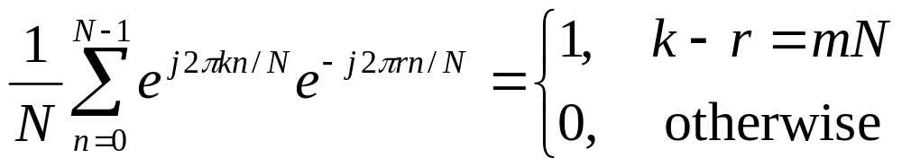
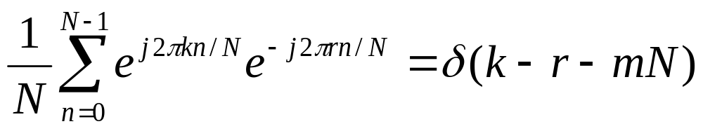
Orthogonality of Complex Exponentials: Identity

Slide 9
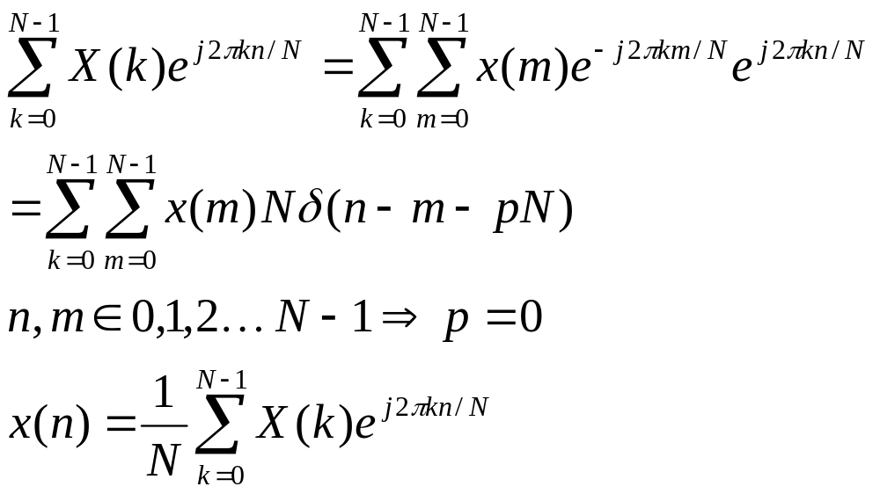
Recovering x(n) from X(k)‏

Slide 10
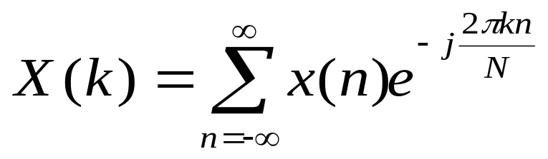
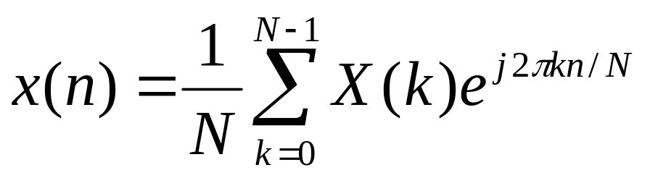
DFT-IDFT Pair
DFT
IDFT

Slide 11
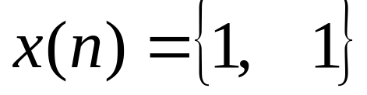
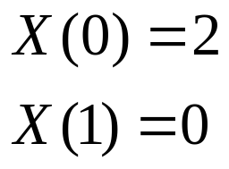
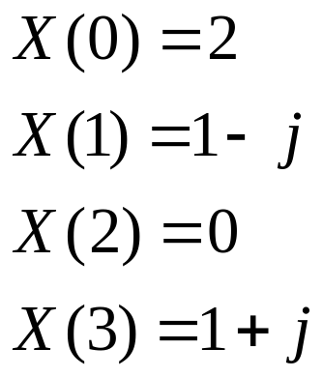
DFT Example
2-point DFT
4-point DFT

Slide 12
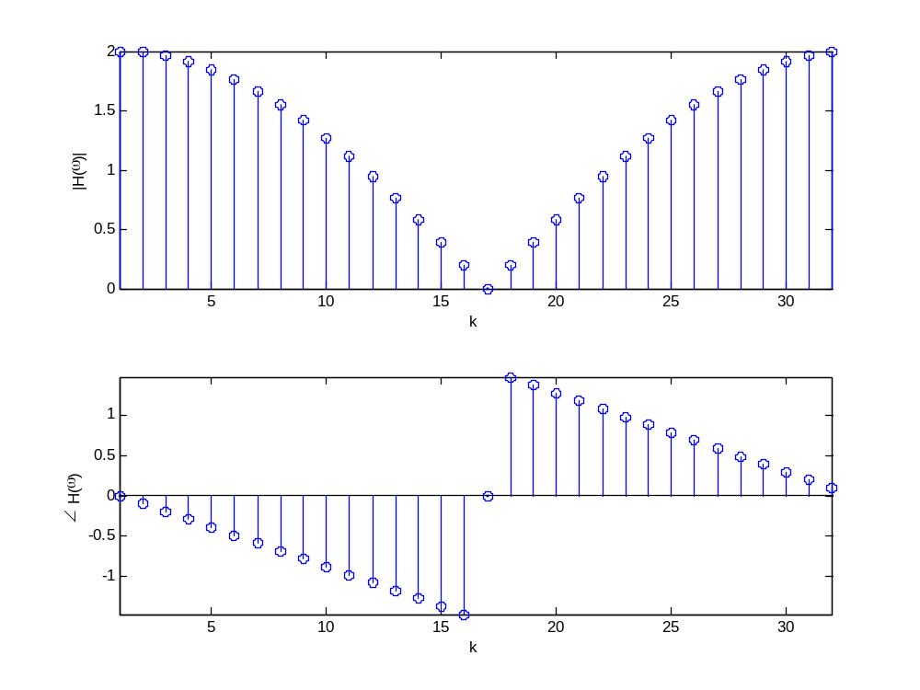
DFT Example: 32 Point

Slide 13
DFT: Number of Points
Zero padding does not provide additional information about the spectrum of the signal
Zero padding allows for better resolution of the Fourier transform

Slide 14
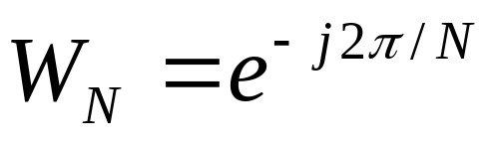
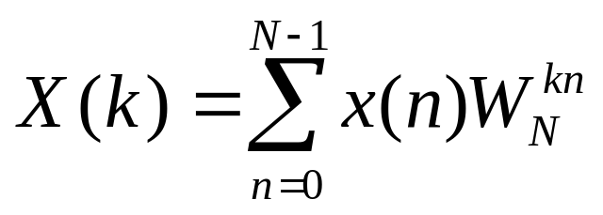
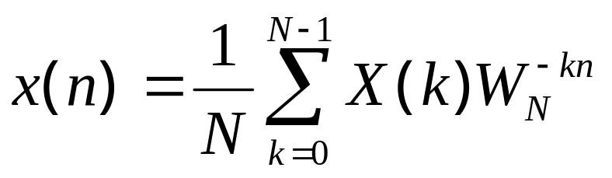
Notation for DFT and IDFT
Define
DFT
IDFT

Slide 15
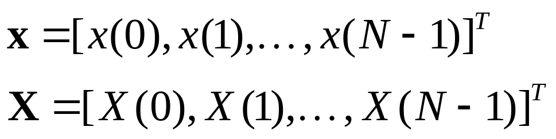
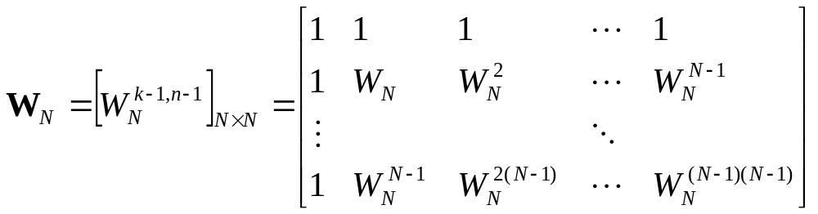
Linear Transformation Interpretation

Slide 16
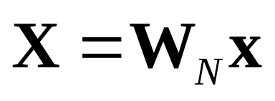
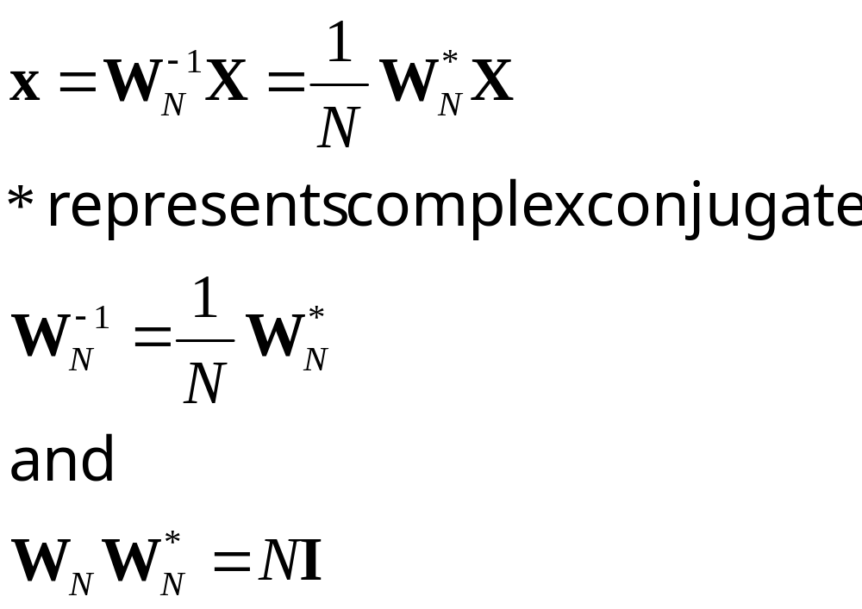
Linear Transformation Interpretation

Slide 17
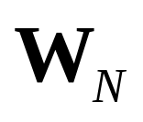
Linear Transformation Interpretation
The matrix is said to be unitary or orthogonal matrix

Slide 18
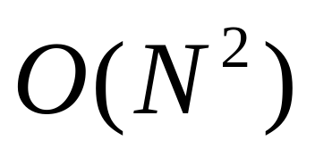
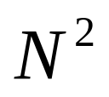
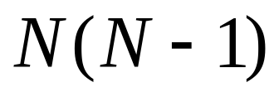
Complexity
For each point of the DFT, you need N complex multiplications and N-1 complex additions
Complete DFT computed in complex multiplications and
complex additions
Likewise for IDFT

Slide 19
Complexity
Structure of the matrix and hence DFT can be used to speed up the computations and derive fast algorithms collectively called Fast Fourier Transforms (FFT)‏

Slide 20
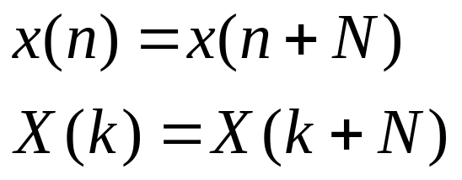
Properties
Periodicity
Linearity

Slide 21
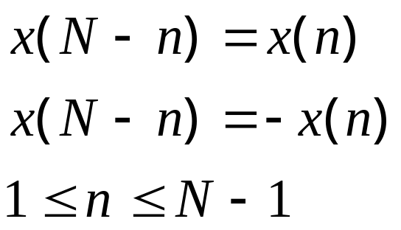
Properties
Any sequence, periodically extended, can be represented as evenly spaced points on a circle
Circularly even: Symmetric about point 0 on the circle. Likewise, Circularly odd

Slide 22
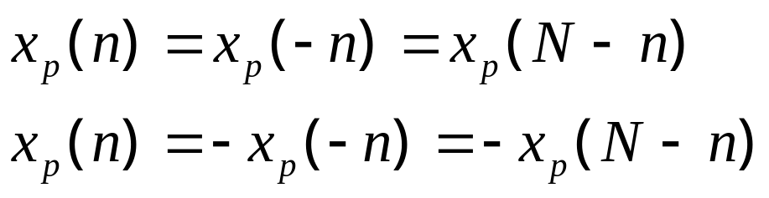
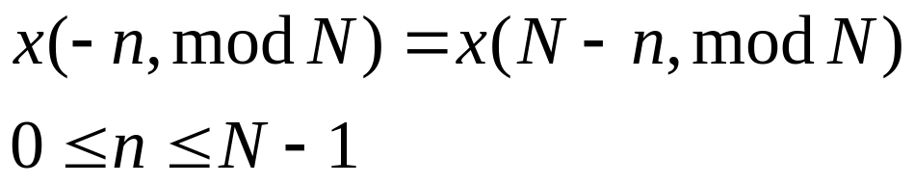
Properties
Even and Odd Sequences
Time reversal

Slide 23
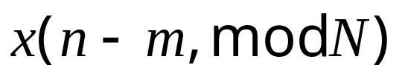
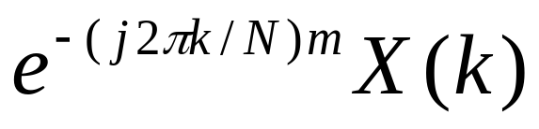
Properties
Circular Shift: What is the DFT of a circularly shifted sequence?
Answer
A circular shift of a N-point sequence is equivalent to a linear shift of a N-periodic extension

Slide 24
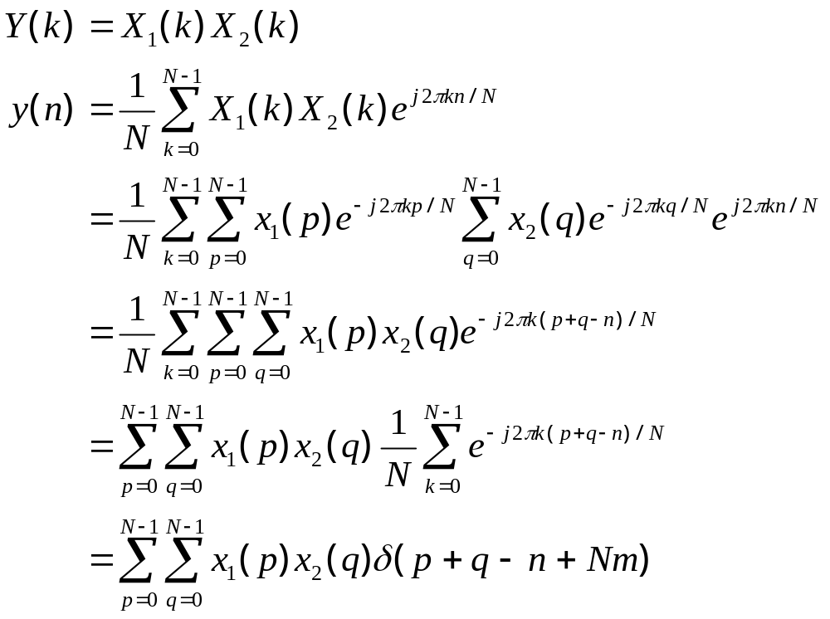
Multiplication of Two DFT Sequences

Slide 25
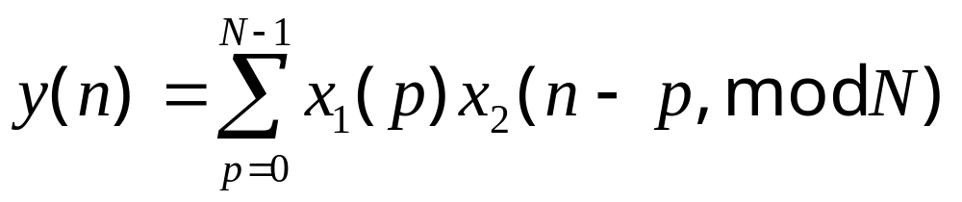
Multiplication of Two DFT Sequences
Multiplication of two DFT sequences is equivalent to circular convolution of the two sequences in the time/spatial domain

Slide 26
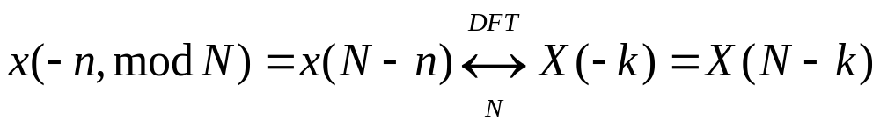
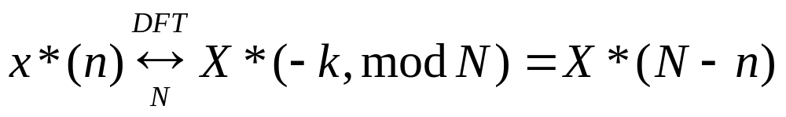
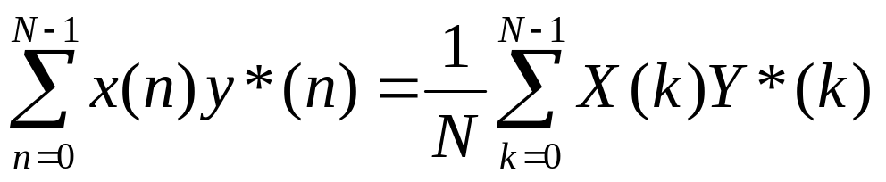
Properties
Time reversal
Complex Conjugate Properties
Parseval’s Theorem

Slide 27

Linear Filtering Based on DFT
Linear convolution of a sequence of length L with a sequence of length of length M results in a sequence of length L+M-1
Convolution can be performed in the Fourier domain

Slide 28
Linear Filtering Based on DFT
Multiplying DFTs results in circular convolution
DFTs of both sequences should have the same number of samples
For true convolution, both sequences need to be zero padded so that their length is M+L-1
Then DFT for both sequences is computed
DFTs are multiplied and IDFT computed to give the convolution sequence

Slide 29
Filtering Long Data Segments using DFT
Impractical to filter a very long stream of data at the same time
Memory and time constraints, especially in real time
Data is segmented and filtered
How do you ensure that the resulting operation is a true convolution?

Slide 30
Assume…
Data segmented into blocks of length L
Filter has a fixed length M
L>>M

Slide 31
Overlap Save Method
Data segmented into N=M+L-1 samples
Each data block consists of M-1 samples from the previous block
Filter padded with L-1 samples
N-point DFT of the two multiplied
IDFT gives the first M-1 points of aliasing and last L points of true filtered signal

Slide 32
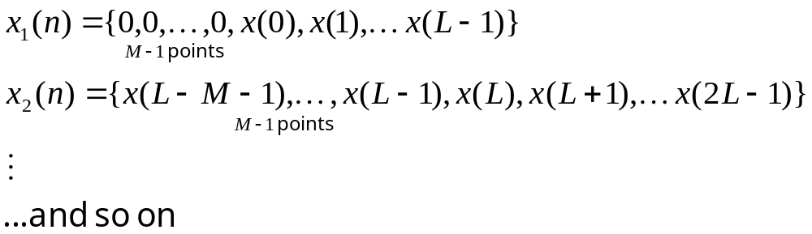
Overlap-Save Method
Save overlap from previous segment

Slide 33
Overlap Add Method
Size of the segment is L samples
L+M-1 point DFTs computed for filter and segment
These DFTs are multiplied and IDFT computed
IDFT gives true convolution of the filter and the segment
The overlapping M-1 segments from consecutive blocks are added

Slide 34
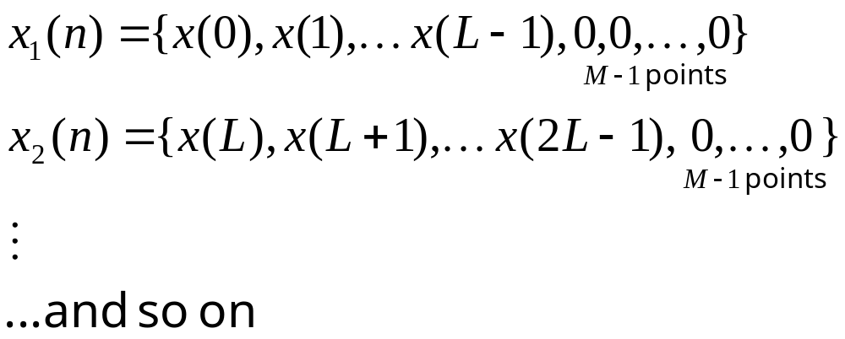
Overlap Save Method

Slide 35
Reading List
Proakis, J. G. and Manolakis, D. M.,”Digital Signal Processing: Principles, Algorithms and Applications,” Prentice-Hall, 1996

