Slide 1
The z-Transform
Ajit S. Bopardikar
Conexant Systems Pvt. Ltd.
Hyderabad

Slide 2
Introduction
Generalization of the DTFT
Encompasses a broader class of systems
Analytically convenient

Slide 3
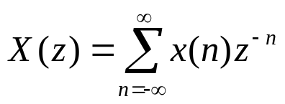
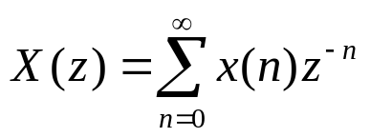


Definition
Bidirectional z-transform
Unidirectional z-transform

Slide 4



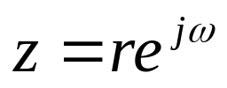
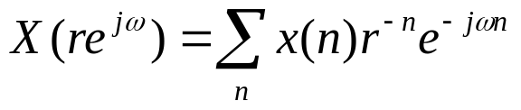
Interpretation
Complex z plane
In general complex z can be expressed as
z-Transform evaluated on the unit circle is the DTFT.

Slide 5







z-Transform: Examples
X(z) converges for all z except z=0

Slide 6



z-Transform: Examples
X(z) converges for all z except z=

Slide 7


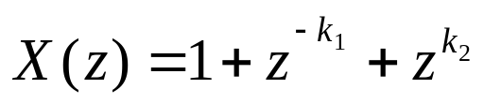
z-Transform: Examples
X(z) converges for all z except z=0 and z=

Slide 8
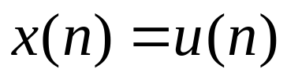
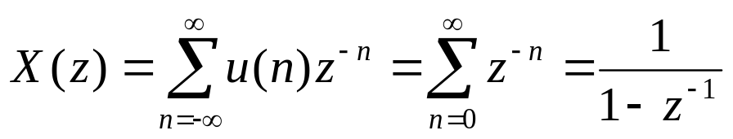

z-Transform: Unit Step
Region of Convergence

Slide 9

z-Transform: Unit Step
Fourier Transform does not converge.
x(n) is not absolutely summable

Slide 10
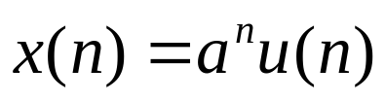
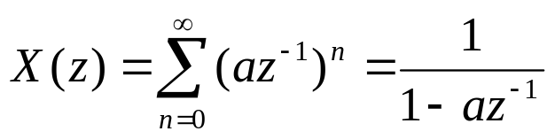
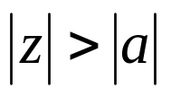
z-Transform: Example
Region of convergence

Slide 11
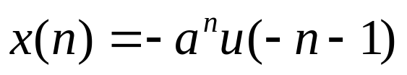
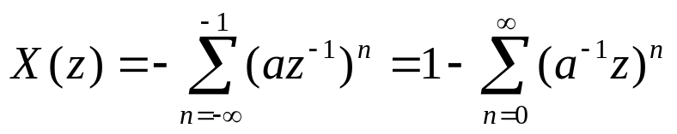
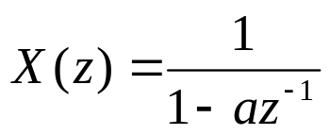
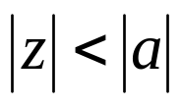
z-Transform: Example
Region of convergence

Slide 12
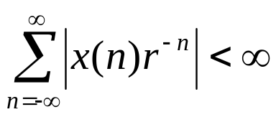
Convergence Issues
For any given sequence, one can define a region of convergence for which the z-transform converges
For absolute convergence
The z-transform may converge even when the DTFT may not
If the region of convergence includes the unit circle, the DTFT converges

Slide 13
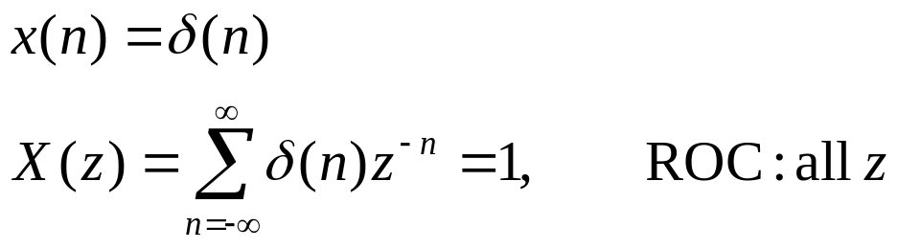
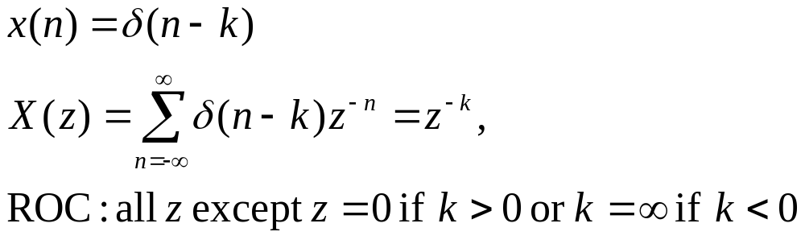
z-Transform: Examples
Unit impulse
Delay

Slide 14
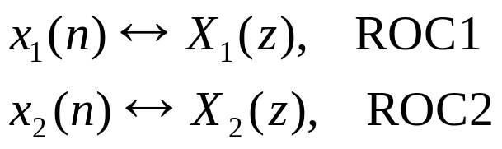
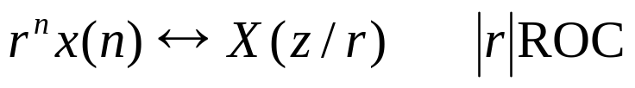
z-Transform: Properties
Linearity
Time shifting
Multiplication by an exponential sequence

Slide 15
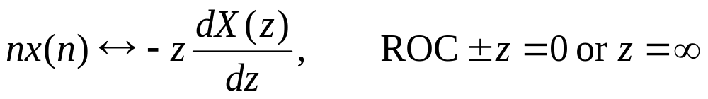


z-Transform: Properties
Differentiation
Complex Conjugate
Time Reversal

Slide 16


z-Transform: Properties
Initial Value Theorem: For a causal sequence
Convolution

Slide 17


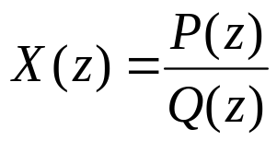

Poles and Zeros
Zeros: The value(s) of z for which X(z)=0
Poles: Value(s) of z for which X(z)=
Zeros: Roots of
Poles: Roots of

Slide 18

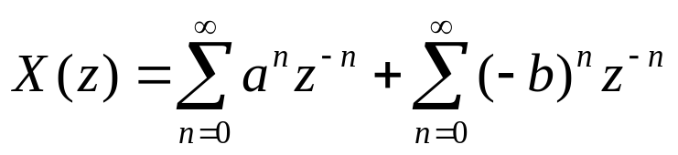
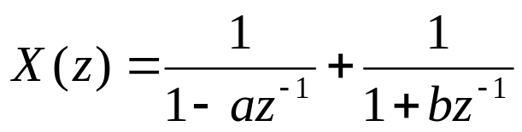
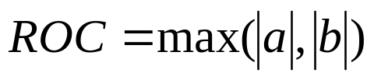
Poles and Zeros: Example

Slide 19
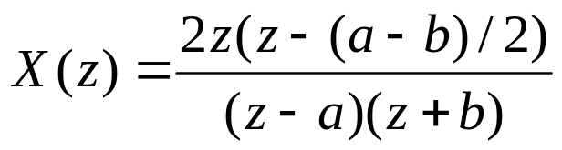




Poles and Zeros: Example
Poles at
Zeros at
ROC cannot contain any poles

Slide 20
Poles and Zeros: Right Sided Sequence
Region of convergence
ROC extends outwards from the outermost pole

Slide 21
Poles and Zeros: Left Sided Sequence
ROC
ROC extends inwards from the innermost pole

Slide 22
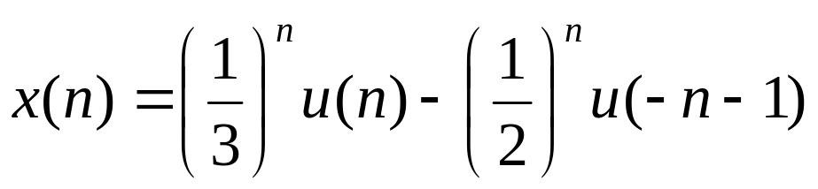
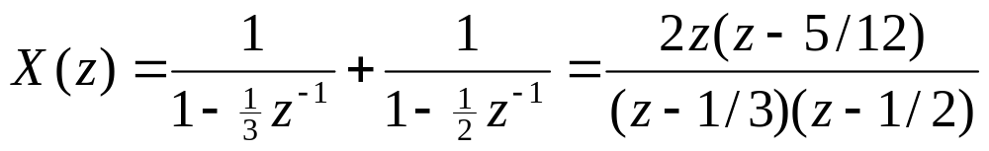
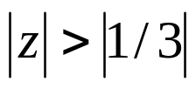
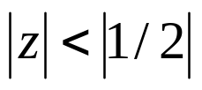
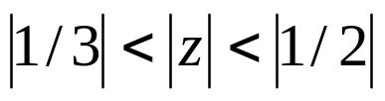
Poles and Zeros: Two Sided Sequence
ROC
The ROC of a two sided infinite sequence is a ring bounded on the
interior and exterior by a pole and does not contain any poles

Slide 23
Inverse z-Transform
Inspection
Partial Fraction Expansion
Power Series Expansion
Contour Integration Based

Slide 24
Inspection
Recognize by inspection certain transform pairs
Express the given z-transform in the form of one of the standard z-transforms

Slide 25
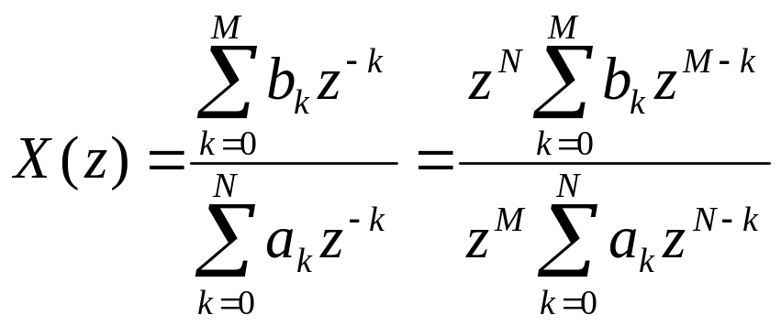
Partial Fraction Expansion
Suppose the z-transform is a rational polynomial
M zeros and N poles at non zero locations plus
N-M zeros at z=0 if M<N
M-N poles at z=0 if M>N
Equal number of poles and zeros.

Slide 26
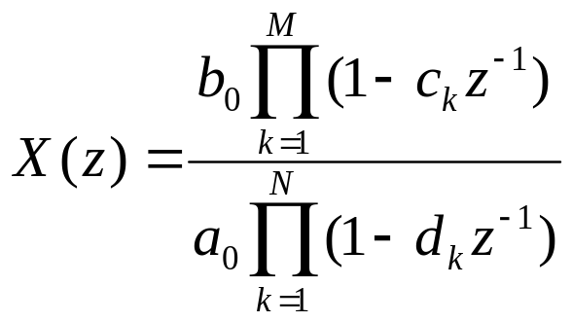

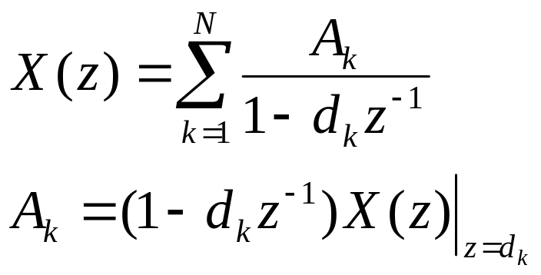
Partial Fraction Expansion: Distinct Poles
Non-zero zeros
Non-zero poles

Slide 27

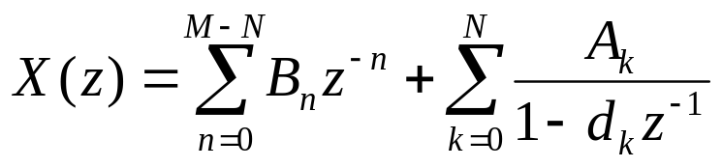
Partial Fraction Expansion
Perform long division of numerator by denominator till the remainder order is less than denominator.

Slide 28
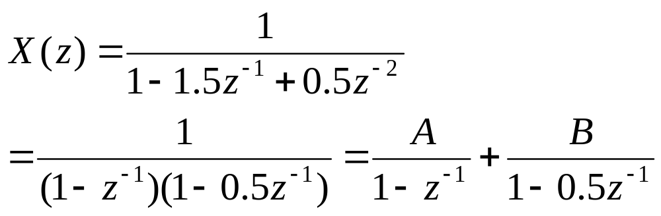
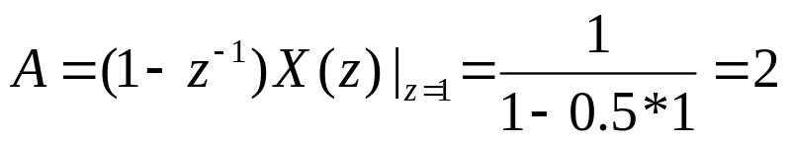
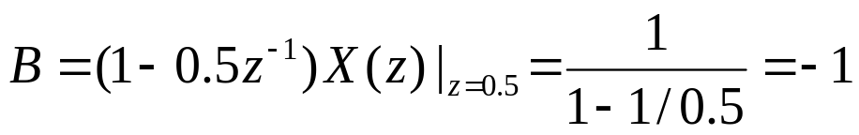
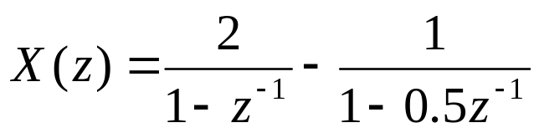
Partial Fraction Expansion: Example: Distinct Poles
Poles at z=1 and z=0.5

Slide 29
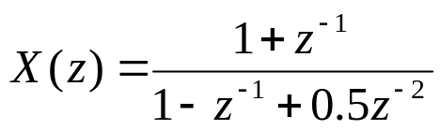

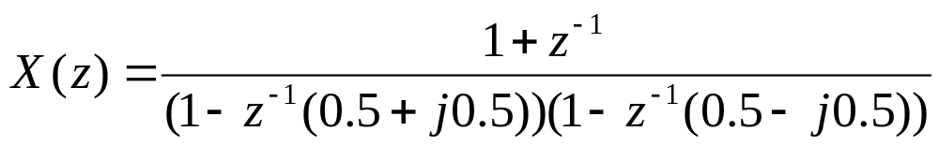
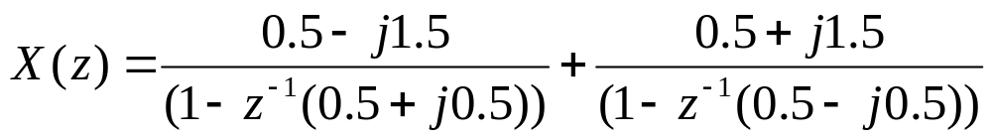
Partial Fraction Expansion: Example: Distinct Complex Conjugate Poles
Complex conjugate poles result in complex conjugate coefficients in the partial fraction expansion
Poles at

Slide 30
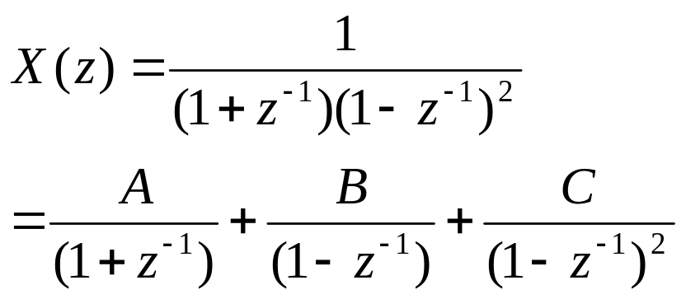




Partial Fraction Expansion: Multiple Poles: Example

Slide 31

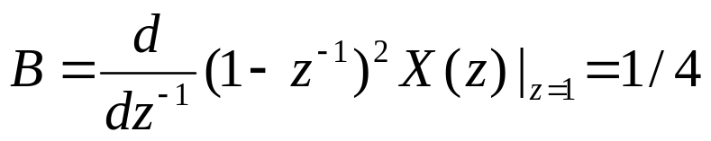
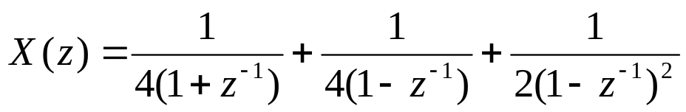
Partial Fraction Expansion: Multiple Poles: Example

Slide 32
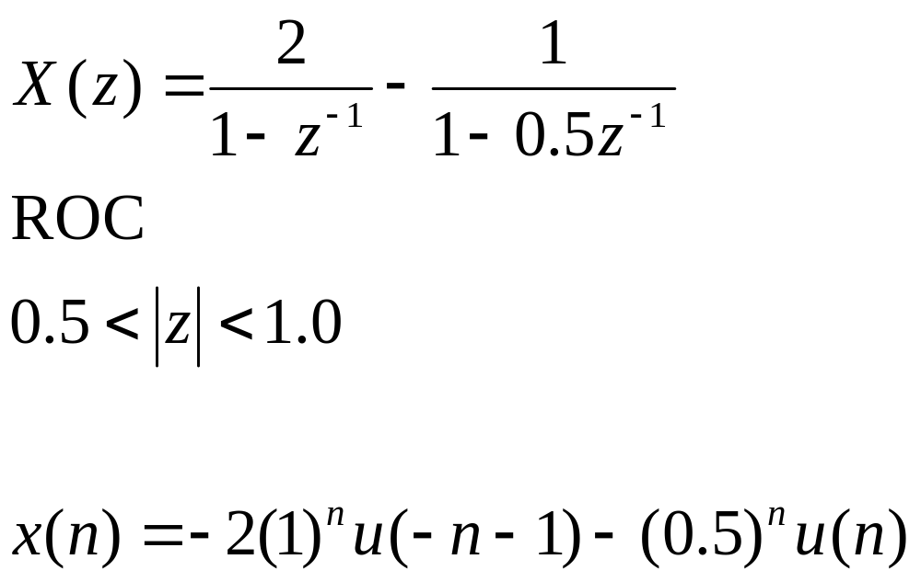
Partial Fractional Expansion: Using ROC for Inverse z-Transform

Slide 33
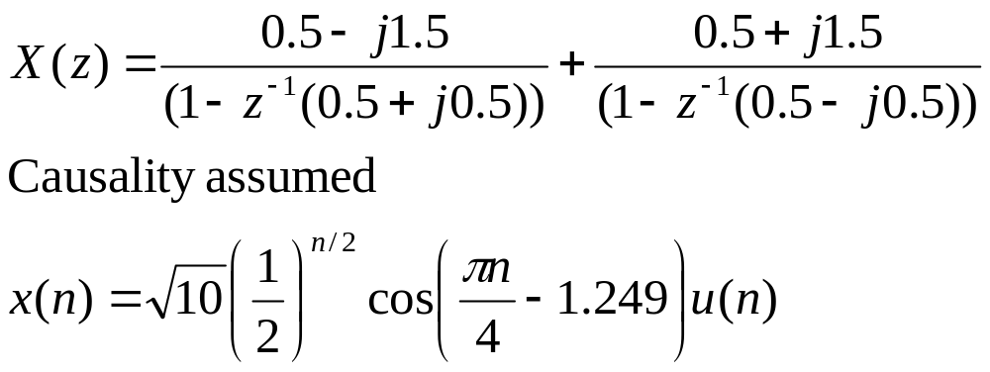
Partial Fractional Expansion: Using ROC for Inverse z-Transform

Slide 34
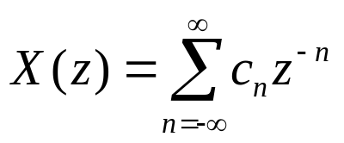
Power Series Expansion
Given a z-Transform and a corresponding ROC we can expand the z-transform into a power series of the form
By uniqueness x(n)=c_{n} for all n
For rational x(n) this expansion can be provided by long division

Slide 35
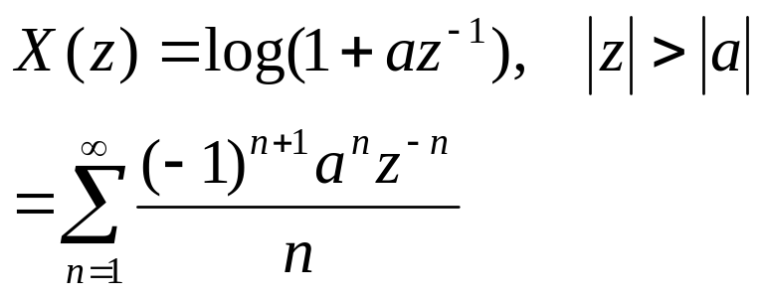
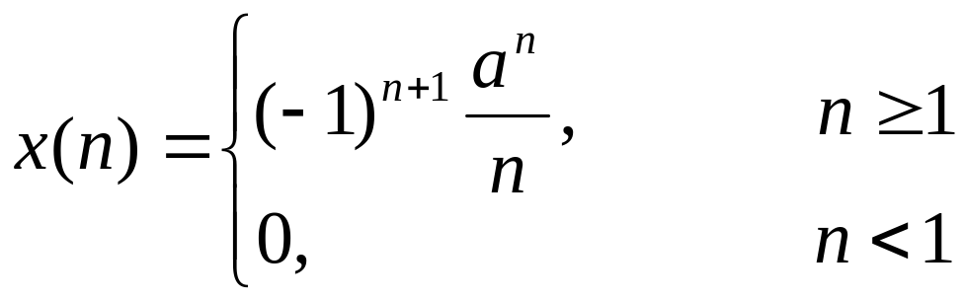
Power Series Expansion

Slide 36
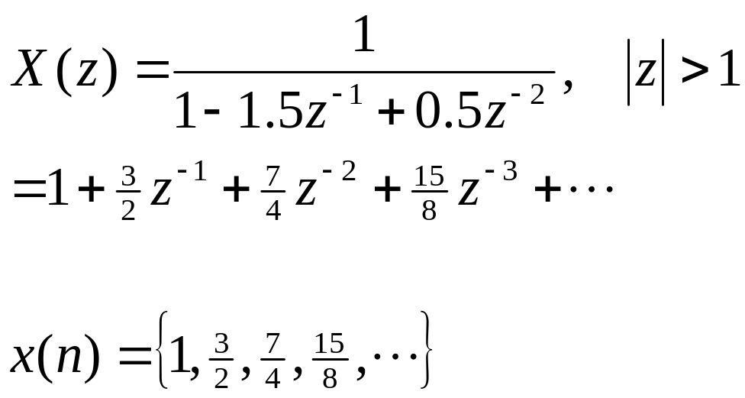
Power Series Expansion
ROC is exterior of a circle so power series expansion in negative powers of z
x(n) is a causal sequence

Slide 37

Power Series Expansion
ROC is interior of a circle so power series expansion in positive powers of z
x(n) is an anticausal sequence

Slide 38
Reading List
E. C. Ifeachor and B. W. Jervis, “Digital Signal Processing, “Pearson Education, 2/e 2004.
Oppenheim, A. V., Schafer, R. W., “Discrete-time Signal Processing,” Prentice-Hall, India, 1989.

