Slide 1
Search Problems
(Where reasoning consists of exploring alternatives)
R&N: Chap. 3, Sect. 3.1–2 + 3.6

Slide 2
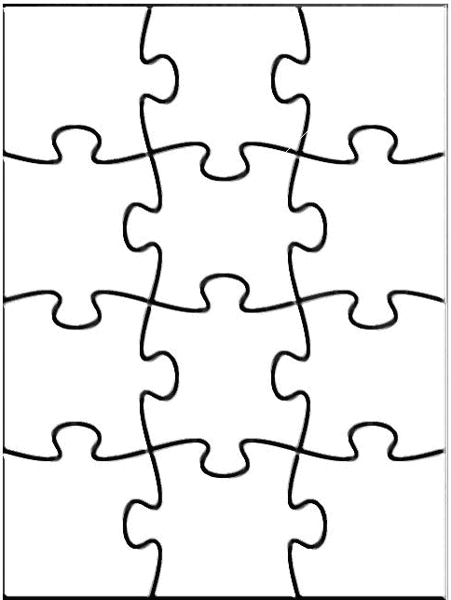
Agent
Declarative knowledge creates alternatives:
● Which pieces of
knowledge to use?
● How to use them?
Search is a about exploring alternatives.
It is a major approach
to exploit knowledge
Perception
Robotics
Reasoning
Search
Learning
Knowledge
rep.
Constraint
satisfaction
Planning
Natural
language
...
Expert
Systems

Slide 3
Example: 8-Puzzle
8
2
1
2
3
3
4
7
4
5
6
5
1
6
7
8
Initial state
Goal state
State: Any arrangement of 8 numbered tiles and an empty tile on a 3x3 board

Slide 4
8-Puzzle: Successor Function
8
2
7
SUCC(state) → subset of states
The successor function is knowledge
about the 8-puzzle game, but it does
not tell us which outcome to use, nor to
which state of the board to apply it.
3
4
5
1
6
8
2
8
2
7
8
2
7
3
4
7
3
4
6
3
4
5
1
6
5
1
5
1
6
Search is about the
exploration of alternatives

Slide 5
Across history, puzzles and games requiring the exploration of alternatives have been considered a challenge for human intelligence:
  Chess originated in Persia and India about 4000 years ago
  Checkers appear in 3600-year-old Egyptian paintings
  Go originated in China over 3000 years ago
So, it’s not surprising that AI uses games
to design and test algorithms

Slide 6


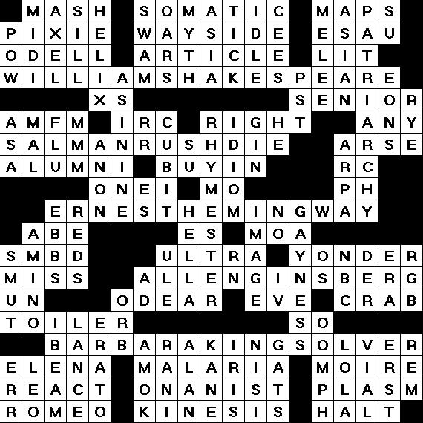
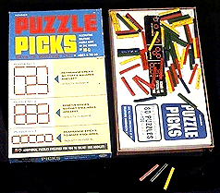
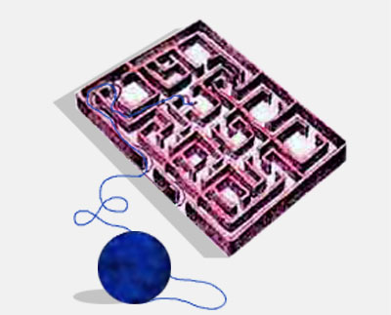
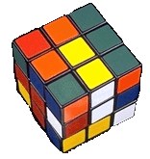
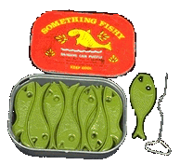
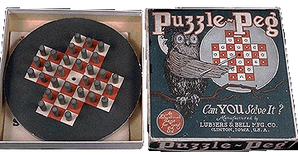

Slide 7
(n²-1)-puzzle
1
2
3
4
....
8
2
3
4
7
5
6
7
8
5
1
6
9
10
11
12
13
14
15

Slide 8

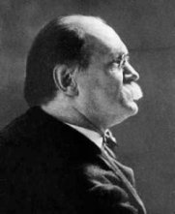
15-Puzzle
Introduced (?) in 1878 by Sam Loyd, who dubbed himself “America’s greatest puzzle-expert”

Slide 9
15-Puzzle
Sam Loyd offered $1,000 of his own money to the first person who would solve the following problem:
1
2
3
4
1
2
3
4
5
6
7
8
5
6
7
8
?
9
10
11
12
9
10
11
12
13
14
15
13
15
14

Slide 10
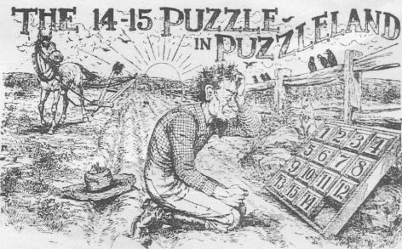
But no one ever won the prize !!

Slide 11
Stating a Problem as a Search Problem
S
State space S
Successor function:
x ∈ S → SUCCESSORS(x) ∈ 2^{S}
Initial state s₀
Goal test:
x∈S → GOAL?(x) =T or F
Arc cost
1
3
2

Slide 12
State Graph
Each state is represented by a distinct node
An arc (or edge) connects a node s
to a node s’ if
s’ ∈ SUCCESSORS(s)
The state graph may contain more than one connected component

Slide 13
Solution to the Search Problem
A solution is a path connecting the initial node to a goal node (any one)
G
I

Slide 14
Solution to the Search Problem
A solution is a path connecting the initial node to a goal node (any one)
The cost of a path is the sum of the arc costs along this path
An optimal solution is a solution path of minimum cost
There might be
no solution !
I
G

Slide 15
How big is the state space of the (n²-1)-puzzle?
8-puzzle → ?? states

Slide 16
How big is the state space of the (n²-1)-puzzle?
8-puzzle → 9! = 362,880 states
15-puzzle → 16! ~ 2.09 x 10¹³ states
24-puzzle → 25! ~ 10²⁵ states
But only half of these states are reachable from any given state
(but you may not know that in advance)

Slide 17
Permutation Inversions
Wlg, let the goal be:
A tile j appears after a tile i if either j appears on the same row as i to the right of i, or on another row below the row of i.
For every i = 1, 2, ..., 15, let n_{i} be the number of tiles j < i that appear after tile i (permutation inversions)
N = n₂ + n₃ + … + n₁₅ + row number of empty tile
1
2
3
4
5
6
7
8
9
10
11
12
13
14
15
1
2
3
4
n₂ = 0 n₃ = 0 n₄ = 0
n₅ = 0 n₆ = 0 n₇ = 1
n₈ = 1 n₉ = 1 n₁₀ = 4
n₁₁ = 0 n₁₂ = 0 n₁₃ = 0
n₁₄ = 0 n₁₅ = 0
5
10
7
8
→ N = 7 + 4
9
6
11
12
13
14
15

Slide 18
Proposition: (N mod 2) is invariant under any legal move of the empty tile
Proof:
  Any horizontal move of the empty tile leaves N unchanged
  A vertical move of the empty tile changes N by an even increment (± 1 ± 1 ± 1 ± 1)
1
2
3
4
1
2
3
4
5
6
7
5
6
11
7
s =
s’ =
N(s’) = N(s) + 3 + 1
9
10
11
8
9
10
8
13
14
15
12
13
14
15
12

Slide 19
Proposition: (N mod 2) is invariant under any legal move of the empty tile
→ For a goal state g to be reachable from a state s, a necessary condition is that N(g) and N(s) have the same parity
It can be shown that this is also a sufficient condition
→ The state graph consists of two connected components of equal size

Slide 20
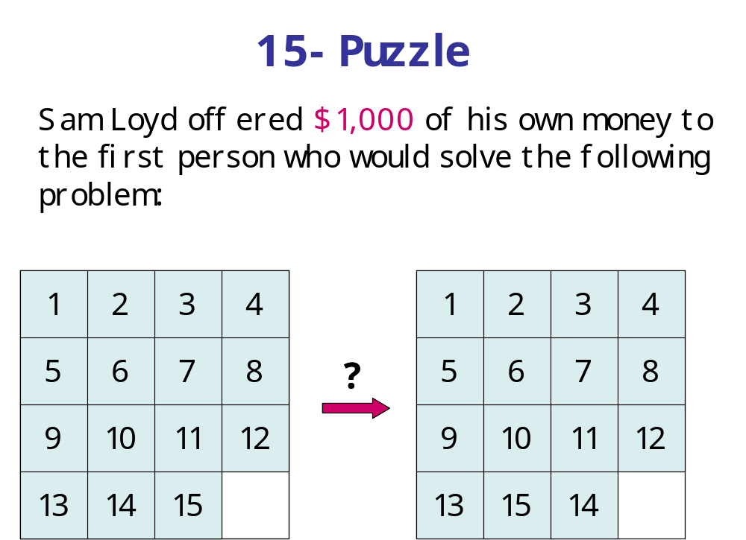
N = 4
N = 5
So, the second state is not reachable from the first, and Sam Loyd took no risk with his money ...

Slide 21
What is the Actual State Space?
The set of all states?
[e.g., a set of 16! states for the 15-puzzle]
The set of all states reachable from a given initial state?
[e.g., a set of 16!/2 states for the 15-puzzle]
In general, the answer is a)
[because one does not know in advance which states are reachable]
But a fast test determining whether a state is reachable from another is very useful, as search techniques are often inefficient when a problem has no solution

Slide 22
Searching the State Space
It is often not feasible (or too expensive) to build a complete representation of the state graph

Slide 23
8-, 15-, 24-Puzzles
8-puzzle → 362,880 states
15-puzzle → 2.09 x 10¹³ states
24-puzzle → 10²⁵ states
0.036 sec
~ 55 hours
> 10⁹ years
100 millions states/sec

Slide 24
Searching the State Space
Often it is not feasible (or too expensive) to build a complete representation of the state graph
A problem solver must construct a solution by exploring a small portion of the graph

Slide 25
Searching the State Space
Search tree

Slide 26
Searching the State Space
Search tree

Slide 27
Searching the State Space
Search tree

Slide 28
Searching the State Space
Search tree

Slide 29
Searching the State Space
Search tree

Slide 30
Searching the State Space
Search tree

Slide 31
Simple Problem-Solving-Agent Algorithm
I ← sense/read initial state
GOAL? ← select/read goal test
Succ ← select/read successor function
solution ← search(I, GOAL?, Succ)
perform(solution)

Slide 32
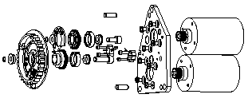
State Space
Each state is an abstract representation of a collection of possible worlds sharing some crucial properties and differing on non-important details only
E.g.: In assembly planning, a state does not define exactly the absolute position of each part
The state space is discrete. It may be finite, or infinite

Slide 33
Successor Function
It implicitly represents all the actions that are feasible in each state

Slide 34
Successor Function
It implicitly represents all the actions that are feasible in each state
Only the results of the actions (the successor states) and their costs are returned by the function
The successor function is a “black box”: its content is unknown
E.g., in assembly planning, the successor function may be quite complex (collision, stability, grasping, ...)

Slide 35
Path Cost
An arc cost is a positive number measuring the “cost” of performing the action corresponding to the arc, e.g.:
  1 in the 8-puzzle example
  expected time to merge two sub-assemblies
We will assume that for any given problem the cost c of an arc always verifies: c ≥ ε > 0, where ε is a constant

Slide 36
Path Cost
An arc cost is a positive number measuring the “cost” of performing the action corresponding to the arc, e.g.:
  1 in the 8-puzzle example
  expected time to merge two sub-assemblies
We will assume that for any given problem the cost c of an arc always verifies: c ≥ ε > 0, where ε is a constant
[This condition guarantees that, if path becomes arbitrarily long, its cost also becomes arbitrarily large]
Why is this needed?

Slide 37
Goal State
1
2
3
It may be explicitly described:
or partially described:
or defined by a condition,
e.g., the sum of every row, of every column, and of every diagonal equals 30
4
5
6
7
8
1
a
a
a
5
a
a
8
a
(“a” stands for “any”
other than 1, 5, and 8)
15
1
2
12
4
10
9
7
8
6
5
11
3
13
14

Slide 38
Other examples

Slide 39
8-Queens Problem
Place 8 queens in a chessboard so that no two queens are in the same row, column, or diagonal.
A solution
Not a solution

Slide 40
Formulation #1
States: all arrangements of 0, 1, 2, ..., 8 queens on the board
Initial state: 0 queens on the board
Successor function: each of the successors is obtained by adding one queen in an empty square
Arc cost: irrelevant
Goal test: 8 queens are on the board, with no queens attacking each other
→ ~ 64x63x...x57 ~ 3x10¹⁴ states

Slide 41
Formulation #2
States: all arrangements of k = 0, 1, 2, ..., 8 queens in the k leftmost columns with no two queens attacking each other
Initial state: 0 queens on the board
Successor function: each successor is obtained by adding one queen in any square that is not attacked by any queen already in the board, in the leftmost empty column
Arc cost: irrelevant
Goal test: 8 queens are on the board
→ 2,057 states

Slide 42
n-Queens Problem
A solution is a goal node, not a path to this node (typical of design problem)
Number of states in state space:
  8-queens → 2,057
  100-queens → 10⁵²
But techniques exist to solve n-queens problems efficiently for large values of n
They exploit the fact that there are many solutions well distributed in the state space

Slide 43
Path Planning
What is the state space?

Slide 44
Formulation #1
Cost of one horizontal/vertical step = 1
Cost of one diagonal step = √2

Slide 45
Optimal Solution
This path is the shortest in the discretized state
space, but not in the original continuous space

Slide 46
Formulation #2
sweep-line

Slide 47
Formulation #2

Slide 48
States

Slide 49
Successor Function

Slide 50
Solution Path
A path-smoothing post-processing step is
usually needed to shorten the path further

Slide 51
Formulation #3
Cost of one step: length of segment

Slide 52
Formulation #3
Visibility graph
Cost of one step: length of segment

Slide 53
Solution Path
The shortest path in this state space is also the
shortest in the original continuous space

Slide 54
Assembly (Sequence) Planning

Slide 55
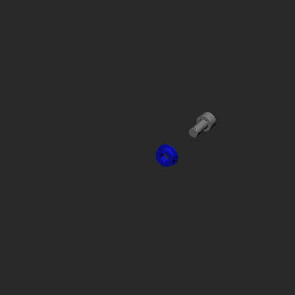

Slide 56
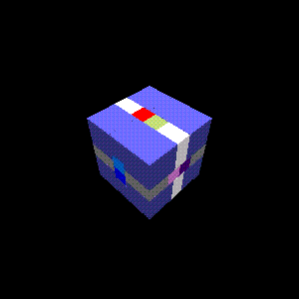

Slide 57
Possible Formulation
States: All decompositions of the assembly into subassemblies (subsets of parts in their relative placements in the assembly)
Initial state: All subassemblies are made of a single part
Goal state: Un-decomposed assembly
Successor function: Each successor of a state is obtained by merging two subassemblies (the successor function must check if the merging is feasible: collision, stability, grasping, ...)
Arc cost: 1 or time to carry the merging

Slide 58
A Portion of State Space

Slide 59
But the formulation rules out “non-monotonic” assemblies

Slide 60
But the formulation rules out “non-monotonic” assemblies

Slide 61
But the formulation rules out “non-monotonic” assemblies

Slide 62
But the formulation rules out “non-monotonic” assemblies

Slide 63
But the formulation rules out “non-monotonic” assemblies

Slide 64
But the formulation rules out “non-monotonic” assemblies
X
This “subassembly” is not
allowed in the definition of
the state space: the 2 parts
are not in their relative
placements in the assembly
Allowing any grouping of parts
as a valid subassembly would
make the state space much
bigger and more difficult
to search

Slide 65
Assumptions in Basic Search
The world is static
The world is discretizable
The world is observable
The actions are deterministic
But many of these assumptions can be
removed, and search still remains an
important problem-solving tool

Slide 66
Search and AI
Search methods are ubiquitous in AI systems. They often are the backbones of both core and peripheral modules
An autonomous robot uses search methods:
  to decide which actions to take and which sensing operations to perform,
  to quickly anticipate collision,
  to plan trajectories,
  to interpret large numerical datasets provided by sensors into compact symbolic representations,
  to diagnose why something did not happen as expected,
  etc...
Many searches may occur concurrently and sequentially

Slide 67
Applications
Search plays a key role in many applications, e.g.:
Route finding: airline travel, networks
Package/mail distribution
Pipe routing, VLSI routing
Comparison and classification of protein folds
Pharmaceutical drug design
Design of protein-like molecules
Video games

