Slide 1
Heuristic (Informed) Search
(Where we try to choose smartly)
R&N: Chap. 4, Sect. 4.1–3

Slide 2
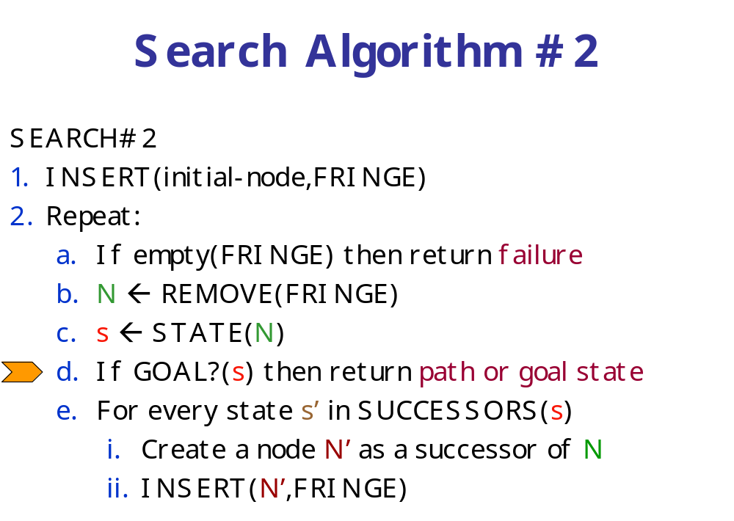
Recall that the ordering
of FRINGE defines the
search strategy

Slide 3
Best-First Search
It exploits state description to estimate how “good” each search node is
An evaluation function f maps each node N of the search tree to a real number
f(N) ≥ 0
[Traditionally, f(N) is an estimated cost; so, the smaller f(N), the more promising N]
Best-first search sorts the FRINGE in increasing f
[Arbitrary order is assumed among nodes with equal f]

Slide 4
Best-First Search
It exploits state description to estimate how “good” each search node is
An evaluation function f maps each node N of the search tree to a real number
f(N) ≥ 0
[Traditionally, f(N) is an estimated cost; so, the smaller f(N), the more promising N]
Best-first search sorts the FRINGE in increasing f
[Arbitrary order is assumed among nodes with equal f]
“Best” does not refer to the quality
of the generated path
Best-first search does not generate
optimal paths in general

Slide 5
How to construct f?
Typically, f(N) estimates:
  either the cost of a solution path through N
    Then f(N) = g(N) + h(N), where
      g(N) is the cost of the path from the initial node to N
      h(N) is an estimate of the cost of a path from N to a goal node
  or the cost of a path from N to a goal node
    Then f(N) = h(N) → Greedy best-search
But there are no limitations on f. Any function of your choice is acceptable.
But will it help the search algorithm?

Slide 6
How to construct f?
Typically, f(N) estimates:
  either the cost of a solution path through N
    Then f(N) = g(N) + h(N), where
      g(N) is the cost of the path from the initial node to N
      h(N) is an estimate of the cost of a path from N to a goal node
  or the cost of a path from N to a goal node
    Then f(N) = h(N)
But there are no limitations on f. Any function of your choice is acceptable.
But will it help the search algorithm?
Heuristic function

Slide 7
Heuristic Function
The heuristic function h(N) ≥ 0 estimates the cost to go from STATE(N) to a goal state
Its value is independent of the current search tree; it depends only on STATE(N) and the goal test GOAL?
Example:
h₁(N) = number of misplaced numbered tiles = 6
[Why is it an estimate of the distance to the goal?]
5
8
1
2
3
4
2
1
4
5
6
7
3
6
7
8
STATE(N)
Goal state

Slide 8
Other Examples
  h₁(N) = number of misplaced numbered tiles = 6
  h₂(N) = sum of the (Manhattan) distance of every numbered tile to its goal position
  = 2 + 3 + 0 + 1 + 3 + 0 + 3 + 1 = 13
  h₃(N) = sum of permutation inversions
  = n₅ + n₈ + n₄ + n₂ + n₁ + n₇ + n₃ + n₆
  = 4 + 6 + 3 + 1 + 0 + 2 + 0 + 0
  = 16
5
8
1
2
3
4
2
1
4
5
6
7
3
6
7
8
STATE(N)
Goal state

Slide 9
8-Puzzle
f(N) = h(N) = number of misplaced numbered tiles
3
3
4
5
3
4
2
4
2
1
3
3
0
4
5
4
The white tile is the empty tile

Slide 10
8-Puzzle
f(N) = g(N) + h(N)
with h(N) = number of misplaced numbered tiles
3+3
1+5
2+3
3+4
5+2
0+4
3+2
4+1
1+3
2+3
5+0
3+4
1+5
2+4

Slide 11
8-Puzzle
f(N) = h(N) = Σ distances of numbered tiles to their goals
6
5
2
5
2
1
4
3
0
4
6
5

Slide 12
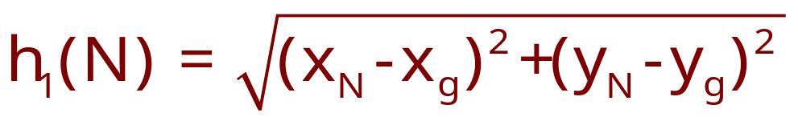
Robot Navigation
y_{N}
N
y_{g}
x_{N}
x_{g}
(L₂ or Euclidean distance)
h₂(N) = |x_{N}-x_{g}| + |y_{N}-y_{g}|
(L₁ or Manhattan distance)

Slide 13
Best-First → Efficiency
Local-minimum problem
f(N) = h(N) = straight distance to the goal

Slide 14
Can we prove anything?
If the state space is infinite, in general the search is not complete
If the state space is finite and we do not discard nodes that revisit states, in general the search is not complete
If the state space is finite and we discard nodes that revisit states, the search is complete, but in general is not optimal

Slide 15
Admissible Heuristic
Let h*(N) be the cost of the optimal path from N to a goal node
The heuristic function h(N) is admissible if:
0 ≤ h(N) ≤ h*(N)
An admissible heuristic function is always optimistic !

Slide 16
Admissible Heuristic
Let h*(N) be the cost of the optimal path from N to a goal node
The heuristic function h(N) is admissible if:
0 ≤ h(N) ≤ h*(N)
An admissible heuristic function is always optimistic !
G is a goal node ➔ h(G) = 0

Slide 17
8-Puzzle Heuristics
h₁(N) = number of misplaced tiles = 6
is ???
h₂(N) = sum of the (Manhattan) distances of
every tile to its goal position
= 2 + 3 + 0 + 1 + 3 + 0 + 3 + 1 = 13
is admissible
h₃(N) = sum of permutation inversions
= 4 + 6 + 3 + 1 + 0 + 2 + 0 + 0 = 16
is not admissible
5
8
1
2
3
4
2
1
4
5
6
7
3
6
7
8
STATE(N)
Goal state

Slide 18
8-Puzzle Heuristics
h₁(N) = number of misplaced tiles = 6
is admissible
h₂(N) = sum of the (Manhattan) distances of
every tile to its goal position
= 2 + 3 + 0 + 1 + 3 + 0 + 3 + 1 = 13
is ???
h₃(N) = sum of permutation inversions
= 4 + 6 + 3 + 1 + 0 + 2 + 0 + 0 = 16
is not admissible
5
8
1
2
3
4
2
1
4
5
6
7
3
6
7
8
STATE(N)
Goal state

Slide 19
8-Puzzle Heuristics
h₁(N) = number of misplaced tiles = 6
is admissible
h₂(N) = sum of the (Manhattan) distances of
every tile to its goal position
= 2 + 3 + 0 + 1 + 3 + 0 + 3 + 1 = 13
is admissible
h₃(N) = sum of permutation inversions
= 4 + 6 + 3 + 1 + 0 + 2 + 0 + 0 = 16
is ???
5
8
1
2
3
4
2
1
4
5
6
7
3
6
7
8
STATE(N)
Goal state

Slide 20
8-Puzzle Heuristics
h₁(N) = number of misplaced tiles = 6
is admissible
h₂(N) = sum of the (Manhattan) distances of
every tile to its goal position
= 2 + 3 + 0 + 1 + 3 + 0 + 3 + 1 = 13
is admissible
h₃(N) = sum of permutation inversions
= 4 + 6 + 3 + 1 + 0 + 2 + 0 + 0 = 16
is not admissible
5
8
1
2
3
4
2
1
4
5
6
7
3
6
7
8
STATE(N)
Goal state

Slide 21

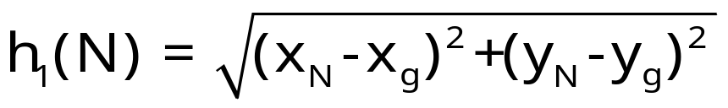
Robot Navigation Heuristics
Cost of one horizontal/vertical step = 1
Cost of one diagonal step =
is admissible

Slide 22
Robot Navigation Heuristics
Cost of one horizontal/vertical step = 1
Cost of one diagonal step =
h₂(N) = |x_{N}-x_{g}| + |y_{N}-y_{g}|
is ???

Slide 23
Robot Navigation Heuristics
Cost of one horizontal/vertical step = 1
Cost of one diagonal step =
h₂(N) = |x_{N}-x_{g}| + |y_{N}-y_{g}|
is admissible if moving along
diagonals is not allowed, and
not admissible otherwise
h*(I) = 4√2
h₂(I) = 8

Slide 24
How to create an admissible h?
An admissible heuristic can usually be seen as the cost of an optimal solution to a relaxed problem (one obtained by removing constraints)
In robot navigation:
  The Manhattan distance corresponds to removing the obstacles
  The Euclidean distance corresponds to removing both the obstacles and the constraint that the robot moves on a grid
More on this topic later

Slide 25
A* Search
(most popular algorithm in AI)
f(N) = g(N) + h(N), where:
    g(N) = cost of best path found so far to N
    h(N) = admissible heuristic function
for all arcs: c(N,N’) ≥ ε > 0
SEARCH#2 algorithm is used
➔ Best-first search is then called A* search

Slide 26
Result #1
A* is complete and optimal
[This result holds if nodes revisiting states are not discarded]

Slide 27
Proof (1/2)
If a solution exists, A* terminates and returns a solution
- For each node N on the fringe,
f(N) = g(N)+h(N) ≥ g(N) ≥ d(N)×ε,
where d(N) is the depth of N in the tree

Slide 28
Proof (1/2)
If a solution exists, A* terminates and returns a solution
- For each node N on the fringe,
f(N) = g(N)+h(N) ≥ g(N) ≥ d(N)×ε,
where d(N) is the depth of N in the tree
- As long as A* hasn’t terminated, a node K
on the fringe lies on a solution path
K

Slide 29
Proof (1/2)
If a solution exists, A* terminates and returns a solution
- For each node N on the fringe,
f(N) = g(N)+h(N) ≥ g(N) ≥ d(N)×ε,
where d(N) is the depth of N in the tree
- As long as A* hasn’t terminated, a node K
on the fringe lies on a solution path
- Since each node expansion increases the
length of one path, K will eventually be
selected for expansion, unless a solution is
found along another path
K

Slide 30
Proof (2/2)
Whenever A* chooses to expand a goal node, the path to this node is optimal
- C*= cost of the optimal solution path
- G’: non-optimal goal node in the fringe
f(G’) = g(G’) + h(G’) = g(G’) > C*
- A node K in the fringe lies on an optimal
path:
f(K) = g(K) + h(K) ≤ C*
- So, G’ will not be selected for expansion
G’
K

Slide 31
Time Limit Issue
When a problem has no solution, A* runs for ever if the state space is infinite or states can be revisited an arbitrary number of times. In other cases, it may take a huge amount of time to terminate
So, in practice, A* is given a time limit. If it has not found a solution within this limit, it stops. Then there is no way to know if the problem has no solution, or if more time was needed to find it
When AI systems are “small” and solving a single search problem at a time, this is not too much of a concern.
When AI systems become larger, they solve many search problems concurrently, some with no solution. What should be the time limit for each of them? More on this in the lecture on Motion Planning ...

Slide 32
8-Puzzle
f(N) = g(N) + h(N)
with h(N) = number of misplaced tiles
3+3
1+5
2+3
3+4
5+2
0+4
3+2
4+1
1+3
2+3
5+0
3+4
1+5
2+4

Slide 33
Robot Navigation

Slide 34
Robot Navigation
f(N) = h(N), with h(N) = Manhattan distance to the goal
(not A*)
8
7
6
5
4
3
2
3
4
5
6
7
5
4
3
5
6
3
2
1
0
1
2
4
7
6
5
8
7
6
5
4
3
2
3
4
5
6

Slide 35
Robot Navigation
f(N) = h(N), with h(N) = Manhattan distance to the goal
(not A*)
8
7
6
5
4
3
2
3
4
5
6
7
5
4
3
5
6
3
2
1
0
0
1
2
4
7
7
6
5
8
7
6
5
4
3
2
3
4
5
6

Slide 36
Robot Navigation
f(N) = g(N)+h(N), with h(N) = Manhattan distance to goal
(A*)
8+3
8+3
7+4
7+4
6+5
6+3
5+6
5+6
4+7
4+7
3+8
3+8
2+9
8
7
6
5
4
3
2+9
3+10
2
3
4
5
6
7+2
7+2
5+6
4+7
3+8
7
5
4
3+8
3
5
6+1
2+9
6+1
2+9
1+10
1+10
0+11
6
3
2
1
0+11
0
1
2
4
7+0
7+0
6+1
7
6+1
6
5
8+1
8+1
7+2
7+2
6+3
6+3
5+4
5+4
4+5
4+5
3+6
3+6
2+7
8
7
6
5
4
3
2+7
3+8
2
3
4
5
6

Slide 37
Best-First Search
An evaluation function f maps each node N of the search tree to a real number
f(N) ≥ 0
Best-first search sorts the FRINGE in increasing f

Slide 38
A* Search
f(N) = g(N) + h(N), where:
    g(N) = cost of best path found so far to N
    h(N) = admissible heuristic function
for all arcs: c(N,N’) ≥ ε > 0
SEARCH#2 algorithm is used
➔ Best-first search is then called A* search

Slide 39
Result #1
A* is complete and optimal
[This result holds if nodes revisiting states are not discarded]

Slide 40
What to do with revisited states?
c = 1
2
The heuristic h is clearly admissible
h = 100
1
2
1
90
100
0

Slide 41
What to do with revisited states?
c = 1
2
f = 1+100
2+1
h = 100
1
2
1
90
4+90
?
100
0
104
If we discard this new node, then the search
algorithm expands the goal node next and
returns a non-optimal solution

Slide 42
What to do with revisited states?
1
2
1+100
2+1
100
1
2
1
90
2+90
4+90
100
0
102
104
Instead, if we do not discard nodes revisiting
states, the search terminates with an optimal
solution

Slide 43
But ...
If we do not discard nodes revisiting states, the size of the search tree can be exponential in the number of visited states
1
1
1
1+1
1+1
1
1
1
2+1
2+1
2+1
2+1
2
2
4
4
4
4
4
4
4
4

Slide 44
But ...
If we do not discard nodes revisiting states, the size of the search tree can be exponential in the number of visited states
1
1
1+1
1+1
1
1
1
2+1
2+1
2+1
2+1
1
2
2
4
4
4
4
4
4
4
4
2n+1 states
O(2^{n}) nodes

Slide 45
It is not harmful to discard a node revisiting a state if the cost of the new path to this state is ≥ cost of the previous path
[so, in particular, one can discard a node if it re-visits a state already visited by one of its ancestors]
A* remains optimal, but states can still be re-visited multiple times
[the size of the search tree can still be exponential in the number of visited states]
Fortunately, for a large family of admissible heuristics – consistent heuristics – there is a much more efficient way to handle revisited states

Slide 46
Consistent Heuristic
An admissible heuristic h is consistent (or monotone) if for each node N and each child N’ of N:
h(N) ≤ c(N,N’) + h(N’)
N
c(N,N’)
N’
h(N)
h(N’)
(triangle inequality)
→ Intuition: a consistent heuristics becomes more precise as we get deeper in the search tree

Slide 47
Consistency Violation
If h tells that N is 100 units from the goal, then moving from N along an arc costing 10 units should not lead to a node N’ that h estimates to be 10 units away from the goal
N
c(N,N’)
=10
N’
h(N)
=100
h(N’)
=10
(triangle inequality)

Slide 48
Consistent Heuristic
(alternative definition)
A heuristic h is consistent (or monotone) if
1) for each node N and each child N’ of N:
h(N) ≤ c(N,N’) + h(N’)
2) for each goal node G:
h(G) = 0
N
c(N,N’)
N’
h(N)
h(N’)
A consistent heuristic
is also admissible
(triangle inequality)

Slide 49
Admissibility and Consistency
A consistent heuristic is also admissible
An admissible heuristic may not be consistent, but many admissible heuristics are consistent

Slide 50
8-Puzzle
5
8
1
2
3
4
2
1
4
5
6
7
3
6
7
8
N
STATE(N)
goal
c(N,N’)
N’
h(N)
  h₁(N) = number of misplaced tiles
  h₂(N) = sum of the (Manhattan) distances
  of every tile to its goal position
  are both consistent (why?)
h(N’)
h(N) ≤ c(N,N’) + h(N’)

Slide 51
Robot Navigation
N
c(N,N’)
N’
h(N)
h(N’)
h(N) ≤ c(N,N’) + h(N’)
Cost of one horizontal/vertical step = 1
Cost of one diagonal step =
is consistent
h₂(N) = |x_{N}-x_{g}| + |y_{N}-y_{g}|
is consistent if moving along
diagonals is not allowed, and
not consistent otherwise

Slide 52
Result #2
If h is consistent, then whenever A* expands a node, it has already found an optimal path to this node’s state

Slide 53
Proof (1/2)
N
N’
Consider a node N and its child N’
Since h is consistent: h(N) ≤ c(N,N’)+h(N’)
f(N) = g(N)+h(N) ≤ g(N)+c(N,N’)+h(N’) = f(N’)
So, f is non-decreasing along any path

Slide 54
Proof (2/2)
If a node K is selected for expansion, then any other node N in the fringe verifies f(N) ≥ f(K)
If one node N lies on another path to the state of K, the cost of this other path is no smaller than that of the path to K:
f(N’) ≥ f(N) ≥ f(K) and h(N’) = h(K)
So, g(N’) ≥ g(K)
K
N
S
N’

Slide 55
Proof (2/2)
Result #2
If h is consistent, then whenever A* expands a node, it has already found an optimal path to this node’s state
If a node K is selected for expansion, then any other node N in the fringe verifies f(N) ≥ f(K)
If one node N lies on another path to the state of K, the cost of this other path is no smaller than that of the path to K:
f(N’) ≥ f(N) ≥ f(K) and h(N’) = h(K)
So, g(N’) ≥ g(K)
K
N
S
N’

Slide 56
Implication of Result #2
The path to N
is the optimal
path to S
N
N₁
S
S₁
N₂ can be
discarded
N₂

Slide 57
Revisited States with Consistent Heuristic
When a node is expanded, store its state into CLOSED
When a new node N is generated:
  If STATE(N) is in CLOSED, discard N
  If there exists a node N’ in the fringe such that STATE(N’) = STATE(N), discard the node – N or N’ – with the largest f (or, equivalently, g)

Slide 58
Is A* with some consistent heuristic all that we need?
No !
There are very dumb consistent heuristic functions

Slide 59
For example: h ≡ 0
It is consistent (hence, admissible) !
A* with h≡0 is uniform-cost search
Breadth-first and uniform-cost are particular cases of A*

Slide 60
Heuristic Accuracy
Let h₁ and h₂ be two consistent heuristics such that for all nodes N:
h₁(N) ≤ h₂(N)
h₂ is said to be more accurate (or more informed) than h₁
h₁(N) = number of misplaced tiles
h₂(N) = sum of distances of every tile to its goal position
h₂ is more accurate than h₁
5
8
1
2
3
4
2
1
4
5
6
7
3
6
7
8
STATE(N)
Goal state

Slide 61
Result #3
Let h₂ be more accurate than h₁
Let A₁* be A* using h₁
and A₂* be A* using h₂
Whenever a solution exists, all the nodes expanded by A₂*, except possibly for some nodes such that
f₁(N) = f₂(N) = C* (cost of optimal solution)
are also expanded by A₁*

Slide 62
Proof
C* = h*(initial-node) [cost of optimal solution]
Every node N such that f(N) < C* is eventually expanded. No node N such that f(N) > C* is ever expanded
Every node N such that h(N) < C*−g(N) is eventually expanded. So, every node N such that h₂(N) < C*−g(N) is expanded by A₂*. Since h₁(N) ≤ h₂(N), N is also expanded by A₁*
If there are several nodes N such that f₁(N) = f₂(N) = C* (such nodes include the optimal goal nodes, if there exists a solution), A₁* and A₂* may or may not expand them in the same order (until one goal node is expanded)

Slide 63
Effective Branching Factor
It is used as a measure the effectiveness of a heuristic
Let n be the total number of nodes expanded by A* for a particular problem and d the depth of the solution
The effective branching factor b* is defined by n = 1 + b* + (b*)² +...+ (b*)^{d}

Slide 64
Experimental Results
(see R&N for details)
8-puzzle with:
  h₁ = number of misplaced tiles
  h₂ = sum of distances of tiles to their goal positions
Random generation of many problem instances
Average effective branching factors (number of expanded nodes):
d | IDS | A₁* | A₂*
2 | 2.45 | 1.79 | 1.79
6 | 2.73 | 1.34 | 1.30
12 | 2.78 (3,644,035) | 1.42 (227) | 1.24 (73)
16 | -- | 1.45 | 1.25
20 | -- | 1.47 | 1.27
24 | -- | 1.48 (39,135) | 1.26 (1,641)

Slide 65
How to create good heuristics?
By solving relaxed problems at each node
In the 8-puzzle, the sum of the distances of each tile to its goal position (h₂) corresponds to solving 8 simple problems:
It ignores negative interactions among tiles
5
8
1
2
3
d_{i} is the length of the
shortest path to move
tile i to its goal position,
ignoring the other tiles,
e.g., d₅ = 2
h₂ = Σ_{i=1,...8} d_{i}
4
2
1
4
5
6
7
3
6
7
8
5
5

Slide 66
Can we do better?
For example, we could consider two more complex relaxed problems:
→ h = d₁₂₃₄ + d₅₆₇₈ [disjoint pattern heuristic]
5
8
1
2
3
d₁₂₃₄ = length of the
shortest path to move
tiles 1, 2, 3, and 4 to
their goal positions,
ignoring the other tiles
4
2
1
4
5
6
7
3
6
7
8
d₅₆₇₈
1
2
3
5
8
4
2
1
4
5
6
3
7
6
7
8

Slide 67
Can we do better?
For example, we could consider two more complex relaxed problems:
→ h = d₁₂₃₄ + d₅₆₇₈ [disjoint pattern heuristic]
How to compute d₁₂₃₄ and d₅₆₇₈?
5
8
1
2
3
d₁₂₃₄ = length of the
shortest path to move
tiles 1, 2, 3, and 4 to
their goal positions,
ignoring the other tiles
4
2
1
4
5
6
7
3
6
7
8
d₅₆₇₈
1
2
3
5
8
4
2
1
4
5
6
3
7
6
7
8

Slide 68
Can we do better?
For example, we could consider two more complex relaxed problems:
→ h = d₁₂₃₄ + d₅₆₇₈ [disjoint pattern heuristic]
These distances are pre-computed and stored
[Each requires generating a tree of 3,024 nodes/states (breadth-first search)]
5
8
1
2
3
d₁₂₃₄ = length of the
shortest path to move
tiles 1, 2, 3, and 4 to
their goal positions,
ignoring the other tiles
4
2
1
4
5
6
7
3
6
7
8
d₅₆₇₈
1
2
3
5
8
4
2
1
4
5
6
3
7
6
7
8

Slide 69
Can we do better?
For example, we could consider two more complex relaxed problems:
→ h = d₁₂₃₄ + d₅₆₇₈ [disjoint pattern heuristic]
These distances are pre-computed and stored
[Each requires generating a tree of 3,024 nodes/states (breadth-first search)]
5
8
1
2
3
d₁₂₃₄ = length of the
shortest path to move
tiles 1, 2, 3, and 4 to
their goal positions,
ignoring the other tiles
4
2
1
4
5
6
→ Several order-of-magnitude speedups
for the 15- and 24-puzzle (see R&N)
7
3
6
7
8
d₅₆₇₈
1
2
3
5
8
4
2
1
4
5
6
3
7
6
7
8

Slide 70
On Completeness and Optimality
A* with a consistent heuristic function has nice properties: completeness, optimality, no need to revisit states
Theoretical completeness does not mean “practical” completeness if you must wait too long to get a solution (remember the time limit issue)
So, if one can’t design an accurate consistent heuristic, it may be better to settle for a non-admissible heuristic that “works well in practice”, even through completeness and optimality are no longer guaranteed

Slide 71
Iterative Deepening A* (IDA*)
Idea: Reduce memory requirement of A* by applying cutoff on values of f
Consistent heuristic function h
Algorithm IDA*:
  Initialize cutoff to f(initial-node)
  Repeat:
    Perform depth-first search by expanding all nodes N such that f(N) ≤ cutoff
    Reset cutoff to smallest value f of non-expanded (leaf) nodes

Slide 72
8-Puzzle
f(N) = g(N) + h(N)
with h(N) = number of misplaced tiles
4
Cutoff=4
6

Slide 73
8-Puzzle
f(N) = g(N) + h(N)
with h(N) = number of misplaced tiles
4
Cutoff=4
4
6
6

Slide 74
8-Puzzle
f(N) = g(N) + h(N)
with h(N) = number of misplaced tiles
4
Cutoff=4
4
5
6
6

Slide 75
8-Puzzle
f(N) = g(N) + h(N)
with h(N) = number of misplaced tiles
5
4
Cutoff=4
4
5
6
6

Slide 76
8-Puzzle
f(N) = g(N) + h(N)
with h(N) = number of misplaced tiles
6
5
4
Cutoff=4
4
5
6
6

Slide 77
8-Puzzle
f(N) = g(N) + h(N)
with h(N) = number of misplaced tiles
4
Cutoff=5
6

Slide 78
8-Puzzle
f(N) = g(N) + h(N)
with h(N) = number of misplaced tiles
4
Cutoff=5
4
6
6

Slide 79
8-Puzzle
f(N) = g(N) + h(N)
with h(N) = number of misplaced tiles
4
Cutoff=5
4
5
6
6

Slide 80
8-Puzzle
f(N) = g(N) + h(N)
with h(N) = number of misplaced tiles
4
Cutoff=5
4
5
7
6
6

Slide 81
8-Puzzle
f(N) = g(N) + h(N)
with h(N) = number of misplaced tiles
4
5
Cutoff=5
4
5
7
6
6

Slide 82
8-Puzzle
f(N) = g(N) + h(N)
with h(N) = number of misplaced tiles
4
5
5
Cutoff=5
4
5
7
6
6

Slide 83
8-Puzzle
f(N) = g(N) + h(N)
with h(N) = number of misplaced tiles
4
5
5
Cutoff=5
4
5
5
7
6
6

Slide 84
Advantages/Drawbacks of IDA*
Advantages:
  Still complete and optimal
  Requires less memory than A*
  Avoid the overhead to sort the fringe
Drawbacks:
  Can’t avoid revisiting states not on the current path
  Available memory is poorly used
  (→ memory-bounded search, see R&N p. 101-104)

Slide 85
Local Search
Light-memory search method
No search tree; only the current state is represented!
Only applicable to problems where the path is irrelevant (e.g., 8-queen), unless the path is encoded in the state
Many similarities with optimization techniques

Slide 86
Steepest Descent
S ← initial state
Repeat:
  S’ ← arg min_{S’∈SUCCESSORS(S)}{h(S’)}
  if GOAL?(S’) return S’
  if h(S’) < h(S) then S ← S’ else return failure
Similar to:
- hill climbing with –h
- gradient descent over continuous space

Slide 87
Application: 8-Queen
Repeat n times:
Pick an initial state S at random with one queen in each column
Repeat k times:
  If GOAL?(S) then return S
  Pick an attacked queen Q at random
  Move Q in its column to minimize the number of attacking queens → new S [min-conflicts heuristic]
Return failure
1
2
2
0
3
2
3
2
2
2
2
2
3
2

Slide 88
Application: 8-Queen
Why does it work ???
There are many goal states that are
well-distributed over the state space
If no solution has been found after a few
steps, it’s better to start it all over again.
Building a search tree would be much less
efficient because of the high branching
factor
Running time almost independent of the
number of queens
Repeat n times:
Pick an initial state S at random with one queen in each column
Repeat k times:
  If GOAL?(S) then return S
  Pick an attacked queen Q at random
  Move Q it in its column to minimize the number of attacking queens is minimum → new S
1
2
2
0
3
2
3
2
2
2
2
2
3
2

Slide 89
Steepest Descent
S ← initial state
Repeat:
  S’ ← arg min_{S’∈SUCCESSORS(S)}{h(S’)}
  if GOAL?(S’) return S’
  if h(S’) < h(S) then S ← S’ else return failure
may easily get stuck in local minima
Random restart (as in n-queen example)
Monte Carlo descent

Slide 90
Monte Carlo Descent
S ← initial state
Repeat k times:
  If GOAL?(S) then return S
  S’ ← successor of S picked at random
  if h(S’) ≤ h(S) then S ← S’
  else
    Δh = h(S’)-h(S)
    with probability ~ exp(−Δh/T), where T is called the “temperature”, do: S ← S’ [Metropolis criterion]
Return failure
Simulated annealing lowers T over the k iterations.
It starts with a large T and slowly decreases T

Slide 91
“Parallel” Local Search Techniques
They perform several local searches concurrently, but not independently:
Beam search
Genetic algorithms
See R&N, pages 115-119

Slide 92
Search problems
Blind search
Heuristic search:
best-first and A*
Construction of heuristics
Variants of A*
Local search

Slide 93
When to Use Search Techniques?
The search space is small, and
  No other technique is available, or
  Developing a more efficient technique is not worth the effort
The search space is large, and
  No other available technique is available, and
  There exist “good” heuristics

