Slide 1
Jeff Edmonds
www.cse.yorku.ca\~jeff\courses\3101
jeff@cse.yorku.ca
CSB 3044, ext. 33295
A: | Jeff Edmonds | MW | 2:30-4:00 | PSE 321
B (Eng): | James Elder | TR | 11:30-1:00 | CLH 110

Slide 2
Jeff Edmonds' Schedule
 | 11:30-1:00 | 1:00-1:30 | 2:30-4:00 | 4:00-4:30
Monday & Wednesday | CSE 6111 | Office 1/2 Hour | CSE 3101 | Office 1/2 Hour
Location | M: ACE 010, W: VC 115 | same | PSE 321 | PSE 321
Office hours after class tend to remain outside the class room.
Longer or private questions, when requested,
can be taken back to my office, CSB 3044.
If no one asks, I may or may not rush back to my office.
Other times by appointment or email.

Slide 3
Jeff Edmonds' Schedule
 | 1:00-2:30 | 2:30-3:00
Monday & Wednesday | CSE 3101 | Office 1/2 Hour
Location | TEL 005 | TEL 005
Office hours after class tend to remain outside the class room.
Longer or private questions, when requested,
can be taken back to my office, CSB 3044.
If no one asks, I may or may not rush back to my office.
Other times by appointment or email.

Slide 4
Jeff Edmonds’ "How to Think about Algorithms".
Slides: www.cs.yorku.ca/~jeff/notes/3101
Andy Mirzaian's on-line Lecture Notes
Cormen, Leiserson, Rivest, and Stein
"Introduction to Algorithms",

Slide 5
Assignment 1 | DATE1, midnight | 7.5%
Assignment 2 | DATE2, midnight | 7.5%
Midterm | DATEMIDTERM, ?? | 25%
Assignment 3 | DATE3, midnight | 7.5%
Assignment 4 Exam | DATE4, midnight DATEFINAL | 7.5% 45%
No crib sheets.
Common
No crib sheets.

Slide 6
You’re cool! Are you free sometime this weekend?
Not interested.
I took the initiative and asked out a guy in my
3101 class.
Studying done in groups.
Assignments are done in pairs.
Best way to learn
is to teach each other!

Slide 7
Do NOT get answers
from other pairs!
Do NOT do half the assignment
and your partner does the other half.
Each try all on your own.
Discuss & write up together.
Longer is not better.

Slide 8
If you are not happy with your mark on a test or an assignment, please
  first read solution set
  consider whether it is worth the effort
    2% of assignment * 7.5 * of mark = 0.0015 marks
  write an explanation on the cover page and resubmit it, the next class
  Please do not talk to me about marks in person
    15 ^{min}/_{person} * 100 people * 5 assignment
    = 125 hrs = ¼ of my time for the term
  Talk to me about the material

Slide 9
Exam Suggestions
I think X is correct.
I give it as my answer.
Sorry, X is wrong.
I give you 30%
for part marks
I know answer X is wrong.
I cant think of another answer. I will leave it blank.
You did not
hand it in.
I must give
you zero.
You show the best understanding.
I give you 60%
for effort.
I will explain why answer X is wrong.

Slide 10
Exam Suggestions
Blaa Blaa Blaa
<correct>
Blaa Blaa Blaa
One correct line in a sea of wrong is not correct.
Think before you write.

Slide 11
I get sooooo
Frustrated!
Marking the SAME
wrong answer hundreds of times!

Slide 12
I will give a list of mistakes
which I particularly hate marking
& for which there is no excuse.
In class I emphasize what is important.
If you do any of these things
you will get -20%
on the question.
Still 1/3 gets it wrong!
1/3 deserve to fail.

Slide 13
In the past, I was a push over
and passed most everyone.
Sorry. No more.
Only 2/3 of the class usually attends.
1/3 did not even buy the notes until the week before the midterm & a few after.
What fraction does the assignments?
Generally, 6 people talk to me.

Slide 14
Think about Algorithms
Abstractly
This course requires completely changing the way you think about algorithms.
Though I keep warning people,
they tend not to get it until they are
Devastated
by the midterm
Change your thinking now.

Slide 15
What do you think about 3101?
Was by far the hardest course ever.
I got the worst midterm mark ever.
I almost gave up.
But opened a door to such an interesting world for me.
Learned to see things abstractly and from different angles
After working a few years, I realized that 3101 was the most useful course I took.
But belled.

Slide 16
What did you think of Jeff?
The best teacher
I have had
in my entire life.
He can’t write English,
messy messy lecture,
can’t spell,
you can’t understand what he is saying. disorganized,
don’t waste your money and time.

Slide 17
What did you think of Jeff?
That is why he wrote notes.
They are definitely easier to read
than Cormen.

Slide 18
What did you think of Jeff?
His slides are great.
Definitely entertaining.
I don’t fall asleep.
It is your job to ask questions
and slow him down.
Don’t get fooled into thinking
the material is easy.
But he goes too fast.

Slide 19

What did you think of Jeff?
Often, his explanations
get a little too abstract.
He is trying to teach you to think abstractly.
He breaks each topic in easy to follow steps.
It is important to trust them.
His analogies:
- fairy good mothers -
- friends, and little birds -
make it easy to understand
and remember the concepts.

Slide 20
What did you think of Jeff?
Easy assignments
He is a fair marker
Impossible Assignments
But not a push over

Slide 21
What did you think of Jeff?
He really does care about the students.

Slide 22
Please feel free
to ask questions!
Help me know what people
are not understanding
Slow down the slides
We do have a lot of material
Please don’t shout out answers
for at least 10sec.

Slide 23
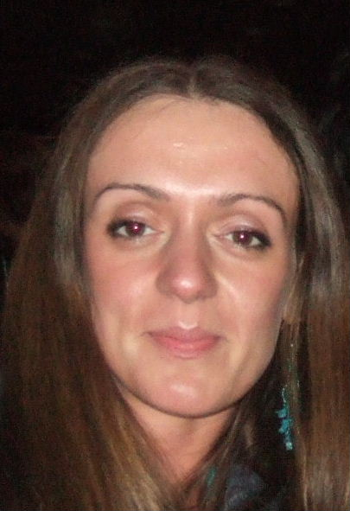
Winter 06, the average of one section was much higher
than the average of the other.
(I taught them both)
My theory was that it was because a student,
Gertruda, constantly asked great questions
and everyone learned from them.
Ask questions for everyone’s sake.

Slide 24
Stationary Hand
Wiggling Hand
((( )))
You have a question or comment of any nature
You have something relevant to say to what is being spoken now
Rudich www.discretemath.com

Slide 25
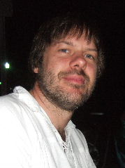
I am not good with names.
Emails and test are effectively anonymous.
If you would like a better rapport with your emails, please include a picture within the text.
:) Jeff

Slide 26
Letter from Student
sir, some of my friend told me that they get marks for assignment 3 answer which are copied from internet. I also wrote those answer from same website but I didn't get marks. As you know, every marks are important because I am just below C+. I need at least C+ in this course to graduate, otherwise I have to retake the course. I am not sure whether I got right information. Please let me know.

Slide 27
Letter from Student
sir, some of my friend told me that they get marks for assignment 3 answer which are copied from internet. I also wrote those answer from same website but I didn't get marks. As you know, every marks are important because I am just below C+. I need at least C+ in this course to graduate, otherwise I have to retake the course. I am not sure whether I got right information. Please let me know.
I know
It is not a reason to get a better mark.

Slide 28
Letter from Student
sir, some of my friend told me that they get marks for assignment 3 answer which are copied from internet. I also wrote those answer from same website but I didn't get marks. As you know, every marks are important because I am just below C+. I need at least C+ in this course to graduate, otherwise I have to retake the course. I am not sure whether I got right information. Please let me know.

Slide 29
Getting answers from the internet is
CHEATING
Getting answers from your friends is
CHEATING
I will send it to the Dean!
You will be nailed!

Slide 30
Two years from now:
May I have a letter of reference for grad school?
I find it awkward to write letters for people that I don’t recognize.
Make yourself KNOWN today to SOME professor.

Slide 31
Two years from now:
May I have a letter of reference for grad school?
I find it awkward to write letters for people that I don’t recognize.
Make yourself KNOWN today to SOME professor.
Sorry email does not help as I don’t remember names

Slide 32
Introduction
Thinking about Algorithms Abstractly
So you want to be a computer scientist?
Grade School Revisited: How To Multiply Two Numbers
Jeff Edmonds
York University
Lecture 1
COSC 3101

Slide 33

So you want to be a computer scientist?

Slide 34

Is your goal to be a mundane programmer?

Slide 35

Or a great leader and thinker?

Slide 36
Original Thinking

Slide 37


Boss assigns task:
  Given today’s prices of pork, grain, sawdust, …
  Given constraints on what constitutes a hotdog.
  Make the cheapest hotdog.
Everyday industry asks these questions.

Slide 38
Your answer:
Um? Tell me what to code.
With more sophisticated software engineering systems,
the demand for mundane programmers will diminish.

Slide 39

Your answer:
I learned this great algorithm that will work.
Soon all known algorithms
will be available in libraries.

Slide 40
Your answer:
I can develop a new algorithm for you.
Great thinkers
will always be needed.

Slide 41
Course Content
A list of algorithms.
  Learn their code.
  Trace them until you are convinced that they work.
  Implement them.
  Worry about details.
class InsertionSortAlgorithm extends SortAlgorithm {
void sort(int a[]) throws Exception {
for (int i = 1; i < a.length; i++) {
int j = i;
int B = a[i];
while ((j > 0) && (a[j-1] > B)) {
a[j] = a[j-1];
j--; }
a[j] = B;
}}

Slide 42




Course Content
A survey of algorithmic design techniques.
Abstract thinking.
How to develop new algorithms for any problem that may arise.

Slide 43

Study:
Many experienced programmers were asked to code up binary search.

Slide 44
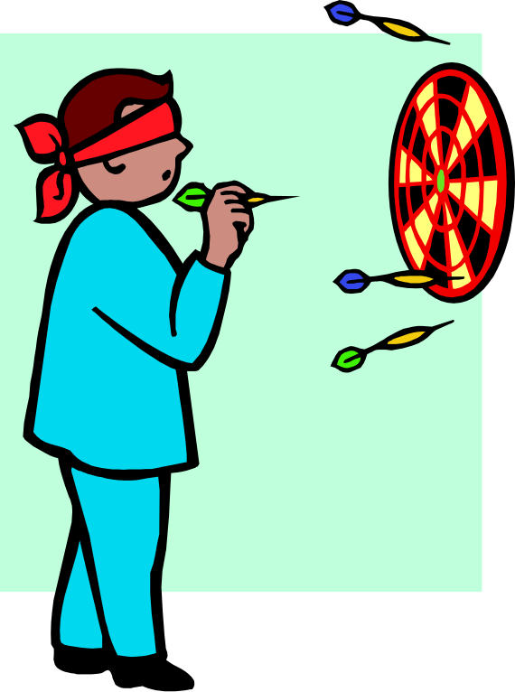
Study:
Many experienced programmers were asked to code up binary search.
80% got it wrong
Good thing is was not for a nuclear power plant.

Slide 45

What did they lack?

Slide 46

What did they lack?
Formal proof methods?

Slide 47
What did they lack?
Formal proof methods?
Yes, likely
Industry is starting to realize that formal methods are important.
But even without formal methods …. ?

Slide 48

What did they lack?
Fundamental understanding of the algorithmic design techniques.
Abstract thinking.

Slide 49
Course Content
Notations, analogies, and abstractions
for developing,
thinking about,
and describing algorithms
so correctness is transparent

Slide 50
A survey of fundamental ideas and algorithmic design techniques
For example . . .

Slide 51
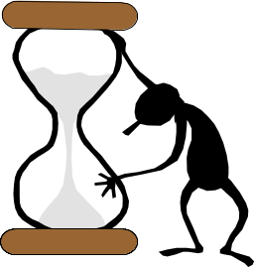
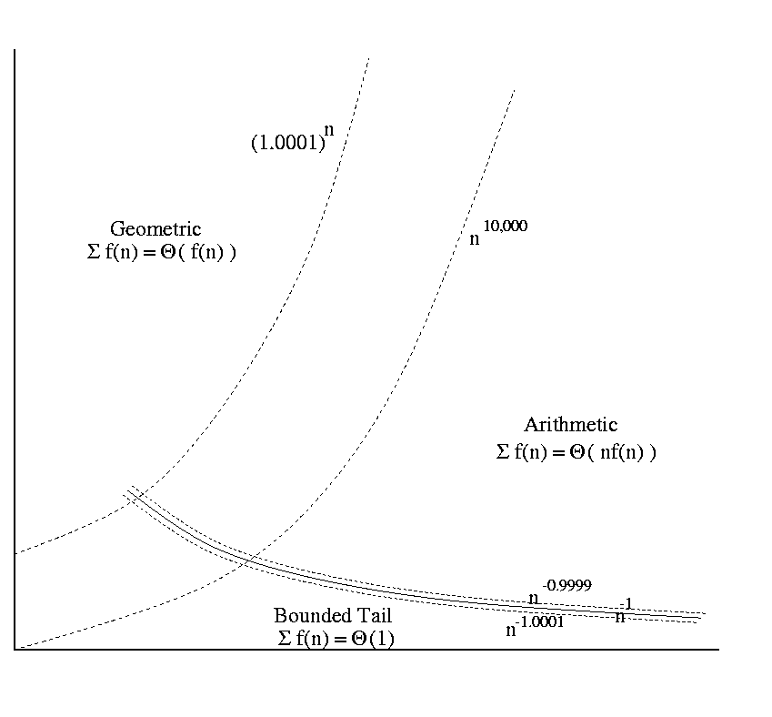
Some Math
Blended in to material.
Classifying Functions
Logic Quantifiers
f(i) = n^{Θ(n)}
∃g ∀b Loves(b,g)
∀b ∃g Loves(b,g)
Time
Time Complexity
Input Size
t(n) = Θ(n²)
Adding Made Easy
∑_{i=1} f(i).
Logs and Exps
Recurrence Relations
2ª × 2^{b} = 2^{a+b}
2^{log n} = n
T(n) = a T(n/b) + f(n)

Slide 52




Iterative Algorithms
Loop Invariants
<preCond>
codeA
loop
<loop-invariant>
exit when <exit Cond>
codeB
codeC
<postCond>
T+1
0
5 km
i-1
i
9 km
i
i
One step at a time
Code
Relay Race

Slide 53
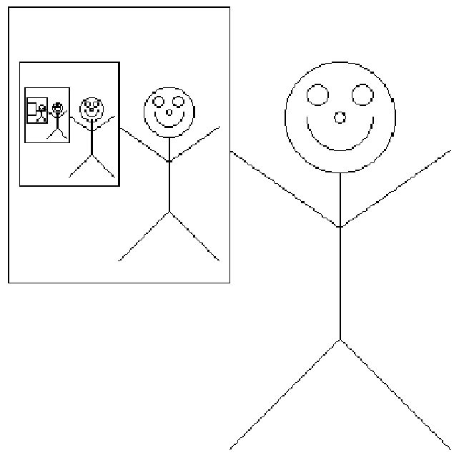
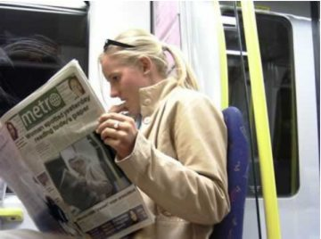
Recursive Algorithms
?
?

Slide 54
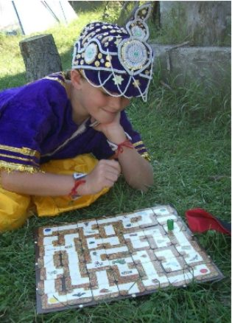
Graph Search Algorithms

Slide 55
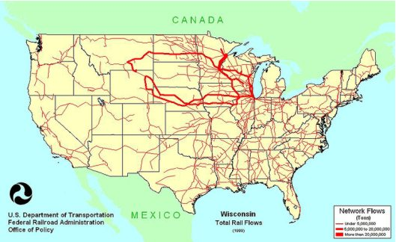
Network Flows

Slide 56
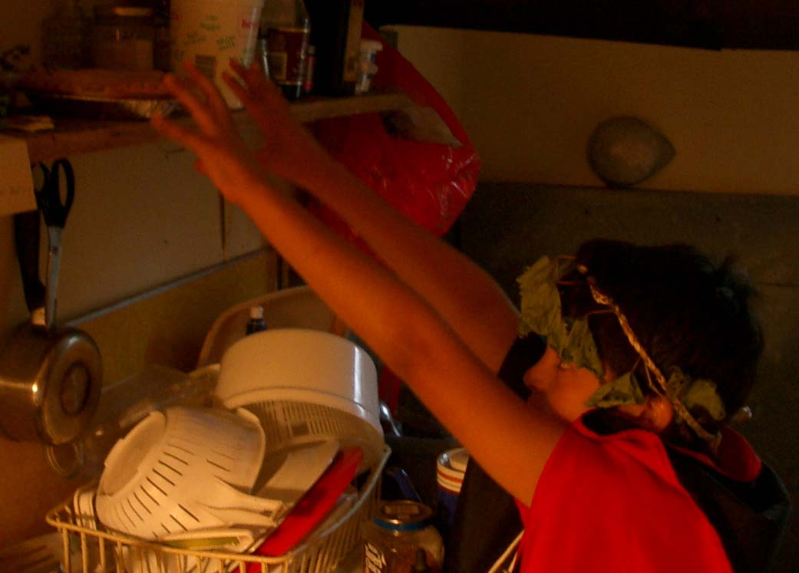
Greedy Algorithms
NEED A PIC HERE
(NOT POOH)

Slide 57
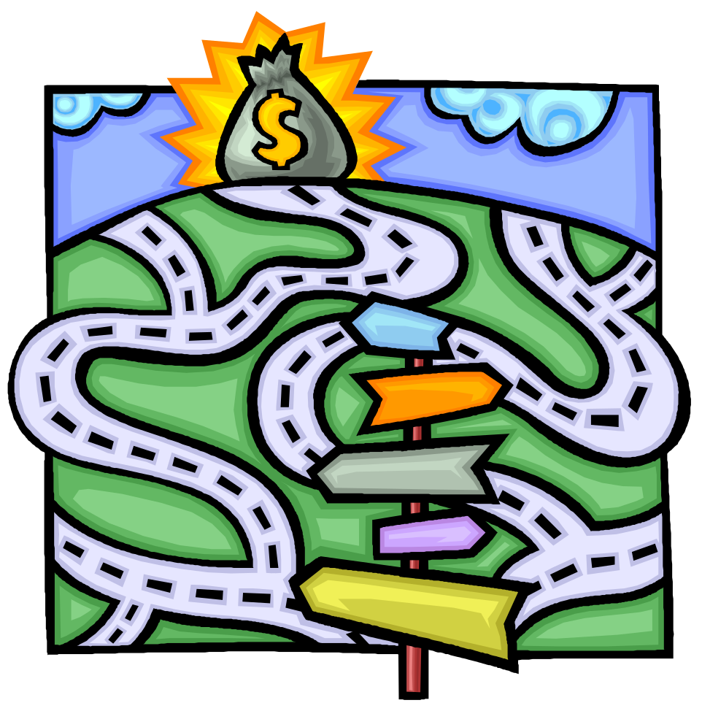

Recursive Back Tracking

Slide 58
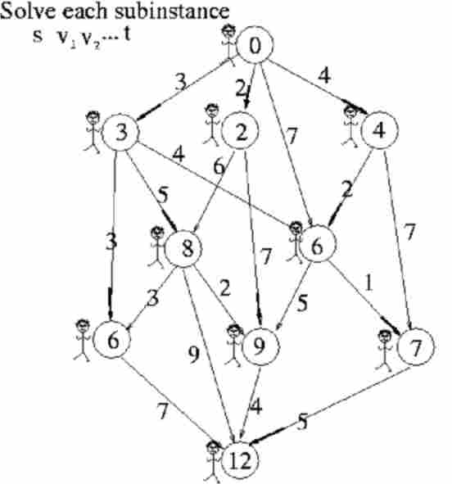
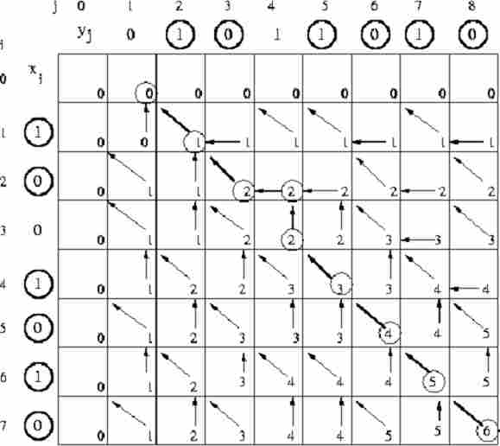
Dynamic Programing

Slide 59
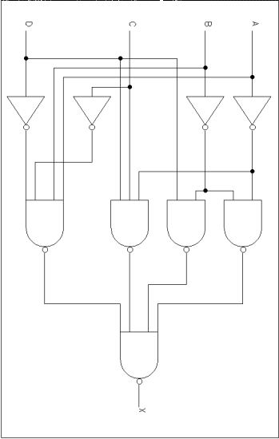
Reduction
=
Rudich www.discretemath.com

Slide 60
Useful Learning Techniques

Slide 61

Read Ahead
You are expected to read the lecture notes before the lecture.
This will facilitate more productive discussion during class.
Also please
proof read
assignments
& tests.
Like in an
English class

Slide 62
Explaining
We are going to test you on your ability to explain the material.
Hence, the best way of studying is to explain the material over and over again out loud to yourself, to each other, and to your stuffed bear.

Slide 63
Day Dream
While going along with your day
Mathematics is not all linear thinking.
Allow the essence of the material to seep into your subconscious
Pursue ideas that percolate up and flashes of inspiration that appear.

Slide 64
Be Creative
Ask questions.
Why is it done this way and not that way?

Slide 65
Guesses and Counter Examples
Guess at potential algorithms for solving a problem.
Look for input instances for which your algorithm gives the wrong answer.
Treat it as a game between these two players.

Slide 66

Refinement:
The best solution comes from a process of repeatedly refining and inventing alternative solutions
Rudich www.discretemath.com

Slide 67
End
Math
Iterative Algorithms

