Slide 1
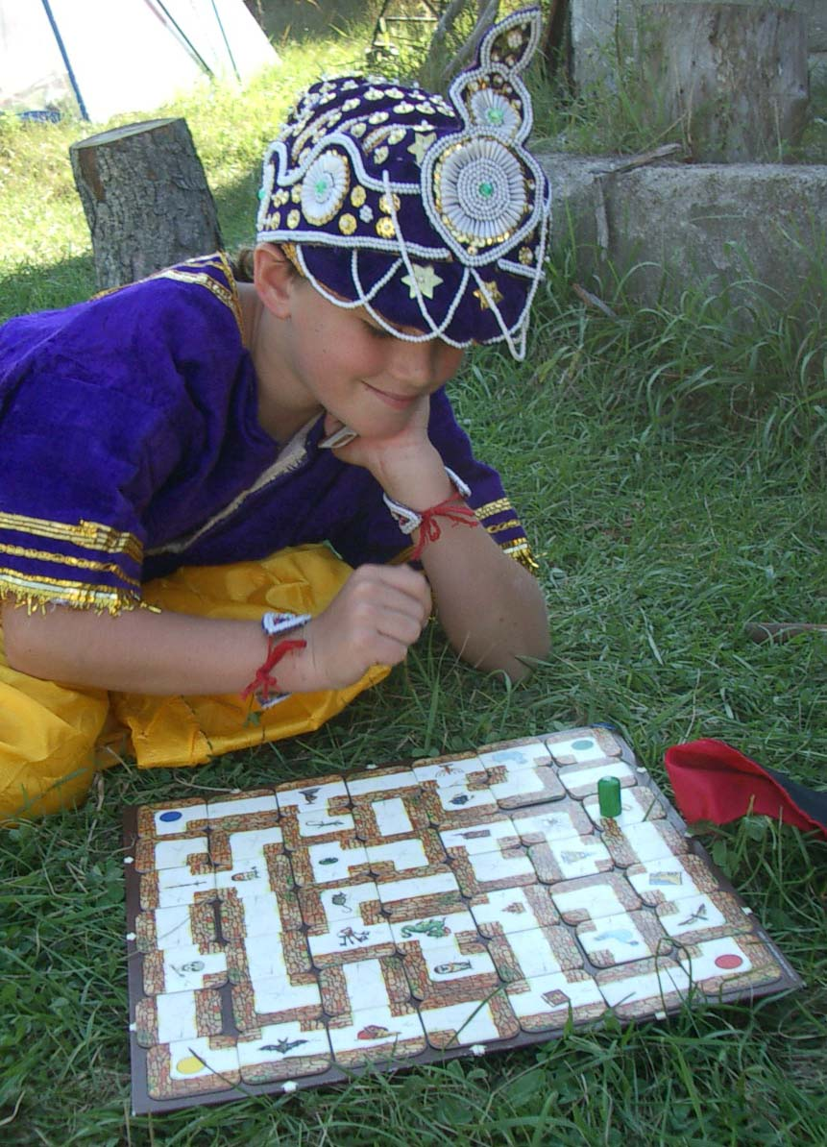
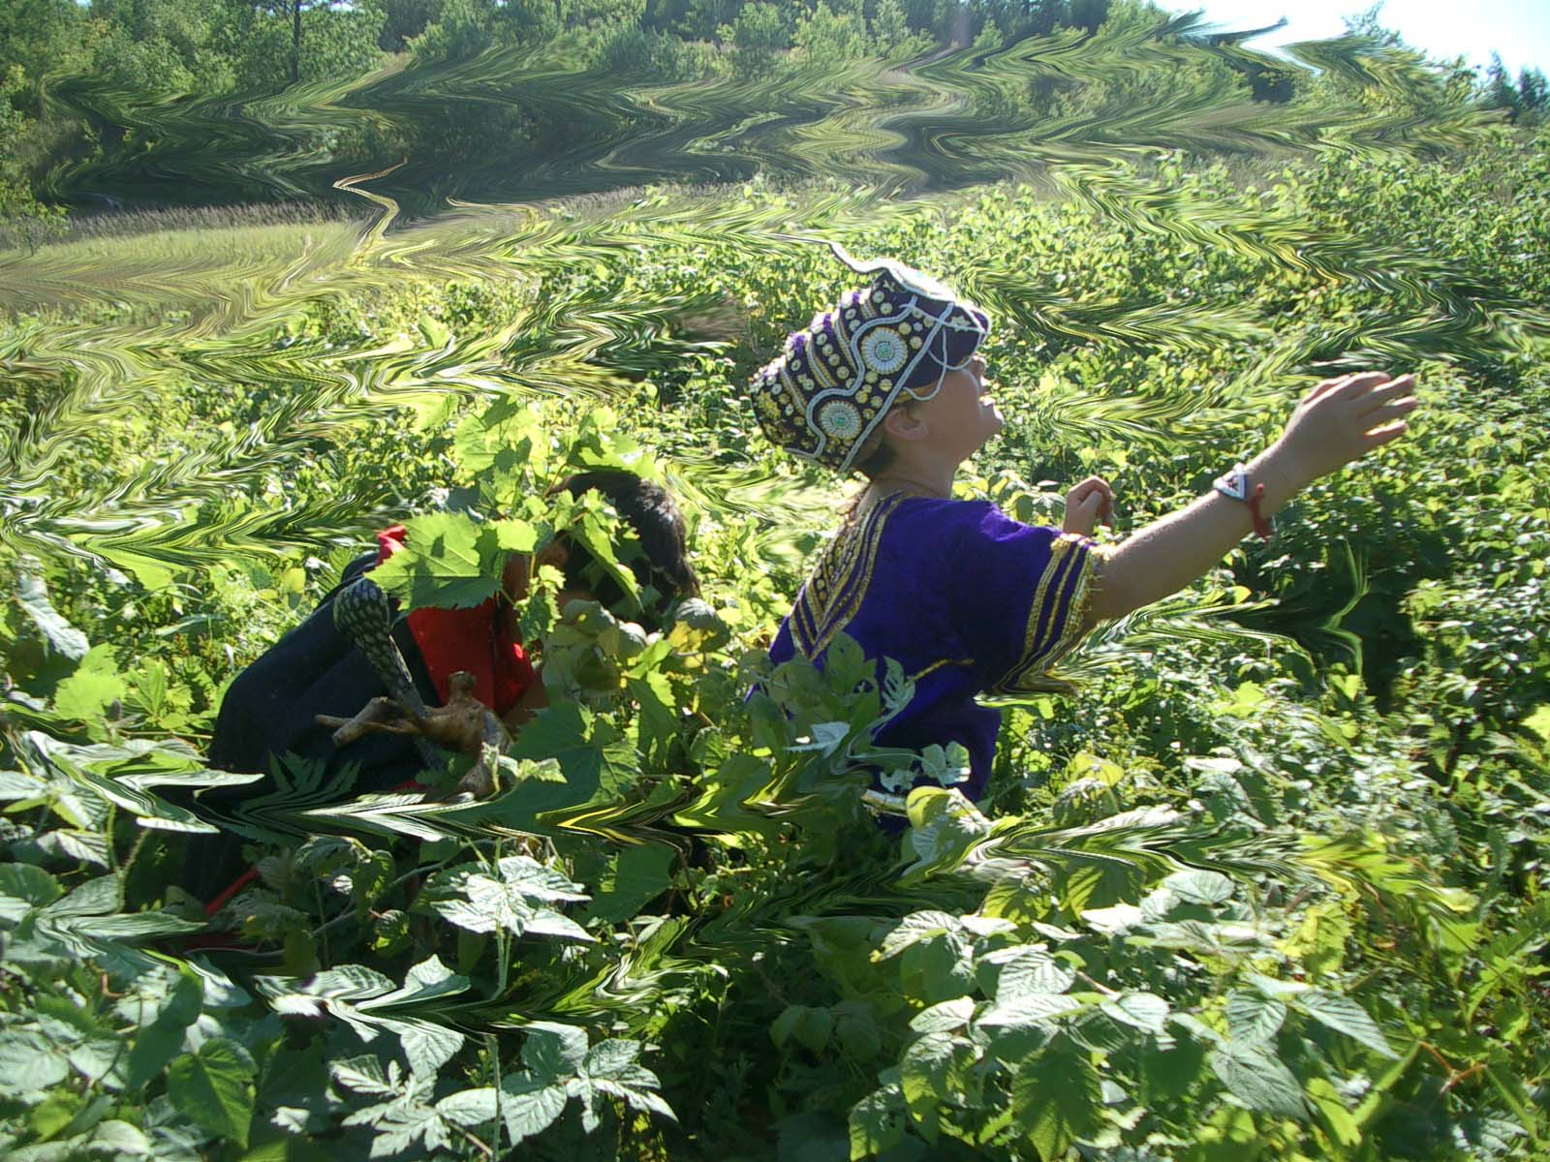
Searching in a Graph
Thinking about Algorithms Abstractly
Jeff Edmonds
York University
Lecture 5
COSC 3101

Slide 2
Generic Search
Breadth First Search
Dijkstra's Shortest Paths Algorithm
Depth First Search
Linear Order

Slide 3
Graph
a
b
Node ~ city or computer
Edge ~ road or network
c
Undirected or Directed
A surprisingly large number of problems
in computer science can be expressed
as a graph theory problem.

Slide 4
Graph Search
Specification: Reachability-from-single-source s
  <preCond>:
  The input is a graph G
  (either directed or undirected)
  and a source node s.
  <postCond>:
  Output all the nodes u that are
  reachable by a path in G from s.

Slide 5
Graph Search
Basic Steps:
s
v
u
Suppose you know that
u is reachable from s
& there is an edge
from u to v
You know that
v is reachable from s
Build up a set of reachable nodes.

Slide 6
Graph Search
b
e
b
e
t
t
h
d
h
d
d
v
d
reachable
f
v
w
s
u
w
reachable
j
reachable
reachable
How do we keep track of
all of this information?
How do we avoid cycling?

Slide 7
Graph Search
s
a
b
d
e
g
c
f
j
i
h
m
k
l

Slide 8
Graph Search
s
a
b
d
e
g
c
f
j
i
h
m
k
l

Slide 9
Graph Search
s
a
b
d
e
g
c
f
j
i
h
m
k
l

Slide 10
Graph Search
s
We know found nodes are reachable from s because we have traced out a path.
a
b
d
e
g
c
f
j
If a node has been handled,
then all of its neighbors
have been found.
i
h
m
k
l
l

Slide 11

Graph Search
s
We know found nodes are reachable from s because we have traced out a path.
a
b
d
e
g
c
f
j
If a node has been handled,
then all of its neighbors
have been found.
i
h
m
k
l
Handle some foundNotHandled node
i.e. find its neighbors
Don’t re-find a node.

Slide 12
Graph Search
s
We know found nodes are reachable from s because we have traced out a path.
a
b
d
e
g
c
f
j
If a node has been handled,
then all of its neighbors
have been found.
i
h
m
k
l
Handle some foundNotHandled node
i.e. find its neighbors

Slide 13
Graph Search
s
We know found nodes are reachable from s because we have traced out a path.
a
b
d
e
g
c
f
j
If a node has been handled,
then all of its neighbors
have been found.
i
h
m
k
l
measure
progress
# of found nodes.
Might not increase.
# of handled nodes.

Slide 14

Graph Search
s
We know found nodes are reachable from s because we have traced out a path.
a
b
d
e
g
c
f
j
If a node has been handled,
then all of its neighbors
have been found.
i
h
m
k
l
Node s is foundNotHandled
Other nodes notFound

Slide 15
Graph Search
s
We know found nodes are reachable from s because we have traced out a path.
a
b
d
e
g
c
f
j
If a node has been handled,
then all of its neighbors
have been found.
i
h
m
k
l
Exit
All nodes found.
No. Might not find all.
When can’t make any more progress.
Handle some foundNotHandled node
When all found nodes are have been handled.

Slide 16
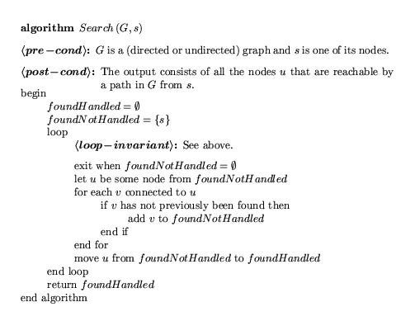

Slide 17

Graph Search
We know found nodes are reachable from s because we have traced out a path.
b
a
d
e
g
c
f
j
If a node has been handled,
then all of its neighbors
have been found.
i
h
m
k
l
Exit
All found nodes are handled.
  <postCond>:
  Output all the nodes u that are
  reachable by a path in G from s.
Exit
Output Found nodes

Slide 18
Graph Search
We know found nodes are reachable from s because we have traced out a path.
b
a
d
e
g
c
f
j
If a node has been handled,
then all of its neighbors
have been found.
i
h
m
k
l
Exit
All found nodes are handled.
  <postCond>:
Exit
Found nodes are reachable from s.
Reachable nodes have been found.

Slide 19
Graph Search
Found = handled
We know found nodes are reachable from s because we have traced out a path.
b
a
d
e
g
c
f
j
If a node has been handled,
then all of its neighbors
have been found.
i
h
handled
m
k
l
notfound
Exit
All found nodes are handled.
  <postCond>:
Reachable nodes have been Found.
Exit
[A ⇒ B] = [¬B ⇒ ¬A]
notFound nodes not reachable.

Slide 20
Graph Search
Specification of Reachability-from-single-source s
  <preCond>:
  The input is a graph G
  (either directed or undirected)
  and a source node s.
  <postCond>:
  Output all the nodes u that are
  reachable by a path in G from s.
Define Problem
Define Loop Invariants
Define Measure of Progress
79 km
to school
Define Step
Define Exit Condition
Maintain Loop Inv
Exit
Exit
Make Progress
Initial Conditions
Ending
Exit
79 km
75 km
0 km
Exit
Exit

Slide 21
Graph Search
# of handled nodes.
Handle some foundNotHandled node
Time =
O(n)
O(n) iterations,
but iteration takes more than O(1)
f
O(n) neighbors
= O(n²)
u
j
Could be fewer?
Each edge visited, times.
2
= O(E)
Linear time.
Size =
O(E)

Slide 22
Graph Search
Which foundNotHandled node do we handle?
Queue: Handle in order found.
  Breadth-First Search
Stack: Handle most recently found
  Depth-First Search
Priority Queue:
Handle node that seems to be closest to s.
  Shortest (Weighted) Paths:

Slide 23
Breadth First Search
<preCond> & <postCond>
Algorithm

Slide 24
BFS
Found
Not Handled
Queue
s
b
a
d
e
g
c
f
j
i
h
m
k
l

Slide 25
BFS
Found
Not Handled
Queue
s
b
a
s
d
e
g
c
f
j
i
h
m
k
l

Slide 26
BFS
Found
Not Handled
Queue
s
b
a
a
e
d
d
g
g
c
b
f
j
i
h
m
k
l

Slide 27
BFS
Found
Not Handled
Queue
s
b
a
e
d
d
g
g
c
b
f
c
j
f
i
h
m
k
l

Slide 28
BFS
Found
Not Handled
Queue
s
b
a
d
e
g
g
c
b
f
c
j
f
i
m
e
h
m
k
l

Slide 29
BFS
Found
Not Handled
Queue
s
b
a
b
c
d
e
f
g
m
c
e
f
j
j
i
h
m
k
l

Slide 30
BFS
Found
Not Handled
Queue
s
b
a
c
d
e
f
g
m
c
e
f
j
j
i
h
m
k
l

Slide 31
BFS
Found
Not Handled
Queue
s
b
a
d
e
f
g
m
c
e
f
j
j
h
i
i
h
m
k
l

Slide 32
BFS
Found
Not Handled
Queue
s
b
a
d
e
g
m
c
e
f
j
j
h
i
i
h
m
k
l

Slide 33
BFS
Found
Not Handled
Queue
s
b
a
d
e
g
c
e
f
j
j
h
i
i
h
l
m
k
l

Slide 34
BFS
Found
Not Handled
Queue
s
b
a
d
e
g
c
f
j
j
h
i
i
h
l
m
k
l

Slide 35
BFS
Found
Not Handled
Queue
s
b
a
d
e
g
c
f
j
h
i
i
h
l
m
k
l

Slide 36
BFS
Found
Not Handled
Queue
s
b
a
e
i
d
l
g
k
c
f
j
i
h
m
k
l

Slide 37
BFS
Found
Not Handled
Queue
s
b
a
d
e
l
g
k
c
f
j
i
h
m
k
l

Slide 38
BFS
Found
Not Handled
Queue
s
b
a
d
e
g
k
c
f
j
i
h
m
k
l

Slide 39
BFS
Found
Not Handled
Queue
s
b
a
d
e
g
c
f
j
i
h
m
k
l

Slide 40
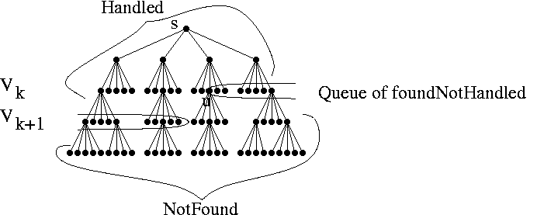
BFS
Algorithm
What order are the nodes found?
So far, the nodes have been found in order of length from s.
i.e. Breadth First Search

Slide 41
BFS
Found
Not Handled
Queue
s
b
a
d
e
g
c
f
j
i
h
m
k
l

Slide 42
BFS
Found
Not Handled
Queue
s
d=0
b
a
s
d=0
d
e
g
c
f
j
i
h
m
k
l

Slide 43
BFS
Found
Not Handled
Queue
s
d=0
d=1
b
a
d=0
e
a
d=1
d
d
g
c
g
f
b
j
i
h
m
k
l

Slide 44
BFS
Found
Not Handled
Queue
s
d=0
d=1
b
a
a
d=1
e
d
d
g
g
c
b
f
j
i
h
m
k
l

Slide 45
BFS
Found
Not Handled
Queue
s
d=0
d=1
b
a
d=1
e
d
d
g
g
c
b
f
c
d=2
j
f
d=2
i
h
m
k
l

Slide 46
BFS
Found
Not Handled
Queue
s
d=0
d=1
b
a
d=1
d
e
g
g
c
b
f
c
d=2
j
f
d=2
i
m
e
h
m
k
l

Slide 47
BFS
Found
Not Handled
Queue
s
d=0
d=1
b
a
d=1
d
e
g
c
b
f
c
d=2
j
f
d=2
i
m
e
h
j
m
k
l

Slide 48
BFS
Found
Not Handled
Queue
s
d=0
d=1
b
a
d=1
d
e
g
c
f
c
d=2
j
f
d=2
i
m
e
h
j
m
k
l

Slide 49
BFS
Found
Not Handled
Queue
s
d=0
d=1
b
a
c
d=2
d
e
f
g
m
c
e
f
j
j
d=2
i
h
m
k
l

Slide 50
BFS
Found
Not Handled
Queue
s
d=0
d=1
b
a
d=2
d
e
f
g
m
c
e
f
j
j
h
d=3
d=2
i
i
h
m
k
d=3
l

Slide 51
BFS
Found
Not Handled
Queue
s
d=0
d=1
b
a
d=2
d
e
g
m
c
e
f
j
j
h
d=3
d=2
i
i
h
m
k
d=3
l

Slide 52
BFS
Found
Not Handled
Queue
s
d=0
d=1
b
a
d=2
d
e
g
c
e
f
j
j
h
d=3
d=2
i
i
h
l
m
k
d=3
l

Slide 53
BFS
Found
Not Handled
Queue
s
d=0
d=1
b
a
d=2
d
e
g
c
f
j
j
h
d=3
d=2
i
i
h
l
m
k
d=3
l

Slide 54
BFS
Found
Not Handled
Queue
s
d=0
d=1
b
a
d=2
d
e
g
c
f
j
h
d=3
d=2
i
i
h
l
m
k
d=3
l

Slide 55
BFS
Found
Not Handled
Queue
s
d=0
d=1
b
a
h
d=3
e
i
d
l
g
c
f
j
d=2
i
h
m
k
d=3
l

Slide 56
BFS
Found
Not Handled
Queue
s
d=0
d=1
b
a
d=3
e
i
d
l
g
k
d=4
c
f
j
d=2
i
h
m
k
d=3
d=4
l

Slide 57
BFS
Found
Not Handled
Queue
s
d=0
d=1
b
a
d=3
d
e
l
g
k
d=4
c
f
j
d=2
i
h
m
k
d=3
d=4
l

Slide 58
BFS
Found
Not Handled
Queue
s
d=0
d=1
b
a
d=3
d
e
g
k
d=4
c
f
j
d=2
i
h
m
k
d=3
d=4
l

Slide 59
BFS
Found
Not Handled
Queue
s
d=0
d=1
b
a
k
d=4
d
e
g
c
f
j
d=2
i
h
m
k
d=3
d=4
l

Slide 60
BFS
Found
Not Handled
Queue
s
d=0
d=1
b
a
d=4
d
e
d=5
g
c
f
j
d=2
i
h
m
k
d=3
d=4
l

Slide 61
BFS
What order are the nodes found?
So far, the nodes have been found in order of length from s.
<postCond>:
Finds a shortest path from s
to each node v and its length.
To prove path is shortest:
Give a path
(witness)
Prove there is a path of this length.
Prove there are no shorter paths.

Slide 62
BFS
Basic Steps:
s
v
u
The shortest path to u
has length d
& there is an edge
from u to v
There is a path to v with length d+1.

Slide 63
BFS
What order are the nodes found?
So far, the nodes have been found in order of length from s.
<postCond>:
Finds a shortest path from s
to each node v and its length.
Prove there are no shorter paths.
When we find v, we know
there isn't a shorter path to it because ?
Otherwise, we would have found it already.

Slide 64
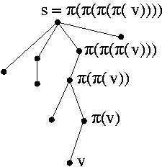
BFS
Data structure for storing tree:
For each node v, store π(v) to be parent of v.

Slide 65
BFS
Basic Steps:
s
v
u
π(v)
Path to u
& there is an edge
from u to v
Parent of v is
π(v) = u.

Slide 66
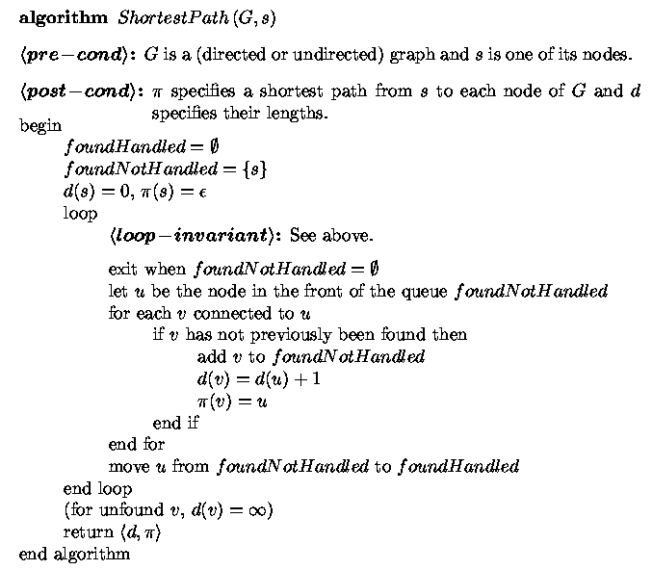

Slide 67
Graph Search
Handle some foundNotHandled node
Queue: Handle in order found.
  Breadth-First Search
Stack: Handle most recently found
  Depth-First Search
Priority Queue:
Handle node that seems to be closest to s.
  Shortest (Weighted) Paths:

Slide 68
Dijkstra's Shortest-Weighted Paths
Specification: Dijkstra's Shortest-Weighted Paths
Reachability-from-single-source s
  <preCond>:
  The input is a graph G
  (either directed or undirected)
  with positive edge weights
  and a source node s.
  <postCond>:
  Finds a shortest weighted path from s
  to each node v and its length.

Slide 69
Dijkstra's Shortest-Weighted Paths
s
1
Length of shortest
path from s to u?
100
w
u
1
4
r
1
1
v

Slide 70
BFS
So far, the nodes have been found in order of length from s.
Is the same true for Dijkstra's Alg?
s
1
100
w
u
1
r
1
1
v
Which node is found first?

Slide 71
BFS
So far, the nodes have been found in order of length from s.
Is the same true for Dijkstra's Alg?
s
1
100
w
u
1
r
1
1
v
Which node is found first?
It has the longest path from s.

Slide 72
Dijkstra's
So far, the nodes have been found in order of length from s.
handled
s
1
100
w
u
1
r
1
1
v
In what order do we handle the foundNotHandled nodes?
Handle node that “seems” to be closest to s.

Slide 73
Dijkstra's
Desired
So far, the nodes have been handled in order of length from s.
<postCond>:
Finds a shortest weighted path
from s to each node v and its length.
To prove path is shortest:
Give a path
(witness)
Prove there is a path of this length.
Prove there are no shorter paths.

Slide 74
Dijkstra's
So far, the nodes have been handled in order of length from s.
<postCond>:
Finds a shortest weighted path
from s to each node v and its length.
To prove path is shortest:
Prove there is a path of this length.
Prove there are no shorter paths.
When we handle v, we know
there isn't a shorter path to it because ?
Otherwise, we would have handled it already.

Slide 75
Dijkstra's
Basic Steps:
Handle node that “seems” to be closest to s.
Need to keep approximate shortest distances.
  Path that we have “seen so far” will be called
  handled paths.
  Let d(v) the length of the shortest such path to v.
Which is further?
s
v
u

Slide 76
Dijkstra's
Basic Steps:
Updating d(u).
The shortest of handled paths
to v has length d(v)
s
v
u
w_{<u,v>}
The shortest of handled paths
to u has length d(u)
& there is an edge
from u to v
The shortest known path to v has length
min( d(v), d(u)+w_{<u,v>} ).

Slide 77
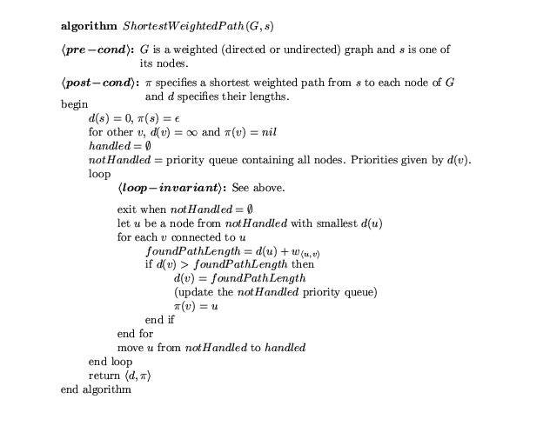
…

Slide 78
Dijkstra's
Definition of handled paths and d(v)
Handled nodes
Found nodes
s
v
u
Handled Edges?

Slide 79
Dijkstra's
Definition of handled paths and d(v)
Handled nodes
Found nodes
s
v
u
Handled Edges
Handled Paths?

Slide 80
Dijkstra's
Definition of handled paths and d(v)
Handled nodes
Found nodes
s
v
u
Handled Edges
Handled Paths

Slide 81
Dijkstra's
Definition of handled paths and d(v)
Handled nodes
s
v
NotFound
u
d(v’)=
∞
For handled u,
d(u) is the length of the
shortest paths to u.
d(v) is the length of the
shortest handled paths to v.

Slide 82
Exit

Slide 83
Dijkstra's
d=0
s
10
1
b
a
d=∞
d=∞
30
30
40
2
3
3
1
2
d
c
d=∞
d=∞
e
d=∞
2
15
1
8
f
2
h
d=∞
1
g
6
d=∞
d=∞
i
3
j
d=∞
d=∞

Slide 84
Dijkstra's
d=0
s
10
1
b
a
d=10
d=1
30
30
40
2
3
3
1
2
d
c
d=40
d=30
e
d=∞
2
15
1
8
f
2
h
d=∞
1
g
6
d=∞
d=∞
i
3
j
d=∞
d=∞

Slide 85
Dijkstra's
d=0
s
10
1
b
a
d=10
d=1
30
30
40
2
3
3
1
2
d
c
d=31
d=30
e
d=∞
2
15
1
8
f
2
h
d=3
1
g
6
d=∞
d=∞
i
3
j
d=∞
d=∞

Slide 86
Dijkstra's
d=0
s
10
1
b
a
d=10
d=1
30
30
40
2
3
3
1
2
d
c
d=31
d=18
e
d=∞
2
15
1
8
f
2
h
d=3
1
g
6
d=∞
d=4
i
3
j
d=∞
d=∞

Slide 87
Dijkstra's
d=0
s
10
1
b
a
d=10
d=1
30
30
40
2
3
3
1
2
d
c
d=6
d=5
e
d=∞
2
1
8
15
1
f
h
d=3
1
g
6
d=10
d=4
i
3
j
d=∞
d=∞

Slide 88
Dijkstra's
d=0
s
10
1
b
a
d=10
d=1
30
30
40
2
3
3
1
2
d
c
d=6
d=5
e
d=∞
2
1
8
15
1
f
h
d=3
1
g
6
d=7
d=4
i
3
j
d=∞
d=∞

Slide 89
Dijkstra's
d=0
s
10
1
b
a
d=9
d=1
30
30
40
2
3
3
1
2
d
c
d=6
d=5
e
d=∞
2
1
8
15
1
f
h
d=3
1
g
6
d=7
d=4
i
3
j
d=∞
d=∞

Slide 90
Dijkstra's
d=0
s
10
1
b
a
d=8
d=1
30
30
40
2
3
3
1
2
d
c
d=6
d=5
e
d=15
2
1
8
15
1
f
h
d=3
1
g
6
d=7
d=4
i
3
j
d=∞
d=∞

Slide 91
Dijkstra's
d=0
s
10
1
b
a
d=8
d=1
30
30
40
2
3
3
1
2
d
c
d=6
d=5
e
d=10
2
1
8
15
1
f
h
d=3
1
g
6
d=7
d=4
i
3
j
d=∞
d=∞

Slide 92
Dijkstra's
d=0
s
10
1
b
a
d=8
d=1
30
30
40
2
3
3
1
2
d
c
d=6
d=5
e
d=10
2
1
8
15
1
f
h
d=3
1
g
6
d=7
d=4
i
3
j
d=∞
d=∞

Slide 93
Dijkstra's
d=0
s
10
1
b
a
d=8
d=1
30
30
40
2
3
3
1
2
d
c
d=6
d=5
e
d=10
2
1
8
15
1
f
h
d=3
1
g
6
d=7
d=4
i
3
j
d=∞
d=∞

Slide 94
Dijkstra's
d=0
s
10
1
b
a
d=8
d=1
30
30
40
2
3
3
1
2
d
c
d=6
d=5
e
d=10
2
1
8
15
1
f
h
d=3
1
g
6
d=7
d=4
DONE
i
3
j
d=∞
d=∞

Slide 95
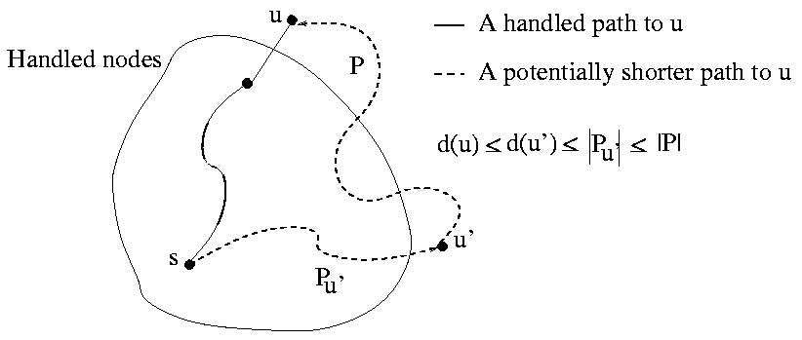
Dijkstra's
For handled w,
d(w) is the length of the
shortest paths to w.
d(v) is the length
of the shortest handled
path to v.
Handle node with smallest d(u).
For handled u, d(u) is the length
of the shortest paths to u.

Slide 96
Dijkstra's
For handled w,
d(w) is the length of the
shortest paths to w.
d(u) is the length
of the shortest handled
path to u.
Handle node with smallest d(u).
For handled u, d(u) is the length
of the shortest paths to u.
d(u)

Slide 97
Dijkstra's
For handled w,
d(w) is the length of the
shortest paths to w.
d(u) is the length
of the shortest handled
path to u.
Handle node with smallest d(u).
For handled u, d(u) is the length
of the shortest paths to u.
d(u)
First not handled
node in path.

Slide 98
Dijkstra's
For handled w,
d(w) is the length of the
shortest paths to w.
d(u) & d(u’) are the length
of the shortest handled
paths to u and u’.
Handle node with smallest d(u).
For handled u, d(u) is the length
of the shortest paths to u.
d(u)
First not handled
node in path.
d(u’)

Slide 99
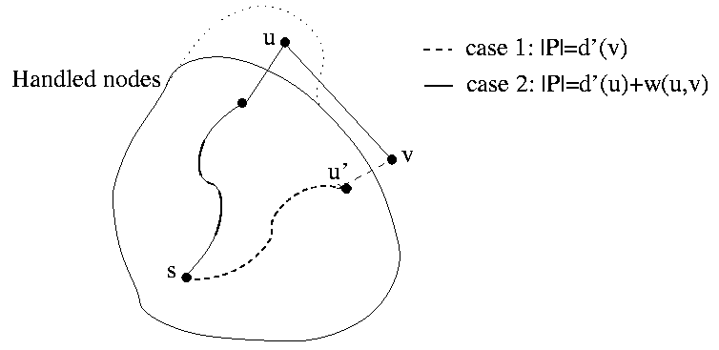
Dijkstra's
For handled w,
d(w) is the length of the
shortest paths to w.
d(v) is the length
of the shortest handled
path to v.
Handle node with smallest d(u).
d(v) is the length of the shortest
handled path to v.
d(u)
w_{<u,v>}
d(v)
d(v) = min( d(v), d(u)+w_{<u,v>} ).

Slide 100
Dijkstra's
2
Each edge visited, times.
Time = O(E)
?
This number of times following an edge.
For each update,
d(v) = min( d(v), d(u)+w_{<u,v>} ).
Must update Priority Queue.
Takes time O(log(n))
Heap
Time = O(E log(n))

Slide 101
Dijkstra's Shortest-Weighted Paths
Specification: Dijkstra's Shortest-Weighted Paths
Reachability-from-single-source s
  <preCond>:
  The input is a graph G
  (either directed or undirected)
  with positive edge weights
  and a source node s.
  <postCond>:
  Finds a shortest weighted path from s
  to each node v and its length.
Define Problem
Define Loop Invariants
Define Measure of Progress
79 km
to school
Define Step
Define Exit Condition
Maintain Loop Inv
Exit
Exit
Make Progress
Initial Conditions
Ending
Exit
79 km
75 km
0 km
Exit
Exit

Slide 102
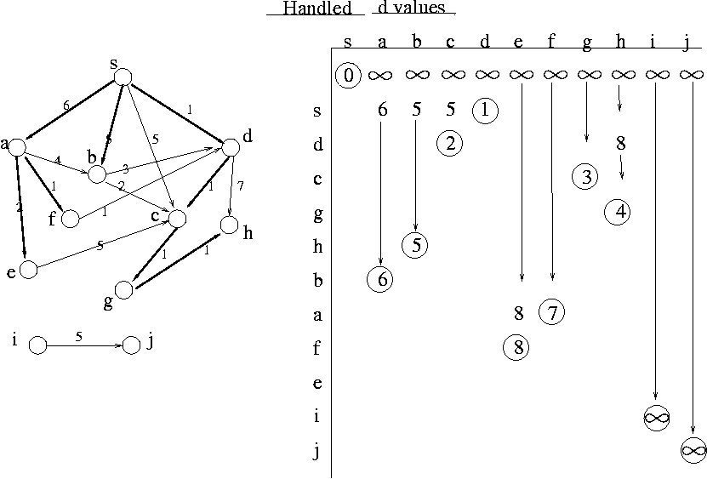
Dijkstra's

Slide 103
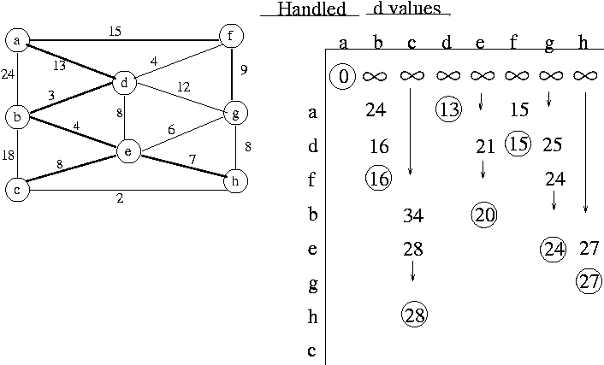
Dijkstra's

Slide 104
Graph Search
Handle some foundNotHandled node
Queue: Handle in order found.
  Breadth-First Search
Stack: Handle most recently found
  Depth-First Search
Priority Queue:
Handle node that seems to be closest to s.
  Shortest (Weighted) Paths:

Slide 105
DFS
Found
Not Handled
Stack
s
b
a
d
e
g
c
f
j
i
h
m
k
l

Slide 106
DFS
Found
Not Handled
Stack
s
b
a
d
e
g
c
f
j
i
s
h
m
k
l

Slide 107
DFS
Found
Not Handled
Stack
s
b
a
d
e
g
c
f
b
j
g
i
d
a
h
m
k
l

Slide 108
DFS
Found
Not Handled
Stack
s
b
a
d
e
g
c
e
f
m
j
g
i
d
a
h
m
k
l

Slide 109
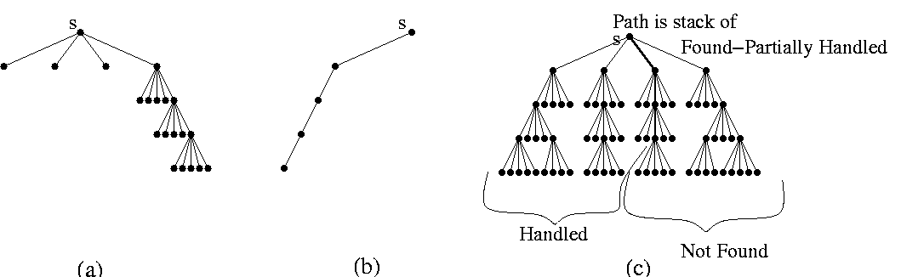
DFS

Slide 110
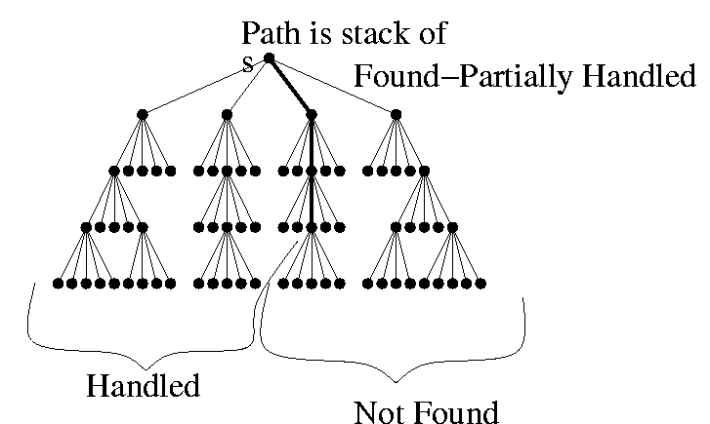
DFS
The nodes in the stack form a path starting at s.

Slide 111
DFS
Found
Not Handled
Stack
<node,# edges>
s
b
a
d
e
g
c
f
j
i
h
m
k
l

Slide 112
DFS
Found
Not Handled
Stack
<node,# edges>
s
b
a
d
e
g
c
f
j
i
s,0
h
m
k
l

Slide 113
DFS
Found
Not Handled
Stack
<node,# edges>
s
b
a
d
e
g
c
f
j
i
a,0
s,1
h
m
k
l

Slide 114
DFS
Found
Not Handled
Stack
<node,# edges>
s
b
a
d
e
g
c
f
j
c,0
i
a,1
s,1
h
m
k
l

Slide 115
DFS
Found
Not Handled
Stack
<node,# edges>
s
b
a
d
e
g
c
f
h,0
j
c,1
i
a,1
s,1
h
m
k
l

Slide 116
DFS
Found
Not Handled
Stack
<node,# edges>
s
b
a
d
e
g
c
f
k,0
h,1
j
c,1
i
a,1
s,1
h
m
k
l

Slide 117
DFS
Found
Not Handled
Stack
<node,# edges>
s
b
a
d
e
g
c
f
h,1
j
c,1
Path on Stack
i
a,1
s,1
h
m
Tree Edge
k
l

Slide 118
DFS
Found
Not Handled
Stack
<node,# edges>
s
b
a
d
e
g
c
f
j
c,1
i
a,1
s,1
h
m
k
l

Slide 119
DFS
Found
Not Handled
Stack
<node,# edges>
s
b
a
d
e
g
c
f
i,0
j
c,2
i
a,1
s,1
h
m
k
l

Slide 120
DFS
Found
Not Handled
Stack
<node,# edges>
s
b
a
d
e
g
c
f
i,1
j
c,2
i
a,1
s,1
h
m
Cross Edge
to handled node
k
l

Slide 121
DFS
Found
Not Handled
Stack
<node,# edges>
s
b
a
d
e
g
c
f
i,2
j
c,2
i
a,1
s,1
h
m
k
l

Slide 122
DFS
Found
Not Handled
Stack
<node,# edges>
s
b
a
d
e
g
c
f
l,0
i,3
j
c,2
i
a,1
s,1
h
m
k
l

Slide 123
DFS
Found
Not Handled
Stack
<node,# edges>
s
b
a
d
e
g
c
f
l,1
i,3
j
c,2
i
a,1
s,1
h
m
k
l

Slide 124
DFS
Found
Not Handled
Stack
<node,# edges>
s
b
a
d
e
g
c
f
i,3
j
c,2
i
a,1
s,1
h
m
k
l

Slide 125
DFS
Found
Not Handled
Stack
<node,# edges>
s
b
a
d
e
g
c
g,0
f
i,4
j
c,2
i
a,1
s,1
h
m
k
l

Slide 126
DFS
Found
Not Handled
Stack
<node,# edges>
s
b
a
d
e
g
j,0
c
g,1
f
i,4
j
c,2
i
a,1
s,1
h
m
k
l

Slide 127
DFS
Found
Not Handled
Stack
<node,# edges>
s
b
a
d
e
g
j,1
c
g,1
f
i,4
j
c,2
i
a,1
s,1
h
m
Back Edge
to node on Stack
k
l
Forms a cycle

Slide 128
DFS
Found
Not Handled
Stack
<node,# edges>
s
b
a
d
e
m,0
g
j,2
c
g,1
f
i,4
j
c,2
i
a,1
s,1
h
m
k
l

Slide 129
DFS
Found
Not Handled
Stack
<node,# edges>
s
b
a
d
e
m,1
g
j,2
c
g,1
f
i,4
j
c,2
i
a,1
s,1
h
m
k
l

Slide 130
DFS
Found
Not Handled
Stack
<node,# edges>
s
b
a
d
e
g
j,2
c
g,1
f
i,4
j
c,2
i
a,1
s,1
h
m
k
l

Slide 131
DFS
Found
Not Handled
Stack
<node,# edges>
s
b
a
d
e
g
c
g,1
f
i,4
j
c,2
i
a,1
s,1
h
m
k
l

Slide 132
DFS
Found
Not Handled
Stack
<node,# edges>
s
b
a
d
e
g
c
f
i,4
j
c,2
i
a,1
s,1
h
m
k
l

Slide 133
DFS
Found
Not Handled
Stack
<node,# edges>
s
b
a
d
e
g
c
f,0
f
i,5
j
c,2
i
a,1
s,1
h
m
k
l

Slide 134
DFS
Found
Not Handled
Stack
<node,# edges>
s
b
a
d
e
g
c
f,1
f
i,5
j
c,2
i
a,1
s,1
h
m
k
l

Slide 135
DFS
Found
Not Handled
Stack
<node,# edges>
s
b
a
d
e
g
c
f
i,5
j
c,2
i
a,1
s,1
h
m
k
l

Slide 136
DFS
Found
Not Handled
Stack
<node,# edges>
s
b
a
d
e
g
c
f
j
c,2
i
a,1
s,1
h
m
k
l

Slide 137
DFS
Found
Not Handled
Stack
<node,# edges>
s
b
a
d
e
g
c
f
j
c,3
i
a,1
s,1
h
m
k
l

Slide 138
DFS
Found
Not Handled
Stack
<node,# edges>
s
b
a
d
e
g
c
f
j
i
a,1
s,1
h
m
k
l

Slide 139
DFS
Found
Not Handled
Stack
<node,# edges>
s
b
a
d
e
g
c
f
j
i
a,2
s,1
h
m
k
l

Slide 140
DFS
Found
Not Handled
Stack
<node,# edges>
s
b
a
d
e
g
c
f
j
i
s,1
h
m
k
l

Slide 141
DFS
Found
Not Handled
Stack
<node,# edges>
s
b
a
d
e
g
c
f
j
i
d,1
s,2
h
m
k
l

Slide 142
DFS
Found
Not Handled
Stack
<node,# edges>
s
b
a
d
e
g
c
f
j
i
d,2
s,2
h
m
k
l

Slide 143
DFS
Found
Not Handled
Stack
<node,# edges>
s
b
a
d
e
g
c
f
j
e,0
i
d,3
s,2
h
m
k
l

Slide 144
DFS
Found
Not Handled
Stack
<node,# edges>
s
b
a
d
e
g
c
f
j
e,1
i
d,3
s,2
h
m
k
l

Slide 145
DFS
Found
Not Handled
Stack
<node,# edges>
s
b
a
d
e
g
c
f
j
i
d,3
s,2
h
m
k
l

Slide 146
DFS
Found
Not Handled
Stack
<node,# edges>
s
b
a
d
e
g
c
f
j
i
s,2
h
m
k
l

Slide 147
DFS
Found
Not Handled
Stack
<node,# edges>
s
b
a
d
e
g
c
f
j
i
s,3
h
m
k
l

Slide 148
DFS
Found
Not Handled
Stack
<node,# edges>
s
b
a
d
e
g
c
f
j
i
b,0
s,4
h
m
k
l

Slide 149
DFS
Found
Not Handled
Stack
<node,# edges>
s
b
a
d
e
g
c
f
j
i
b,1
s,4
h
m
k
l

Slide 150
DFS
Found
Not Handled
Stack
<node,# edges>
s
b
a
d
e
g
c
f
j
i
b,2
s,4
h
m
k
l

Slide 151
DFS
Found
Not Handled
Stack
<node,# edges>
s
b
a
d
e
g
c
f
j
i
b,3
s,4
h
m
k
l

Slide 152
DFS
Found
Not Handled
Stack
<node,# edges>
s
b
a
d
e
g
c
f
j
i
s,4
h
m
k
l

Slide 153
DFS
Found
Not Handled
Stack
<node,# edges>
s
b
a
d
e
g
c
f
j
i
h
m
k
done
l

Slide 154
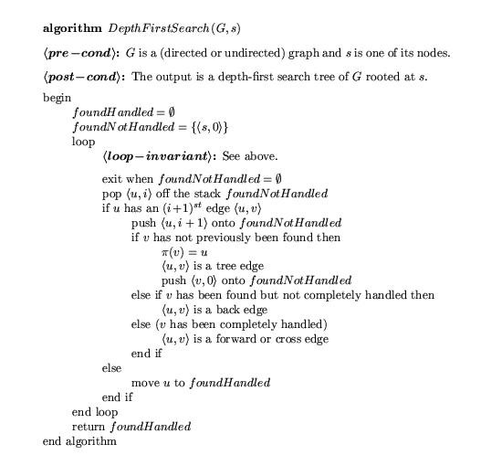

Slide 155
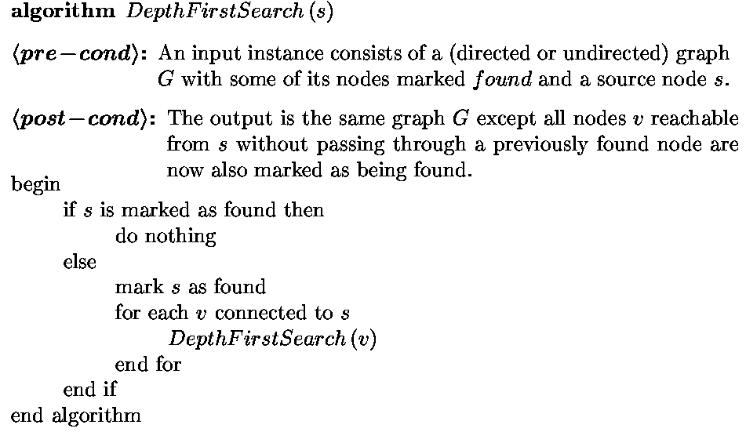
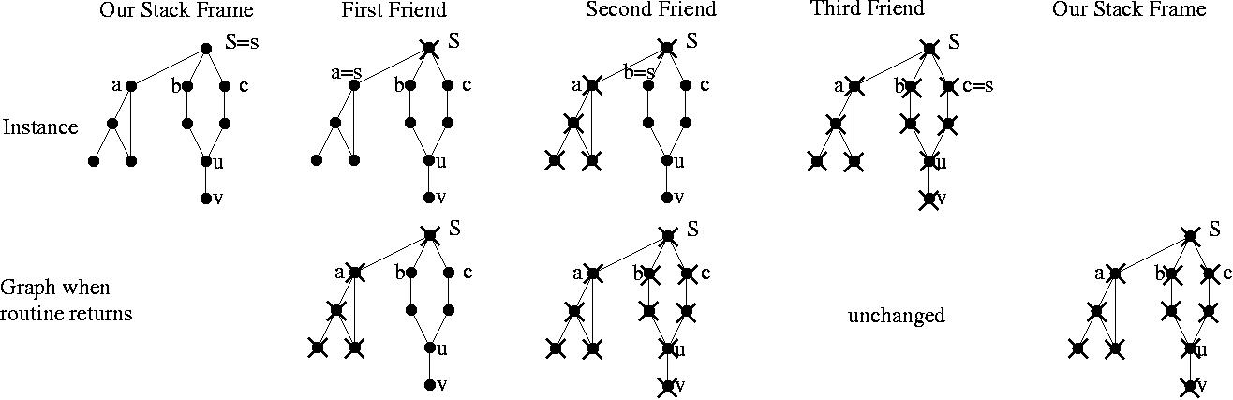
Recursive
Depth First
Search
Get help from
friends

Slide 156
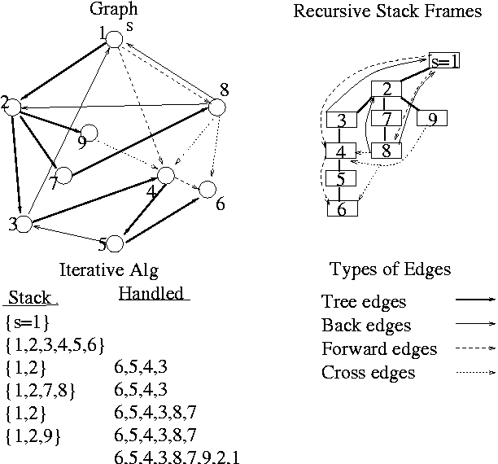

Slide 157


Linear Order
underwear
socks
pants
shoes
underwear
pants
socks
shoes
socks
underwear
pants
shoes

Slide 158

Linear Order
underwear
socks
pants
shoes
?

Slide 159
Linear Order
a
<preCond>:
A Directed Acyclic Graph
(DAG)
<postCond>:
Find one valid linear order
b
h
c
i
d
j
e
k
g
Algorithm:
Find a sink.
Put it last in order.
Delete & Repeat
?
f
l
….. l

Slide 160
Linear Order
a
<preCond>:
A Directed Acyclic Graph
(DAG)
<postCond>:
Find one valid linear order
b
h
c
i
d
j
e
k
g
Algorithm:
Find a sink.
Put it last in order.
Delete & Repeat
f
l
Θ(n)
Θ(n²)
….. l

Slide 161
Linear Order
Found
Not Handled
Stack
Alg: DFS
a
b
h
c
i
d
j
e
k
g
f
g
f
l
e
d
….. f

Slide 162
Linear Order
Found
Not Handled
Stack
Alg: DFS
a
b
h
c
i
d
j
e
k
g
l
g
f
l
e
d
When take off stack
add to backwards order
….. f

Slide 163
Linear Order
Found
Not Handled
Stack
Alg: DFS
a
b
h
c
i
d
j
e
k
g
g
f
l
e
d
When take off stack
add to backwards order
l,f

Slide 164
Linear Order
Found
Not Handled
Stack
Alg: DFS
a
b
h
c
i
d
j
e
k
g
f
l
e
d
When take off stack
add to backwards order
g,l,f

Slide 165
Linear Order
Found
Not Handled
Stack
Alg: DFS
a
b
h
c
i
d
j
e
k
g
f
l
d
When take off stack
add to backwards order
e,g,l,f

Slide 166
Linear Order
Found
Not Handled
Stack
Alg: DFS
a
b
h
c
i
d
j
e
k
g
f
l
When take off stack
add to backwards order
d,e,g,l,f

Slide 167
Linear Order
Found
Not Handled
Stack
Alg: DFS
a
b
h
c
i
d
j
e
k
g
k
j
f
l
i
When take off stack
add to backwards order
d,e,g,l,f

Slide 168
Linear Order
Found
Not Handled
Stack
Alg: DFS
a
b
h
c
i
d
j
e
k
g
j
f
l
i
When take off stack
add to backwards order
k,d,e,g,l,f

Slide 169
Linear Order
Found
Not Handled
Stack
Alg: DFS
a
b
h
c
i
d
j
e
k
g
f
l
i
When take off stack
add to backwards order
j,k,d,e,g,l,f

Slide 170
Linear Order
Found
Not Handled
Stack
Alg: DFS
a
b
h
c
i
d
j
e
k
g
f
l
When take off stack
add to backwards order
i,j,k,d,e,g,l,f

Slide 171
Linear Order
Found
Not Handled
Stack
Alg: DFS
a
b
h
c
i
d
j
e
k
g
c
f
l
b
When take off stack
add to backwards order
i,j,k,d,e,g,l,f

Slide 172
Linear Order
Found
Not Handled
Stack
Alg: DFS
a
b
h
c
i
d
j
e
k
g
f
l
b
When take off stack
add to backwards order
c,i,j,k,d,e,g,l,f

Slide 173
Linear Order
Found
Not Handled
Stack
Alg: DFS
a
b
h
c
i
d
j
e
k
g
f
l
When take off stack
add to backwards order
b,c,i,j,k,d,e,g,l,f

Slide 174
Linear Order
Found
Not Handled
Stack
Alg: DFS
a
b
h
c
i
d
j
e
k
g
h
f
l
a
When take off stack
add to backwards order
b,c,i,j,k,d,e,g,l,f

Slide 175
Linear Order
Found
Not Handled
Stack
Alg: DFS
a
b
h
c
i
d
j
e
k
g
f
l
a
When take off stack
add to backwards order
h,b,c,i,j,k,d,e,g,l,f

Slide 176
Linear Order
Found
Not Handled
Stack
Alg: DFS
a
b
h
c
i
d
j
e
k
g
f
l
When take off stack
add to backwards order
a,h,b,c,i,j,k,d,e,g,l,f
done

Slide 177
Linear Order
Found
Not Handled
Stack
Consider each edge
Proof:
Case 1: u goes on stack first before v.
  Because of edge,
  v goes on before u comes off
  v comes off before u comes off
  v goes after u in order. ☺
v
…
u
…
u
v
u…
v…

Slide 178
Linear Order
Found
Not Handled
Stack
Consider each edge
Proof:
Case 1: u goes on stack first before v.
Case 2: v goes on stack first before u.
v comes off before u goes on.
  v goes after u in order. ☺
u
…
v
…
u
v
u…
v…

Slide 179
Linear Order
Found
Not Handled
Stack
Consider each edge
Proof:
Case 1: u goes on stack first before v.
Case 2: v goes on stack first before u.
v comes off before u goes on.
Case 3: v goes on stack first before u.
u goes on before v comes off.
  Panic: u goes after v in order. ☹
  Cycle means linear order
  is impossible ☺
u
…
v
…
The nodes in the stack form a path starting at s.
u
v
v…
u…
done

Slide 180
End

