Slide 1

Network Flow &
Linear Programming
Thinking about Algorithms Abstractly
Network Flow
Linear Programming
Jeff Edmonds York University
Lecture 5
COSC 3101

Slide 2
Optimization Problems
Ingredients:
  Instances: The possible inputs to the problem.
  Solutions for Instance: Each instance has an exponentially large set of solutions.
  Cost of Solution: Each solution has an easy to compute cost or value.
Specification
  <preCond>: The input is one instance.
  <postCond>: A valid solution with optimal cost. (minimum or maximum)

Slide 3
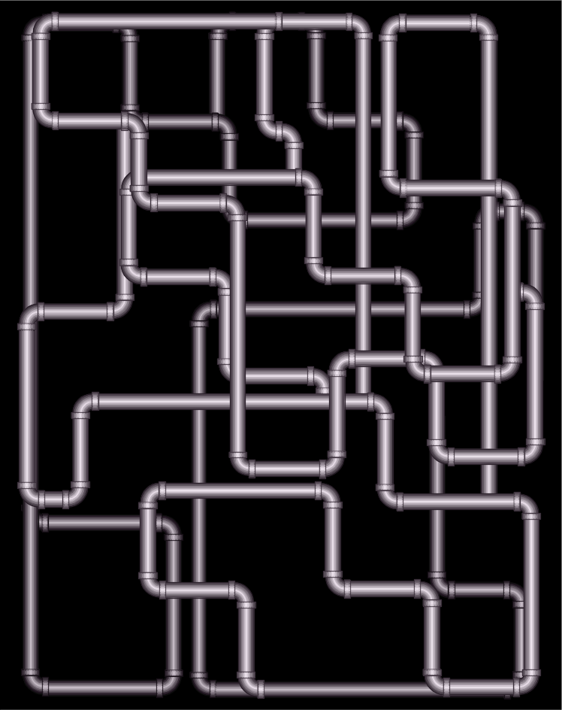




Network Flow
Instance:
  A Network is a directed graph G
  Edges represent pipes that carry flow
  Each edge <u,v> has a maximum capacity c_{<u,v>}
  A source node s out of which flow leaves
  A sink node t into which flow arrives
Goal:
Max Flow

Slide 4
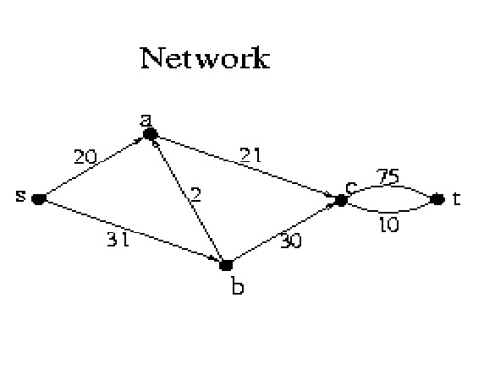
Network Flow
Instance:
  A Network is a directed graph G
  Edges represent pipes that carry flow
  Each edge <u,v> has a maximum capacity c_{<u,v>}
  A source node s out of which flow leaves
  A sink node t into which flow arrives

Slide 5
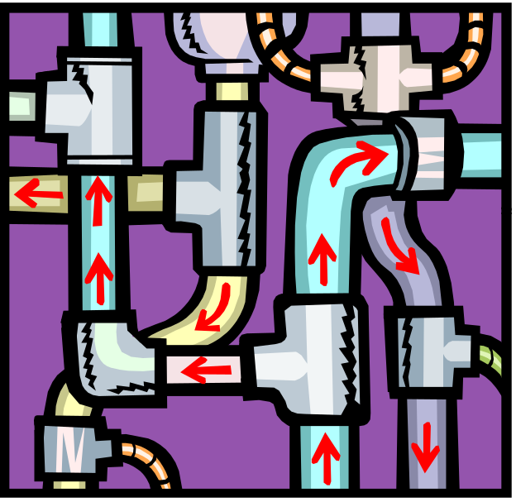
Network Flow
Solution:
  The amount of flow F_{<u,v>} through each edge.
  Flow can’t exceed capacity i.e. F_{<u,v>} ≤ c_{<u,v>}.
  Unidirectional flow
    F_{<u,v>} ≥ 0 and F_{<v,u>} = 0
    or
    F_{<u,v>} = 0 and F_{<v,u>} ≥ 0
Some texts:
F_{<u,v>} = -F_{<v,u>}

Slide 6

Network Flow
Solution:
  The amount of flow F_{<u,v>} through each edge.
  Flow F_{<u,v>} can’t exceed capacity c_{<u,v>}.
  Unidirectional flow
  No leaks, no extra flow.

Slide 7
Network Flow
Solution:
  The amount of flow F_{<u,v>} through each edge.
  Flow F_{<u,v>} can’t exceed capacity c_{<u,v>}.
  Unidirectional flow
  No leaks, no extra flow.
    For each node v: flow in = flow out
  ∑_{u} F_{<u,v>} = ∑_{w} F_{<v,w>}
Except for s and t.

Slide 8
Network Flow
Value of Solution:
  Flow from s into the network
  minus flow from the network back into s.
  rate(F) = ∑_{u} F_{<s,u>}
  = flow from network into t
  minus flow back in.
  = ∑_{u} F_{<u,t>} - ∑_{v} F_{<t,v>}
- ∑_{v} F_{<v,s>}
What about
flow back into s?
Goal:
Max Flow

Slide 9
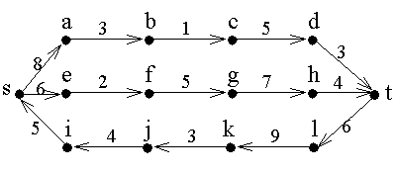
Network Flow
A network
with its edge capacities
What is the maximum that can flow from s to t?

Slide 10
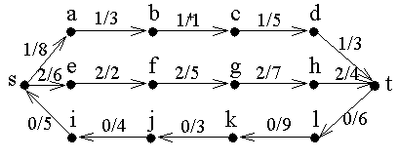
Network Flow
A network
with its edge capacities
The max total rate of the flow is 1+2-0 = 3.
flow/capacity = 2/5
Prove that total can not be higher.

Slide 11
Network Flow
No more flow can be pushed
along the top path because the
edge <b,c> is at capacity.
Similarly, the edge <e,f>.
No flow is pushed along the bottom path because this would decrease the total from s to t.

Slide 12
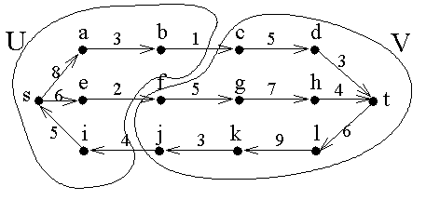
Network Flow
<U,V> is a minimum cut
Its capacity is the sum of the capacities crossing the cut
= 1+2 = 3.
<i,j> is not included in because it is going in the wrong direction.

Slide 13
Network Flow
The edges crossing forward across the cut are at capacity
those crossing backwards have zero flow.
This is always true.

Slide 14
Network Flow
The maximum flow is 1+2=3
The minimum cut is 1+2=3.
These are always equal.

Slide 15








An Application: Matching
Sam | Mary
Bob | Beth
John | Sue
Fred | Ann
3 matches
Can we do better?
4 matches
Who loves whom.
Who should be matched with whom
so as many as possible matched
and nobody matched twice?

Slide 16
An Application: Matching
s
t
1
1
u
v
c_{<s,u>} = 1
  Total flow out of u = flow into u ≤ 1
  Boy u matched to at most one girl.
c_{<v,t>} = 1
  Total flow into v = flow out of v ≤ 1
  Girl v matched to at most one boy.

Slide 17
Network Flow
Strategy:
  Push flow into s.
  Must make decisions.
  Get stuck and must backtrack.
  Difficult and time consuming.
c=100
c=1
c=100
f=100
s
f=100
c=100

Slide 18

Network Flow
Strategy:
  Find a path for a single drop.
  Push as much flow through as fits.
  w = augment = Min_{<u,v> ∈ Path} c_{<u,v>}

Slide 19
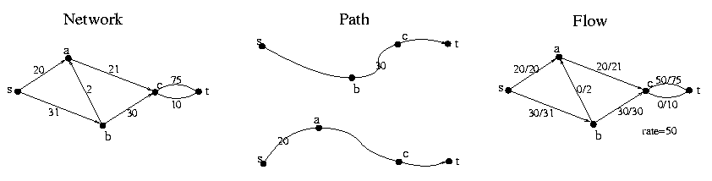
Network Flow
Strategy:
  Find a path for a single drop.
  Push as much flow through as fits.
  w = augment = Min_{<u,v> ∈ Path} c_{<u,v>}
flow/capacity = 20/21

Slide 20

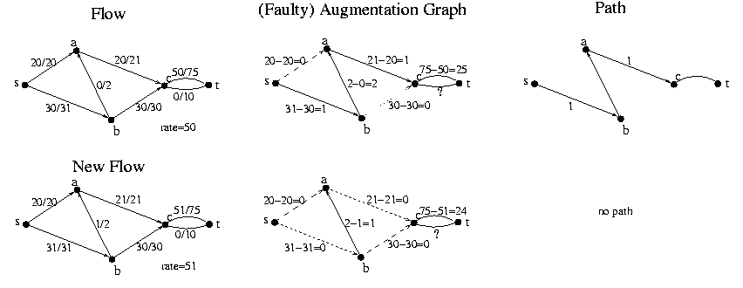
Network Flow
+w
+w
+w
+w
Given Flow F
  Construct Augmenting Graph G_{F}
  Find path P using BFS, DFS,
  or generic search algorithm
  Let w be the max amount flow
  can increase along path P.
  Increase flow along path P by w.
  i.e newF = oldF + w × P

Slide 21
Network Flow
Given Flow F
  Construct Augmenting Graph G_{F}
  Find path P using BFS, DFS,
  or generic search algorithm
  No path
  Stop.

Slide 22

Hill Climbing
We have a valid solution.
(not necessarily optimal)
measure
progress
Value of our solution.
Take a step that goes up.
Make small local changes to your solution to
construct a slightly better solution.
Initially have the “zero
Global Max
Exit
Cant take a step that goes up.
Local Max
Problems:
Running time?
Can our Network Flow
Algorithm get stuck
in a local maximum?
If you take small step,
could be exponential time.

Slide 23
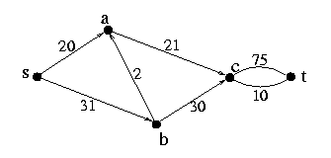
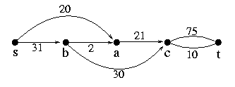
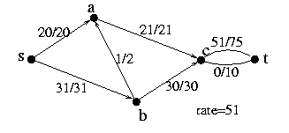
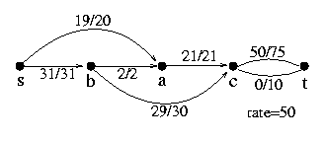
Network Flow
Can our Network Flow Algorithm
get stuck in local max?
Yes!
Need only one example.
Previous Input
Same Input
Previous Output
Worse Output

Slide 24
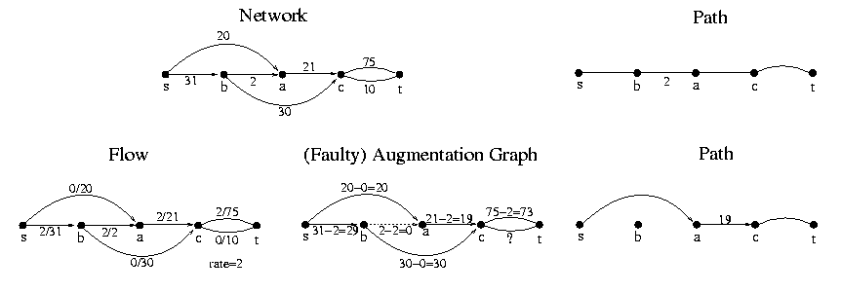
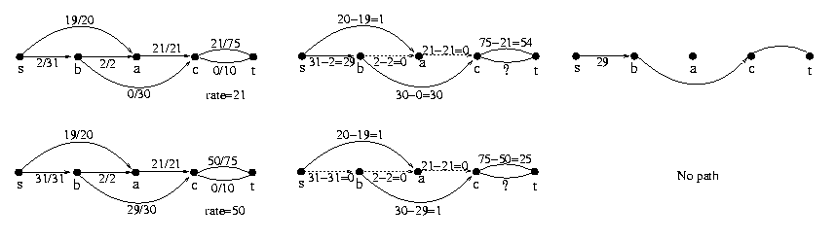
Network Flow

Slide 25
Network Flow
Yes! Our Network Flow
Algorithm can get stuck.
Need only one example.
Previous Input
Same Input
Previous Output
Worse Output

Slide 26
Hill Climbing
Avoiding getting stuck
in a local maximum
Bad Execution
Good Execution
Made better choices of direction
  Hard
Back up an retry
  Exponential time
Define a bigger step

Slide 27
Hill Climbing
Different
Solutions
Alg defines
to where alg can step
i.e. what small local
changes can be made to
current solution
Current
Solution
This defines
the topography

Slide 28
Hill Climbing
Different
Solutions
Define a slightly
bigger step
Current
Solution
This defines
the topography
Perhaps removes some local maxima

Slide 29
Network Flow
Mistake?
Putting 2 through
this edge
Previous Input
Same Input
Previous Output
Worse Output

Slide 30
Network Flow
Mistake?
We need to decrease the flow in this edge.
But if we decrease the total flow then
the algorithm might run exponentially
or forever.
We need to decrease the flow in this edge
AND increase the total flow.
Putting 2 through
this edge

Slide 31
Network Flow
Locally in each edge,
we see how much we can change the flow.
Allowed Flow ≠ Allowed Change in Flow
People find this hard.
This is my first attempt to explain it.

Slide 32
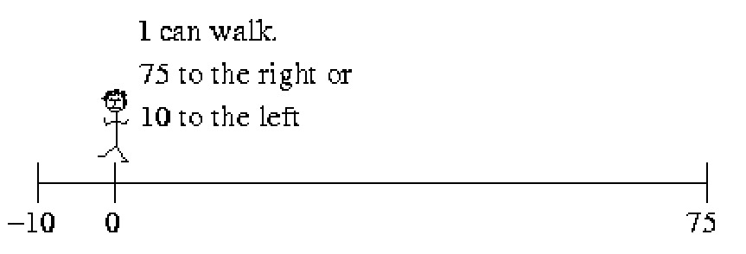
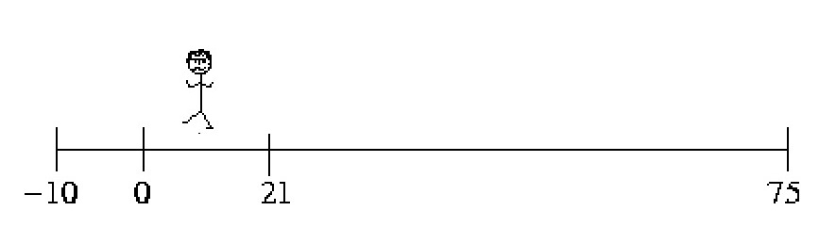
Network Flow
Old Flow Graph
0/75
u
v
0/10
Walking 10
New Flow Graph
10/75
u
v
0/10

Slide 33
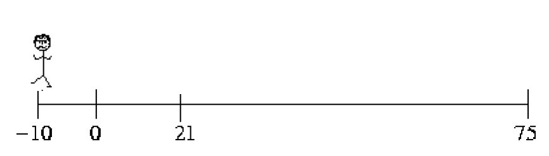
Network Flow
Old Flow Graph
0/75
u
v
0/10
Walking 10
New Flow Graph
0/75
u
v
10/10

Slide 34
Network Flow
Same
Old Flow Graph
0/75
u
v
0/10
Walking -10
Walking 10
New Flow Graph
New Flow Graph
-10/75
Not allowed
0/75
u
v
u
v
0/10
10/10

Slide 35
Network Flow
Same
Eqv Flow Graph
F_{<u,v>}∈[-10,75]
u
v
F_{<u,v>} = -10
Walking -10
Walking 10
New Flow Graph
New Flow Graph
-10/75
Not allowed
0/75
u
v
u
v
0/10
10/10

Slide 36
Network Flow
Eqv Flow Graph
F_{<u,v>}∈[-10,75]
u
v
F_{<u,v>} = 10
Walking Δ
New Flow Graph
10+Δ ≤ 75
F_{<u,v>}+Δ ≤ c_{<u,v>}
Δ ≤ c_{<u,v>}-F _{<u,v>}
10+Δ /75
u
v
0/10

Slide 37
Network Flow
Eqv Flow Graph
F_{<u,v>}∈[-10,75]
u
v
F_{<u,v>} = 10
Walking Δ
10-Δ ≥ -10
F_{<u,v>}-Δ ≥ -c_{<v,u>}
Δ ≤ F _{<u,v>} + c_{<v,u>}
New Flow Graph
10- Δ /75
u
v
0/10

Slide 38
Network Flow
Eqv Flow Graph
F_{<u,v>}∈[-10,75]
u
v
F_{<u,v>} = 10
Augmentation Graph
Δ ≤ c_{<u,v>}-F _{<u,v>}
u
v
Δ ≤ F _{<u,v>} + c_{<v,u>}

Slide 39
Network Flow
Locally in each edge,
we see how much we can change the flow.
Allowed Flow ≠ Allowed Change in Flow
People find this hard.
This is my second attempt to explain it.

Slide 40
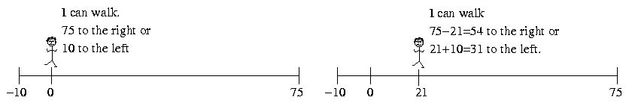
Network Flow
Flow Graph
0/75
u
v
0/10
Augmentation Graph
75
u
v
10

Slide 41
Network Flow
Walking
Flow Graph
21+2=23
21/75
u
v
0/10
Augmentation Graph
75-21=54
u
v
2

Slide 42
Network Flow
Walking -10
Walking 10
Flow Graph
21-10=11
21/75
u
v
0
10
Edge shouldn’t
have flow in
both directions.
0/10
Augmentation Graph
75-21=54
u
v
10
10
?

Slide 43
Network Flow
Flow Graph
0/75
u
v
0/10
Augmentation Graph
75
u
v
10

Slide 44
Network Flow
Walking -10
Walking 10
Flow Graph
21-10=11
21/75
u
v
0
10
Edge shouldn’t
have flow in
both directions.
0/10
Augmentation Graph
75-21=54
u
v
10
10
?

Slide 45
Network Flow
Flow Graph
11/75
u
v
Capacity of 10 not met
0/10
Augmentation Graph
75-21=54
u
v
10
10
?

Slide 46
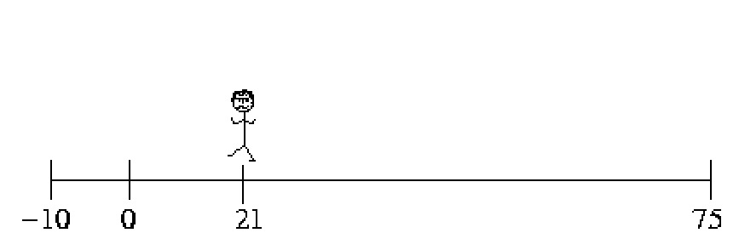
Network Flow
Flow Graph
21/75
u
v
Capacity of 10 exceeded
21
0/10
Augmentation Graph
75-21=54
u
v
21
10
?

Slide 47
Network Flow
Walking
Flow Graph
21+2=23
21/75
u
v
0/10
Augmentation Graph
75-21=54
u
v
2

Slide 48
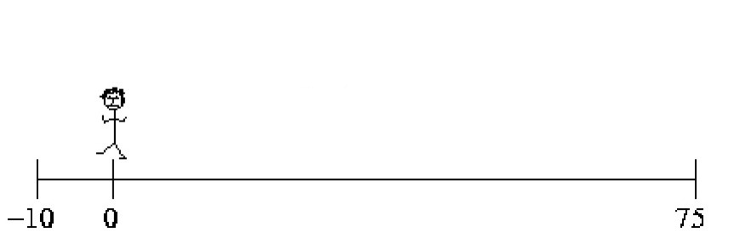
Network Flow
Walking -21
Walking 21
Flow Graph
21-21=0
21/75
u
v
Capacity of 10 not met
0/10
Augmentation Graph
75-21=54
u
v
21
10
?

Slide 49
Network Flow
Walking 21
and another 10
Flow Graph
21-21=0
21/75
u
v
Capacity of 10 met
10
0/10
Augmentation Graph
75-21=54
u
v
21+10
10
?
21+10=31

Slide 50
Network Flow
Walking 25
Flow Graph
21-25=-4
0
21/75
u
v
4
0/10
Augmentation Graph
75-21=54
u
v
25
21+10=31

Slide 51
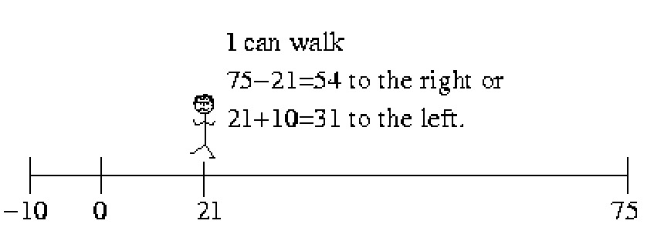
Network Flow
Walking
c_{<v,u>}
F_{<u,v>}
c_{<u,v>}
Flow Graph
Augmentation Graph
F_{<u,v>}+w
F_{<u,v>}/c_{<u,v>}
c_{<u,v>}-F_{<u,v>}
u
v
u
w
v
0/c_{<v,u>}
F_{<u,v>}+c_{<v,u>}

Slide 52
Network Flow
Walking
c_{<u,v>}
F_{<u,v>}
c_{<u,v>}
Flow Graph
Augmentation Graph
F_{<u,v>}-w
F_{<u,v>}/c_{<u,v>}
c_{<u,v>}-F_{<u,v>}
u
v
u
w
v
0/c_{<v.u>}
F_{<u,v>}+c_{<v,u>}

Slide 53
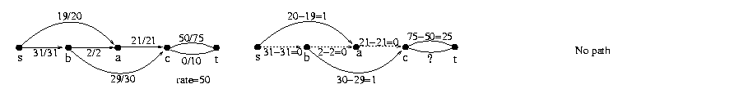
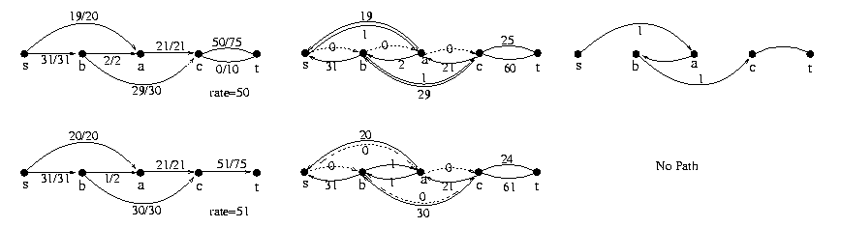
Network Flow
Where we got stuck before
Old
New
Given Flow F
  Construct Augmenting Graph G_{F}
  Find path P

Slide 54
Network Flow
+w
?
+w
-w
+w
Given Flow F
  Construct Augmenting Graph G_{F}
  Find path P
  Let w be the max amount flow
  can increase along path P.
  Increase flow along path P by w.
  i.e newF = oldF + w × P

Slide 55
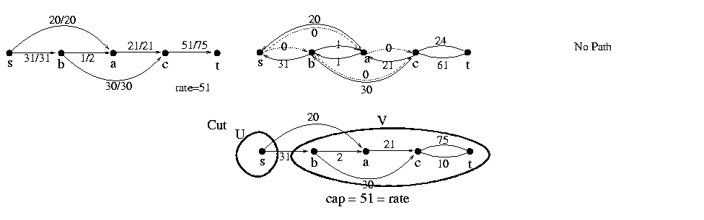
Network Flow
Given Flow F
  Construct Augmenting Graph G_{F}
  Find path P using BFS, DFS,
  or generic search algorithm
  No path
  Stop.

Slide 56
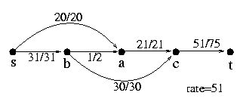
Network Flow
Previous Input
Same Input
Previous Output
Worse Output
Same Output

Slide 57
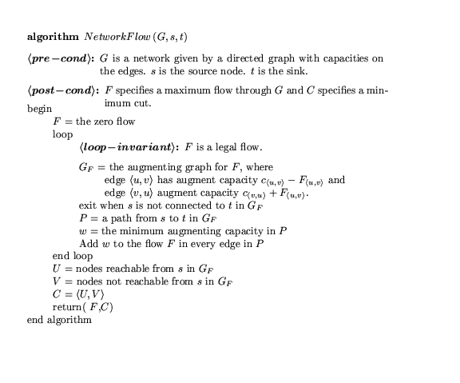

Slide 58
An Application: Matching
Sam | Mary
Bob | Beth
John | Sue
Fred | Ann
3 matches
Can we do better?
4 matches
Who loves whom.
Who should be matched with whom
so as many as possible matched
and nobody matched twice?

Slide 59
An Application: Matching
Flow
New Flow
s
t
s
t
Augmentation Graph
Augmentation Path
Alternates
  adding edge
  removing edge
  adding edge
  removing edge
  adding edge
Extra edge added
s
t

Slide 60
An Application: Matching
Sam | Mary
Bob | Beth
John | Sue
Fred | Ann
3 matches
Can we do better?
4 matches
Who loves whom.
Who should be matched with whom
so as many as possible matched
and nobody matched twice?

Slide 61
Network Flow
Can our Network Flow Algorithm
get stuck in local max?
No!
Need to prove
  for every input network
  for every choice of augmenting paths
Maximum Flow is found!
How?

Slide 62

Primal-Dual Hill Climbing
Mars settlement has hilly landscape
and many layers of roofs.

Slide 63
Primal-Dual Hill Climbing
Primal Problem:
Exponential # of locations to stand.
Find a highest one.
Dual problem:
Exponential # of roofs.
Find a lowest one.

Slide 64
Primal-Dual Hill Climbing
Prove:
Every roof is above every location to stand.
∀ R ∀ L height(R) ≥ height(L)
⇒ height(R_{min}) ≥ height(L_{max})
Is there a gap?

Slide 65
Primal-Dual Hill Climbing
Prove:
For every location to stand either:
  the alg takes a step up or
  the alg gives a reason that explains why not
  by giving a ceiling of equal height.
  i.e. ∀ L [∃ L’ height(L’) ≥ height(L) or
∃ R height(R) = height(L)]
or
No Gap
But ∀ R ∀ L height(R) ≥ height(L)

Slide 66
Primal-Dual Hill Climbing
Prove:
For every location to stand either:
  the alg takes a step up or
  the alg gives a reason that explains why not
  by giving a ceiling of equal height.
  i.e. ∀ L [∃ L’ height(L’) ≥ height(L) or
∃ R height(R) = height(L)]
or
?
Cant go up from this location
and no matching ceiling.
Cant happen!

Slide 67
Primal-Dual Hill Climbing
Prove:
For every location to stand either:
  the alg takes a step up or
  the alg gives a reason that explains why not
  by giving a ceiling of equal height.
  i.e. ∀ L [∃ L’ height(L’) ≥ height(L) or
∃ R height(R) = height(L)]
or
No local maximum!

Slide 68

Primal-Dual Hill Climbing
Exit
Claim: Primal and dual have the same optimal value.
height(R_{min}) = height(L_{max})
Proved: ∀ R ∀ L, height(R) ≥ height(L)
Proved: Alg runs until it provides L_{alg} and R_{alg}
height(R_{alg}) = height(L_{alg})
height(R_{min}) ≤
height(R_{alg}) =
height(L_{alg}) ≤
height(L_{max})
height(R_{min}) ≥
height(L_{max})
No Gap
L_{alg} witness that height(L_{max}) is no smaller.
R_{alg} witness that height(L_{max}) is no bigger.

Slide 69
Network Flow
A network
with its edge capacities
What is the maximum that can flow from s to t?

Slide 70
Network Flow
A network
with its edge capacities
The max total rate of the flow is 1+2-0 = 3.
flow/capacity = 2/5
Prove that total can not be higher.

Slide 71
Network Flow
No more flow can be pushed
along the top path because the
edge <b,c> is at capacity.
Similarly, the edge <e,f>.
No flow is pushed along the bottom path because this would decrease the total from s to t.

Slide 72
Network Flow
<U,V> is a minimum cut
Its capacity is the sum of the capacities crossing the cut
= 1+2 = 3.
<i,j> is not included in because it is going in the wrong direction.

Slide 73
Network Flow
The edges crossing forward across the cut are at capacity
those crossing backwards have zero flow.
This is always true.

Slide 74
Network Flow
The maximum flow is 1+2=3
The minimum cut is 1+2=3.
These are always equal.

Slide 75
Primal-Dual Network Flow
Primal Problem: Max Flow
Dual Problem:
What are the roofs to the flows?
Min Cut

Slide 76
Min Cut
Instance:
  A Network is a directed graph G
  Special nodes s and t.
  Edges represent pipes that carry flow
  Each edge <u,v> has a maximum capacity c_{<u,v>}
s
t

Slide 77
Min Cut
Instance:
  A Network is a directed graph G
  Special nodes s and t.
  Edges represent pipes that carry flow
  Each edge <u,v> has a maximum capacity c_{<u,v>}

Slide 78
Min Cut
Solution:
C = partition of nodes <U,V> with s∈U, t∈V.
U
= Canada
s
V
= USA
York
t
UC Berkeley

Slide 79
Min Cut
Solution:
C = partition of nodes <U,V> with s∈U, t∈V.
s
York
Ontario
t
UC Berkeley

Slide 80
Min Cut
Solution:
C = partition of nodes <U,V> with s∈U, t∈V.
Toronto
s
York
t
UC Berkeley

Slide 81
Min Cut
Solution:
C = partition of nodes <U,V> with s∈U, t∈V.
York
s
York
t
UC Berkeley

Slide 82
Min Cut
Solution:
C = partition of nodes <U,V> with s∈U, t∈V.
s
York
UCB
t
UC Berkeley

Slide 83
Min Cut
Solution:
C = partition of nodes <U,V> with s∈U, t∈V.
s
York
Berkeley
t
UC Berkeley

Slide 84
Min Cut
Solution:
C = partition of nodes <U,V> with s∈U, t∈V.
U
s
York
V
t
UC Berkeley

Slide 85
Min Cut
Value Solution C=<U,V>:
cap(C) = how much can flow from U to V
= ∑_{u∈U,v∈V} c_{<u,v>}
Goal:
Min Cut
U
s
V
u
v
t

Slide 86
Max Flow = Min Cut
Theorem:
  For all Networks Max_{F} rate(F) = Min_{C} cap(C)
Prove: ∀ F,C rate(F) ≤ cap(C)
Exit
Prove: ∀ flow F, alg either
  finds a better flow F
  or finds cut C such that rate(F) = cap(C)
Alg stops with an F and C for which rate(F) = cap(C)
  F witnesses that the optimal flow cant be less
  C witnesses that it cant be more.
U
V
u
v

Slide 87
Max Flow = Min Cut
Prove: ∀ flow F, cut C rate(F) ≤ cap(C)
cap(C) = how much can flow from U to V
= ∑_{u∈U,v∈V} c_{<u,v>}
rate(F,C) = Flow from U to V minus flow V to U
= ∑_{u∈U,v∈V} F_{<u,v>} - F_{<v,u>}
Lemma: rate(F) = rate(F,C) ≤ cap(C)
No leaks, no extra flow.
F_{<u,v>} ≤ c_{<u,v>} & F_{<v,u>} ≥ 0
U
= Canada
s
V
= USA
York
+
-
t
UC Berkeley

Slide 88
Max Flow = Min Cut
Lemma: ∀F,C rate(F,C) = rate(F)
Proof: By induction on the size of U.
Base case: C = <{s},G-{s}>
rate(F) = Flow from s into the network
minus flow from the network back into s
  = ∑_{u} F_{<s,u>} - ∑_{v} F_{<v,t>}
  = rate(F,C) where C = <{s},G-{s}>
+
s
York
-
t
UC Berkeley

Slide 89
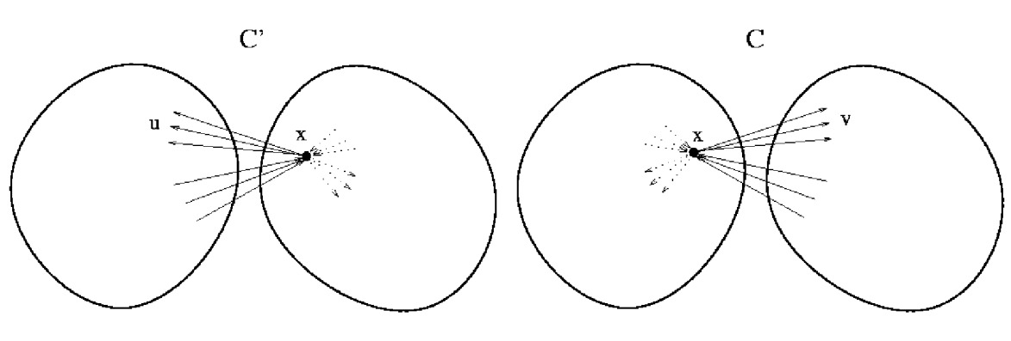
Max Flow = Min Cut
Lemma: ∀F,C rate(F,C) = rate(F)
Proof: By induction on the size of C.
Base case: C = <{s},G-{s}>
Inductive step: Move nodes across C one at a time.
Flow into x = Flow out.
Hence, flow across cut does not change.
rate(F) = rate(F,C) ≤ cap(C)

Slide 90
Max Flow = Min Cut
Theorem:
  For all Networks Max_{F} rate(F) = Min_{C} cap(C)
Prove: ∀ F,C rate(F) ≤ cap(C)
Prove: ∀ flow F, alg either
  finds a better flow F
  or finds cut C such that rate(F) = cap(C)
U
V
u
v

Slide 91
Max Flow = Min Cut
+w
-w
+w
+w
Given Flow F
  Construct Augmenting Graph G_{F}
  Find path P
  Let w be the max amount flow
  can increase along path P.
  Increase flow along path P by w.
  i.e newF = oldF + w × P

Slide 92
Max Flow = Min Cut
Given Flow F
  Construct Augmenting Graph G_{F}
  Find path P using BFS, DFS,
  or generic search algorithm
  No path
  Stop

Slide 93
Max Flow = Min Cut
Bad example because
U might contain
more than s.
  Let F_{alg} be this final flow.
  Let cut C_{alg}=<U,V>,
    where U are the nodes reachable from s
    in the augmented graph
    and V not.
  Claim: rate(F_{alg}) = cap(C_{alg})

Slide 94
Max Flow = Min Cut
Prove: rate(F_{alg}) = cap(C_{alg})
=
Prove: rate(F_{alg},C_{alg}) = cap(C_{alg})

Slide 95
Max Flow = Min Cut
Prove: rate(F_{alg},C_{alg}) = cap(C_{alg})
cap(C) = how much can flow from U to V
= ∑_{u∈U,v∈V} c_{<u,v>}
rate(F,C) = Flow from U to V minus flow V to U
= ∑_{u∈U,v∈V} F_{<u,v>} - F_{<v,u>}
Flow Graph
U
V
+
F_{<u,v>}/c_{<u,v>}
u
v
-
F_{<u’,v’>}/c_{<u’,v’>}
v’
u’

Slide 96
Max Flow = Min Cut
Prove: rate(F_{alg},C_{alg}) = cap(C_{alg})
cap(C) = how much can flow from U to V
= ∑_{u∈U,v∈V} c_{<u,v>}
rate(F,C) = Flow from U to V minus flow V to U
= ∑_{u∈U,v∈V} F_{<u,v>} - F_{<v,u>}
Flow Graph
U
V
need equal
+
F_{<u,v>}/c_{<u,v>}
u
v
need zero
-
F_{<u’,v’>}/c_{<u’,v’>}
v’
u’

Slide 97
Max Flow = Min Cut
Prove: rate(F_{alg},C_{alg}) = cap(C_{alg})
cap(C) = how much can flow from U to V
= ∑_{u∈U,v∈V} c_{<u,v>}
rate(F,C) = Flow from U to V minus flow V to U
= ∑_{u∈U,v∈V} F_{<u,v>} - F_{<v,u>}
Flow Graph
Augmentation Graph
U
V
reachable from s =
U
V
= not
need equal
not edges
+
F_{<u,v>}/c_{<u,v>}
c_{<u,v>}-F_{<u,v>}
=0
u
v
u
v
need zero
-
F_{<u’,v’>}/c_{<u’,v’>}
v’
u’
v’
u’
F_{<u’,v’>}+c_{<v’,u’>}
=0

Slide 98
Max Flow = Min Cut
Theorem:
  For all Networks Max_{F} rate(F) = Min_{C} cap(C)
Prove: ∀ F,C rate(F) ≤ cap(C)
Prove: ∀ flow F, alg either
  finds a better flow F
  or finds cut C such that rate(F) = cap(C)
Alg stops with an F and C for which rate(F) = cap(C)
  F witnesses that the optimal flow cant be less
  C witnesses that it cant be more.
U
V
u
v

Slide 99
Hill Climbing
Problems:
Can our Network Flow
Algorithm get stuck
in a local maximum?
Global Max
No!
Local Max

Slide 100
Hill Climbing
Problems:
Running time?
If you take small step,
could be exponential time.

Slide 101
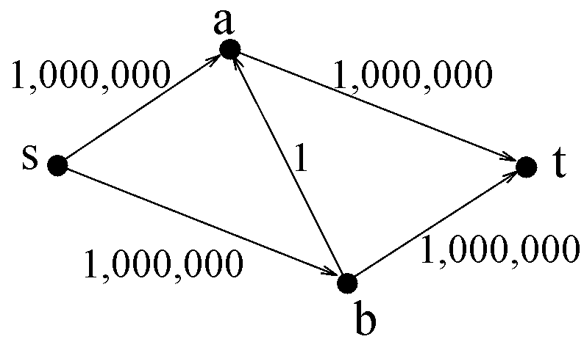
Network Flow

Slide 102
Network Flow
Add flow 1

Slide 103
Network Flow
Add flow 1

Slide 104
Hill Climbing
Problems:
Running time?
If each iteration you take
the biggest step possible,
  Alg is poly time
    in number of nodes
    and number of bits in capacities.
If each iteration you take
path with the fewest edges
  Alg is poly time
    in number of nodes

Slide 105
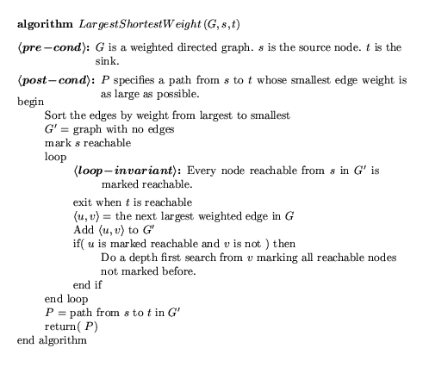
Taking the biggest step possible

Slide 106
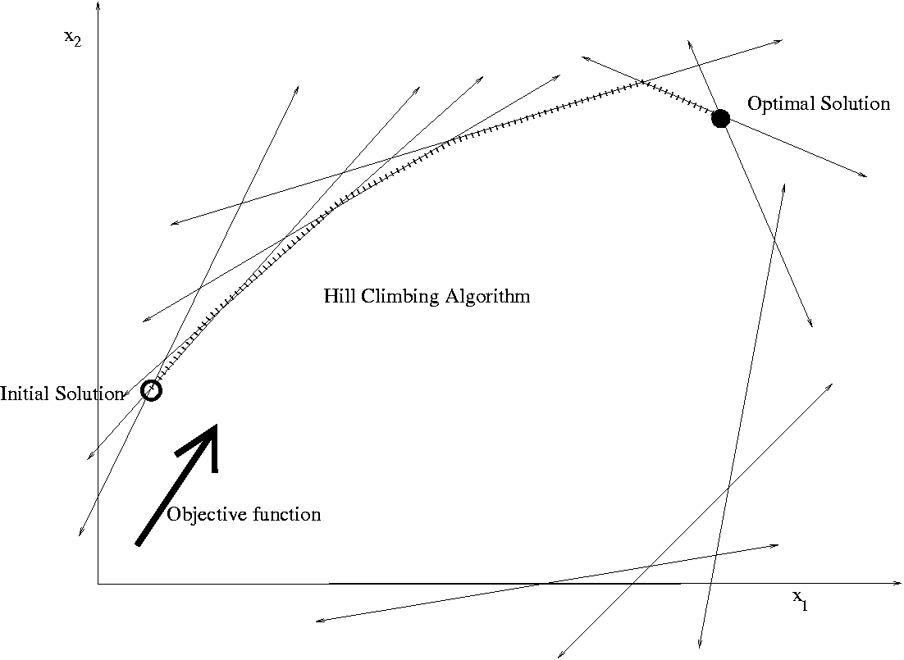
Linear Programming

Slide 107

A Hotdog
A combination of pork, grain, and sawdust, …

Slide 108
Constraints:
  Amount of moisture
  Amount of protein,
  …

Slide 109
The Hotdog Problem
Given today’s prices,
what is a fast algorithm
to find the cheapest hotdog?

Slide 110

There are deep ideas within the simplicity.
Abstraction
=
Goal: Understand and think about complex things in simple ways.
There are deep ideas within the simplicity.
Rudich www.discretemath.com

Slide 111
Abstract Out Essential Details
sawdust
grain
pork
water
Amount to add: x₁, x₂, x₃, x₄
Cost: 29, 8, 1, 2
Cost of Hotdog:
29x₁ + 8x₂ + 1x₃ + 2x₄
Constraints:
  moisture
  protean,
  …
3x₁ + 4x₂ – 7x₃ + 8x₄ ³ 12
2x₁ - 8x₂ + 4x₃ - 3x₄ ³ 24
-8x₁ + 2x₂ – 3x₃ - 9x₄ ³ 8
x₁ + 2x₂ + 9x₃ - 3x₄ ³ 31

Slide 112
Abstract Out Essential Details
Minimize:
29x₁ + 8x₂ + 1x₃ + 2x₄
Subject to:
3x₁ + 4x₂ – 7x₃ + 8x₄ ³ 12
2x₁ - 8x₂ + 4x₃ - 3x₄ ³ 24
-8x₁ + 2x₂ – 3x₃ - 9x₄ ³ 8
x₁ + 2x₂ + 9x₃ - 3x₄ ³ 31

Slide 113
A Fast Algorithm
For decades people thought that there was no fast algorithm.
≈
Then one was found!
Minimize:
29x₁ + 8x₂ + 1x₃ + 2x₄
Theoretical Computer Science
finds new algorithms every day.
Subject to:
3x₁ + 4x₂ – 7x₃ + 8x₄ ³ 12
2x₁ - 8x₂ + 4x₃ - 3x₄ ³ 24
-8x₁ + 2x₂ – 3x₃ - 9x₄ ³ 8
x₁ + 2x₂ + 9x₃ - 3x₄ ³ 31

Slide 114
Network Flow as a
Linear Program
Given an instance of Network Flow: <G,c_{<u,v>}>
express it as a Linear Program:
  The variables:
  Maximize:
  Subject to:
  Flows f_{<u,v>} for each edge.
rate(F) = ∑_{u} F_{<u,t>} - ∑_{v} F_{<t,v>}
∀<u,v>: F_{<u,v>} ≤ c_{<u,v>}. (Flow cant exceed capacity)
∀v: ∑_{u} F_{<u,v>} = ∑_{w} F_{<v,w>} (flow in = flow out)

Slide 116
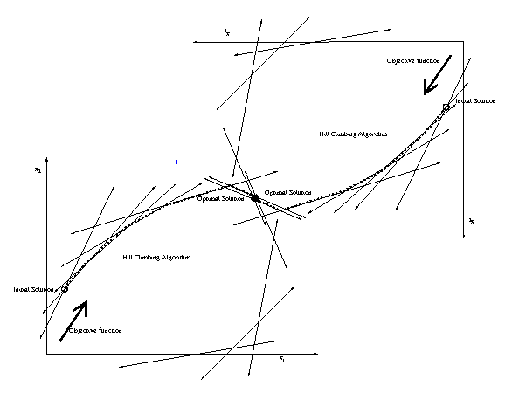
Dual
Primal

Slide 117
End

