Slide 1
Lower Bounds
& Models of Computation
Thinking about Algorithms Abstractly
Jeff Edmonds
York University
Lecture 8
COSC 3101

Slide 2
Lower Bounds for Sorting using Information Theory

Slide 3
The Time Complexity of a Problem P
Merge, Quick, and Heap Sort can sort N numbers
using O(N log N) comparisons between the values.
Theorem: No algorithm can sort faster.
The Time Complexity of a Problem P:
The minimum time needed
by an algorithm to solve it.

Slide 4
The Time Complexity of a Problem P
The minimum time needed by an algorithm to solve it.
Upper Bound:
Problem P is computable in time T_{upper}(n)
    if there is an algorithm A which
      outputs the correct answer
      in this much time
∃ A, ∀ I, A(I)=P(I) and Time(A,I) ≤ T_{upper}(|I|)
Eg: Sorting computable in T_{upper}(n) = O(n²) time.

Slide 5
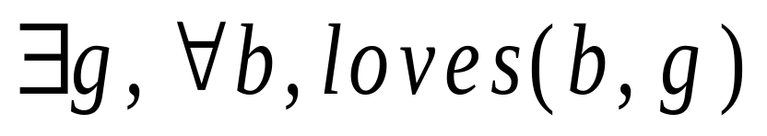
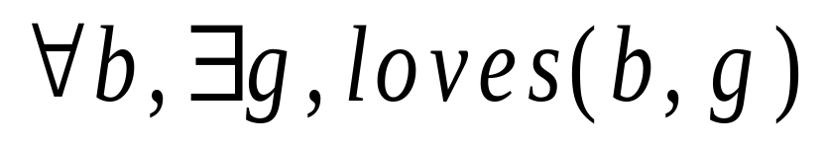
Understand Quantifiers!!!
Could be a separate girl for each boy.
One girl
Sam | Mary
Bob | Beth
John | Marilin Monro
Fred | Ann
Sam | Mary
Bob | Beth
John | Marilin Monro
Fred | Ann
Input
Algorithm
∃ A, ∀ I, A(I)=P(I) and Time(A,I) ≤ T_{upper}(|I|)

Slide 6
The Time Complexity of a Problem P
The minimum time needed by an algorithm to solve it.
∃ A, ∀ I, A(I)=P(I) and Time(A,I) ≤ T_{upper}(|I|)
∀ I, ∃ A, A(I)=P(I) and Time(A,I) ≤ T_{upper}(|I|)
What does this say?
True for any problem P and time T_{upper}.
Given fixed I. Its output is P(I).
Let A_{P(I)} be the algorithm that outputs the string P(I).

Slide 7
The Time Complexity of a Problem P
The minimum time needed by an algorithm to solve it.
Lower Bound:
Time T_{lower}(n) is a lower bound for problem p
  if no algorithm solve the problem faster.
There may be algorithms that give the correct answer
or run quickly on some inputs instance.

Slide 8
The Time Complexity of a Problem P
The minimum time needed by an algorithm to solve it.
Lower Bound:
Time T_{upper}(n) is a lower bound for problem p
  if no algorithm solve the problem faster.
But for every algorithm, there is at least one instance I for which either the algorithm gives the wrong answer or it runs in too much time.
∀ A, ∃ I, A(I) = P(I) or Time(A,I) ≥ T_{lower}(|I|)
Eg: No algorithm can sort N values
in T_{lower} = sqrt(N) time.

Slide 9
Understand Quantifiers!!!
Could be a separate girl for each boy.
One girl
Sam | Mary
Bob | Beth
John | Marilin Monro
Fred | Ann
Sam | Mary
Bob | Beth
John | Marilin Monro
Fred | Ann
Algorithm
Input
∀ A, ∃ I, A(I) = P(I) or Time(A,I) ≥ T_{lower}(|I|)

Slide 10
The Time Complexity of a Problem P
The minimum time needed by an algorithm to solve it.
Upper Bound:
∃ A, ∀ I, A(I)=P(I) and Time(A,I) ≤ T_{upper}(|I|)
Lower Bound:
∀ A, ∃ I, A(I) = P(I) or Time(A,I) ≥ T_{lower}(|I|)
“There is” and “there isn’t a faster algorithm”
are almost negations of each other.

Slide 11
Prover-Adversary Game
Upper Bound:
∃ A, ∀ I, A(I)=P(I) and Time(A,I) ≤ T_{upper}(|I|)
I have an algorithm A that I claim works and is fast.
Oh yeah, I have an input I for which it does not.
I win if A on input I gives
  the correct output
  in the allotted time.
What we have been doing all along.

Slide 12
Prover-Adversary Game
Lower Bound:
∀ A, ∃ I, [ A(I) = P(I) or Time(A,I) ≥ T_{lower}(|I|)]
I have an algorithm A that I claim works and is fast.
Oh yeah, I have an input I for which it does not .
I win if A on input I gives
  the wrong output or
  runs slow.
Proof by contradiction.

Slide 13
Prover-Adversary Game
Lower Bound:
∀ A, ∃ I, [ A(I) = P(I) or Time(A,I) ≥ T_{lower}(|I|)]
I have an algorithm A that I claim works and is fast.
Lower bounds are very hard to prove, because I must consider every algorithm
no matter how strange.

Slide 14
The Yes/No Questions Game
I choose a number ∈[1..N].
I ask you yes/no questions.
I answer.
I determine the number.
Time is the number of questions
asked in the worst case.

Slide 15
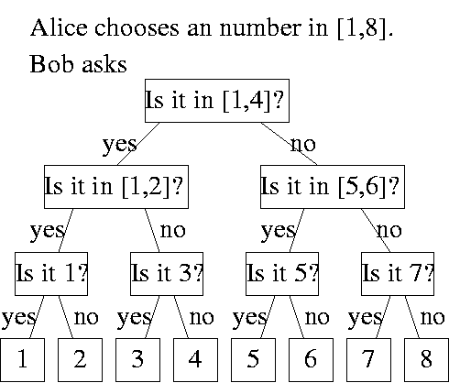
The Yes/No Questions Game
Upper Bound
6
Great!

Slide 16
The Yes/No Questions Game
Upper Bound
Time
= # of questions
= height
= log₂(N)
N leaves

Slide 17
The Yes/No Questions Game
Lower Bound?
Time
= # of questions
= height
Is the third bit 1?
= log₂(N)
Is there a faster
algorithm?
If different
questions?
N leaves

Slide 18
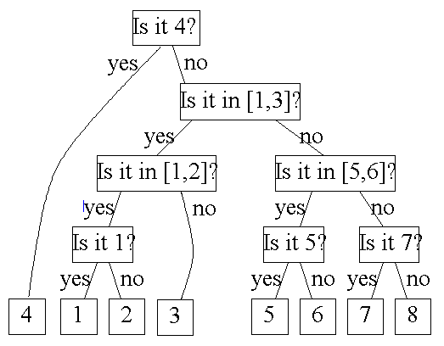
The Yes/No Questions Game
Lower Bound?
Time
= # of questions
= height
= log₂(N)
Best case
Is there a faster
algorithm?
If it has a different
structure?
Worst case
N leaves

Slide 19
The Yes/No Questions Game
Lower Bound
Theorem: For every question strategy A,
with the worst case object I to ask about,
log₂ N questions need to be asked
to determine one of N objects.
∀ A, ∃ I, A(I) = P(I) or Time(A,I) ≥ log₂ N
Proof: Prover/Adversary Game

Slide 20
Lower Bound Proof
I have an algorithm A that
I claim works and is fast.
Oh yeah, I have an input I for which it does not.
Two cases:
# output leaves < N
# output leaves ≥ N

Slide 21
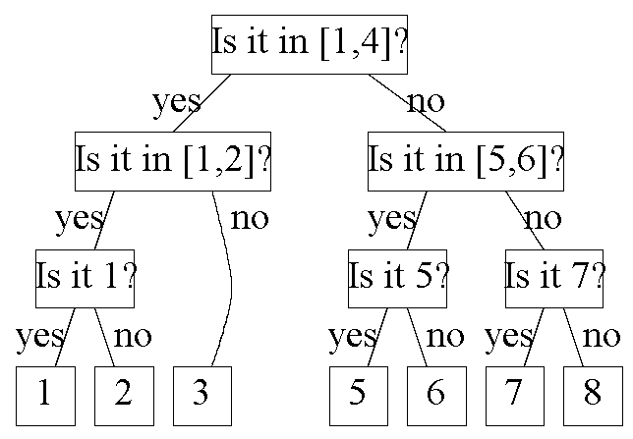
Lower Bound Proof: case 1
I have an algorithm A that
I claim works and is fast.
Man your algorithm does
not have N output leaves.
I give a input I = 4
with missing output.
I win if A on input I gives
  the wrong output or
  requires log N questions.

Slide 22
Lower Bound Proof: case 2
I have an algorithm A that I claim works and is fast.
Good now your algorithm
has all N outputs as leaves.
It must have height ≥ log N.
I give a input I = 5 at a deep leaf.
I win if A on input I gives
  the wrong output or
  requires log N questions.

Slide 23
The Yes/No Questions Game
Lower Bound
Theorem: For every question strategy A,
with the worst case object I to ask about,
log₂ N questions need to be asked
to determine one of N objects.
∀ A, ∃ I, A(I) = P(I) or Time(A,I) ≥ log₂ N
Proof: Prover/Adversary Game
End of Proof.

Slide 24
Communication Complexity
I choose a number ∈[1..N].
Or a obj ∈a set of N objs.
I send you a stream of bits.
I determine the object.
Time is the number of bits
sent in the worst case.

Slide 25
Communication Complexity
Upper Bound
6
Great!

Slide 26
Communication Complexity
Lower Bound
Theorem: For every communication strategy A,
with the worst case object I to communicate,
log₂ N bits need to transmitted
to communicate one of N objects.
∀ A, ∃ I, A(I) = P(I) or Time(A,I) ≥ log₂ N

Slide 27
The Sorting Game
I choose a permutation of {1,2,3,…,N}.
I ask you yes/no questions.
I answer.
I determine the permuation.
Time is the number of questions
asked in the worst case.

Slide 28
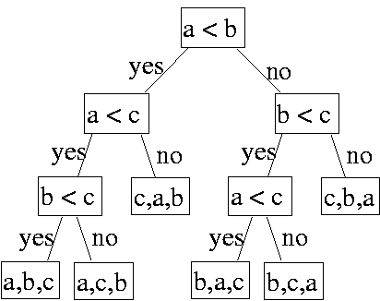
Sorting
Upper Bound
b,c,a
Great!

Slide 29
Sorting
Upper Bound
Time
= # of questions
= height
= log₂(N!)
N! leaves

Slide 30
Bounding log(N!)
^{N}/₂
^{N}/₂ ≤
^{N}/₂ factors each at least ^{N}/₂.
N! = 1 × 2 × 3 × … × ^{N}/₂ × … × N
N factors each at most N.
≤ N^{N}
^{N}/₂ log(^{N}/₂) ≤ log(N!) ≤ N log(N)
= Θ(N log(N)).

Slide 31
Sorting
Lower Bound
Time
Is the third bit of c 1?
= # of questions
= height
= log₂(N!)
= Θ(N log(N)).
Is there a faster
algorithm?
If different
questions?
N! leaves

Slide 32
Sorting
Lower Bound
Is there a faster algorithm?
If different model of computation?
class InsertionSortAlgorithm {
for (int i = 1; i < a.length; i++) {
int j = i;
while ((j > 0) && (a[j-1] > a[i])) {
a[j] = a[j-1];
j--; }
a[j] = B; }}

Slide 33
Sorting
Lower Bound
Theorem: For every sorting algorithm A,
with the worst case input instance I,
Θ(N log₂ N) comparisons (or other bit operations)
need to be executed to sort N objects.
∀ A, ∃ I, A(I) = P(I) or Time(A,I) ≥ N log₂ N
Proof: Prover/Adversary Game

Slide 34
Lower Bound Proof
I have an algorithm A that I claim works and is fast.
class InsertionSortAlgorithm {
for (int i = 1; i < a.length; i++) {
int j = i;
while ((j > 0) && (a[j-1] > a[i])) {
a[j] = a[j-1];
j--; }
a[j] = B; }}
Oh yeah, I will find an input I
for which it does not.

Slide 35
Lower Bound Proof
I have an algorithm A that I claim works and is fast.
class InsertionSortAlgorithm {
for (int i = 1; i < a.length; i++) {
int j = i;
while ((j > 0) && (a[j-1] > a[i])) {
a[j] = a[j-1];
j--; }
a[j] = B; }}
But first let me translate your algorithm into a decision tree.

Slide 36
Lower Bound Proof
class InsertionSortAlgorithm {
for (int i = 1; i < a.length; i++) {
int j = i;
while ((j > 0) && (a[j-1] > a[i])) {
a[j] = a[j-1];
j--; }
a[j] = B; }}
I choose a permutation of {1,2,3,…,N}.
I run my algorithm until
I need to know something about the input permutation.
I ask you this yes/no question.
I answer.
I determine the permuation.

Slide 37
Lower Bound Proof
class InsertionSortAlgorithm {
for (int i = 1; i < a.length; i++) {
int j = i;
while ((j > 0) && (a[j-1] > a[i])) {
a[j] = a[j-1];
j--; }
a[j] = B; }}

Slide 38
Lower Bound Proof
I have an algorithm A that
I claim works and is fast.
Oh yeah, I have an input I for which it does not.
Two cases:
# output leaves < N!
# output leaves ≥ N!

Slide 39
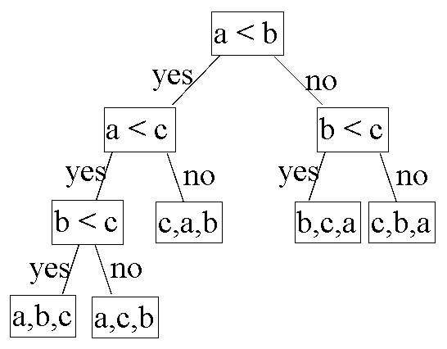
Lower Bound Proof: case 1
I have an algorithm A that
I claim works and is fast.
<b,a,c>
Man your algorithm does
not have N! output leaves.
I give a input I = <b,a,c>
with missing output.
I win if A on input I gives
  the wrong output or
  requires log N questions.

Slide 40
Lower Bound Proof: case 2
I have an algorithm A that I claim works and is fast.
Good now your algorithm
has all N! outputs as leaves.
It must have height ≥ log N!.
I give a input I = <b,a,c> at a deep leaf.
I win if A on input I gives
  the wrong output or
  requires log N! questions.
= Θ(N log(N)).

Slide 41
Sorting
Lower Bound
Theorem: For every sorting algorithm A,
on the worst case input instance I,
Θ(N log₂ N) comparisons (or other bit operations)
need to be executed to sort N objects.
∀ A, ∃ I, A(I) = P(I) or Time(A,I) ≥ N log₂ N
Proof: Prover/Adversary Game
End of Proof.

Slide 42
End

