Slide 1
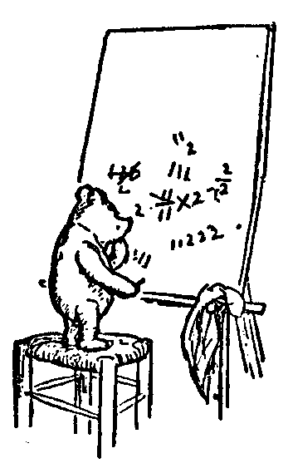
Relevant Mathematics
Thinking about Algorithms Abstractly
Logic Quantifiers
The Time Complexity of an Algorithm
Classifying Functions
Adding Made Easy
Recurrence Relations
Jeff Edmonds
York University
Lecture ?
COSC 3101

Slide 2

Some Math
Logic Quantifiers
∃g ∀b Loves(b,g)
∀b ∃g Loves(b,g)
Done here
Time Complexity
t(n) = Θ(n²)
In Iterative Algs (GCD)
Repeated here

Slide 3
Some Math
Logs and Exps
2ª × 2^{b} = 2^{a+b}
2^{log n} = n
You are on your own.
Classifying Functions
f(i) = n^{Θ(n)}
Done here
Time
Input Size

Slide 4
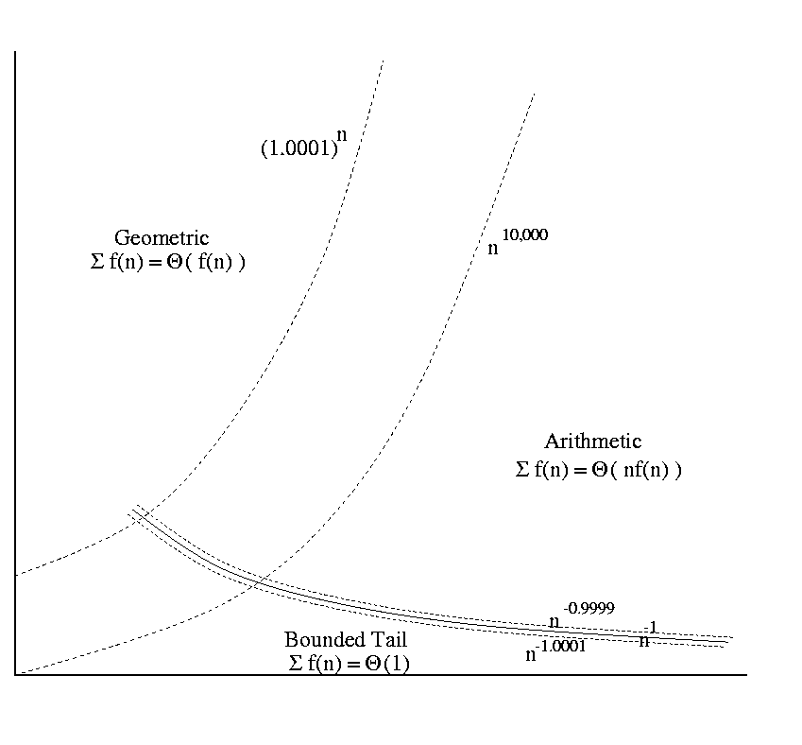
Some Math
Adding Made Easy
In Iterative Algs
(Insertion Sort)
In Recursive Algs
(Multiplying)
Repeated here.
∑_{i=1} f(i).
Recurrence Relations
In Recursive Algs
(Multiplying,
Towers of Hanoi,
Merge Sort)
Repeated here.
T(n) = a T(n/b) + f(n)

Slide 5
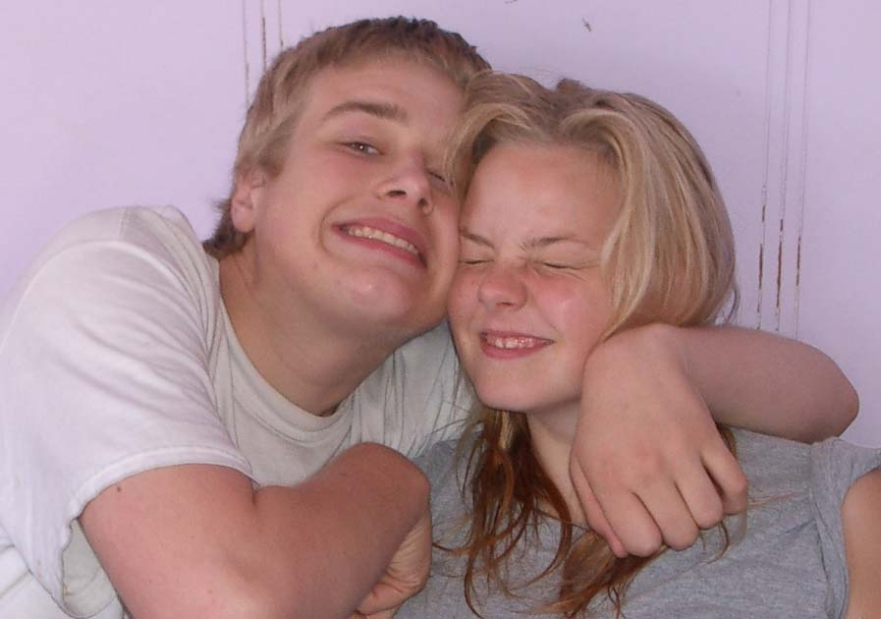





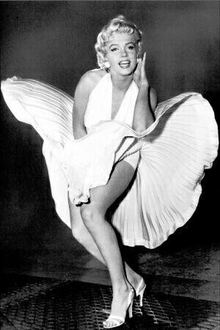


Understand Quantifiers!!!
Loves(b, g)
A relation/predicate
returns True/False
depending whether objects b and g
have relation Loves.
Sam
Mary
Loves(Sam,Mary) = False
Bob
Beth
Loves(Sam,Beth) = True
John
Marilin Monro
Fred
Ann

Slide 6
Understand Quantifiers!!!
∀ b, Loves(b, MM)
“Every boy loves Marilin Monro”
Sam
Mary
Sam
Mary
Bob
Beth
Bob
Beth
John
Marilin Monro
John
Marilin Monro
Fred
Ann
Fred
Ann
True
False

Slide 7
Understand Quantifiers!!!
∀ b, Loves(b, MM)
¬[∀ b, Loves(b, MM)]
¬[∃ b, ¬Loves(b, MM)]
∃ b, ¬Loves(b, MM)
Sam
Mary
Sam
Mary
Bob
Beth
Bob
Beth
John
Marilin Monro
John
Marilin Monro
Fred
Ann
Fred
Ann
True
False

Slide 8
Understand Quantifiers!!!
Proof:
∃ b, ¬Loves(b, MM)
I claim that there is a boy that does not love MM.
Oh yeah! Prove it.
I produce Sam
Sam
Mary
And prove Sam does not loves MM.
Bob
Beth
John
Marilin Monro
I can win.
Hence, statement is true.
Fred
Ann

Slide 9
Understand Quantifiers!!!
Proof:
∃ b, ¬Loves(b, MM)
I claim that there is a boy that does not love MM.
Oh yeah! Prove it.
I produce Sam
Sam
Mary
Oops Sam does loves MM.
Bob
Beth
John
Marilin Monro
I cannot win.
Hence, statement is false.
Fred
Ann

Slide 10
Understand Quantifiers!!!
Proof:
∀ b, Loves(b, MM)
I claim that every boy loves MM.
No! I produce Sam
Sam does not
loves MM.
Sam
Mary
Bob
Beth
I cannot win.
Hence, statement is false.
John
Marilin Monro
Fred
Ann

Slide 11
Understand Quantifiers!!!
Proof:
∀ b, Loves(b, MM)
I claim that every boy loves MM.
No! I produce Sam
Sam
Mary
I prove Sam does loves MM.
Bob
Beth
I can always win.
Hence, statement is true.
John
Marilin Monro
Fred
Ann

Slide 12
Understand Quantifiers!!!
Proof:
∀ b, Loves(b, MM)
I claim that every boy loves MM.
No! I produce boy x.
I prove x does loves MM.
Sam
Mary
This proof needs to
work without
knowing x
Bob
Beth
John
Marilin Monro
I can always win.
Hence, statement is true.
Fred
Ann

Slide 13
Understand Quantifiers!!!
Proof:
∀ b, Loves(b, MM)
I claim that every boy loves MM.
No! I produce boy x.
I give an “alg”
with input x,
and output
a proof that
x loves MM.
Sam
Mary
Bob
Beth
John
Marilin Monro
I can always win.
Hence, statement is true.
Fred
Ann

Slide 14
Understand Quantifiers!!!
∃ g, ∀ b, Loves(b, g)
“There is a girl whom every boy loves”
Sam
Mary
Sam
Mary
Bob
Beth
Bob
Beth
John
Marilin Monro
John
Marilin Monro
Fred
Ann
Fred
Ann
True
False

Slide 15
Understand Quantifiers!!!
∀ b, ∃ g, Loves(b, g)
“Every boy loves some girl.”
Sam
Mary
Sam
Mary
Bob
Beth
Bob
Beth
John
Marilin Monro
John
Marilin Monro
Fred
Ann
Fred
Ann
True
False
Still True
True

Slide 16
Understand Quantifiers!!!
∃ g, ∀ b, Loves(b, g)
∀ b, ∃ g, Loves(b, g)
vs
Could be a separate girl for each boy.
One girl
Sam
Mary
Sam
Mary
Bob
Beth
Bob
Beth
John
Marilin Monro
John
Marilin Monro
Fred
Ann
Fred
Ann

Slide 17
Understand Quantifiers!!!
Proof:
∃ g, ∀ b, Loves(b, g)
We read this left to right.
I produce the object when it is a ∃.
I produce the object when it is a ∀.
Sam
Mary
I can always win
if and only if
statement is true.
Bob
Beth
John
Marilin Monro
Fred
Ann

Slide 18
Understand Quantifiers!!!
Proof:
∃ g, ∀ b, Loves(b, g)
I claim “there is a girl whom every boy loves.”
Oh yeah! Prove it.
I produce MM
Sam
Mary
I proceed to prove
“every boy loves MM”
Bob
Beth
John
Marilin Monro
Fred
Ann

Slide 19
Understand Quantifiers!!!
Proof:
∃ g, ∀ b, Loves(b, g)
I proceed to prove “every boy loves MM”
No! I produce boy x.
I give an “alg”
with input x,
and output
a proof that
x loves MM.
Sam
Mary
Bob
Beth
John
Marilin Monro
I can always win.
Hence, statement is true.
Fred
Ann

Slide 20
Understand Quantifiers!!!
Proof:
∀ b, ∃ g, Loves(b, g)
I claim “Every boy loves some girl.”
No! I produce boy x.
I proceed to prove
“x loves some girl.”
Sam
Mary
I produce girl y
Bob
Beth
I prove x loves y.
John
Marilin Monro
I can always win.
Hence, statement is true.
Fred
Ann

Slide 21
Understand Quantifiers!!!
Proof:
∀ b, ∃ g, Loves(b, g)
I claim “Every boy loves some girl.”
No! I produce boy x.
I proceed to prove
“x loves some girl.”
Sam
Mary
I give an “alg”
with input x,
and output an y
and a proof that
x loves y.
Bob
Beth
John
Marilin Monro
Fred
Ann

Slide 22
Understand Quantifiers!!!
Proof:
∀ b, ∃ g, Loves(b, g)
I give an “alg”
with input y,
and output an x
and a proof that
x loves y.
Sam
Mary
You give Sam,
I give Beth.
Bob
Beth
You give Bob,
I give MM.
John
Marilin Monro
…
Fred
Ann

Slide 23
Understand Quantifiers!!!
∃ g, ∀ b, Loves(b, g)
¬[ ]
= ∀ g, ¬[ ∀ b, Loves(b, g) ]
= ∀ g, ∃ b, ¬[ Loves(b, g) ]
= ∀ g, ∃ b, ¬Loves(b, g)
¬ moves right
∃ ∀

Slide 24
Understand Quantifiers!!!
Proof:
∀ x, ∃ y, x+y=5
Let x be an arbitrary real number.
Let y = 5-x.
The relation is true.
x+y = x + (5-x) = 5
I can always win.
Hence, the statement is true.

Slide 25
Understand Quantifiers!!!
Proof:
∀ x, ∃ y, x×y=5
Let x be an arbitrary real number.
Let y = ⁵/_{x}.
The relation is true.
x×y = x × ⁵/_{x} = 5
I can always win.
Hence, the statement is true.
What a minute the statement is false!

Slide 26
Understand Quantifiers!!!
Proof:
¬[ ∀ x, ∃ y, x×y=5 ]
= ∃ x, ∀ y, x×y =5
Let x=0.
Let y be an arbitrary real number.
The negated relation is true.
x×y = 0×y = 0 = 5
I can always win.
Hence, the negated statement is true
and the original statement is false.

Slide 27
Some Math
Logs and Exps
2ª × 2^{b} = 2^{a+b}
2^{log n} = n
You are on your own.

Slide 28
The Time Complexity of an Algorithm
Specifies how the running time depends on the size of the input.

Slide 29
Purpose?

Slide 30
Purpose
To estimate how long a program will run.
To estimate the largest input that can reasonably be given to the program.
To compare the efficiency of different algorithms.
To help focus on the parts of code that are executed the largest number of times.
To choose an algorithm for an application.

Slide 31
Time Complexity Is a Function
Specifies how the running time depends on the size of the input.
A function mapping
“size” of input
“time” T(n) executed .

Slide 32
Definition of Time?

Slide 33

Definition of Time
# of seconds (machine dependent).
# lines of code executed.
# of times a specific operation is performed (e.g., addition).
Which?

Slide 34
Definition of Time
# of seconds (machine dependent).
# lines of code executed.
# of times a specific operation is performed (e.g., addition).
These are all reasonable definitions of time, because they are within a constant factor of each other.

Slide 35
Size of Input Instance?
83920

Slide 36
Size of Input Instance
5
83920
1’’
2’’
Size of paper
# of bits
# of digits
Value
- n = 2 in²
- n = 17 bits
- n = 5 digits
- n = 83920
Which are reasonable?

Slide 37
Size of Input Instance
5
83920
1’’
2’’
Size of paper
# of bits
# of digits
Value
- n = 2 in²
- n = 17 bits
- n = 5 digits
- n = 83920
Intuitive

Slide 38
Size of Input Instance
5
83920
1’’
2’’
Size of paper
# of bits
# of digits
Value
- n = 2 in²
- n = 17 bits
- n = 5 digits
- n = 83920
Intuitive
Formal

Slide 39
Size of Input Instance
5
83920
1’’
2’’
Size of paper
# of bits
# of digits
Value
- n = 2 in²
- n = 17 bits
- n = 5 digits
- n = 83920
Intuitive
Formal
Reasonable
# of bits =
3.32 * # of digits

Slide 40
Size of Input Instance
5
83920
1’’
2’’
Size of paper
# of bits
# of digits
Value
- n = 2 in²
- n = 17 bits
- n = 5 digits
- n = 83920
Intuitive
Formal
Reasonable
Unreasonable
# of bits = log₂(Value) Value = 2^{# of bits}

Slide 41
Two Example Algorithms
Sum N array entries:
  A(1) + A(2) + A(3) + …
Factor value N:
  Input N=5917 & Output N=97*61.
  Algorithm N/2, N/3, N/4, …. ?
Time = N
Time = N
Time?
Is this reasonable?
No! One is considered fast and the other slow!

Slide 42
Two Example Algorithms
N = hard drive
= 60G < 2³⁶
Sum N array entries:
  A(1) + A(2) + A(3) + …
Factor value N:
  Input N=5917 & Output N=97*61.
  Algorithm N/2, N/3, N/4, …. ?
Time = N
N = crypto key
= 2¹⁰⁰
Time = N
Standard input size?

Slide 43
Two Example Algorithms
Sum N array entries:
  A(1) + A(2) + A(3) + …
Factor value N:
  Input N=5917 & Output N=97*61.
  Algorithm N/2, N/3, N/4, …. ?
size n = N
Time = N
size n = log N
Time = N
Size of Input Instance?

Slide 44
Two Example Algorithms
Sum N array entries:
  A(1) + A(2) + A(3) + …
Factor value N:
  Input N=5917 & Output N=97*61.
  Algorithm N/2, N/3, N/4, …. ?
size n = N
Time = N
= n
size n = log N
Time = N
= 2^{n}
Time as function of input size?
Time for you to solve problem instance
as a function of
time for me to give you the problem instance.

Slide 45
Two Example Algorithms
Sum N array entries:
  A(1) + A(2) + A(3) + …
Factor value N:
  Input N=5917 & Output N=97*61.
  Algorithm N/2, N/3, N/4, …. ?
size n = N
Time = N
= n
size n = log N
Time = N
= 2^{n}
Linear vs Exponential Time!

Slide 46
Size of Input Instance?
14,23,25,30,31,52,62,79,88,98

Slide 47
Size of Input Instance
10
14,23,25,30,31,52,62,79,88,98
# of elements = n = 10 elements

Slide 48
Size of Input Instance
10
14,23,25,30,31,52,62,79,88,98
# of elements = n = 10 elements
Is this reasonable?

Slide 49
Size of Input Instance
10
14,23,25,30,31,52,62,79,88,98
# of elements = n = 10 elements Reasonable
If each element has size c
# of bits = c * # of elements

Slide 50
Size of Input Instance
10
14,23,25,30,31,52,62,79,88,98
~
# of elements = n = 10 elements Reasonable
If each element is in [1..n]
each element has size log n
# of bits = n log n ≈ n

Slide 51
Time Complexity Is a Function
Specifies how the running time depends on the size of the input.
A function mapping
# of bits n needed to represent the input
# of operations T(n) executed .

Slide 52
Which Input of size n?
There are 2^{n} inputs of size n.
Which do we consider
for the time T(n)?

Slide 53
Which Input of size n?
Typical Input
Average Case
Worst Case

Slide 54
Which Input of size n?
Typical Input | But what is typical?
Average Case | For what distribution?
Worst Case | Time for all inputs is bound. Easiest to compute

Slide 55


What is the height of tallest person in the class?
Bigger than this?
Smaller than this?
Need to look at
only one person
Need to look at
every person

Slide 56
Time Complexity of Algorithm
The time complexity of an algorithm is
the largest time required on any input
of size n.
O(n²): Prove that for every input of size n, the algorithm takes no more than cn² time.
Ω(n²): Find one input of size n, for which the algorithm takes at least this much time.
θ (n²): Do both.

Slide 57
Time Complexity of Problem
The time complexity of a problem is
the time complexity of the fastest algorithm that solves the problem.
O(n²): Provide an algorithm that solves the problem in no more than this time.
Ω(n²): Prove that no algorithm can solve it faster.
θ (n²): Do both.

Slide 58
Classifying Functions
T(n)
10
100
1,000
10,000
log n
3
6
9
13
amoeba
n^{1/2}
3
10
31
100
bird
n
10
100
1,000
10,000
human
n log n
30
600
9,000
130,000
my father
n²
100
10,000
10⁶
10⁸
elephant
n³
1,000
10⁶
10⁹
10¹²
dinosaur
2^{n}
1,024
10³⁰
10³⁰⁰
10³⁰⁰⁰
the universe
Note: The universe contains approximately 10⁵⁰ particles.

Slide 59
Classifying Functions
Functions
Exp
Constant
Polynomial
Exponential
Double Exp
Poly Logarithmic
n⁵
2^{5n}
5
(log n)⁵
n⁵
2^{5n}
2
2
<<
<<
<<
<<
<<
n^{θ(1)}
2^{θ(n)}
θ(1)
(log n)^{θ(1)}
n^{θ(1)}
2^{θ(n)}
2
2

Slide 60
Classifying Functions
Polynomial
= n^{θ(1)}
?
Cubic
Linear
Quadratic
Others
θ(n)
θ(n²)
θ(n³)
θ(n⁴)
θ(n³ log⁷(n))
log(n) not absorbed
because not
Mult-constant

Slide 61
Classifying Functions
We consider two (of many)
levels in this hierarchy
Functions
Poly.
Exp.
Ignore
Power-constant
n^{θ(1)}
2^{θ(n)}
Ignore
Mult-constant
θ(n²)
θ(n³ log(n))
θ(2^{4n} / n¹⁰⁰)
θ(2^{4n})
8·n²
7·n³log(n)
8·2^{4n} / n¹⁰⁰
8·2^{4n} + n³
Individuals

Slide 62
BigOh and Theta?
5n² + 8n + 2log n = Θ(n²)
5n² log n + 8n + 2log n = Θ(n² log n)
Drop low-order terms.
Drop multiplicative constant.

Slide 63
Which Functions are Polynomials?
n^{c}
n^{0.0001}
n¹⁰⁰⁰⁰
5n² + 8n + 2log n
5n² log n
5n^{2.5}
Drop low-order terms.
Drop constant, log, (and poly) factors.
Ignore power constant.
Write n^{θ(1)}

Slide 64
Which Functions are Exponential?
2^{n}
2^{0.0001 n}
2^{10000 n}
8^{n}
2^{n} / n¹⁰⁰
2^{n} · n¹⁰⁰
Drop low-order terms.
Drop constant, log, and poly factors.
Ignore power constant.
Write 2^{θ(n)}

Slide 65
Notations
Theta | f(n) = θ(g(n)) | f(n) ≈ c g(n)
BigOh | f(n) = O(g(n)) | f(n) ≤ c g(n)
Omega | f(n) = Ω(g(n)) | f(n) ≥ c g(n)
Little Oh | f(n) = o(g(n)) | f(n) << c g(n)
Little Omega | f(n) = ω(g(n)) | f(n) >> c g(n)

Slide 66
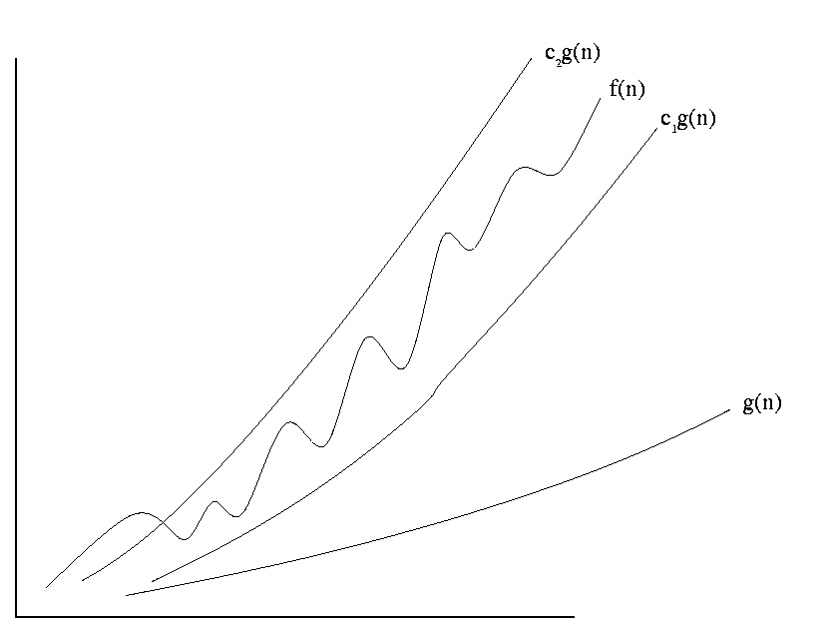
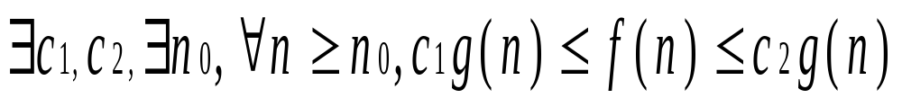
Definition of Theta
f(n) = θ(g(n))

Slide 67
Definition of Theta
f(n) = θ(g(n))
f(n) is sandwiched between c₁g(n) and c₂g(n)

Slide 68
Definition of Theta
f(n) = θ(g(n))
f(n) is sandwiched between c₁g(n) and c₂g(n)
for some sufficiently small c₁ (= 0.0001)
for some sufficiently large c₂ (= 1000)

Slide 69
Definition of Theta
f(n) = θ(g(n))
For all sufficiently large n

Slide 70
Definition of Theta
f(n) = θ(g(n))
For all sufficiently large n
For some definition of “sufficiently large”

Slide 71
Definition of Theta
3n² + 7n + 8 = θ(n²)

Slide 72
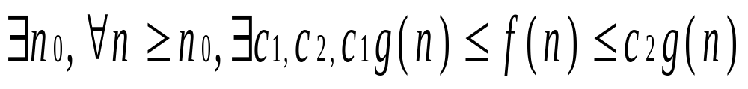
Order of Quantifiers
f(n) = θ(g(n))
No! It cannot be a different c₁ and c₂
for each n.

Slide 73
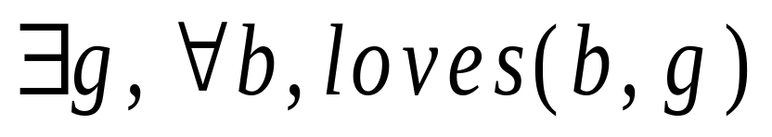
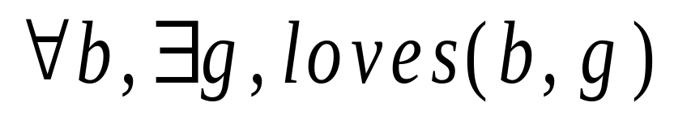

Understand Quantifiers!!!
Could be a separate girl for each boy.
One girl
Sam | Mary
Bob | Beth
John | Marilin Monro
Fred | Ann
Sam | Mary
Bob | Beth
John | Marilin Monro
Fred | Ann

Slide 74
End of first part of math review
Recursive Algorithms

Slide 75
Adding
The Classic Techniques
Evaluating ∑_{i=1} f(i).
^{n}

Slide 76

Arithmetic Sum
∑_{i=1..n} i = 1 + 2 + 3 + . . . + n
= ?
Gauss

Slide 77
Adding Made Easy
= number of white dots
1
+
2
+
3
+
. . .
+
n-1
+
n
=
S
1 2 . . . . . . . . n

Slide 78
Adding Made Easy
= number of white dots
1
+
2
+
3
+
. . .
+
n-1
+
n
=
S
n
+
n-1
+
n-2
+
. . .
+
2
+
1
=
S
= number of yellow dots
n . . . . . . . 2 1
1 2 . . . . . . . . n

Slide 79
Adding Made Easy
= number of white dots
1
+
2
+
3
+
. . .
+
n-1
+
n
=
S
n
+
n-1
+
n-2
+
. . .
+
2
+
1
=
S
= number of yellow dots
n
2S dots
n
n
= n(n+1) dots in the grid
n
n
n (n+1)
n
S =
2
n+1 n+1 n+1 n+1 n+1

Slide 80
Arithmetic Sum
∑_{i=1..n} i = 1 + 2 + 3 + . . . + n
= Θ(# of terms · last term)
Gauss
True when ever terms increase slowly

Slide 81
Geometric Sum
∑_{i=0..n} 2^{i} = 1 + 2 + 4 + 8 +. . . + 2^{n}
= ?

Slide 82
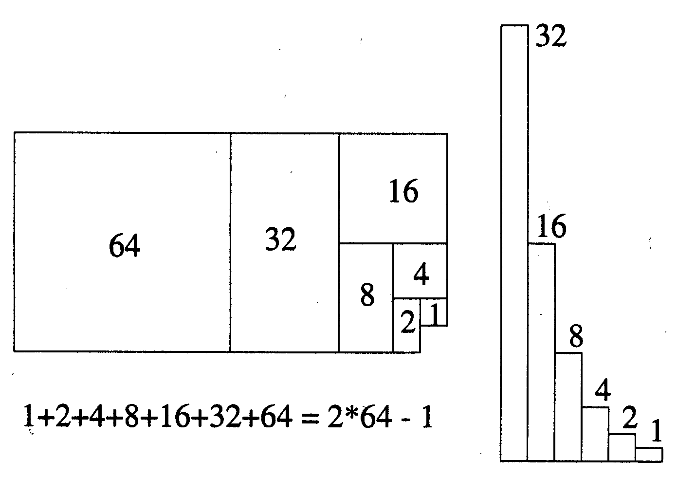
Geometric Sum

Slide 83
Geometric Sum
∑_{i=0..n} 2^{i} = 1 + 2 + 4 + 8 +. . . + 2^{n}
= 2 · last term - 1

Slide 84
Geometric Sum
∑_{i=0..n} r^{i} = r⁰ + r¹ + r² +. . . + r^{n}
= ?

Slide 85
Geometric Sum
S
=
1
+
r
+
r
2
+
r
3
+
+
n
.
.
.
r
Sr
=
r
+
r
2
+
r
3
+
.
.
.
+
r
n
+
r
n
+
1
S
−
Sr
=
1
−
r
n
+
1
r
n
+
1
−
1
S
=
r
−
1

Slide 86
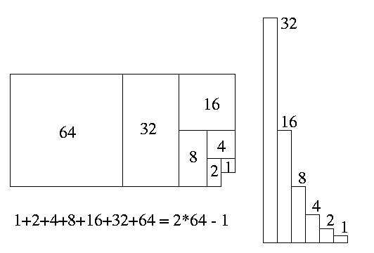
Geometric Sum
When r>1?
r
n
+
1
−
1
∑_{i=0..n} r^{i}
=
r
−
1

Slide 87
Geometric Sum
When r>1
r
n
+
1
−
1
∑_{i=0..n} r^{i}
=
= θ(r^{n})
Biggest Term
r
−
1

Slide 88
Geometric Increasing
∑_{i=0..n} r^{i} = r⁰ + r¹ + r² +. . . + r^{n}
= Θ(biggest term)
True when ever terms increase quickly

Slide 89
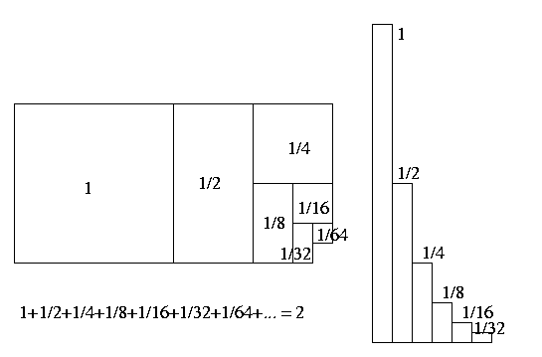
Geometric Sum
When r<1?
1 r
n
+
1
−
∑_{i=0..n} r^{i}
=
−
1 r

Slide 90
Geometric Sum
When r<1
1 r
n
+
1
−
∑_{i=0..n} r^{i}
=
= θ(1)
Biggest Term
−
1 r

Slide 91
Bounded Tail
∑_{i=0..n} r^{i} = r⁰ + r¹ + r² +. . . + r^{n}
= Θ(1)
True when ever terms decrease quickly

Slide 92
Harmonic Sum
∑_{i=1..n} ¹/_{i}
= ¹/₁ + ¹/₂ + ¹/₃ + ¹/₄ + ¹/₅ + …+ ¹/_{n}
= ?

Slide 93
Sum of Shrinking Function
n
f(i) = 1
∑_{i=1..n} f(i) = n

Slide 94
Sum of Shrinking Function
n
f(i) = ?
∑_{i=1..n} f(i) = n^{1/2}

Slide 95
Sum of Shrinking Function
∞
f(i) = 1/2^{i}
∑_{i=1..n} f(i) = 2

Slide 96
Sum of Shrinking Function
n
f(i) = 1/i
∑_{i=1..n} f(i) = ?

Slide 97
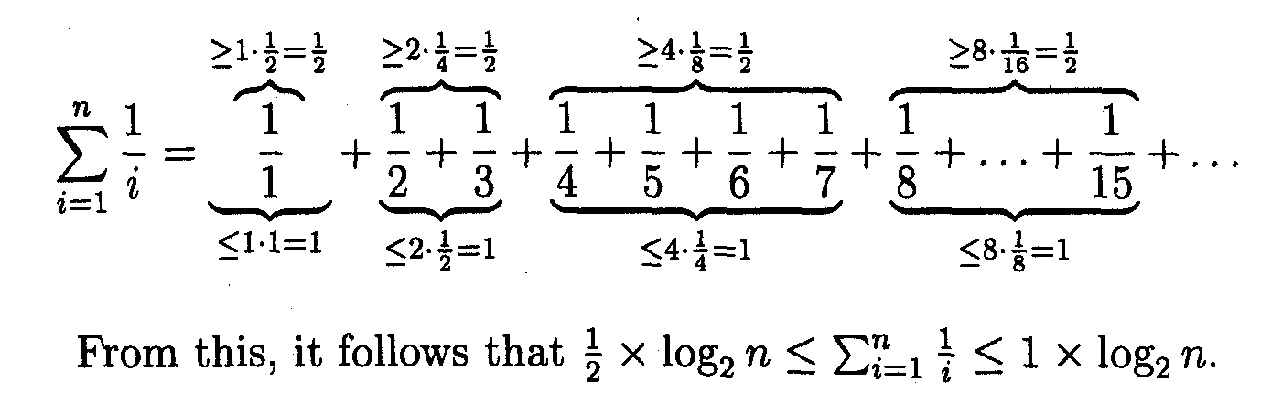
Harmonic Sum

Slide 98
Harmonic Sum
∑_{i=1..n} ¹/_{i}
= ¹/₁ + ¹/₂ + ¹/₃ + ¹/₄ + ¹/₅ + …+ ¹/_{n}
= Θ(log(n))

Slide 99
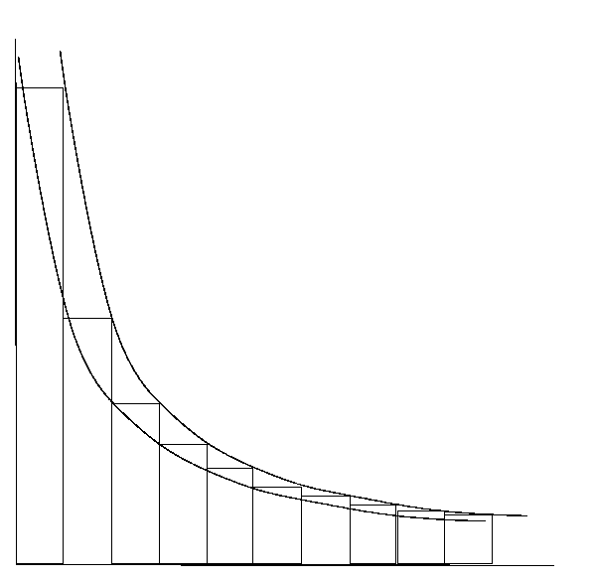
Approximating Sum by Integrating
∑_{i=1..n} f(i) ≈ ∫_{x=1..n} f(x) dx
The area under the curve
approximates the sum

Slide 100
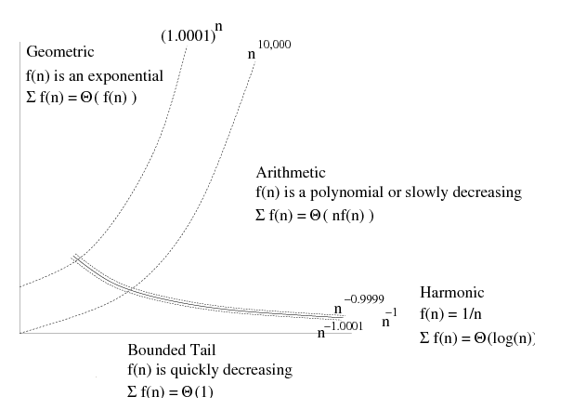
Adding Made Easy
(For +, -, ×, ÷ , exp, log functions f(n))

Slide 101
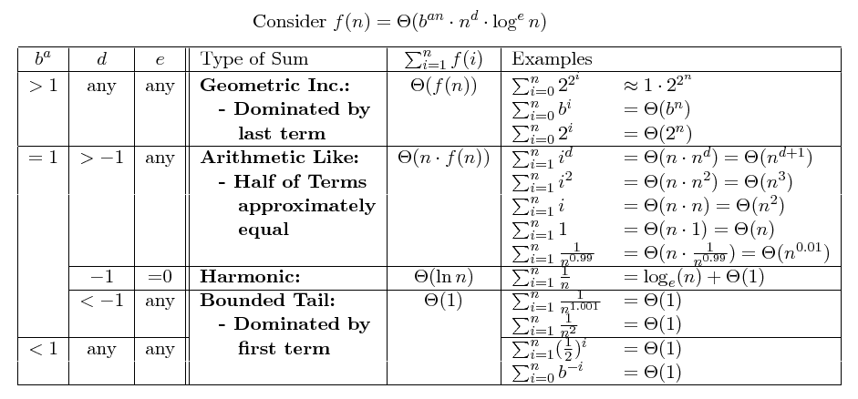
Adding Made Easy

Slide 102
Adding Made Easy
Geometric Like: If f(n) ≥ 2^{Ω(n)}, then ∑_{i=1..n} f(i) = θ(f(n)).
Arithmetic Like: If f(n) = n^{θ(1)-1}, then ∑_{i=1..n} f(i) = θ(n · f(n)).
Harmonic: If f(n) = ¹/_{n} , then ∑_{i=1..n} f(i) = log_{e}n + θ(1).
Bounded Tail: If f(n) ≤ n^{-1-Ω(1)}, then ∑_{i=1..n} f(i) = θ(1).
(For +, -, ⋅, ÷ , exp, log functions f(n))
This may seem confusing, but it is really not.
It should help you compute most sums easily.

Slide 103
Recurrence Relations
T(1) = 1
T(n) = a T(n/b) + f(n)

Slide 104
Recurrence Relations
≈ Time of Recursive Program
procedure Eg(I_{n})
n = |I_{n}|
if(n≤1) then
put “Hi”
else
loop i=1..f(n)
put “Hi”
loop i=1..a
I_{n/b} = I_{n} cut in b pieces
Eg(I_{n/b})
?
Recurrence relations
arise from the timing
of recursive programs.
Let T(n) be the # of “Hi”s
on an input of “size” n.

Slide 105
Recurrence Relations
≈ Time of Recursive Program
procedure Eg(I_{n})
n = |I_{n}|
if(n≤1) then
put “Hi”
else
loop i=1..f(n)
put “Hi”
loop i=1..a
I_{n/b} = I_{n} cut in b pieces
Eg(I_{n/b})
Given size 1,
the program outputs
T(1)=1 Hi’s.

Slide 106
Recurrence Relations
≈ Time of Recursive Program
procedure Eg(I_{n})
n = |I_{n}|
if(n≤1) then
put “Hi”
else
loop i=1..f(n)
put “Hi”
loop i=1..a
I_{n/b} = I_{n} cut in b pieces
Eg(I_{n/b})
Given size n,
the stackframe outputs
f(n) Hi’s.

Slide 107
Recurrence Relations
≈ Time of Recursive Program
procedure Eg(I_{n})
n = |I_{n}|
if(n≤1) then
put “Hi”
else
loop i=1..f(n)
put “Hi”
loop i=1..a
I_{n/b} = I_{n} cut in b pieces
Eg(I_{n/b})
Recursing
on an instances of size n/b
generates T(n/b) “Hi”s.

Slide 108
Recurrence Relations
≈ Time of Recursive Program
procedure Eg(I_{n})
n = |I_{n}|
if(n≤1) then
put “Hi”
else
loop i=1..f(n)
put “Hi”
loop i=1..a
I_{n/b} = I_{n} cut in b pieces
Eg(I_{n/b})
Recursing
a times
generates a·T(n/b) “Hi”s.

Slide 109
Recurrence Relations
≈ Time of Recursive Program
procedure Eg(I_{n})
n = |I_{n}|
if(n≤1) then
put “Hi”
else
loop i=1..f(n)
put “Hi”
loop i=1..a
I_{n/b} = I_{n} cut in b pieces
Eg(I_{n/b})
For a total of
T(1) = 1
T(n) = a·T(n/b) + f(n)
“Hi”s.

Slide 110
Evaluating: T(n) = aT(n/b)+f(n)
Level |  | Instance size | Work in stack frame | # stack frames | Work in Level
0 |  | n | f(n) | 1 | 1 · f(n)
1 |  | n/b | f(n/b) | a | a · f(n/b)
2 |  | n/b² | f(n/b²) | a² | a² · f(n/b²)
i |  | n/b^{i} | f(n/b^{i}) | a^{i} | a^{i} · f(n/b^{i})
h = ^{log n}/_{log b} |  | n/b^{h} | T(1)
^{log a}/_{log b}
^{log a}/_{log b}
n
n · T(1)
Dominated by Top Level or Base Cases

Slide 111
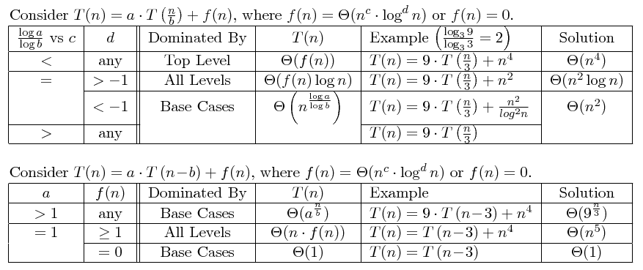
Evaluating: T(n) = aT(n/b)+f(n)

Slide 112
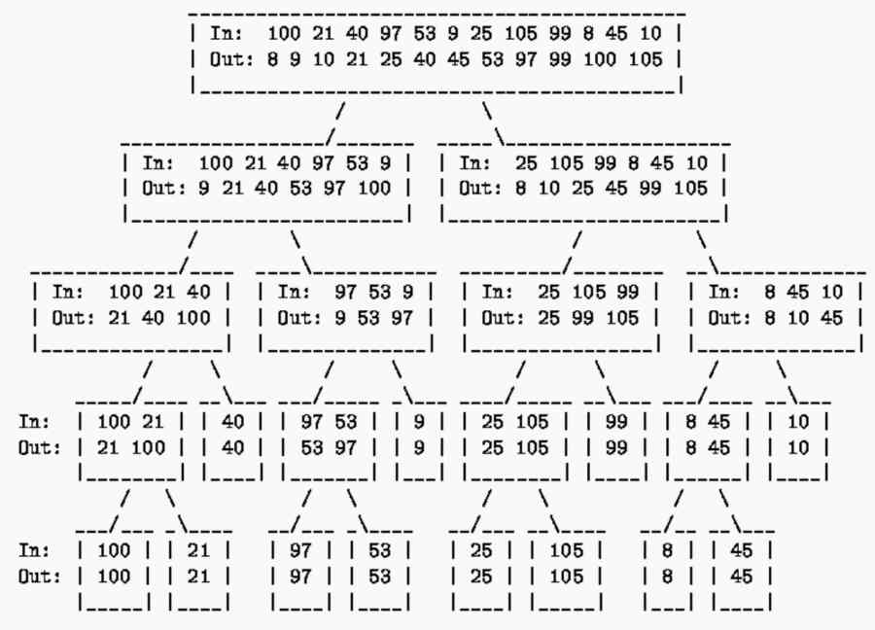
Merge Sort Sort
Time: T(n) =
2T(n/2) + Θ(n)
= Θ(n log(n))
Total work
at any level
= Θ(n)
# levels
= Θ(log(n))

Slide 113
Evaluating: T(n) = aT(n/b)+f(n)
2T(n/2) + Θ(n)
Level |  | Instance size | Work in stack frame | # stack frames | Work in Level
0 |  | n | f(n) | 1 | 1 · f(n)
1 |  | n/b | f(n/b) | a | a · f(n/b)
2 |  | n/b² | f(n/b²) | a² | a² · f(n/b²)
i |  | n/b^{i} | f(n/b^{i}) | a^{i} | a^{i} · f(n/b^{i})
h = ^{log n}/_{log b} |  | n/b^{h} | T(1)
2^{i}·Θ(n/2^{i}) = Θ(n)
^{log a}/_{log b}
^{log a}/_{log b}
n
n · T(1)
All levels basically the same.
Total Work T(n) = ∑_{i=0..h} a^{i}⋅f(n/b^{i})
= Θ(n) · log(n)

Slide 114
Evaluating: T(n) = aT(n/b)+f(n)

Slide 115
Logs
log 27
=
log 9

Slide 116
Logs
log? 27
=
log? 9
Which base?

Slide 117
Logs
log₂ 27
log₂ c
· log_{c} 27
log_{c} 27
=
=
log₂ 9
log₂ c
· log_{c} 9
log_{c} 9
It does not matter.
Which is easiest?

Slide 118
Logs
log₃ 27
log₃ 3³
3
=
=
log₃ 9
log₃ 3²
2
Please no calculators in exams.
And I wont ask
log 25
log 9

Slide 119
Evaluating: T(n) = 4T(n/2)+ n³/log⁵n

Slide 120
Evaluating: T(n) = 4T(n/2)+ n³/log⁵n
Time for top level?:

Slide 121
Evaluating: T(n) = 4T(n/2)+ n³/log⁵n
Time for top level: f(n) = n³/log⁵n
Time for base cases?:

Slide 122
Evaluating: T(n) = 4T(n/2)+ n³/log⁵n
Time for top level: f(n) = n³ /log⁵n
Time for base cases:
^{log a}/_{log b}
^{log ?}/_{log ?}
θ(n ) =
θ(n )

Slide 123
Evaluating: T(n) = 4T(n/2)+ n³/log⁵n
Time for top level: f(n) = n³ /log⁵n
Time for base cases:
^{log a}/_{log b}
^{log 4}/_{log 2}
θ(n ) =
θ(n ) = ?

Slide 124
Evaluating: T(n) = 4T(n/2)+ n³/log⁵n
Time for top level: f(n) = n³/log⁵n
Time for base cases:
Dominated?: c = ?
^{log a}/_{log b}
^{log 4}/_{log 2}
θ(n ) =
θ(n ) = θ(n²)
^{log a}/_{log b} = ?

Slide 125
Evaluating: T(n) = 4T(n/2)+ n³/log⁵n
Time for top level: f(n) = n³/log⁵n
Time for base cases:
Dominated?: c = 3 > 2 = ^{log a}/_{log b}
^{log a}/_{log b}
^{log 4}/_{log 2}
θ(n ) =
θ(n ) = θ(n²)
Hence, T(n) = ?

Slide 126
Evaluating: T(n) = 4T(n/2)+ n³/log⁵n
Time for top level: f(n) = n³/log⁵n
Time for base cases:
Dominated?: c = 3 > 2 = ^{log a}/_{log b}
^{log a}/_{log b}
^{log 4}/_{log 2}
θ(n ) =
θ(n ) = θ(n²)
Hence, T(n) = θ(top) = θ(f(n)) = θ(n³/log⁵n).

Slide 127
Evaluating: T(n) = 4T(n/2)+ 2^{n}
bigger
Time for top level: f(n) = 2^{n}
Time for base cases:
Dominated?: c = ? > 2 = ^{log a}/_{log b}
^{log a}/_{log b}
^{log 4}/_{log 2}
θ(n ) =
θ(n ) = θ(n²)
>big
Hence, T(n) = θ(top) = θ(f(n)) = θ(2^{n}).
The time is even more dominated
by the top level of recursion

Slide 128
Evaluating: T(n) = 4T(n/2)+ n log⁵n
Time for top level: f(n) = n log⁵n
Time for base cases:
Dominated?: c = ? 2 = ^{log a}/_{log b}
^{log a}/_{log b}
^{log 4}/_{log 2}
θ(n ) =
θ(n ) = θ(n²)
1<
^{log a}/_{log b}
Hence, T(n) = ?
= θ(base cases) = θ(n ) = θ(n²).

Slide 129
Evaluating: T(n) = 4T(n/2)+ log⁵n
Time for top level: f(n) = log⁵n
Time for base cases:
Dominated?: c = ? 2 = ^{log a}/_{log b}
^{log a}/_{log b}
^{log 4}/_{log 2}
θ(n ) =
θ(n ) = θ(n²)
0<
^{log a}/_{log b}
Hence, T(n) = ?
= θ(base cases) = θ(n ) = θ(n²).

Slide 130
Evaluating: T(n) = 4T(n/2)+ n²
Time for top level: f(n) = n²
Time for base cases:
Dominated?: c = ? 2 = ^{log a}/_{log b}
^{log a}/_{log b}
^{log 4}/_{log 2}
θ(n ) =
θ(n ) = θ(n²)
2=
Hence, T(n) = ?
= θ(f(n) log(n) ) = θ(n² log(n)).

Slide 131
Evaluating: T(n) = 4T(n/2)+ n² log⁵n
Time for top level: f(n) = n² log⁵n
Time for base cases:
Dominated?: c = 2 = 2 = ^{log a}/_{log b}
^{log a}/_{log b}
^{log 4}/_{log 2}
θ(n ) =
θ(n ) = θ(n²)
5 ?
d = ?
> -1
Hence, T(n) = ?
= θ(f(n) log(n) ) = θ(n² log⁶(n)).

Slide 132
Evaluating: T(n) = aT(n/b)+f(n)

Slide 133
Evaluating: T(n) = aT(n-b)+f(n)
Level
Instance
size
Work
in stack
frame
# stack frames
Work in Level
0
n
f(n)
1
1 · f(n)
1
n-b
f(n-b)
a
a · f(n-b)
2
n-2b
f(n-2b)
a²
a² · f(n-2b)
i
n-ib
f(n-ib)
a^{i}
a^{i} · f(n-ib)
h = ?
^{n}/_{b}
^{n}/_{b}
h = ^{n}/_{b}
n-hb
T(0)
a
a · T(0)
|base case| = 0 = n-hb
h = ^{n}/_{b}
Likely dominated by base cases
Exponential

Slide 134
Evaluating: T(n) = 1T(n-b)+f(n)
Level
Instance
size
Work
in stack
frame
# stack frames
Work in Level
0
n
f(n)
1
f(n)
1
n-b
f(n-b)
1
f(n-b)
2
n-2b
f(n-2b)
1
f(n-2b)
i
n-ib
f(n-ib)
1
f(n-ib)
h = ?
h = ^{n}/_{b}
n-hb
T(0)
1
f(0)
Total Work T(n) = ∑_{i=0..h} f(b·i)
= θ(f(n)) or θ(n·f(n))

Slide 135
Evaluating: T(n) = aT(n/b)+f(n)

Slide 136
End of second part of math review
More Math
Graphs Searching Algorithms

