Slide 1
CS 332: Algorithms
Linear-Time Sorting Continued
Medians and Order Statistics

Slide 2
Review: Comparison Sorts
Comparison sorts: O(n lg n) at best
  Model sort with decision tree
  Path down tree = execution trace of algorithm
  Leaves of tree = possible permutations of input
  Tree must have n! leaves, so O(n lg n) height

Slide 3
Review: Counting Sort
Counting sort:
  Assumption: input is in the range 1..k
  Basic idea:
    Count number of elements k ≤ each element i
    Use that number to place i in position k of sorted array
  No comparisons! Runs in time O(n + k)
  Stable sort
  Does not sort in place:
    O(n) array to hold sorted output
    O(k) array for scratch storage

Slide 4
Review: Counting Sort
1 CountingSort(A, B, k)
2 for i=1 to k
3 C[i]= 0;
4 for j=1 to n
5 C[A[j]] += 1;
6 for i=2 to k
7 C[i] = C[i] + C[i-1];
8 for j=n downto 1
9 B[C[A[j]]] = A[j];
10 C[A[j]] -= 1;

Slide 5
Review: Radix Sort
How did IBM get rich originally?
Answer: punched card readers for census tabulation in early 1900’s.
  In particular, a card sorter that could sort cards into different bins
    Each column can be punched in 12 places
    Decimal digits use 10 places
  Problem: only one column can be sorted on at a time

Slide 6
Review: Radix Sort
Intuitively, you might sort on the most significant digit, then the second msd, etc.
Problem: lots of intermediate piles of cards (read: scratch arrays) to keep track of
Key idea: sort the least significant digit first
  RadixSort(A, d)
  for i=1 to d
  StableSort(A) on digit i
  Example: Fig 9.3

Slide 7
Radix Sort
Can we prove it will work?
Sketch of an inductive argument (induction on the number of passes):
  Assume lower-order digits {j: j<i}are sorted
  Show that sorting next digit i leaves array correctly sorted
    If two digits at position i are different, ordering numbers by that digit is correct (lower-order digits irrelevant)
    If they are the same, numbers are already sorted on the lower-order digits. Since we use a stable sort, the numbers stay in the right order

Slide 8
Radix Sort
What sort will we use to sort on digits?
Counting sort is obvious choice:
  Sort n numbers on digits that range from 1..k
  Time: O(n + k)
Each pass over n numbers with d digits takes time O(n+k), so total time O(dn+dk)
  When d is constant and k=O(n), takes O(n) time
How many bits in a computer word?

Slide 9
Radix Sort
Problem: sort 1 million 64-bit numbers
  Treat as four-digit radix 2¹⁶ numbers
  Can sort in just four passes with radix sort!
Compares well with typical O(n lg n) comparison sort
  Requires approx lg n = 20 operations per number being sorted
So why would we ever use anything but radix sort?

Slide 10
Radix Sort
In general, radix sort based on counting sort is
  Fast
  Asymptotically fast (i.e., O(n))
  Simple to code
  A good choice
To think about: Can radix sort be used on floating-point numbers?

Slide 11
Summary: Radix Sort
Radix sort:
  Assumption: input has d digits ranging from 0 to k
  Basic idea:
    Sort elements by digit starting with least significant
    Use a stable sort (like counting sort) for each stage
  Each pass over n numbers with d digits takes time O(n+k), so total time O(dn+dk)
    When d is constant and k=O(n), takes O(n) time
  Fast! Stable! Simple!
  Doesn’t sort in place

Slide 12
Bucket Sort
Bucket sort
  Assumption: input is n reals from [0, 1)
  Basic idea:
    Create n linked lists (buckets) to divide interval [0,1) into subintervals of size 1/n
    Add each input element to appropriate bucket and sort buckets with insertion sort
  Uniform input distribution → O(1) bucket size
    Therefore the expected total time is O(n)
  These ideas will return when we study hash tables

Slide 13
Order Statistics
The ith order statistic in a set of n elements is the ith smallest element
The minimum is thus the 1st order statistic
The maximum is (duh) the nth order statistic
The median is the n/2 order statistic
  If n is even, there are 2 medians
How can we calculate order statistics?
What is the running time?

Slide 14
Order Statistics
How many comparisons are needed to find the minimum element in a set? The maximum?
Can we find the minimum and maximum with less than twice the cost?
Yes:
  Walk through elements by pairs
    Compare each element in pair to the other
    Compare the largest to maximum, smallest to minimum
  Total cost: 3 comparisons per 2 elements = O(3n/2)

Slide 15
Finding Order Statistics:
The Selection Problem
A more interesting problem is selection: finding the ith smallest element of a set
We will show:
  A practical randomized algorithm with O(n) expected running time
  A cool algorithm of theoretical interest only with O(n) worst-case running time

Slide 16
Randomized Selection
Key idea: use partition() from quicksort
  But, only need to examine one subarray
  This savings shows up in running time: O(n)
We will again use a slightly different partition than the book:
  q = RandomizedPartition(A, p, r)
≤ A[q]
≥ A[q]
p
q
r

Slide 17
Randomized Selection
RandomizedSelect(A, p, r, i)
if (p == r) then return A[p];
q = RandomizedPartition(A, p, r)
k = q - p + 1;
if (i == k) then return A[q]; // not in book
if (i < k) then
return RandomizedSelect(A, p, q-1, i);
else
return RandomizedSelect(A, q+1, r, i-k);
k
≤ A[q]
≥ A[q]
p
q
r

Slide 18
Randomized Selection
Analyzing RandomizedSelect()
  Worst case: partition always 0:n-1
    T(n) = T(n-1) + O(n) = ???
    = O(n²) (arithmetic series)
    No better than sorting!
  “Best” case: suppose a 9:1 partition
    T(n) = T(9n/10) + O(n) = ???
    = O(n) (Master Theorem, case 3)
    Better than sorting!
    What if this had been a 99:1 split?

Slide 19
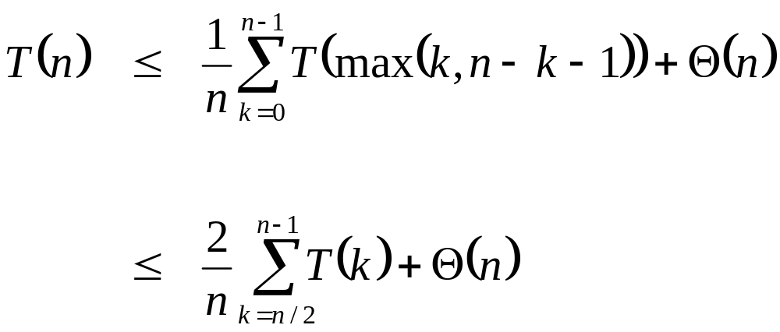
Randomized Selection
Average case
  For upper bound, assume ith element always falls in larger side of partition:
  Let’s show that T(n) = O(n) by substitution
What happened here?

Slide 20
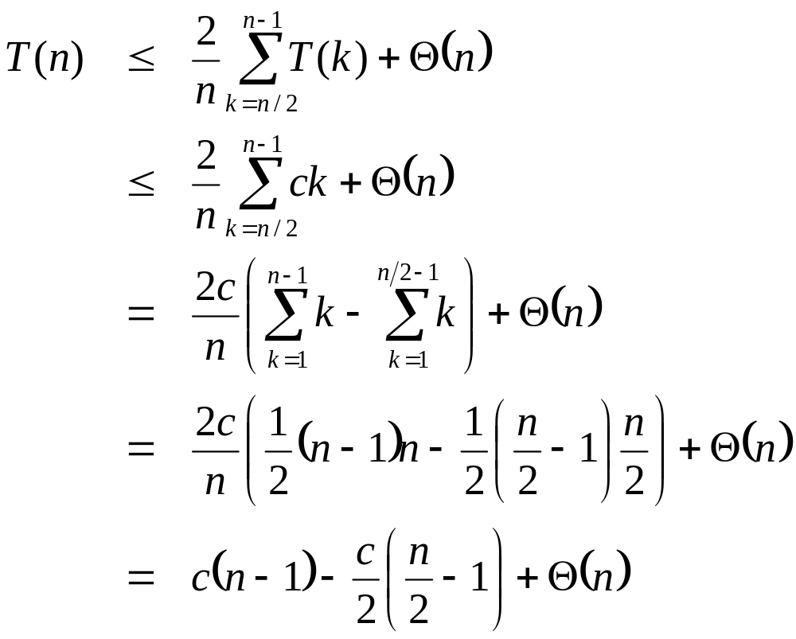
Randomized Selection
Assume T(n) ≤ cn for sufficiently large c:
The recurrence we started with
Substitute T(n) ≤ cn for T(k)
What happened here?
What happened here?
“Split” the recurrence
Expand arithmetic series
What happened here?
Multiply it out
What happened here?

Slide 21
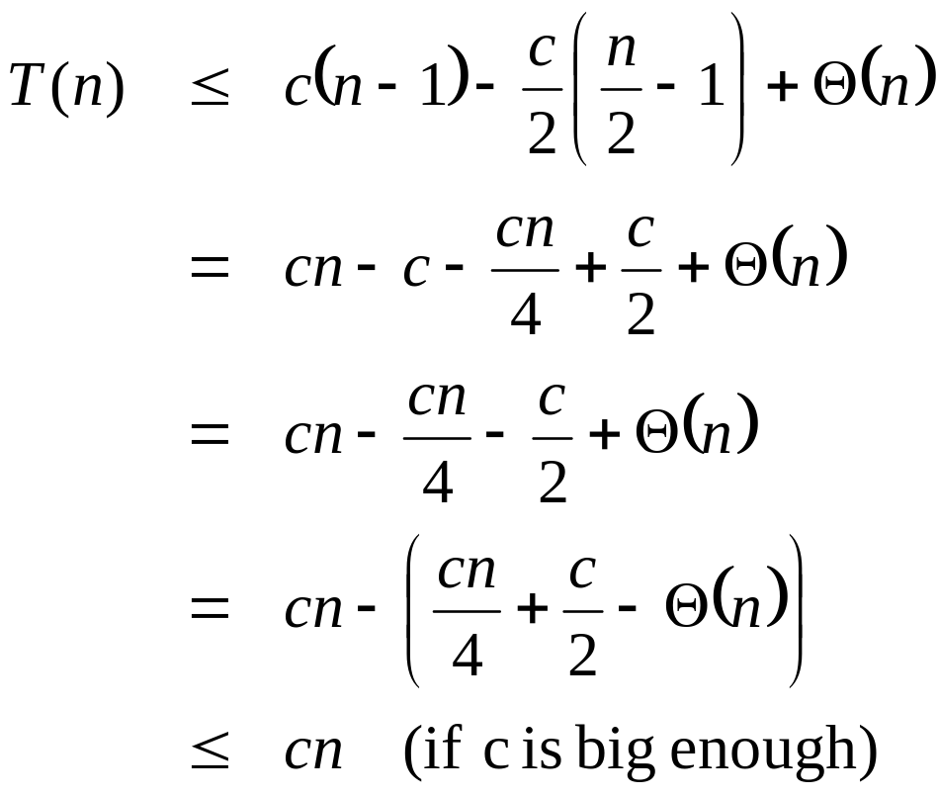
Randomized Selection
Assume T(n) ≤ cn for sufficiently large c:
The recurrence so far
What happened here?
Multiply it out
What happened here?
Subtract c/2
Rearrange the arithmetic
What happened here?
What we set out to prove
What happened here?

Slide 22
Worst-Case Linear-Time Selection
Randomized algorithm works well in practice
What follows is a worst-case linear time algorithm, really of theoretical interest only
Basic idea:
  Generate a good partitioning element
  Call this element x

Slide 23
Worst-Case Linear-Time Selection
The algorithm in words:
  1. Divide n elements into groups of 5
  2. Find median of each group (How? How long?)
  3. Use Select() recursively to find median x of the ⎣n/5⎦ medians
  4. Partition the n elements around x. Let k = rank(x)
  5. if (i == k) then return x
  if (i < k) then use Select() recursively to find ith smallest element in first partition
  else (i > k) use Select() recursively to find (i-k)th smallest element in last partition

Slide 24
Worst-Case Linear-Time Selection
(Sketch situation on the board)
How many of the 5-element medians are ≤ x?
  At least 1/2 of the medians = ⎣⎣n/5⎦ / 2⎦ = ⎣n/10⎦
How many elements are ≤ x?
  At least 3 ⎣n/10 ⎦ elements
For large n, 3 ⎣n/10 ⎦ ≥ n/4 (How large?)
So at least n/4 elements ≤ x
Similarly: at least n/4 elements ≥ x

Slide 25
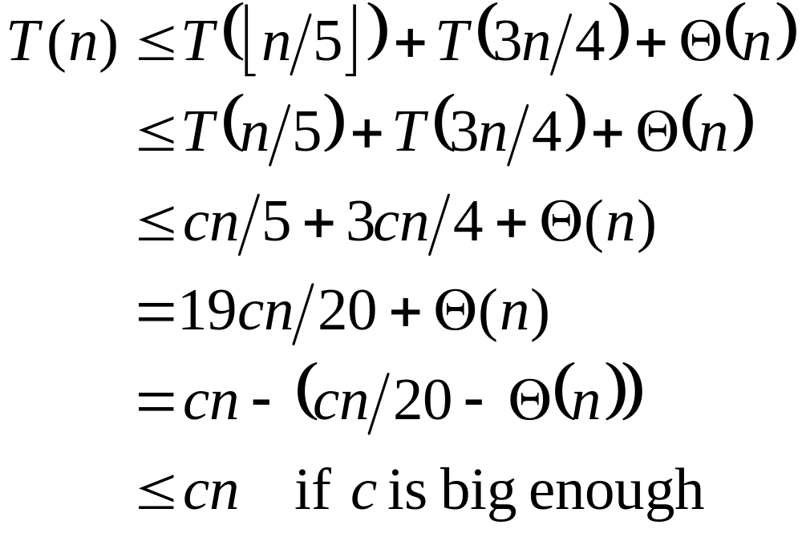
Worst-Case Linear-Time Selection
Thus after partitioning around x, step 5 will call Select() on at most 3n/4 elements
The recurrence is therefore:
⎣n/5 ⎦ ≤ n/5
???
Substitute T(n) = cn
???
Combine fractions
???
Express in desired form
???
What we set out to prove
???

Slide 26
Worst-Case Linear-Time Selection
Intuitively:
  Work at each level is a constant fraction (19/20) smaller
    Geometric progression!
  Thus the O(n) work at the root dominates

Slide 27
Linear-Time Median Selection
Given a “black box” O(n) median algorithm, what can we do?
  ith order statistic:
    Find median x
    Partition input around x
    if (i ≤ (n+1)/2) recursively find ith element of first half
    else find (i - (n+1)/2)th element in second half
    T(n) = T(n/2) + O(n) = O(n)
  Can you think of an application to sorting?

Slide 28
Linear-Time Median Selection
Worst-case O(n lg n) quicksort
  Find median x and partition around it
  Recursively quicksort two halves
  T(n) = 2T(n/2) + O(n) = O(n lg n)

Slide 29
The End

