Slide 1
CS 332: Algorithms
Medians and Order Statistics
Structures for Dynamic Sets

Slide 2
Homework 3
On the web shortly…
  Due Wednesday at the beginning of class (test)

Slide 3
Review: Radix Sort
Radix sort:
  Assumption: input has d digits ranging from 0 to k
  Basic idea:
    Sort elements by digit starting with least significant
    Use a stable sort (like counting sort) for each stage
  Each pass over n numbers with d digits takes time O(n+k), so total time O(dn+dk)
    When d is constant and k=O(n), takes O(n) time
  Fast! Stable! Simple!
  Doesn’t sort in place

Slide 4
Review: Bucket Sort
Bucket sort
  Assumption: input is n reals from [0, 1)
  Basic idea:
    Create n linked lists (buckets) to divide interval [0,1) into subintervals of size 1/n
    Add each input element to appropriate bucket and sort buckets with insertion sort
  Uniform input distribution → O(1) bucket size
    Therefore the expected total time is O(n)
  These ideas will return when we study hash tables

Slide 5
Review: Order Statistics
The ith order statistic in a set of n elements is the ith smallest element
The minimum is thus the 1st order statistic
The maximum is (duh) the nth order statistic
The median is the n/2 order statistic
  If n is even, there are 2 medians
Could calculate order statistics by sorting
  Time: O(n lg n) w/ comparison sort
  We can do better

Slide 6
Review: The Selection Problem
The selection problem: find the ith smallest element of a set
Two algorithms:
  A practical randomized algorithm with O(n) expected running time
  A cool algorithm of theoretical interest only with O(n) worst-case running time

Slide 7
Review: Randomized Selection
Key idea: use partition() from quicksort
  But, only need to examine one subarray
  This savings shows up in running time: O(n)
≤ A[q]
≥ A[q]
p
q
r

Slide 8
Review: Randomized Selection
RandomizedSelect(A, p, r, i)
if (p == r) then return A[p];
q = RandomizedPartition(A, p, r)
k = q - p + 1;
if (i == k) then return A[q]; // not in book
if (i < k) then
return RandomizedSelect(A, p, q-1, i);
else
return RandomizedSelect(A, q+1, r, i-k);
k
≤ A[q]
≥ A[q]
p
q
r

Slide 9
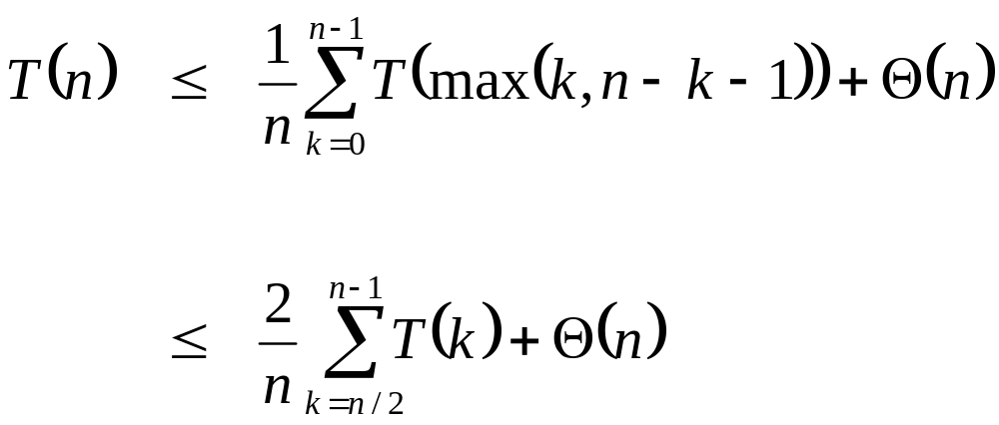
Review: Randomized Selection
Average case
  For upper bound, assume ith element always falls in larger side of partition:
  We then showed that T(n) = O(n) by substitution

Slide 10
Worst-Case Linear-Time Selection
Randomized algorithm works well in practice
What follows is a worst-case linear time algorithm, really of theoretical interest only
Basic idea:
  Generate a good partitioning element
  Call this element x

Slide 11
Worst-Case Linear-Time Selection
The algorithm in words:
  1. Divide n elements into groups of 5
  2. Find median of each group (How? How long?)
  3. Use Select() recursively to find median x of the ⎣n/5⎦ medians
  4. Partition the n elements around x. Let k = rank(x)
  5. if (i == k) then return x
  if (i < k) then use Select() recursively to find ith smallest element in first partition
  else (i > k) use Select() recursively to find (i-k)th smallest element in last partition

Slide 12
Worst-Case Linear-Time Selection
(Sketch situation on the board)
How many of the 5-element medians are ≤ x?
  At least 1/2 of the medians = ⎣⎣n/5⎦ / 2⎦ = ⎣n/10⎦
How many elements are ≤ x?
  At least 3 ⎣n/10 ⎦ elements
For large n, 3 ⎣n/10 ⎦ ≥ n/4 (How large?)
So at least n/4 elements ≤ x
Similarly: at least n/4 elements ≥ x

Slide 13
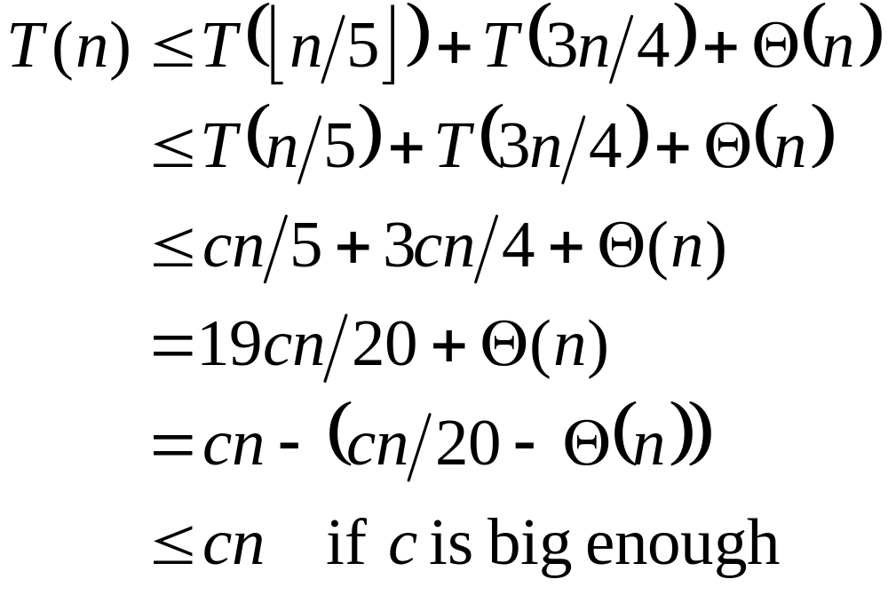
Worst-Case Linear-Time Selection
Thus after partitioning around x, step 5 will call Select() on at most 3n/4 elements
The recurrence is therefore:
⎣n/5 ⎦ ≤ n/5
???
Substitute T(n) = cn
???
Combine fractions
???
Express in desired form
???
What we set out to prove
???

Slide 14
Worst-Case Linear-Time Selection
Intuitively:
  Work at each level is a constant fraction (19/20) smaller
    Geometric progression!
  Thus the O(n) work at the root dominates

Slide 15
Linear-Time Median Selection
Given a “black box” O(n) median algorithm, what can we do?
  ith order statistic:
    Find median x
    Partition input around x
    if (i ≤ (n+1)/2) recursively find ith element of first half
    else find (i - (n+1)/2)th element in second half
    T(n) = T(n/2) + O(n) = O(n)
  Can you think of an application to sorting?

Slide 16
Linear-Time Median Selection
Worst-case O(n lg n) quicksort
  Find median x and partition around it
  Recursively quicksort two halves
  T(n) = 2T(n/2) + O(n) = O(n lg n)

Slide 17
Structures…
Done with sorting and order statistics for now
Ahead of schedule, so…
Next part of class will focus on data structures
We will get a couple in before the first exam
  Yes, these will be on this exam

Slide 18
Dynamic Sets
Next few lectures will focus on data structures rather than straight algorithms
In particular, structures for dynamic sets
  Elements have a key and satellite data
  Dynamic sets support queries such as:
    Search(S, k), Minimum(S), Maximum(S), Successor(S, x), Predecessor(S, x)
  They may also support modifying operations like:
    Insert(S, x), Delete(S, x)

Slide 19
Binary Search Trees
Binary Search Trees (BSTs) are an important data structure for dynamic sets
In addition to satellite data, eleements have:
  key: an identifying field inducing a total ordering
  left: pointer to a left child (may be NULL)
  right: pointer to a right child (may be NULL)
  p: pointer to a parent node (NULL for root)

Slide 20
Binary Search Trees
BST property:
key[left(x)] ≤ key[x] ≤ key[right(x)]
Example:
F
B
H
A
D
K

Slide 21
Inorder Tree Walk
What does the following code do?
  TreeWalk(x)
  TreeWalk(left[x]);
  print(x);
  TreeWalk(right[x]);
A: prints elements in sorted (increasing) order
This is called an inorder tree walk
  Preorder tree walk: print root, then left, then right
  Postorder tree walk: print left, then right, then root

Slide 22
Inorder Tree Walk
Example:
How long will a tree walk take?
Prove that inorder walk prints in monotonically increasing order
F
B
H
A
D
K

Slide 23
Operations on BSTs: Search
Given a key and a pointer to a node, returns an element with that key or NULL:
TreeSearch(x, k)
if (x = NULL or k = key[x])
return x;
if (k < key[x])
return TreeSearch(left[x], k);
else
return TreeSearch(right[x], k);

Slide 24
BST Search: Example
Search for D and C:
F
B
H
A
D
K

Slide 25
Operations on BSTs: Search
Here’s another function that does the same:
TreeSearch(x, k)
while (x != NULL and k != key[x])
if (k < key[x])
x = left[x];
else
x = right[x];
return x;
Which of these two functions is more efficient?

Slide 26
Operations of BSTs: Insert
Adds an element x to the tree so that the binary search tree property continues to hold
The basic algorithm
  Like the search procedure above
  Insert x in place of NULL
  Use a “trailing pointer” to keep track of where you came from (like inserting into singly linked list)

Slide 27
BST Insert: Example
Example: Insert C
F
B
H
A
D
K
C

Slide 28
BST Search/Insert: Running Time
What is the running time of TreeSearch() or TreeInsert()?
A: O(h), where h = height of tree
What is the height of a binary search tree?
A: worst case: h = O(n) when tree is just a linear string of left or right children
  We’ll keep all analysis in terms of h for now
  Later we’ll see how to maintain h = O(lg n)

Slide 29
Sorting With Binary Search Trees
Informal code for sorting array A of length n:
  BSTSort(A)
  for i=1 to n
  TreeInsert(A[i]);
  InorderTreeWalk(root);
Argue that this is Ω(n lg n)
What will be the running time in the
  Worst case?
  Average case? (hint: remind you of anything?)

Slide 30
Sorting With BSTs
Average case analysis
  It’s a form of quicksort!
for i=1 to n
TreeInsert(A[i]);
InorderTreeWalk(root);
3 1 8 2 6 7 5
3
1 2
8 6 7 5
1
8
2
6 7 5
2
6
5
7
5
7

Slide 31
Sorting with BSTs
Same partitions are done as with quicksort, but in a different order
  In previous example
    Everything was compared to 3 once
    Then those items < 3 were compared to 1 once
    Etc.
  Same comparisons as quicksort, different order!
    Example: consider inserting 5

Slide 32
Sorting with BSTs
Since run time is proportional to the number of comparisons, same time as quicksort: O(n lg n)
Which do you think is better, quicksort or BSTsort? Why?

Slide 33
Sorting with BSTs
Since run time is proportional to the number of comparisons, same time as quicksort: O(n lg n)
Which do you think is better, quicksort or BSTSort? Why?
A: quicksort
  Better constants
  Sorts in place
  Doesn’t need to build data structure

Slide 34
More BST Operations
BSTs are good for more than sorting. For example, can implement a priority queue
What operations must a priority queue have?
  Insert
  Minimum
  Extract-Min

Slide 35
BST Operations: Minimum
How can we implement a Minimum() query?
What is the running time?

Slide 36
BST Operations: Successor
For deletion, we will need a Successor() operation
Draw Fig 13.2
What is the successor of node 3? Node 15? Node 13?
What are the general rules for finding the successor of node x? (hint: two cases)

Slide 37
BST Operations: Successor
Two cases:
  x has a right subtree: successor is minimum node in right subtree
  x has no right subtree: successor is first ancestor of x whose left child is also ancestor of x
    Intuition: As long as you move to the left up the tree, you’re visiting smaller nodes.
Predecessor: similar algorithm

Slide 38
BST Operations: Delete
Deletion is a bit tricky
3 cases:
  x has no children:
    Remove x
  x has one child:
    Splice out x
  x has two children:
    Swap x with successor
    Perform case 1 or 2 to delete it
F
B
H
A
D
K
Example: delete K
or H or B
C

Slide 39
BST Operations: Delete
Why will case 2 always go to case 0 or case 1?
A: because when x has 2 children, its successor is the minimum in its right subtree
Could we swap x with predecessor instead of successor?
A: yes. Would it be a good idea?
A: might be good to alternate

Slide 40
The End
Up next: guaranteeing a O(lg n) height tree

