Slide 1
CS 332: Algorithms
Review for Exam 1

Slide 2
Administrative
Reminder: homework 3 due today
Reminder: Exam 1 Wednesday, Feb 13
  1 8.5x11 crib sheet allowed
    Both sides, mechanical reproduction okay
    You will turn it in with the exam

Slide 3
Review Of Topics
Asymptotic notation
Solving recurrences
Sorting algorithms
  Insertion sort
  Merge sort
  Heap sort
  Quick sort
  Counting sort
  Radix sort
Medians/order statistics
  Randomized algorithm
  Worst-case algorithm
Structures for dynamic sets
  Priority queues
  BST basics

Slide 4
Review: Induction
Suppose
  S(k) is true for fixed constant k
    Often k = 0
  S(n) → S(n+1) for all n >= k
Then S(n) is true for all n >= k

Slide 5
Proof By Induction
Claim:S(n) is true for all n >= k
Basis:
  Show formula is true when n = k
Inductive hypothesis:
  Assume formula is true for an arbitrary n
Step:
  Show that formula is then true for n+1

Slide 6
Induction Example:
Gaussian Closed Form
Prove 1 + 2 + 3 + … + n = n(n+1) / 2
  Basis:
    If n = 0, then 0 = 0(0+1) / 2
  Inductive hypothesis:
    Assume 1 + 2 + 3 + … + n = n(n+1) / 2
  Step (show true for n+1):
    1 + 2 + … + n + n+1 = (1 + 2 + …+ n) + (n+1)
    = n(n+1)/2 + n+1 = [n(n+1) + 2(n+1)]/2
    = (n+1)(n+2)/2 = (n+1)(n+1 + 1) / 2

Slide 7
Induction Example:
Geometric Closed Form
Prove a⁰ + a¹ + … + a^{n} = (a^{n+1} - 1)/(a - 1) for all a ≠ 1
  Basis: show that a⁰ = (a⁰⁺¹ - 1)/(a - 1)
    a⁰ = 1 = (a¹ - 1)/(a - 1)
  Inductive hypothesis:
    Assume a⁰ + a¹ + … + a^{n} = (a^{n+1} - 1)/(a - 1)
  Step (show true for n+1):
    a⁰ + a¹ + … + a^{n+1} = a⁰ + a¹ + … + a^{n} + a^{n+1}
    = (a^{n+1} - 1)/(a - 1) + a^{n+1} = (a^{n+1+1} - 1)/(a - 1)

Slide 8
Review: Asymptotic Performance
Asymptotic performance: How does algorithm behave as the problem size gets very large?
    Running time
    Memory/storage requirements
  Use the RAM model:
    All memory equally expensive to access
    No concurrent operations
    All reasonable instructions take unit time
      Except, of course, function calls
    Constant word size

Slide 9
Review: Running Time
Number of primitive steps that are executed
  Except for time of executing a function call most statements roughly require the same amount of time
  We can be more exact if need be
Worst case vs. average case

Slide 10
Review: Asymptotic Notation
Upper Bound Notation:
  f(n) is O(g(n)) if there exist positive constants c and n₀ such that f(n) ≤ c ⋅ g(n) for all n ≥ n₀
  Formally, O(g(n)) = { f(n): ∃ positive constants c and n₀ such that f(n) ≤ c ⋅ g(n) ∀ n ≥ n₀
Big O fact:
  A polynomial of degree k is O(n^{k})

Slide 11
Review: Asymptotic Notation
Asymptotic lower bound:
  f(n) is Ω(g(n)) if ∃ positive constants c and n₀ such that 0 ≤ c⋅g(n) ≤ f(n) ∀ n ≥ n₀
Asymptotic tight bound:
  f(n) is Θ(g(n)) if ∃ positive constants c₁, c₂, and n₀ such that c₁ g(n) ≤ f(n) ≤ c₂ g(n) ∀ n ≥ n₀
  f(n) = Θ(g(n)) if and only if
  f(n) = O(g(n)) AND f(n) = Ω(g(n))

Slide 12
Review:
Other Asymptotic Notations
A function f(n) is o(g(n)) if ∃ positive constants c and n₀ such that
f(n) < c g(n) ∀ n ≥ n₀
A function f(n) is ω(g(n)) if ∃ positive constants c and n₀ such that
c g(n) < f(n) ∀ n ≥ n₀
Intuitively,
  o() is like <
  O() is like ≤
  ω() is like >
  Ω() is like ≥
  Θ() is like =

Slide 13
Review: Merge Sort
MergeSort(A, left, right) {
if (left < right) {
mid = floor((left + right) / 2);
MergeSort(A, left, mid);
MergeSort(A, mid+1, right);
Merge(A, left, mid, right);
}
}
// Merge() takes two sorted subarrays of A and
// merges them into a single sorted subarray of A.
// Code for this is in the book. It requires O(n)
// time, and *does* require allocating O(n) space

Slide 14
Review: Analysis of Merge Sort
Statement Effort
So T(n) = Θ(1) when n = 1, and 2T(n/2) + Θ(n) when n > 1
This expression is a recurrence
MergeSort(A, left, right) { T(n)
if (left < right) { Θ(1)
mid = floor((left + right) / 2); Θ(1)
MergeSort(A, left, mid); T(n/2)
MergeSort(A, mid+1, right); T(n/2)
Merge(A, left, mid, right); Θ(n)
}
}

Slide 15
Review: Solving Recurrences
Substitution method
Iteration method
Master method

Slide 16
Review: Solving Recurrences
The substitution method
  A.k.a. the “making a good guess method”
  Guess the form of the answer, then use induction to find the constants and show that solution works
  Example: merge sort
    T(n) = 2T(n/2) + cn
    We guess that the answer is O(n lg n)
    Prove it by induction
  Can similarly show T(n) = Ω(n lg n), thus Θ(n lg n)

Slide 17
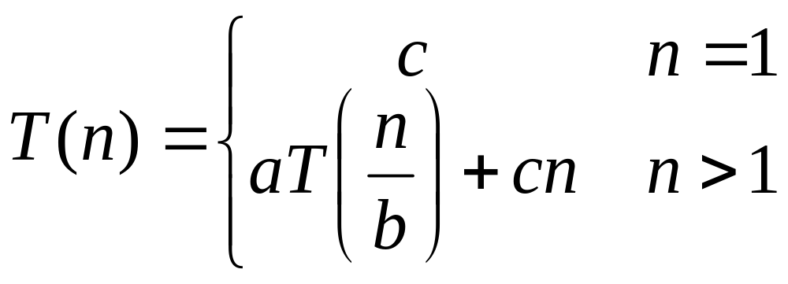
Review: Solving Recurrences
The “iteration method”
  Expand the recurrence
  Work some algebra to express as a summation
  Evaluate the summation
We showed several examples including complex ones:

Slide 18
Review: The Master Theorem
Given: a divide and conquer algorithm
  An algorithm that divides the problem of size n into a subproblems, each of size n/b
  Let the cost of each stage (i.e., the work to divide the problem + combine solved subproblems) be described by the function f(n)
Then, the Master Theorem gives us a cookbook for the algorithm’s running time:

Slide 19
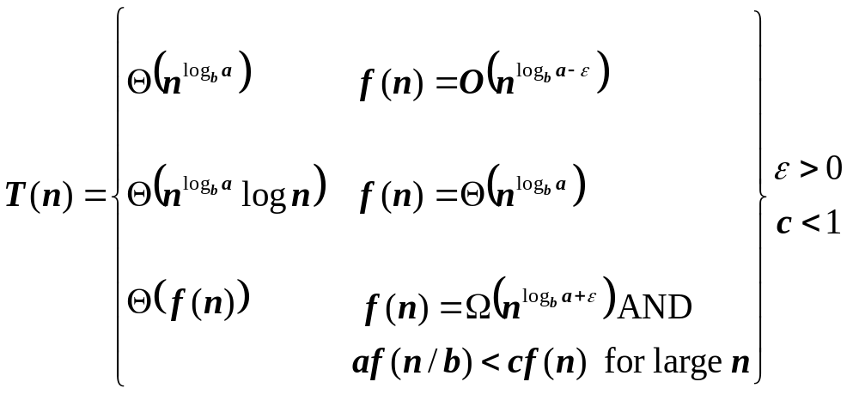
Review: The Master Theorem
if T(n) = aT(n/b) + f(n) then

Slide 20
Review: Heaps
A heap is a “complete” binary tree, usually represented as an array:
16
4
10
14
7
9
3
2
8
1
A =
16
14
10
8
7
9
3
2
4
1

Slide 21
Review: Heaps
To represent a heap as an array:
  Parent(i) { return ⎣i/2⎦; }
  Left(i) { return 2*i; }
  right(i) { return 2*i + 1; }

Slide 22
Review: The Heap Property
Heaps also satisfy the heap property:
A[Parent(i)] ≥ A[i] for all nodes i > 1
  In other words, the value of a node is at most the value of its parent
  The largest value is thus stored at the root (A[1])
Because the heap is a binary tree, the height of any node is at most Θ(lg n)

Slide 23
Review: Heapify()
Heapify(): maintain the heap property
  Given: a node i in the heap with children l and r
  Given: two subtrees rooted at l and r, assumed to be heaps
  Action: let the value of the parent node “float down” so subtree at i satisfies the heap property
    If A[i] < A[l] or A[i] < A[r], swap A[i] with the largest of A[l] and A[r]
    Recurse on that subtree
  Running time: O(h), h = height of heap = O(lg n)

Slide 24
Review: BuildHeap()
We can build a heap in a bottom-up manner by running Heapify() on successive subarrays
  Fact: for array of length n, all elements in range
  A[⎣n/2⎦ + 1 .. n] are heaps (Why?)
  So:
    Walk backwards through the array from n/2 to 1, calling Heapify() on each node.
    Order of processing guarantees that the children of node i are heaps when i is processed

Slide 25
Review: BuildHeap()
// given an unsorted array A, make A a heap
BuildHeap(A)
{
heap_size(A) = length(A);
for (i = ⎣length[A]/2⎦ downto 1)
Heapify(A, i);
}

Slide 26
Review: Priority Queues
Heapsort is a nice algorithm, but in practice Quicksort (coming up) usually wins
But the heap data structure is incredibly useful for implementing priority queues
  A data structure for maintaining a set S of elements, each with an associated value or key
  Supports the operations Insert(), Maximum(), and ExtractMax()
  What might a priority queue be useful for?

Slide 27
Review: Priority Queue Operations
Insert(S, x) inserts the element x into set S
Maximum(S) returns the element of S with the maximum key
ExtractMax(S) removes and returns the element of S with the maximum key

Slide 28
Review:
Implementing Priority Queues
HeapInsert(A, key) // what’s running time?
{
heap_size[A] ++;
i = heap_size[A];
while (i > 1 AND A[Parent(i)] < key)
{
A[i] = A[Parent(i)];
i = Parent(i);
}
A[i] = key;
}

Slide 29
Review:
Implementing Priority Queues
HeapExtractMax(A)
{
if (heap_size[A] < 1) { error; }
max = A[1];
A[1] = A[heap_size[A]]
heap_size[A] --;
Heapify(A, 1);
return max;
}

Slide 30
Review: Quicksort
Another divide-and-conquer algorithm
  The array A[p..r] is partitioned into two non-empty subarrays A[p..q] and A[q+1..r]
    Invariant: All elements in A[p..q] are less than all elements in A[q+1..r]
  The subarrays are recursively sorted by calls to quicksort
  Unlike merge sort, no combining step: two subarrays form an already-sorted array

Slide 31
Review: Quicksort Code
Quicksort(A, p, r)
{
if (p < r)
{
q = Partition(A, p, r);
Quicksort(A, p, q);
Quicksort(A, q+1, r);
}
}

Slide 32
Review: Partition
Clearly, all the action takes place in the partition() function
  Rearranges the subarray in place
  End result:
    Two subarrays
    All values in first subarray ≤ all values in second
  Returns the index of the “pivot” element separating the two subarrays

Slide 33
Review: Partition In Words
Partition(A, p, r):
  Select an element to act as the “pivot” (which?)
  Grow two regions, A[p..i] and A[j..r]
    All elements in A[p..i] <= pivot
    All elements in A[j..r] >= pivot
  Increment i until A[i] >= pivot
  Decrement j until A[j] <= pivot
  Swap A[i] and A[j]
  Repeat until i >= j
  Return j
Note: slightly different from old book’s partition(), very different from new book

Slide 34
Review: Analyzing Quicksort
What will be the worst case for the algorithm?
  Partition is always unbalanced
What will be the best case for the algorithm?
  Partition is balanced
Which is more likely?
  The latter, by far, except...
Will any particular input elicit the worst case?
  Yes: Already-sorted input

Slide 35
Review: Analyzing Quicksort
In the worst case:
  T(1) = Θ(1)
  T(n) = T(n - 1) + Θ(n)
Works out to
T(n) = Θ(n²)

Slide 36
Review: Analyzing Quicksort
In the best case:
  T(n) = 2T(n/2) + Θ(n)
What does this work out to?
  T(n) = Θ(n lg n)

Slide 37
Review: Analyzing Quicksort (Average Case)
Intuitively, the O(n) cost of a bad split
(or 2 or 3 bad splits) can be absorbed
into the O(n) cost of each good split
Thus running time of alternating bad and good splits is still O(n lg n), with slightly higher constants
We can be more rigorous…

Slide 38
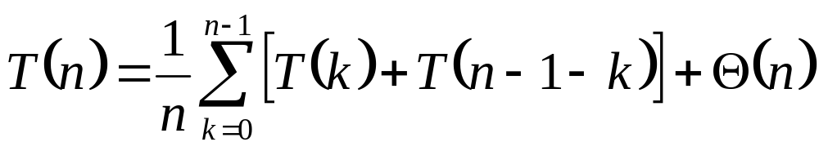
Analyzing Quicksort: Average Case
So partition generates splits
(0:n-1, 1:n-2, 2:n-3, … , n-2:1, n-1:0)
each with probability 1/n
If T(n) is the expected running time,
What is each term under the summation for?
What is the Θ(n) term for?

Slide 39
Analyzing Quicksort: Average Case
So partition generates splits
(0:n-1, 1:n-2, 2:n-3, … , n-2:1, n-1:0)
each with probability 1/n
If T(n) is the expected running time,
  What are terms under the summation for? the Θ(n)?
Massive proof that you should look over

Slide 40
Sorting Summary
Insertion sort:
  Easy to code
  Fast on small inputs (less than ~50 elements)
  Fast on nearly-sorted inputs
  O(n²) worst case
  O(n²) average (equally-likely inputs) case
  O(n²) reverse-sorted case

Slide 41
Sorting Summary
Merge sort:
  Divide-and-conquer:
    Split array in half
    Recursively sort subarrays
    Linear-time merge step
  O(n lg n) worst case
  Doesn’t sort in place

Slide 42
Sorting Summary
Heap sort:
  Uses the very useful heap data structure
    Complete binary tree
    Heap property: parent key > children’s keys
  O(n lg n) worst case
  Sorts in place
  Fair amount of shuffling memory around

Slide 43
Sorting Summary
Quick sort:
  Divide-and-conquer:
    Partition array into two subarrays, recursively sort
    All of first subarray < all of second subarray
    No merge step needed!
  O(n lg n) average case
  Fast in practice
  O(n²) worst case
    Naïve implementation: worst case on sorted input
    Address this with randomized quicksort

Slide 44
Review: Comparison Sorts
Comparison sorts: O(n lg n) at best
  Model sort with decision tree
  Path down tree = execution trace of algorithm
  Leaves of tree = possible permutations of input
  Tree must have n! leaves, so O(n lg n) height

Slide 45
Review: Counting Sort
Counting sort:
  Assumption: input is in the range 1..k
  Basic idea:
    Count number of elements k ≤ each element i
    Use that number to place i in position k of sorted array
  No comparisons! Runs in time O(n + k)
  Stable sort
  Does not sort in place:
    O(n) array to hold sorted output
    O(k) array for scratch storage

Slide 46
Review: Counting Sort
1 CountingSort(A, B, k)
2 for i=1 to k
3 C[i]= 0;
4 for j=1 to n
5 C[A[j]] += 1;
6 for i=2 to k
7 C[i] = C[i] + C[i-1];
8 for j=n downto 1
9 B[C[A[j]]] = A[j];
10 C[A[j]] -= 1;

Slide 47
Review: Radix Sort
Radix sort:
  Assumption: input has d digits ranging from 0 to k
  Basic idea:
    Sort elements by digit starting with least significant
    Use a stable sort (like counting sort) for each stage
  Each pass over n numbers with d digits takes time O(n+k), so total time O(dn+dk)
    When d is constant and k=O(n), takes O(n) time
  Fast! Stable! Simple!
  Doesn’t sort in place

Slide 48
Review: Bucket Sort
Bucket sort
  Assumption: input is n reals from [0, 1)
  Basic idea:
    Create n linked lists (buckets) to divide interval [0,1) into subintervals of size 1/n
    Add each input element to appropriate bucket and sort buckets with insertion sort
  Uniform input distribution → O(1) bucket size
    Therefore the expected total time is O(n)
  These ideas will return when we study hash tables

Slide 49
Review: Order Statistics
The ith order statistic in a set of n elements is the ith smallest element
The minimum is thus the 1st order statistic
The maximum is (duh) the nth order statistic
The median is the n/2 order statistic
  If n is even, there are 2 medians
Could calculate order statistics by sorting
  Time: O(n lg n) w/ comparison sort
  We can do better

Slide 50
Review: The Selection Problem
The selection problem: find the ith smallest element of a set
Two algorithms:
  A practical randomized algorithm with O(n) expected running time
  A cool algorithm of theoretical interest only with O(n) worst-case running time

Slide 51
Review: Randomized Selection
Key idea: use partition() from quicksort
  But, only need to examine one subarray
  This savings shows up in running time: O(n)
≤ A[q]
≥ A[q]
p
q
r

Slide 52
Review: Randomized Selection
RandomizedSelect(A, p, r, i)
if (p == r) then return A[p];
q = RandomizedPartition(A, p, r)
k = q - p + 1;
if (i == k) then return A[q]; // not in book
if (i < k) then
return RandomizedSelect(A, p, q-1, i);
else
return RandomizedSelect(A, q+1, r, i-k);
k
≤ A[q]
≥ A[q]
p
q
r

Slide 53
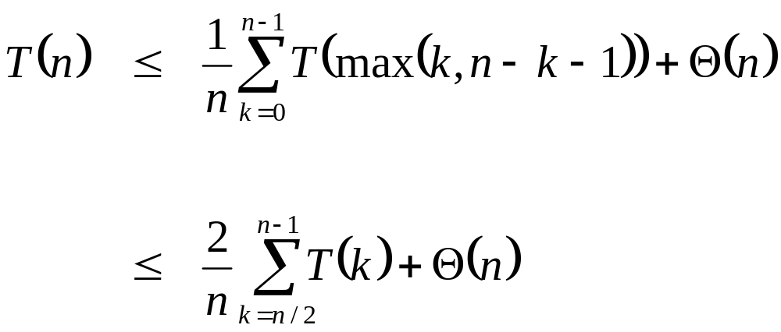
Review: Randomized Selection
Average case
  For upper bound, assume ith element always falls in larger side of partition:
  We then showed that T(n) = O(n) by substitution

Slide 54
Review:
Worst-Case Linear-Time Selection
Randomized algorithm works well in practice
What follows is a worst-case linear time algorithm, really of theoretical interest only
Basic idea:
  Generate a good partitioning element
  Call this element x

Slide 55
Review:
Worst-Case Linear-Time Selection
The algorithm in words:
  1. Divide n elements into groups of 5
  2. Find median of each group (How? How long?)
  3. Use Select() recursively to find median x of the ⎣n/5⎦ medians
  4. Partition the n elements around x. Let k = rank(x)
  5. if (i == k) then return x
  if (i < k) then use Select() recursively to find ith smallest element in first partition
  else (i > k) use Select() recursively to find (i-k)th smallest element in last partition

Slide 56
Review:
Worst-Case Linear-Time Selection
(Sketch situation on the board)
How many of the 5-element medians are ≤ x?
  At least 1/2 of the medians = ⎣⎣n/5⎦ / 2⎦ = ⎣n/10⎦
How many elements are ≤ x?
  At least 3 ⎣n/10 ⎦ elements
For large n, 3 ⎣n/10 ⎦ ≥ n/4 (How large?)
So at least n/4 elements ≤ x
Similarly: at least n/4 elements ≥ x

Slide 57
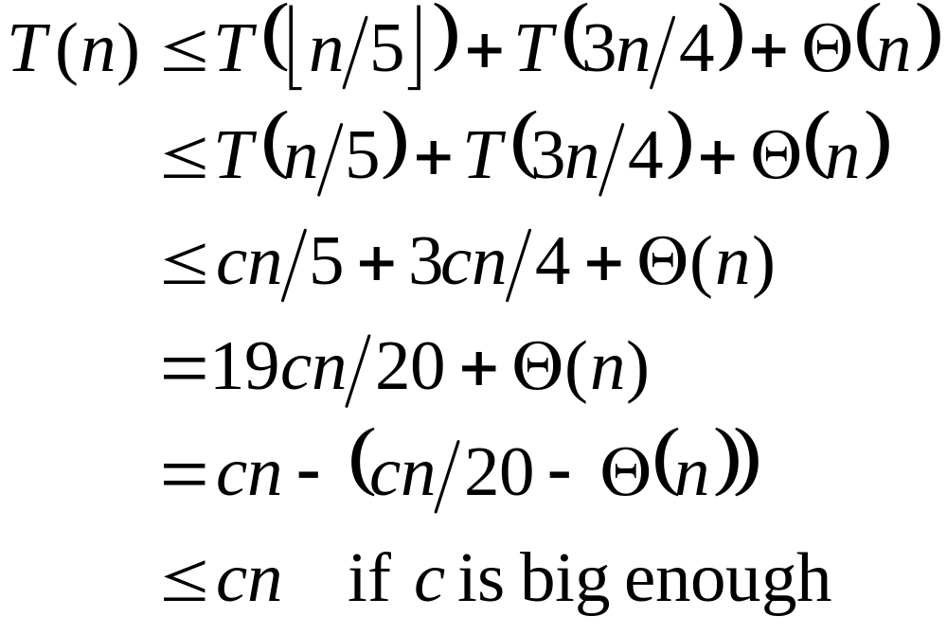
Review:
Worst-Case Linear-Time Selection
Thus after partitioning around x, step 5 will call Select() on at most 3n/4 elements
The recurrence is therefore:
⎣n/5 ⎦ ≤ n/5
???
Substitute T(n) = cn
???
Combine fractions
???
Express in desired form
???
What we set out to prove
???

Slide 58
Review: Binary Search Trees
Binary Search Trees (BSTs) are an important data structure for dynamic sets
In addition to satellite data, elements have:
  key: an identifying field inducing a total ordering
  left: pointer to a left child (may be NULL)
  right: pointer to a right child (may be NULL)
  p: pointer to a parent node (NULL for root)

Slide 59
Review: Binary Search Trees
BST property:
key[left(x)] ≤ key[x] ≤ key[right(x)]
Example:
F
B
H
A
D
K

Slide 60
Review: Inorder Tree Walk
An inorder walk prints the set in sorted order:
  TreeWalk(x)
  TreeWalk(left[x]);
  print(x);
  TreeWalk(right[x]);
  Easy to show by induction on the BST property
  Preorder tree walk: print root, then left, then right
  Postorder tree walk: print left, then right, then root

