Slide 1
CS 332: Algorithms
Universal Hashing

Slide 2
Reminder: Homework 4
Programming assignment:
  Implement Skip Lists
  Evaluate performance
  Extra credit: compare performance to randomly built BST
  Due Mar 9 (Fri before Spring Break)
    Monday after break counts as 1 late day

Slide 3
Review: Resolving Collisions
How can we solve the problem of collisions?
Open addressing
  To insert: if slot is full, try another slot, and another, until an open slot is found (probing)
  To search, follow same sequence of probes as would be used when inserting the element
Chaining
  Keep linked list of elements in slots
  Upon collision, just add new element to list

Slide 4
Review: Chaining
Chaining puts elements that hash to the same slot in a linked list:
T
U
(universe of keys)
——
k₁
k₄
——
——
k₁
——
K
(actual
keys)
k₄
k₅
——
k₇
k₅
k₂
k₇
——
——
k₂
k₃
k₈
k₃
——
k₆
k₈
k₆
——
——

Slide 5
Review: Analysis Of Hash Tables
Simple uniform hashing: each key in table is equally likely to be hashed to any slot
Load factor α = n/m = average # keys per slot
  Average cost of unsuccessful search = O(1+α)
  Successful search: O(1+ α/2) = O(1+ α)
  If n is proportional to m, α = O(1)
So the cost of searching = O(1) if we size our table appropriately

Slide 6
Review: Choosing A Hash Function
Choosing the hash function well is crucial
  Bad hash function puts all elements in same slot
  A good hash function:
    Should distribute keys uniformly into slots
    Should not depend on patterns in the data
We discussed three methods:
  Division method
  Multiplication method
  Universal hashing

Slide 7
Review: The Division Method
h(k) = k mod m
  In words: hash k into a table with m slots using the slot given by the remainder of k divided by m
Elements with adjacent keys hashed to different slots: good
If keys bear relation to m: bad
Upshot: pick table size m = prime number not too close to a power of 2 (or 10)

Slide 8
Review: The Multiplication Method
For a constant A, 0 < A < 1:
h(k) = ⎣ m (kA - ⎣kA⎦) ⎦
Upshot:
  Choose m = 2^{P}
  Choose A not too close to 0 or 1
  Knuth: Good choice for A = (√5 - 1)/2
Fractional part of kA

Slide 9
Review: Universal Hashing
When attempting to foil an malicious adversary, randomize the algorithm
Universal hashing: pick a hash function randomly when the algorithm begins
(not upon every insert!)
  Guarantees good performance on average, no matter what keys adversary chooses
  Need a family of hash functions to choose from

Slide 10
Universal Hashing
Let  be a (finite) collection of hash functions
  …that map a given universe U of keys…
  …into the range {0, 1, …, m - 1}.
 is said to be universal if:
  for each pair of distinct keys x, y ∈ U,
  the number of hash functions h ∈ 
  for which h(x) = h(y) is ||/m
  In other words:
    With a random hash function from , the chance of a collision between x and y is exactly 1/m (x ≠ y)

Slide 11
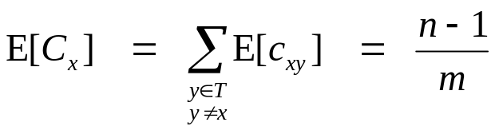
Universal Hashing
Theorem 12.3:
  Choose h from a universal family of hash functions
  Hash n keys into a table of m slots, n ≤ m
  Then the expected number of collisions involving a particular key x is less than 1
  Proof:
    For each pair of keys y, z, let c_{yx} = 1 if y and z collide, 0 otherwise
    E[c_{yz}] = 1/m (by definition)
    Let C_{x} be total number of collisions involving key x
    Since n ≤ m, we have E[C_{x}] < 1

Slide 12
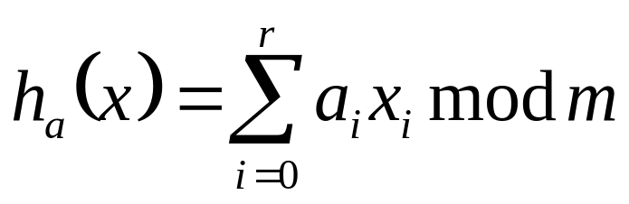
A Universal Hash Function
Choose table size m to be prime
Decompose key x into r+1 bytes, so that
x = {x₀, x₁, …, x_{r}}
  Only requirement is that max value of byte < m
  Let a = {a₀, a₁, …, a_{r}} denote a sequence of r+1 elements chosen randomly from {0, 1, …, m - 1}
  Define corresponding hash function h_{a} ∈ :
  With this definition,  has m^{r+1} members

Slide 13
A Universal Hash Function
 is a universal collection of hash functions (Theorem 12.4)
How to use:
  Pick r based on m and the range of keys in U
  Pick a hash function by (randomly) picking the a’s
  Use that hash function on all keys

Slide 14
Augmenting Data Structures
This course is supposed to be about design and analysis of algorithms
So far, we’ve only looked at one design technique (What is it?)

Slide 15
Augmenting Data Structures
This course is supposed to be about design and analysis of algorithms
So far, we’ve only looked at one design technique: divide and conquer
Next up: augmenting data structures
  Or, “One good thief is worth ten good scholars”

Slide 16
Dynamic Order Statistics
We’ve seen algorithms for finding the ith element of an unordered set in O(n) time
Next, a structure to support finding the ith element of a dynamic set in O(lg n) time
  What operations do dynamic sets usually support?
  What structure works well for these?
  How could we use this structure for order statistics?
  How might we augment it to support efficient extraction of order statistics?

Slide 17
Order Statistic Trees
OS Trees augment red-black trees:
  Associate a size field with each node in the tree
  x->size records the size of subtree rooted at x, including x itself:
M
8
C
5
P
2
A
1
F
3
Q
1
D
1
H
1

Slide 18
Selection On OS Trees
M
8
C
5
P
2
A
1
F
3
Q
1
D
1
H
1
How can we use this property
to select the ith element of the set?

Slide 19
OS-Select
OS-Select(x, i)
{
r = x->left->size + 1;
if (i == r)
return x;
else if (i < r)
return OS-Select(x->left, i);
else
return OS-Select(x->right, i-r);
}

