Slide 1
CS 332: Algorithms
Merge Sort
Solving Recurrences
The Master Theorem

Slide 2
Administrative Question
Who here cannot make Monday-Wednesday office hours at 10 AM?
If nobody, should we change class time?

Slide 3
Homework 1
Homework 1 will be posted later today
  (Problem with the exercise numbering, sorry)
  Due Monday Jan 28 at 9 AM
  Should be a fairly simple warm-up problem set

Slide 4
Review: Asymptotic Notation
Upper Bound Notation:
  f(n) is O(g(n)) if there exist positive constants c and n₀ such that f(n) ≤ c ⋅ g(n) for all n ≥ n₀
  Formally, O(g(n)) = { f(n): ∃ positive constants c and n₀ such that f(n) ≤ c ⋅ g(n) ∀ n ≥ n₀
Big O fact:
  A polynomial of degree k is O(n^{k})

Slide 5
Review: Asymptotic Notation
Asymptotic lower bound:
  f(n) is Ω(g(n)) if ∃ positive constants c and n₀ such that 0 ≤ c⋅g(n) ≤ f(n) ∀ n ≥ n₀
Asymptotic tight bound:
  f(n) is Θ(g(n)) if ∃ positive constants c₁, c₂, and n₀ such that c₁ g(n) ≤ f(n) ≤ c₂ g(n) ∀ n ≥ n₀
  f(n) = Θ(g(n)) if and only if
  f(n) = O(g(n)) AND f(n) = Ω(g(n))

Slide 6
Other Asymptotic Notations
A function f(n) is o(g(n)) if ∃ positive constants c and n₀ such that
f(n) < c g(n) ∀ n ≥ n₀
A function f(n) is ω(g(n)) if ∃ positive constants c and n₀ such that
c g(n) < f(n) ∀ n ≥ n₀
Intuitively,
  o() is like <
  O() is like ≤
  ω() is like >
  Ω() is like ≥
  Θ() is like =

Slide 7
Merge Sort
MergeSort(A, left, right) {
if (left < right) {
mid = floor((left + right) / 2);
MergeSort(A, left, mid);
MergeSort(A, mid+1, right);
Merge(A, left, mid, right);
}
}
// Merge() takes two sorted subarrays of A and
// merges them into a single sorted subarray of A
// (how long should this take?)

Slide 8
Merge Sort: Example
Show MergeSort() running on the array
A = {10, 5, 7, 6, 1, 4, 8, 3, 2, 9};

Slide 9
Analysis of Merge Sort
Statement Effort
So T(n) = Θ(1) when n = 1, and 2T(n/2) + Θ(n) when n > 1
So what (more succinctly) is T(n)?
MergeSort(A, left, right) { T(n)
if (left < right) { Θ(1)
mid = floor((left + right) / 2); Θ(1)
MergeSort(A, left, mid); T(n/2)
MergeSort(A, mid+1, right); T(n/2)
Merge(A, left, mid, right); Θ(n)
}
}

Slide 10
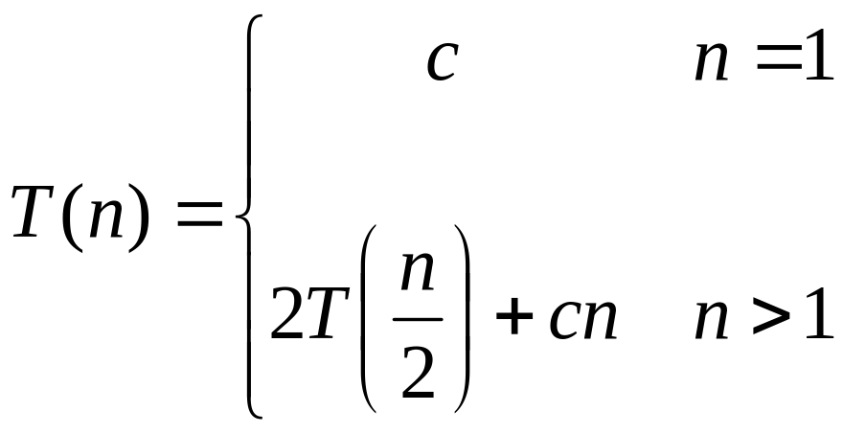
Recurrences
The expression:
is a recurrence.
  Recurrence: an equation that describes a function in terms of its value on smaller functions

Slide 11

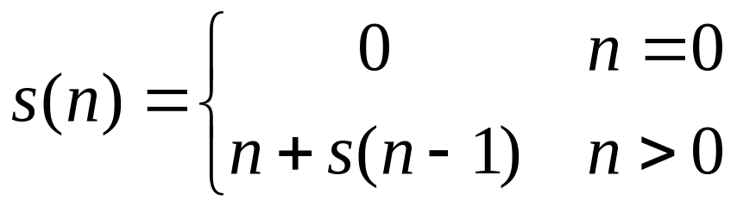

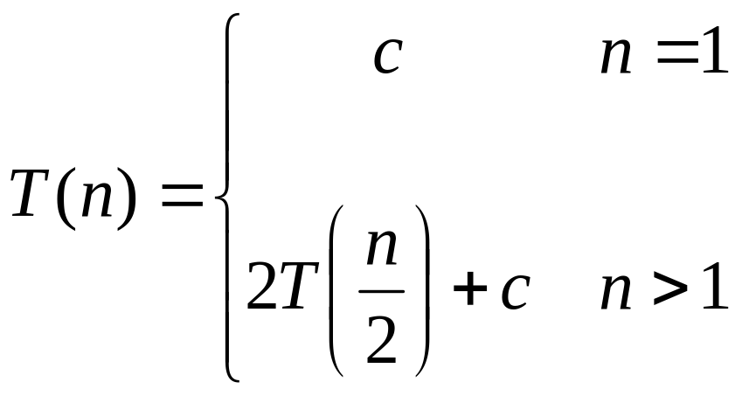
Recurrence Examples

Slide 12
Solving Recurrences
Substitution method
Iteration method
Master method

Slide 13
Solving Recurrences
The substitution method (CLR 4.1)
  A.k.a. the “making a good guess method”
  Guess the form of the answer, then use induction to find the constants and show that solution works
  Examples:
    T(n) = 2T(n/2) + Θ(n) → T(n) = Θ(n lg n)
    T(n) = 2T(⎣n/2⎦) + n → ???

Slide 14
Solving Recurrences
The substitution method (CLR 4.1)
  A.k.a. the “making a good guess method”
  Guess the form of the answer, then use induction to find the constants and show that solution works
  Examples:
    T(n) = 2T(n/2) + Θ(n) → T(n) = Θ(n lg n)
    T(n) = 2T(⎣n/2⎦) + n → T(n) = Θ(n lg n)
    T(n) = 2T(⎣n/2⎦ )+ 17) + n → ???

Slide 15
Solving Recurrences
The substitution method (CLR 4.1)
  A.k.a. the “making a good guess method”
  Guess the form of the answer, then use induction to find the constants and show that solution works
  Examples:
    T(n) = 2T(n/2) + Θ(n) → T(n) = Θ(n lg n)
    T(n) = 2T(⎣n/2⎦) + n → T(n) = Θ(n lg n)
    T(n) = 2T(⎣n/2⎦+ 17) + n → Θ(n lg n)

Slide 16
Solving Recurrences
Another option is what the book calls the “iteration method”
  Expand the recurrence
  Work some algebra to express as a summation
  Evaluate the summation
We will show several examples

Slide 17

s(n) =
c + s(n-1)
c + c + s(n-2)
2c + s(n-2)
2c + c + s(n-3)
3c + s(n-3)
…
kc + s(n-k) = ck + s(n-k)

Slide 18
So far for n >= k we have
  s(n) = ck + s(n-k)
What if k = n?
  s(n) = cn + s(0) = cn

Slide 19
So far for n >= k we have
  s(n) = ck + s(n-k)
What if k = n?
  s(n) = cn + s(0) = cn
So
Thus in general
  s(n) = cn

Slide 20
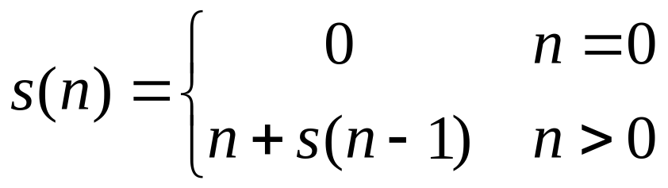
s(n)
= n + s(n-1)
= n + n-1 + s(n-2)
= n + n-1 + n-2 + s(n-3)
= n + n-1 + n-2 + n-3 + s(n-4)
= …
= n + n-1 + n-2 + n-3 + … + n-(k-1) + s(n-k)

Slide 21
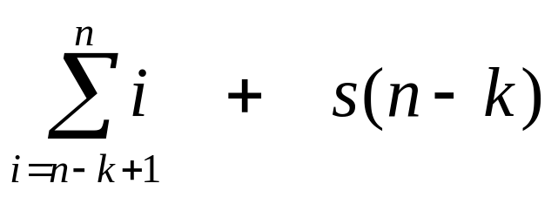
s(n)
= n + s(n-1)
= n + n-1 + s(n-2)
= n + n-1 + n-2 + s(n-3)
= n + n-1 + n-2 + n-3 + s(n-4)
= …
= n + n-1 + n-2 + n-3 + … + n-(k-1) + s(n-k)
=

Slide 22
So far for n >= k we have

Slide 23
So far for n >= k we have
What if k = n?

Slide 24
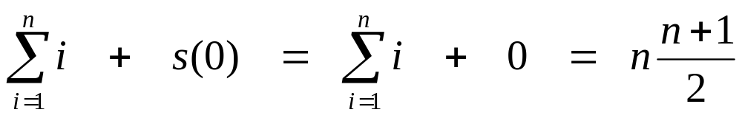
So far for n >= k we have
What if k = n?

Slide 25
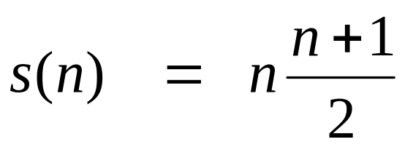
So far for n >= k we have
What if k = n?
Thus in general

Slide 26
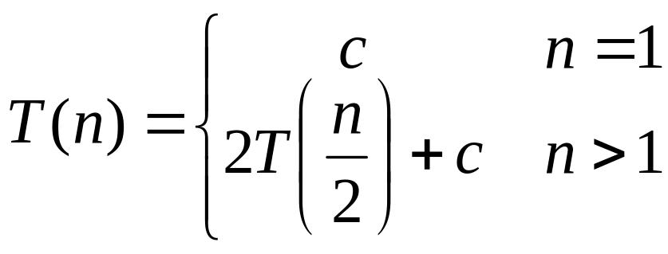
T(n) =
2T(n/2) + c
2(2T(n/2/2) + c) + c
2²T(n/2²) + 2c + c
2²(2T(n/2²/2) + c) + 3c
2³T(n/2³) + 4c + 3c
2³T(n/2³) + 7c
2³(2T(n/2³/2) + c) + 7c
2⁴T(n/2⁴) + 15c
…
2^{k}T(n/2^{k}) + (2^{k} - 1)c

Slide 27
So far for n > 2k we have
  T(n) = 2^{k}T(n/2^{k}) + (2^{k} - 1)c
What if k = lg n?
  T(n) = 2^{lg n} T(n/2^{lg n}) + (2^{lg n} - 1)c
  = n T(n/n) + (n - 1)c
  = n T(1) + (n-1)c
  = nc + (n-1)c = (2n - 1)c

