Slide 1
CS 332: Algorithms
Dynamic Programming

Slide 2
Review: Amortized Analysis
To illustrate amortized analysis we examined dynamic tables
  1. Init table size m = 1
  2. Insert elements until number n > m
  3. Generate new table of size 2m
  4. Reinsert old elements into new table
  5. (back to step 2)
What is the worst-case cost of an insert?
What is the amortized cost of an insert?

Slide 3
Review:
Analysis Of Dynamic Tables
Let c_{i} = cost of ith insert
c_{i} = i if i-1 is exact power of 2, 1 otherwise
Example:
  Operation Table Size Cost
1
2
3
4
5
6
7
Insert(1)
1
1
1
8
Insert(2)
2
1 + 1
2
9
Insert(3)
4
1 + 2
Insert(4)
4
1
Insert(5)
8
1 + 4
Insert(6)
8
1
Insert(7)
8
1
Insert(8)
8
1
Insert(9)
16
1 + 8

Slide 4
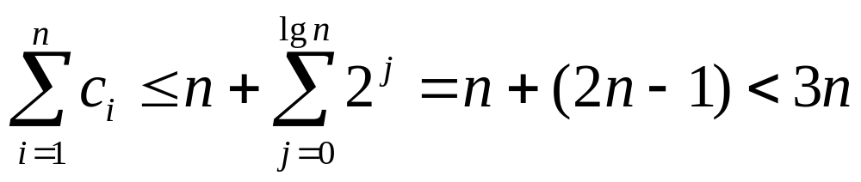
Review: Aggregate Analysis
n Insert() operations cost
Average cost of operation
= (total cost)/(# operations) < 3
Asymptotically, then, a dynamic table costs the same as a fixed-size table
  Both O(1) per Insert operation

Slide 5
Review: Accounting Analysis
Charge each operation $3 amortized cost
  Use $1 to perform immediate Insert()
  Store $2
When table doubles
  $1 reinserts old item, $1 reinserts another old item
  We’ve paid these costs up front with the last n/2 Insert()s
Upshot: O(1) amortized cost per operation

Slide 6
Review: Accounting Analysis
Suppose must support insert & delete, table should contract as well as expand
  Table overflows ⇒ double it (as before)
  Table < 1/4 full ⇒ halve it
  Charge $3 for Insert (as before)
  Charge $2 for Delete
    Store extra $1 in emptied slot
    Use later to pay to copy remaining items to new table when shrinking table
What if we halve size when table < 1/8 full?

Slide 7
Dynamic Programming
Another strategy for designing algorithms is dynamic programming
  A metatechnique, not an algorithm
  (like divide & conquer)
  The word “programming” is historical and predates computer programming
Use when problem breaks down into recurring small subproblems

Slide 8
Dynamic Programming Example:
Longest Common Subsequence
Longest common subsequence (LCS) problem:
  Given two sequences x[1..m] and y[1..n], find the longest subsequence which occurs in both
  Ex: x = {A B C B D A B }, y = {B D C A B A}
  {B C} and {A A} are both subsequences of both
    What is the LCS?
  Brute-force algorithm: For every subsequence of x, check if it’s a subsequence of y
    How many subsequences of x are there?
    What will be the running time of the brute-force alg?

Slide 9
LCS Algorithm
Brute-force algorithm: 2^{m} subsequences of x to check against n elements of y: O(n 2^{m})
We can do better: for now, let’s only worry about the problem of finding the length of LCS
  When finished we will see how to backtrack from this solution back to the actual LCS
Notice LCS problem has optimal substructure
  Subproblems: LCS of pairs of prefixes of x and y

Slide 10
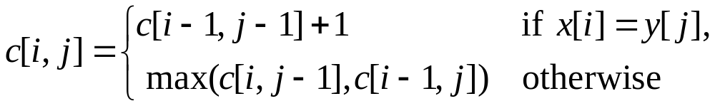
Finding LCS Length
Define c[i,j] to be the length of the LCS of x[1..i] and y[1..j]
  What is the length of LCS of x and y?
Theorem:
What is this really saying?

Slide 11
The End

