Slide 1
CS 332: Algorithms
Review for Final

Slide 2
Final Exam
Coverage: the whole semester
Goal: doable in 2 hours
Cheat sheet: you are allowed two 8’11” sheets, both sides

Slide 3
Final Exam: Study Tips
Study tips:
  Study each lecture
  Study the homework and homework solutions
  Study the midterm exams
Re-make your previous cheat sheets
  I recommend handwriting or typing them
  Think about what you should have had on it the first time…cheat sheets is about identifying important concepts

Slide 4
Graph Representation
Adjacency list
Adjacency matrix
Tradeoffs:
  What makes a graph dense?
  What makes a graph sparse?
  What about planar graphs?

Slide 5
Basic Graph Algorithms
Breadth-first search
  What can we use BFS to calculate?
  A: shortest-path distance to source vertex
Depth-first search
  Tree edges, back edges, cross and forward edges
  What can we use DFS for?
  A: finding cycles, topological sort

Slide 6
Topological Sort, MST
Topological sort
  Examples: getting dressed, project dependency
  To what kind of graph does topological sort apply?
Minimum spanning tree
  Optimal substructure
  Min edge theorem (enables greedy approach)

Slide 7
MST Algorithms
Prim’s algorithm
  What is the bottleneck in Prim’s algorithm?
  A: priority queue operations
Kruskal’s algorithm
  What is the bottleneck in Kruskal’s algorithm?
  Answer: depends on disjoint-set implementation
    As covered in class, disjoint-set union operations
    As described in book, sorting the edges

Slide 8
Single-Source Shortest Path
Optimal substructure
Key idea: relaxation of edges
What does the Bellman-Ford algorithm do?
  What is the running time?
What does Dijkstra’s algorithm do?
  What is the running time?
  When does Dijkstra’s algorithm not apply?

Slide 9
Disjoint-Set Union
We talked about representing sets as linked lists, every element stores pointer to list head
What is the cost of merging sets A and B?
  A: O(max(|A|, |B|))
What is the maximum cost of merging n
1-element sets into a single n-element set?
  A: O(n²)
How did we improve this? By how much?
  A: always copy smaller into larger: O(n lg n)

Slide 10
Amortized Analysis
Idea: worst-case cost of an operation may overestimate its cost over course of algorithm
Goal: get a tighter amortized bound on its cost
  Aggregate method: total cost of operation over course of algorithm divided by # operations
    Example: disjoint-set union
  Accounting method: “charge” a cost to each operation, accumulate unused cost in bank, never go negative
    Example: dynamically-doubling arrays

Slide 11
Dynamic Programming
Indications: optimal substructure, repeated subproblems
What is the difference between memoization and dynamic programming?
A: same basic idea, but:
  Memoization: recursive algorithm, looking up subproblem solutions after computing once
  Dynamic programming: build table of subproblem solutions bottom-up

Slide 12
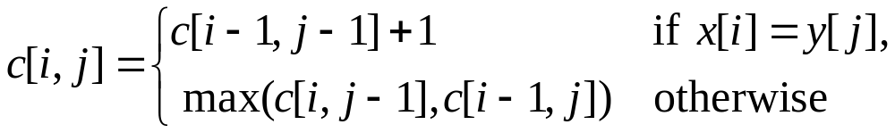
LCS Via Dynamic Programming
Longest common subsequence (LCS) problem:
  Given two sequences x[1..m] and y[1..n], find the longest subsequence which occurs in both
Brute-force algorithm: 2^{m} subsequences of x to check against n elements of y: O(n 2^{m})
Define c[i,j] = length of LCS of x[1..i], y[1..j]
Theorem:

Slide 13
Greedy Algorithms
Indicators:
  Optimal substructure
  Greedy choice property: a locally optimal choice leads to a globally optimal solution
Example problems:
  Activity selection: Set of activities, with start and end times. Maximize compatible set of activities.
  Fractional knapsack: sort items by $/lb, then take items in sorted order
  MST

Slide 14
NP-Completeness
What do we mean when we say a problem
is in P?
  A: A solution can be found in polynomial time
What do we mean when we say a problem
is in NP?
  A: A solution can be verified in polynomial time
What is the relation between P and NP?
  A: P ⊆ NP, but no one knows whether P = NP

Slide 15
Review: NP-Complete
What, intuitively, does it mean if we can reduce problem P to problem Q?
  P is “no harder than” Q
How do we reduce P to Q?
  Transform instances of P to instances of Q in polynomial time s.t. Q: “yes” iff P: “yes”
What does it mean if Q is NP-Hard?
  Every problem P∈NP ≤_{p} Q
What does it mean if Q is NP-Complete?
  Q is NP-Hard and Q ∈ NP

Slide 16
Review:
Proving Problems NP-Complete
What was the first problem shown to be
NP-Complete?
A: Boolean satisfiability (SAT), by Cook
How do we usually prove that a problem R
is NP-Complete?
A: Show R ∈NP, and reduce a known
NP-Complete problem Q to R

Slide 17
Review:
Reductions
Review the reductions we’ve covered:
  Directed hamiltonian cycle → undirected hamiltonian cycle
  Undirected hamiltonian cycle → traveling salesman problem
  3-CNF → k-clique
  k-clique → vertex cover
  Homework 7

Slide 18
Next: Detailed Review
Up next: a detailed review of the first half of the course
  The following 100+ slides are intended as a resource for your studying
  Since you probably remember the more recent stuff better, I just provide this for the early material

Slide 19
Review: Induction
Suppose
  S(k) is true for fixed constant k
    Often k = 0
  S(n)  S(n+1) for all n >= k
Then S(n) is true for all n >= k

Slide 20
Proof By Induction
Claim:S(n) is true for all n >= k
Basis:
  Show formula is true when n = k
Inductive hypothesis:
  Assume formula is true for an arbitrary n
Step:
  Show that formula is then true for n+1

Slide 21
Induction Example:
Gaussian Closed Form
Prove 1 + 2 + 3 + … + n = n(n+1) / 2
  Basis:
    If n = 0, then 0 = 0(0+1) / 2
  Inductive hypothesis:
    Assume 1 + 2 + 3 + … + n = n(n+1) / 2
  Step (show true for n+1):
    1 + 2 + … + n + n+1 = (1 + 2 + …+ n) + (n+1)
    = n(n+1)/2 + n+1 = [n(n+1) + 2(n+2)]/2
    = (n+1)(n+2)/2 = (n+1)(n+1 + 1) / 2

Slide 22
Induction Example:
Geometric Closed Form
Prove a⁰ + a¹ + … + a^{n} = (a^{n+1} - 1)/(a - 1) for all a != 1
  Basis: show that a⁰ = (a⁰⁺¹ - 1)/(a - 1)
    a⁰ = 1 = (a¹ - 1)/(a - 1)
  Inductive hypothesis:
    Assume a⁰ + a¹ + … + a^{n} = (a^{n+1} - 1)/(a - 1)
  Step (show true for n+1):
    a⁰ + a¹ + … + a^{n+1} = a⁰ + a¹ + … + a^{n} + a^{n+1}
    = (a^{n+1} - 1)/(a - 1) + a^{n+1} = (a^{n+1+1} - 1)(a - 1)

Slide 23
Review: Analyzing Algorithms
We are interested in asymptotic analysis:
  Behavior of algorithms as problem size gets large
  Constants, low-order terms don’t matter

Slide 24
An Example: Insertion Sort
30
10
40
20
i = ∅ j = ∅ key = ∅
A[j] = ∅ A[j+1] = ∅
1
2
3
4
InsertionSort(A, n) {
for i = 2 to n {
key = A[i]
j = i - 1;
while (j > 0) and (A[j] > key) {
A[j+1] = A[j]
j = j - 1
}
A[j+1] = key
}
}

Slide 25
An Example: Insertion Sort
30
10
40
20
i = 2 j = 1 key = 10
A[j] = 30 A[j+1] = 10
1
2
3
4
InsertionSort(A, n) {
for i = 2 to n {
key = A[i]
j = i - 1;
while (j > 0) and (A[j] > key) {
A[j+1] = A[j]
j = j - 1
}
A[j+1] = key
}
}

Slide 26
An Example: Insertion Sort
30
30
40
20
i = 2 j = 1 key = 10
A[j] = 30 A[j+1] = 30
1
2
3
4
InsertionSort(A, n) {
for i = 2 to n {
key = A[i]
j = i - 1;
while (j > 0) and (A[j] > key) {
A[j+1] = A[j]
j = j - 1
}
A[j+1] = key
}
}

Slide 27
An Example: Insertion Sort
30
30
40
20
i = 2 j = 1 key = 10
A[j] = 30 A[j+1] = 30
1
2
3
4
InsertionSort(A, n) {
for i = 2 to n {
key = A[i]
j = i - 1;
while (j > 0) and (A[j] > key) {
A[j+1] = A[j]
j = j - 1
}
A[j+1] = key
}
}

Slide 28
An Example: Insertion Sort
30
30
40
20
i = 2 j = 0 key = 10
A[j] = ∅ A[j+1] = 30
1
2
3
4
InsertionSort(A, n) {
for i = 2 to n {
key = A[i]
j = i - 1;
while (j > 0) and (A[j] > key) {
A[j+1] = A[j]
j = j - 1
}
A[j+1] = key
}
}

Slide 29
An Example: Insertion Sort
30
30
40
20
i = 2 j = 0 key = 10
A[j] = ∅ A[j+1] = 30
1
2
3
4
InsertionSort(A, n) {
for i = 2 to n {
key = A[i]
j = i - 1;
while (j > 0) and (A[j] > key) {
A[j+1] = A[j]
j = j - 1
}
A[j+1] = key
}
}

Slide 30
An Example: Insertion Sort
10
30
40
20
i = 2 j = 0 key = 10
A[j] = ∅ A[j+1] = 10
1
2
3
4
InsertionSort(A, n) {
for i = 2 to n {
key = A[i]
j = i - 1;
while (j > 0) and (A[j] > key) {
A[j+1] = A[j]
j = j - 1
}
A[j+1] = key
}
}

Slide 31
An Example: Insertion Sort
10
30
40
20
i = 3 j = 0 key = 10
A[j] = ∅ A[j+1] = 10
1
2
3
4
InsertionSort(A, n) {
for i = 2 to n {
key = A[i]
j = i - 1;
while (j > 0) and (A[j] > key) {
A[j+1] = A[j]
j = j - 1
}
A[j+1] = key
}
}

Slide 32
An Example: Insertion Sort
10
30
40
20
i = 3 j = 0 key = 40
A[j] = ∅ A[j+1] = 10
1
2
3
4
InsertionSort(A, n) {
for i = 2 to n {
key = A[i]
j = i - 1;
while (j > 0) and (A[j] > key) {
A[j+1] = A[j]
j = j - 1
}
A[j+1] = key
}
}

Slide 33
An Example: Insertion Sort
10
30
40
20
i = 3 j = 0 key = 40
A[j] = ∅ A[j+1] = 10
1
2
3
4
InsertionSort(A, n) {
for i = 2 to n {
key = A[i]
j = i - 1;
while (j > 0) and (A[j] > key) {
A[j+1] = A[j]
j = j - 1
}
A[j+1] = key
}
}

Slide 34
An Example: Insertion Sort
10
30
40
20
i = 3 j = 2 key = 40
A[j] = 30 A[j+1] = 40
1
2
3
4
InsertionSort(A, n) {
for i = 2 to n {
key = A[i]
j = i - 1;
while (j > 0) and (A[j] > key) {
A[j+1] = A[j]
j = j - 1
}
A[j+1] = key
}
}

Slide 35
An Example: Insertion Sort
10
30
40
20
i = 3 j = 2 key = 40
A[j] = 30 A[j+1] = 40
1
2
3
4
InsertionSort(A, n) {
for i = 2 to n {
key = A[i]
j = i - 1;
while (j > 0) and (A[j] > key) {
A[j+1] = A[j]
j = j - 1
}
A[j+1] = key
}
}

Slide 36
An Example: Insertion Sort
10
30
40
20
i = 3 j = 2 key = 40
A[j] = 30 A[j+1] = 40
1
2
3
4
InsertionSort(A, n) {
for i = 2 to n {
key = A[i]
j = i - 1;
while (j > 0) and (A[j] > key) {
A[j+1] = A[j]
j = j - 1
}
A[j+1] = key
}
}

Slide 37
An Example: Insertion Sort
10
30
40
20
i = 4 j = 2 key = 40
A[j] = 30 A[j+1] = 40
1
2
3
4
InsertionSort(A, n) {
for i = 2 to n {
key = A[i]
j = i - 1;
while (j > 0) and (A[j] > key) {
A[j+1] = A[j]
j = j - 1
}
A[j+1] = key
}
}

Slide 38
An Example: Insertion Sort
10
30
40
20
i = 4 j = 2 key = 20
A[j] = 30 A[j+1] = 40
1
2
3
4
InsertionSort(A, n) {
for i = 2 to n {
key = A[i]
j = i - 1;
while (j > 0) and (A[j] > key) {
A[j+1] = A[j]
j = j - 1
}
A[j+1] = key
}
}

Slide 39
An Example: Insertion Sort
10
30
40
20
i = 4 j = 2 key = 20
A[j] = 30 A[j+1] = 40
1
2
3
4
InsertionSort(A, n) {
for i = 2 to n {
key = A[i]
j = i - 1;
while (j > 0) and (A[j] > key) {
A[j+1] = A[j]
j = j - 1
}
A[j+1] = key
}
}

Slide 40
An Example: Insertion Sort
10
30
40
20
i = 4 j = 3 key = 20
A[j] = 40 A[j+1] = 20
1
2
3
4
InsertionSort(A, n) {
for i = 2 to n {
key = A[i]
j = i - 1;
while (j > 0) and (A[j] > key) {
A[j+1] = A[j]
j = j - 1
}
A[j+1] = key
}
}

Slide 41
An Example: Insertion Sort
10
30
40
20
i = 4 j = 3 key = 20
A[j] = 40 A[j+1] = 20
1
2
3
4
InsertionSort(A, n) {
for i = 2 to n {
key = A[i]
j = i - 1;
while (j > 0) and (A[j] > key) {
A[j+1] = A[j]
j = j - 1
}
A[j+1] = key
}
}

Slide 42
An Example: Insertion Sort
10
30
40
40
i = 4 j = 3 key = 20
A[j] = 40 A[j+1] = 40
1
2
3
4
InsertionSort(A, n) {
for i = 2 to n {
key = A[i]
j = i - 1;
while (j > 0) and (A[j] > key) {
A[j+1] = A[j]
j = j - 1
}
A[j+1] = key
}
}

Slide 43
An Example: Insertion Sort
10
30
40
40
i = 4 j = 3 key = 20
A[j] = 40 A[j+1] = 40
1
2
3
4
InsertionSort(A, n) {
for i = 2 to n {
key = A[i]
j = i - 1;
while (j > 0) and (A[j] > key) {
A[j+1] = A[j]
j = j - 1
}
A[j+1] = key
}
}

Slide 44
An Example: Insertion Sort
10
30
40
40
i = 4 j = 3 key = 20
A[j] = 40 A[j+1] = 40
1
2
3
4
InsertionSort(A, n) {
for i = 2 to n {
key = A[i]
j = i - 1;
while (j > 0) and (A[j] > key) {
A[j+1] = A[j]
j = j - 1
}
A[j+1] = key
}
}

Slide 45
An Example: Insertion Sort
10
30
40
40
i = 4 j = 2 key = 20
A[j] = 30 A[j+1] = 40
1
2
3
4
InsertionSort(A, n) {
for i = 2 to n {
key = A[i]
j = i - 1;
while (j > 0) and (A[j] > key) {
A[j+1] = A[j]
j = j - 1
}
A[j+1] = key
}
}

Slide 46
An Example: Insertion Sort
10
30
40
40
i = 4 j = 2 key = 20
A[j] = 30 A[j+1] = 40
1
2
3
4
InsertionSort(A, n) {
for i = 2 to n {
key = A[i]
j = i - 1;
while (j > 0) and (A[j] > key) {
A[j+1] = A[j]
j = j - 1
}
A[j+1] = key
}
}

Slide 47
An Example: Insertion Sort
10
30
30
40
i = 4 j = 2 key = 20
A[j] = 30 A[j+1] = 30
1
2
3
4
InsertionSort(A, n) {
for i = 2 to n {
key = A[i]
j = i - 1;
while (j > 0) and (A[j] > key) {
A[j+1] = A[j]
j = j - 1
}
A[j+1] = key
}
}

Slide 48
An Example: Insertion Sort
10
30
30
40
i = 4 j = 2 key = 20
A[j] = 30 A[j+1] = 30
1
2
3
4
InsertionSort(A, n) {
for i = 2 to n {
key = A[i]
j = i - 1;
while (j > 0) and (A[j] > key) {
A[j+1] = A[j]
j = j - 1
}
A[j+1] = key
}
}

Slide 49
An Example: Insertion Sort
10
30
30
40
i = 4 j = 1 key = 20
A[j] = 10 A[j+1] = 30
1
2
3
4
InsertionSort(A, n) {
for i = 2 to n {
key = A[i]
j = i - 1;
while (j > 0) and (A[j] > key) {
A[j+1] = A[j]
j = j - 1
}
A[j+1] = key
}
}

Slide 50
An Example: Insertion Sort
10
30
30
40
i = 4 j = 1 key = 20
A[j] = 10 A[j+1] = 30
1
2
3
4
InsertionSort(A, n) {
for i = 2 to n {
key = A[i]
j = i - 1;
while (j > 0) and (A[j] > key) {
A[j+1] = A[j]
j = j - 1
}
A[j+1] = key
}
}

Slide 51
An Example: Insertion Sort
10
20
30
40
i = 4 j = 1 key = 20
A[j] = 10 A[j+1] = 20
1
2
3
4
InsertionSort(A, n) {
for i = 2 to n {
key = A[i]
j = i - 1;
while (j > 0) and (A[j] > key) {
A[j+1] = A[j]
j = j - 1
}
A[j+1] = key
}
}

Slide 52
An Example: Insertion Sort
10
20
30
40
i = 4 j = 1 key = 20
A[j] = 10 A[j+1] = 20
1
2
3
4
InsertionSort(A, n) {
for i = 2 to n {
key = A[i]
j = i - 1;
while (j > 0) and (A[j] > key) {
A[j+1] = A[j]
j = j - 1
}
A[j+1] = key
}
}
Done!

Slide 53
Insertion Sort
Statement Effort
InsertionSort(A, n) {
for i = 2 to n { c₁n
key = A[i] c₂(n-1)
j = i - 1; c₃(n-1)
while (j > 0) and (A[j] > key) { c₄T
A[j+1] = A[j] c₅(T-(n-1))
j = j - 1 c₆(T-(n-1))
} 0
A[j+1] = key c₇(n-1)
} 0
}
T = t₂ + t₃ + … + t_{n} where t_{i} is number of while expression evaluations for the i^{th} for loop iteration

Slide 54
Analyzing Insertion Sort
T(n) = c₁n + c₂(n-1) + c₃(n-1) + c₄T + c₅(T - (n-1)) + c₆(T - (n-1)) + c₇(n-1)
= c₈T + c₉n + c₁₀
What can T be?
  Best case -- inner loop body never executed
    t_{i} = 1  T(n) is a linear function
  Worst case -- inner loop body executed for all previous elements
    t_{i} = i  T(n) is a quadratic function
  If T is a quadratic function, which terms in the above equation matter?

Slide 55
Upper Bound Notation
We say InsertionSort’s run time is O(n²)
  Properly we should say run time is in O(n²)
  Read O as “Big-O” (you’ll also hear it as “order”)
In general a function
  f(n) is O(g(n)) if there exist positive constants c and n₀ such that f(n) ≤ c ⋅ g(n) for all n ≥ n₀
Formally
  O(g(n)) = { f(n): ∃ positive constants c and n₀ such that f(n) ≤ c ⋅ g(n) ∀ n ≥ n₀

Slide 56
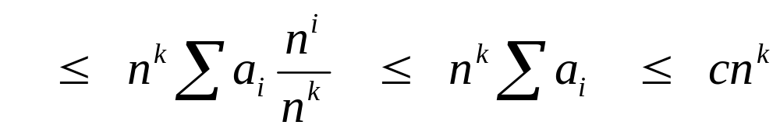
Big O Fact
A polynomial of degree k is O(n^{k})
Proof:
  Suppose f(n) = b_{k}n^{k} + b_{k-1}n^{k-1} + … + b₁n + b₀
    Let a_{i} = | b_{i} |
  f(n) ≤ a_{k}n^{k} + a_{k-1}n^{k-1} + … + a₁n + a₀

Slide 57
Lower Bound Notation
We say InsertionSort’s run time is Ω(n)
In general a function
  f(n) is Ω(g(n)) if ∃ positive constants c and n₀ such that 0 ≤ c⋅g(n) ≤ f(n) ∀ n ≥ n₀

Slide 58
Asymptotic Tight Bound
A function f(n) is Θ(g(n)) if ∃ positive constants c₁, c₂, and n₀ such that
c₁ g(n) ≤ f(n) ≤ c₂ g(n) ∀ n ≥ n₀

Slide 59
Other Asymptotic Notations
A function f(n) is o(g(n)) if ∃ positive constants c and n₀ such that
f(n) < c g(n) ∀ n ≥ n₀
A function f(n) is ω(g(n)) if ∃ positive constants c and n₀ such that
c g(n) < f(n) ∀ n ≥ n₀
Intuitively,
  o() is like <
  O() is like ≤
  ω() is like >
  Ω() is like ≥
  Θ() is like =

Slide 60

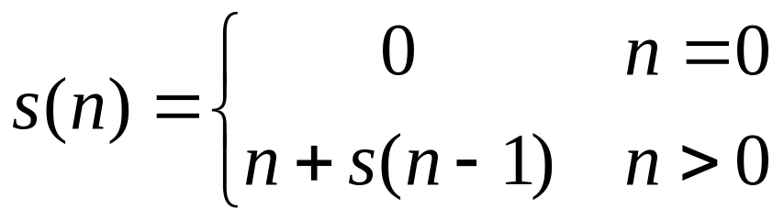

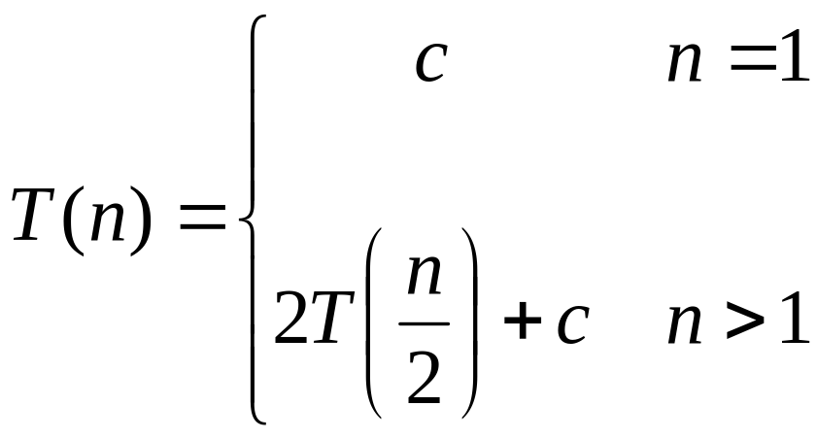
Review: Recurrences
Recurrence: an equation that describes a function in terms of its value on smaller functions

Slide 61
Review: Solving Recurrences
Substitution method
Iteration method
Master method

Slide 62
Review: Substitution Method
Substitution Method:
  Guess the form of the answer, then use induction to find the constants and show that solution works
  Example:
    T(n) = 2T(n/2) + Θ(n)  T(n) = Θ(n lg n)
    T(n) = 2T(n/2 + n  ???

Slide 63
Review: Substitution Method
Substitution Method:
  Guess the form of the answer, then use induction to find the constants and show that solution works
  Examples:
    T(n) = 2T(n/2) + Θ(n)  T(n) = Θ(n lg n)
    T(n) = 2T(n/2) + n  T(n) = Θ(n lg n)
  We can show that this holds by induction

Slide 64
Substitution Method
Our goal: show that
  T(n) = 2T(⎣n/2⎦) + n = O(n lg n)
Thus, we need to show that T(n) ≤ c n lg n with an appropriate choice of c
  Inductive hypothesis: assume
  T(⎣n/2⎦) ≤ c ⎣n/2⎦ lg ⎣n/2⎦
  Substitute back into recurrence to show that
  T(n) ≤ c n lg n follows, when c ≥ 1
  (show on board)

Slide 65
Review: Iteration Method
Iteration method:
  Expand the recurrence k times
  Work some algebra to express as a summation
  Evaluate the summation

Slide 66

Review:
s(n) =
c + s(n-1)
c + c + s(n-2)
2c + s(n-2)
2c + c + s(n-3)
3c + s(n-3)
…
kc + s(n-k) = ck + s(n-k)

Slide 67
Review:
So far for n >= k we have
  s(n) = ck + s(n-k)
What if k = n?
  s(n) = cn + s(0) = cn

Slide 68
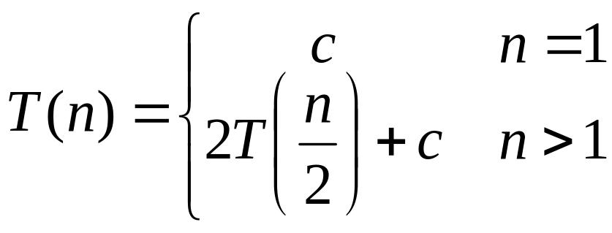
Review:
T(n) =
2T(n/2) + c
2(2T(n/2/2) + c) + c
2²T(n/2²) + 2c + c
2²(2T(n/2²/2) + c) + 3c
2³T(n/2³) + 4c + 3c
2³T(n/2³) + 7c
2³(2T(n/2³/2) + c) + 7c
2⁴T(n/2⁴) + 15c
…
2^{k}T(n/2^{k}) + (2^{k} - 1)c

Slide 69
Review:
So far for n > 2k we have
  T(n) = 2^{k}T(n/2^{k}) + (2^{k} - 1)c
What if k = lg n?
  T(n) = 2^{lg n} T(n/2^{lg n}) + (2^{lg n} - 1)c
  = n T(n/n) + (n - 1)c
  = n T(1) + (n-1)c
  = nc + (n-1)c = (2n - 1)c

Slide 70
Review: The Master Theorem
Given: a divide and conquer algorithm
  An algorithm that divides the problem of size n into a subproblems, each of size n/b
  Let the cost of each stage (i.e., the work to divide the problem + combine solved subproblems) be described by the function f(n)
Then, the Master Theorem gives us a cookbook for the algorithm’s running time:

Slide 71
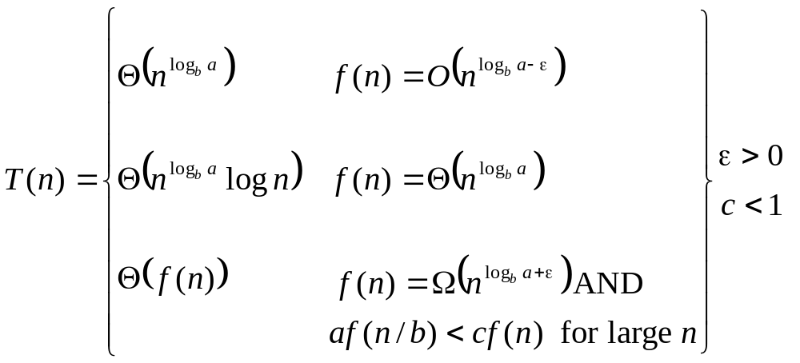
Review: The Master Theorem
if T(n) = aT(n/b) + f(n) then

Slide 72
Review: Merge Sort
MergeSort(A, left, right) {
if (left < right) {
mid = floor((left + right) / 2);
MergeSort(A, left, mid);
MergeSort(A, mid+1, right);
Merge(A, left, mid, right);
}
}
// Merge() takes two sorted subarrays of A and
// merges them into a single sorted subarray of A.
// Merge()takes O(n) time, n = length of A

Slide 73
Review: Analysis of Merge Sort
Statement Effort
So T(n) = Θ(1) when n = 1, and 2T(n/2) + Θ(n) when n > 1
Solving this recurrence (how?) gives T(n) = n lg n
MergeSort(A, left, right) { T(n)
if (left < right) { Θ(1)
mid = floor((left + right) / 2); Θ(1)
MergeSort(A, left, mid); T(n/2)
MergeSort(A, mid+1, right); T(n/2)
Merge(A, left, mid, right); Θ(n)
}
}

Slide 74
Review: Heaps
A heap is a “complete” binary tree, usually represented as an array:
16
4
10
14
7
9
3
2
8
1
A =
16
14
10
8
7
9
3
2
4
1

Slide 75
Review: Heaps
To represent a heap as an array:
  Parent(i) { return ⎣i/2⎦; }
  Left(i) { return 2*i; }
  right(i) { return 2*i + 1; }

Slide 76
Review: The Heap Property
Heaps also satisfy the heap property:
A[Parent(i)] ≥ A[i] for all nodes i > 1
  In other words, the value of a node is at most the value of its parent
  The largest value is thus stored at the root (A[1])
Because the heap is a binary tree, the height of any node is at most Θ(lg n)

Slide 77
Review: Heapify()
Heapify(): maintain the heap property
  Given: a node i in the heap with children l and r
  Given: two subtrees rooted at l and r, assumed to be heaps
  Action: let the value of the parent node “float down” so subtree at i satisfies the heap property
    If A[i] < A[l] or A[i] < A[r], swap A[i] with the largest of A[l] and A[r]
    Recurse on that subtree
  Running time: O(h), h = height of heap = O(lg n)

Slide 78
Review: BuildHeap()
BuildHeap(): build heap bottom-up by running Heapify() on successive subarrays
  Walk backwards through the array from n/2 to 1, calling Heapify() on each node.
  Order of processing guarantees that the children of node i are heaps when i is processed
Easy to show that running time is O(n lg n)
Can be shown to be O(n)
  Key observation: most subheaps are small

Slide 79
Review: Heapsort()
Heapsort(): an in-place sorting algorithm:
  Maximum element is at A[1]
  Discard by swapping with element at A[n]
    Decrement heap_size[A]
    A[n] now contains correct value
  Restore heap property at A[1] by calling Heapify()
  Repeat, always swapping A[1] for A[heap_size(A)]
Running time: O(n lg n)
  BuildHeap: O(n), Heapify: n * O(lg n)

Slide 80
Review: Priority Queues
The heap data structure is often used for implementing priority queues
  A data structure for maintaining a set S of elements, each with an associated value or key
  Supports the operations Insert(), Maximum(), and ExtractMax()
  Commonly used for scheduling, event simulation

Slide 81
Priority Queue Operations
Insert(S, x) inserts the element x into set S
Maximum(S) returns the element of S with the maximum key
ExtractMax(S) removes and returns the element of S with the maximum key

Slide 82
Implementing Priority Queues
HeapInsert(A, key) // what’s running time?
{
heap_size[A] ++;
i = heap_size[A];
while (i > 1 AND A[Parent(i)] < key)
{
A[i] = A[Parent(i)];
i = Parent(i);
}
A[i] = key;
}

Slide 83
Implementing Priority Queues
HeapMaximum(A)
{
// This one is really tricky:
return A[i];
}

Slide 84
Implementing Priority Queues
HeapExtractMax(A)
{
if (heap_size[A] < 1) { error; }
max = A[1];
A[1] = A[heap_size[A]]
heap_size[A] --;
Heapify(A, 1);
return max;
}

Slide 85
Example: Combat Billiards
Extract the next collision C_{i} from the queue
Advance the system to the time T_{i} of the collision
Recompute the next collision(s) for the ball(s) involved
Insert collision(s) into the queue, using the time of occurrence as the key
Find the next overall collision C_{i+1} and repeat

Slide 86
Review: Quicksort
Quicksort pros:
  Sorts in place
  Sorts O(n lg n) in the average case
  Very efficient in practice
Quicksort cons:
  Sorts O(n²) in the worst case
  Naïve implementation: worst-case = sorted
  Even picking a different pivot, some particular input will take O(n²) time

Slide 87
Review: Quicksort
Another divide-and-conquer algorithm
  The array A[p..r] is partitioned into two non-empty subarrays A[p..q] and A[q+1..r]
    Invariant: All elements in A[p..q] are less than all elements in A[q+1..r]
  The subarrays are recursively quicksorted
  No combining step: two subarrays form an already-sorted array

Slide 88
Review: Quicksort Code
Quicksort(A, p, r)
{
if (p < r)
{
q = Partition(A, p, r);
Quicksort(A, p, q);
Quicksort(A, q+1, r);
}
}

Slide 89
Review: Partition Code
Partition(A, p, r)
x = A[p];
i = p - 1;
j = r + 1;
while (TRUE)
repeat
j--;
until A[j] <= x;
repeat
i++;
until A[i] >= x;
if (i < j)
Swap(A, i, j);
else
return j;
partition() runs in O(n) time

Slide 90
Review: Analyzing Quicksort
What will be the worst case for the algorithm?
  Partition is always unbalanced
What will be the best case for the algorithm?
  Partition is perfectly balanced
Which is more likely?
  The latter, by far, except...
Will any particular input elicit the worst case?
  Yes: Already-sorted input

Slide 91
Review: Analyzing Quicksort
In the worst case:
  T(1) = Θ(1)
  T(n) = T(n - 1) + Θ(n)
Works out to
T(n) = Θ(n²)

Slide 92
Review: Analyzing Quicksort
In the best case:
  T(n) = 2T(n/2) + Θ(n)
Works out to
  T(n) = Θ(n lg n)

Slide 93
Review: Analyzing Quicksort
Average case works out to T(n) = Θ(n lg n)
Glance over the proof (lecture 6) but you won’t have to know the details
Key idea: analyze the running time based on the expected split caused by Partition()

Slide 94
Review: Improving Quicksort
The real liability of quicksort is that it runs in O(n²) on already-sorted input
Book discusses two solutions:
  Randomize the input array, OR
  Pick a random pivot element
How do these solve the problem?
  By insuring that no particular input can be chosen to make quicksort run in O(n²) time

Slide 95
Sorting Summary
Insertion sort:
  Easy to code
  Fast on small inputs (less than ~50 elements)
  Fast on nearly-sorted inputs
  O(n²) worst case
  O(n²) average (equally-likely inputs) case
  O(n²) reverse-sorted case

Slide 96
Sorting Summary
Merge sort:
  Divide-and-conquer:
    Split array in half
    Recursively sort subarrays
    Linear-time merge step
  O(n lg n) worst case
  Doesn’t sort in place

Slide 97
Sorting Summary
Heap sort:
  Uses the very useful heap data structure
    Complete binary tree
    Heap property: parent key > children’s keys
  O(n lg n) worst case
  Sorts in place
  Fair amount of shuffling memory around

Slide 98
Sorting Summary
Quick sort:
  Divide-and-conquer:
    Partition array into two subarrays, recursively sort
    All of first subarray < all of second subarray
    No merge step needed!
  O(n lg n) average case
  Fast in practice
  O(n²) worst case
    Naïve implementation: worst case on sorted input
    Address this with randomized quicksort

Slide 99
Review: Comparison Sorts
Comparison sorts: O(n lg n) at best
  Model sort with decision tree
  Path down tree = execution trace of algorithm
  Leaves of tree = possible permutations of input
  Tree must have n! leaves, so O(n lg n) height

Slide 100
Review: Counting Sort
Counting sort:
  Assumption: input is in the range 1..k
  Basic idea:
    Count number of elements k ≤ each element i
    Use that number to place i in position k of sorted array
  No comparisons! Runs in time O(n + k)
  Stable sort
  Does not sort in place:
    O(n) array to hold sorted output
    O(k) array for scratch storage

Slide 101
Review: Counting Sort
1 CountingSort(A, B, k)
2 for i=1 to k
3 C[i]= 0;
4 for j=1 to n
5 C[A[j]] += 1;
6 for i=2 to k
7 C[i] = C[i] + C[i-1];
8 for j=n downto 1
9 B[C[A[j]]] = A[j];
10 C[A[j]] -= 1;

Slide 102
Review: Radix Sort
Radix sort:
  Assumption: input has d digits ranging from 0 to k
  Basic idea:
    Sort elements by digit starting with least significant
    Use a stable sort (like counting sort) for each stage
  Each pass over n numbers with d digits takes time O(n+k), so total time O(dn+dk)
    When d is constant and k=O(n), takes O(n) time
  Fast! Stable! Simple!
  Doesn’t sort in place

Slide 103
Review: Binary Search Trees
Binary Search Trees (BSTs) are an important data structure for dynamic sets
In addition to satellite data, elements have:
  key: an identifying field inducing a total ordering
  left: pointer to a left child (may be NULL)
  right: pointer to a right child (may be NULL)
  p: pointer to a parent node (NULL for root)

Slide 104
Review: Binary Search Trees
BST property:
key[left(x)] ≤ key[x] ≤ key[right(x)]
Example:
F
B
H
A
D
K

Slide 105
Review: Inorder Tree Walk
An inorder walk prints the set in sorted order:
  TreeWalk(x)
  TreeWalk(left[x]);
  print(x);
  TreeWalk(right[x]);
  Easy to show by induction on the BST property
  Preorder tree walk: print root, then left, then right
  Postorder tree walk: print left, then right, then root

Slide 106
Review: BST Search
TreeSearch(x, k)
if (x = NULL or k = key[x])
return x;
if (k < key[x])
return TreeSearch(left[x], k);
else
return TreeSearch(right[x], k);

Slide 107
Review: BST Search (Iterative)
IterativeTreeSearch(x, k)
while (x != NULL and k != key[x])
if (k < key[x])
x = left[x];
else
x = right[x];
return x;

Slide 108
Review: BST Insert
Adds an element x to the tree so that the binary search tree property continues to hold
The basic algorithm
  Like the search procedure above
  Insert x in place of NULL
  Use a “trailing pointer” to keep track of where you came from (like inserting into singly linked list)
Like search, takes time O(h), h = tree height

Slide 109
Review: Sorting With BSTs
Basic algorithm:
  Insert elements of unsorted array from 1..n
  Do an inorder tree walk to print in sorted order
Running time:
  Best case: Ω(n lg n) (it’s a comparison sort)
  Worst case: O(n²)
  Average case: O(n lg n) (it’s a quicksort!)

Slide 110
Review: Sorting With BSTs
Average case analysis
  It’s a form of quicksort!
for i=1 to n
TreeInsert(A[i]);
InorderTreeWalk(root);
3 1 8 2 6 7 5
3
1 2
8 6 7 5
1
8
2
6 7 5
2
6
5
7
5
7

Slide 111
Review: More BST Operations
Minimum:
  Find leftmost node in tree
Successor:
  x has a right subtree: successor is minimum node in right subtree
  x has no right subtree: successor is first ancestor of x whose left child is also ancestor of x
    Intuition: As long as you move to the left up the tree, you’re visiting smaller nodes.
Predecessor: similar to successor

Slide 112
Review: More BST Operations
Delete:
  x has no children:
    Remove x
  x has one child:
    Splice out x
  x has two children:
    Swap x with successor
    Perform case 1 or 2 to delete it
F
B
H
A
D
K
Example: delete K
or H or B
C

Slide 113
Review: Red-Black Trees
Red-black trees:
  Binary search trees augmented with node color
  Operations designed to guarantee that the height
  h = O(lg n)

Slide 114
Red-Black Properties
The red-black properties:
  1. Every node is either red or black
  2. Every leaf (NULL pointer) is black
    Note: this means every “real” node has 2 children
  3. If a node is red, both children are black
    Note: can’t have 2 consecutive reds on a path
  4. Every path from node to descendent leaf contains the same number of black nodes
  5. The root is always black
black-height: # black nodes on path to leaf
  Lets us prove RB tree has height h ≤ 2 lg(n+1)

Slide 115
Operations On RB Trees
Since height is O(lg n), we can show that all BST operations take O(lg n) time
Problem: BST Insert() and Delete() modify the tree and could destroy red-black properties
Solution: restructure the tree in O(lg n) time
  You should understand the basic approach of these operations
  Key operation: rotation

Slide 116
RB Trees: Rotation
Our basic operation for changing tree structure:
Rotation preserves inorder key ordering
Rotation takes O(1) time (just swaps pointers)
y
x
rightRotate(y)
x
C
A
y
leftRotate(x)
A
B
B
C

Slide 117
Review: Skip Lists
A relatively recent data structure
  “A probabilistic alternative to balanced trees”
  A randomized algorithm with benefits of r-b trees
    O(lg n) expected search time
    O(1) time for Min, Max, Succ, Pred
  Much easier to code than r-b trees
  Fast!

Slide 118
Review: Skip Lists
The basic idea:
Keep a doubly-linked list of elements
  Min, max, successor, predecessor: O(1) time
  Delete is O(1) time, Insert is O(1)+Search time
Add each level-i element to level i+1 with probability p (e.g., p = 1/2 or p = 1/4)
level 3
level 2
level 1
3
9
12
18
29
35
37

Slide 119
Review: Skip List Search
To search for an element with a given key:
  Find location in top list
    Top list has O(1) elements with high probability
    Location in this list defines a range of items in next list
  Drop down a level and recurse
O(1) time per level on average
O(lg n) levels with high probability
Total time: O(lg n)

Slide 120
Review: Skip List Insert
Skip list insert: analysis
  Do a search for that key
  Insert element in bottom-level list
  With probability p, recurse to insert in next level
  Expected number of lists = 1+ p + p² + … = ???
    = 1/(1-p) = O(1) if p is constant
  Total time = Search + O(1) = O(lg n) expected
Skip list delete: O(1)

Slide 121
Review: Skip Lists
O(1) expected time for most operations
O(lg n) expected time for insert
O(n²) time worst case
  But random, so no particular order of insertion evokes worst-case behavior
O(n) expected storage requirements
Easy to code

Slide 122
Review: Hashing Tables
Motivation: symbol tables
  A compiler uses a symbol table to relate symbols to associated data
    Symbols: variable names, procedure names, etc.
    Associated data: memory location, call graph, etc.
  For a symbol table (also called a dictionary), we care about search, insertion, and deletion
  We typically don’t care about sorted order

Slide 123
Review: Hash Tables
More formally:
  Given a table T and a record x, with key (= symbol) and satellite data, we need to support:
    Insert (T, x)
    Delete (T, x)
    Search(T, x)
  Don’t care about sorting the records
Hash tables support all the above in
O(1) expected time

Slide 124
Review: Direct Addressing
Suppose:
  The range of keys is 0..m-1
  Keys are distinct
The idea:
  Use key itself as the address into the table
  Set up an array T[0..m-1] in which
    T[i] = x if x∈ T and key[x] = i
    T[i] = NULL otherwise
  This is called a direct-address table

Slide 125
Review: Hash Functions
Next problem: collision
T
U
(universe of keys)
0
h(k₁)
k₁
h(k₄)
K
(actual
keys)
k₄
k₅
h(k₂) = h(k₅)
k₂
h(k₃)
k₃
m - 1

Slide 126
Review: Resolving Collisions
How can we solve the problem of collisions?
Open addressing
  To insert: if slot is full, try another slot, and another, until an open slot is found (probing)
  To search, follow same sequence of probes as would be used when inserting the element
Chaining
  Keep linked list of elements in slots
  Upon collision, just add new element to list

Slide 127
Review: Chaining
Chaining puts elements that hash to the same slot in a linked list:
T
U
(universe of keys)
——
k₁
k₄
——
——
k₁
——
K
(actual
keys)
k₄
k₅
——
k₇
k₅
k₂
k₇
——
——
k₂
k₃
k₈
k₃
——
k₆
k₈
k₆
——
——

Slide 128
Review: Analysis Of Hash Tables
Simple uniform hashing: each key in table is equally likely to be hashed to any slot
Load factor α = n/m = average # keys per slot
  Average cost of unsuccessful search = O(1+α)
  Successful search: O(1+ α/2) = O(1+ α)
  If n is proportional to m, α = O(1)
So the cost of searching = O(1) if we size our table appropriately

Slide 129
Review: Choosing A Hash Function
Choosing the hash function well is crucial
  Bad hash function puts all elements in same slot
  A good hash function:
    Should distribute keys uniformly into slots
    Should not depend on patterns in the data
We discussed three methods:
  Division method
  Multiplication method
  Universal hashing

Slide 130
Review: The Division Method
h(k) = k mod m
  In words: hash k into a table with m slots using the slot given by the remainder of k divided by m
Elements with adjacent keys hashed to different slots: good
If keys bear relation to m: bad
Upshot: pick table size m = prime number not too close to a power of 2 (or 10)

Slide 131
Review: The Multiplication Method
For a constant A, 0 < A < 1:
h(k) = ⎣ m (kA - ⎣kA⎦) ⎦
Upshot:
  Choose m = 2^{P}
  Choose A not too close to 0 or 1
  Knuth: Good choice for A = (√5 - 1)/2
Fractional part of kA

Slide 132
Review: Universal Hashing
When attempting to foil an malicious adversary, randomize the algorithm
Universal hashing: pick a hash function randomly when the algorithm begins (not upon every insert!)
  Guarantees good performance on average, no matter what keys adversary chooses
  Need a family of hash functions to choose from

Slide 133
Review: Universal Hashing
Let  be a (finite) collection of hash functions
  …that map a given universe U of keys…
  …into the range {0, 1, …, m - 1}.
If  is universal if:
  for each pair of distinct keys x, y ∈ U,
  the number of hash functions h ∈ 
  for which h(x) = h(y) is ||/m
  In other words:
    With a random hash function from , the chance of a collision between x and y (x ≠ y) is exactly 1/m

Slide 134
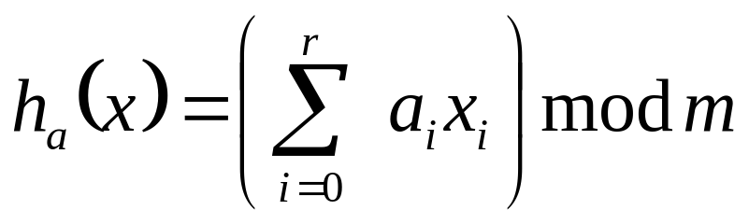
Review: A Universal Hash Function
Choose table size m to be prime
Decompose key x into r+1 bytes, so that
x = {x₀, x₁, …, x_{r}}
  Only requirement is that max value of byte < m
  Let a = {a₀, a₁, …, a_{r}} denote a sequence of r+1 elements chosen randomly from {0, 1, …, m - 1}
  Define corresponding hash function h_{a} ∈ :
  With this definition,  has m^{r+1} members

Slide 135
Review: Dynamic Order Statistics
We’ve seen algorithms for finding the ith element of an unordered set in O(n) time
OS-Trees: a structure to support finding the ith element of a dynamic set in O(lg n) time
  Support standard dynamic set operations (Insert(), Delete(), Min(), Max(), Succ(), Pred())
  Also support these order statistic operations:
    void OS-Select(root, i);
    int OS-Rank(x);

Slide 136
Review: Order Statistic Trees
OS Trees augment red-black trees:
  Associate a size field with each node in the tree
  x->size records the size of subtree rooted at x, including x itself:
M
8
C
5
P
2
A
1
F
3
Q
1
D
1
H
1

Slide 137
Review: OS-Select
Example: show OS-Select(root, 5):
OS-Select(x, i)
{
r = x->left->size + 1;
if (i == r)
return x;
else if (i < r)
return OS-Select(x->left, i);
else
return OS-Select(x->right, i-r);
}
M
8
C
5
P
2
A
1
F
3
Q
1
D
1
H
1

Slide 138
Review: OS-Select
Example: show OS-Select(root, 5):
OS-Select(x, i)
{
r = x->left->size + 1;
if (i == r)
return x;
else if (i < r)
return OS-Select(x->left, i);
else
return OS-Select(x->right, i-r);
}
M
8
i = 5
r = 6
C
5
P
2
A
1
F
3
Q
1
D
1
H
1

Slide 139
Review: OS-Select
Example: show OS-Select(root, 5):
OS-Select(x, i)
{
r = x->left->size + 1;
if (i == r)
return x;
else if (i < r)
return OS-Select(x->left, i);
else
return OS-Select(x->right, i-r);
}
M
8
i = 5
r = 6
C
5
i = 5
r = 2
P
2
A
1
F
3
Q
1
D
1
H
1

Slide 140
Review: OS-Select
Example: show OS-Select(root, 5):
OS-Select(x, i)
{
r = x->left->size + 1;
if (i == r)
return x;
else if (i < r)
return OS-Select(x->left, i);
else
return OS-Select(x->right, i-r);
}
M
8
i = 5
r = 6
C
5
i = 5
r = 2
P
2
A
1
F
3
i = 3
r = 2
Q
1
D
1
H
1

Slide 141
Review: OS-Select
Example: show OS-Select(root, 5):
OS-Select(x, i)
{
r = x->left->size + 1;
if (i == r)
return x;
else if (i < r)
return OS-Select(x->left, i);
else
return OS-Select(x->right, i-r);
}
M
8
i = 5
r = 6
C
5
i = 5
r = 2
P
2
A
1
F
3
i = 3
r = 2
Q
1
D
1
H
1
i = 1
r = 1

Slide 142
Review: OS-Select
Example: show OS-Select(root, 5):
  Note: use a sentinel NIL element at the leaves with size = 0 to simplify code, avoid testing for NULL
OS-Select(x, i)
{
r = x->left->size + 1;
if (i == r)
return x;
else if (i < r)
return OS-Select(x->left, i);
else
return OS-Select(x->right, i-r);
}
M
8
i = 5
r = 6
C
5
i = 5
r = 2
P
2
A
1
F
3
i = 3
r = 2
Q
1
D
1
H
1
i = 1
r = 1

Slide 143
Review: Determining The
Rank Of An Element
Idea: rank of right child x is one
more than its parent’s rank, plus the size of x’s left subtree
M
8
C
5
P
2
OS-Rank(T, x)
{
r = x->left->size + 1;
y = x;
while (y != T->root)
if (y == y->p->right)
r = r + y->p->left->size + 1;
y = y->p;
return r;
}
A
1
F
3
Q
1
D
1
H
1

Slide 144
Review: Determining The
Rank Of An Element
Example 1:
find rank of element with key H
M
8
C
5
P
2
OS-Rank(T, x)
{
r = x->left->size + 1;
y = x;
while (y != T->root)
if (y == y->p->right)
r = r + y->p->left->size + 1;
y = y->p;
return r;
}
A
1
F
3
Q
1
D
1
H
1
y
r = 1

Slide 145
Review: Determining The
Rank Of An Element
Example 1:
find rank of element with key H
M
8
C
5
P
2
OS-Rank(T, x)
{
r = x->left->size + 1;
y = x;
while (y != T->root)
if (y == y->p->right)
r = r + y->p->left->size + 1;
y = y->p;
return r;
}
A
1
F
3
y
r = 1+1+1 = 3
Q
1
D
1
H
1
r = 1

Slide 146
Review: Determining The
Rank Of An Element
Example 1:
find rank of element with key H
M
8
C
5
y
r = 3+1+1 = 5
P
2
OS-Rank(T, x)
{
r = x->left->size + 1;
y = x;
while (y != T->root)
if (y == y->p->right)
r = r + y->p->left->size + 1;
y = y->p;
return r;
}
A
1
F
3
r = 3
Q
1
D
1
H
1
r = 1

Slide 147
Review: Determining The
Rank Of An Element
Example 1:
find rank of element with key H
M
8
y
r = 5
C
5
r = 5
P
2
OS-Rank(T, x)
{
r = x->left->size + 1;
y = x;
while (y != T->root)
if (y == y->p->right)
r = r + y->p->left->size + 1;
y = y->p;
return r;
}
A
1
F
3
r = 3
Q
1
D
1
H
1
r = 1

Slide 148
Review: Maintaining Subtree Sizes
So by keeping subtree sizes, order statistic operations can be done in O(lg n) time
Next: maintain sizes during Insert() and Delete() operations
  Insert(): Increment size fields of nodes traversed during search down the tree
  Delete(): Decrement sizes along a path from the deleted node to the root
  Both: Update sizes correctly during rotations

Slide 149
Reivew: Maintaining Subtree Sizes
y
19
x
19
rightRotate(y)
x
11
7
6
y
12
leftRotate(x)
6
4
4
7
Note that rotation invalidates only x and y
Can recalculate their sizes in constant time
Thm 15.1: can compute any property in O(lg n) time that depends only on node, left child, and right child

Slide 150
Review: Interval Trees
The problem: maintain a set of intervals
  E.g., time intervals for a scheduling program:
  Query: find an interval in the set that overlaps a given query interval
    [14,16] → [15,18]
    [16,19] → [15,18] or [17,19]
    [12,14] → NULL
7
10
5
11
17
19
4
8
15
18
21
23

Slide 151
Interval Trees
Following the methodology:
  Pick underlying data structure
    Red-black trees will store intervals, keyed on i→low
  Decide what additional information to store
    Store the maximum endpoint in the subtree rooted at i
  Figure out how to maintain the information
    Insert: update max on way down, during rotations
    Delete: similar
  Develop the desired new operations

Slide 152
Searching Interval Trees
IntervalSearch(T, i)
{
x = T->root;
while (x != NULL && !overlap(i, x->interval))
if (x->left != NULL && x->left->max ≥ i->low)
x = x->left;
else
x = x->right;
return x
}
Running time: O(lg n)

Slide 153
Review: Correctness of IntervalSearch()
Key idea: need to check only 1 of node’s 2 children
  Case 1: search goes right
    Show that ∃ overlap in right subtree, or no overlap at all
  Case 2: search goes left
    Show that ∃ overlap in left subtree, or no overlap at all

Slide 154
Review: Correctness of IntervalSearch()
Case 1: if search goes right, ∃ overlap in the right subtree or no overlap in either subtree
  If ∃ overlap in right subtree, we’re done
  Otherwise:
    x→left = NULL, or x → left → max < x → low (Why?)
    Thus, no overlap in left subtree!
while (x != NULL && !overlap(i, x->interval))
if (x->left != NULL && x->left->max ≥ i->low)
x = x->left;
else
x = x->right;
return x;

Slide 155
Review: Correctness of IntervalSearch()
Case 2: if search goes left, ∃ overlap in the left subtree or no overlap in either subtree
  If ∃ overlap in left subtree, we’re done
  Otherwise:
    i →low ≤ x →left →max, by branch condition
    x →left →max = y →high for some y in left subtree
    Since i and y don’t overlap and i →low ≤ y →high,
    i →high < y →low
    Since tree is sorted by low’s, i →high < any low in right subtree
    Thus, no overlap in right subtree
while (x != NULL && !overlap(i, x->interval))
if (x->left != NULL && x->left->max ≥ i->low)
x = x->left;
else
x = x->right;
return x;

