Slide 1
CS 332: Algorithms
Quicksort

Slide 2
Homework 2
Assigned today, due next Wednesday
Will be on web page shortly after class
Go over now

Slide 3
Review: Quicksort
Sorts in place
Sorts O(n lg n) in the average case
Sorts O(n²) in the worst case
  But in practice, it’s quick
  And the worst case doesn’t happen often (but more on this later…)

Slide 4
Quicksort
Another divide-and-conquer algorithm
  The array A[p..r] is partitioned into two non-empty subarrays A[p..q] and A[q+1..r]
    Invariant: All elements in A[p..q] are less than all elements in A[q+1..r]
  The subarrays are recursively sorted by calls to quicksort
  Unlike merge sort, no combining step: two subarrays form an already-sorted array

Slide 5
Quicksort Code
Quicksort(A, p, r)
{
if (p < r)
{
q = Partition(A, p, r);
Quicksort(A, p, q);
Quicksort(A, q+1, r);
}
}

Slide 6
Partition
Clearly, all the action takes place in the partition() function
  Rearranges the subarray in place
  End result:
    Two subarrays
    All values in first subarray ≤ all values in second
  Returns the index of the “pivot” element separating the two subarrays
How do you suppose we implement this?

Slide 7
Partition In Words
Partition(A, p, r):
  Select an element to act as the “pivot” (which?)
  Grow two regions, A[p..i] and A[j..r]
    All elements in A[p..i] <= pivot
    All elements in A[j..r] >= pivot
  Increment i until A[i] >= pivot
  Decrement j until A[j] <= pivot
  Swap A[i] and A[j]
  Repeat until i >= j
  Return j
Note: slightly different from book’s partition()

Slide 8
Partition Code
Partition(A, p, r)
x = A[p];
i = p - 1;
j = r + 1;
while (TRUE)
repeat
j--;
until A[j] <= x;
repeat
i++;
until A[i] >= x;
if (i < j)
Swap(A, i, j);
else
return j;
Illustrate on
A = {5, 3, 2, 6, 4, 1, 3, 7};
What is the running time of partition()?

Slide 9
Partition Code
Partition(A, p, r)
x = A[p];
i = p - 1;
j = r + 1;
while (TRUE)
repeat
j--;
until A[j] <= x;
repeat
i++;
until A[i] >= x;
if (i < j)
Swap(A, i, j);
else
return j;
partition() runs in O(n) time

Slide 10
Analyzing Quicksort
What will be the worst case for the algorithm?
  Partition is always unbalanced
What will be the best case for the algorithm?
  Partition is perfectly balanced
Which is more likely?
  The latter, by far, except...
Will any particular input elicit the worst case?
  Yes: Already-sorted input

Slide 11
Analyzing Quicksort
In the worst case:
  T(1) = Θ(1)
  T(n) = T(n - 1) + Θ(n)
Works out to
T(n) = Θ(n²)

Slide 12
Analyzing Quicksort
In the best case:
  T(n) = 2T(n/2) + Θ(n)
What does this work out to?
  T(n) = Θ(n lg n)

Slide 13
Improving Quicksort
The real liability of quicksort is that it runs in O(n²) on already-sorted input
Book discusses two solutions:
  Randomize the input array, OR
  Pick a random pivot element
How will these solve the problem?
  By insuring that no particular input can be chosen to make quicksort run in O(n²) time

Slide 14
Analyzing Quicksort: Average Case
Assuming random input, average-case running time is much closer to O(n lg n) than O(n²)
First, a more intuitive explanation/example:
  Suppose that partition() always produces a 9-to-1 split. This looks quite unbalanced!
  The recurrence is thus:
  T(n) = T(9n/10) + T(n/10) + n
  How deep will the recursion go? (draw it)
Use n instead of O(n)
for convenience (how?)

Slide 15
Analyzing Quicksort: Average Case
Intuitively, a real-life run of quicksort will produce a mix of “bad” and “good” splits
  Randomly distributed among the recursion tree
  Pretend for intuition that they alternate between best-case (n/2 : n/2) and worst-case (n-1 : 1)
  What happens if we bad-split root node, then good-split the resulting size (n-1) node?

Slide 16
Analyzing Quicksort: Average Case
Intuitively, a real-life run of quicksort will produce a mix of “bad” and “good” splits
  Randomly distributed among the recursion tree
  Pretend for intuition that they alternate between best-case (n/2 : n/2) and worst-case (n-1 : 1)
  What happens if we bad-split root node, then good-split the resulting size (n-1) node?
    We fail English

Slide 17
Analyzing Quicksort: Average Case
Intuitively, a real-life run of quicksort will produce a mix of “bad” and “good” splits
  Randomly distributed among the recursion tree
  Pretend for intuition that they alternate between best-case (n/2 : n/2) and worst-case (n-1 : 1)
  What happens if we bad-split root node, then good-split the resulting size (n-1) node?
    We end up with three subarrays, size 1, (n-1)/2, (n-1)/2
    Combined cost of splits = n + n -1 = 2n -1 = O(n)
    No worse than if we had good-split the root node!

Slide 18
Analyzing Quicksort: Average Case
Intuitively, the O(n) cost of a bad split
(or 2 or 3 bad splits) can be absorbed
into the O(n) cost of each good split
Thus running time of alternating bad and good splits is still O(n lg n), with slightly higher constants
How can we be more rigorous?

Slide 19
Analyzing Quicksort: Average Case
For simplicity, assume:
  All inputs distinct (no repeats)
  Slightly different partition() procedure
    partition around a random element, which is not included in subarrays
    all splits (0:n-1, 1:n-2, 2:n-3, … , n-1:0) equally likely
What is the probability of a particular split happening?
Answer: 1/n

Slide 20
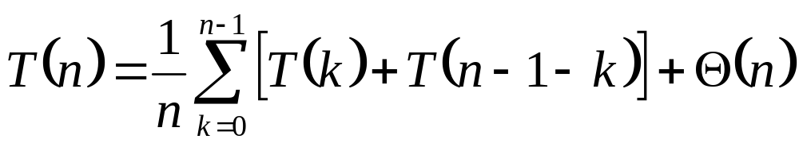
Analyzing Quicksort: Average Case
So partition generates splits
(0:n-1, 1:n-2, 2:n-3, … , n-2:1, n-1:0)
each with probability 1/n
If T(n) is the expected running time,
What is each term under the summation for?
What is the Θ(n) term for?

Slide 21
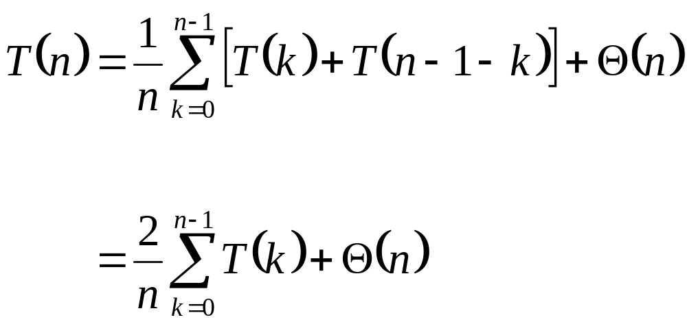
Analyzing Quicksort: Average Case
So…
  Note: this is just like the book’s recurrence (p166), except that the summation starts with k=0
  We’ll take care of that in a second
Write it on
the board

Slide 22
Analyzing Quicksort: Average Case
We can solve this recurrence using the dreaded substitution method
  Guess the answer
  Assume that the inductive hypothesis holds
  Substitute it in for some value < n
  Prove that it follows for n

Slide 23
Analyzing Quicksort: Average Case
We can solve this recurrence using the dreaded substitution method
  Guess the answer
    What’s the answer?
  Assume that the inductive hypothesis holds
  Substitute it in for some value < n
  Prove that it follows for n

Slide 24
Analyzing Quicksort: Average Case
We can solve this recurrence using the dreaded substitution method
  Guess the answer
    T(n) = O(n lg n)
  Assume that the inductive hypothesis holds
  Substitute it in for some value < n
  Prove that it follows for n

Slide 25
Analyzing Quicksort: Average Case
We can solve this recurrence using the dreaded substitution method
  Guess the answer
    T(n) = O(n lg n)
  Assume that the inductive hypothesis holds
    What’s the inductive hypothesis?
  Substitute it in for some value < n
  Prove that it follows for n

Slide 26
Analyzing Quicksort: Average Case
We can solve this recurrence using the dreaded substitution method
  Guess the answer
    T(n) = O(n lg n)
  Assume that the inductive hypothesis holds
    T(n) ≤ an lg n + b for some constants a and b
  Substitute it in for some value < n
  Prove that it follows for n

Slide 27
Analyzing Quicksort: Average Case
We can solve this recurrence using the dreaded substitution method
  Guess the answer
    T(n) = O(n lg n)
  Assume that the inductive hypothesis holds
    T(n) ≤ an lg n + b for some constants a and b
  Substitute it in for some value < n
    What value?
  Prove that it follows for n

Slide 28
Analyzing Quicksort: Average Case
We can solve this recurrence using the dreaded substitution method
  Guess the answer
    T(n) = O(n lg n)
  Assume that the inductive hypothesis holds
    T(n) ≤ an lg n + b for some constants a and b
  Substitute it in for some value < n
    The value k in the recurrence
  Prove that it follows for n

Slide 29
Analyzing Quicksort: Average Case
We can solve this recurrence using the dreaded substitution method
  Guess the answer
    T(n) = O(n lg n)
  Assume that the inductive hypothesis holds
    T(n) ≤ an lg n + b for some constants a and b
  Substitute it in for some value < n
    The value k in the recurrence
  Prove that it follows for n
    Grind through it…

Slide 30
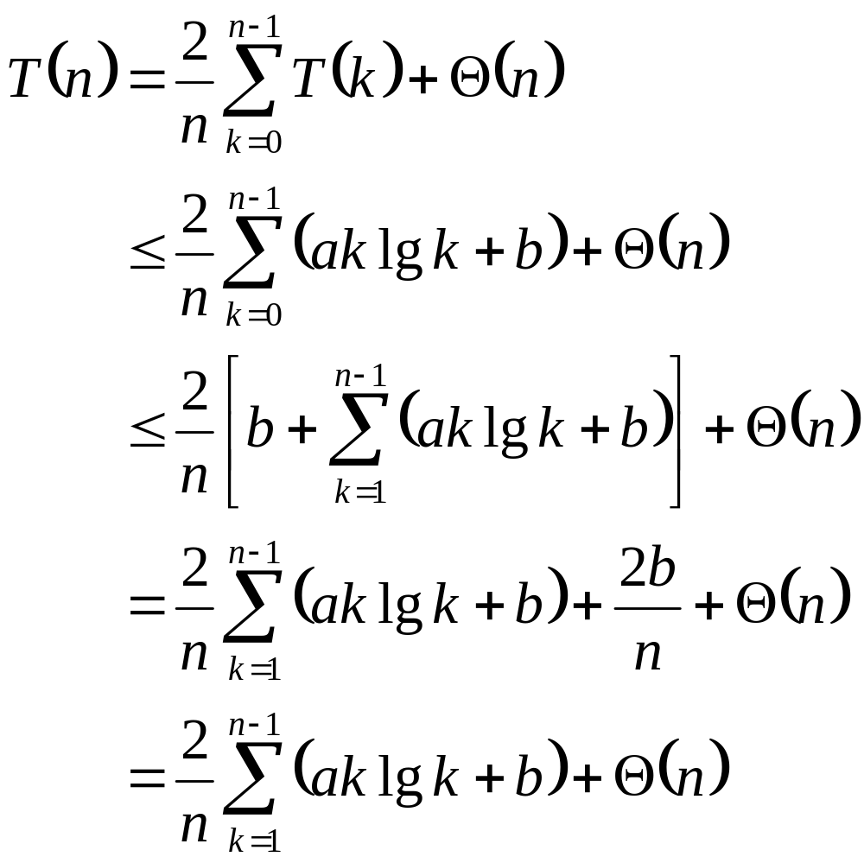
Analyzing Quicksort: Average Case
The recurrence to be solved
Plug in inductive hypothesis
What are we doing here?
Expand out the k=0 case
What are we doing here?
2b/n is just a constant,
so fold it into Θ(n)
What are we doing here?
Note: leaving the same recurrence as the book

Slide 31
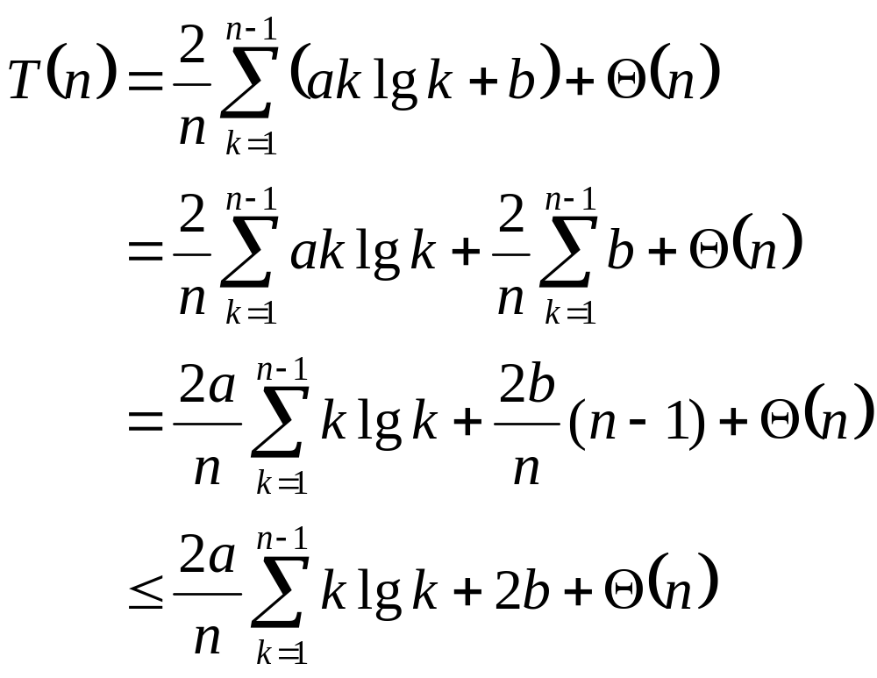
Analyzing Quicksort: Average Case
The recurrence to be solved
Distribute the summation
What are we doing here?
Evaluate the summation:
b+b+…+b = b (n-1)
What are we doing here?
Since n-1<n, 2b(n-1)/n < 2b
What are we doing here?
This summation gets its own set of slides later

Slide 32
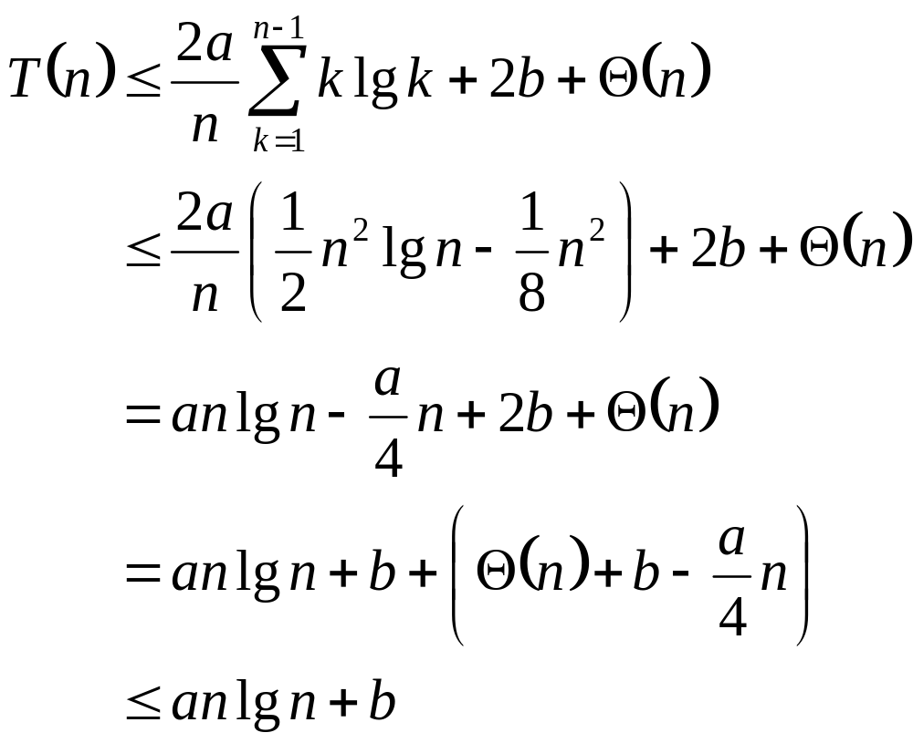
Analyzing Quicksort: Average Case
The recurrence to be solved
We’ll prove this later
What the hell?
Distribute the (2a/n) term
What are we doing here?
Remember, our goal is to get T(n) ≤ an lg n + b
What are we doing here?
Pick a large enough that
an/4 dominates Θ(n)+b
How did we do this?

Slide 33
Analyzing Quicksort: Average Case
So T(n) ≤ an lg n + b for certain a and b
  Thus the induction holds
  Thus T(n) = O(n lg n)
  Thus quicksort runs in O(n lg n) time on average (phew!)
Oh yeah, the summation…

Slide 34
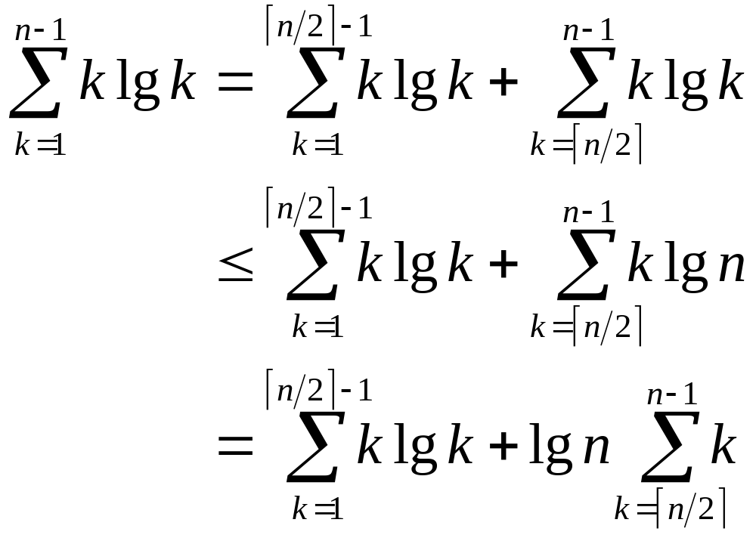
Tightly Bounding
The Key Summation
Split the summation for a tighter bound
What are we doing here?
The lg k in the second term is bounded by lg n
What are we doing here?
Move the lg n outside the summation
What are we doing here?

Slide 35
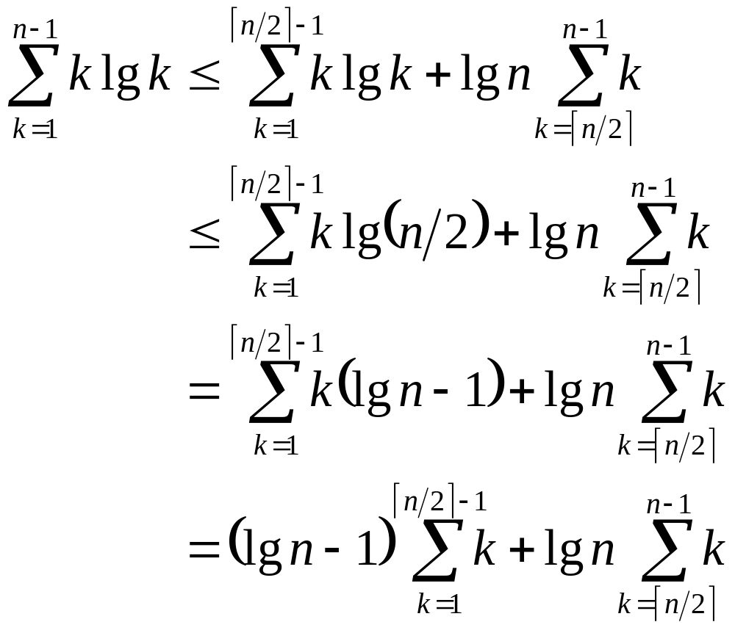
Tightly Bounding
The Key Summation
The summation bound so far
The lg k in the first term is bounded by lg n/2
What are we doing here?
lg n/2 = lg n - 1
What are we doing here?
Move (lg n - 1) outside the summation
What are we doing here?

Slide 36
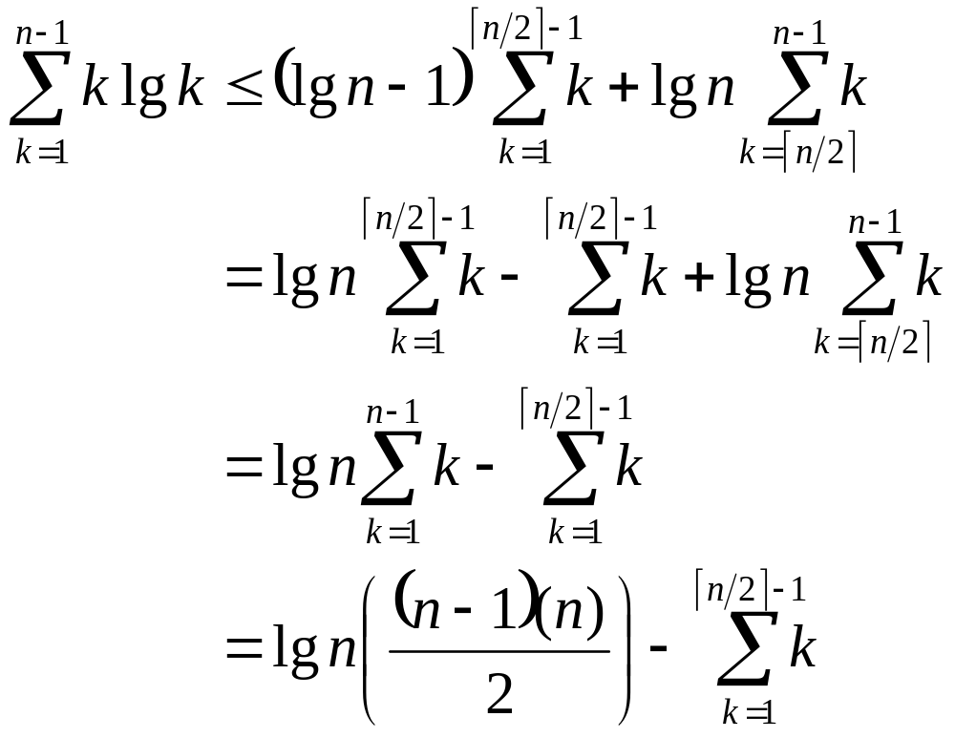
Tightly Bounding
The Key Summation
The summation bound so far
Distribute the (lg n - 1)
What are we doing here?
The summations overlap in range; combine them
What are we doing here?
The Guassian series
What are we doing here?

Slide 37
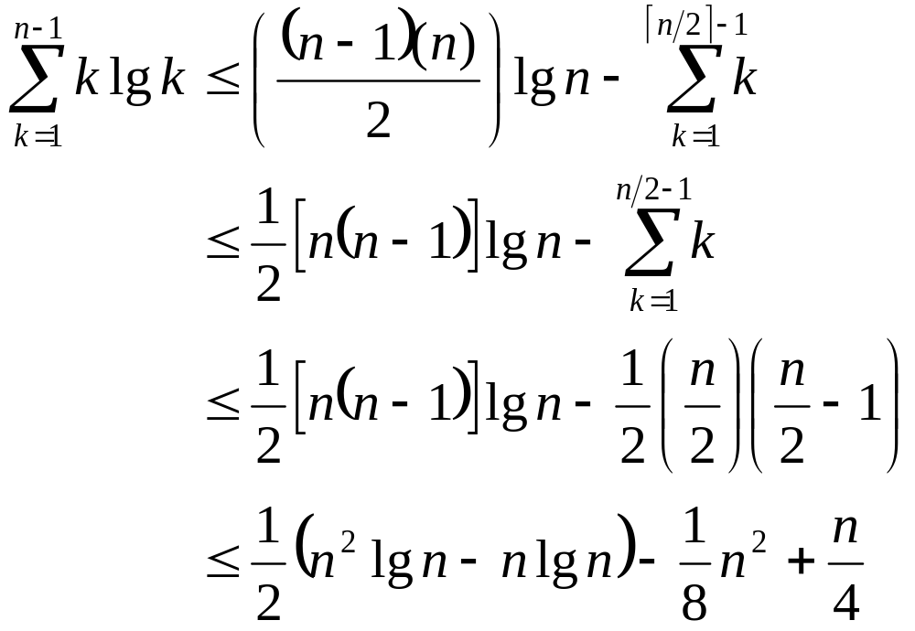
Tightly Bounding
The Key Summation
The summation bound so far
Rearrange first term, place upper bound on second
What are we doing here?
X Guassian series
What are we doing?
Multiply it
all out
What are we doing?

Slide 38
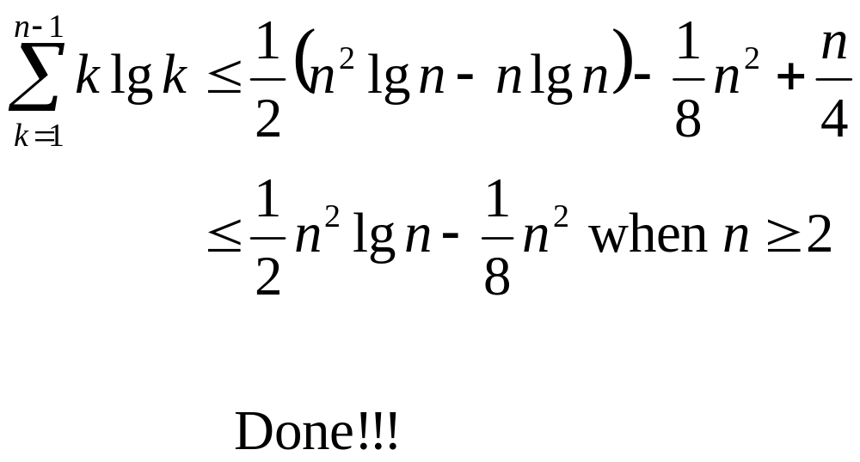
Tightly Bounding
The Key Summation

