Slide 1
CS 332: Algorithms
Quicksort

Slide 2
Review: Analyzing Quicksort
What will be the worst case for the algorithm?
  Partition is always unbalanced
What will be the best case for the algorithm?
  Partition is balanced
Which is more likely?
  The latter, by far, except...
Will any particular input elicit the worst case?
  Yes: Already-sorted input

Slide 3
Review: Analyzing Quicksort
In the worst case:
  T(1) = Θ(1)
  T(n) = T(n - 1) + Θ(n)
Works out to
T(n) = Θ(n²)

Slide 4
Review: Analyzing Quicksort
In the best case:
  T(n) = 2T(n/2) + Θ(n)
What does this work out to?
  T(n) = Θ(n lg n)

Slide 5
Review: Analyzing Quicksort (Average Case)
Intuitively, a real-life run of quicksort will produce a mix of “bad” and “good” splits
  Randomly distributed among the recursion tree
  Pretend for intuition that they alternate between best-case (n/2 : n/2) and worst-case (n-1 : 1)
  What happens if we bad-split root node, then good-split the resulting size (n-1) node?

Slide 6
Review: Analyzing Quicksort (Average Case)
Intuitively, a real-life run of quicksort will produce a mix of “bad” and “good” splits
  Randomly distributed among the recursion tree
  Pretend for intuition that they alternate between best-case (n/2 : n/2) and worst-case (n-1 : 1)
  What happens if we bad-split root node, then good-split the resulting size (n-1) node?
    We end up with three subarrays, size 1, (n-1)/2, (n-1)/2
    Combined cost of splits = n + n -1 = 2n -1 = O(n)
    No worse than if we had good-split the root node!

Slide 7
Review: Analyzing Quicksort (Average Case)
Intuitively, the O(n) cost of a bad split
(or 2 or 3 bad splits) can be absorbed
into the O(n) cost of each good split
Thus running time of alternating bad and good splits is still O(n lg n), with slightly higher constants
How can we be more rigorous?

Slide 8
Analyzing Quicksort: Average Case
For simplicity, assume:
  All inputs distinct (no repeats)
  Slightly different partition() procedure
    partition around a random element, which is not included in subarrays
    all splits (0:n-1, 1:n-2, 2:n-3, … , n-1:0) equally likely
What is the probability of a particular split happening?
Answer: 1/n

Slide 9
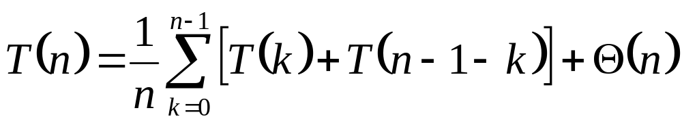
Analyzing Quicksort: Average Case
So partition generates splits
(0:n-1, 1:n-2, 2:n-3, … , n-2:1, n-1:0)
each with probability 1/n
If T(n) is the expected running time,
What is each term under the summation for?
What is the Θ(n) term for?

Slide 10
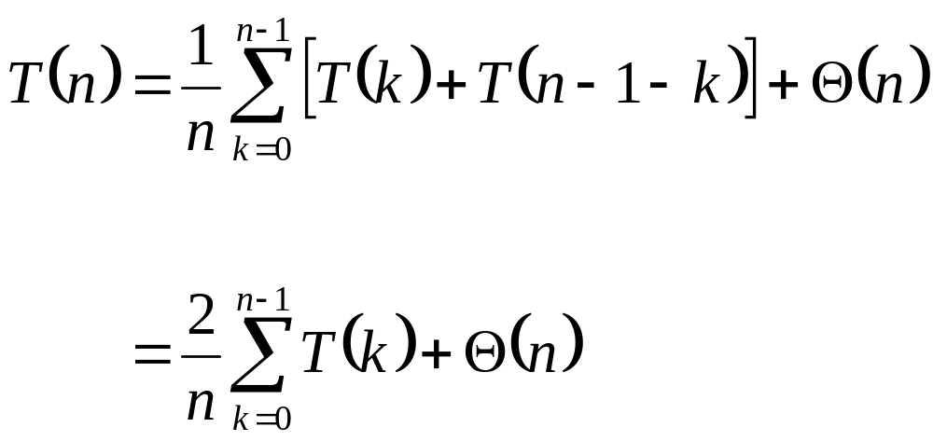
Analyzing Quicksort: Average Case
So…
Write it on
the board

Slide 11
Analyzing Quicksort: Average Case
We can solve this recurrence using the dreaded substitution method
  Guess the answer
  Assume that the inductive hypothesis holds
  Substitute it in for some value < n
  Prove that it follows for n

Slide 12
Analyzing Quicksort: Average Case
We can solve this recurrence using the dreaded substitution method
  Guess the answer
    What’s the answer?
  Assume that the inductive hypothesis holds
  Substitute it in for some value < n
  Prove that it follows for n

Slide 13
Analyzing Quicksort: Average Case
We can solve this recurrence using the dreaded substitution method
  Guess the answer
    T(n) = O(n lg n)
  Assume that the inductive hypothesis holds
  Substitute it in for some value < n
  Prove that it follows for n

Slide 14
Analyzing Quicksort: Average Case
We can solve this recurrence using the dreaded substitution method
  Guess the answer
    T(n) = O(n lg n)
  Assume that the inductive hypothesis holds
    What’s the inductive hypothesis?
  Substitute it in for some value < n
  Prove that it follows for n

Slide 15
Analyzing Quicksort: Average Case
We can solve this recurrence using the dreaded substitution method
  Guess the answer
    T(n) = O(n lg n)
  Assume that the inductive hypothesis holds
    T(n) ≤ an lg n + b for some constants a and b
  Substitute it in for some value < n
  Prove that it follows for n

Slide 16
Analyzing Quicksort: Average Case
We can solve this recurrence using the dreaded substitution method
  Guess the answer
    T(n) = O(n lg n)
  Assume that the inductive hypothesis holds
    T(n) ≤ an lg n + b for some constants a and b
  Substitute it in for some value < n
    What value?
  Prove that it follows for n

Slide 17
Analyzing Quicksort: Average Case
We can solve this recurrence using the dreaded substitution method
  Guess the answer
    T(n) = O(n lg n)
  Assume that the inductive hypothesis holds
    T(n) ≤ an lg n + b for some constants a and b
  Substitute it in for some value < n
    The value k in the recurrence
  Prove that it follows for n

Slide 18
Analyzing Quicksort: Average Case
We can solve this recurrence using the dreaded substitution method
  Guess the answer
    T(n) = O(n lg n)
  Assume that the inductive hypothesis holds
    T(n) ≤ an lg n + b for some constants a and b
  Substitute it in for some value < n
    The value k in the recurrence
  Prove that it follows for n
    Grind through it…

Slide 19
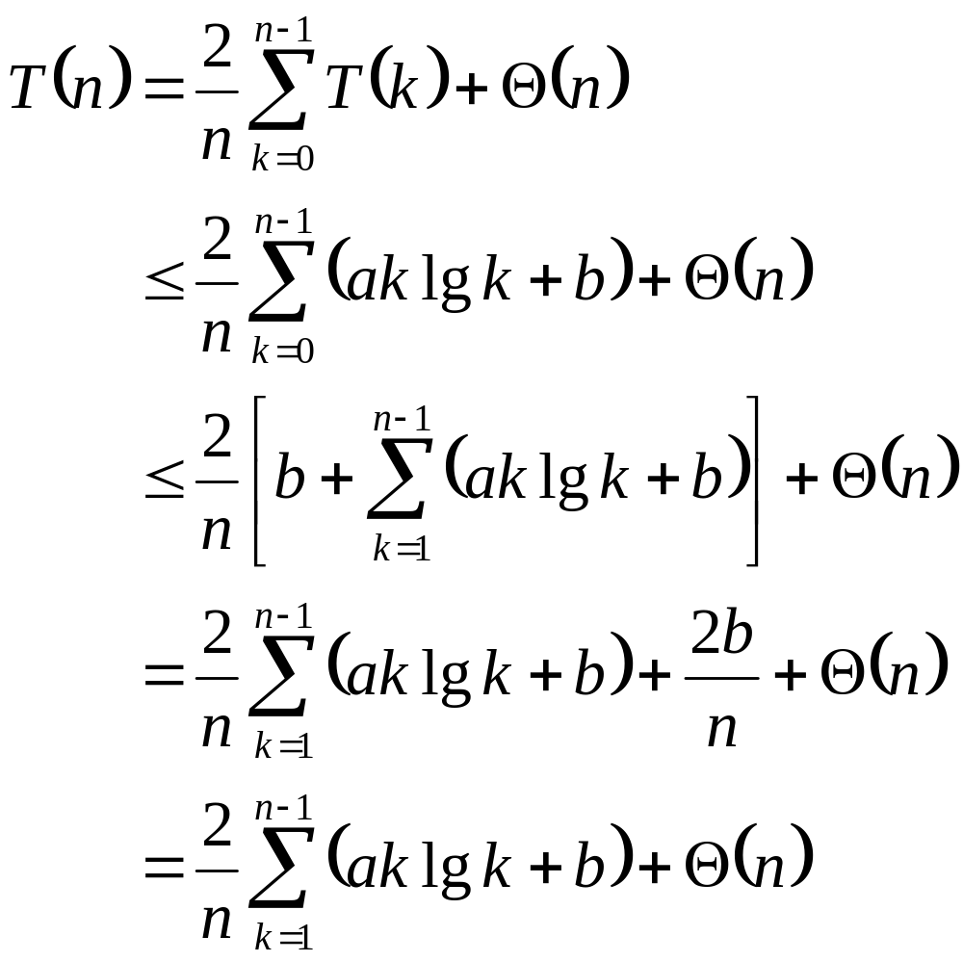
Analyzing Quicksort: Average Case
The recurrence to be solved
Plug in inductive hypothesis
What are we doing here?
Expand out the k=0 case
What are we doing here?
2b/n is just a constant,
so fold it into Θ(n)
What are we doing here?
Note: leaving the same recurrence as the book

Slide 20
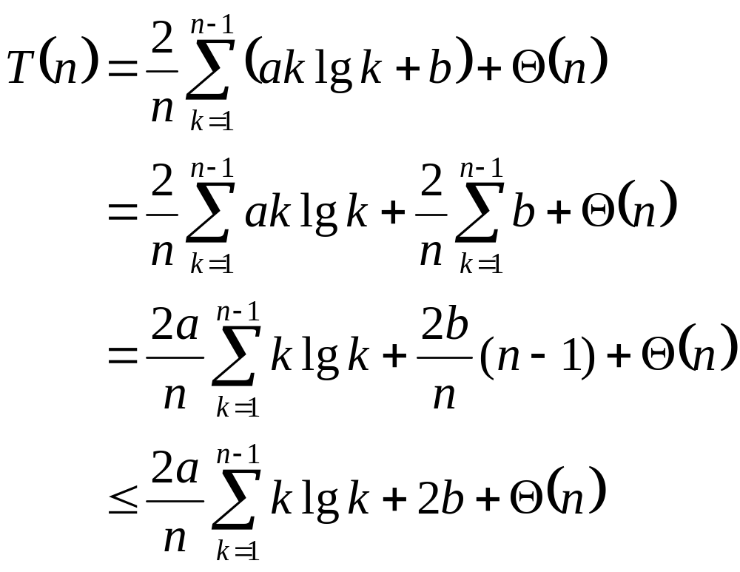
Analyzing Quicksort: Average Case
The recurrence to be solved
Distribute the summation
What are we doing here?
Evaluate the summation:
b+b+…+b = b (n-1)
What are we doing here?
Since n-1<n, 2b(n-1)/n < 2b
What are we doing here?
This summation gets its own set of slides later

Slide 21
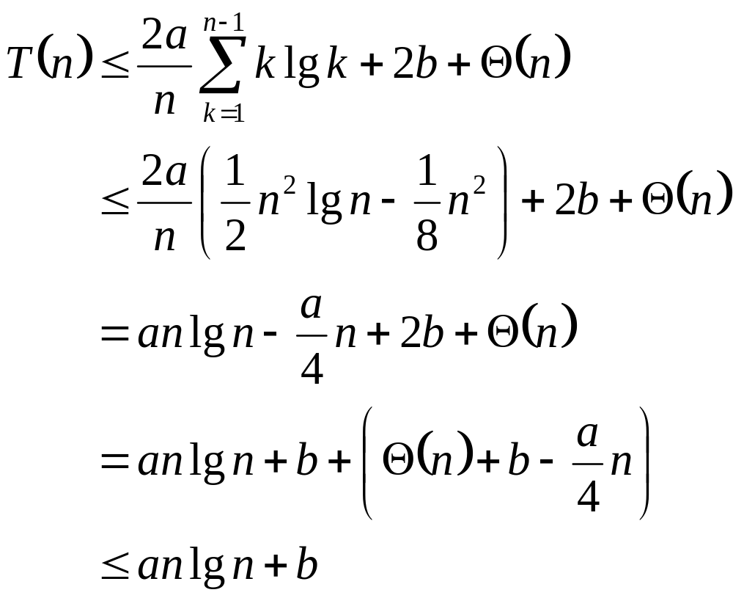
Analyzing Quicksort: Average Case
The recurrence to be solved
We’ll prove this later
What the hell?
Distribute the (2a/n) term
What are we doing here?
Remember, our goal is to get T(n) ≤ an lg n + b
What are we doing here?
Pick a large enough that
an/4 dominates Θ(n)+b
How did we do this?

Slide 22
Analyzing Quicksort: Average Case
So T(n) ≤ an lg n + b for certain a and b
  Thus the induction holds
  Thus T(n) = O(n lg n)
  Thus quicksort runs in O(n lg n) time on average (phew!)
Oh yeah, the summation…

Slide 23
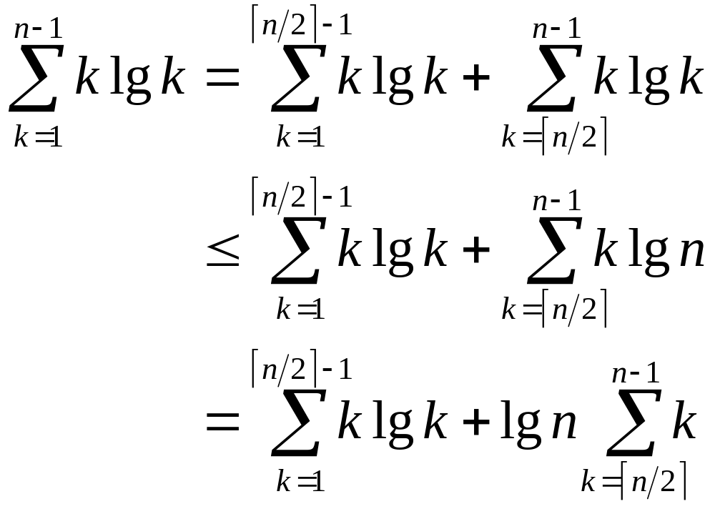
Tightly Bounding
The Key Summation
Split the summation for a tighter bound
What are we doing here?
The lg k in the second term is bounded by lg n
What are we doing here?
Move the lg n outside the summation
What are we doing here?

Slide 24
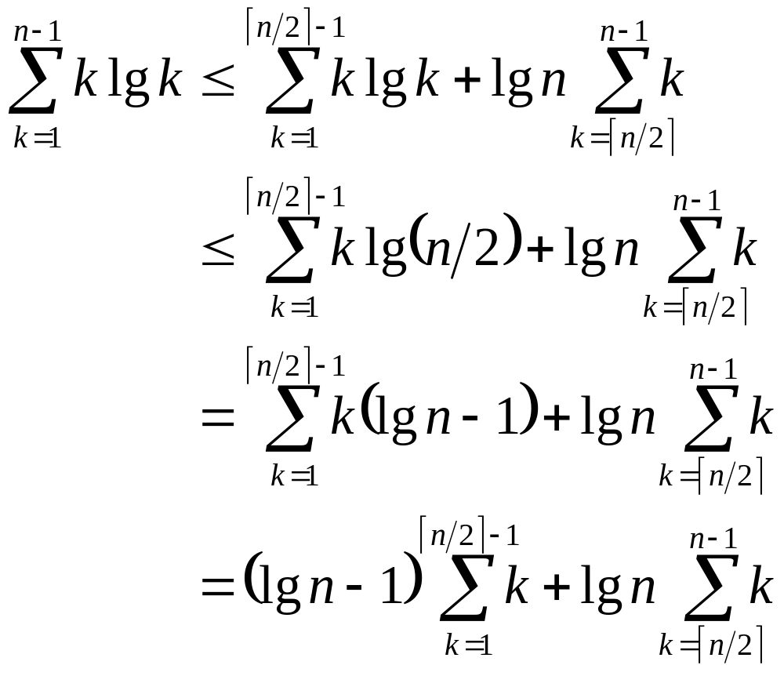
Tightly Bounding
The Key Summation
The summation bound so far
The lg k in the first term is bounded by lg n/2
What are we doing here?
lg n/2 = lg n - 1
What are we doing here?
Move (lg n - 1) outside the summation
What are we doing here?

Slide 25
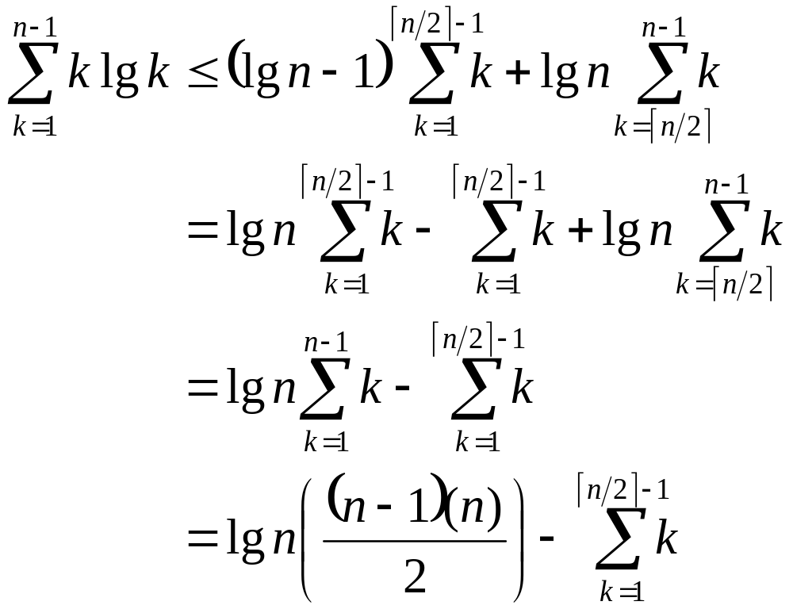
Tightly Bounding
The Key Summation
The summation bound so far
Distribute the (lg n - 1)
What are we doing here?
The summations overlap in range; combine them
What are we doing here?
The Guassian series
What are we doing here?

Slide 26
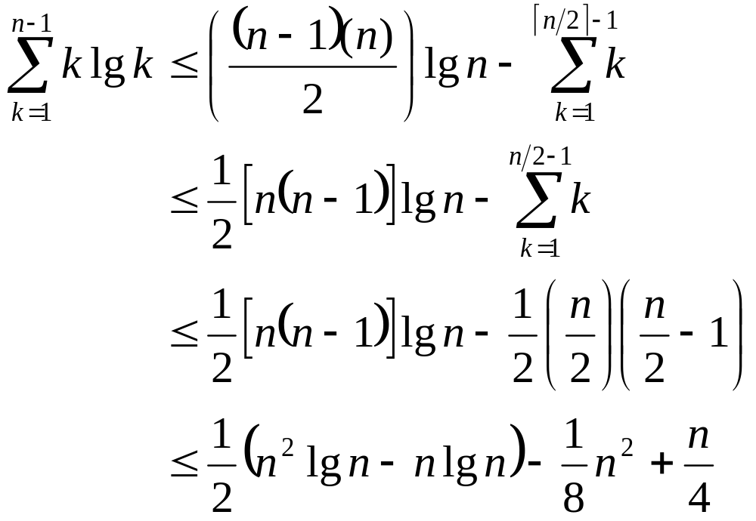
Tightly Bounding
The Key Summation
The summation bound so far
Rearrange first term, place upper bound on second
What are we doing here?
X Guassian series
What are we doing?
Multiply it
all out
What are we doing?

Slide 27
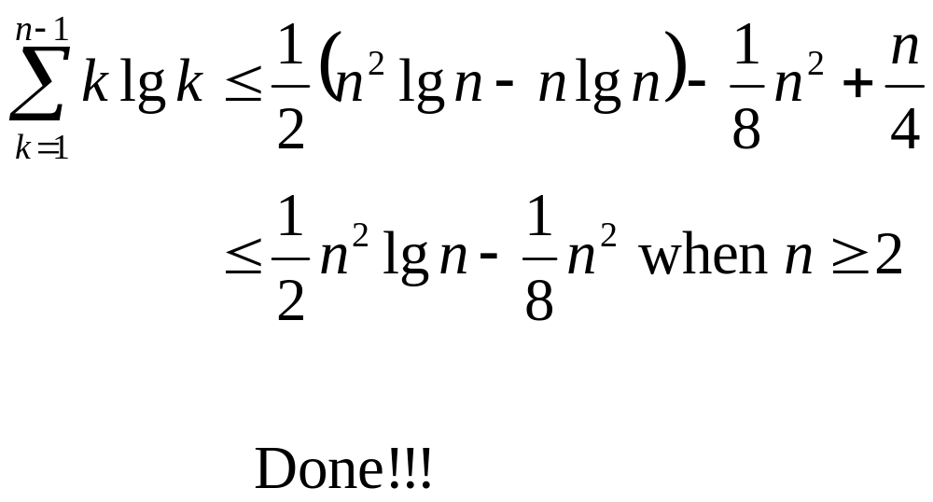
Tightly Bounding
The Key Summation

