Slide 1
Elementary Graph Algorithms

Slide 2
What is a Graph?
G=(V,E), Where V is a finite non-empty set and E is a subset of 2-element subsets of V.
E is a binary relation on V which is irreflexive and Symmetric.\
V is set of objects, there is an edge between two objects if they are related.

Slide 3
What is a Graph?
Graph G = (V,E) ( simple, Undirected)
  Set V of vertices (nodes): A non-empty finite set
  Set E of edges: E ⊆V² , 2-element 2-subsets of V.
    Elements of E are unordered pairs {v,w} where v,w ∈ V.
  So a graph is an order pair of two sets V and E.
Variations: Directed graph, ( E ⊆ V ×V)
Weighted graph: W: E→R, c: V →R

Slide 4
What is a Graph?
Modeling view;
G=(V,E)
  V: A finite set of objects
  E: A symmetric, irreflexive binary relation on V.
  When E becomes just a relation it gives rise to a directed graph.

Slide 5
What is a Graph?
Any n X n 0-1 symmetric matrix is a graph
  Vertices are row ( colum) numbers and there is an edge between two vertices i and j if the ij th entry is 1. (Adjacency matrix)

Slide 6
Graphs: Diagramatic representation
Vertices (aka nodes)

Slide 7
Graphs — Diagramatic Representation
Vertices (aka nodes)
3
2
1
4
5
6
Edges

Slide 8
Graphs — Weighted graphs
Vertices (aka nodes)
3
618
2
1
2273
211
190
4
318
344
1987
5
2145
2462
6
Weights
Undirected
Edges

Slide 9
Directed Graph (digraph)
Vertices (aka nodes)
3
2
1
4
5
6
Edges

Slide 10
Terminology
Path: a list of nodes (v[1], v[2],...,v[n]) s.t. (v[i],v[i+1]) ∈ E for all 0 < i < n
Simple Path: No vertex is repeated in a simple path
The length of the above path is n-1
Cycle : a simple path that begins and ends with the same node
Cyclic graph – contains at least one cycle
Acyclic graph - no cycles

Slide 11
Terminology, cont’d
Connected graph: a graph where for every pair of nodes there exists a path between them.
Connected component of a graph G
  a maximal connected subgraph of G.
  deg(v)= number of edges of the form vw, w in V
  deg(v)=|N(v)={w| vw is an edge}|

Slide 12
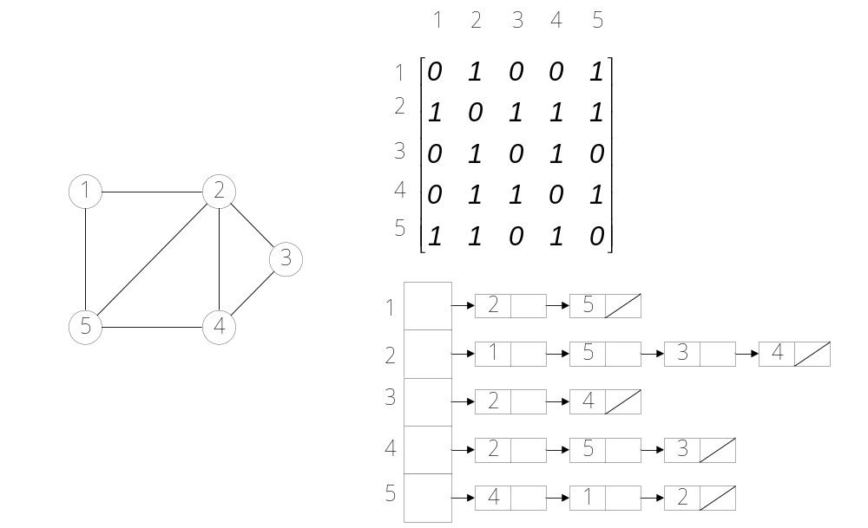
1 Representations of undirected graphs
adjacency-matrix representation (dense)
adjacency-list representation (sparse)
symmetric !!

Slide 13
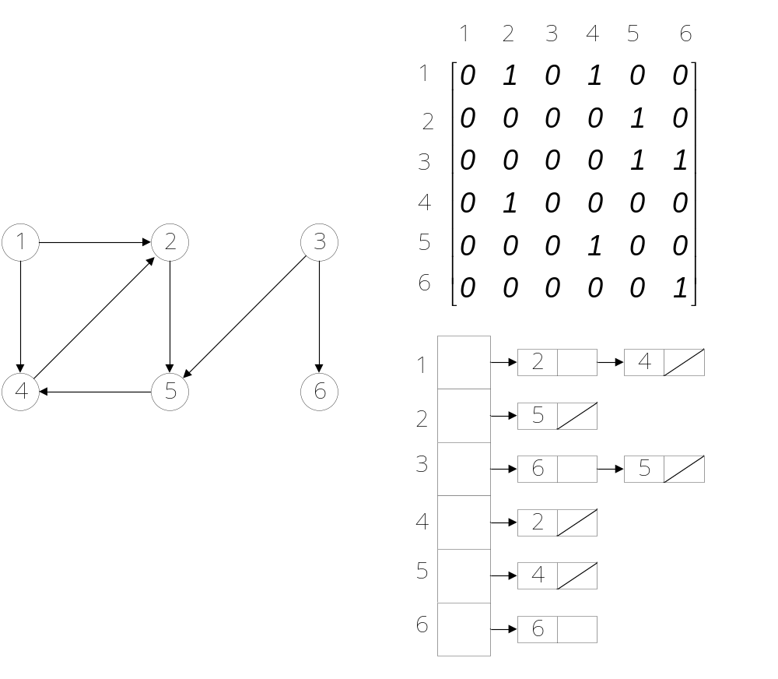
Representations of directed graphs
Weighted graphs,
w: E → R
1
2
3
4
5
6

Slide 14
Graph Structure
G = (V, E): Graph = (Verteces, Edges)
Adj[u]: all the vertices v s.t. there is an (u, v) ∈ E
Adjacency lists
  when the graph is sparse ( i.e., | E | << | V |² )
  space: Θ(V + E)
Adjacency matrix
  when the graph is dense ( i.e., | E | ~ | V |² )
  or more efficient edge connection checking is necessary
  space: Θ(V ²)
Either way is applicable to both directed and undirected graphs

Slide 15
2 Breadth-first search
BFS(G, s)
1 for each vertex u ∈ V(G) − {s}
2 do color[u] ← WHITE
3 d[u] ← ∞
4 π[u] ← NIL
5 color[s] ← GRAY
6 d[s] ← 0
7 π[u] ← NIL
8 Q ← {s}
9 while Q ≠ ∅
10 do u ← DEQUEUE(Q)
11 for each v ← Adj[u]
12 do if color[v] = WHITE
13 then color[v] ← GRAY
14 d[v] ← d[u] + 1
15 π[v] ← u
16 ENQUEUE(Q, v)
17 color[u] ← BLACK
π[u]: predecessor of u
Complexity: O(V+E )

Slide 16
Print out vertices on a shortest path
PRINT-PATH(G, s, v )
1 if v = s
2 then print s
3 else if π[v] = NIL
4 then print “no path from” s “to” v “exist”
5 else PRINT-PATH(G, s, π[v])
6 print v

Slide 17
3 Depth-First Search
DFS(G)
1 for each vertex u∈V[G]
2 do color[u] ← WHITE
3 π[u] ← NIL
4 time ← 0
5 for each vertex u∈V[G]
6 do if color[u] = WHITE
7 then DFS-VISIT(u)
DFS-VISIT(u)
1 color[u] = GRAY
2 d[u] ← time ← time +1
3 for each v ∈ Adj[u]
4 do if color[v] = WHITE
5 then π[v] ← u
6 DFS-VISIT(v)
7 color[u] = BLACK
8 f[u] ← time ← time + 1
a global variable
d[u] : discovery time
f[u]: finishing time
Complexity: O(V+E)

Slide 18
Lab 6

Slide 19
Lab
Q1. Use adjacency matrix and answer the following:
Given v, find degree(v).
Given uv, check whether uv is an edge
Number of edges of G
Q2. Do the same using Adjacency List
Q3. Implement BFS using a Queue and decide whether G is connected.

