Slide 1
Cell Division, Cell Cycle & Apoptosis
Prof. Mahitosh Mandal
School of Medical Science and Technology
IIT-Kharagpur

Slide 2
Cell Division

Slide 3
What is Cell Division?
Separation of a single cell into two new cells
Very vital event in all living organisms (unicellular or multicellular)
What is cell division cycle or cell cycle?
Orderly sequence of molecular events in which a single cell duplicates its contents and divides into two identical cells.
This cycle of duplication and division is known as cell cycle or cell division cycle.

Slide 4
Why cell division / cell division cycle is so important in living system?
An essential mechanism for all living beings to reproduce and survive.
Cell division must be balanced by cell growth in a particular species (critical for unicellular organisms)
Cell division is required for formation of different tissues and organs (critical in multicellular organism)
Control of cell division cycle is vital to all organisms
Partial or complete loss of normal control on cell division cycle leads to disease, cancer and death

Slide 5
The detailed molecular events of cell division cycle vary from organism to organism and in a single organism it may vary in time and space
Most fundamental event in cell division cycle of living system is common:
Duplication of genetic material/information (DNA) in the parent cell and accurate distribution (segregation) of identical DNA into two cells of next generation (progeny/daughter cells)
In eukaryotes, the DNA molecules are contained in the chromosomes
Chromosome: the specially organized structure of the genetic material of an organism involved in storage and transmission of the biological information (genes)
Genome: the complete genetic information (i.e. total DNA content) carried by a cell or organism

Slide 6
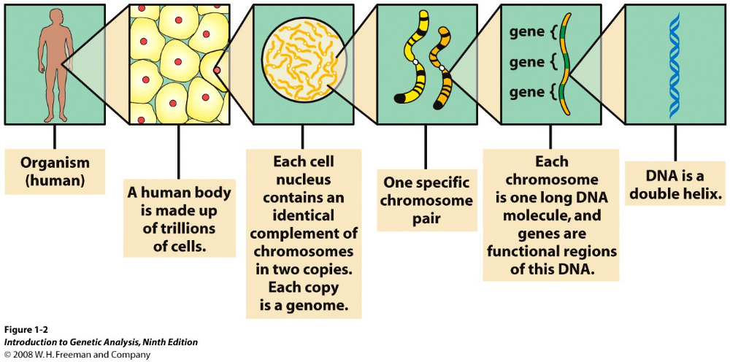
Each cell contains chromosomes, and chromosomes contain genes

Slide 7
Most of the higher eukaryotes are diploid (2n) i.e. their body (somatic) cells contain two copies of the basic genome set (two sets of homologous chromosomes)
Some eukaryotes and the sex cells (gametes) of most higher eukaryotes are haploid (n) i.e. these cells contain one basic genome set (one set of chromosomes)
How the ‘2n’ genome arises?
n + n -----→ 2n
Through fertilization of two sex cells (gametes) : one basic genome set (n) from male gamete or father’s sperm and another set (n) from female gamete or mother’s egg.
How the ‘n’ genome arises?
2n -----→ n + n
By one kind of cell division (meiosis)

Slide 8
In eukaryotic organism, two different types of cell divisions occur
Mitosis (equal division): When the somatic (body) cells just increase in number.
One cell --------→ (genome duplication) --------→ Two cells
2n ---(4n)---→ 2n + 2n
n ---(2n)---→ n + n
Meiosis (reduction division) : For sexually reproducing diploid organism specialized diploid cells (meiocytes) undergo two sequential nuclear divisions to form four haploid cells.
One cell --------→ (genome duplication) --------→ Four cells
2n ---(4n)---→ (2n) + (2n) ----→ n + n+ +n + n
These haploid cells are called gametes (sperms and eggs in plants, animals) or spores (fungi, algae).

Slide 9
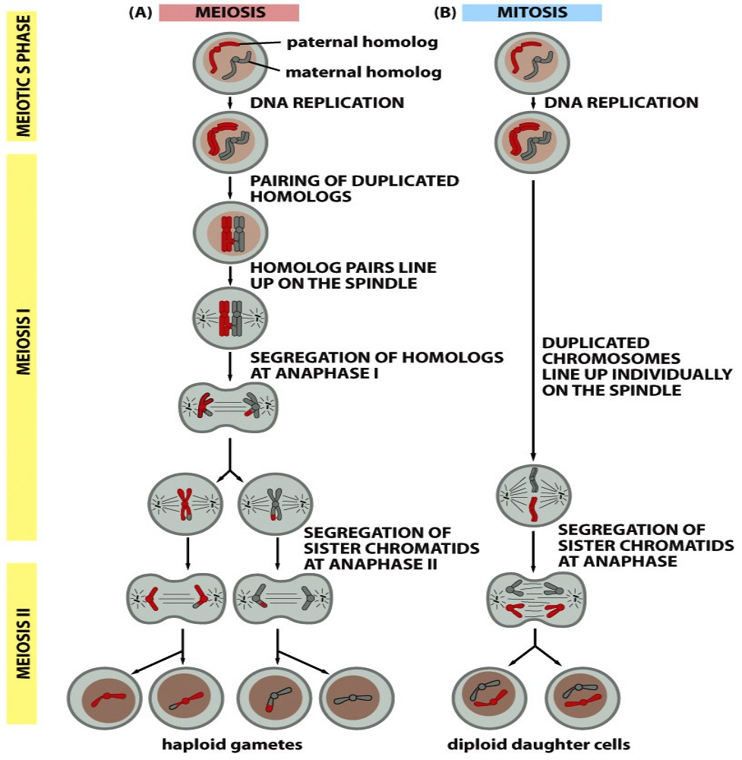

Unique features of mitosis and meiosis compared
2n
2n
Meiosis: single round of chromosome duplication followed by two rounds of chromosome segregation.
1st round (Meiosis-I) segregates the homologs that pair up.
2nd round (Meiosis-II) segregates the sister-chromatids
Mitosis: homologs do not pair up and segregate
but the sister-chromatids segregate
4n
4n
2n
2n
4n
n n n n
2n 2n

Slide 10
Unique features of mitosis and meiosis compared
Mitosis ensures that every cell in a individual carries the same chromosomes number/ genomic content/ biological information. Thus genetically conservative
Meiosis distributes one member of each chromosome pair to each gametes and restores the species specific chromosome number/ genomic content/ biological information after fertilization of male and female gametes. Additionally, it contributes to genetic diversity that stimulates evolution.

Slide 11
Cell Cycle

Slide 12
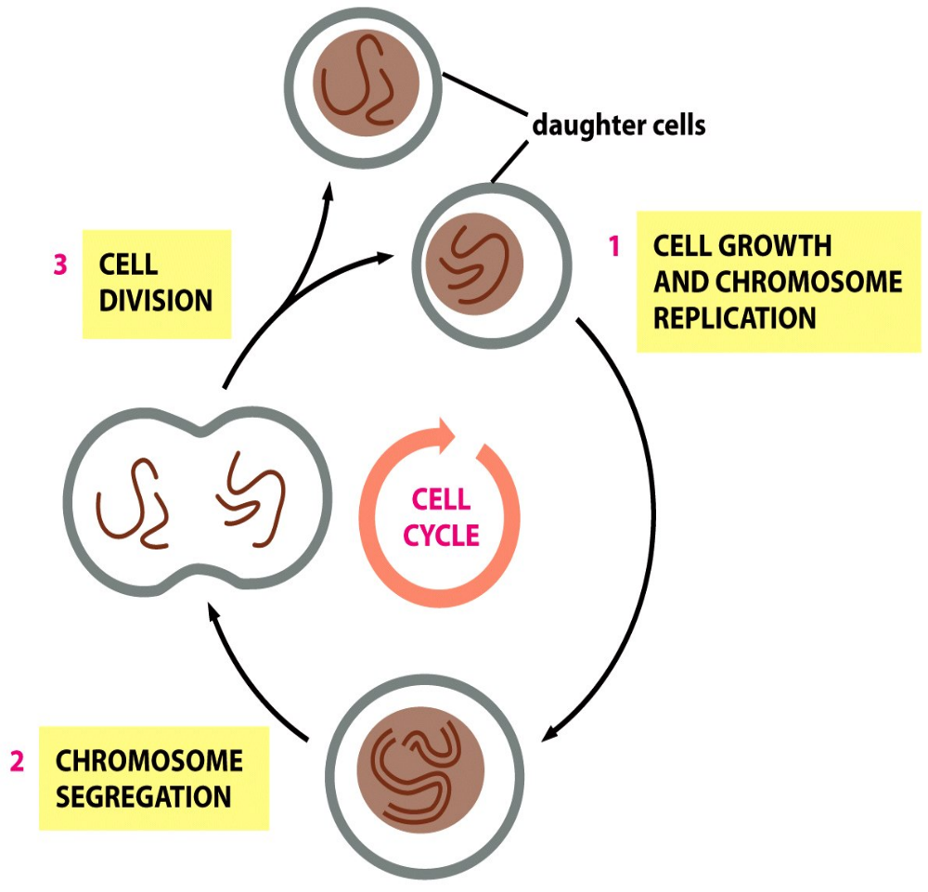
Essential events in a cell cycle
Repeating pattern of
cell growth (including chromosome duplication)
and
cell division (including chromosome segregation).

Slide 13
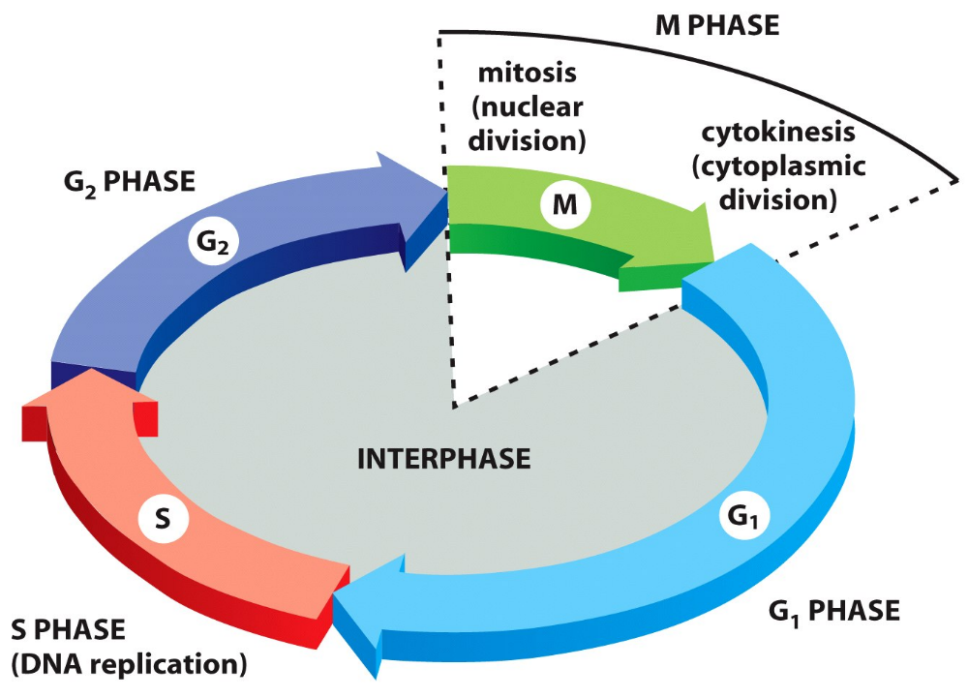
Cell cycle alternates between mitosis (M) and interphase (G1, S, G2)
(Monitor the environment)
~ 4.5 hours
~ 0.5 hour
~ 10 hours
~ 9 hours
(Monitor the environment)
A typical human cell has cell division cycle of 24 hours

Slide 14
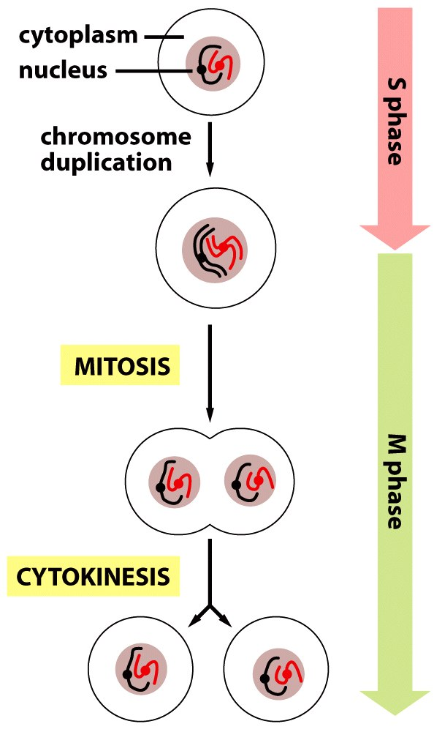
Two major phases of cell cycle

Slide 15
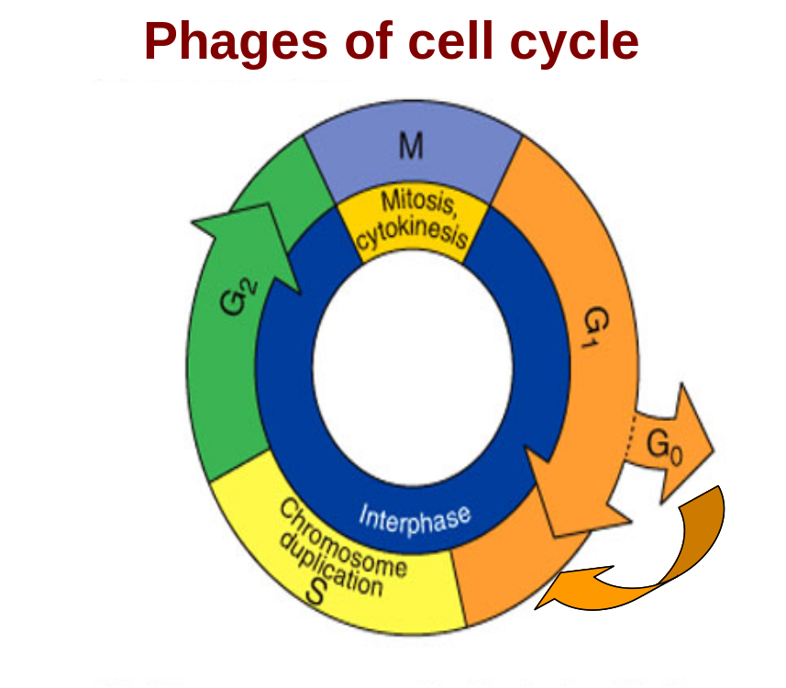
Interphase – long period of cell cycle between two divisions. Here cells grow, duplicate chromosomes and prepare for the division
G1: gap phase – birth of cell to the onset of chromosome duplication. (the diploid cells with 2n and haploid cells with n number of chromosomes)
S: synthesis phase – chromosome duplication due to replication of DNA
4n / 2n
2n / n
G2: gap phase – end of chromosome duplication (formation of sister chromatids) to the onset of mitosis. (the diploid cells with 4n and haploid cells with 2n number of chromosomes)
M: mitosis phase – nuclear division follows division of cytoplasmic content (cytokinesis) to separate sister chromatids into daughter cells
G0: resting phase – cells exit from cell cycle and survive for days or years

Slide 16
Some features of cell cycle
All normal cells undergo complete cell cycle
Different species has different time period for each cell cycle
Cells in different tissues of the same species have different cell cycle duration
A typical eukaryotic cell cycle has four phases: G1, S, G2 and M
One critical event i.e. chromosome duplication occurs in S-phase
Another critical event i.e. segregation of duplicated chromosome occurs in M-phase
M-phase and S-phase are separated by G1-phase and G2 phase, when various intracellular and extracellular signals monitor the cell cycle progression

Slide 17
Some features of cell cycle (Contd..)
A typical human cell has cell division cycle of 24 hours: G1 ~ 9 h, S ~ 10 h, G2 ~ 4.5 h and M ~ 0.5 h
However, cancer cells and embryonic cells skip G1, and G2, so cell cycle is shorter
All normal cells in an individual do not undergo the cell cycle at the same time (asynchronous)
A few type of cells withdraw from the cycle of division and remain quiescent (G₀ state) for long time or forever (e.g. cells that are fully differentiated i.e. eye lens cells and nerve cells)
Cell cycle organization and control/regulation are highly conserved during evolution from single cell to multicellular organism

Slide 18
Control of cell cycle

Slide 19
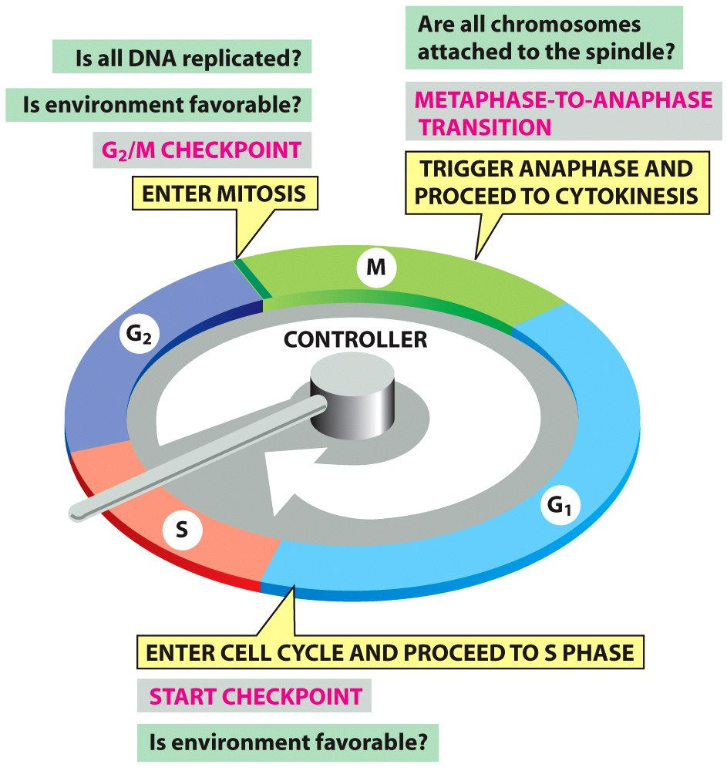
Cell cycle control system triggers the sequential events
The eukaryotic cell cycle control system has three major checkpoints as surveillance mechanism for cell cycle progression or transitions :
Start or restriction point
ii) G2/M checkpoint
iii)Metaphase/anaphase

Slide 20
Cyclin-dependent kinases (CDKs)
Family of protein kinases first discovered for their role in regulating the cell cycle.
Involved in regulating transcription, mRNA processing, and the differentiation of nerve cells.
Present in all eukaryotes, and their regulatory function in the cell cycle has been evolutionarily conserved.
CDKs are relatively small proteins, with molecular weights ranging from 34 to 40 kDa.
CDK binds to regulatory protein called a cyclin. Without cyclin, CDK has little kinase activity; only the cyclin-CDK complex is an active kinase.

Slide 21
Cyclins and CDKs by Cell-Cycle Phase
Cyclins and CDKs by Cell-Cycle Phase
Phase | Cyclin | CDK
G0 | C | Cdk3
G1 | D, E | Cdk4, Cdk2, Cdk6
S | A, E | Cdk2
G2 | A | Cdk2, Cdk1
M | B | Cdk1

Slide 22
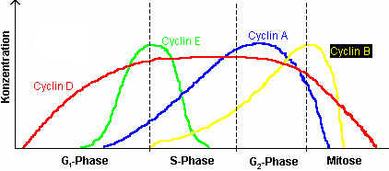
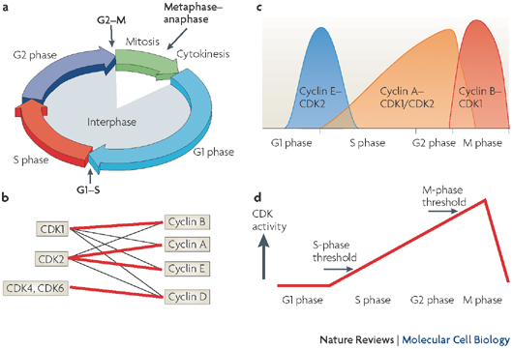
Cyclin levels in different stages of the cell cycle
Concentration

Slide 23
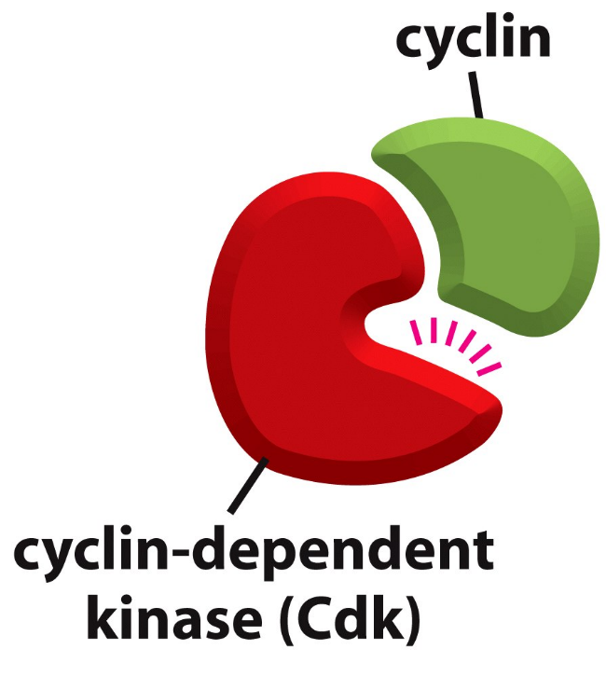
Cyclins & cyclin-dependent kinases (Cdks)
Cyclin-Cdk complex consisted of a regulatory cyclin subunit and a catalytic cyclin-dependent kinase subunit
Cyclin protein regulates the assembly and activation of the cyclin-Cdk complex
This activation triggers the sequential events for cell cycle progression.
Biochemical switches include phosphorylation, de-phosphorylation, activation or inactivation of other activator or inhibitor proteins, new sets of gene expression and proteasome-mediated degradation of proteins

Slide 24
Regulation of Cell cycle
In each phase the regulatory molecules activate the steps required in that particular phase and also prepare the cell for the next phase of the cell-cycle. Thus, sequential and ordered events/phases are maintained in the cell cycle.
Partial or complete loss of control of cell-cycle (and apoptosis) may lead to diseased condition or cancer.
In normal cells, the minor damages in DNA are repaired and small errors in molecular events are corrected. The cell-cycle checkpoints delay or arrest the cells to proceed to the next stage until the DNA damage is repaired or other molecular events of each phase are completed / corrected before the next step is initiated.

Slide 25
Regulation of Cell cycle (contd..)
If the DNA damage can not be repaired or any other faulty events occurred during any phase of cell cycle, the defective cell will not complete the division to proliferate, rather the cell death or apoptosis program will be induced to eliminate them from the normal healthy organism.
Several defects in the cell cycle checkpoints may lead to abnormal or faulty molecular events, accumulation of multiple mutations and DNA rearrangements in the genome resulting in disease or cancer phenotype.
Understanding the detailed control mechanism of cell cycle will have significant consequences in the treatment of diseases and cancer by designing suitable drugs and therapeutic strategies.

Slide 26
Apoptosis / Programmed Cell Death (PCD)

Slide 27
Apoptosis / Programmed Cell Death
Definition
Apoptosis (Greek word meaning ‘dropping off’ or ‘falling off’, as leaves from a tree) is one type of programmed cell death (PCD) in which a ‘suicide’ program is activated within an animal cell, leading to rapid cell death.
In multicellular organisms (animals and plants), programmed cell death (PCD) is a genetically controlled natural process by which the cells kill themselves or commit suicide through the activation of a intracellular death program.
This is an essential and critically important part in the the organism’s growth and development and continues into adulthood or maturity.
Features

Slide 28
Apoptotic pathway: Components
The apoptotic pathway has three major components:
Cell membrane-bound receptors,
Intracellular regulatory proteins and
Effector proteases/ proteolytic enzymes called caspases.
There are certain morphological and biochemical changes occur in the apoptotic cells including sometimes formation of membrane-bound bodies called apoptotic bodies .
In contrast to apoptosis or PCD, the animal cells that die accidentally in response to an acute injury (e.g. trauma or lack of blood supply) or pathogen infection by a process called cell necrosis.

Slide 29
Why does apoptosis occur?
“Genetically determined, internal, self-destruct mechanism of cell death, which is activated under a variety of circumstances:”
  Developmental morphogenesis
  Physiological turnover of cells in renewable tissues
  Immune regulation
  Deprivation of hormones and other trophic factors
  Environmental hazards
  Cancers, in which most of the neoplastic cells undergo apoptosis

Slide 30
Apoptotic cells vs. normal cells
The apoptotic cells
shrink, condense,
cytoskeleton collapses,
membrane blebbing occurs
most cell components broken down including condensation of nucleus and fragmentation of the chromatin/DNA.
Sometimes (if the cells are large), the broken cell components are released as membrane-bound bodies called apoptotic bodies.
Because the dying cells and the apoptotic bodies are engulfed by the neighboring cells or macrophages rapidly before they can spill their contents, there is no inflammatory response in PCD.

Slide 31
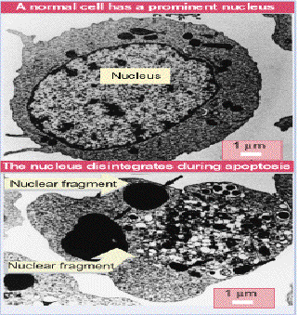
Morphology of Apoptotic cells
Apoptotic cells are shrunken and detached form their neighbors
Nuclear condensation and fragmentation
Segregation of cytoplasmic organelles into distinct regions
Surface membrane blebs
Fragmentation of the dead or dying cell into membrane-bound bodies
Characteristic electrophoretic pattern

Slide 32
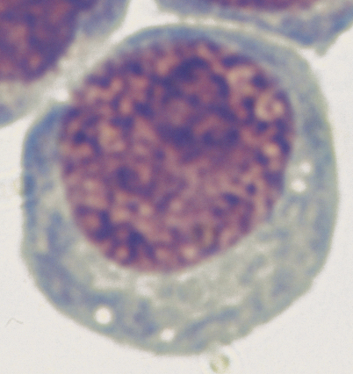
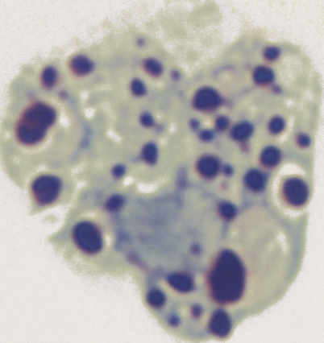
Morphology of Apoptotic cells
Normal Cell
Apoptotic Cell

Slide 33
Apoptosis versus Necrosis: morphological comparison
Apoptosis | Necrosis
Physiological/pathological | Accidental
Tightly regulated | Unregulated/poorly regulated
Membranes intact till late stage | Membranes lost early
No leakage of cell content | Leakage of cell content
Cell shrinkage | Cytoplasmic swelling
No mitochondrial swelling | Mitochondrial swelling

Slide 34
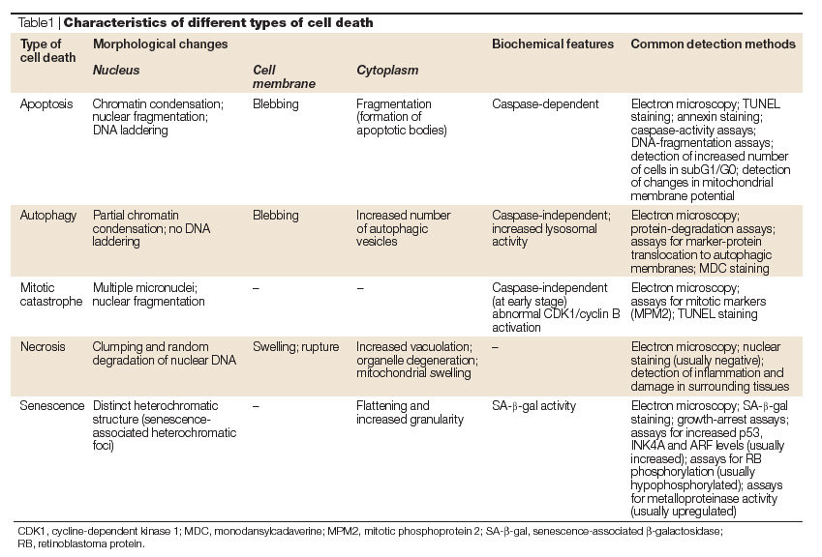
Apoptotic and non-apoptotic death of cells

Slide 35
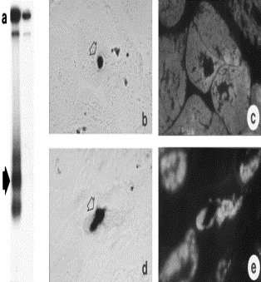
Biochemical Hallmarks of Cancer
•DNA laddering Internucleosomal 200 bp
•Early/TUNEL+ve nuclei (TUNEL=Terminal deoxy-nucleotidyl transferase-mediated dUTP Nick End Labelling)
• IHC for same cell
• Late/TUNEL+nuclei

Slide 36
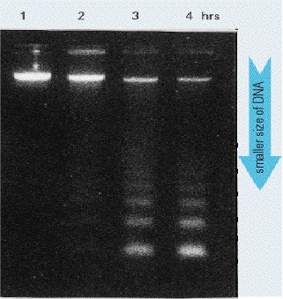
DNA laddering
Time Course of DNA Laddering
•Apoptosis was initiated and cells were harvested at different time intervals
•DNA laddering was evident at 3h

Slide 37
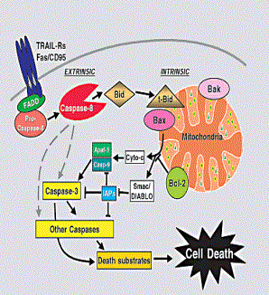
Introduction to the apoptosis players
•Death Pathways
•Triggering stimuli
•Caspases
•Bcl-2 family
•Mitochondria
•Death by apoptosis vs necrosis

Slide 38
Apoptotic cells : Biochemical changes
Apoptotic cells have characteristics biochemical changes that can be used to identify the PCD.
1. Chromosomal DNA gets fragmented
2. Phosphatidylserine (a negatively charged phospholipid) which normally exclusively located in the inner leaflet of lipid bilayer of plasma membrane, flips to the outer leaflet in apoptotic cells. This phosphatidylserine, now acts as biochemical marker of the apoptotic cells.
Due to the phosphatidylserine surface markers, the apoptotic cells display “eat me” signals to the neighboring cells and macrophages which, in turn, phagocytose the dying cells.
Most healthy cells display certain “don’t eat me” signals or survival signals (called trophic factors), so that macrophages do not engulf any normal cells.

Slide 39
Apoptotic cells : Biochemical changes (contd..)
Thus, in addition to expressing the “eat me” signal i.e. phosphatidylserine surface marker, these apoptotic cells must lose or inactivate the “don’t eat me” signals or trophic factors.
The apoptotic cells lose the characteristic features of normal mitochondria.
Loss of usual electrical potential that exists across of the inner membrane in normal mitochondria.
[A decrease in labeling of mitochondria by positively charged fluorescent dyes indicates the cells are undergoing apoptosis.]
The protein cytochrome C, normally located in the intermembrane space of mitochondria, released into cytosol in apoptotic cells.
[This relocation of cytochrome C from mitochondria to the cytosol is another marker of PCD.]

