Slide 1
ONLINE SALES PORTAL
Software Labaratory Project

Slide 2
TABLE OF CONTENTS
01
02
03
Our Team
Project description
Technical Details
04
05
Use Cases
Challenges Faced

Slide 3
OUR TEAM
MANTRI JASWANTH
KANCHI RAM PREETHAM
VARUN MUPPARAJU

Slide 4
Problem Description
Buyer
Seller
Manager
Search for items and find different sellers
Raise a request to buy an item
Negotiate on price with the seller
Pay money online if seller accepts
Add or remove categories
Review items and remove items of poor quality
Help negotiations between buyer and seller by resolving issues
Upload the product with specifications
Negotiate on price with the buyer
Accept or reject the request after negotiating

Slide 5
Technical Details
Django is a free and open-source, python based web framework that follows the model-template-view (MTV) architectural pattern. MTV is a software design that separates the user interface (UI), data, and application logic into separate components.
Models
Created classes for each entity of system
Frontend
Django template language and Bootstrap
Templates
Created different pages with unique urls
OSP
Views
Implemeted application logic for different events of the system
Backend
Django and SQLite database

Slide 6
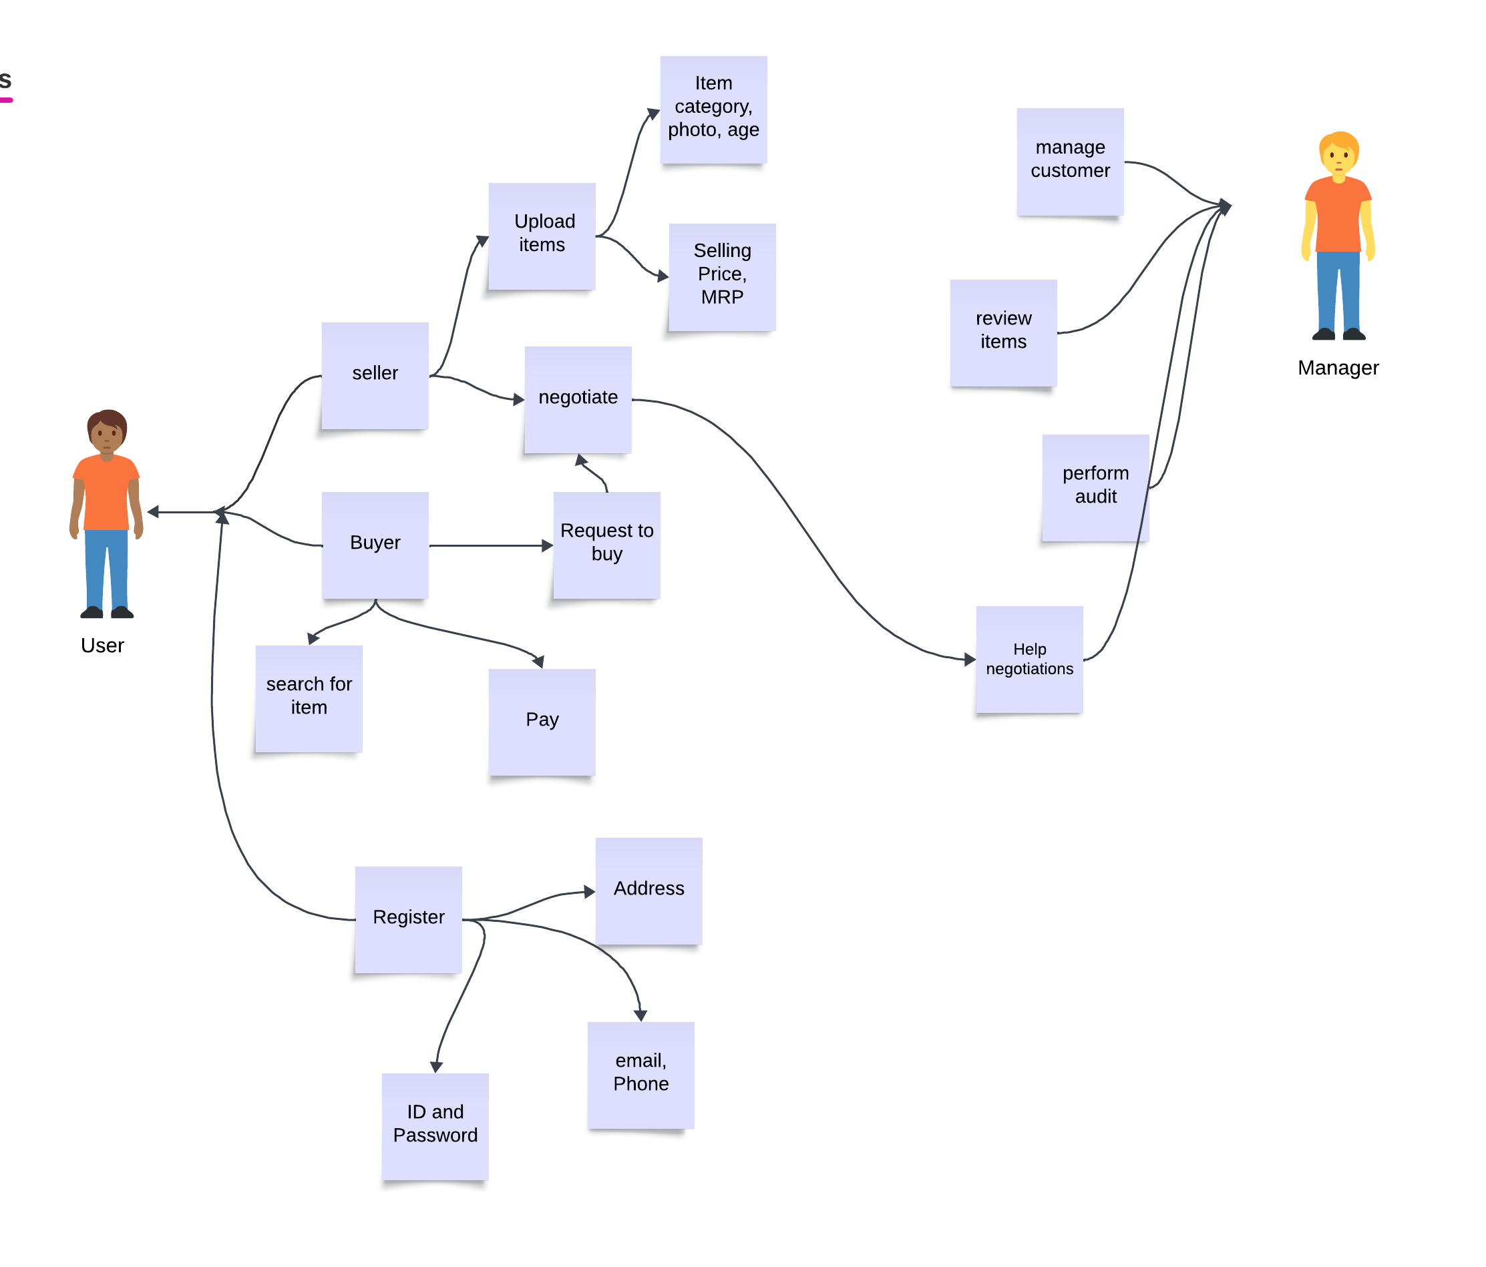
Use cases

Slide 7
Challenges Faced
Since we were new to Django and Django template language, getting familiarised with syntax and working was challenging
We did not have any experience working with SQL, so migrating changes to existing database while development was big challenge
Although we used Git and Github for version control and collaboration, merging individual works was challenging and it caused merge conflicts because we used local database

