Slide 1
ENGR 10 Final Presentation
Wind Turbine Blade Design by Yixu Liu

Slide 2
Design Inspiration
The design was inspired by common wind turbine blades but adjusted to fit a small motor.
I tested different blade shapes and sizes to find one that could generate enough torque to lift a weight.

Slide 3
Obstacles Encountered
- Initial design didn’t fit the motor.
- Second design was too small to generate lift.
- Balancing strength and lightweight design was challenging.

Slide 4
Data Collected
- Voltage output: 1.35 V
- Current output: 0.23 A
- Speed: 0.0119 m/s (20 cm in 16.81 seconds)

Slide 6

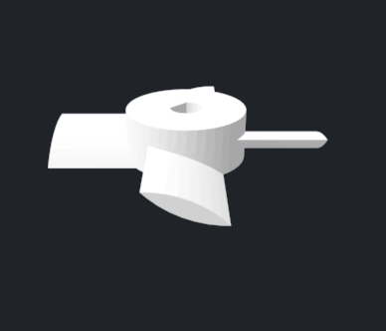
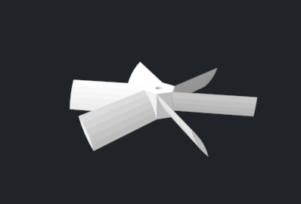
Fan Test Images

