Slide 1
Bad Air and it’s impact on YOU
Some of India’s most air-polluted cities have air qualities that can reduce a person’s lifespan by 10 years due to air quality alone!
Won’t it be great to get 10 years of your life back? Not to mention, live better the whole time?

Slide 2
Goal of this Study
To explore the distribution of cities with air quality issues
Try and understand more about what activities might be causing this
Explore suggestions to remediate this
What we found
Northern regions of the country have significantly worse Air Quality
Human related activities, such as industrialization (and possibly others) are the leading cause of high AQI
Since industrial emissions is a possible contributing factor, addressing this could help reduce air pollution
Other factors and correlations can be explored

Slide 3
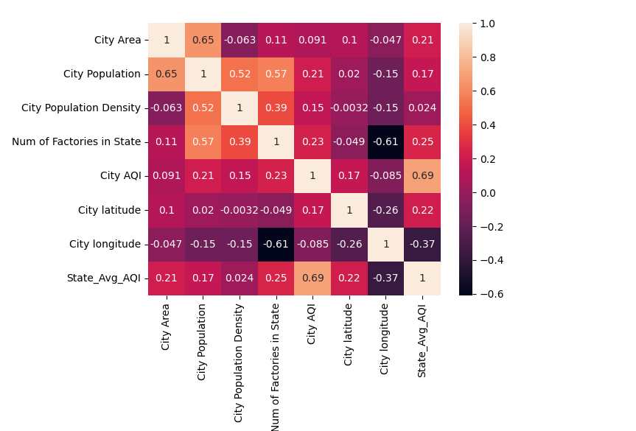
What was explored?
Data about City Area, location, Population and Density, along with State Data, specifically the number of factories in the state that denotes the level of industrialization.
City AQI correlates most strongly (although still weak) with Population, number of factories, followed by latitude and population density.
The association between City AQI and State Avg AQI is expected

Slide 4
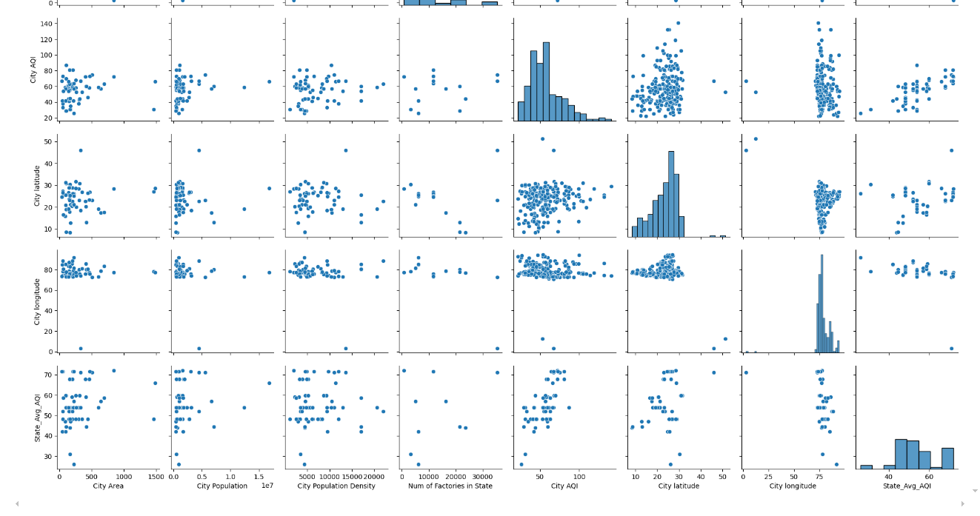
What was explored?

Slide 5
What was Observed?
There is a weak correlation between City AQI and City Population and Population Density.
There is also a weak correlation between City and State AQI and number of factories in State
This suggests that industrialization could be a significant factor to bad air quality
This also gives another insight - highly industrialized areas tend to be more populous - This could exacerbate air quality issues caused by other human activities as well

Slide 6
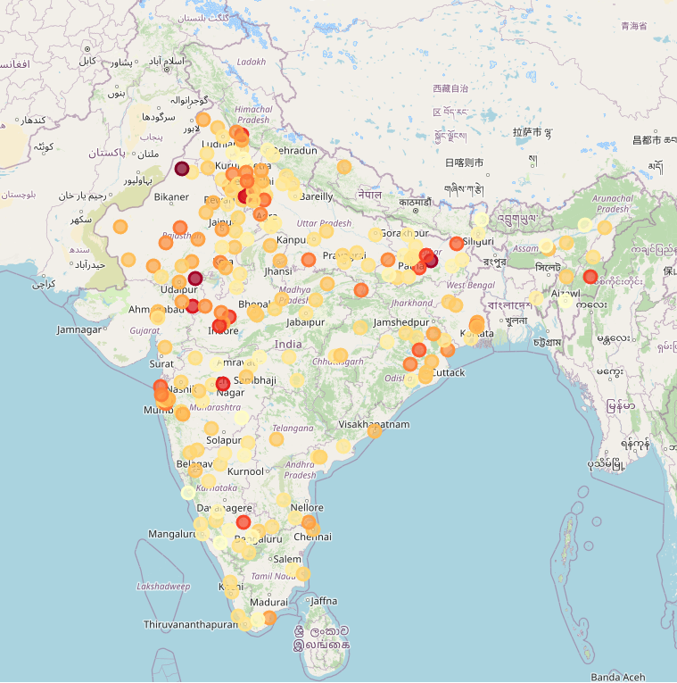
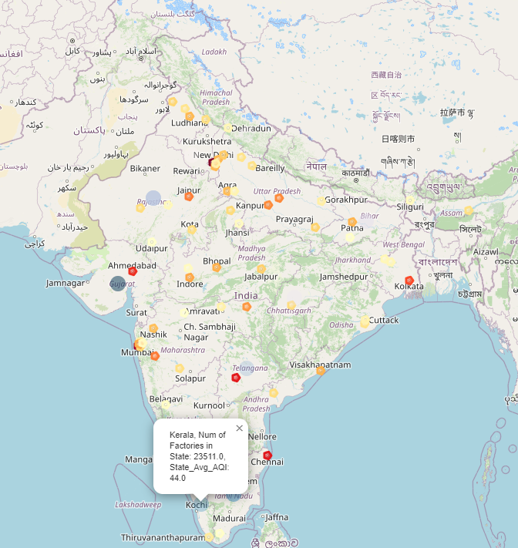
What was Observed?
The left map shows how a lot of the worse air quality regions are in the Northern parts of the country
The right map shows major metros, and hubs of commerce and industrialization had disproportionately worse air quality
Darker circles indicate higher AQI (worse Air Quality)
Darker polygons indicate higher Population
Darker circles indicate higher number of factories in state (industrialization)

Slide 7
What was observed?
In general, northern parts of India had higher AQI than southern areas
Population was found to be the most correlated with bad air quality, followed by population density and industrialization.
The most populated areas, especially the four major metros as well as cities like Ahmedabad and Hyderabad have higher AQIs.
This trend of populated areas having high AQIs are observed throughout India

Slide 8
Conclusions
A combination of industrialization and other population related effects could be the causes of air pollution.
More exploration needs to be performed to determine the root causes and remedial measures

Slide 9
Actions
Since industrialization is a significant contributing factor, think of solutions to reduce industrial emissions
Understand better what human activities lead to higher air pollution
Other factors that can be explored: Motor vehicles, electric vehicles, outdoor burning, combination of factors

Slide 10
Challenges
Lack of good data was the biggest challenge – For example, AQI was available for 228 cities but less than half of them had population information, making comparisons among these variables difficult.
Industrialization information was also only available for 22 of the 28 states.
Other information such as outdoor burning was difficult to come by

