Slide 1
DataGiri Presented 17th November By : Himanshu Shrivastava

Slide 2
Objective of Machine Learning?
Solving real life problems using data
Find a function from data which is able to make accurate predictions in future
This function/model should be an implementable and interpretable solution
https://www.wired.com/2012/04/netflix-prize-costs/
https://www.risk.net/asset-management/6119616/blackrock-shelves-unexplainable-ai-liquidity-models

Slide 3
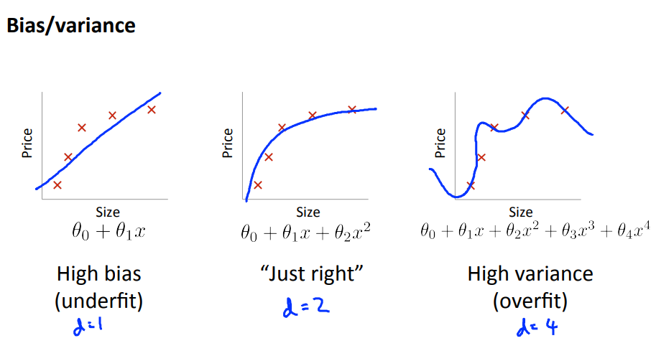
Good Visualizations!!!
Tree based models : http://www.r2d3.us/visual-intro-to-machine-learning-part-1/
Bias Variance tradeoff: http://www.r2d3.us/visual-intro-to-machine-learning-part-2/
Bias Variance Trade Off: (Model Complexity vs Error)

Slide 4
Additive Modeling
Foundation of bagging and boosting algorithms
Add a bunch of simple terms together to create a more complicated expression
A useful technique because we can often conjure up the simple terms more easily than cracking the overall function in one go

Slide 5
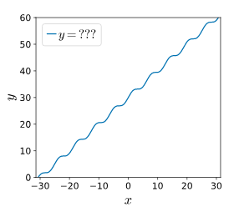
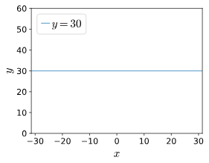
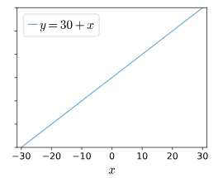
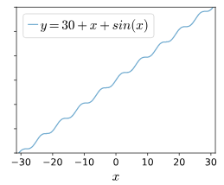

Illustration:
Mathematically,

Slide 6
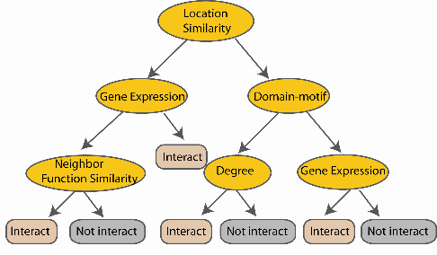
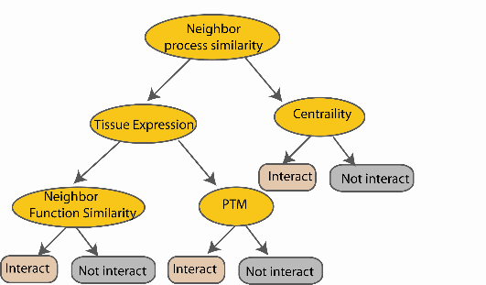

Random Forest Classifier – Uses Bagging
Training Data
For each test example, every decision tree votes.
Example is labeled as the class having majority of the votes
Building Decision Trees
....…
Bagging
Notes:
Finally the given an input data the decision is made as follows given an input data,

Slide 7
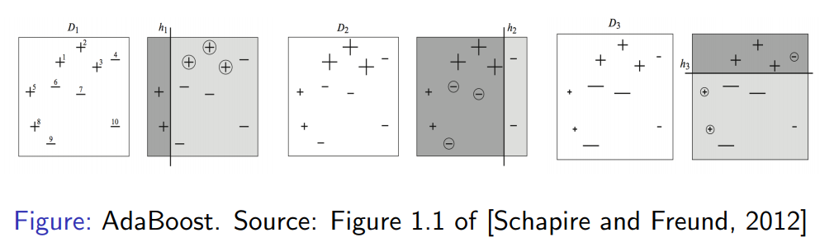
AdaBoost
Fit an additive model (ensemble) in a forward stage-wise manner
In each stage, introduce a weak learner to compensate the shortcomings of existing weak learners
“Shortcomings” are identified by high-weight data points

Slide 8
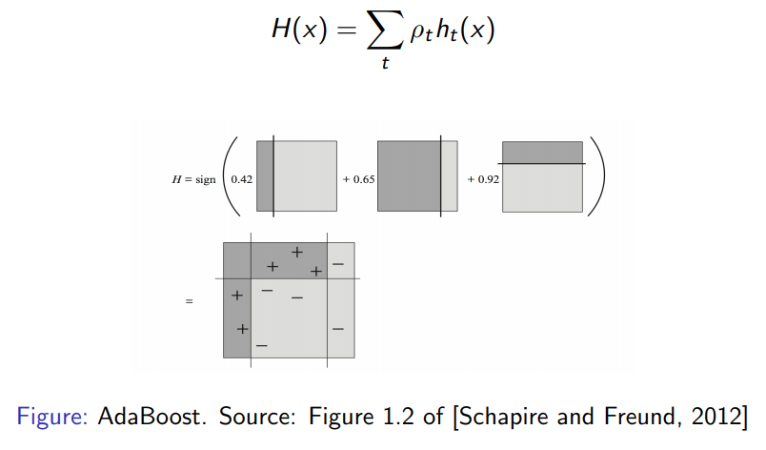

Slide 9
Building Intuition – Gradient Boosting Machines
You are given (x1, y1),(x2, y2), ...,(xn, yn), and the task is to fit a model F(x) to minimize square loss.
Suppose your friend wants to help you and gives you a model F. You check his model and find the model is good but not perfect.
There are some mistakes: F(x1) = 0.8, while y1 = 0.9, and F(x2) = 1.4 while y2 = 1.3...
How can you improve this model?
Rules of the game:
You are not allowed to remove anything from F or change any parameter in F
You can add an additional model (regression tree) h to F, so the new prediction will be F(x) + h(x).

Slide 10
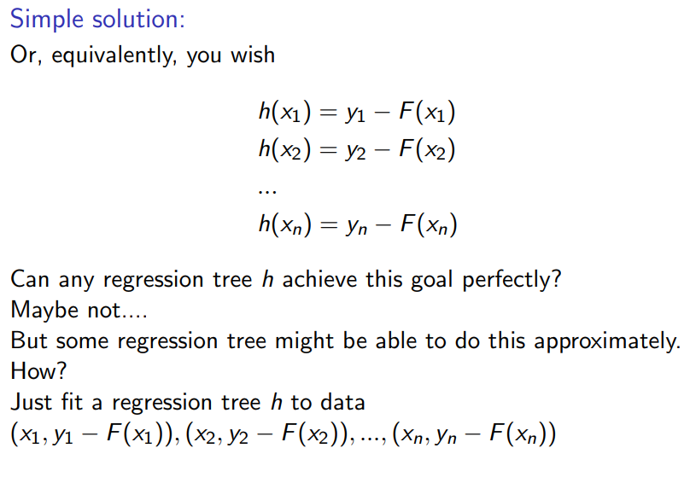

Slide 11
yi − F(xi) are called residuals
These are the parts that existing model F cannot do well. The role of h is to compensate the shortcoming of existing model F
If the new model F + h is still not satisfactory, we can add another regression tree...
We are improving the predictions of training data, is the procedure also useful for test data?
Yes! Because we are building a model, and the model can be applied to test data as well.

Slide 12
Gradient Boosting
Gradient Boosting = Gradient Descent + Boosting
Fit an additive model (ensemble) in a forward stage-wise manner
In each stage, introduce a weak learner to compensate the shortcomings of existing weak learners
In Gradient Boosting, “shortcomings” are identified by residuals/gradients
Recall that, in Adaboost, “shortcomings” are identified by high-weight data points
Both high-weight data points and gradients tell us how to improve our model.

Slide 13
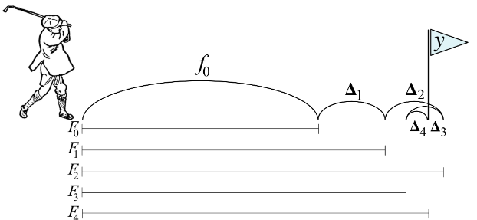
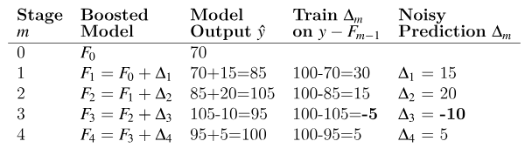
GBM / Residual Modeling?

Slide 14
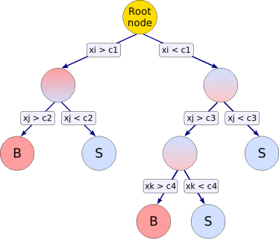
GBM (Gradient Boosting Machine)
Sequence of simple trees built in succession on the prediction residuals of preceding tree so as to improve on the prediction
Algorithm:
First tree fitted to data/mean(y) can be used
Residuals are computed
Regression tree is fitted to the residuals from the preceding tree
Process repeated through a chain of successive trees
Final predicted value is sum of weighted contribution of each tree
Compute Residuals
R_{mi} = y_{i} – F_{m-1}(x_{i})
R_{mi} is the residual of ith observation of mth tree
i is the indexes observations
F_{m-1} is the weighted sum of all previous m-1 regression trees
F_{m}=F_{m-1} + last regression tree of residuals
Features:
They often have a degree of accuracy that cannot be obtained using a large, single-tree model.
Can handle hundreds or thousands of potential predictor variables.
Irrelevant predictor variables are identified automatically and do not affect the predictive model.
They are invariant under all (strictly) monotone transformations of the predictor variables. So transformations such as (a*x+b), log(x) or exp(x) do not affect the model.
Can handle both continuous and categorical predictor and target variables.

Slide 15
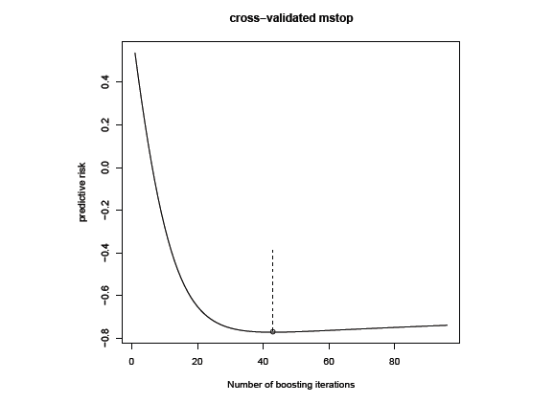
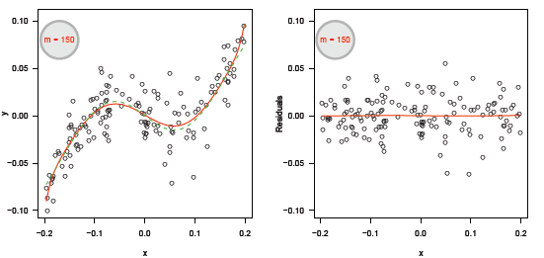
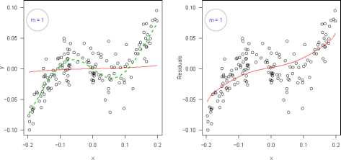
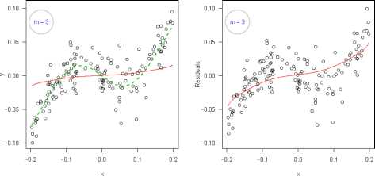
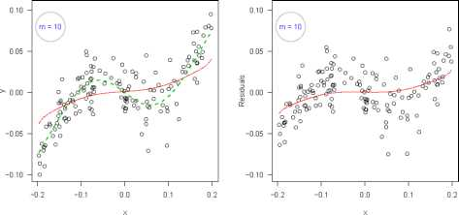
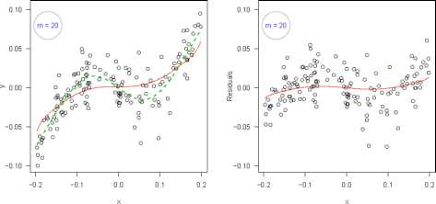
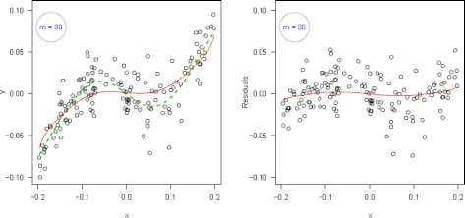
Illustration of Iterative boosting
In case of Gaussian regression, gradient boosting is equivalent to iteratively re-fitting the residuals of the model
m_{stop} is chosen using the cross validation technique such that it maximizes accuracy
y = (0.5 - 0.9 e^{-50 *x2}) x + 0.02 e
Residuals

Slide 16
Important parameters of GBM
Available options are "gaussian" (squared error), "laplace" (absolute loss), "bernoulli" (logistic regression for 0-1 outcomes), "adaboost" (the AdaBoost exponential loss for 0-1 outcomes), "poisson" (count outcomes), and "coxph" (right censored observations).
GBM
N-trees
Shrinkage
Cross Validation
Bag Fraction
Interactions
Distribution
Total number of trees to fit. This is equivalent to the number of iterations and the number of basis functions in the additive expansion.
This is to retard the learning rate of the series, so that series is longer and accuracy is better
Depth to which interaction must be considered is specified using this parameter.
Segments of data are used for model building and validation based on this parameter. Also, it helps in finding max iter.
At each iteration, only a random fraction, bag, of the residuals is selected and tree is built on this subset.

Slide 17
Thank You ☺

