Slide 2
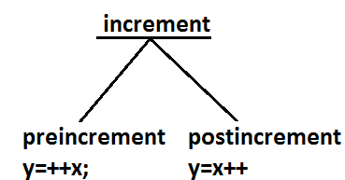
Increment & Decrement operators

Slide 3
Expression | initial value of x | value of y | final value of x
y=++x | 10 | 11 | 11
y=x++ | 10 | 10 | 11
y=--x | 10 | 9 | 9
y=x-- | 10 | 10 | 9
The following table will demonstrate the use of increment and decrement operators.

Slide 4
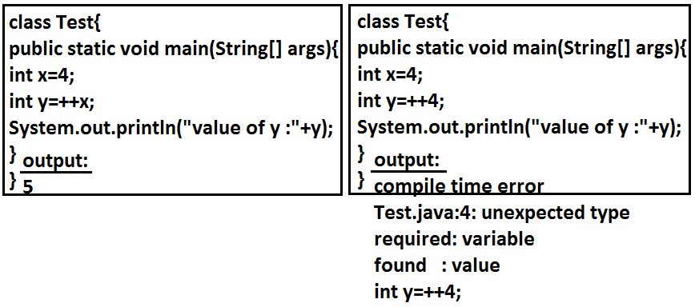

Slide 5
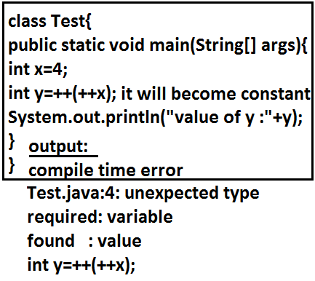

Slide 6
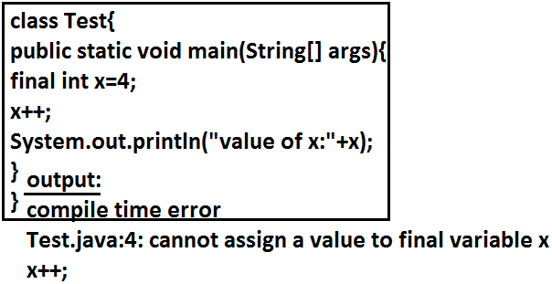

Slide 7
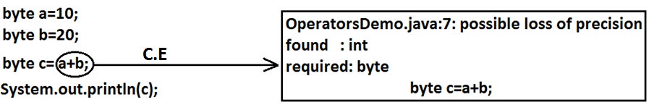
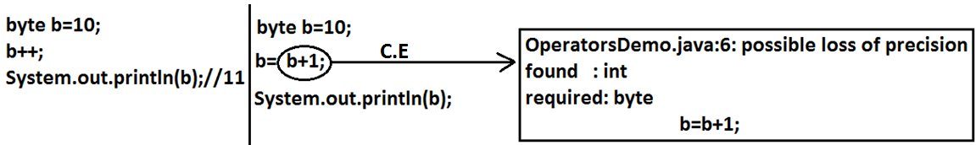
Difference between b++ and b = b+1?

Slide 8
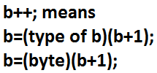
In the case of Increment & Decrement operators internal type casting will be performed automatically by the compiler

Slide 9
Arithmetic Operator :
If we apply any Arithmetic operation b/w 2 variables a & b , the result type is always max(int , type of a , type of b)

Slide 10
Example :
byte + byte=int
byte+short=int
short+short=int
short+long=long
double+float=double
int+double=double
char+char=int
char+int=int
char+double=double
System.out.println('a' + 'b'); // output : 195
System.out.println('a' + 1); // output : 98
System.out.println('a' + 1.2); // output : 98.

Slide 11
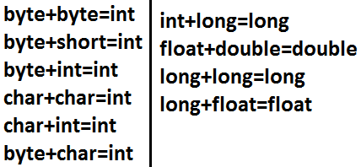

Slide 12
String Concatenation operator
Ex :
String a="ashok";
int b=10 , c=20 , d=30 ;
System.out.println(a+b+c+d); //output : ashok102030
System.out.println(b+c+d+a); //output : 60ashok
System.out.println(b+c+a+d); //output : 30ashok30
System.out.println(b+a+c+d); //output : 10ashok 2030

Slide 13
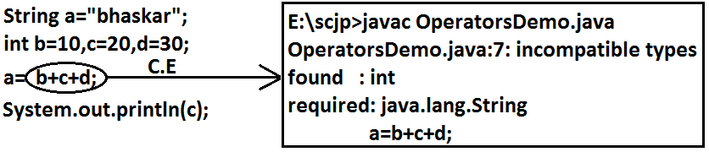

Slide 14
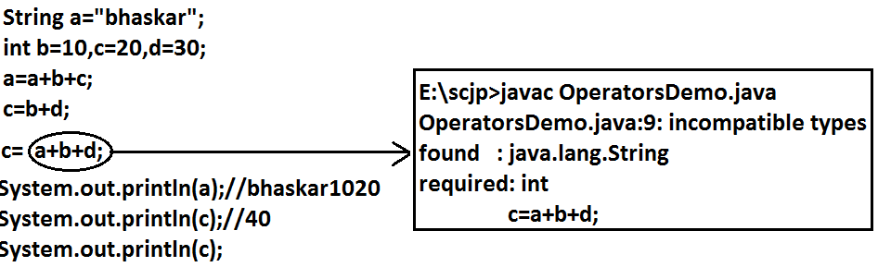

Slide 15

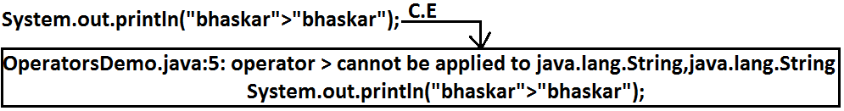
Relational Operators(< , <= , > , >= )

Slide 16
Equality Operators : (== , !=)
System.out.println(10 == 20) ; //false
System.out.println('a' == 'b' ); //false
System.out.println('a' == 97.0 ) //true
System.out.println(false == false) //true

Slide 17
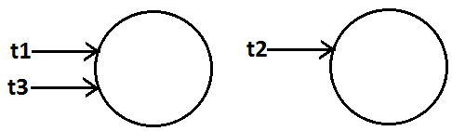
Thread t1=new Thread( ) ;
Thread t2=new Thread( );
Thread t3=t1 ;
System.out.println(t1==t2); //false
System.out.println(t1==t3); //true

Slide 19
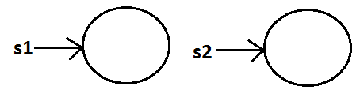
What is the difference between == operator and .equals( ) method ?
In general we can use .equals( ) for content comparision where as == operator for reference comparision
String s1=new String("ashok");
String s2=new String("ashok");
System.out.println(s1==s2); //false
System.out.println(s1.equals(s2)); //true

Slide 20
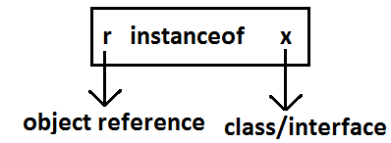
instanceof operator
We can use the instanceof operator to check whether the given an object is perticular type or not

Slide 21
Object o=l.get(0);
// l is an array name
if(o instanceof Student) {
Student s=(Student)o ;
//perform student specific operation
}
elseif(o instanceof Customer) {
Customer c=(Customer)o;
//perform Customer specific operations
}

Slide 22
Bitwise Operators : ( & , | , ^)
& (AND) : If both arguments are true then only result is true.
| (OR) : if at least one argument is true. Then the result is true.
^ (X-OR) : if both are different arguments. Then the result is true
System.out.println(true&false);//false
System.out.println(true|false);//true
System.out.println(true^false);//true

Slide 23
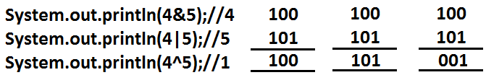

Slide 24

Bitwise complement (~) (tilde symbol) operator
We can apply this operator only for integral types but not for boolean types

Slide 25
Example :
System.out.println(~true); // CE :opetator ~ can not be applied to boolean
System.out.println(~4); //-5
description about above program :
4--> 0 000.......0100 0-----+ve
~4--> 1 111.......1011 1--- -ve
2's compliment of ~4 --> 000....0100 add 1
result is : 000...0101 =5

Slide 26
Boolean complement (!) operator
&
| Applicable for both boolean and integral types.
^
~ --------Applicable for integral types only but not for boolean types.
! --------Applicable for boolean types only but not for integral types.

Slide 27
Short circuit (&&, ||) operators
Output:
int x=10 , y=15 ;
if(++x < 10 || ++y > 15) { //instead of || using &,&&, | operators
x++;
}
else {
y++;
}
System.out.println(x+"----"+y);
operator | x | y
& | 11 | 17
| | 12 | 16
&& | 11 | 16
|| | 12 | 16

Slide 28

implicit type casting :
The compiler is responsible to perform this type casting.
When ever we are assigning lower datatype value to higher datatype variable then implicit type cast will be performed .
It is also known as Widening or Upcasting.
There is no lose of information in this type casting.
The following are various possible implicit type casting.

Slide 29
Example 1:
int x='a';
System.out.println(x);//97
Note: Compiler converts char to int type automatically by implicit type casting.
Example 2:
double d=10;
System.out.println(d);//10.0
Note: Compiler converts int to double type automatically by implicit type casting.

Slide 30
Explicit type casting:
Programmer is responsible for this type casting.
Whenever we are assigning bigger data type value to the smaller data type variable then explicit type casting is required.
Also known as Narrowing or down casting.
There may be a chance of lose of information in this type casting.
The following are various possible conversions where explicit type casting is required.

Slide 31
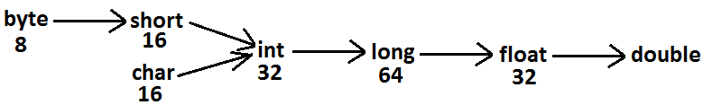

Slide 32
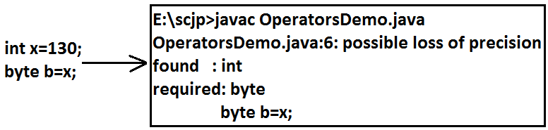

Slide 33
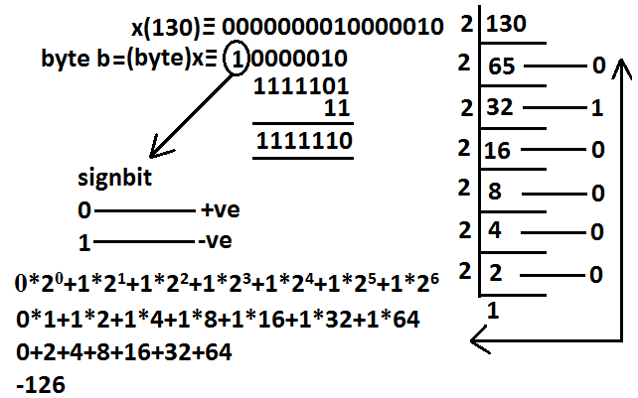
Example : int x=130; byte b=(byte)x; System.out.println(b); //-126

Slide 34
Assignment Operator
There are 3 types of assignment operators
Simple assignment:
Example: int x=10;
Chained assignment:
Example:
int a,b,c,d;
a=b=c=d=20;
System.out.println(a+"---"+b+"---"+c+"---"+d);//20---20---20---20
int b , c , d ;
int a=b=c=d=20 ; //valid

Slide 35
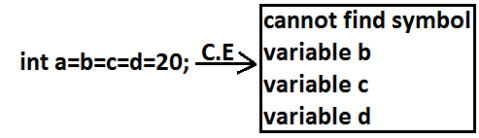
We can't perform chained assignment directly at the time of declaration.

Slide 36
Compound assignment
Sometimes we can mixed assignment operator with some other operator to form compound assignment operator.
Ex:
int a=10 ;
a +=20 ;
System.out.println(a); //30

Slide 37
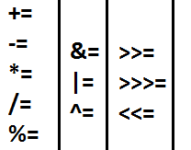

Slide 38
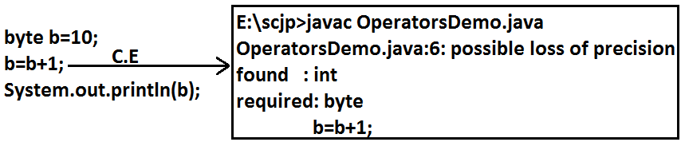

Slide 39
Conditional Operator (? :)
The only possible ternary operator in java is conditional operator
Ex 1 :
int x=(10>20)?30:40;
System.out.println(x); //40
Ex 2 :
int x=(10>20)?30:((40>50)?60:70);
System.out.println(x); //70

Slide 40
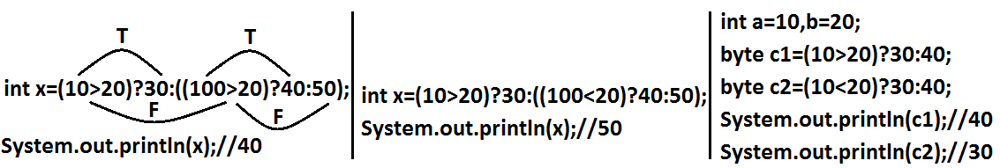

Slide 41
Java operator precedence
Unary operators: [] , x++ , x-- , ++x , --x , ~ , ! , new , <type>
Arithmetic operators : * , / , % , + , - .
Shift operators : >> , >>> , << .
Comparision operators : <, <=,>,>=, instanceof.
Equality operators: == , !=
Bitwise operators: & , ^ , | .
Short circuit operators: && , || .
Conditional operator: (?:)
Assignment operators: += , -= , *= , /= , %= . . .

Slide 42
Example:
class OperatorsDemo {
public static void main(String[] args) {
System.out.println(m1(1)+m1(2)*m1(3)/m1(4)*m1(5)+m1(6));
}
public static int m1(int i) {
System.out.println(i);
return i;
}

Slide 43
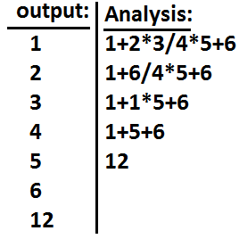

Slide 44
new Vs newInstance( )
new is an operator to create an objects , if we know class name at the beginning then we can create an object by using new operator .
newInstance( ) is a method presenting class " Class " , which can be used to create object.
If we don't know the class name at the beginning and its available dynamically Runtime then we should go for newInstance() method

Slide 45
public class Test {
public static void main(String[] args) Throws Exception {
Object o=Class.forName(arg[0]).newInstance( ) ;
System.out.println(o.getClass().getName( ) );
}
}

