Slide 1

Spark
Part-2

Slide 2
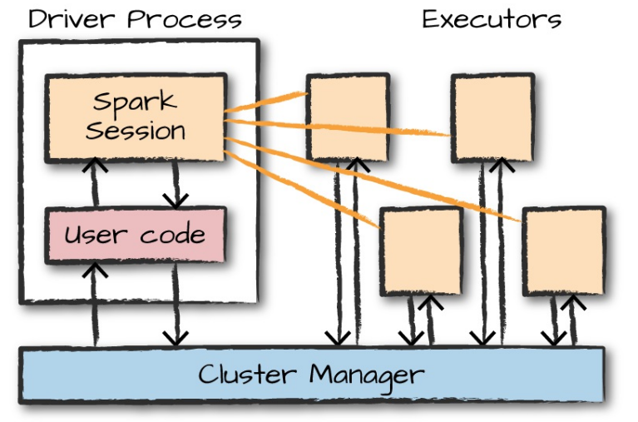
Spark Application Architecture

Slide 3
Components of Application Architecture
Driver Responsibilities:
Maintaining information about spark application
Responding to a user’s program or input;
Analyzing, distributing, and scheduling work across the executors
Executor Responsibilities:
Executing code assigned to it by the driver
Reporting the state of the computation on that executor back to the driver node
Cluster Manager
Managing and coordinating the execution of tasks on data across a cluster of computers.

Slide 4
Spark's Language API
The driver can be “driven” from a number of different languages through Spark’s language APIs
Spark’s language APIs make it possible for you to run Spark code using various programming languages.
Spark presents some core “concepts” in every language; these concepts are then translated into Spark code that runs on the cluster of machines.
Scala : Spark is primarily written in Scala, making it Spark’s “default” language.
Java : Even though Spark is written in Scala, Spark’s authors have been careful to ensure that you can write Spark code in Java.
Python: Python supports nearly all constructs that Scala supports
SQL: Spark supports a subset of the ANSI SQL 2003 standard. This makes it easy for analysts and non-programmers to take advantage of the big data powers of Spark
R : Spark has two commonly used R libraries: one as a part of Spark core (SparkR) and another as an R community-driven package (sparklyr)

Slide 5
Spark Session
Spark Application through a driver process called the Spark Session
The Spark Session instance is the way Spark executes user-defined manipulations across the cluster.
For starting the spark console:
Spark
In Scala, you should see something like the following:
res0: org.apache.spark.sql.SparkSession = org.apache.spark.sql.SparkSession@...
In Python you’ll see something like this:

Slide 6
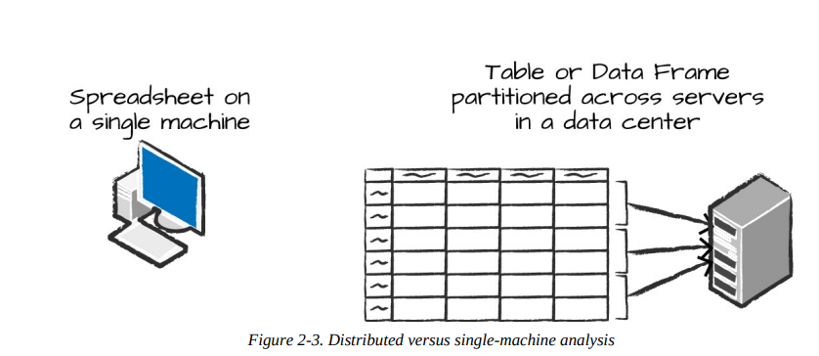
Spark APIs
Data Frames:
A DataFrame is the most common Structured API and simply represents a table of data with rows and columns.
The list that defines the columns and the types within those columns is called the schema.
A spreadsheet sits on one computer in one specific location, whereas a Spark DataFrame can span thousands of computers
R and Python both have similar concepts. However, Python/R DataFrames exist on one machine rather than multiple machines
As Spark has language interfaces for both Python and R, it’s quite easy to convert Pandas (Python) DataFrames to Spark DataFrames, and R DataFrames to Spark DataFrames. N

Slide 7
Spark APIs
Partitions :
A partition is a collection of rows that sit on one physical machine in your cluster. A DataFrame’s partitions represent how the data is physically distributed across the cluster of machines during execution.
A DataFrame’s partitions represent how the data is physically distributed across the cluster of machines during execution.
Spark's parallelism depends upon the availability of computation/ executing resources available

Slide 8
Spark APIs
Transformations:
In Spark, the core data structures are immutable, meaning they cannot be changed after they’re created.
The instructions we give Spark to tell it what modifications we want it to apply upon the Data Frames are called transformations.
Ex:
# in Scala
val divisBy2 = myRange.where("number % 2 = 0")
# in Python
divisBy2 = myRange.where("number % 2 = 0")
Spark will not act on transformations until we call an action

Slide 9
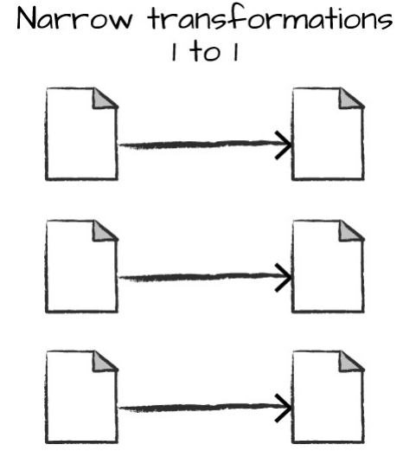
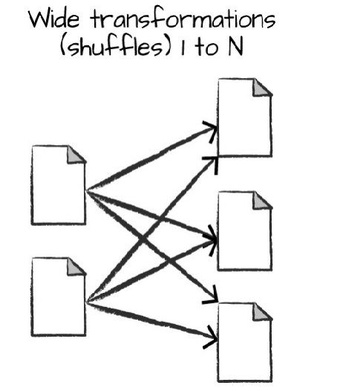
Types of Transformations

Slide 10
Lazy Evaluation
. In Spark, instead of modifying the data immediately when you express some operation, you build up a plan of transformations that you would like to apply to your source data.
By waiting until the last minute to execute the code, Spark compiles this plan from your raw DataFrame transformations to a streamlined physical plan that will run as efficiently as possible across the cluster.

Slide 11
Spark API
Actions:
Transformations allow us to build up our logical transformation plan.
To trigger the computation, we run an action.
An action instructs Spark to compute a result from a series of transformations
Ex:
divisBy2.count()
There are three kinds of actions:
Actions to view data in the console
Actions to collect data to native objects in the respective language
Actions to write to output data sources

Slide 12
An End-to-End Example
Consider a csv (semistructured data) file of an Airline having the details of Destination and Origin countries of a flight passengers.
$ head /data/flight-data/csv/2015-summary.csv
DEST_COUNTRY_NAME, ORIGIN_COUNTRY_NAME, count
United States,Romania,15
United States,Croatia,1
United States,Ireland,344

Slide 13
Reading a CSV file
// in Scala
val flightData2015 = spark .read .option("inferSchema", "true") .option("header", "true") .csv("/data/flight-data/csv/2015-summary.csv")
# in Python
flightData2015 = spark\ .read\ .option("inferSchema", "true")\ .option("header", "true")\ .csv("/data/flight-data/csv/2015-summary.csv")

Slide 14
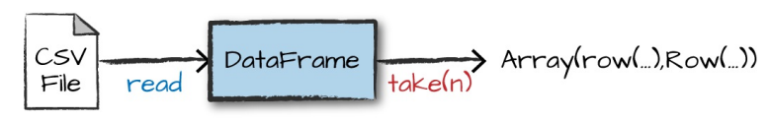
An End-to-End Example
Each of these DataFrames (in Scala and Python) have a set of columns with an unspecified number of rows.
The reason the number of rows is unspecified is because reading data is a transformation, and is therefore a lazy operation.
Reading rows and imposing array like structure on them
flightData2015.take(3)

Slide 15
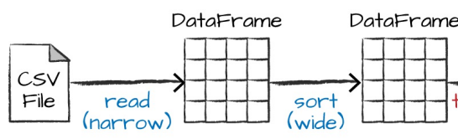
An End-to-End Example
Sort our data according to the count column.
Sort does not modify the DataFrame.
We use sort as a transformation that returns a new DataFrame by transforming the previous DataFrame

Slide 16
An End-to-End Example
Explain plan
flightData2015.sort("count").explain()
= Physical Plan ==
*Sort [count#195 ASC NULLS FIRST], true, 0
+- Exchange rangepartitioning(count#195 ASC NULLS FIRST, 200)
+- *FileScan csv [DEST_COUNTRY_NAME#193,ORIGIN_COUNTRY_NAME#194,count#195] ...

Slide 17
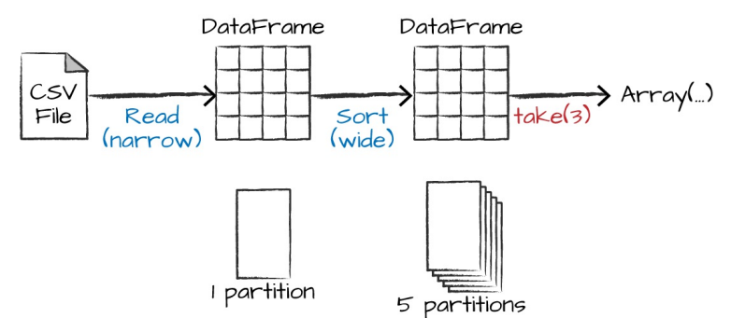
An End-to-End Example
Above shown execution plan will be executed upon applying an action 'take'
By default, when we perform a shuffle, Spark outputs 200 shuffle partitions.
But we can change the no: by configuring
spark.conf.set("spark.sql.shuffle.partitions", "5")
flightData2015.sort("count").take(2)
... Array([United States,Singapore,1], [Moldova,United States,1])

Slide 18
DataFrames and SQL
A user can express your business logic in SQL or DataFrames (either in R, Python, Scala, or Java)
Spark will compile that logic down to an underlying plan before actually executing your code
With Spark SQL, you can register any DataFrame as a table or view (a temporary table) and query it using pure SQL.
Ex:
flightData2015.createOrReplaceTempView("flight_data_2015")
General SQL queries can be applied upon this converted data by using a spark session variable Spark
A SQL query against a DataFrame returns another DataFrame.

Slide 19
Example Dataframe Querying
// in Scala
val sqlWay = spark.sql(""" SELECT DEST_COUNTRY_NAME, count(1)
FROM flight_data_2015 GROUP BY DEST_COUNTRY_NAME """)
val dataFrameWay = flightData2015 .groupBy('DEST_COUNTRY_NAME) .count()
sqlWay.explain
dataFrameWay.explain

Slide 20
== Physical Plan ==
*HashAggregate(keys=[DEST_COUNTRY_NAME#182], functions=[count(1)])
+- Exchange hashpartitioning(DEST_COUNTRY_NAME#182, 5)
+- *HashAggregate(keys=[DEST_COUNTRY_NAME#182], functions=[partial_count(1)])
+- *FileScan csv [DEST_COUNTRY_NAME#182] ...
== Physical Plan ==
*HashAggregate(keys=[DEST_COUNTRY_NAME#182], functions=[count(1)])
+- Exchange hashpartitioning(DEST_COUNTRY_NAME#182, 5)
+- *HashAggregate(keys=[DEST_COUNTRY_NAME#182], functions=[partial_count(1)])
+- *FileScan csv [DEST_COUNTRY_NAME#182] ..

Slide 21
Example Dataframe Querying
We will use the max function, to establish the maximum number of flights to and from any given location
SQL
spark.sql("SELECT max(count) from flight_data_2015").take(1)
DataFrame
// in Scala
import org.apache.spark.sql.functions.max
flightData2015.select(max("count")).take(1)
# in Python
from pyspark.sql.functions import max
flightData2015.select(max("count")).take(1)

Slide 22
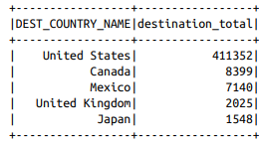
Example Dataframe Querying- SQL
// in Scala
val maxSql = spark.sql(""" SELECT DEST_COUNTRY_NAME, sum(count) as destination_total FROM flight_data_2015 GROUP BY DEST_COUNTRY_NAME ORDER BY sum(count) DESC LIMIT 5 """)
maxSql.show()
# in Python
maxSql = spark.sql(""" SELECT DEST_COUNTRY_NAME, sum(count) as destination_total FROM flight_data_2015 GROUP BY DEST_COUNTRY_NAME ORDER BY sum(count) DESC LIMIT 5 """)
maxSql.show()

Slide 23
Example Dataframe Querying - DataFrame
# in Python
from pyspark.sql.functions import desc
flightData2015\
.groupBy("DEST_COUNTRY_NAME")\ .sum("count")\ .withColumnRenamed("sum(count)",
"destination_total")\
.sort(desc("destination_total"))\
.limit(5)\ .show()
// in Scala
import org.apache.spark.sql.functions.desc
flightData2015
.groupBy("DEST_COUNTRY_NAME")
.sum("count")
.withColumnRenamed("sum(count)", "destination_total")
.sort(desc("destination_total"))
.limit(5) .show()

Slide 24
Spark Toolkit –Running Production Applications
Spark also makes it easy to turn your interactive exploration into production applications with spark-submit, a built-in command-line tool
It lets you send your application code to a cluster and launch it to execute there. Upon submission, the application will run until it exits (completes the task) or encounters an error.
All Spark’s support cluster managers including Standalone, Mesos, and YARN will accommodate this functionality.
You can write applications in any of Spark’s supported languages and then submit them for execution.

Slide 25
Running Production Applications
./bin/spark-submit \
-class org.apache.spark.examples.SparkPi \
--master local \
./examples/jars/spark-examples_2.11-2.2.0.jar 10
master- used to specify the cluster manager upon which the code has to be executed
class – used to specify the class name to be executed
Jar file – specifies the location of the desired file

Slide 26
Datasets: Type-Safe Structured APIs
Dataset is a type-safe version of Spark’s structured API
It can be used for writing statically typed code in Java and Scala
The Dataset API is not available in Python and R, because those languages are dynamically typed.
The Dataset API gives users the ability to assign a Java/Scala class to the records within a DataFrame and manipulate it as a collection of typed objects, similar to a Java ArrayList or Scala Seq.
The APIs available on Datasets are type-safe, meaning that you cannot accidentally view the objects in a Dataset as being of another class than the class you put in initially.
The Dataset class is parameterized with the type of object contained inside: Dataset in Java and Dataset[T] in Scala.
Datasets can be used only when you need or want to
After we’ve performed our manipulations, Spark can automatically turn it back into a DataFrame, and we can manipulate it further by using the hundreds of functions that Spark includes.

Slide 27
When to use Datasets
When the operation(s) you would like to perform cannot be expressed using DataFrame manipulations
When you want or need type-safety, and you’re willing to accept the cost of performance to achieve it

Slide 28
Dataset- Example
Example showing how you can use both type-safe functions and DataFrame-like SQL expressions to quickly write business logic:
// in Scala
case class Flight(DEST_COUNTRY_NAME: String, ORIGIN_COUNTRY_NAME: String, count: BigInt)
val flightsDF = spark.read .parquet("/data/flight-data/parquet/2010-summary.parquet/")
val flights = flightsDF.as[Flight]
flights .filter(flight_row => flight_row.ORIGIN_COUNTRY_NAME != "Canada") .map(flight_row => flight_row) .take(5)

Slide 29
Structured Streaming
Structured Streaming is a high-level API for stream processing
With Structured Streaming, you can take the same operations that you perform in batch mode using Spark’s structured APIs and run them in a streaming fashion. This can reduce latency and allow for incremental processing
Structured Streaming allows us to rapidly and quickly extract value out of streaming systems with virtually no code changes

Slide 30
Retail Dataset Example
InvoiceNo,StockCode,Description,Quantity,InvoiceDate,UnitPrice,CustomerID,Country 536365,85123A,WHITE HANGING HEART T-LIGHT HOLDER,6,2010-12-01 08:26:00,2.55,17... 536365,71053,WHITE METAL LANTERN,6,2010-12-01 08:26:00,3.39,17850.0,United Kin... 536365,84406B,CREAM CUPID HEARTS COAT HANGER,8,2010-12-01 08:26:00,2.75,17850...

Slide 31
Analyze the data as a static dataset
// in Scala
val staticDataFrame = spark.read.format("csv")
.option("header", "true")
.option("inferSchema", "true")
.load("/data/retail-data/by-day/*.csv")
staticDataFrame.createOrReplaceTempView("retail_data")
val staticSchema = staticDataFrame.schema
// in Python
staticDataFrame = spark.read.format("csv")\
.option("header", "true") \
.option("inferSchema", "true")\
.load("/data/retail-data/by-day/*.csv")
staticDataFrame.createOrReplaceTempView("retail_data")
staticSchema = staticDataFrame.schema

Slide 32
on what days a customer spent the most?
// in Scala
import org.apache.spark.sql.functions.{window, column, desc, col}
staticDataFrame
.selectExpr( "CustomerId", "(UnitPrice * Quantity) as total_cost", "InvoiceDate")
.groupBy( col("CustomerId"), window(col("InvoiceDate"), "1 day"))
.sum("total_cost") .show(5)

Slide 33
# in Python
from pyspark.sql.functions import window, column, desc, col
staticDataFrame\
.selectExpr( "CustomerId", "(UnitPrice * Quantity) as total_cost", "InvoiceDate")\
.groupBy( col("CustomerId"), window(col("InvoiceDate"), "1 day"))\
.sum("total_cost")\ .show(5)

Slide 34
Streaming code
// in Scala
val streamingDataFrame = spark.readStream
.schema(staticSchema)
.option("maxFilesPerTrigger", 1) // No: of files to read at once
.format("csv")
.option("header", "true")
.load("/data/retail-data/by-day/*.csv")
# in Python
streamingDataFrame = spark.readStream\
.schema(staticSchema)\
.option("maxFilesPerTrigger", 1)\
.format("csv")\
.option("header", "true")\
.load("/data/retail-data/by-day/*.csv")
streamingDataFrame.isStreaming / --- Tells wheather our data is streaming or not

Slide 35
on what days a customer spent the most?​
// in Scala
val purchaseByCustomerPerHour = streamingDataFrame
.selectExpr( "CustomerId", "(UnitPrice * Quantity) as total_cost", "InvoiceDate")
.groupBy( $"CustomerId", window($"InvoiceDate", "1 day"))
.sum("total_cost")
# in Python
purchaseByCustomerPerHour = streamingDataFrame\
.selectExpr( "CustomerId", "(UnitPrice * Quantity) as total_cost", "InvoiceDate")\
.groupBy( col("CustomerId"), window(col("InvoiceDate"), "1 day"))\
.sum("total_cost")

Slide 36
Actions in Straming
Abobe operation is a lazy operation, so we will need to call a streaming action to start the execution of this data flow.
Streaming actions are a bit different from our conventional static action because we’re going to be populating data somewhere instead of just calling something like count.
The action we will use will output to an in-memory table that we will update after each trigger.
Spark will mutate the data in the in-memory table such that we will always have the highest value.

Slide 37
Updating the result
// in Scala
purchaseByCustomerPerHour.writeStream
.format("memory") // memory = store in-memory table
.queryName("customer_purchases") // the name of the in-memory table
.outputMode("complete") // complete = all the counts should be in the table
.start()
# in Python
purchaseByCustomerPerHour.writeStream\
.format("memory")\
.queryName("customer_purchases")\
.outputMode("complete")\
.start()

Slide 38
Querying the updated data
// in Scala
spark.sql(""" SELECT * FROM customer_purchases ORDER BY `sum(total_cost)` DESC """)
.show(5)
# in Python
spark.sql(""" SELECT * FROM customer_purchases ORDER BY `sum(total_cost)` DESC """)\
.show(5)

Slide 39
Display the result on Console
purchaseByCustomerPerHour.writeStream
.format("console")
.queryName("customer_purchases_2")
.outputMode("complete")
.start()

Slide 40
Machine Learning and Advanced Analytics
Another popular aspect of Spark is its ability to perform large-scale machine learning with a built-in library of machine learning algorithms called MLlib.
MLlib allows for preprocessing, munging, training of models, and making predictions at scale on data.
We can even use models trained in MLlib to make predictions in Strucutred Streaming.
Spark provides a sophisticated machine learning API for performing classification, regression, clustering and deep learning.

Slide 41
Preprocessing
Spark includes a number of preprocessing methods out of the box.
Raw data
staticDataFrame.printSchema()
root
|-- InvoiceNo: string (nullable = true)
|-- StockCode: string (nullable = true)
|-- Description: string (nullable = true)
|-- Quantity: integer (nullable = true)
|-- InvoiceDate: timestamp (nullable = true)
|-- UnitPrice: double (nullable = true)
|-- CustomerID: double (nullable = true)
|-- Country: string (nullable = true)
Machine learning algorithms in MLlib require that data is represented as numerical values.
Therefore we need to transform this data into some numerical representation.

Slide 42
// in Scala
import org.apache.spark.sql.functions.date_format
val preppedDataFrame = staticDataFrame
.na.fill(0) // convert all NULL entries to 0
withColumn("day_of_week", date_format($"InvoiceDate", "EEEE")) // createa new column which has the day_of_the _week format of date
.coalesce(5) // Limit the no: of partitions to 5
# in Python
from pyspark.sql.functions import date_format, col
preppedDataFrame = staticDataFrame\
.na.fill(0)\
.withColumn("day_of_week", date_format(col("InvoiceDate"), "EEEE"))\
.coalesce(5)

Slide 43
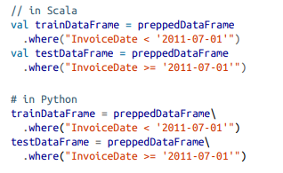

Train and Test Sets
Manually split the data into training and test sets by the date on which a certain purchase occurred.
To check the no: of samples in each set

Slide 44
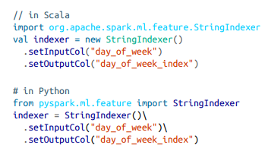
General Transformation with StringIndexer
This will turn our days of weeks into corresponding numerical values.
For example, Spark might represent Saturday as 6, and Monday as 1.

Slide 45
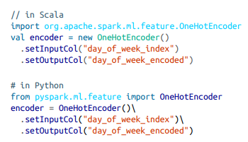
OneHotEncoding
If we do not want to assign more value to one entry over the other by assigning poor numeric value, we use a OneHotEncoder to encode each of these values as their own column.

Slide 46
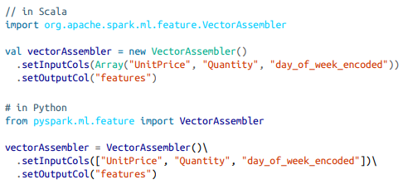
Preparing Feature Vector

Slide 47
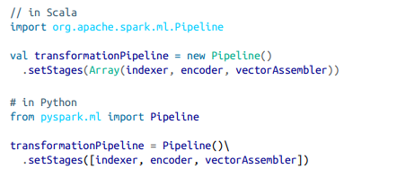
Pipeline

Slide 48


Model Fitting
We first need to fit our transformers to the required dataset.
Pipeline fitted in this way can be used to transform all of our data in a consistent and repeatable way:

Slide 49
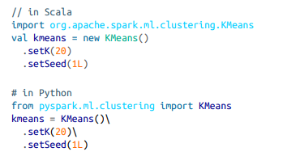
Training
We’ll use caching, an optimization that will put a copy of the intermediately transformed dataset into memory, allowing us to repeatedly access it at much lower cost than running the entire pipeline again.
Initiate ML algorithm

Slide 50
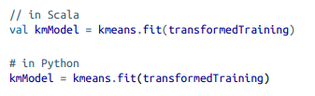
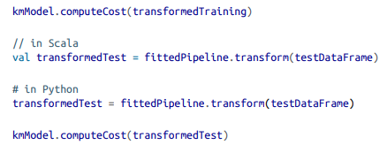
Training
Computing Cost

