Slide 1
MongoDB
UNIT3-Part2

Slide 2
Overview
MogoDB is a cross-platform, document oriented NoSQL database
Initially released on August 27,2009
MongoDB replaces the concept of rows in RDBMS with that of Documents
It’s a Schema Free model with High Performance, High Availability
Easy Scalability

Slide 3
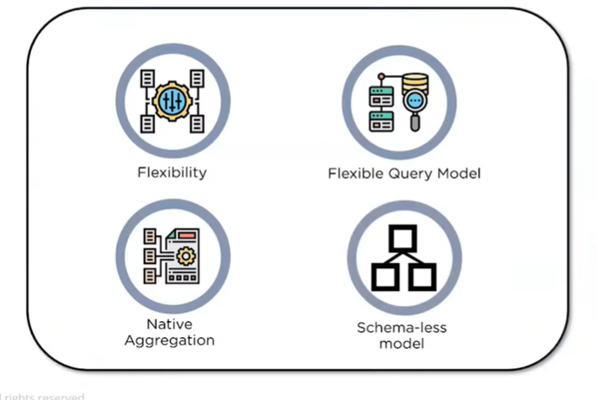
Why MongoDB
Flexibility
Nested and hierarchical structure of documents makes it is flexible and expressive
Flexible Query Model
Any part of the Database can be accessed by developing queries based on attribute values, regular expressions and ranges
Navigate Aggregation
Allows the data to be loaded from and exported to any data source or application
Schema-less Model
Different properties can be represented in different ways

Slide 4
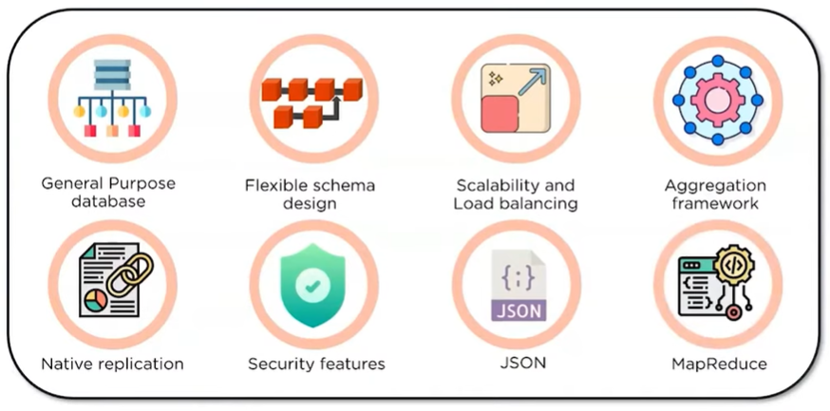
Characteristics of MongoDB

Slide 5
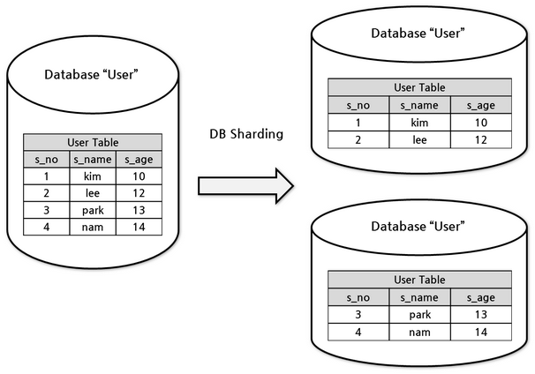
Characteristics of MongoDB
General Purpose Database
Can serve heterogeneous data sources and multiple purposes of an application
Flexible Schema
Non-defined attributes that can be modified on the fly makes it flexible
Scalability and Load-balancing
Mongodb scales both vertically and horizontally
Sharding concept achieves load-balancing
Aggregation Framework
Offers an ETL(Extract Load and Transform) Framework that eliminates the need for complex data pipeline

Slide 6
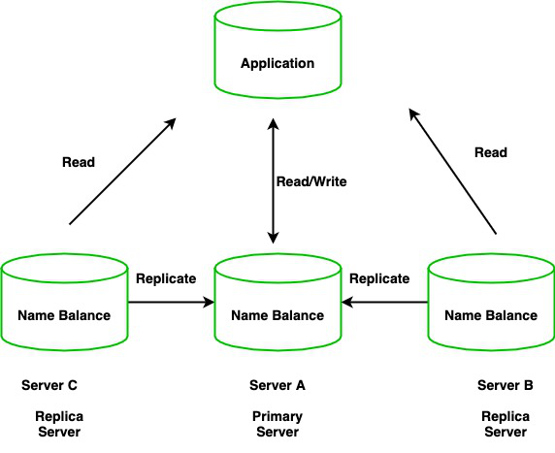
Characteristics of MongoDB
Native Replication
Data gets replicated across set of replications
Security Features
implements Authentication and Authorization
JSON compatibility
The database structure is compatible with the JSON structure which is being used by most of the Internet applications
Mapreduce
Works with Mapreduce readily

Slide 7
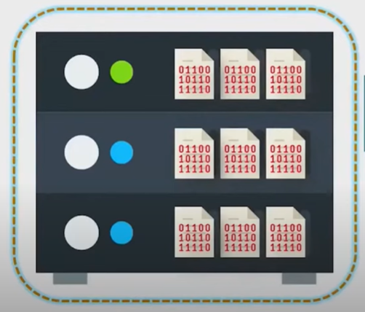
Working of MongoDB
Document
Collection
Binary Format- B-SON
Database

Slide 8
MongoDB
Database
Database is a physical container for collections. Each database gets its own set of files on the file system. A single MongoDB server typically has multiple databases.
Collection
Collection is a group of MongoDB documents. It is the equivalent of an RDBMS table. A collection exists within a single database. Collections do not enforce a schema. Documents within a collection can have different fields. Typically, all documents in a collection are of similar or related purpose.
Document
A document is a set of key-value pairs. Documents have dynamic schema. Dynamic schema means that documents in the same collection do not need to have the same set of fields or structure, and common fields in a collection's documents may hold different types of data.

Slide 9
Relation between RDBMS and MongoDB
RDBMS | MongoDB
Database | Database
Table | Collection
Tuple/Row | Document
column | Field
Table Join | Embedded Documents
Primary Key | Primary Key (Default key _id provided by MongoDB itself)
Database Server and Client
mysqld/Oracle | mongod
mysql/sqlplus | mongo

Slide 10
Environment
Installing MongoDB in ubuntu
Command to import the MongoDB public GPG(GNU Privacy Guard) key
sudo apt-key adv --keyserver hkp://keyserver.ubuntu.com:80 --recv 7F0CEB10
Downloading MongoDB repository
echo 'deb http://downloads-distro.mongodb.org/repo/ubuntu-upstart dist 10gen' | sudo tee /etc/apt/sources.list.d/mongodb.list
update the repository
sudo apt-get update(upgrade)
install the MongoDB
apt-get install mongodb-10gen = 4.2

Slide 11
Environment
Start MongoDB
sudo service mongodb start
Stop MongoDB
sudo service mongodb stop
Restart MongoDB
sudo service mongodb restart
To use MongoDB run the following command.
mongo

Slide 12
Data Modelling
MongoDB's data will have flexible scheme.
It is not mandatory for all the collections to have same set of fields.
Common fields of different collections can hold different values of different datatype.
MongoDB provides two different Data models
Embedded Data Model
Organizes all the related documents in a single collection
Normalized Data Model
Organizes related documents separately by maintaining reference links

Slide 13
Embedded Data Model
{
_id: ,
Emp_ID: "10025AE336"
Personal_details:
{
First_Name: "Parth",
Last_Name: "Goel",
Date_Of_Birth: "1985-09-26"
},
Contact:
{
email: "parth_goel@gmail.com",
phone: "9876543210"
},
Address:
{
city: "Chicago",
Area: "North America",
State: "USA"
}
}

Slide 14
Normalized Data Model
Employee:
{
_id: <ObjectId101>,
Emp_ID: "10025AE336"
}
Personal_details:
{
_id: <ObjectId102>,
empDocID: " ObjectId101",
First_Name: "Parth",
Last_Name: "Goel",
Date_Of_Birth: "1985-09-26"
},
Contact:
{
_id: <ObjectId103>,
empDocID: " ObjectId101",
email: "parth_goel@gmail.com",
phone: "9876543210"
},
Address:
{
_id: <ObjectId104>,
empDocID: " ObjectId101",
city: "Chicago",
Area: "North America",
State: "USA"
}

Slide 15
Datatypes
String − This is the most commonly used datatype to store the data. String in MongoDB must be UTF-8 valid.
Integer − This type is used to store a numerical value. Integer can be 32 bit or 64 bit depending upon your server.
Boolean − This type is used to store a boolean (true/ false) value.
Double − This type is used to store floating point values.
Min/ Max keys − This type is used to compare a value against the lowest and highest BSON elements.
Arrays − This type is used to store arrays or list or multiple values into one key.
Timestamp − ctimestamp. This can be handy for recording when a document has been modified or added.
Object − This datatype is used for embedded documents.

Slide 16
Datatypes
Null − This type is used to store a Null value.
Symbol − This datatype is used identically to a string; however, it's generally reserved for languages that use a specific symbol type.
Date − This datatype is used to store the current date or time in UNIX time format. You can specify your own date time by creating object of Date and passing day, month, year into it.
Object ID − This datatype is used to store the document’s ID.
Binary data − This datatype is used to store binary data.
Code − This datatype is used to store JavaScript code into the document.
Regular expression − This datatype is used to store regular expression.

Slide 17
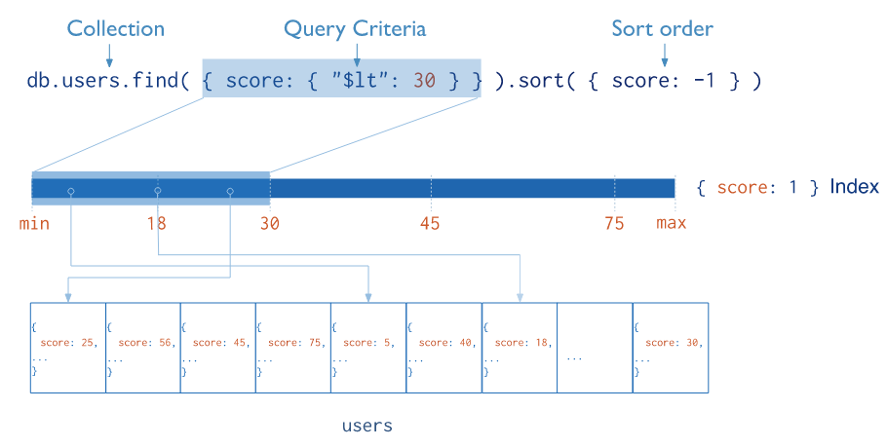
Indexing in MongoDB
Indexes support the efficient execution of queries in MongoDB
If an appropriate index exists for a query, MongoDB can use the index to limit the number of documents it must inspect.
Indexes are special data structures that store a small portion of the collection's data set in an easy to traverse form.
The index stores the value of a specific field or set of fields, ordered by the value of the field

Slide 18
Indexing in MongoDB
MongoDB creates a unique index on the _id field during the creation of a collection.
For creating an index in MongoDB we use
db.collection.createIndex()
Syntax db.collection.createIndex( <key and index type specification>, <options> )
1st Parameter : document that contains the field and value pairs where the field is the index key and the value describes the type of index for that field.

Slide 19
Aggregation
Aggregation operations process multiple documents and return computed results.
They can be used to:
Group values from multiple documents together.
Perform operations on the grouped data to return a single result.
Analyze data changes over time.
Aggregation pipelines are the preferred method for performing aggregations.
An aggregation pipeline consists of one or more stages that process documents:
Each stage performs an operation on the input documents. For example, a stage can filter documents, group documents, and calculate values.
The documents that are output from a stage are passed to the next stage.
An aggregation pipeline can return results for groups of documents. For example, return the total, average, maximum, and minimum values.

Slide 20
db.orders.aggregate( [
// Stage 1: Filter pizza order documents by pizza size
{
$match: { size: "medium" }
},
// Stage 2: Group remaining documents by pizza name and calculate total quantity
{
$group: { _id: "$name", totalQuantity: { $sum: "$quantity" } }
}
] )

Slide 21
Single Purpose Aggregation Methods
The single purpose aggregation methods aggregate documents from a single collection. The methods are simple but lack the capabilities of an aggregation pipeline.
Method | Description
db.collection.estimatedDocumentCount() | Returns an approximate count of the documents in a collection or a view.
db.collection.count() | Returns a count of the number of documents in a collection or a view.
db.collection.distinct() | Returns an array of documents that have distinct values for the specified field.

Slide 22
Replica set in MongoDB
A replica set in MongoDB is a group of mongod processes that maintain the same data set.
Replica sets provide redundancy and high availability, and are the basis for all production deployments.
Replication provides redundancy and increases data availability.
With multiple copies of data on different database servers, replication provides a level of fault tolerance against the loss of a single database server.
replication can provide increased read capacity as clients can send read operations to different servers.
Maintaining copies of data in different data centers can increase data locality and availability for distributed applications.
You can also maintain additional copies for dedicated purposes, such as disaster recovery, reporting, or backup.

Slide 23
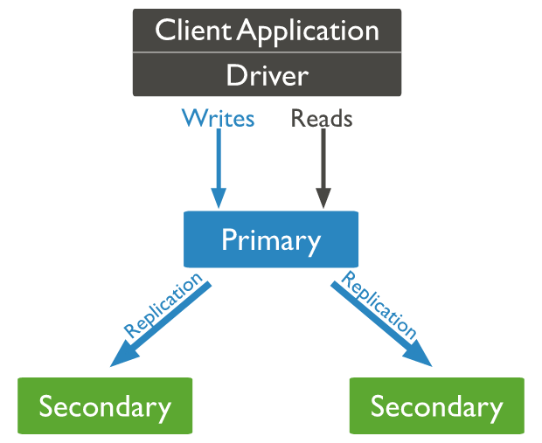
Replica set
A replica set is a group of mongod instances that maintain the same data set
A replica set contains several data bearing nodes and optionally one arbiter node.
Of the data bearing nodes, one and only one member is deemed the primary node
The other nodes are deemed secondary nodes.
The primary node receives all write operations.
The primary records all changes to its data sets in its operation log, i.e. oplog

Slide 24
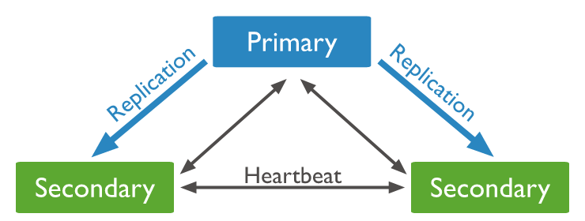
Replica set
The secondaries replicate the primary's oplog and apply the operations to their data sets such that the secondaries' data sets reflect the primary's data set.
If the primary is unavailable, an eligible secondary will hold an election to elect itself the new primary.

Slide 25
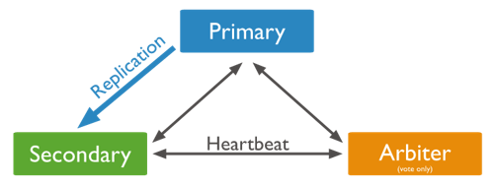
Replica set
When we cannot afford for additional secondary node, we may choose to add a mongod instance to a replica set as an arbiter.
An arbiter participates in elections but does not hold data
An arbiter will always be an arbiter whereas
A primary may step down and become a secondary and
A secondary may become the primary during an election.

Slide 26
Sharding
Sharding is a method for distributing data across multiple machines.
A Database systems with large data sets or high throughput applications can challenge the capacity of a single server.
Ex: High query rates can exhaust the CPU capacity of the server
There are two methods for addressing system growth:
vertical and horizontal scaling.
MongoDB supports horizontal scaling through sharding.

Slide 27
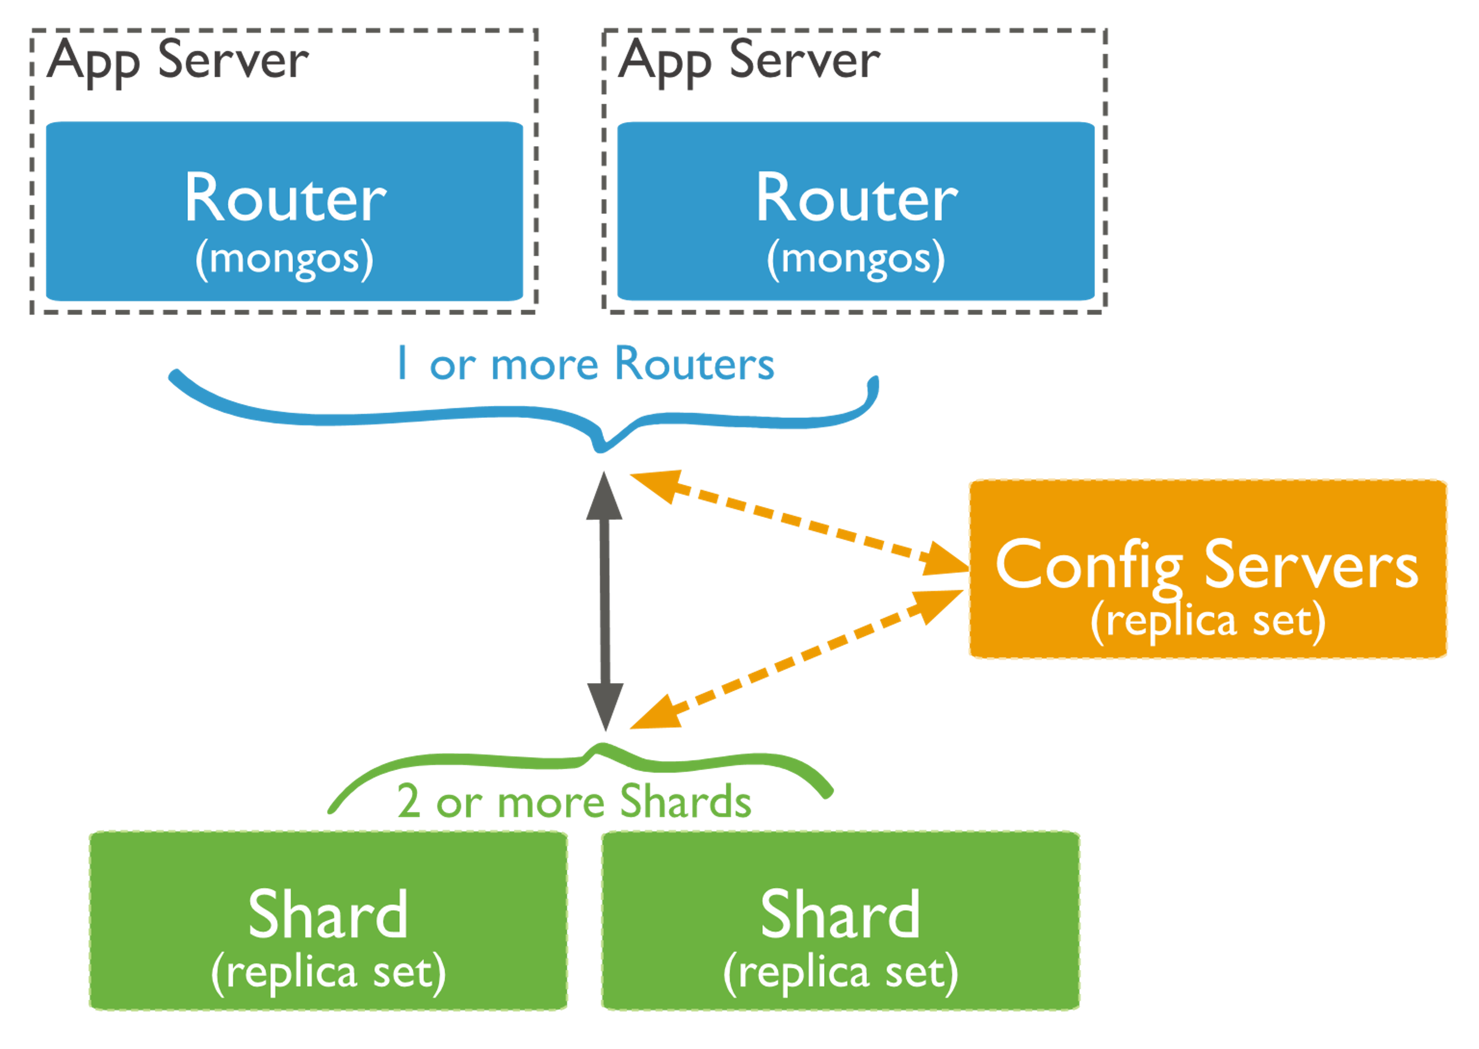
Sharded Cluster-Architecture
A MongoDB sharded cluster consists of the following components:
shard: Each shard contains a subset of the sharded data. Each shard can be deployed as a replica set.
mongos: The mongos acts as a query router, providing an interface between client applications and the sharded cluster.
​​​
config servers: Config servers store metadata and configuration settings for the cluster.​​​
​​​

Slide 28
Shard Keys
MongoDB uses the shard key to distribute the collection's documents across shards.
The shard key consists of a field or multiple fields in the documents.
In version 4.2 and earlier, shard key fields must exist in every document for a sharded collection.
the choice of shard key cannot be changed after sharding.
a document's shard key field value is immutable.
Starting in version 4.4 , documents in sharded collections can be missing the shard key fields.
you can refine a shard key by adding a suffix field or fields to the existing shard key.
Missing shard key fields are treated as having null values when distributing the documents across shards but not when routing queries.

Slide 29
Missing Shard Keys
Document Missing Shard Key | Falls into Same Range As
{ x: "hello" } | { x: "hello", y: null }
{ y: "goodbye" } | { x: null, y: "goodbye" }
{ z: "oops" } | { x: null, y: null }
To target documents with missing shard key fields, you can use the { $exists: false } filter condition on the shard key fields.
db.shardedcollection.find( { $or: [ { x: { $exists: false } }, { y: { $exists: false } } ] } )
For some write operations, which require an equality match on the shard key, we should include another filter condition with document id
{ _id: <value>, <shardkeyfield>: null }

Slide 30
Chunks
MongoDB partitions sharded data into chunks.
Each chunk has an inclusive lower and exclusive upper range based on the shard key
In an attempt to achieve an even distribution of chunks across all shards in the cluster, a balancer runs in the background to migrate chunks across the shards.

Slide 31
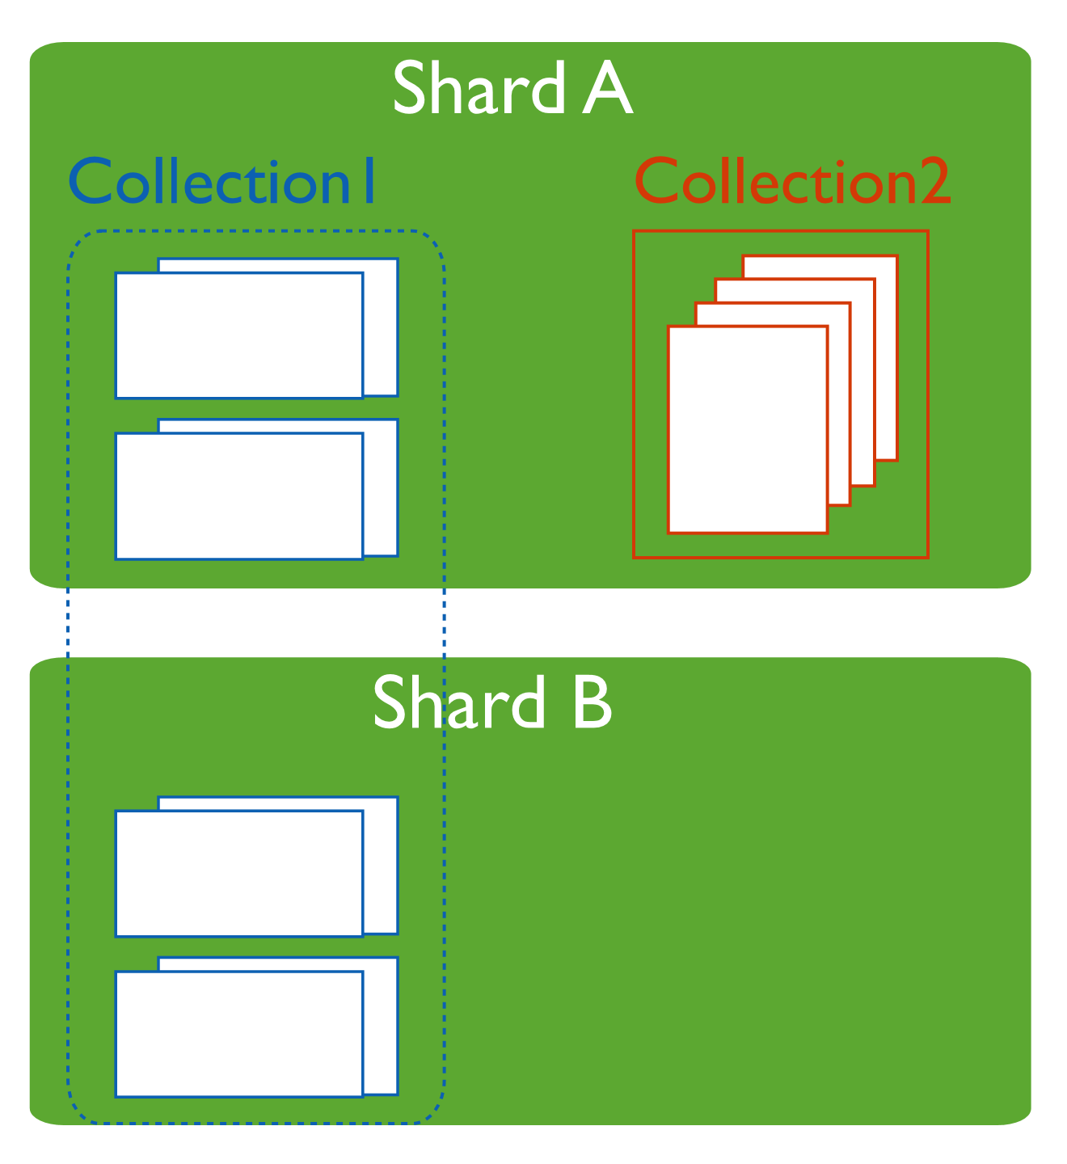
Sharded and Non-Sharded Collections
Sharded collections are partitioned and distributed across the shards in the cluster.
Unsharded collections are stored on a primary shard. Each database has its own primary shard.

Slide 32
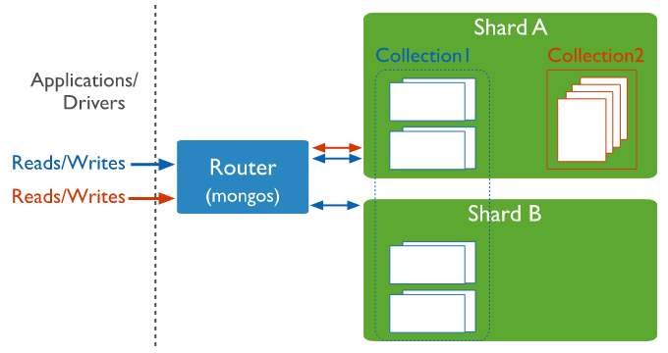
Connecting to a Sharded Cluster
For a sharded cluster, the mongos instances provide the interface between the client applications and the sharded cluster.
The mongos instances route queries and write operations to the shards.
From the perspective of the application, a mongos instance behaves identically to any other MongoDB instance.

Slide 33
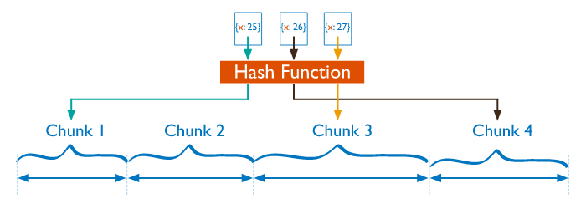
Sharding Strategy
MongoDB supports two sharding strategies for distributing data across sharded clusters.
Hashed Sharding
Hashed Sharding involves computing a hash of the shard key field's value.
Each chunk is then assigned a range based on the hashed shard key values.​
MongoDB automatically computes the hashes when resolving queries using hashed indexes.
While a range of shard keys may be "close", their hashed values are unlikely to be on the same chunk.
Data distribution based on hashed values facilitates more even data distribution, especially in data sets where the shard key changes monotonically

Slide 34
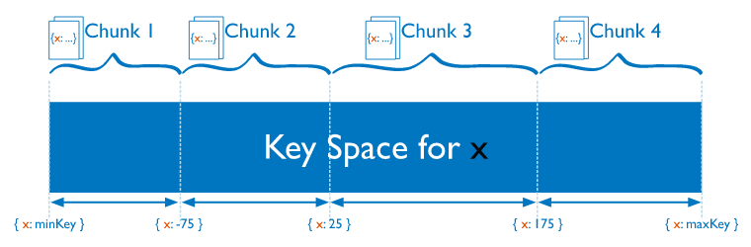
Sharding Strategy
Ranged Sharding
Ranged sharding involves dividing data into ranges based on the shard key values.
Each chunk is then assigned a range based on the shard key values.
A range of shard keys whose values are "close" are more likely to reside on the same chunk
The efficiency of ranged sharding depends on the shard key chosen. Poorly considered shard keys can result in uneven distribution of data, which can negate some benefits of sharding or can cause performance bottlenecks.

