Slide 1
Field Progress App
Team 04 prototype presentation
10/04/2019

Slide 2
Project Overview
The aim of the project is to help local campaign volunteers travel to their voters more efficiently
During campaigns, there comes a time when campaign managers have to assign volunteers to a particular districts to talk to voters. The current process is time consuming, as the managers have to manually draw out territories on a map (cut turfs) in order to assign them to voters using GIS tools. Either that or they create a spreadsheet of various voters for various volunteers

Slide 3
Overview contd
The aim of our project is to help automate the process of turf cutting for the campaign managers. This way we free up time for the managers to put towards other productive activities
Our product will aim to automate the turf cutting process, and help volunteers optimize their time spent on the field talking to voters. This way managers can measure metrics about the volunteers interaction with voters, and better optimize the process

Slide 4
Core Capabilities
There are two core capabilities of the project
An algorithm that automates the process of cutting the turfs. This is basically a clustering algorithm that assigns the voters to certain clusters based on the number of volunteers. There will be certain heuristics included to help optimize the time and distance volunteers need to travel
The visualization aspect. In order to visualize the result of the algorithm, and the clustering of voters on a map, various tools will be used for this; these include MapBox, Deck.gl and some other GIS tools

Slide 5
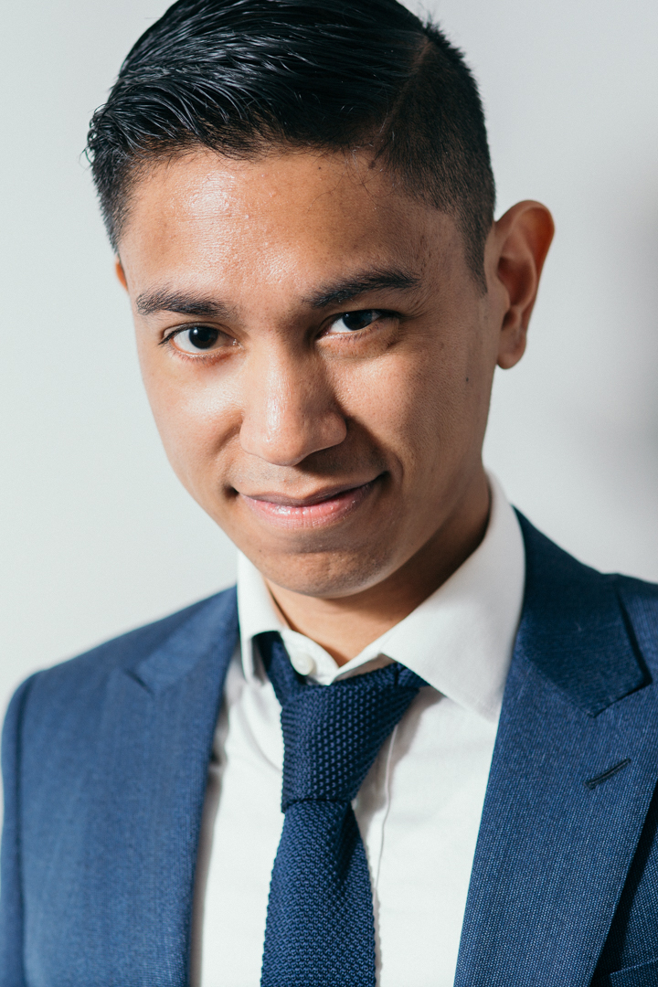
Personas - 1
Name: Kevin Keller
Age: 32
Gender: Male
Location: Los Angeles, CA
Description: Kevin is a graduate of Georgetown University in Washington D.C, where he studied political science in his undergraduate degree. Since he was a kid he had always been interested in politics, and has worked his way to being a campaign manager .
User Stories: During campaigns, Kevin always wants to ensure that the volunteers are always spending their time efficiently talking to voters, so he is always meticulous when assigning them turfs to go to, as he draws them out himself on a GIS tool, but always ends up spending valuable time than required because of his meticulous nature
Computer Literacy: Has an above average understanding in the use of excel as he uses it daily, has an Iphone, macbook, ipad and iwatch. Sometimes feels bold enough to use the terminal on his mac, and considers himself tech savvy

Slide 6
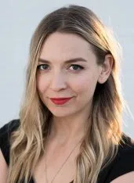
Personas - 2
Name: Sarah Liberman
Age: 28
Gender: Female
Location: Seattle, WA
Description: Originally from Texas, Sarah recently moved to Seattle because she wants to help her best friend Jackie who is running for councilman win her campaign. She enjoys the atmosphere of seattle and wants to move after the campaign is over
User Stories: As a novice to campaigning and campaign strategies, she seeks to always find new opportunities to optimize the time she spends doing campaign activities.She notices that when they have volunteers, she spends a lot of time planning out the turfs and places their volunteers are to go to and wants to find a more efficient way to optimize this process so she can spend her time completing other tasks
Computer Literacy: Basic computer Literacy. She uses her computer everyday, and spends a lot of her time using google and reading wiki pages. Also uses a chromebook and a fitbit to track her steps a day

Slide 7
Functionalities Prototyped
Algorithm: Prototyping of the algorithm helps in providing a basis of understanding on what turf cutting using an algorithm should look like. With the basic in mind, we can implement heuristics to help improve the functionality of the algorithm
Visualization: In order to visually see progress, visualization comes into play. The need to see data on the map, or a result of data transformation requires some form of visualization which will be implemented with some COTS software
COTS integration: With the algorithm outputting voter data in clusters, the visual component will have to take that information and render it, so that users (campaign managers and volunteers) can see where their time can be spent. Prototyping this would reduce the risk of COTS integration issues down the line

Slide 8
Risk Mitigation
Risk - Algorithm for turf cutting
Risk Mitigation – Implemented the K-means clustering algorithm which would be the foundation on top which further improvements and heuristics can be applied to add additional features.
Risk - Visualization using COTS
Risk Mitigation –We were successful in mitigating the risk of COTS software integration for implementing the visualization of the turfs by integrating Mapbox and Jupyter notebook for visualizing the results of the algorithm.

