Slide 1
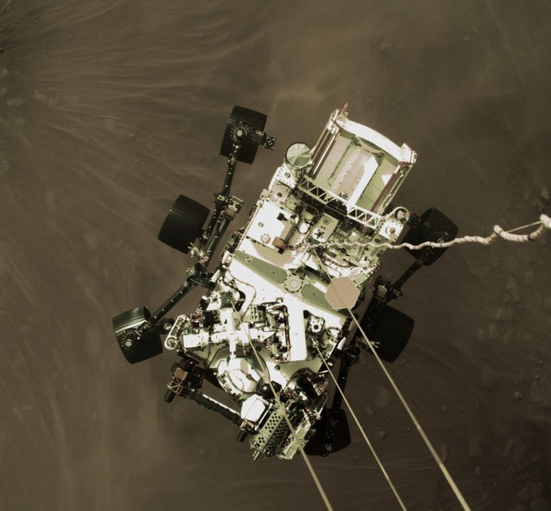

5th Planetary Data Workshop & 2nd Planetary Science Informatics and Data Analytics Meeting
Cloud Processing of PDS Archival Products with Amazon Web Services, Kubernetes, and Elasticsearch
Kevin Grimes – kevin.m.grimes@jpl.nasa.gov
Co-Authors: Rishi Verma, James Michael McAuley, Tariq Soliman, Anil Natha, Zachary M. Taylor
Wednesday, June 30, 2021

Slide 2

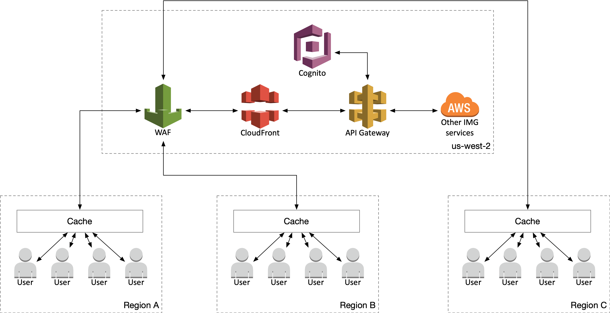
Cloud Processing of PDS Archival Products
5th Planetary Data Workshop & 2nd Planetary Science Informatics and Data Analytics Meeting
Get the slides!
Nearly 2 PB of data at PDS Imaging Node (and growing!)
Challenge: Making large amounts of data searchable and accessible as quickly as possible
Option A – on-prem
Buy more hardware
Hire more system administrators
Option B – the cloud
AWS Cloud
Managed services
Microservices architecture
Containerization
https://bit.ly/3gIdrmW

Slide 3
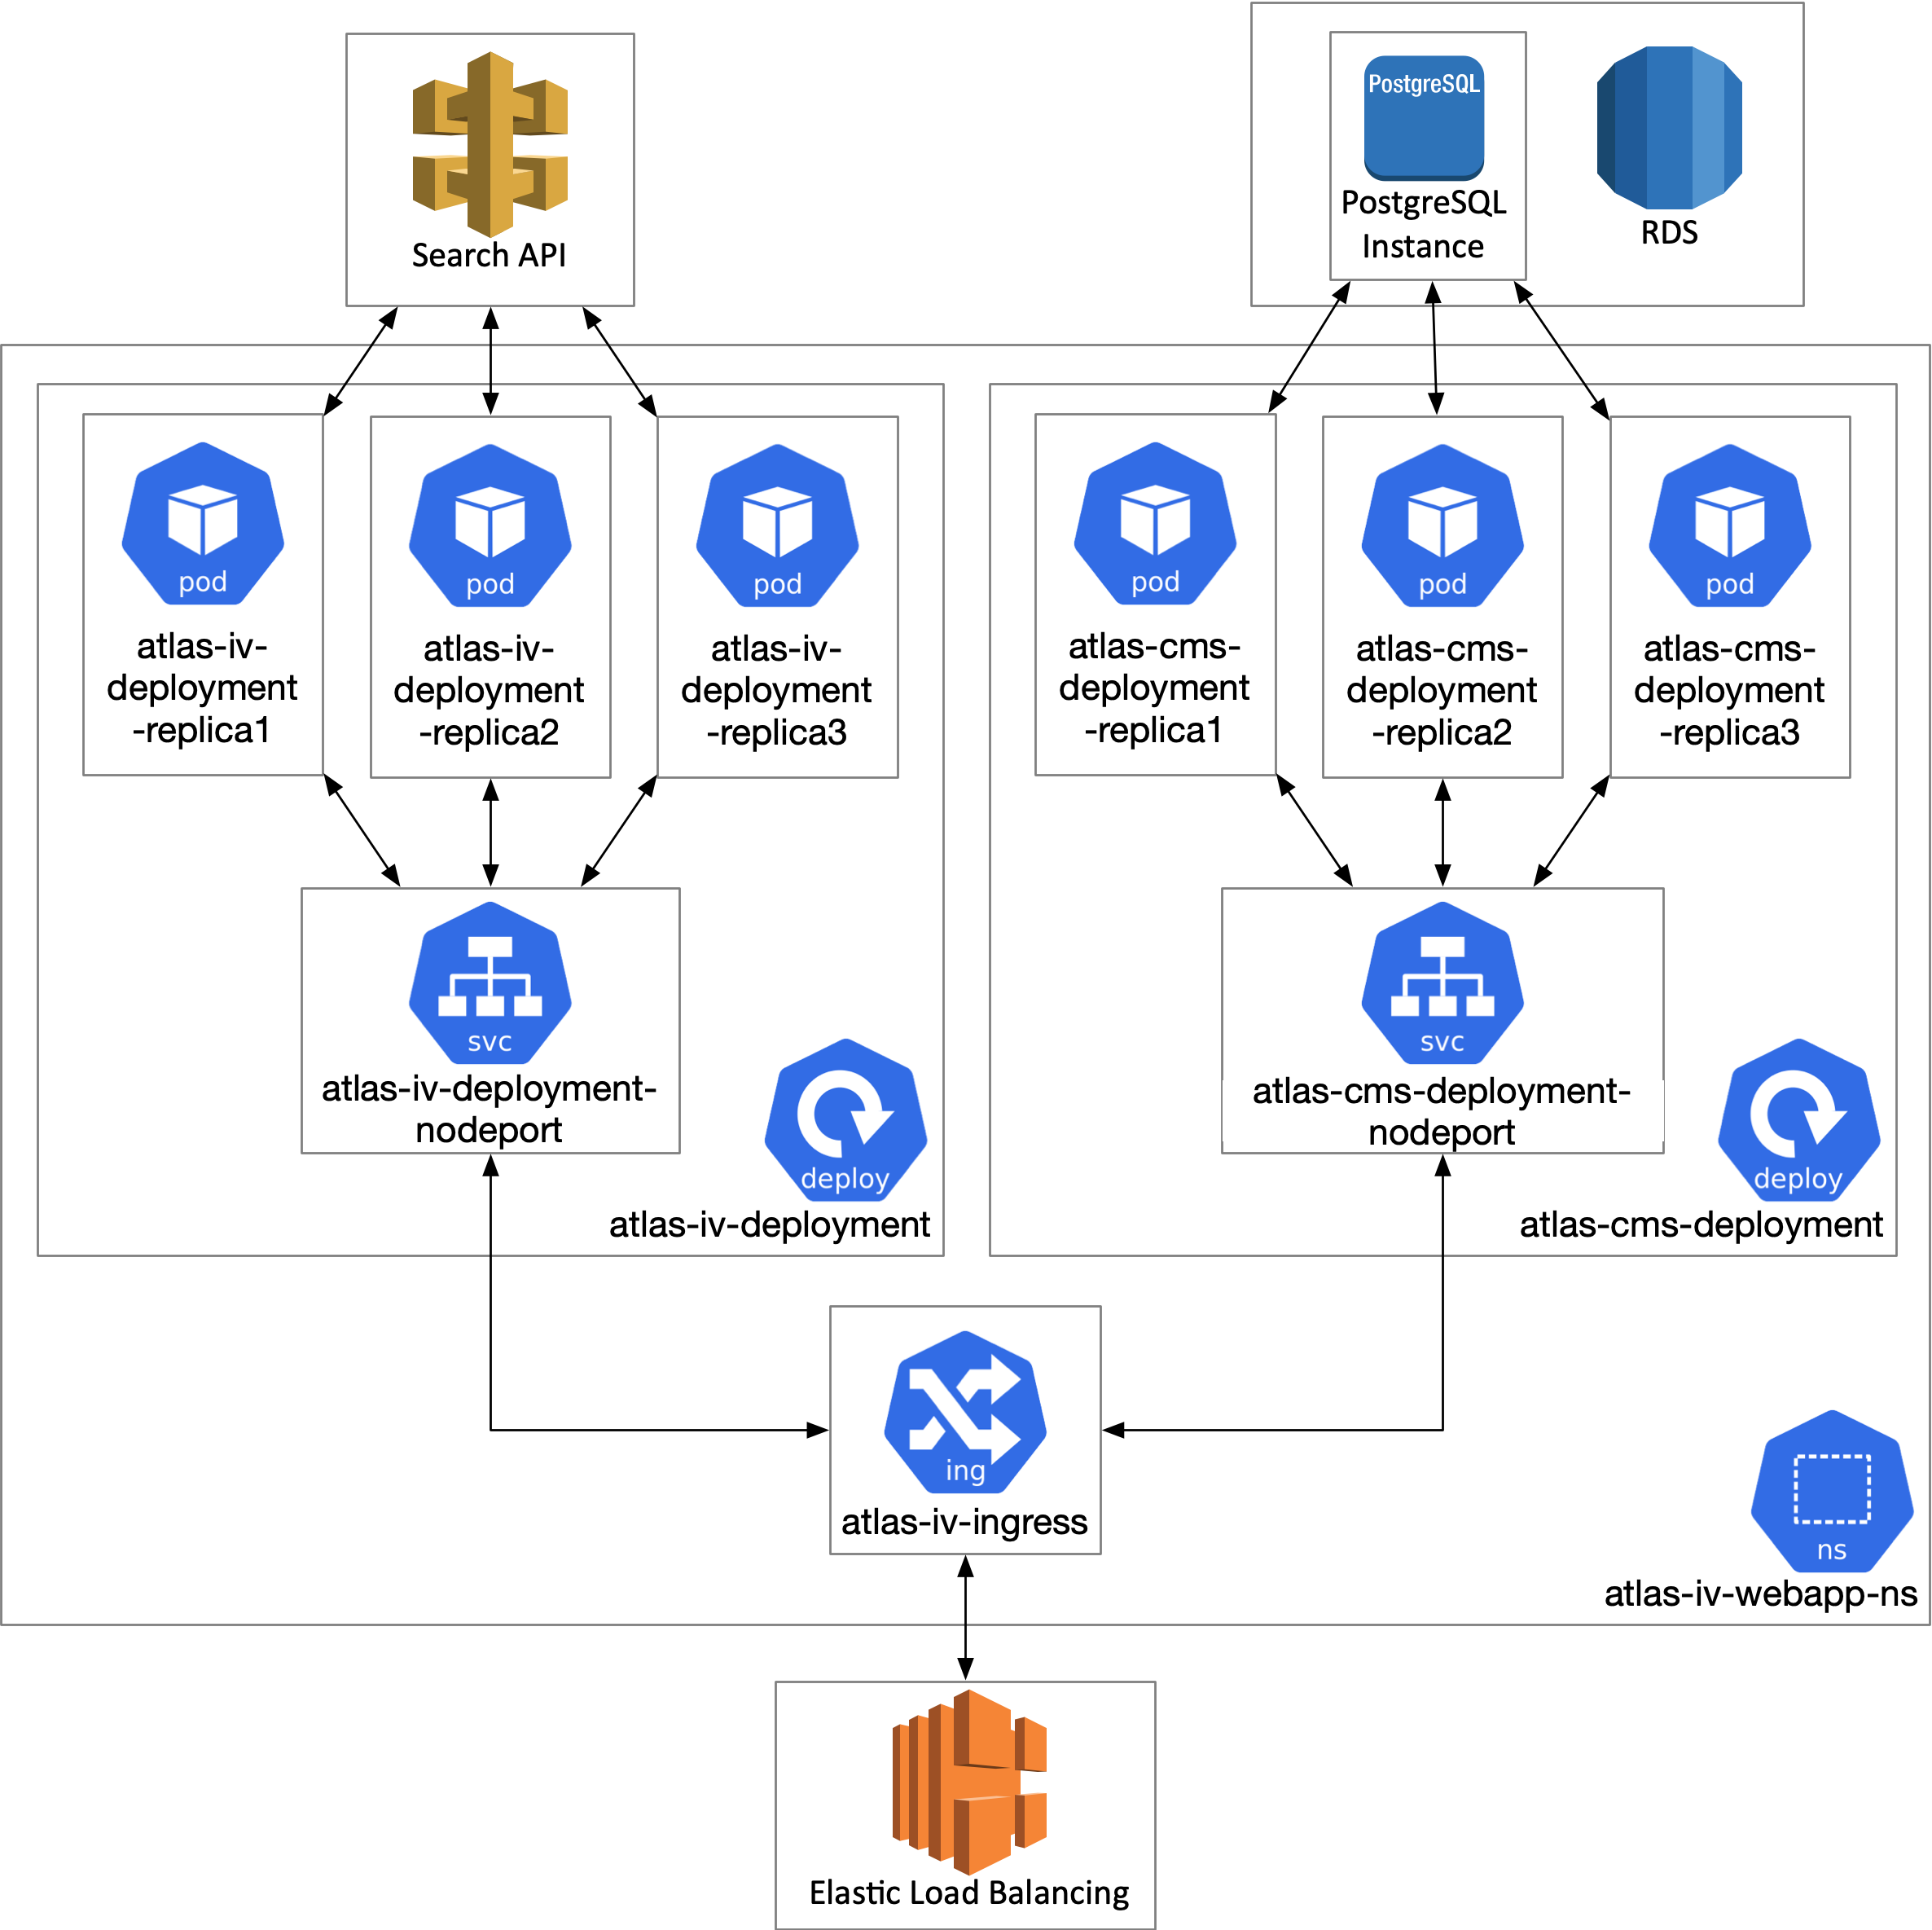
Cloud Processing of PDS Archival Products
5th Planetary Data Workshop & 2nd Planetary Science Informatics and Data Analytics Meeting
Get the slides!
https://bit.ly/3gIdrmW
Solution: Microservices on Kubernetes
Build application components into Docker images
Each “microservice” is built of multiple Docker containers
Microservices communicate with each other via Kubernetes service interfaces
High availability, zero-downtime upgrades
Running on AWS’s managed Kubernetes-as-a-service, Elastic Kubernetes Service
Replica of system on-premises for development

Slide 4
References
5th Planetary Data Workshop & 2nd Planetary Science Informatics and Data Analytics Meeting
Get the slides!
https://bit.ly/3gIdrmW
“PIA24428: High-Resolution Still Image of Perseverance's Landing”. https://photojournal.jpl.nasa.gov/catalog/PIA24428. NASA/JPL-Caltech.
“PDS Imaging Node”. https://pds-imaging.jpl.nasa.gov. NASA/JPL-Caltech
All other icon assets provided with Omnigraffle Stencil Pack, authorized for limited use by Omni Group.

