Slide 1
Module 1: Lesson 1 – Harvesting Equipment

Slide 2
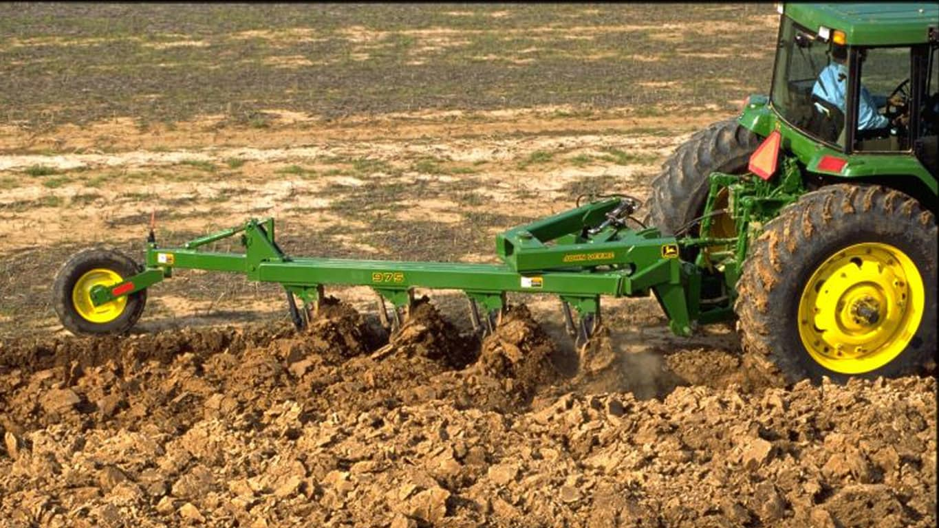
Introduction: What is Tillage?
Tillage is the mechanical manipulation of the soil to provide favorable conditions for crop production
Primary Tillage
Secondary Tillage

Slide 3
Sources
Ou

