Slide 1
Test-Driven Development in action Live session
@kamgrzybek

Slide 2
About me
@kamgrzybek
Software Architect, Team Leader
12 years of commercial exp.
.NET Platform
ITSG Global, Warsaw
Blogger,
OSS Contriubutor
kamilgrzybek.com
github.com/kgrzybek
@kamgrzybek
Enthusiast, Craftsman
Software Architecture
Domain-Driven Design
Clean Code

Slide 3
1. Introduction
@kamgrzybek
Quick introduction to TDD

Slide 4
Test-Driven Development
@kamgrzybek
A software development process that relies on tests to drive the software design and development

Slide 5
1. Write a test
@kamgrzybek
Describe what you want to achieve before you consider how
Write a failing test to indicate which functionality needs to be added and how it should behave
Invent the interface you wish you had

Slide 6
2. Make it run
@kamgrzybek
Write just enough code to make the test pass
„Quick green excuses all sins. But only for a moment”. Kent Beck

Slide 7
3. Make it right
@kamgrzybek
Refactor the code
Make it clean
Safety net - test protection

Slide 8
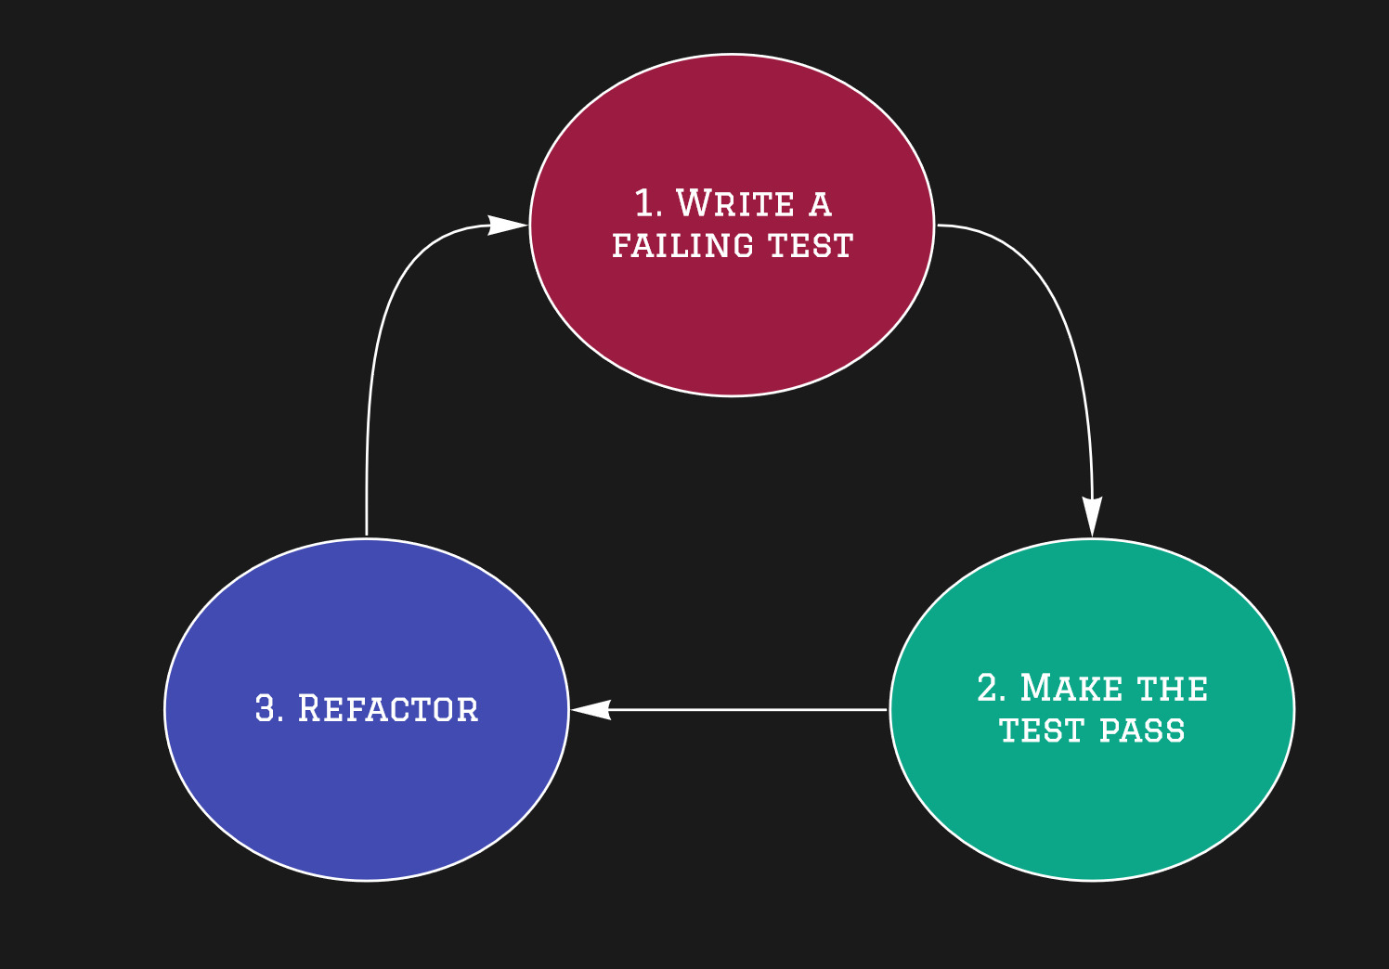
The TDD Cycle
@kamgrzybek

Slide 9
Benefits
@kamgrzybek
Makes us clarify the acceptance criteria
Encourages us to write loosely coupled components
Adds an executable description of what the code does
Adds to a complete regression suite (detects errors)
lets us know when we’ve done enough

Slide 10
2. Live demo
@kamgrzybek

Slide 11
Call to Action
@kamgrzybek
Demo code repository – https://github.com/kgrzybek/tdd-live-session
Books
„Test Driven Development By Example” – Kent Beck
„Growing Object-Oriented Software, Guided by Tests” - Steve Freeman, Nat Pryce.
„Unit Testing Principles, Practices, and Patterns” – Vladimir Khorikov
„The Art of Unit Testing” – Roy Osherove

Slide 12
Thanks!
Any questions? You can find me at
Twitter: @kamgrzybek
Contact: https://www.kamilgrzybek.com/contact/

