Slide 1
Tamil Nadu Assembly 2026
Neutral election briefing for AtliQ Media
Codebasics Resume Project Challenge #21
ECI public data · 234 constituencies · 2021 vs 2026
In 2026, Tamil Nadu’s assembly became more fragmented: TVK won 108 seats, 163 of 234 constituencies changed hands, and average winning margins fell from 11.8% to 7.7%.
Notes:
Open with headline: In 2026, Tamil Nadu’s assembly became more fragmented: TVK won 108 seats, 163 of 234 constituencies changed hands, and average winning margins fell from 11.8% to 7.7%.

Slide 2
The challenge
Hackathon problem statement · RPC #21
Client: AtliQ Media needs ideas for a one-hour TV special on the 2026 TN Assembly election.
Constraints (non-negotiable):
• Election Commission of India data only — no news, exit polls, or social media
• Neutral, descriptive tone — no predictions, causal claims, or party commentary
• Pick 3 of 6 research threads and connect them into one clear story
Deliverables: 5–7 min video pitch · 8–10 slide deck · public GitHub · optional dashboard
Notes:
Frame the RPC as a producer briefing, not a political argument. Mention six research questions exist; we chose margins, flips, and TVK vote share.

Slide 3
Our solution
Data → insights → editorial run-of-show → interactive briefing
1. Reproducible pipeline
• Python ETL on ECI CSVs → AC-level metrics, Sankey flows, regional tables
2. Three lead narratives (research threads addressed)
• Margin of victory — fragmentation and close races (Q6)
• Seat flips — 2021→2026 party transitions (Q2)
• Vote share & TVK — new entrant scale by region (Q3)
3. Interactive briefing dashboard
• Editorial brief, statewide KPIs, charts, constituency explorer
4. This deck + video script — explicit 60-minute show recommendation
Notes:
Emphasize selection skill: depth on three threads, not all six.

Slide 4
Technology stack
Built for reproducibility and demo-ready storytelling
Data & analytics
• Python 3 · pandas · Jupyter notebook (`notebooks/01_build_and_explore.ipynb`)
• Shared metrics module (`src/metrics.py`, `docs/METRIC_DEFINITIONS.md`)
Backend
• FastAPI — REST API over `data/processed/` CSVs
Frontend
• React · TypeScript · Vite · Apache ECharts
Deliverables automation
• `scripts/build_processed_data.py` · `build_presentation.py` · Playwright E2E
Deployment
• Local: uvicorn :8000 · optional ngrok for sharing
Notes:
Point reviewers to GitHub README for one-command reproduction.

Slide 5
Data & methodology
How we turned ECI files into comparable 2021 vs 2026 metrics
Sources
• `tn_2021_results.csv`, `tn_2026_results.csv`, `constituency_master.csv` (234 ACs)
Join key: assembly constituency number (`ac_number`) — not constituency name
Definitions
• Valid votes = sum of candidate votes excluding NOTA
• Winner = highest votes among non-NOTA candidates per AC
• Margin % = (winner − runner-up) / valid votes × 100
• Flip = normalized 2021 winner party ≠ normalized 2026 winner party
Party labels normalized before seat and flip counts (see README mapping table)
Notes:
Stress descriptive-only analysis. 2026 turnout blank in starter file.

Slide 6
Research questions — coverage map
Hackathon brief: pick 3 of 6 · we go deep on Q6/Q2/Q3 and cover Q1/Q4/Q5 as supporting views
• Q1 Geography → flip rate Chennai Metro 93.8% vs Delta 45.5%
• Q2 Flips (LEAD) → 163/234 ACs · 69.7% of state
• Q3 Vote share (LEAD) → TVK 35.1% · DMK 2021 38.0% (statewide + by-region)
• Q4 Reserved → GEN/SC/ST flip rates, margin distribution, party × category table (2021 vs 2026)
• Q5 Turnout → state record 2026 ~85.1% · per-AC delta chart in dashboard when ECI Form-20 is loaded
• Q6 Margins (LEAD) → avg 11.8% → 7.7% · 61 winners <35% · 103 races <5pp
Plus deep electoral-science measures: ENP 3.74→4.29 · Pedersen 36.4 · Gallagher LSq 15.2→8.7
Notes:
Show that we go beyond the six required questions with structural electoral-science indices.

Slide 7
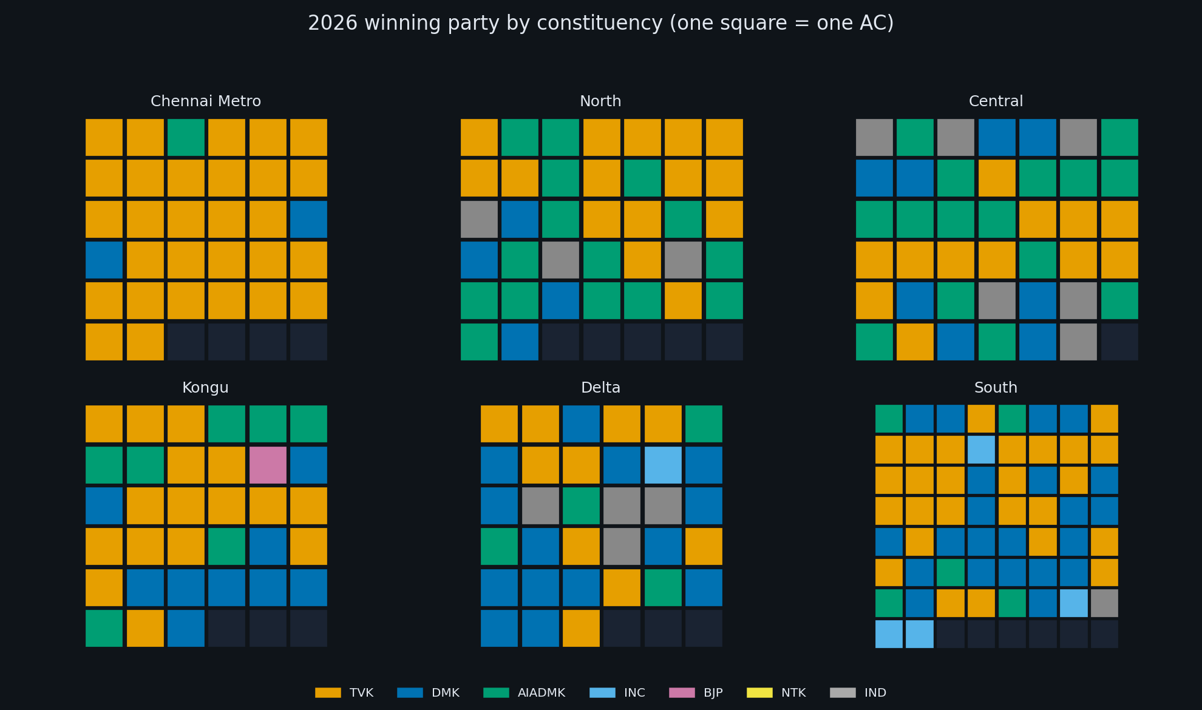
Q1 — Geographic pattern
Where flips and TVK seats cluster
234-tile mosaic
• One square = one AC · equal visual weight
Regional contrast
• Top flip rate: Chennai Metro (93.8%)
• Lowest: Delta (45.5%)
On air
• Pair with district map and 2021↔2026 toggle
Notes:
Good B-roll: zoom one region at a time.

Slide 8
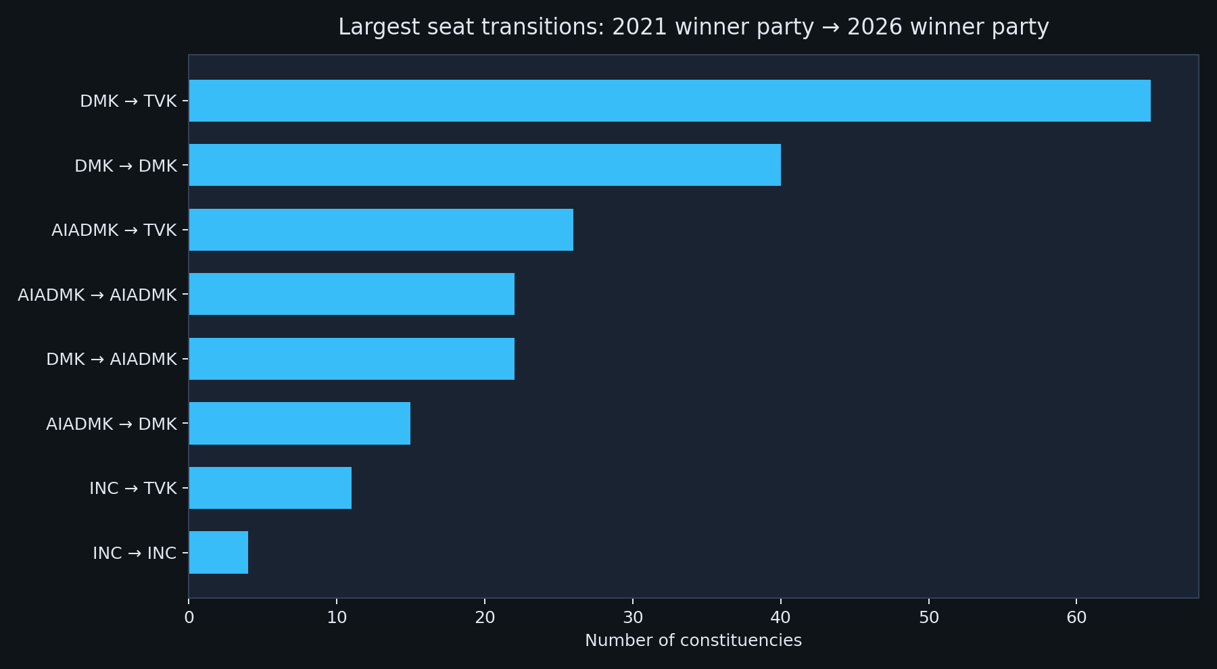
Q2 — Seat churn at scale (LEAD)
Where seats moved between 2021 and 2026
Scale
• 163 of 234 ACs changed winner
• Largest flow: DMK (2021) → TVK (2026): 65 seats
Regional pattern
• Highest flip rate: Chennai Metro (93.8%)
• Lowest: Delta (45.5%)
Neutral framing
• Say constituencies changed hands — not voters switched allegiance
Notes:
Top flows: DMK→TVK(65); DMK→DMK(40); AIADMK→TVK(26)

Slide 9
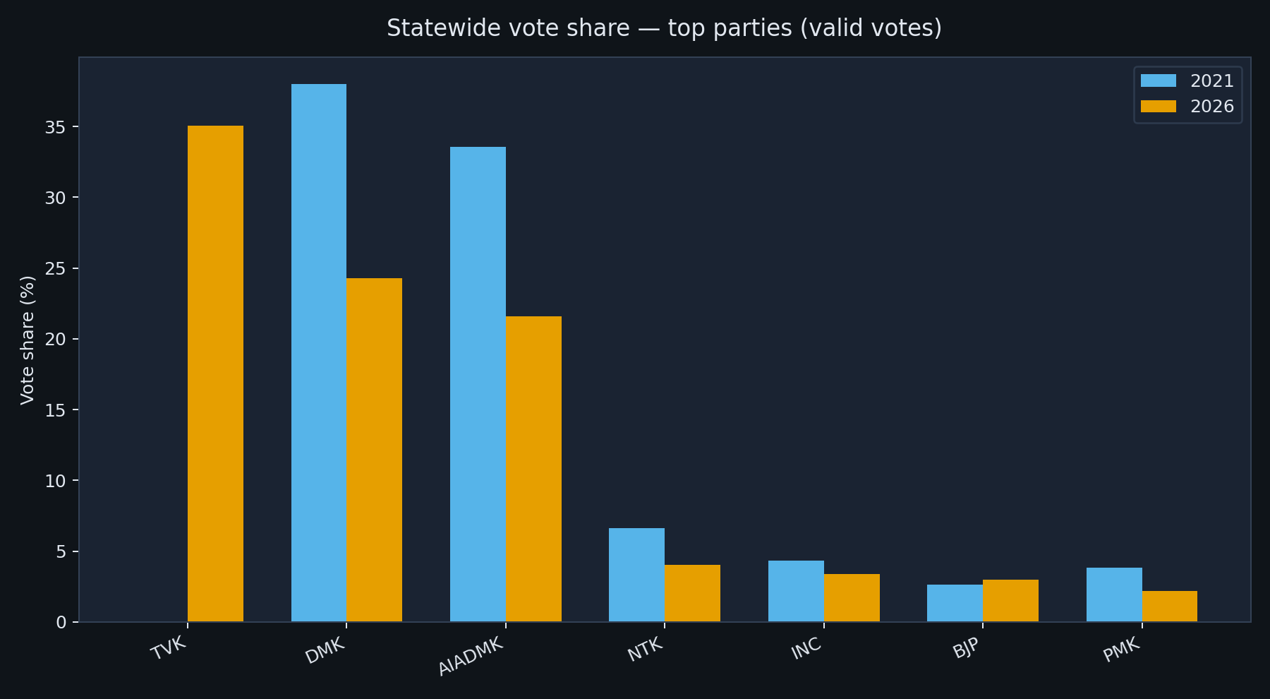
Q3 — Vote share statewide (LEAD)
Where TVK landed at the state level — descriptive comparison
Statewide
• TVK: 108 seats · ~35.1% valid vote share
• DMK 2021 baseline: 133 seats · ~38.0% share
Regional seats won (TVK)
• Chennai Metro (29), South (26), Kongu (16)
Neutral framing
• Report shares side-by-side — do not claim whose votes moved where
Notes:
Descriptive comparison only.

Slide 10
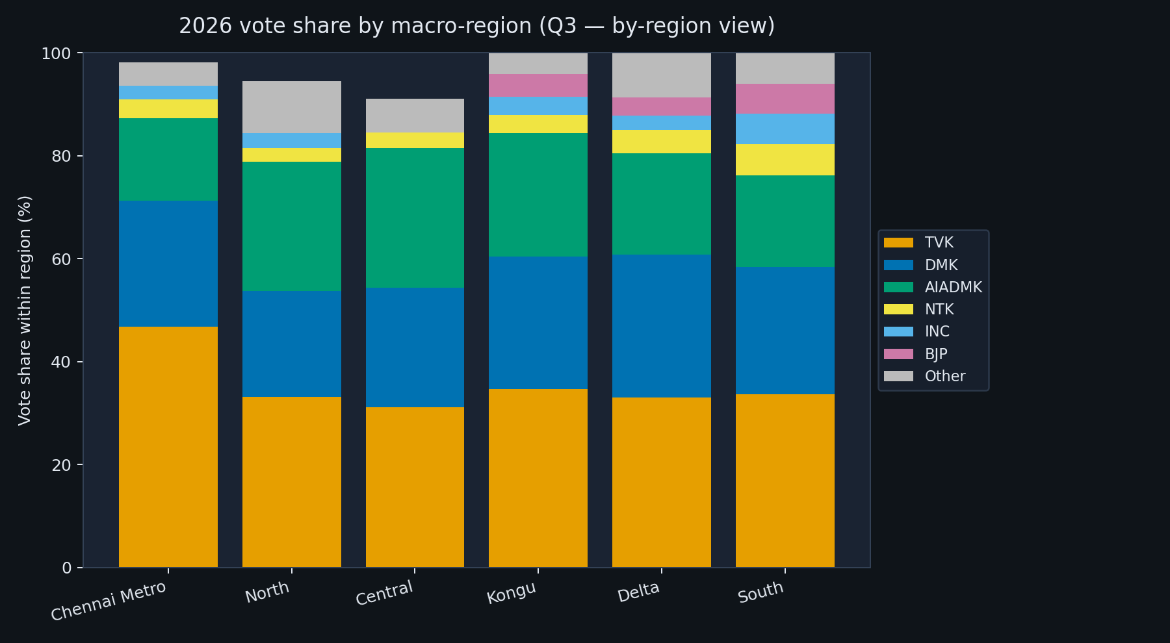
Q3 — Vote share by region
Region-level composition shows where TVK is heavier or lighter
Notes:
Region-level vote share within each macro-region. Shows that TVK and the major Dravidian parties carry very different shares in Chennai Metro vs Delta. Pair on air with the regional seats chart.

Slide 11
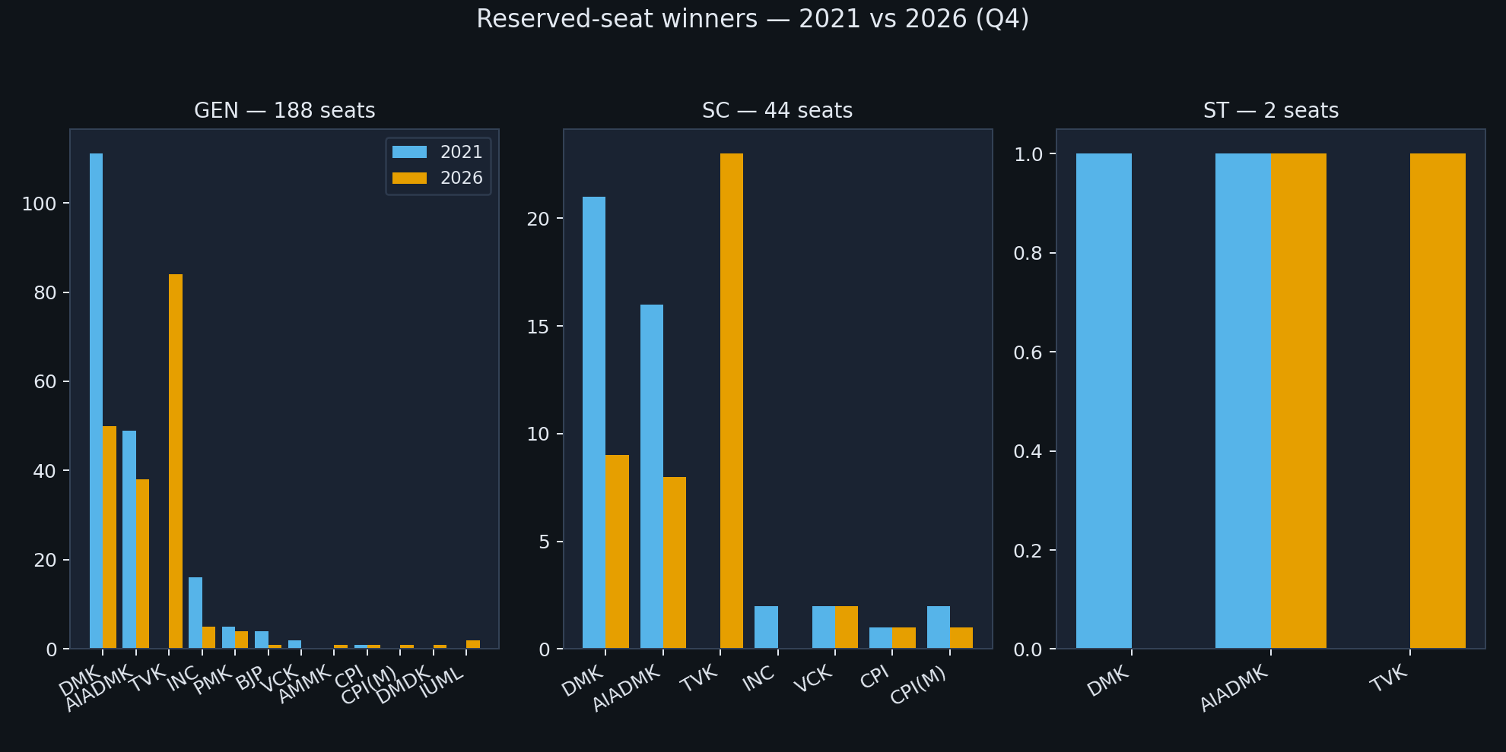
Q4 — Reserved seats (GEN / SC / ST)
Did reserved constituencies behave differently from general seats?
Notes:
Compare 2021 vs 2026 winner mix in each reserved category. SC and GEN flip rates are similar in the data; ST is just 2 seats so treat as illustrative.

Slide 12
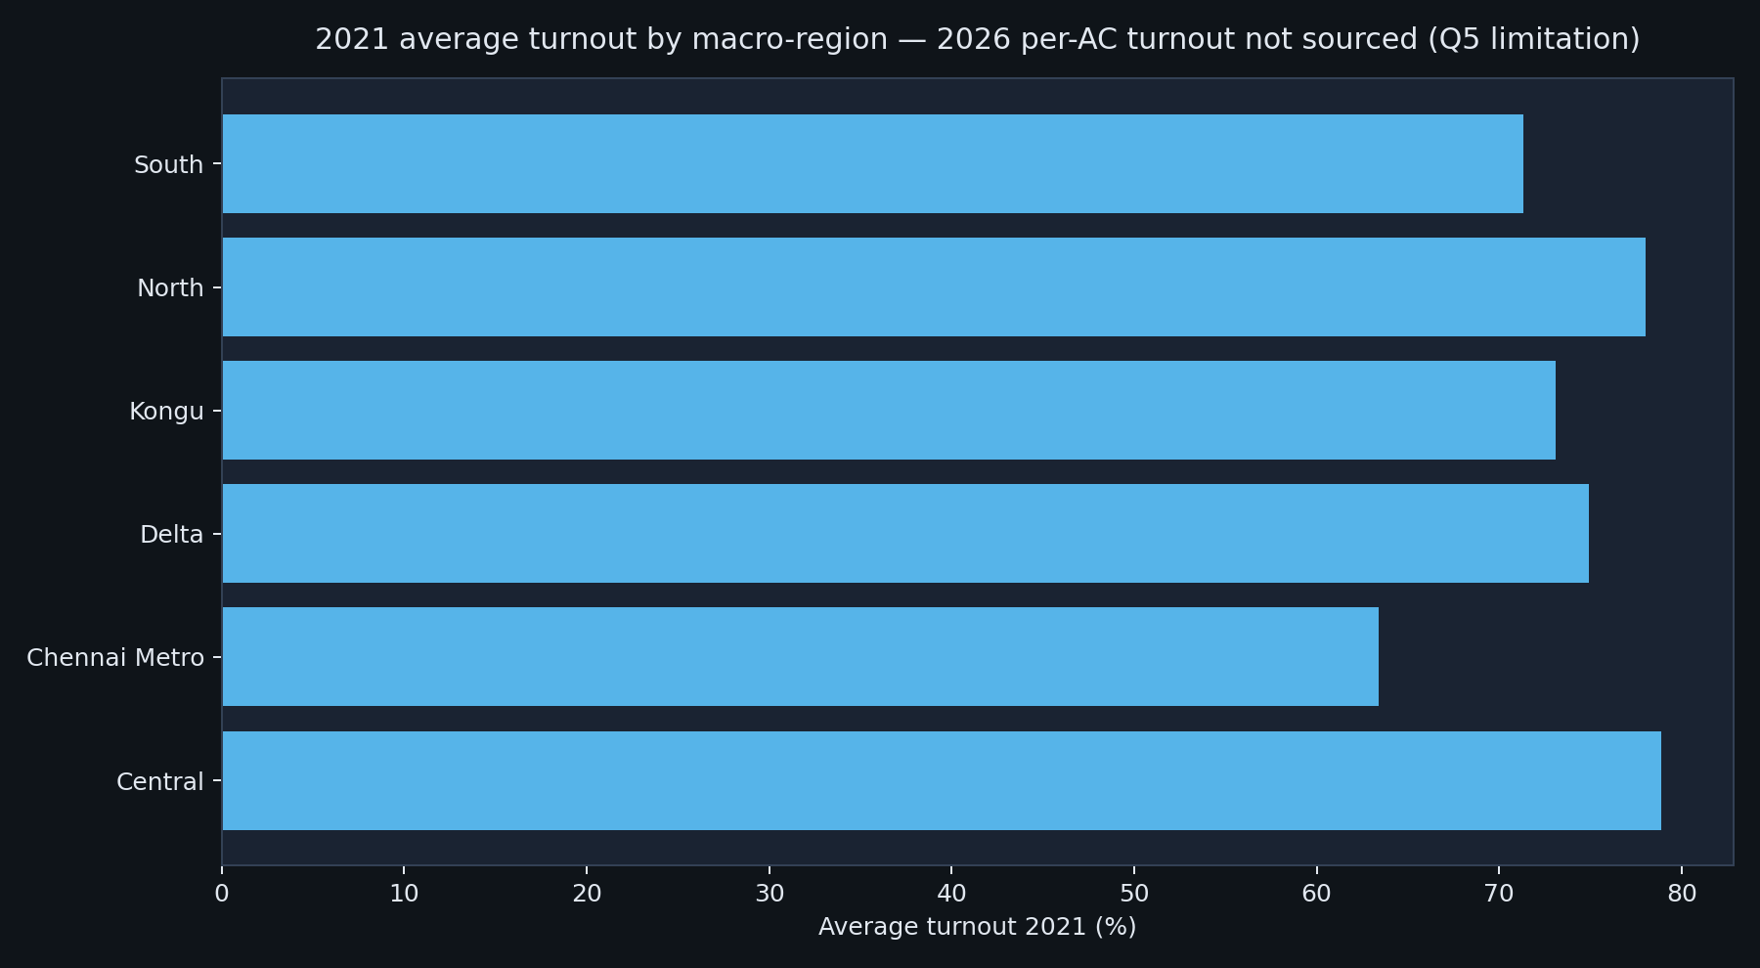
Q5 — Turnout
Statewide record · per-AC delta requires ECI Form-20 ingestion
Notes:
State-record 85.1% statewide turnout in 2026 per ECI. Per-AC turnout is intentionally blank in the starter CSV; pipeline reads data/external/turnout_2026.csv once analyst loads Form-20 values, then the Top-20 turnout-increase chart populates automatically.

Slide 13
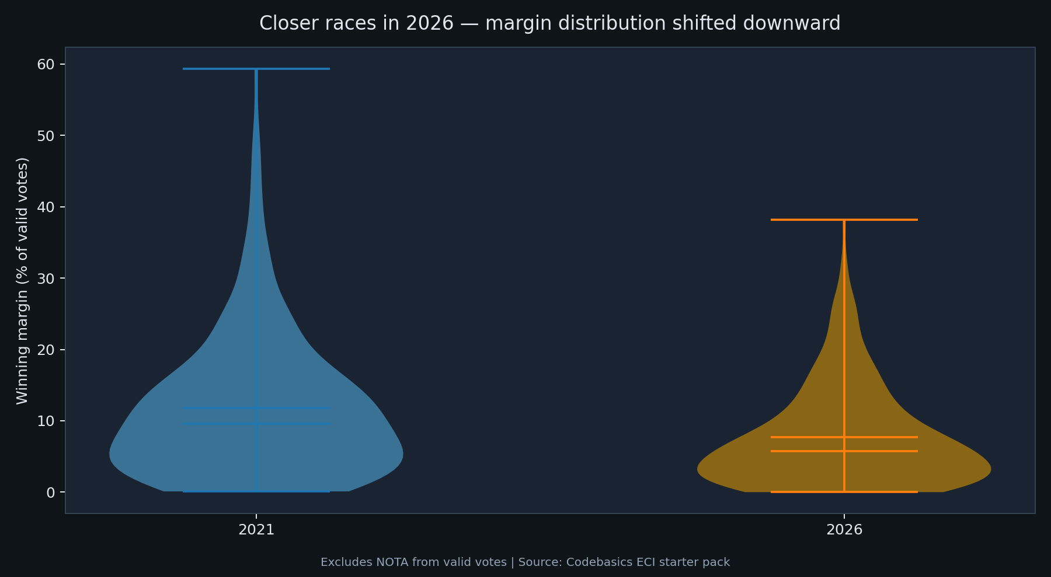
Q6 — Margin of victory (LEAD)
Closer races, fewer landslides
What changed
• Mean margin: 11.8% → 7.7%
What it means for TV
• 103 seats under 5-point margin
• 61 plurality winners (<35% share)
Neutral framing
• Describe distribution shift — do not explain voter motivation
Notes:
Point to 2026 beeswarm sitting below 2021.

Slide 14
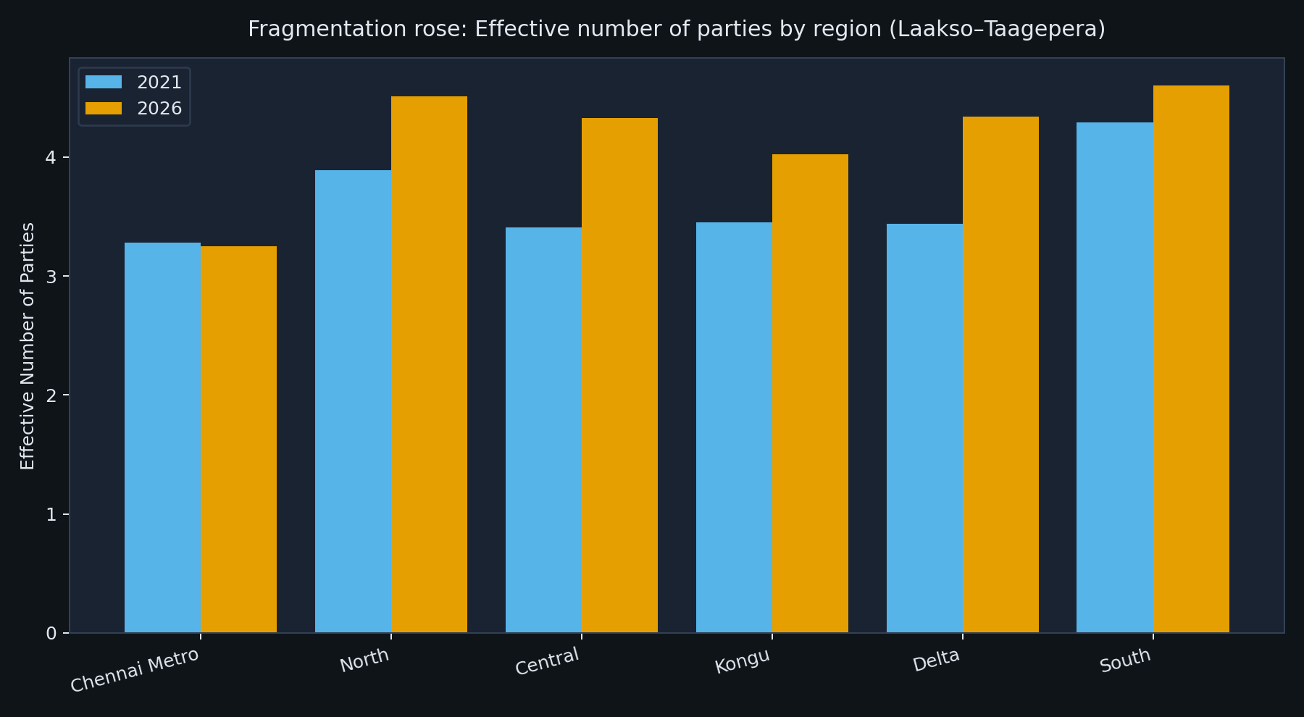
Deep insight — electoral arithmetic
Indices that summarise the structural shift between 2021 and 2026
Fragmentation
• Effective Number of Parties: 3.74 → 4.29
• Multi-cornered races (top-2 < 70%): 132 of 234
Volatility & proportionality
• Pedersen index: 36.4 — above 20 is 'high' in literature
• Gallagher LSq: 15.2 → 8.7
Neutral framing
• These are descriptive electoral-science measures — no causal claim
Notes:
ENP rose from 3.74 to 4.29 — the assembly contest moved from 'two-and-a-half party' to 'three-and-a-half party' arithmetic on vote-share weights. Pedersen 36 indicates the system underwent the largest party-share churn between any two elections we measured. Lower Gallagher in 2026 means seats track votes more closely than 2021 — fewer 'wasted' votes.

Slide 15
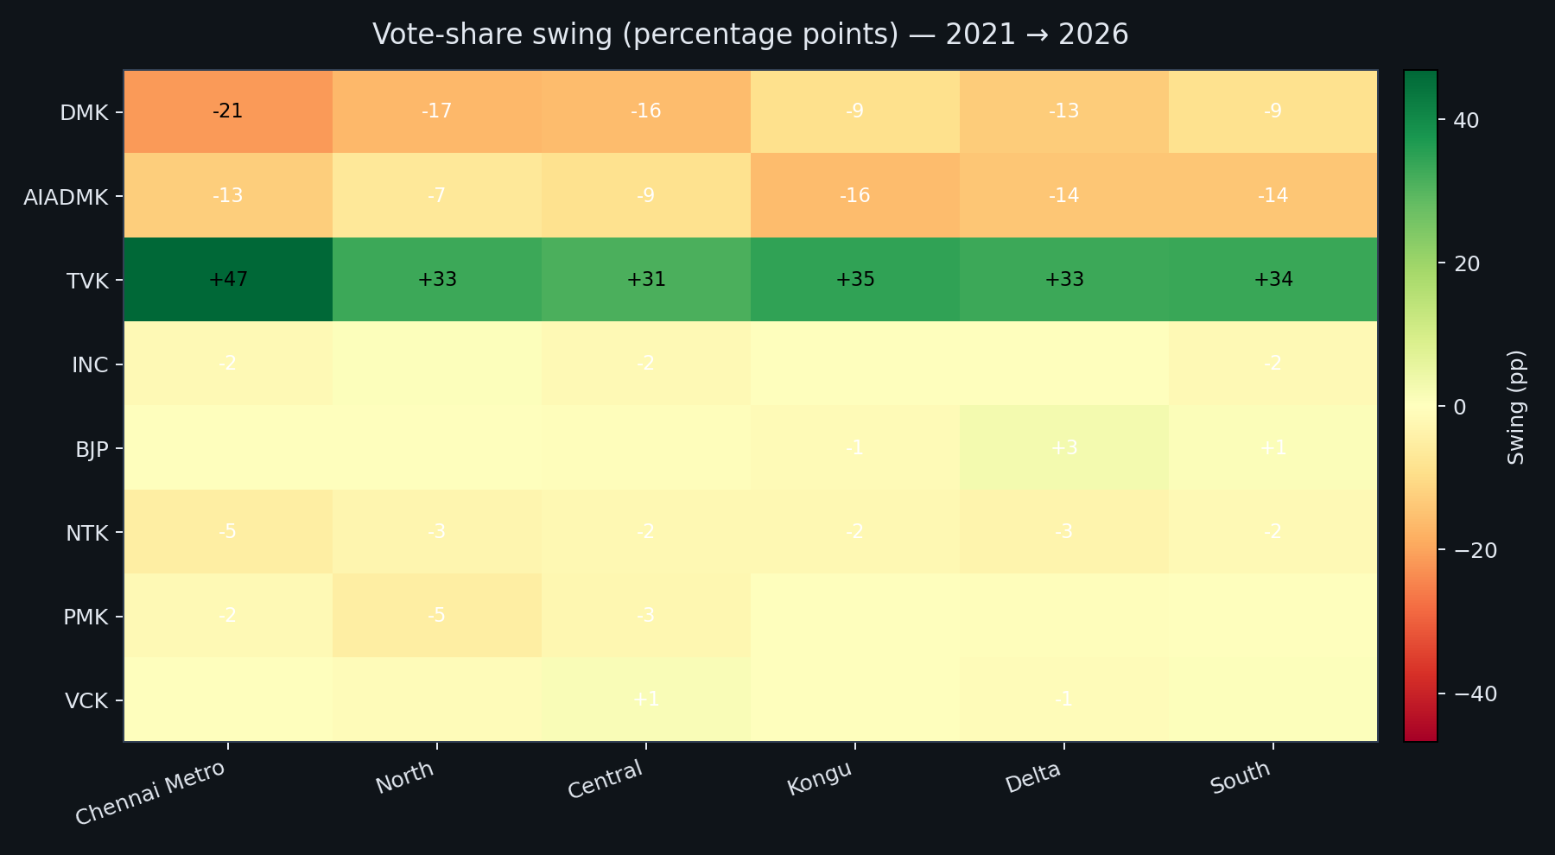
Deep insight — regional swing
Where each party gained or lost vote share between cycles
Notes:
Highest party-share churn: Chennai Metro (Pedersen 49.2). Anti-incumbency varies sharply by region: Chennai Metro 93.8% of seats changed party, vs Delta 45.5%. Heatmap shows green = vote-share gain, red = loss in percentage points.

Slide 16
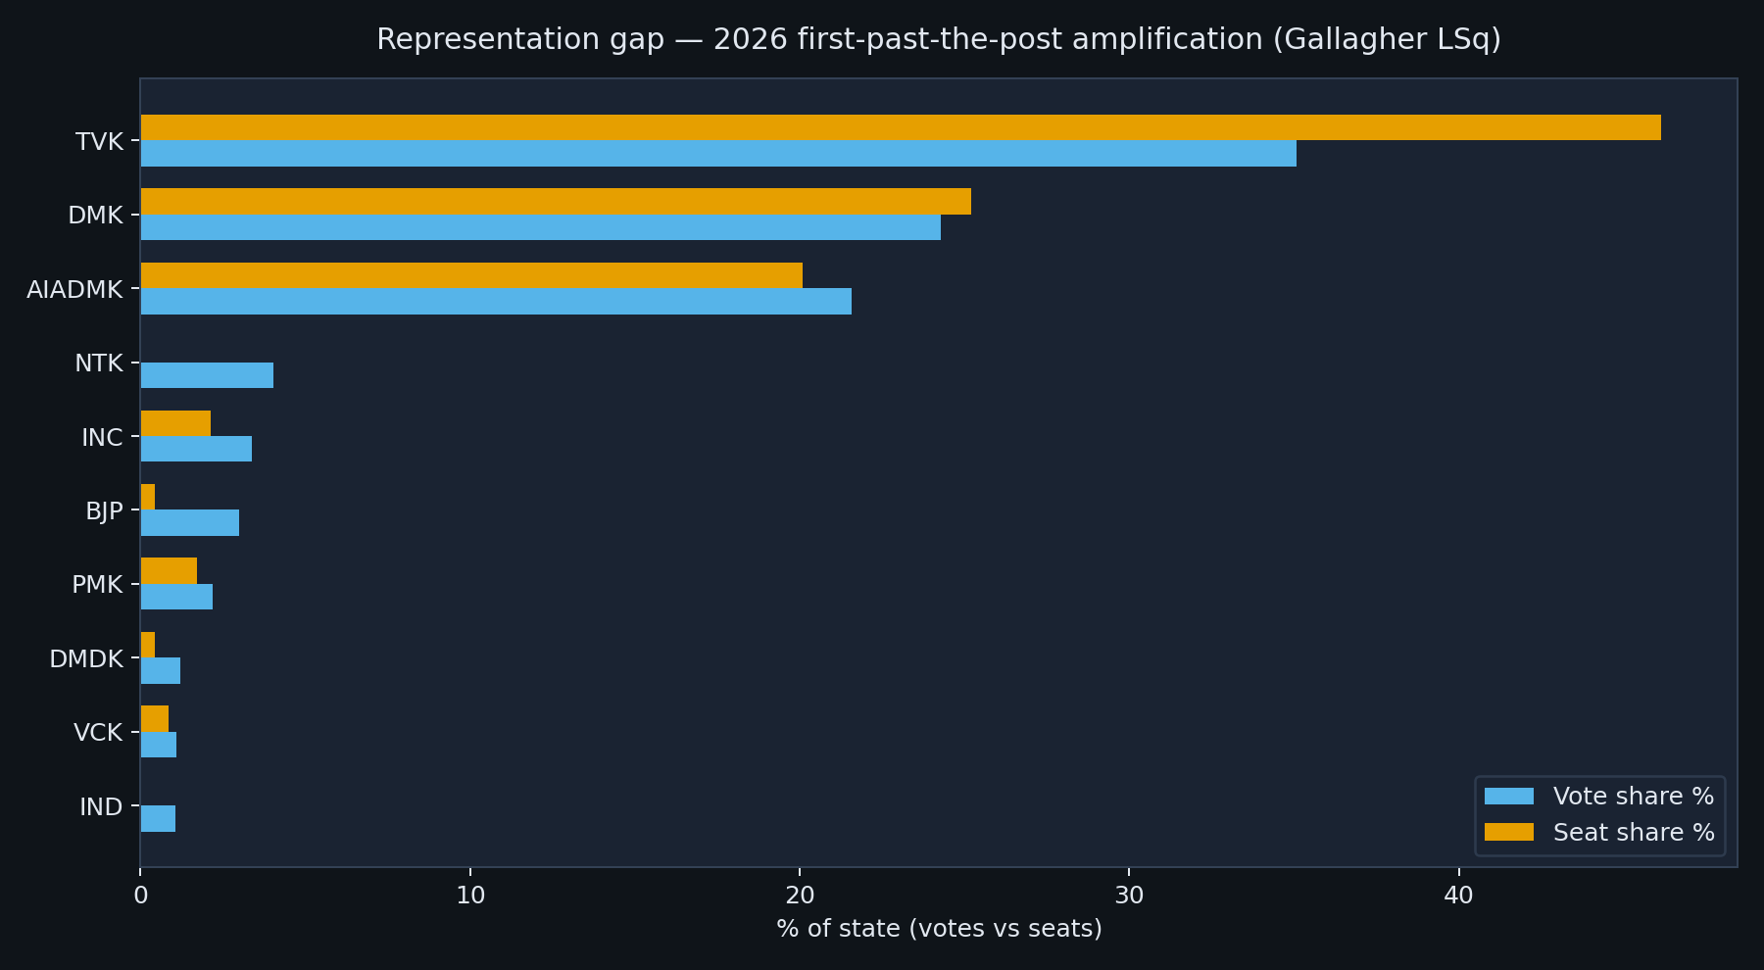
Deep insight — representation gap
First-past-the-post amplifies leading parties — by how much in 2026?
How it works
• Vote share = % of valid votes statewide
• Seat share = % of 234 ACs won
• Gap = seat share − vote share (pp)
What the data shows (2026)
• TVK gap: +11.1 pp (leading-party bonus)
• BJP gap: -2.6 pp (small parties penalised)
On air
• Use to explain why seat count alone overstates dominance
Notes:
Gallagher LSq is the headline disproportionality measure (lower = fairer). It fell from 15.15 in 2021 to 8.74 in 2026 because TVK's vote share (~35%) maps more closely to its seat share (~46%) than DMK's 38% / 56% split in 2021. Both elections are first-past-the-post wins, but the gap is structurally smaller this cycle.

Slide 17
Limitations & reproducibility
Limitations
• 2026 turnout not in starter CSV — Q5 optional; 2021 turnout only in dashboard
• Constituency-level data — no booth-level or voter-age tables
• Party labels normalized — raw ECI strings differ slightly from seat counts
• Descriptive only — no forecasts or causal explanations
Reproduce this analysis
• `python scripts/build_all_deliverables.py`
• Dashboard: `uvicorn api.main:app --port 8000` (after `cd web && npm run build`)
Thank you — questions on methodology and constituency drill-down welcome
Notes:
Close with honesty on data gaps. Offer live dashboard demo.

