Slide 1
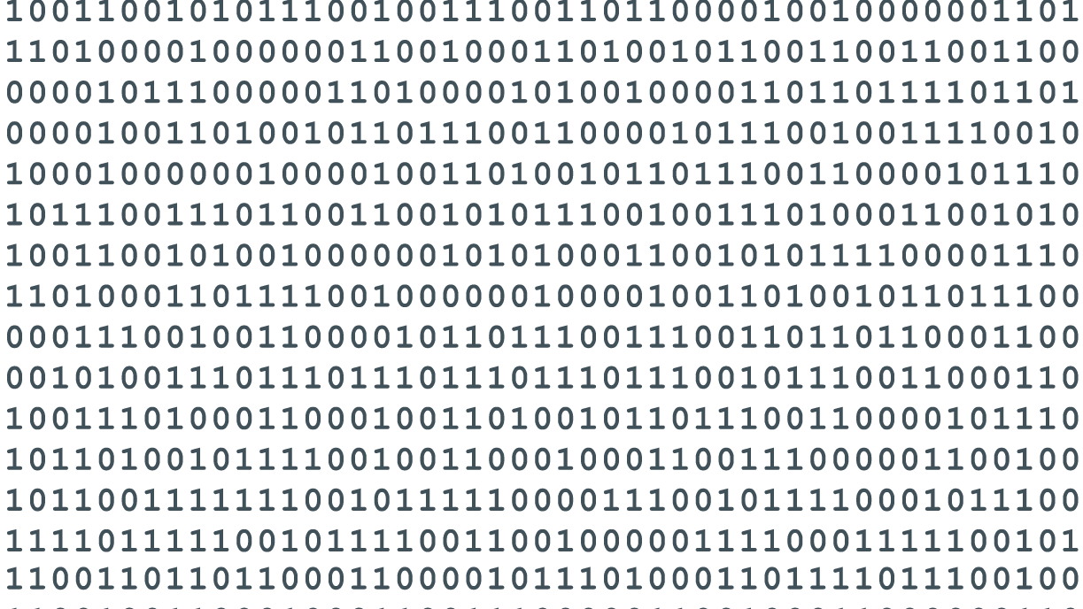
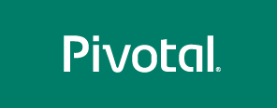
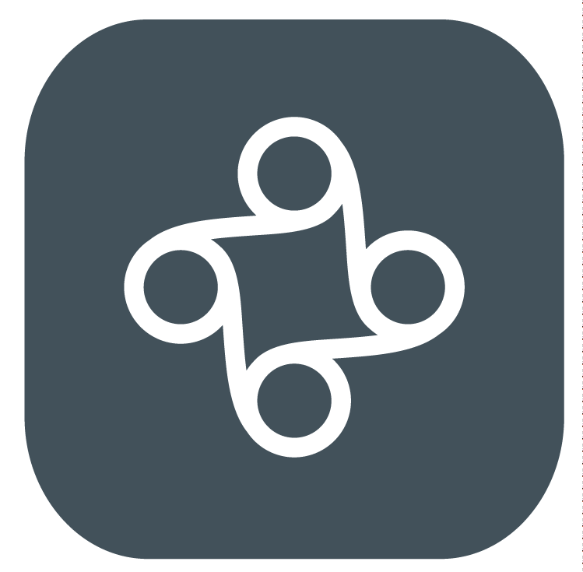
iDA Cloud App Architecting Workshop
Cloud Foundry and Microservices

Slide 2
What To Cover
Know Each Other
Workshop Objectives
Pivotal Solution
iDA Use Cases
Workshop Agenda

Slide 3
Know Each Other

Slide 4
Workshop Objectives

Slide 5
Workshop Objectives
Currently, iDA DSG team have to handle a lot of ad hoc requirements getting different format of data from different government agencies do cleansing, reason over it, do app and share it out via many individual small web apps or REST API. The apps return in different languages, handle different data sources with different data tools. All these apps now are parking as silos in different government agencies’ DC. When the number of apps increase : development, provisioning, management and communications all become tedious jobs . This become a challenge on how to reuse these assets to rapidly develop new apps, do innovations via software.

Slide 6
Workshop Objectives
This workshop is to introduce how to address the above issues by using Pivotal CF, Enterprise PaaS and Mciroservice Architecture to build cloud native application.

Slide 7
Pivotal Solution

Slide 8
Cloud Transformation – IaaS, PaaS and SaaS
Traditional
Cloud
SaaS
Application/Software
The mission of PaaS is to make “Application Platform” as a service. Application Platform essentially are all the technologies and tools around application build (language, frameworks), run(Middleware), deployment and management.
Language
Runtime
Data Tools
App Server
Messaging
Deployment
APM
PaaS
Operating System
IaaS
Virtualization Platform
Physical Servers
Notes:
No need to configure VMs, databases, AppServers, Load-balancers…
Developers can focus on development and not infrastructure plumbing
Separate the concerns of AppDev and Operations
Eliminate the bottleneck of provisioning and deployment processes
Make full use of investments in the “Cloud”

Slide 9











Platform-as-a-Service
A Modern Foundation for High-Quality Software
GREAT DEVELOPER EXPERIENCE
AUTOMATED OPERATIONS
BROAD CHOICE OF SERVICES
Seamlessly integrate build, CI and deployment tooling
Mobile Services – Push, Data Sync, API Gateway
Health Management, Load Balancing & High Availability
</>
Broad language and framework support
Data Services – Relational, NoSQL, Graph, IMDG
Robust CLI and scripting APIs
Identity and User Roles/Rights Management
Integration Services – enterprise systems, APIs, and Data sources
Deploy, Operate, Update, Scale on any Infrastructure
….and more
Notes:
Let’s spend a minute talking about Cloud Foundry
First, Cloud Foundry is an Open Source project which has been around for 4 years, and in production at scale for companies like Warner Music and Baidu.com. This year Pivotal created a foundation, endorsed by HP, IBM, SAP and many others to govern this work.
Pivotal CF is a commercial distribution of Cloud Foundry that runs on a Private Cloud Infrastructure.
Pivotal CF provides several important benefits:
A great developer experience is delivered through broad language and app development framework support, seamless integration of build, continuous integration (CI) and deployment tooling, and through a great Command Line Interface and API
Pivotal CF helps to automate operations including health management, load balancing and high availability, along with identity and user roles and rights management
And, a broad choice of services are included in the platform, including mobile, data, and enterprise integration.
Openness and portability is also important.
Pivotal CF has the ability to deploy, operate, update and scale on any infrastructure, including VMware, Amazon Web Services, OpenStack, and the Google Cloud Platform.

Slide 10




Cloud Native Application Architecture
Start New Software Projects Using Cloud Native Patterns
Scale Horizontally
Architected for Zero Downtime
Have No Physical Dependencies
Often Organized as Microservices
Assume That Failure Happens
Treat Data Like a Service
Use 12-Factor Patterns*
* The Twelve-Factor App - http://12factor.net
Notes:
Modern software is different
Typical corporate software is built and deployed in a layered model with a relational database underneath it all. It’s usually powered by one of the “BIG VENDORS” like Microsoft, Oracle or IBM. The software is often wired deeply into these vendor stacks and gets really complicated over time as business needs evolve and requirements change. Delivering things quickly and “continuously” is incredibility difficult if not impossible.
By contrast, a modern software system uses lightening-fast in-memory operations to engage the user in a real-time way. It is instrumented heavily, meaning, everything the user does is tracked, logged and used to help drive personalization along with ongoing improvements and updates. It’s architected as a distributed API of services, organized into sets of projects, and worked by small app development teams. These teams frequently use Open Source and whatever data or application technology that makes sense, provided they adhere to standards required by the API “framework”. Updates are made without downtime and the system is designed with an assumption that failure happens. In fact, many consumer internet platforms like Netflix and Amazon regularly push synthetic failures through their systems to ensure durability.
So… this is a very general representation of all things that are new and different about modern software.
The key thing to know is Internet Giants like Google, Facebook and Netflix have been architecting systems like this for years. The approaches they’ve pioneered and patterns they’ve invented are well established; and a lot of what they’ve done has been open sourced for the world to reuse.
Our customers generally are not there. Not even close. They need to rethink Software Development and leverage blueprints defined by Internet Giants to innovate and do it well.

Slide 11
iDA Use Cases

Slide 12
iDA Use Cases
3 small Python Apps
Show how to implement it with Pivotal Solution

Slide 13
Workshop Agenda

Slide 14
Workshop Agenda
Kickoff (day 1)
PCF 101 for developers (day 1)
Build Cloud Native App & Microservice Architectures By using Spring Boot, Spring Cloud Service(day 2&3)
API Management Tool (day 4)
iDA Use Cases Deployment (day 4)
Lab Time (day 5)

