Slide 1
Aspiring Minds
Rounds- 2

Slide 2




Answer: #1
Description:
Developed a contact form to submit the user contact information. This form is validated using a captcha before submission. Used the standard captcha available PHP Yii framework.API Authentication - API store the user contact information is authenticated using basicAuth.
Technology Used:
Frontend Middleware Source Code management
PHP Yii Framework NodeJS ExpressJS Git
2017
2019

Slide 3
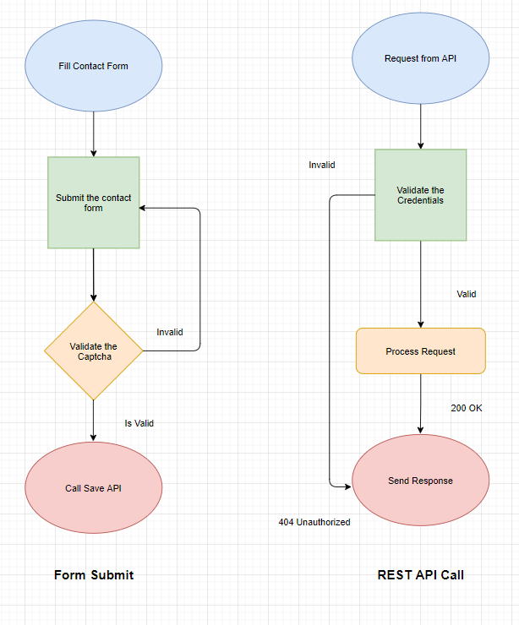
2. Functional Flow
Any requests will be rejected without a valid credentials.

Slide 4
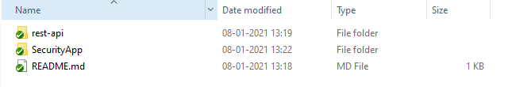
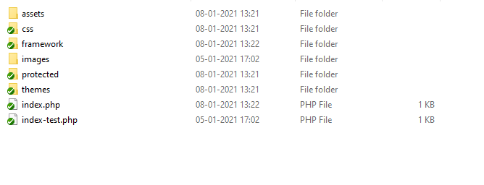
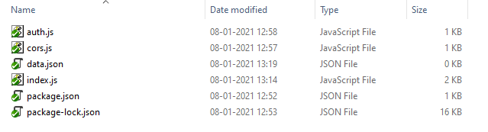
4. Application Folder Structure
auth.js - holds the user name and password to validate the incoming api request for authentication
cors.js - hold to validate the origin server request
index.js - route the request and store the data

Slide 5
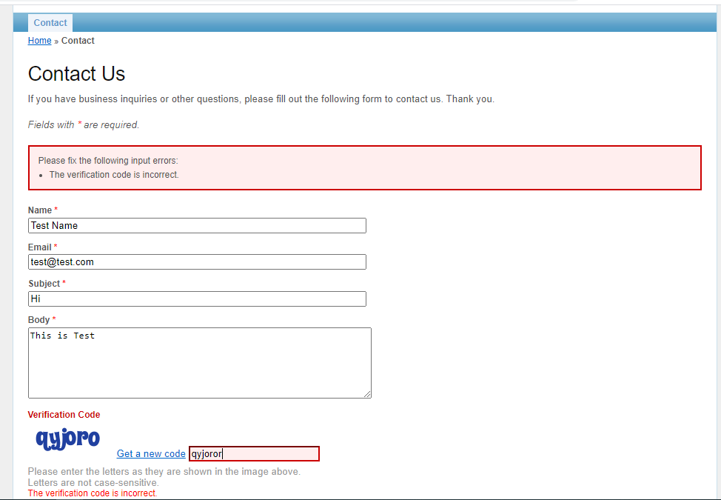
5.1 Screens
Captcha invalid screen1

Slide 6
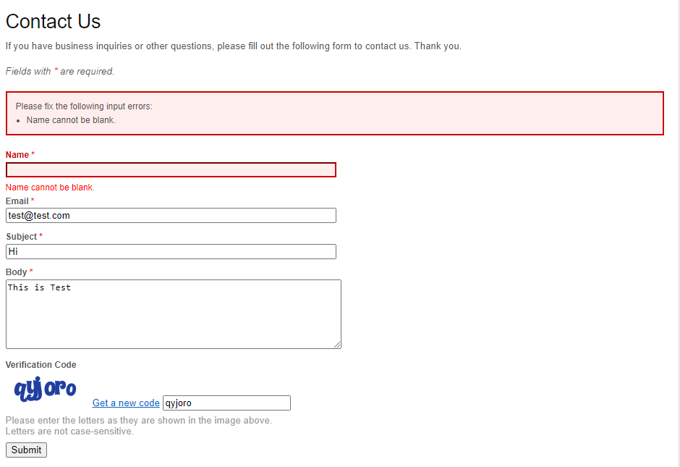
5.2 Screens
Captcha valid Screen 2

Slide 7
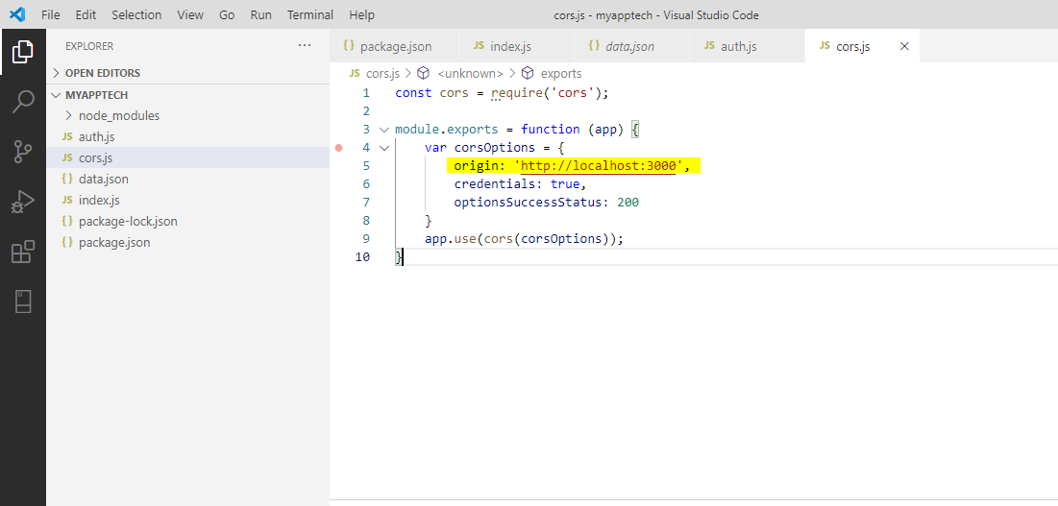
5.3 Screens
Cors valid Screen 3

Slide 8
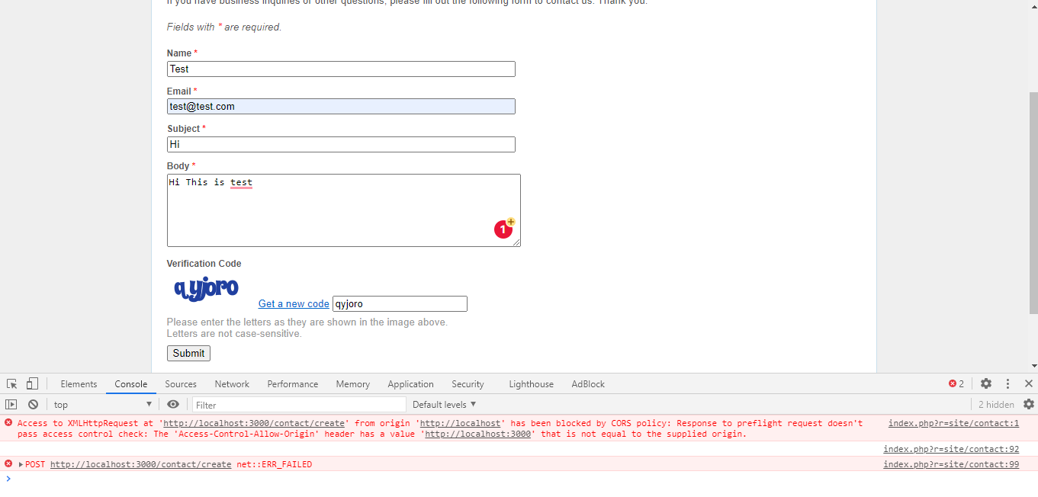
5.4 Screens
Cors invalid screen4

Slide 9
6. Involvement From Team
Core Development - Dhanakumar.M
Testing - Dineshkumar.D & Kanagaraj.R
Mentor - Balu Periyasamy

Slide 10
Thank You

