Slide 1
Aspiring Minds
Rounds- 2

Slide 2








Answer: #3
Description:
A License User Tracking system developed for tracking the user information and capturing the details like IP address, System Browser, Device type &
Operating System from different devices, Concurrent User Restriction and Multiple Devices Restriction is enabled in the system as well.
Implemented the requirement using the web application and developed an API / component.
Technology Used:
Frontend Backend API Logging & Documentation
PHP 7.3.2 Yii Framework 1.1.20 Bootstrap MYSQL 5.5.15 PHP 7.3.2 Yii Framework 1.1.20 Yii Core Log Database log
Unit Testing Authentication Source Code management
PHP Unit JWT Git
2017
2019

Slide 3
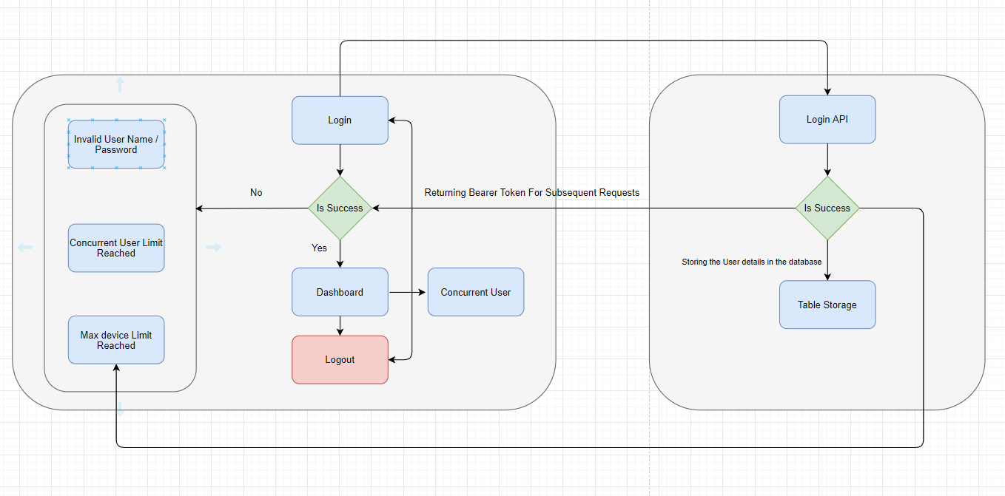
2. Functional Flow

Slide 4
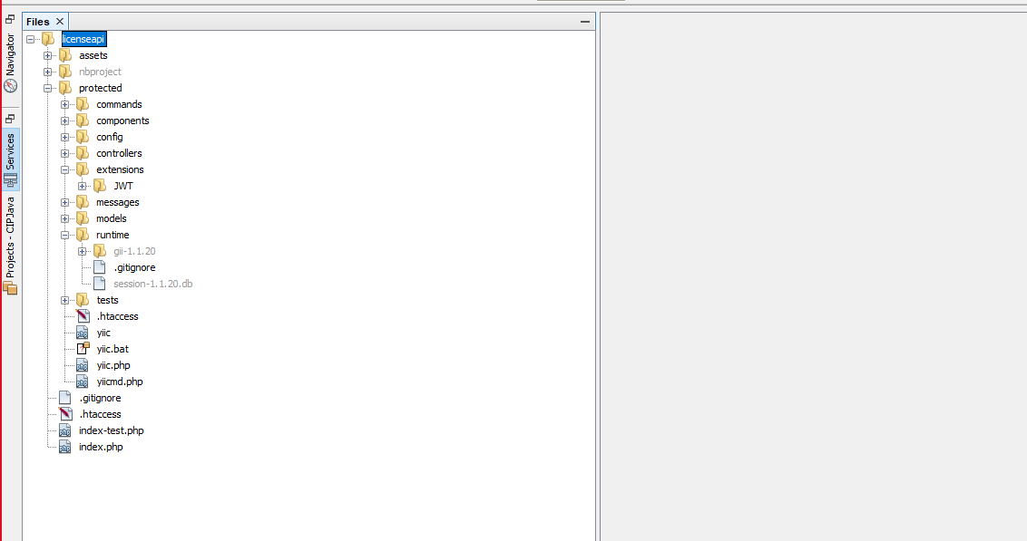
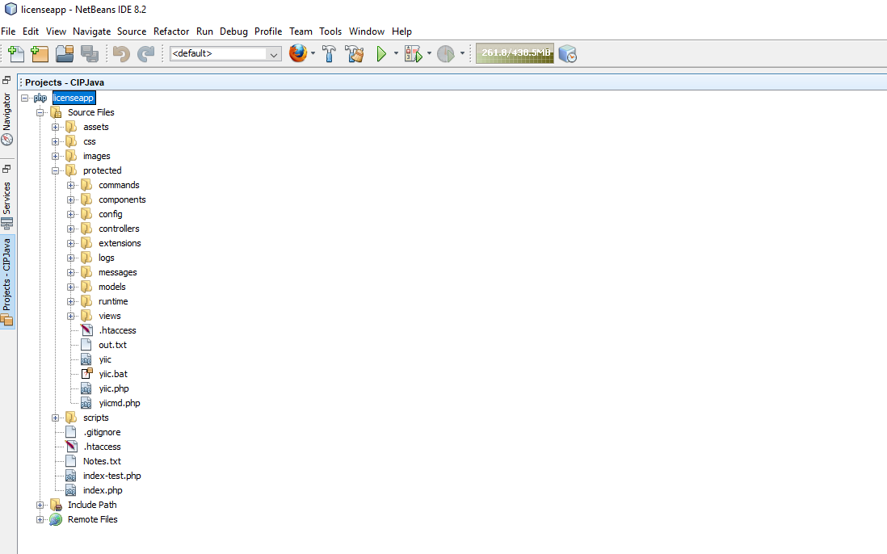
3. Application & API Folder Structure
Assets - used for storing project's temporary files
Css - External stylesheets files will be present here
Scripts - Javascript files
Protected - Main Application Directory
Commands - Console command files
Components - Main Controller file & framework's extension files
Config - Application's configuration files
Models - Database related files
Controllers - Intermediate files where the endpoints are located
Tests - Unit & Functional Tests Folder
Views - Application's view files
Extensions - Third Party Extensions like JWT will be here
Runtime - Application's session & log directory
.htaccess - Server Configuration file
index.php - Entry script of the application
index-test.php - Entry Script File for the functional and unit testing
.htaccess - Server Configuration file

Slide 5
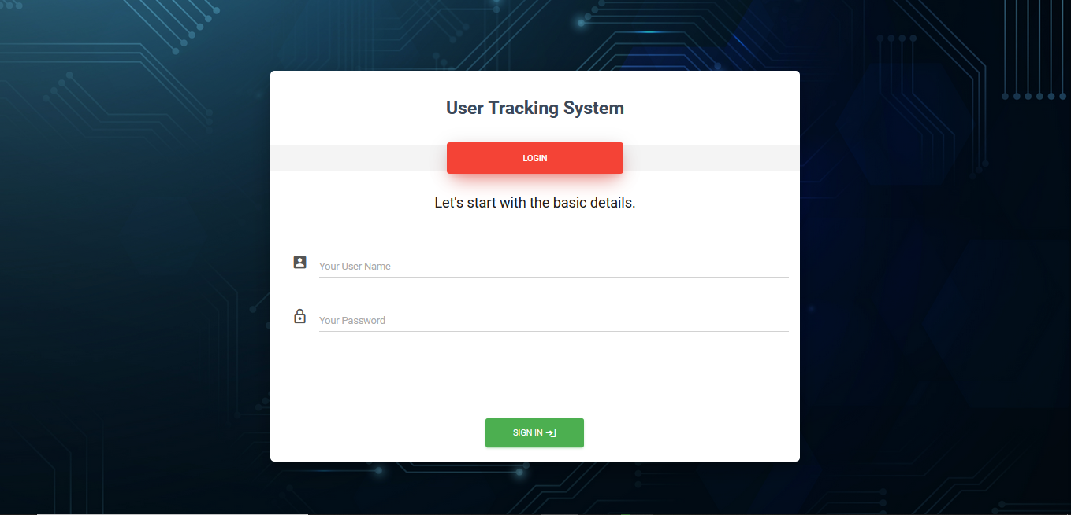
4.1 Screens
Login Screen

Slide 6
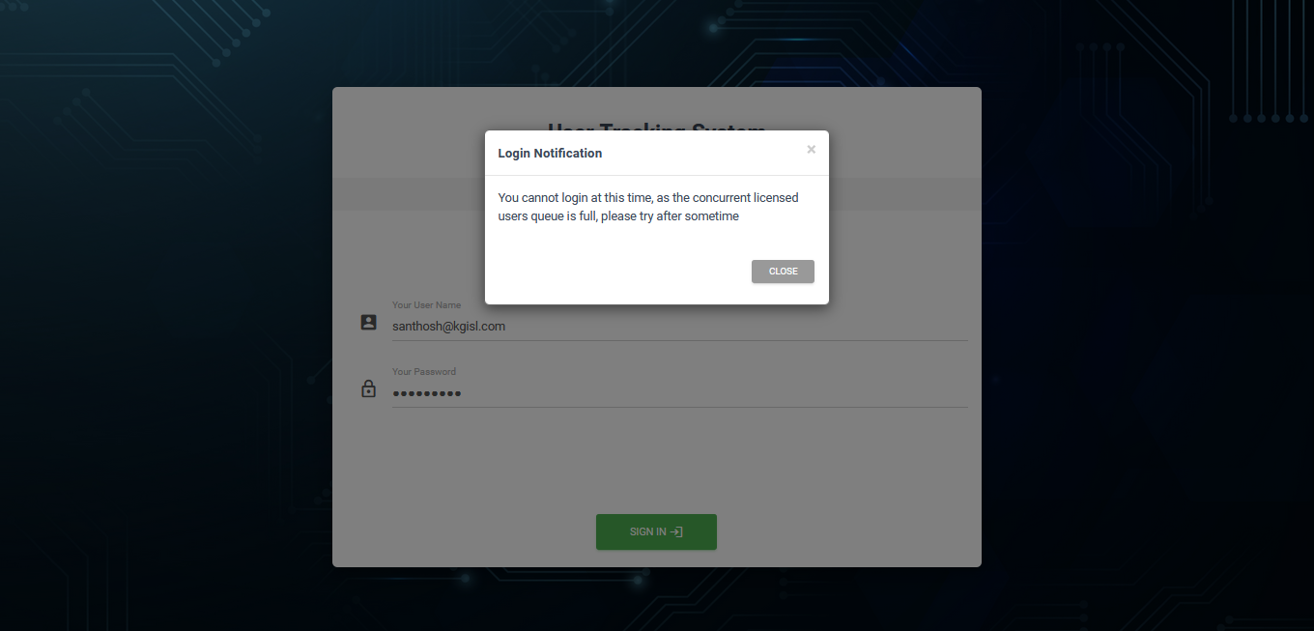
4.2 Screens
Concurrent User Validation Message

Slide 7
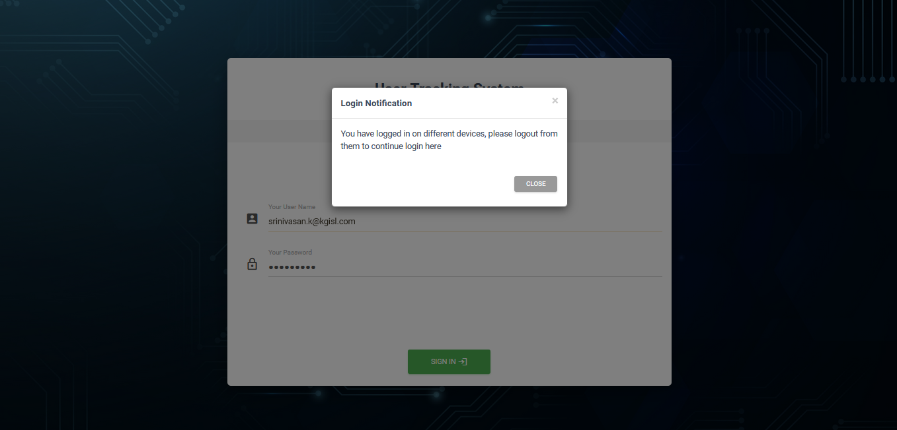
4.3 Screens
User Multiple Devices Logged In Validation

Slide 8
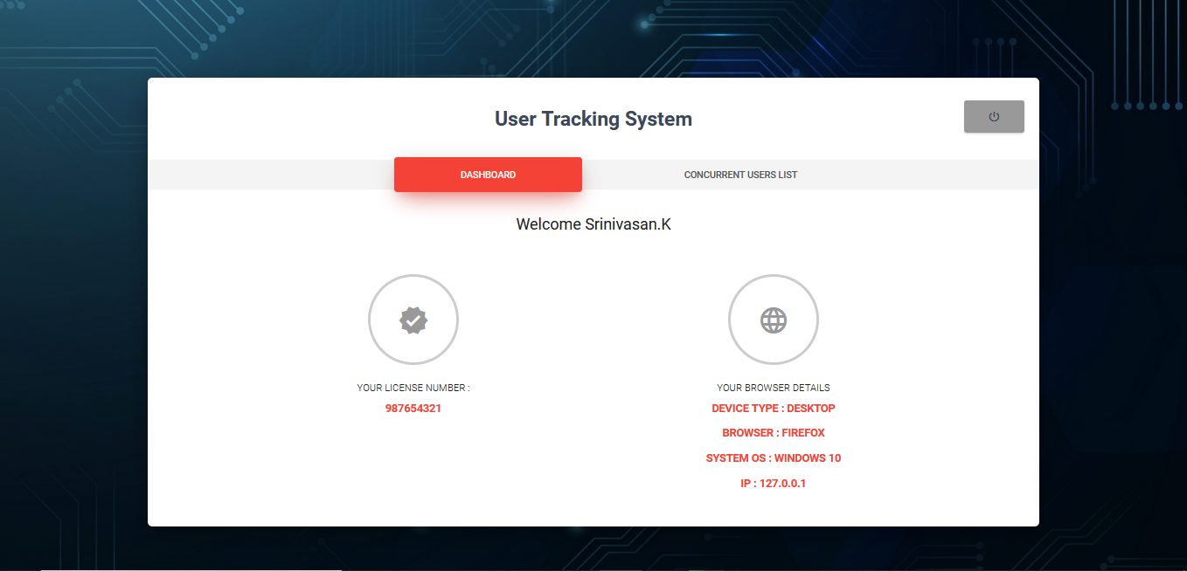
4.4 Screens
Dashboard Screen

Slide 9
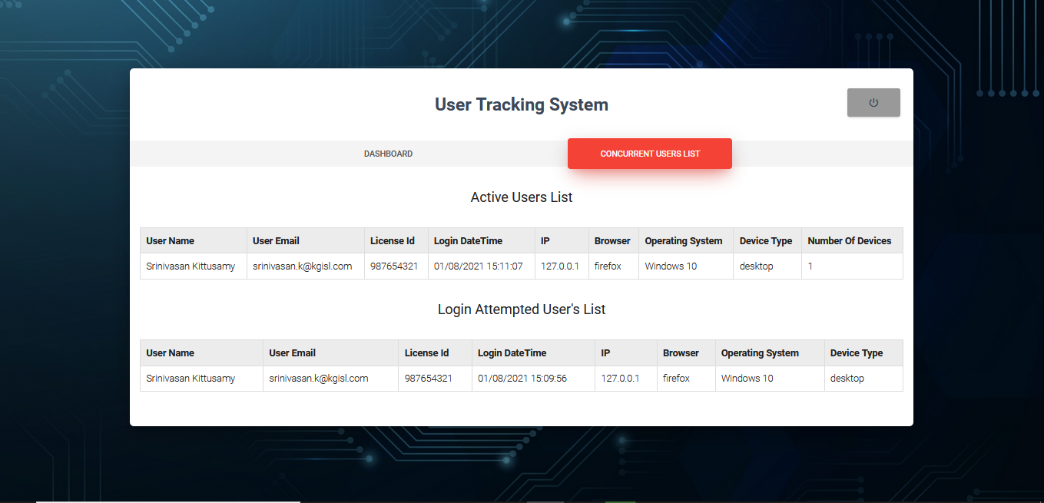
4.5 Screens
Concurrent User Details Screen

Slide 10
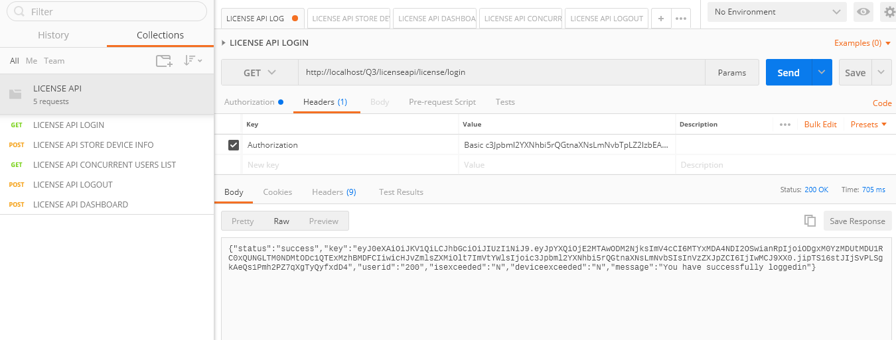
5.1 API
Login screen

Slide 11
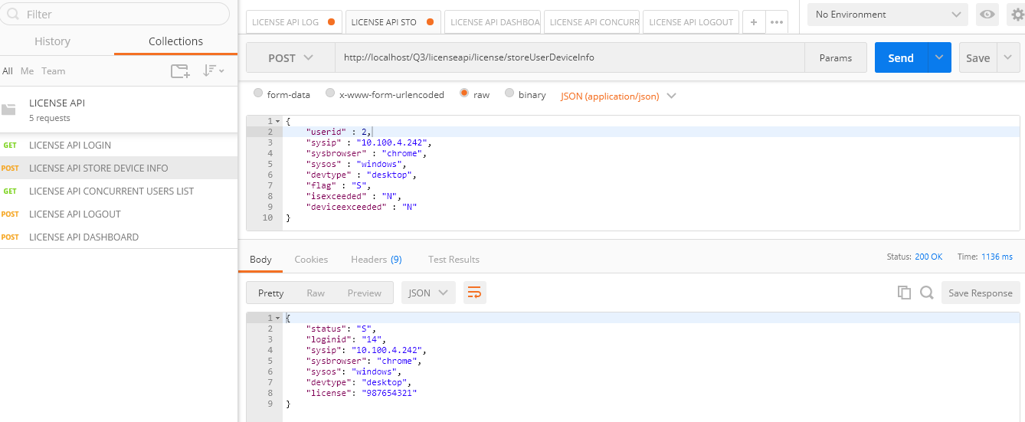
5.2 API
Store User Information

Slide 12
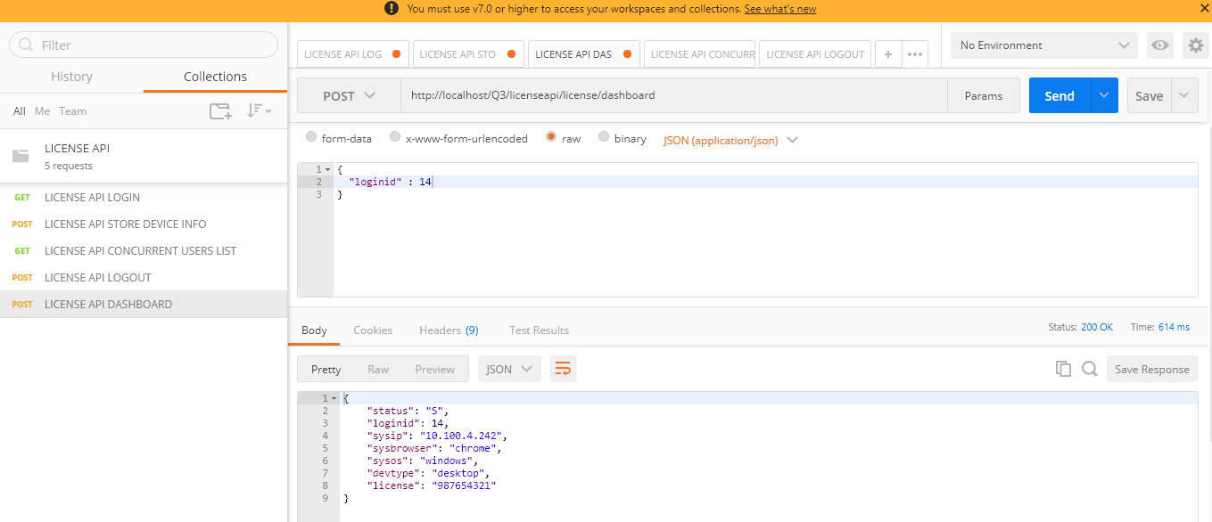
5.3 API
Dashboard

Slide 13
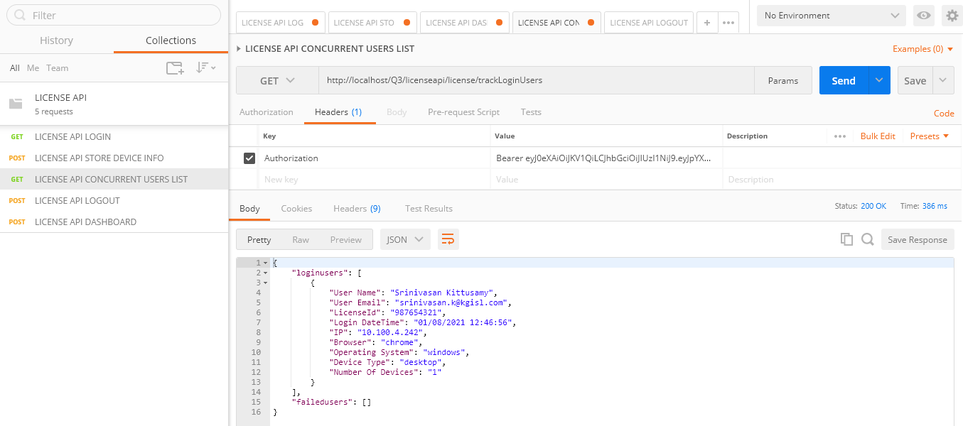
5.4 API
Concurrent User Details ( Logged In Users & Failed Users )

Slide 14
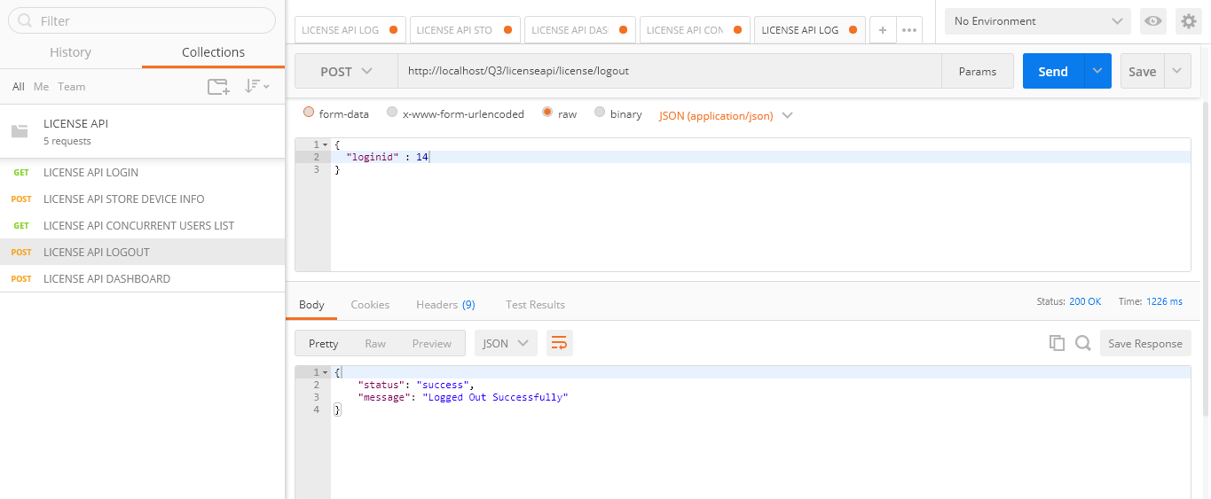
5.5 API
Logout

Slide 15
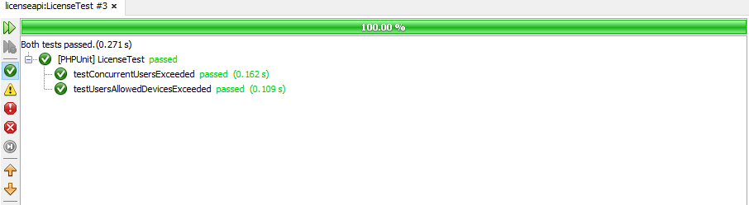
5.6 API
Unit Testing

Slide 16
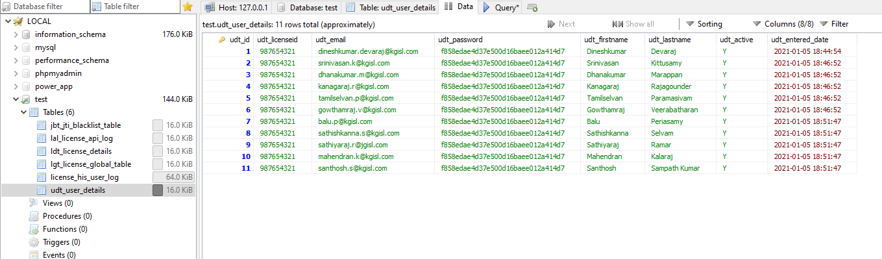
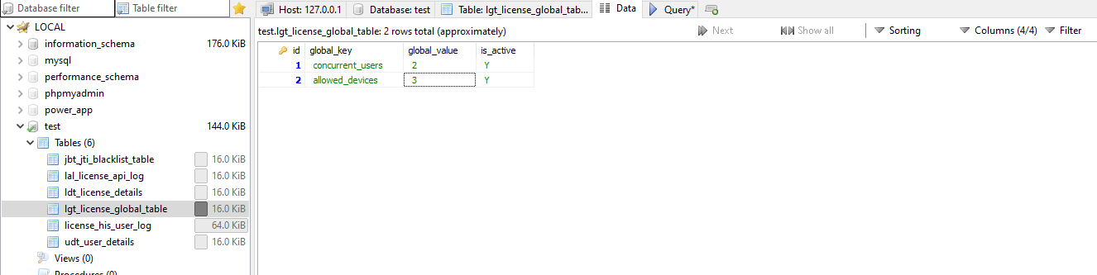
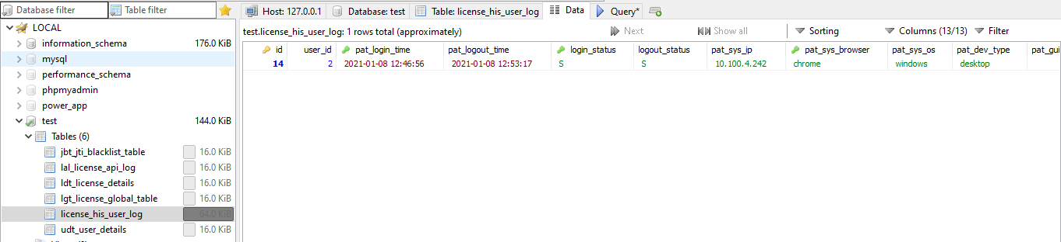
6.1 DATABASE
udt_user_details - Users Table
jbt_jti_blacklist_table - Blacklist Table For Storing GUID
lal_license_api_log - INPUT & OUTPUT LOGS
ldt_license_details - License details
lgt_license_global_table - Global config table
license_his_user_log - Browser Info
lmg_license_response_messages - Response Messages

Slide 17
7. Involvement From Team
UI & UX – Santhosh & Srinivasan
Core Development – Dineshkumar & Srinivasan
Documentation – Dineshkumar
Presentation - Santhosh
Unit Testing - Srinivasan
Testing– Dhanakumar, TamilSelvan & Kanagaraj
Mentor - Balu Periasamy

Slide 18
Thank You

