Slide 1
Aspiring Minds
Rounds- 2 Q4 – Chat Bot

Slide 2





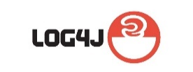
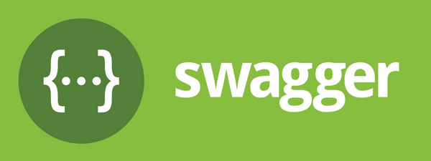
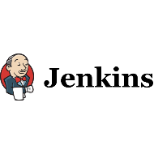
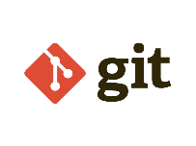

Answer: #4
Description:
A basic bot application to communicate with user queries. It is fully developed based on plain Web Socket programming with NodeJS & Express server.
Technology Used:
Frontend Middleware Backend Logging & Documentation
HTML5 CSS3 NodeJS ExpressJS MongoDB Log4JS Swagger UI
Test Case Deployment Source Code management
Mocha Jenkins Git
2017
2019

Slide 3
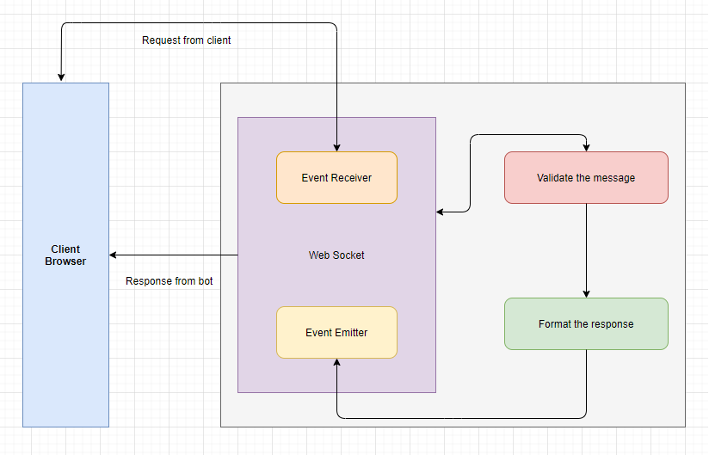
2. Functional Flow

Slide 4
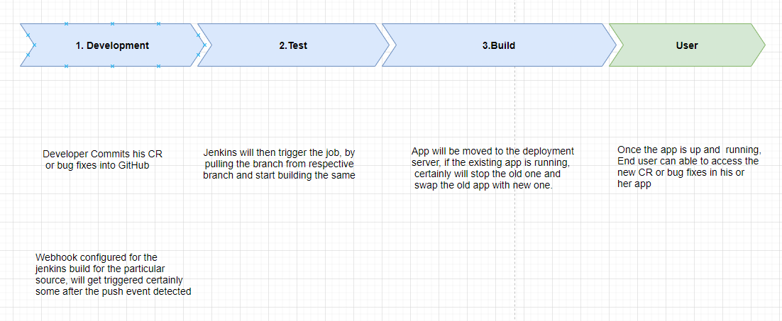





3. Auto Deployment

Slide 5
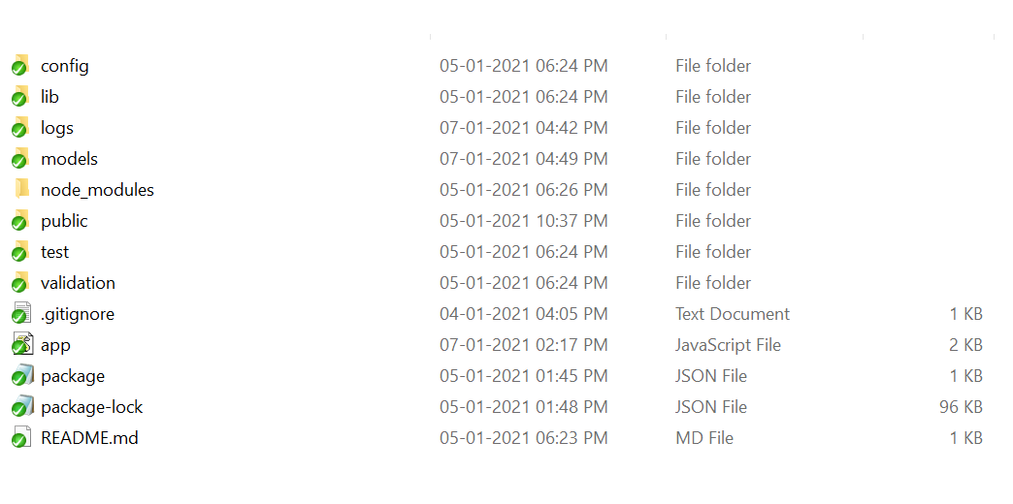
4. Application Folder Structure
Config - holds the running port, logging & database details
Lib - hold logger & db object initialization
Logs - hold the application logs of each steps
Models - holds the database objects
Public - holds the static content like images, html & css
Test - holds the unit test scripts
Validation - holds the bot auto reply message validations, questions & constants
App.js - Application initialization with web socket and port binding
Package.json - holds the dependencies required for the application

Slide 6
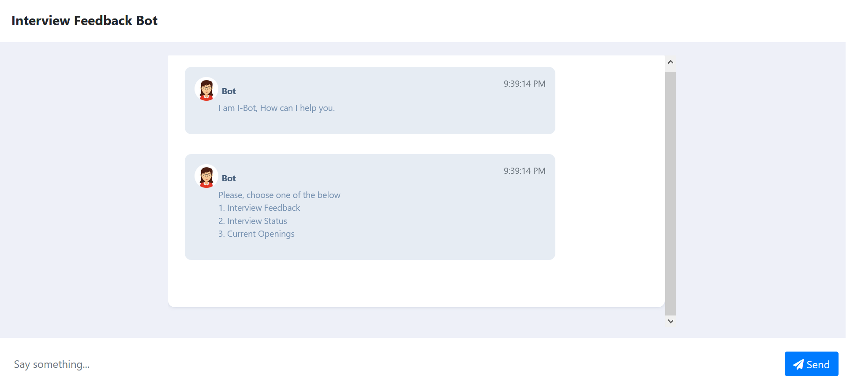
5.1 Screens
Chatbot Initialization

Slide 7
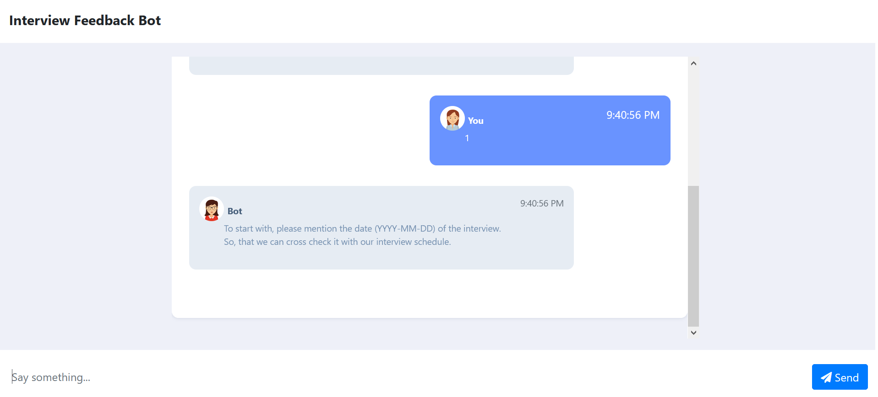
5.2 Screens
Chatbot Choose the option

Slide 8
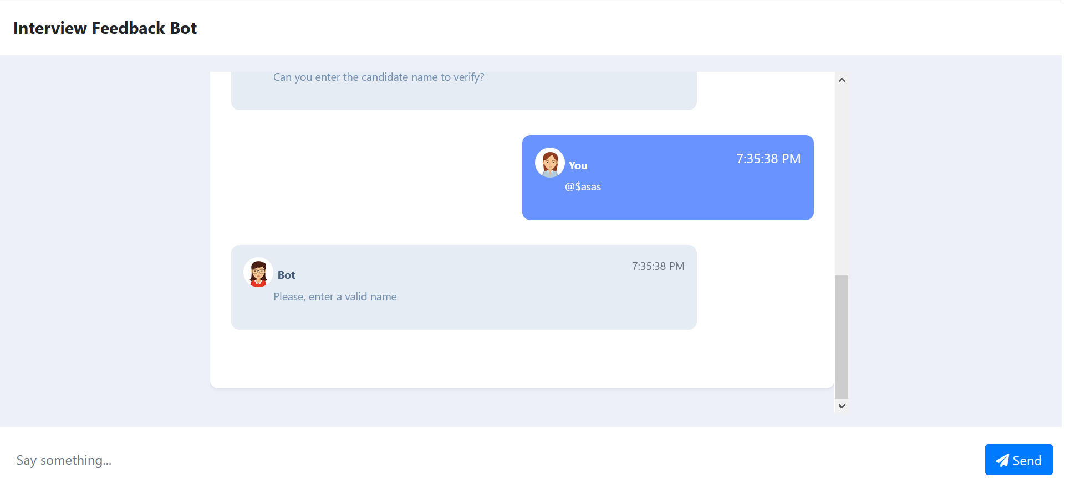
5.3 Screens
Chatbot Wrong Input from user

Slide 9
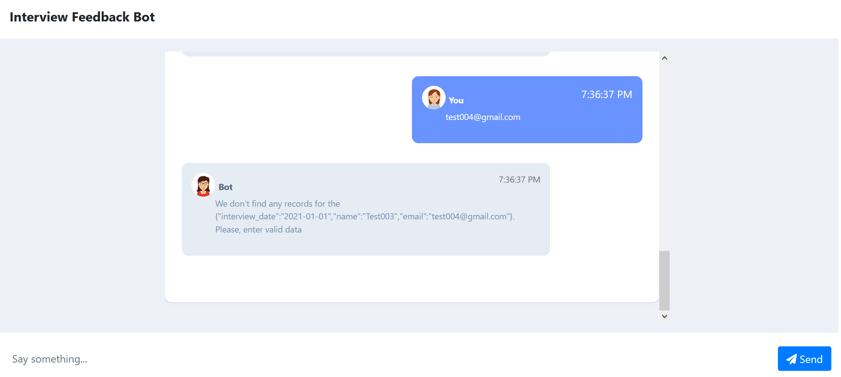
5.4 Screens
Chat box validation error message

Slide 10
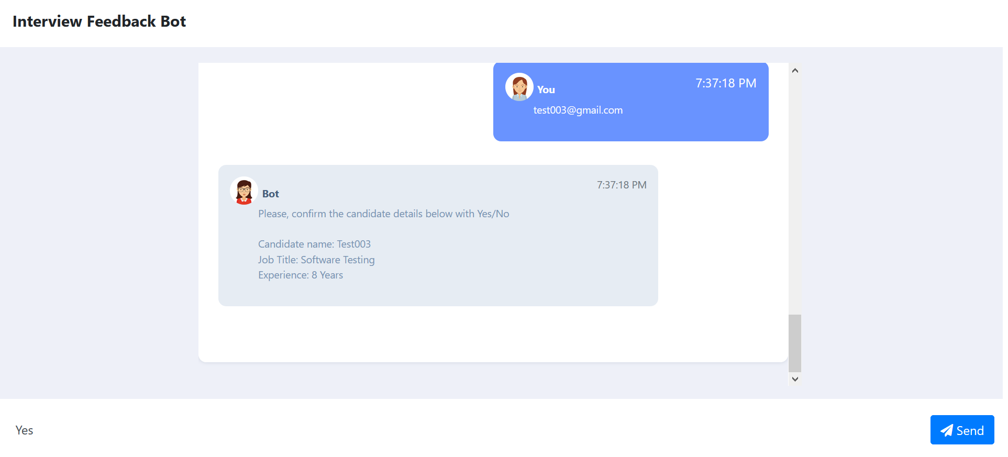
5.5 Screens
Chatbot confirmation of successful candidate filter

Slide 11
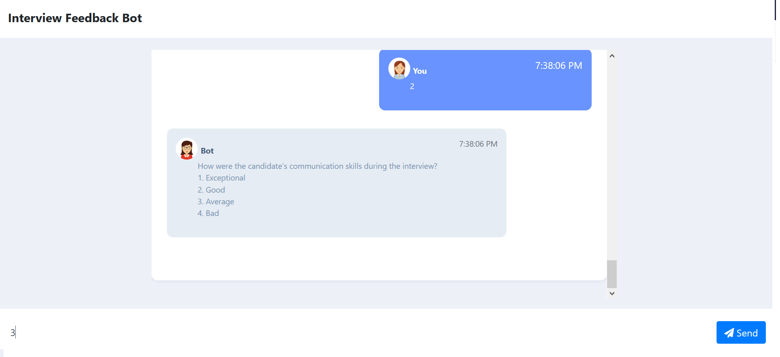
5.6 Screens
Chatbot Q&A

Slide 12

5.7 Screens
Chatbox completion

Slide 13
6. Involvement From Team
UI & UX - Santhosh
BDD Preparation - Sathiyaraj
Core Development - TamilSelvan.P
Testing - GowthamRaj & Dhanakumar
Build Automation – SathishKanna
Mentor - Balu Periyasamy

Slide 14
Thank You

