Slide 1
SENTIMENT ANALYZER
by
D. Sreelekha 16251A0510
G. Kaumudi 16251A0515
K. Nirmala 17255A0508
(BATCH NO – 08)

Slide 2
INTRODUCTION
PROBLEM STATEMENT:
Given a product name and different models or brands, compare and decide which is the most accepted using positive, negative, or neutral sentiments. For messages conveying both a positive and negative sentiment, whichever is the stronger sentiment should be chosen.

Slide 3
OBJECTIVES
To extract the most recent and relevant tweets for analyzing the sentiment of an electronic product.
To reduce the labour cost using the tweepy package.
To easily identify customer opinions without many expenses for business firms.
To provide user friendly interface with easy navigation through the web application.
Graphical representation of the sentiment in the form of Pie-Chart

Slide 4
APPLICATIONS
Reputation Management:
Checks social media reviews to make a decision before purchasing.
Customer Support:
Customers call out on Facebook/ Instagram etc for help.
Competitor Monitoring:
Chances are some of the competitors are getting bad press online. It’s where one could step in as long as one is aware of those negative mentions

Slide 5
TWITTER DATA
Using Twitter for Sentiment Analysis
Popular micro-blogging site
Short Text Messages of 140 characters
240+ million active users
500 million tweets are generated every day
Tweets are small in length and hence ambiguous making it rather challenging to analyze them

Slide 6
APPROACH
Dataset
- Emotion labelled sentences of electronic product reviews.
- A huge dataset with 10086 reviews.
Preprocessing
- Removing non-English Tweets
- Remove URL, Target Mentions , Hashtags, Numbers
Feature Extractor
- unigrams and bigrams of the each tweet
Classifier and Prediction
- The features extracted are next passed on to SVM classifier
- The model built is used to predict the sentiment of the new tweets
Tweet Downloader
- Download the tweet using Twitter API

Slide 7
SVM CLASSIFIER
Support vector machines are supervised models with associated learning algorithms that analyze data used for classification and regression analysis. It makes use of the concept of decision planes that define decision boundaries.
Advantages:
Training a SVM with a linear kernel is faster than with any other kernel.
When training a SVM with a linear kernel, only the optimization of the C Regularization parameter is required.

Slide 8
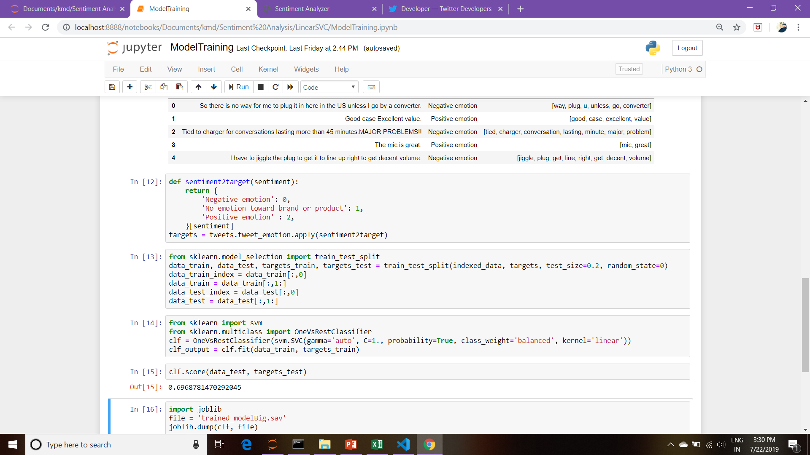
MODEL TRAINING: OVR SVC

Slide 9
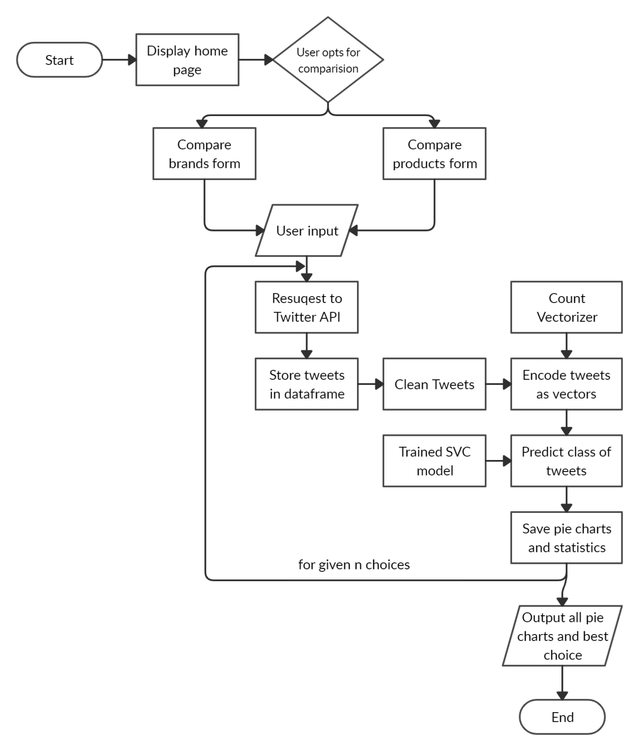
FLOW CHART

Slide 10
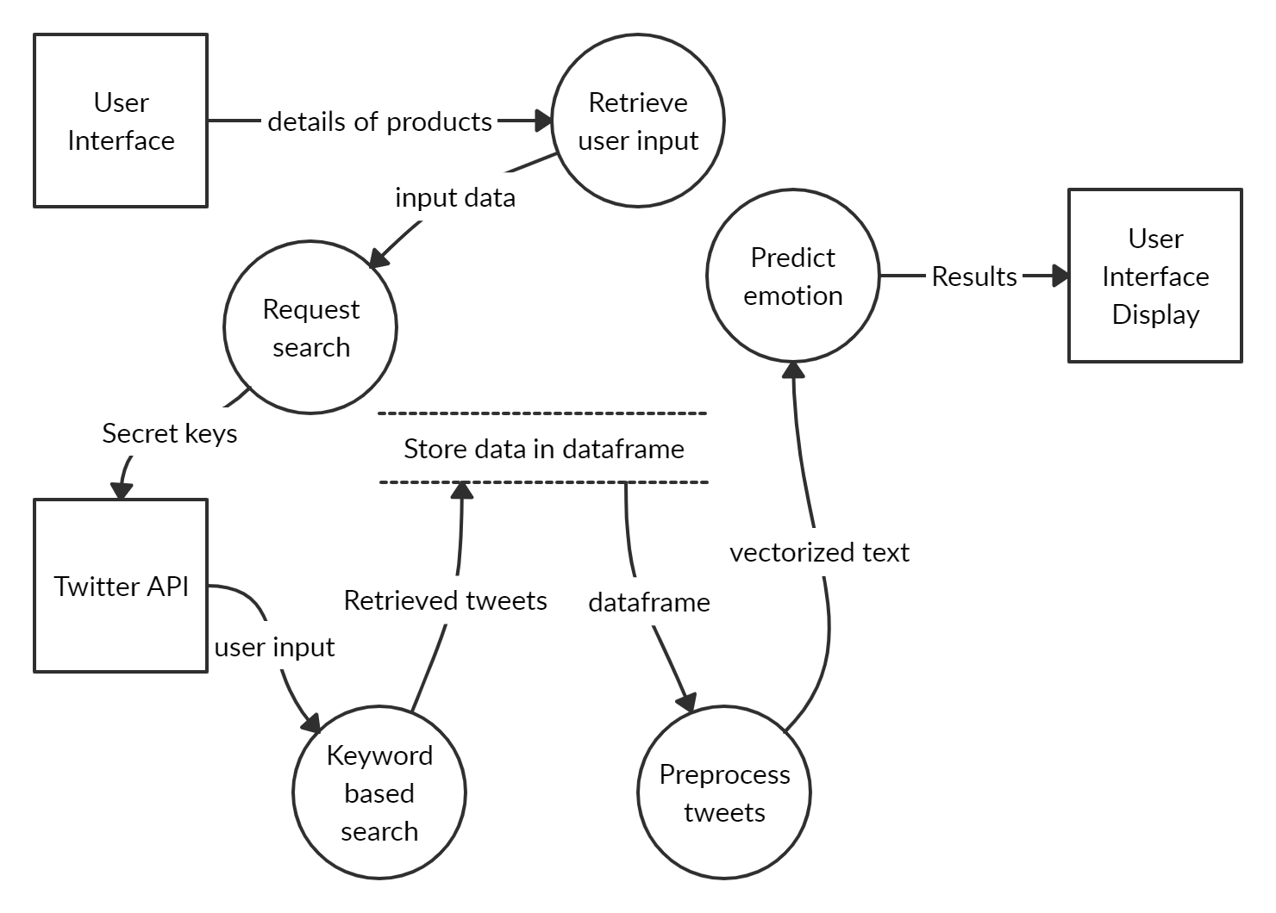
DATA FLOW DIAGRAM

Slide 11
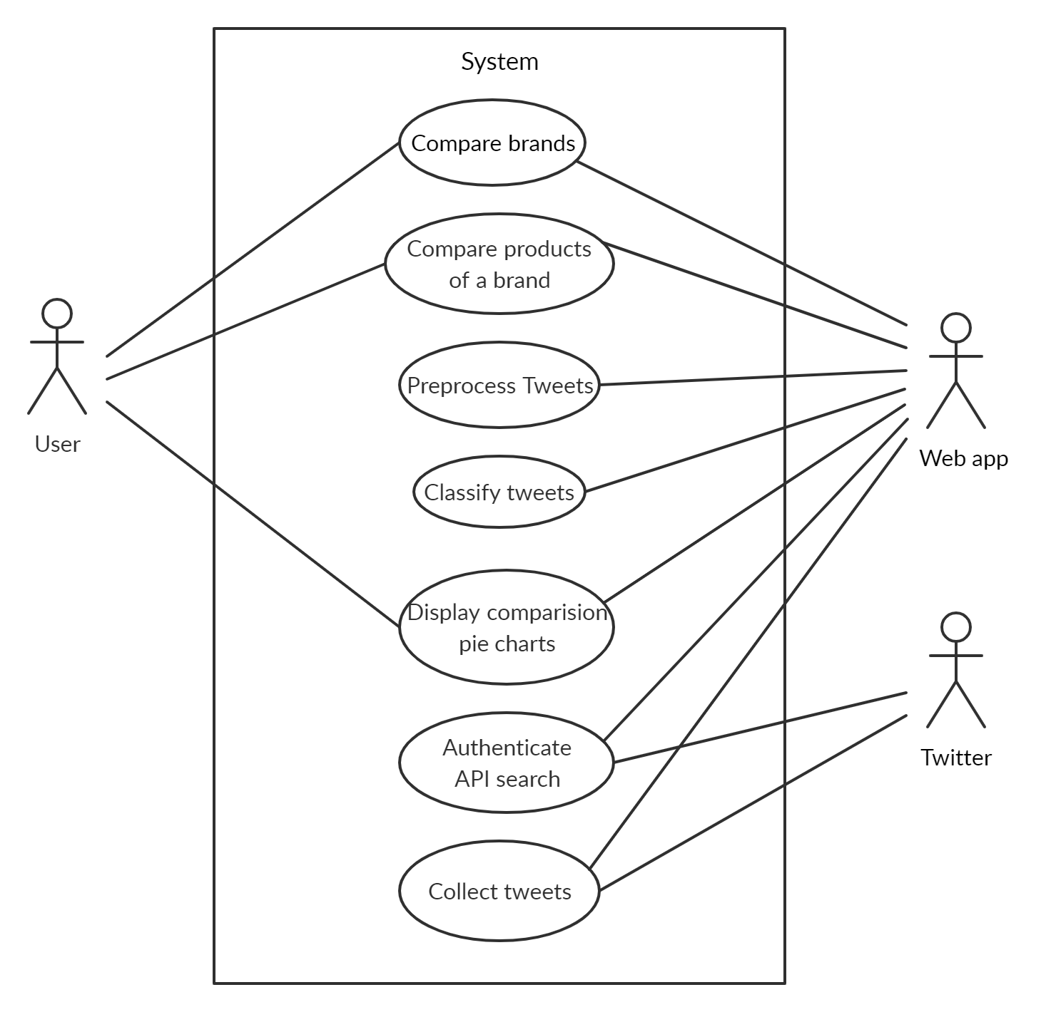
USE CASE DIAGRAM

Slide 12
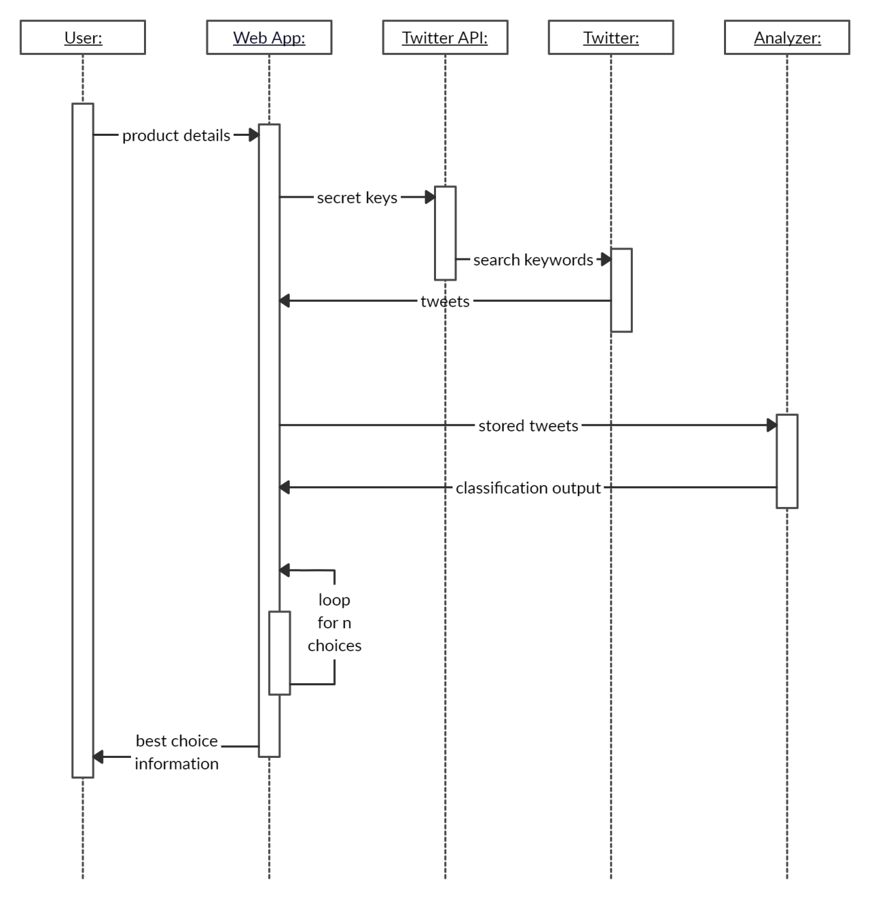
SEQUENCE DIAGRAM

Slide 13
TECHNOLOGIES USED
Machine Learning:
Machine learning for natural language processing and text analytics involves using machine learning algorithms to understand the meaning of text documents.
Python:
Python is an interpreted language, high-level language, general purpose programming language. Sentiment analysis commonly uses python technology.
Django
  A web application development framework wtitten in Python
  with MVC.
Jinja
A templating language used to embed Python logic into HTML.

Slide 14
RESULT AND OUTPUT
Output is shown in the form of pie charts – one for each choice. The best choice is displayed to the user.
The performance of the proposed algorithm is analyzed using three parameters:
  Accuracy = (TP+TN) / (TP+FP+TN+FN)
  Recall = TP / (TP+FN)
  Precision = TP / (TP+FP)

Slide 15
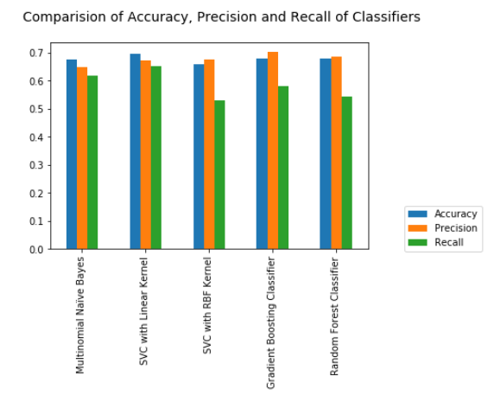
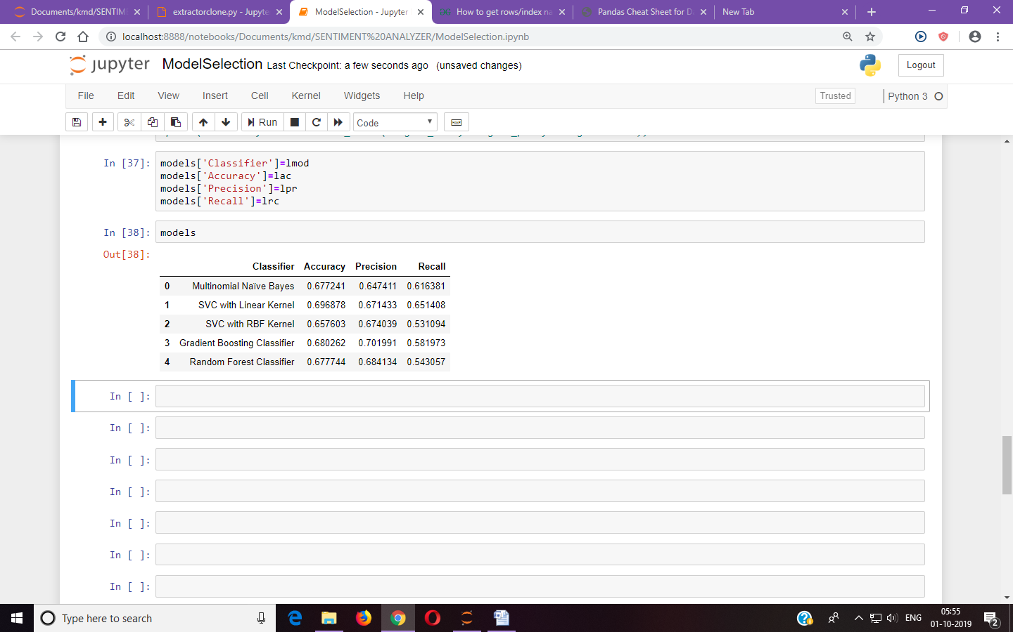
BEST MODEL

Slide 16
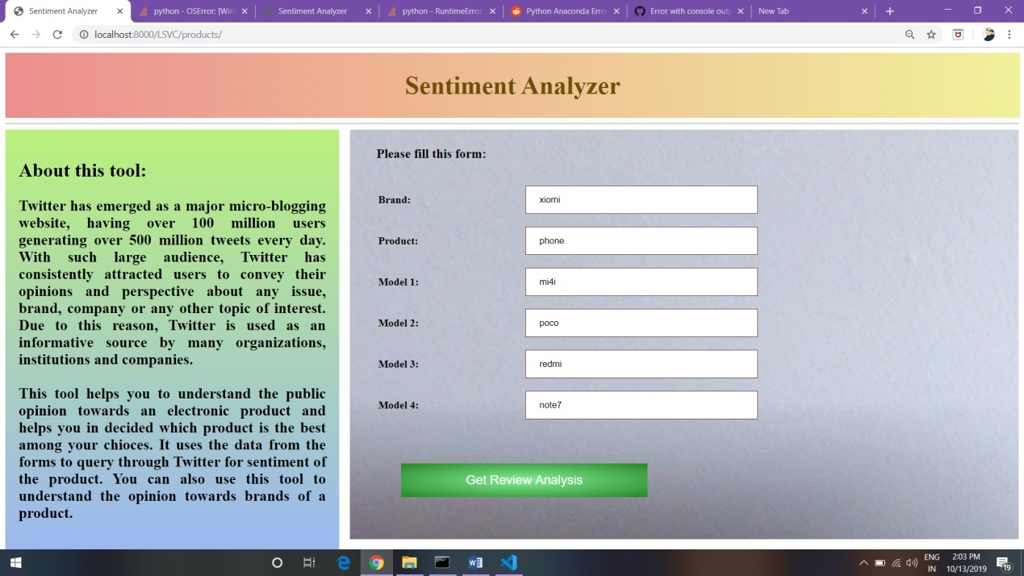
INPUT FORM: BEST MODEL

Slide 17
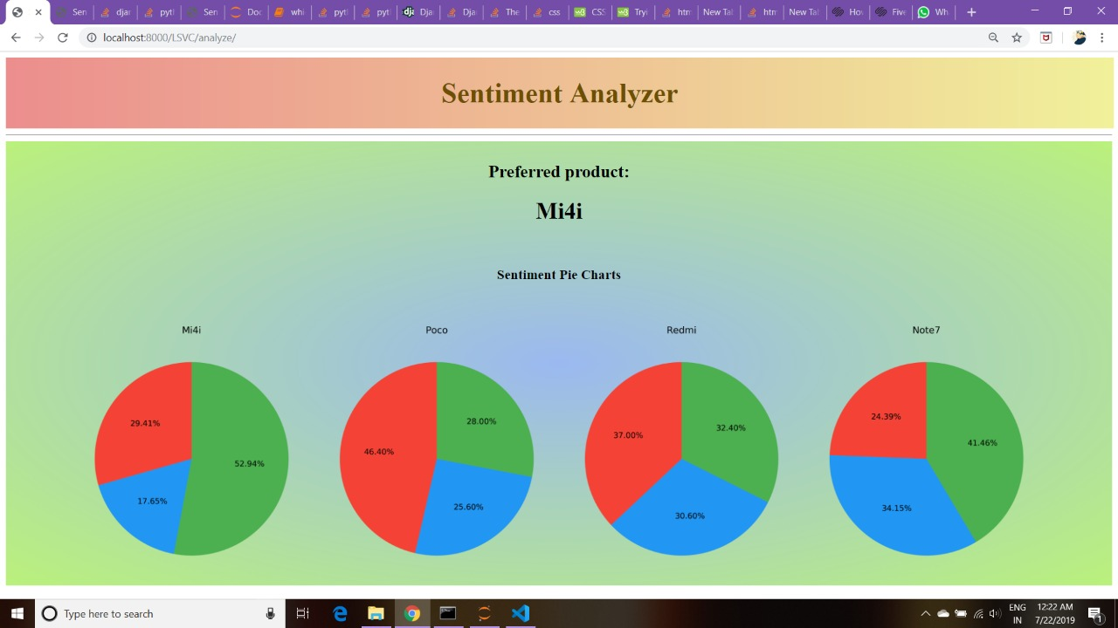
ANALYSIS: BEST MODEL

Slide 18
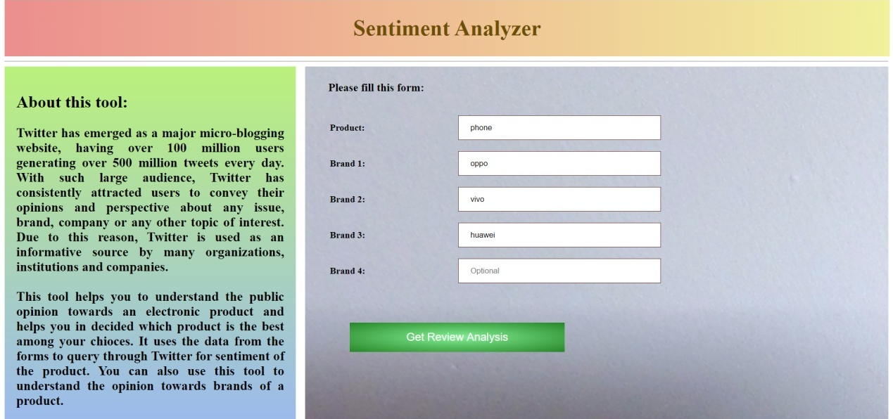
INPUT FORM: BEST BRAND

Slide 19
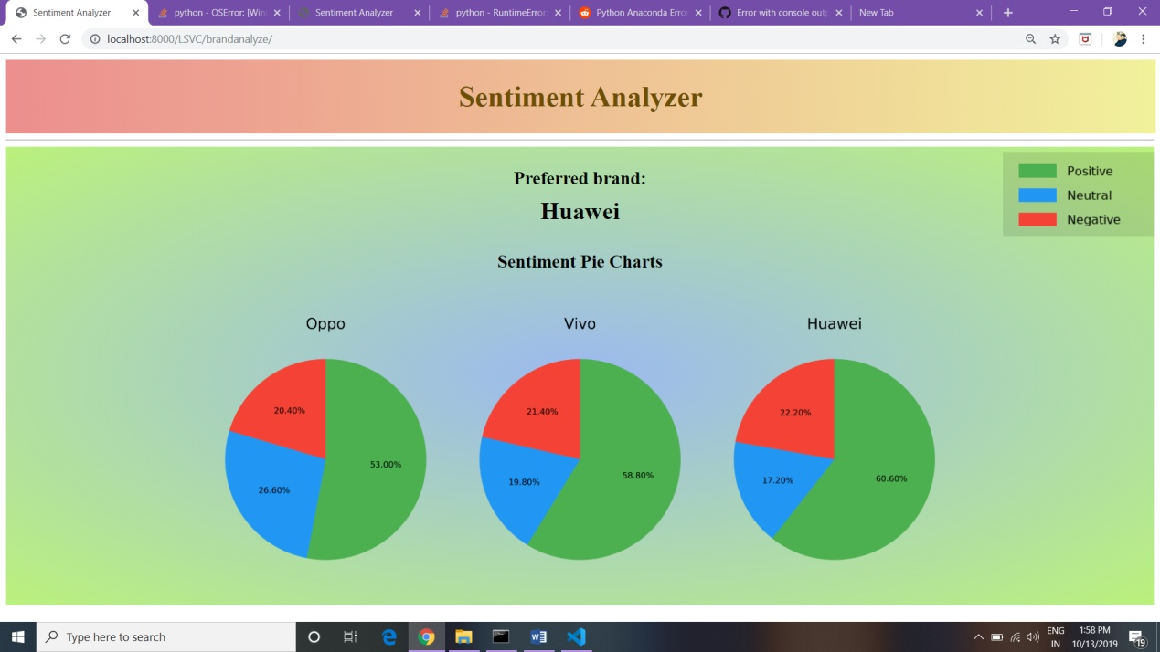
ANALYSIS: BEST BRAND

Slide 20
CONCLUSION
The most recent and relevant tweets are extracted using Twitter Search API.
Linear SVM is applied for the classification of sentiments of different electronic products.
Labour cost is reduced using the tweepy package.
It provides user friendly interface for customer experience.
It helps user to choose best brand and best model of Electronic products.

Slide 21
FUTURE WORK
The current web app works best for electronic products. To extend this to other ares by using domain specific datasets.
To recognize things like sarcasm and irony, negations jokes-the sort of things a person would have trouble identifying.
To identify underlying meaning of the Emoticons.

