Slide 1
BOX-JENKINS METHODOLOGY • ARIMA • RNN • LSTM
Gold Price Prediction
A Time Series Forecasting Study : Classical Statistics vs. Deep Learning
Presented by
Krishna Gupta
ZDA23B011
Notes:
[~10s] Greet the room, state the title: Gold Price Prediction using Box-Jenkins ARIMA, benchmarked against RNN and LSTM.

Slide 2
Contents
01
Problem Statement & Dataset
02
Stationarity, Differencing & ACF/PACF
03
Model Selection :AIC vs BIC
04
Forecast Results : Multi-Step vs One-Step
05
Deep Learning Benchmark : RNN & LSTM
06
Final Comparison & Conclusion
Notes:
[~15s] Quick orientation: mention this deck is structured around the Box-Jenkins workflow, then the deep-learning benchmark. Skip reading every line aloud.

Slide 3
INTRODUCTION
Problem Statement
Forecast the next-day closing price of gold (COMEX Gold Futures, GC=F) using historical daily price data.
Apply the classical Box-Jenkins methodology end-to-end: Identification → Estimation → Diagnostic Checking → Forecasting.
Benchmark the statistical ARIMA model against deep learning sequence models : a vanilla RNN and an LSTM (PyTorch).
Evaluate forecasting skill at two distinct horizons: a long multi-step forecast and a rolling one-step-ahead forecast — to test whether model complexity actually buys predictive power.
01
02
03
04
Identification
Estimation
Diagnostic
Checking
Forecasting
Gold Price Prediction | Box-Jenkins & Deep Learning
3
Notes:
[~25s] State the objective in one sentence, then point at the 4-step flow: this is the exact sequence we'll walk through. Mention RNN/LSTM benchmark is the second half.

Slide 4
DATA
Dataset Overview & Specifications
Source
Yahoo Finance (via yfinance)
2,884
Ticker
GC=F : COMEX Gold Futures (USD/oz)
Target Variable
Daily Close Price
Total Daily
Observations
Period
2015-01-02 → 2026-06-24 (~11.5 years)
Frequency
Daily (trading days)
0
Total Observations
2,884
Missing
Values
Missing Values
None
Train-Val / Test Split (80 / 20 : performed BEFORE any EDA to prevent leakage)
TRAIN — 2,307 obs (2015-01-02 → 2024-03-07)
TEST
577 obs
Test window: 2024-03-08 → 2026-06-24
Gold Price Prediction | Box-Jenkins & Deep Learning
4
Notes:
[~30s] Mention the split was done BEFORE any EDA specifically to avoid data leakage — this is a methodology point worth stating explicitly.

Slide 5
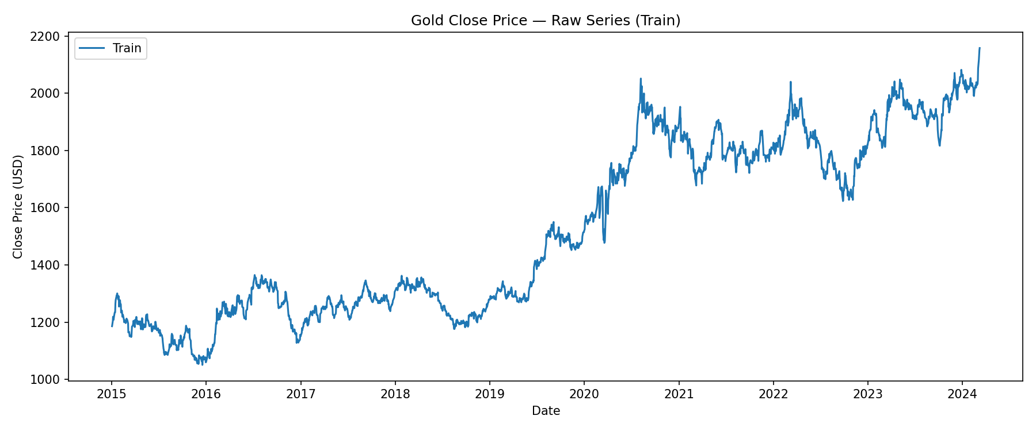
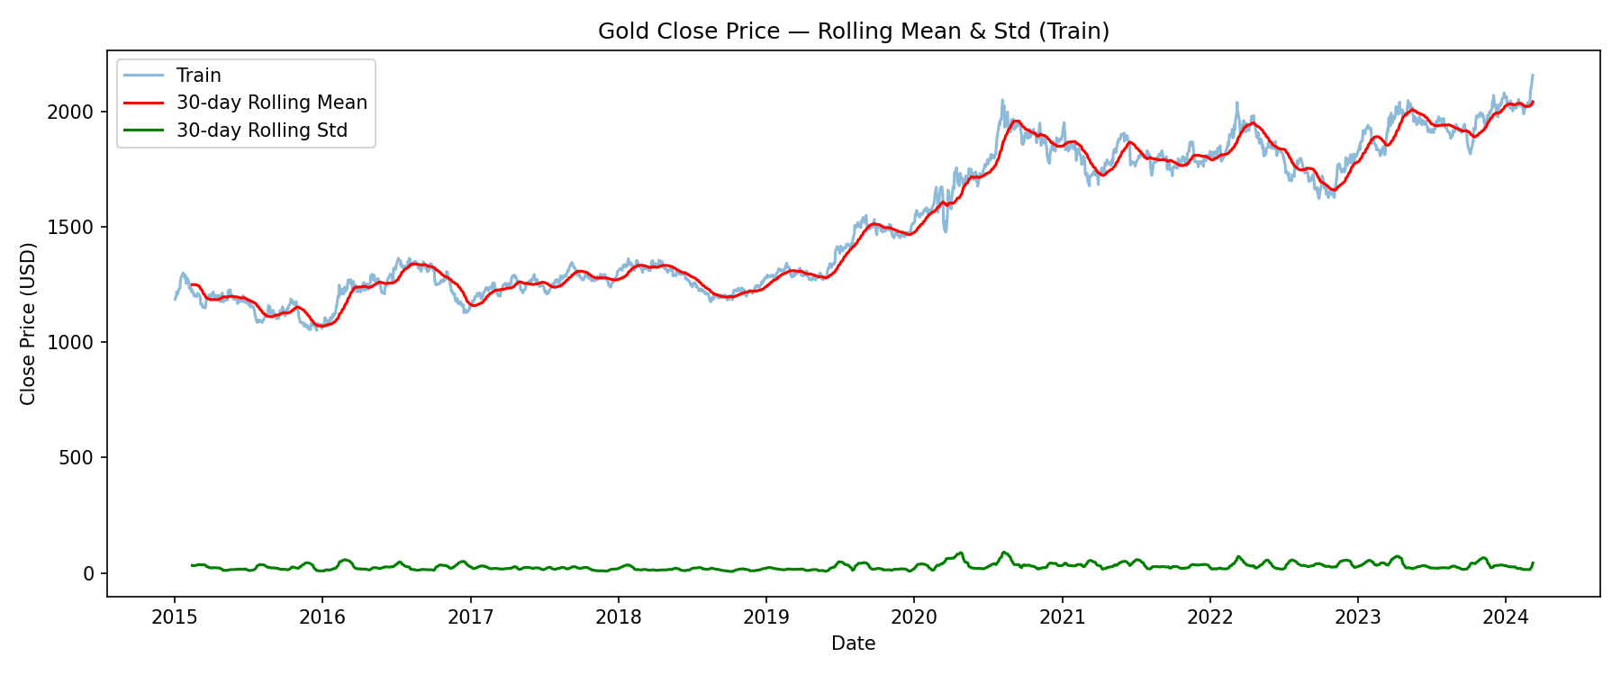
EXPLORATORY ANALYSIS
Exploratory Data Analysis (Train Only)
Close Price : Raw Series
TRAIN SET SUMMARY
Mean
$1,892.71
Std Dev
877.60
Min
$1,050.80
30-Day Rolling Mean & Std
Median
$1,729.45
Max
$2,158.00
Multi-modal price distribution and a steadily rising rolling mean both point to a non-stationary, trending series.
Gold Price Prediction | Box-Jenkins & Deep Learning
5
Notes:
[~30s] Point at the rolling mean clearly drifting, not flat — that's the visual cue for non-stationarity, confirmed statistically next slide.

Slide 6
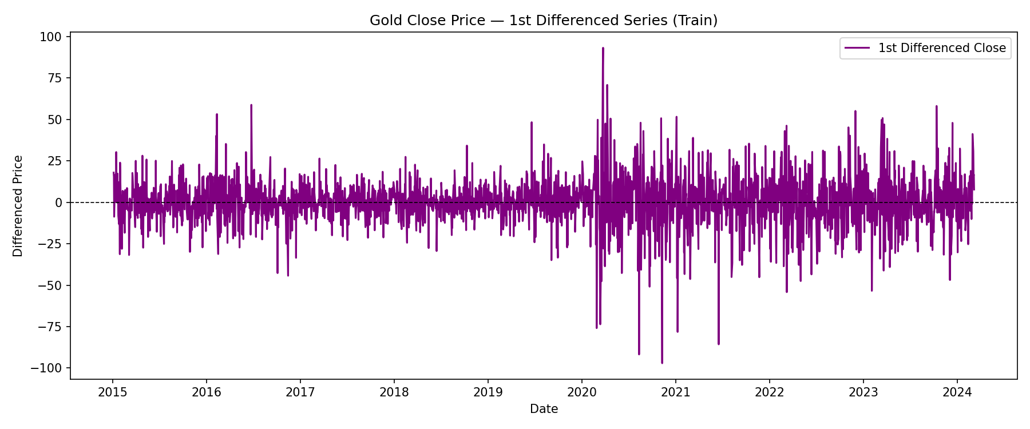
IDENTIFICATION : STEP 1
Stationarity Testing & Differencing
BEFORE DIFFERENCING (Raw)
ADF p-value = 0.9336
ADF statistic: −0.24 (vs. 5% critical value −2.86)
NON-STATIONARY
AFTER 1st DIFFERENCING (d = 1)
ADF p-value ≈ 0.0000
ADF statistic: −19.77 (well past 1% critical value −3.43)
STATIONARY : d = 1 is sufficient
1st Differenced Close Price : oscillates around zero, no visible trend
Gold Price Prediction | Box-Jenkins & Deep Learning
6
Notes:
[~35s] Walk through both ADF results side by side — emphasize the p-value jump from 0.93 to ~0.0000 after one difference. d=1 is locked in.

Slide 7
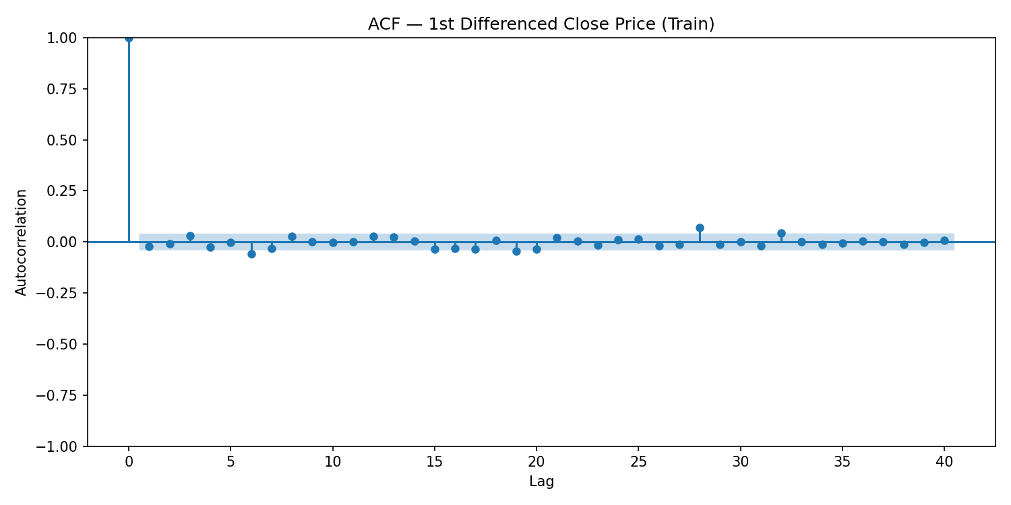
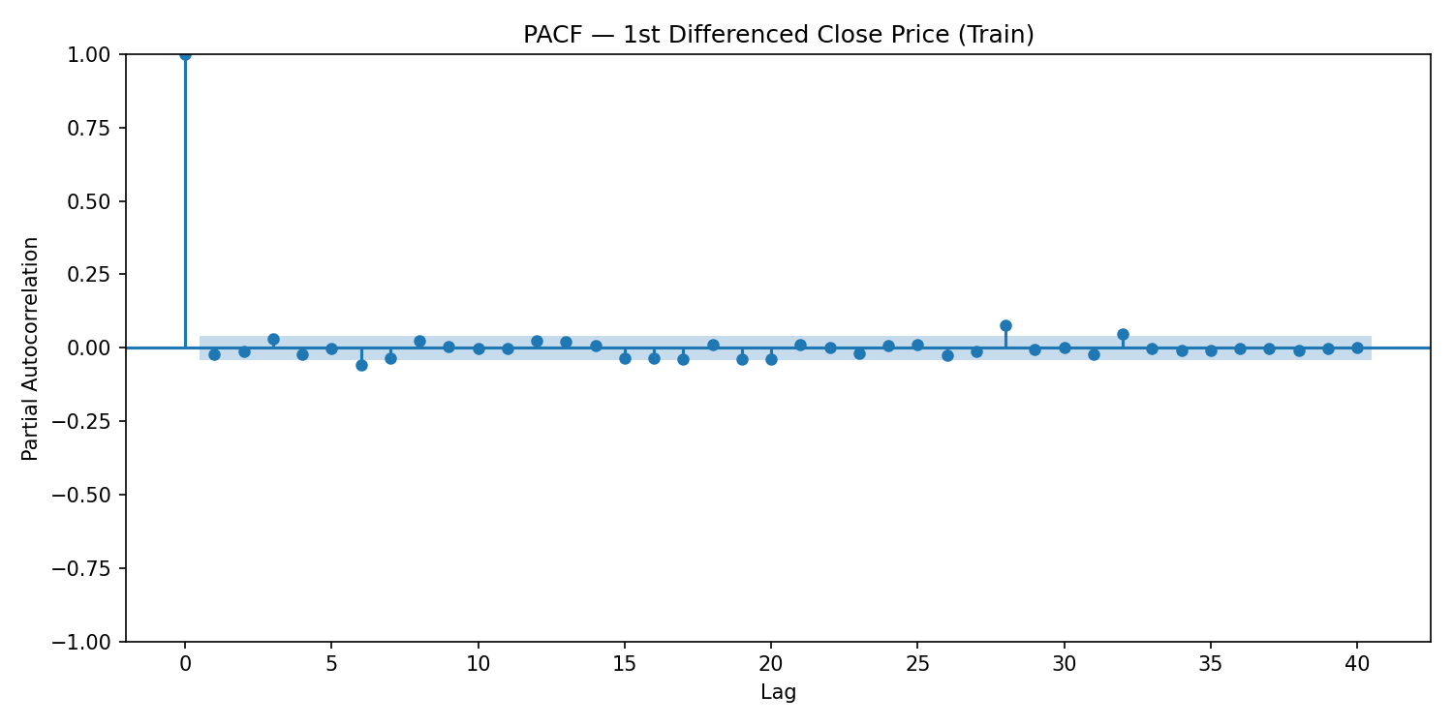
IDENTIFICATION : STEP 2
ACF & PACF Analysis
ACF : Differenced Series
PACF : Differenced Series
INTERPRETATION
No lag beyond 0 crosses the 95% confidence band in either plot : both resemble pure white noise.
The minor blips at lags 28 & 32 are expected false positives.
Visual read: p = 0, q = 0 → candidate model ARIMA(0,1,0), confirmed next via AIC/BIC grid search.
Gold Price Prediction | Box-Jenkins & Deep Learning
7
Notes:
[~55s] KEY SLIDE — sir wants this emphasized. Point at both plots: every bar inside the band. Explicitly name the lag-28/32 blips as expected false positives, not signal. State the visual candidate (0,1,0) before AIC/BIC.

Slide 8
ESTIMATION
Model Selection : AIC vs BIC Grid Search
Order | AIC | BIC
(3,1,3) | 18936.12 | 18976.33
(0,1,0) ★ | 18936.79 | 18942.54
(0,1,1) | 18937.83 | 18949.32
(1,1,0) | 18937.85 | 18949.34
(2,1,2) | 18938.85 | 18967.57
Both AIC and BIC are penalized likelihood criteria.
AIC : penalizes the extra parameter used
2k-2ln(L) k : no. of parameters ; 2k is the penalty
L : Likelihood
BIC : penalizes the no. of observations( greater the sample size, more BIC penalty)
k.ln(n)-2ln(L) k : no. of parameters ; k.ln(n) is the penalty
L : Likelihood
n: no of observations.
FINAL MODEL: ARIMA(0,1,0)
Gold's daily Close behaves as a random walk : no exploitable autocorrelation in the first difference.
Gold Price Prediction | Box-Jenkins & Deep Learning
8
Notes:
[~65s] KEY SLIDE — sir explicitly wants this. Explain: AIC's 'winner' (3,1,3) only beats (0,1,0) by 0.67 AIC points (statistically meaningless, rule of thumb <2) AND it failed to converge. BIC clearly prefers (0,1,0). This is the actual model-selection reasoning, not just 'lowest number wins'.

Slide 9
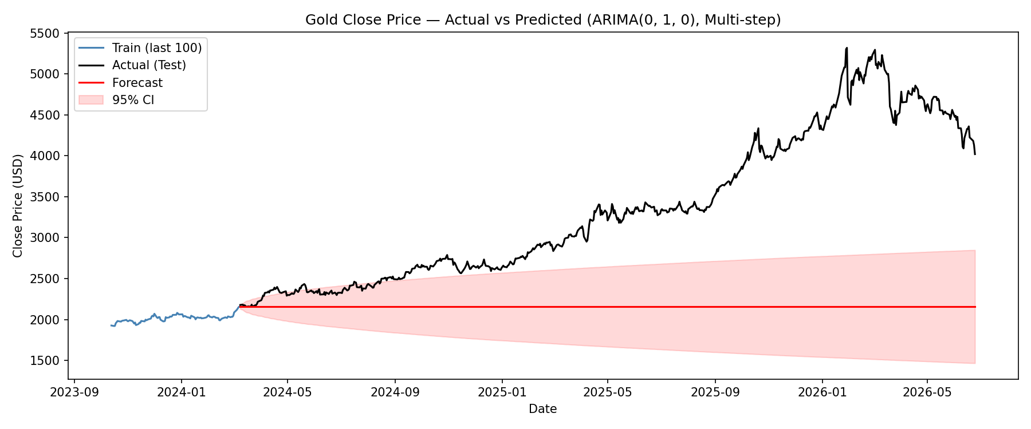
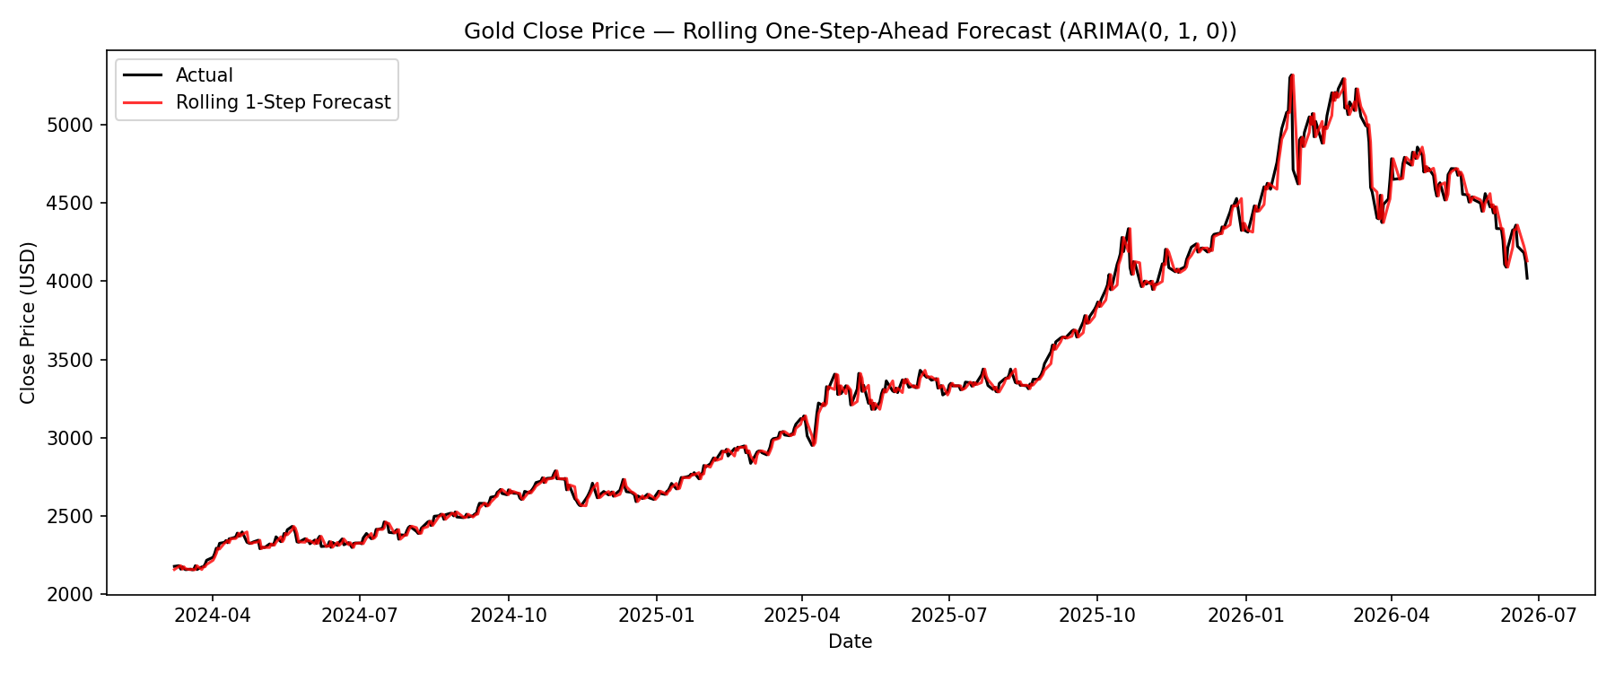
FORECASTING
Forecast Horizon Matters
31.30%
1.01%
Multi-Step Forecast MAPE (577-day horizon, single anchor)
Rolling One-Step-Ahead MAPE (re-anchored daily on actuals)
Flat random-walk forecast can't anticipate a sustained 2-year rally : actuals breach the 95% CI entirely.
Re-anchoring daily on the real previous close tracks the actual path almost perfectly.
Gold Price Prediction | Box-Jenkins & Deep Learning
10
Notes:
[~45s] This is the single most important contrast in the whole study. Same model, same data — horizon alone changes MAPE by 30x. Point at how the left plot's actual line breaks outside the CI band entirely.

Slide 10
DEEP LEARNING BENCHMARK
RNN & LSTM : Architecture & Setup
RNN
LSTM
Architecture
Architecture
2 stacked layers • 64 hidden units • dropout 0.2
2 stacked layers • 64 hidden units • dropout 0.2
Lookback Window
Lookback Window
30 days
30 days
Input Feature
Input Feature
Scaled daily return
Scaled daily return
TRAINABLE PARAMETERS
TRAINABLE PARAMETERS
12,673
50,497
Shared Training Setup: PyTorch • Adam optimizer (lr = 0.001) • MSE loss • 50 epochs • Batch size 32 • Evaluated one-step-ahead only, for a fair comparison against ARIMA's best case
30 Day Window
(scaled return)
RNN / LSTM
(2 layers, 64 units)
Predicted
Next-Day Return
Reconstructed
Price
Gold Price Prediction | Box-Jenkins & Deep Learning
11
Notes:
[~25s] Quick architecture overview — don't over-dwell, the real story is in the results slides ahead. Mention briefly that returns (not raw price) are the input feature, foreshadowing the bug-fix slide.

Slide 11
METHODOLOGY RIGOR
A Real Bug Caught : Scaler Extrapolation
INITIAL ATTEMPT : Raw Price Scaling
THE FIX : Return-Based Modeling
RNN: 14.98% LSTM: 13.70%
RNN: 1.01% LSTM: 1.01%
MAPE — far worse than ARIMA's 1.01%
MAPE — now on par with ARIMA
MinMaxScaler (normalizes values to range[0,1], fit on train prices)
(max ≈ $2,158) On training set
Test-period gold rose as high as $5,318, far outside the scaler's training range.
Scaled test inputs reached up to 3.85 (should be ≤ 1.0).
Neural nets cannot extrapolate reliably beyond the input range they trained on.
Model % daily returns instead of raw price level.
Returns stay bounded (≈ ±5–11%) regardless of how high the absolute price climbs.
Scale-invariant : no extrapolation problem, ever.
Same principle ARIMA already used via first-differencing.
Gold Price Prediction | Box-Jenkins & Deep Learning
12
Notes:
[~30s] Good rigor story for the professor — frame this as 'we caught our own mistake', not just a result. Explain extrapolation in one sentence, then the returns-based fix.

Slide 12
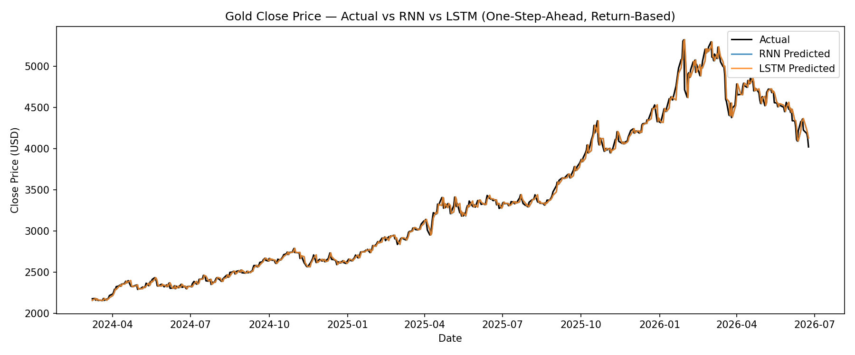
RESULTS
RNN vs LSTM : Actual vs Predicted (One-Step)
RNN and LSTM predictions overlap almost perfectly with the actual price : and with each other, across the full test period.
Gold Price Prediction | Box-Jenkins & Deep Learning
13
Notes:
[~35s] Acknowledge upfront that lines visually overlap — that itself is the finding, not a plotting issue. Zoomed view next slide makes the small differences visible.

Slide 13
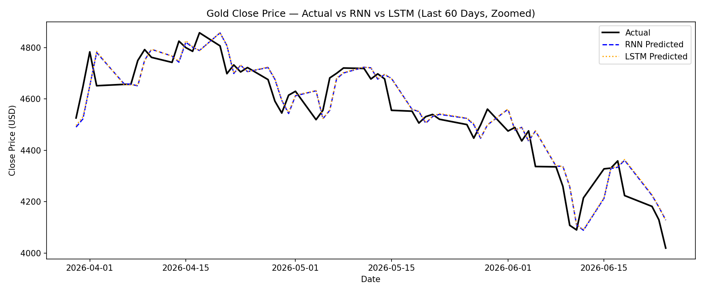
RESULTS
RNN vs LSTM : Zoomed View (Last 60 Days)
At nearly every turning point, predictions lag the actual by one day : both models can only react to a move the day after it happens, never anticipate it.
Gold Price Prediction | Box-Jenkins & Deep Learning
14
Notes:
[~35s] Point at a specific turning point on screen and trace the one-day lag with your finger — this is the most visually persuasive evidence in the whole deck.

Slide 14
FINAL COMPARISON
ARIMA vs RNN vs LSTM : Head to Head
50,000×
more trainable parameters in LSTM than ARIMA :
for statistically identical accuracy.
No model — classical or deep learning — extracted exploitable signal beyond “tomorrow ≈ today.” This is strong, convergent evidence consistent with the weak-form Efficient Market Hypothesis for daily gold prices.
Model | RMSE | MAE | MAPE | Params
ARIMA(0,1,0) | 58.59 | 36.44 | 1.013% | 1
RNN | 58.61 | 36.40 | 1.012% | 12,673
LSTM | 58.48 | 36.25 | 1.007% | 50,497
Gold Price Prediction | Box-Jenkins & Deep Learning
15
Notes:
[~40s] The punchline slide. Let the 50,000x number land before reading the table. This is the strongest single takeaway for Q&A.

Slide 15
CONCLUSION
Key Insights, Limitations & Conclusion
KEY INSIGHTS
Gold's daily Close behaves as a random walk : Box-Jenkins correctly identified ARIMA(0,1,0).
Forecast horizon is decisive: 1.01% MAPE one-step-ahead vs. 31.30% over a 577-day multi-step horizon.
RNN and LSTM tie with ARIMA despite up to 50,000× more parameters : no extra signal to extract from price history alone.
Gen-Win
For one-step-ahead daily gold forecasting, ARIMA(0,1,0) is the practical choice equal accuracy, full interpretability, no training cost, no GPU required.
Gold Price Prediction | Box-Jenkins & Deep Learning
16
Notes:
[~55s] Close strong: restate the practical recommendation, name the one real limitation (GARCH for volatility), and open the floor for questions.

Slide 16
Thank You
Questions & Discussion
Krishna Gupta
Notes:
[~10s] Thank the audience, invite questions.

