Slide 1
Pirates VS Ninjas
Andrew Scott and Keshav Gurushankar

Slide 2

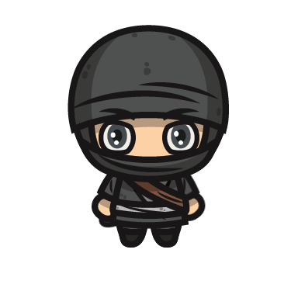
Introduction
It’s Pirates against ninjas in an office building in Tokyo for the final internet showdown of 2005!
Fight other players, or just incompetent A.I. to prove your side’s superiority!

Slide 3
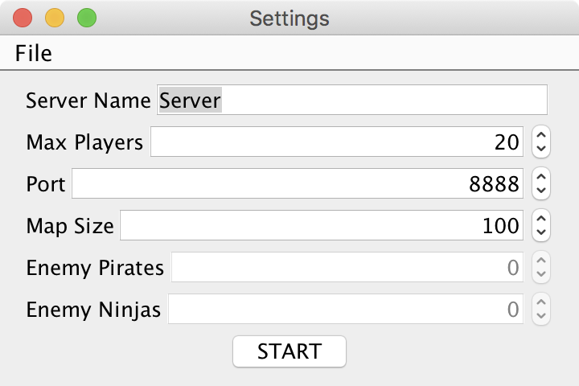
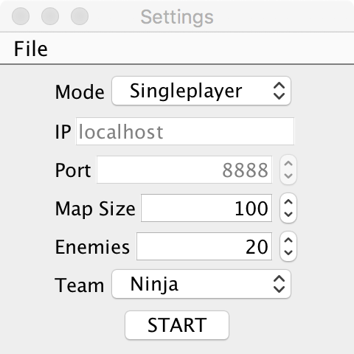
How to play
click and join a server, or the provided server
select your team
use WASD or arrow keys to move
use your mouse to fire
when you die, join another server, or try to get back on the one you were just playing on

Slide 4
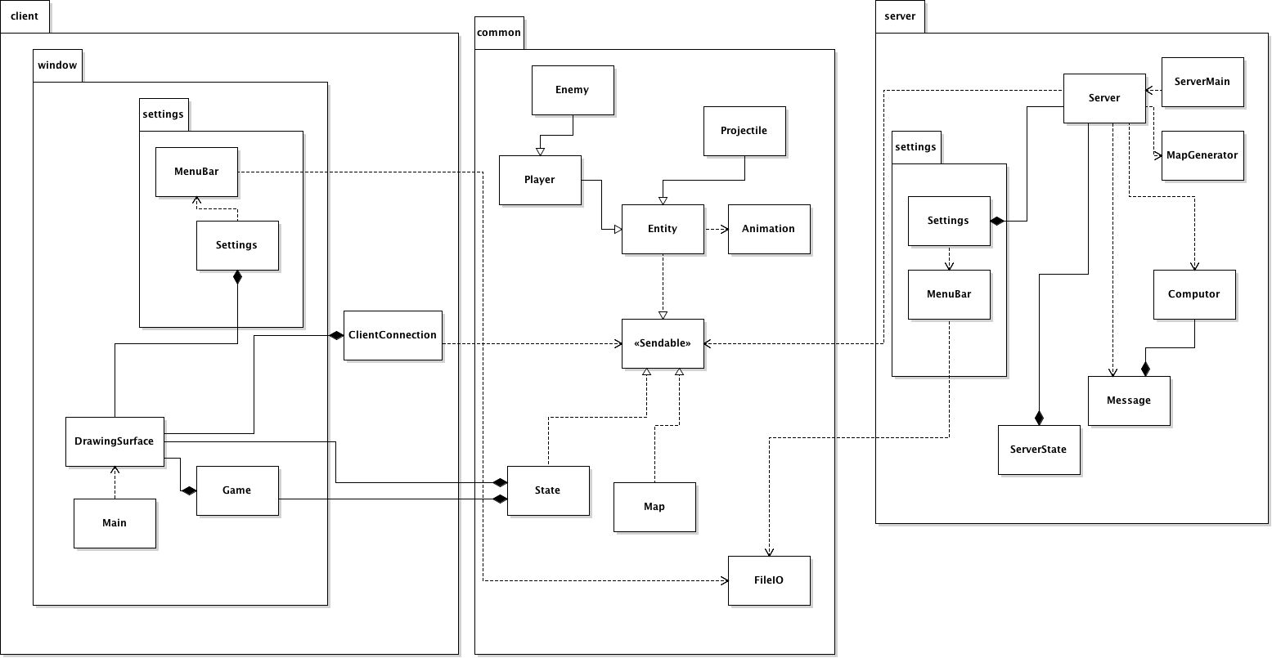
UML

Slide 5
Problems and Design
Notes:
Fire dir
Purchasing assets
2x map
Click vs hold
Corners

Slide 6
Features
Randomly generated map
PvP
Single Player mode (PvE)
Can choose teams
Animated players
Server can be configured
Enemy with a incompetent (but existent) AI

Slide 7
“Features”
java.net.SocketException: Connection reset
at java.net.SocketInputStream.read(Unknown Source)
at java.net.SocketInputStream.read(Unknown Source)
at sun.nio.cs.StreamDecoder.readBytes(Unknown Source)
at sun.nio.cs.StreamDecoder.implRead(Unknown Source)
at sun.nio.cs.StreamDecoder.read(Unknown Source)
at java.io.InputStreamReader.read(Unknown Source)
at java.io.BufferedReader.fill(Unknown Source)
at java.io.BufferedReader.readLine(Unknown Source)
at java.io.BufferedReader.readLine(Unknown Source)
at server.Server$Connection.run(Server.java:167)
at java.lang.Thread.run(Unknown Source)
If many characters are using the same animation sequence, the animation starts to run faster
Server sometimes crashes when people die/disconnect

Slide 8
Let’s Play
IP: 172.16.241.6
Port: 4444

Slide 9
Next Steps
AI Improvements
Map generation refinements
Powerups
WAN capabilities
Team balancing
Team changing mid game
Improve drawing code, and standardize render distances
Switch the heart image
Smoother motion

