Slide 1
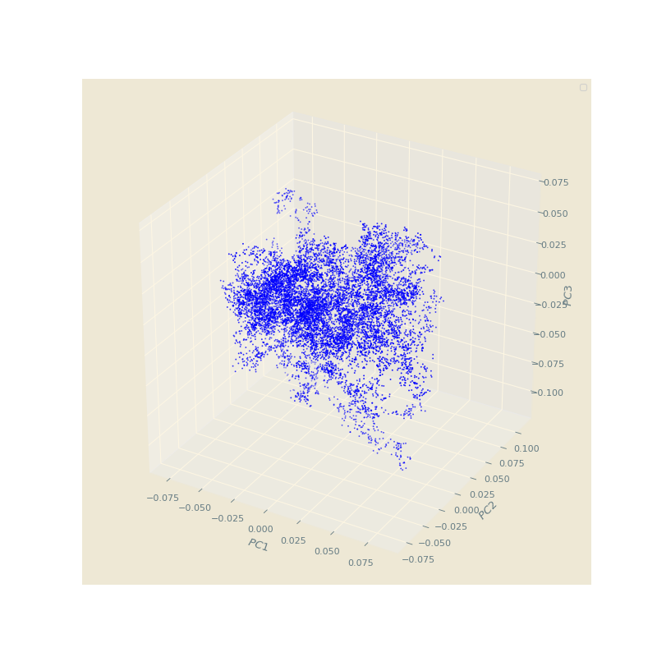
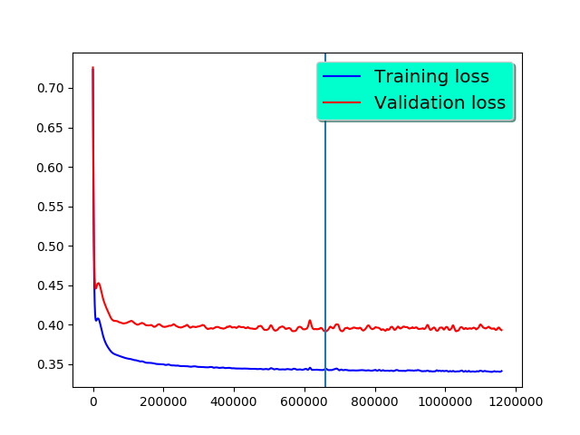
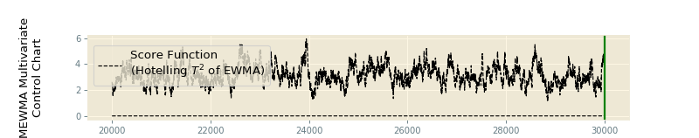
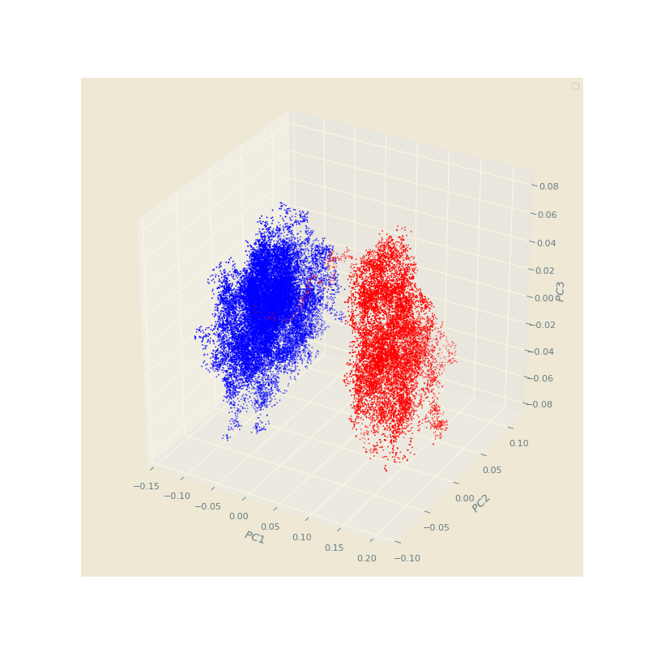
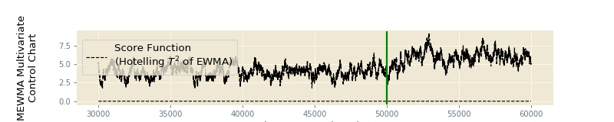
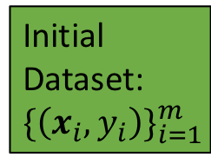
Method A:
Score Clustering
Method B:
MEWMA
Initial Dataset: $\{\left(x_{i}, y_{i}\right)\}_{i=1}^{m}$
Reduce sample size
The dataset has concept drift

Slide 2
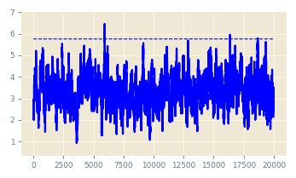
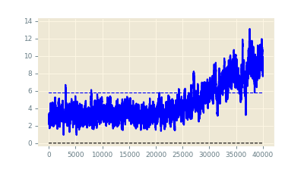
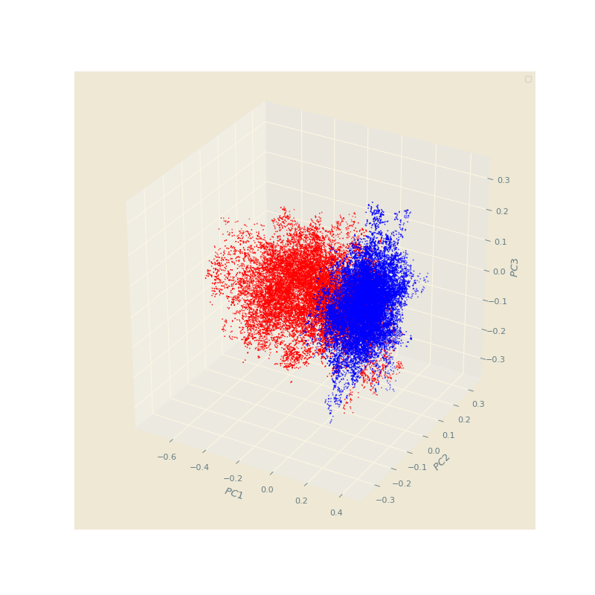
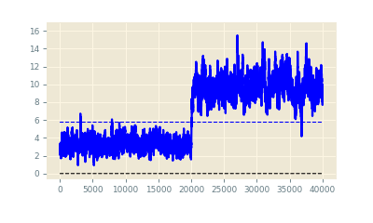
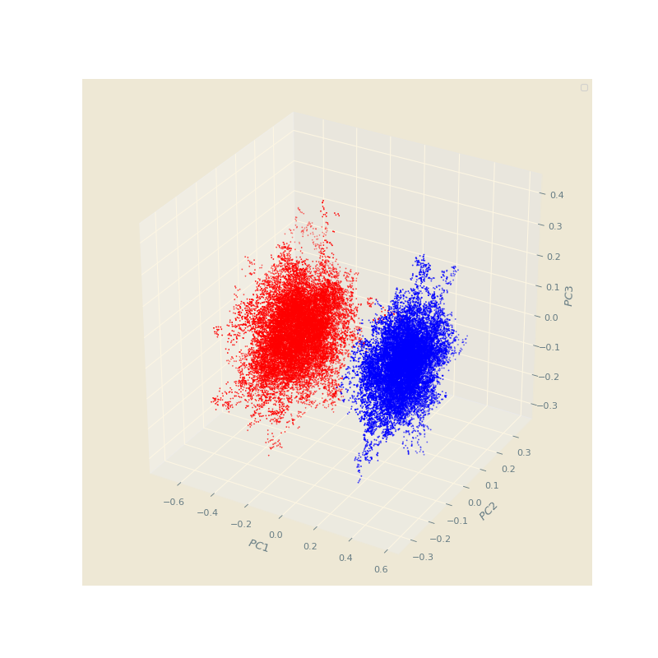
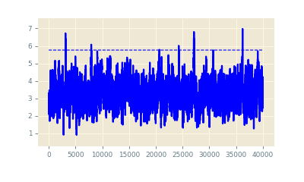
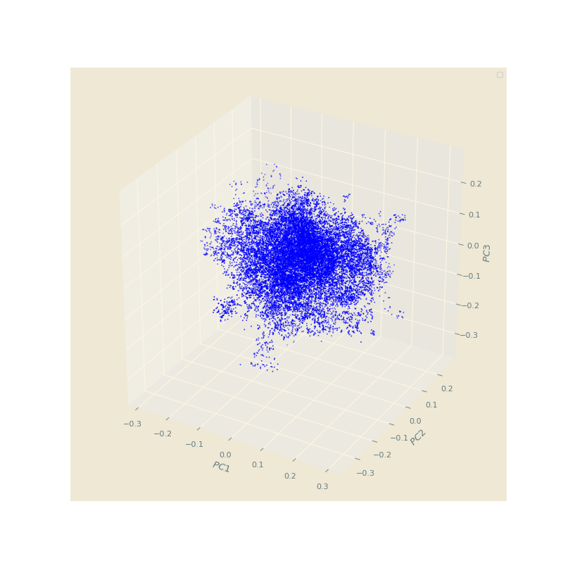




Training Dataset: $\{\left(x_{i}, y_{i}\right)\}_{i=1}^{n_{1}}$
Model
Stationary Dataset: $\{\left(x_{i}, y_{i}\right)\}_{i=1}^{n}$
Phase-I Dataset: $\{\left(x_{i}, y_{i}\right)\}_{i=1}^{n_{2}}$
Phase-II Dataset: $\{\left(x_{i}, y_{i}\right)\}_{i=1}^{n_{3}}$
Gradual
Abrupt
In-Control

Slide 3
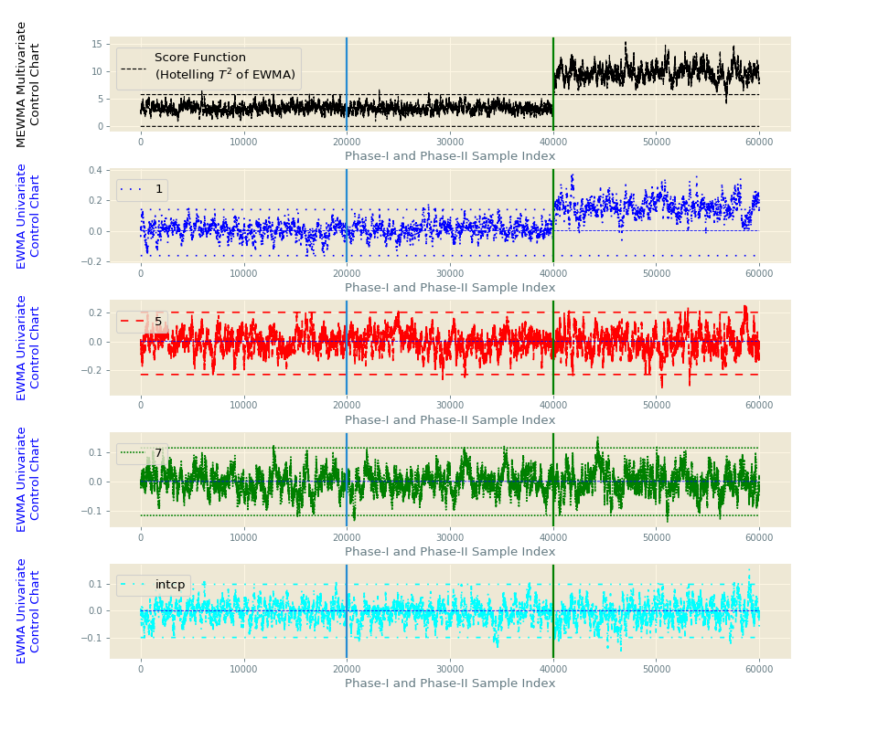
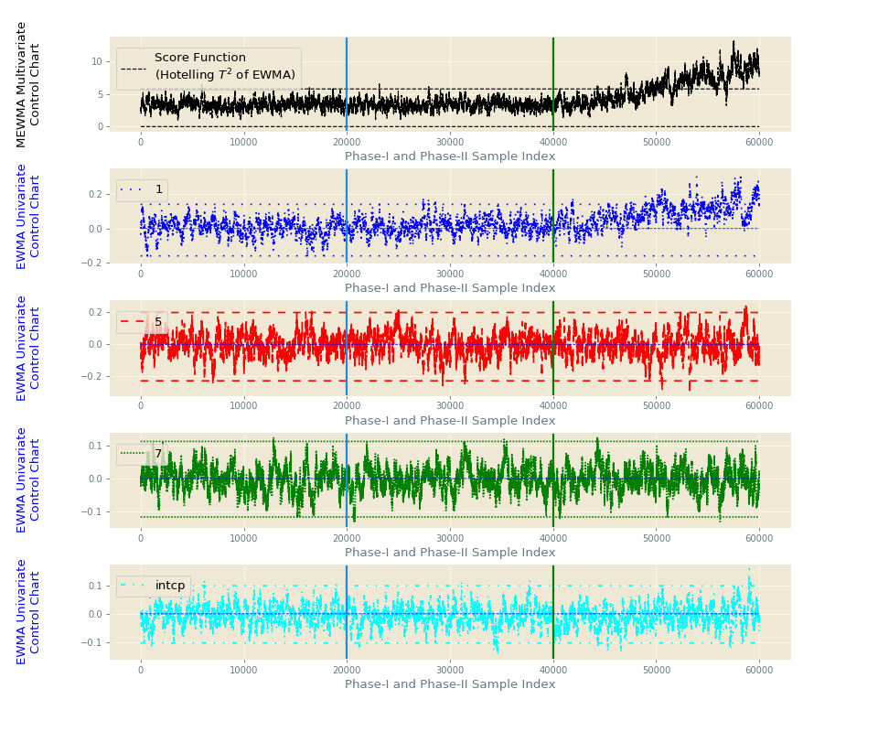
Diagnose the origin of concept drift

