Slide 1
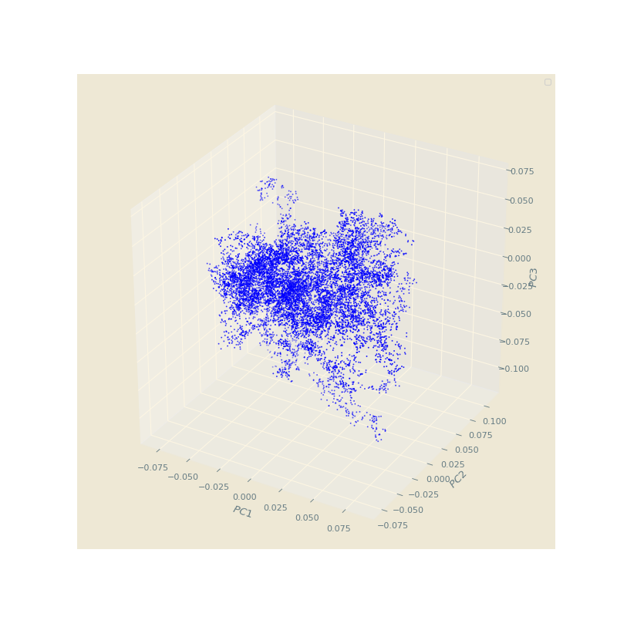
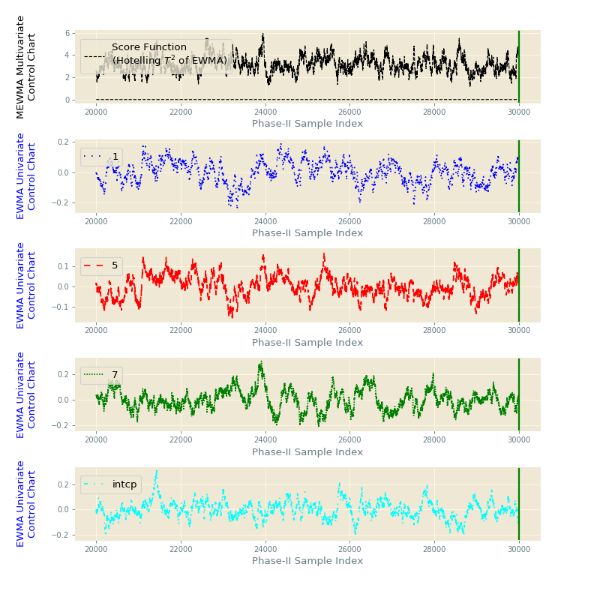
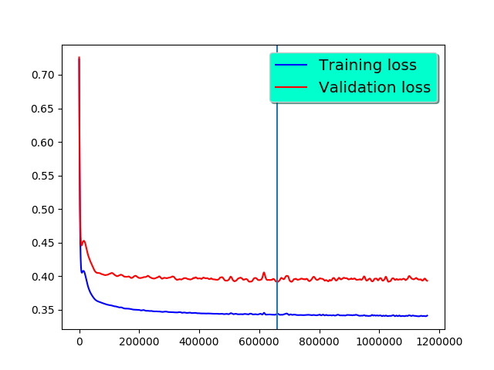
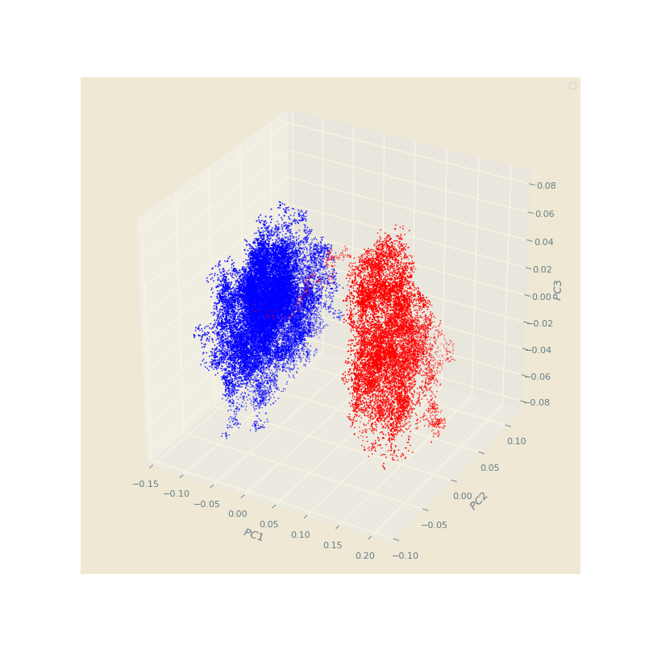
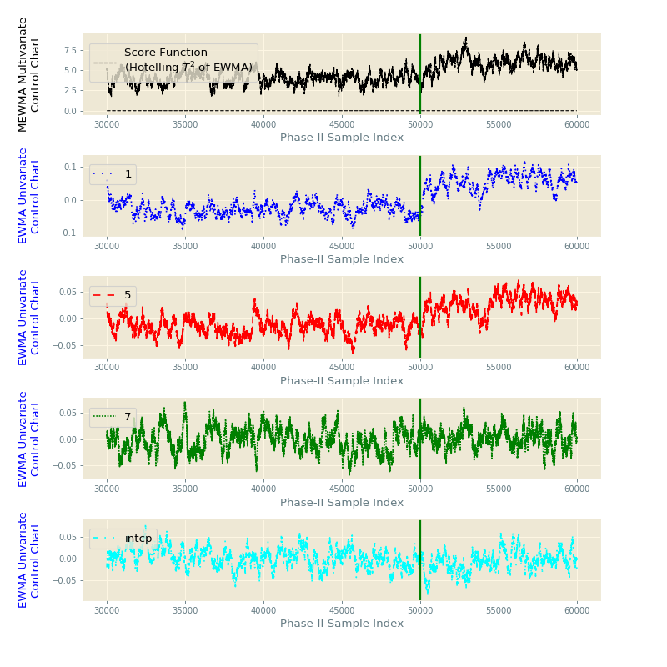

Method A: Score Clustering
Method B: MEWMA
No
Dataset: $\{\left(x_{i}, y_{i}\right)\}_{i=1}^{m}$
Concept Drift?
Training
Remove unstable data
Yes
The dataset has concept drift

Slide 2
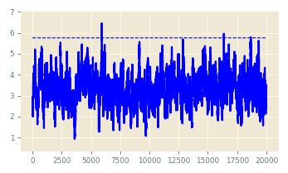
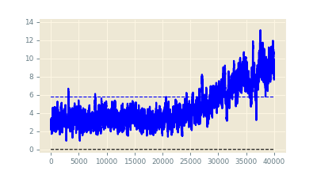
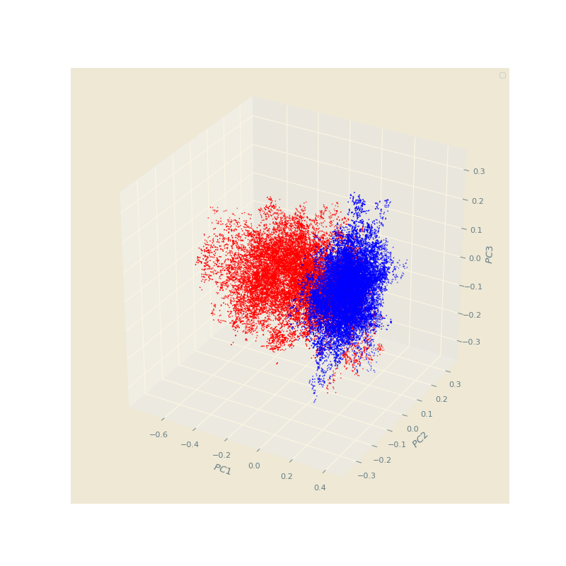
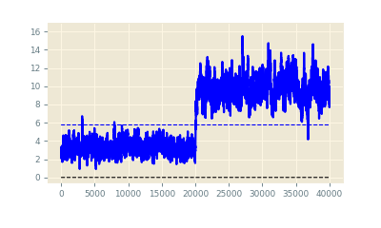
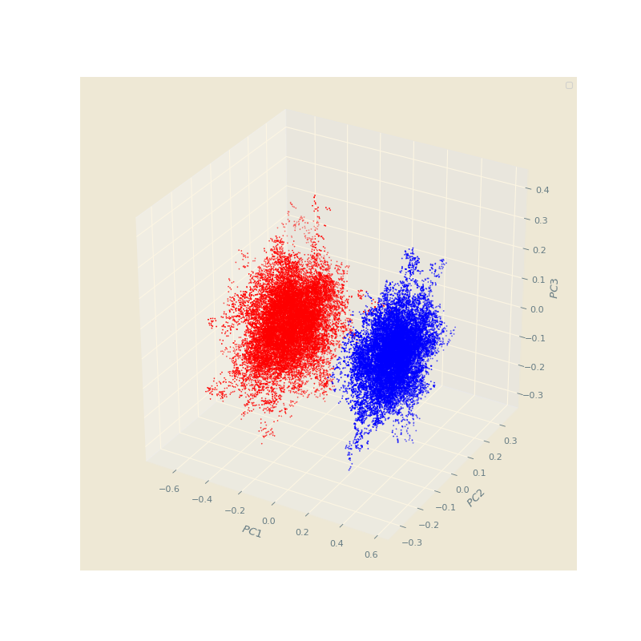
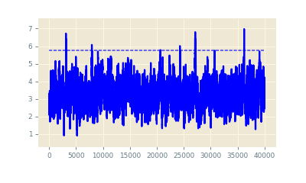
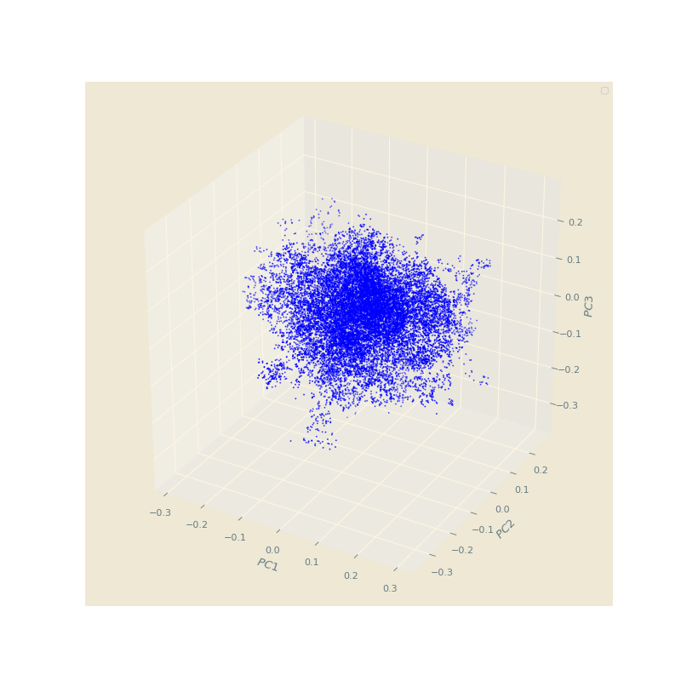




Training Dataset: $\{\left(x_{i}, y_{i}\right)\}_{i=1}^{n_{1}}$
Obtain CL
Training
Stationary Dataset: $\{\left(x_{i}, y_{i}\right)\}_{i=1}^{n}$
Model
Apply CL
Phase-I Dataset: $\{\left(x_{i}, y_{i}\right)\}_{i=n_{1}+1}^{n}$
Calculate CL
Monitoring
Phase-II Dataset: $\{\left({\tilde{x}}_{i}, {\tilde{y}}_{i}\right)\}_{i=1}^{\tilde{n} }$
Gradual
Abrupt
In-Control

Slide 3
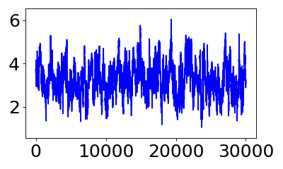
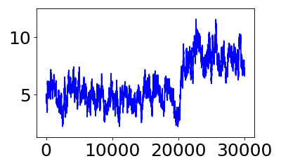

MEWMA
No
Data Set: $\{\left(x_{i}, y_{i}\right)\}_{i=1}^{m}$
Concept Drift?
Training
Remove unstable data
MEWMA
Yes
The data set has concept drift

Slide 4
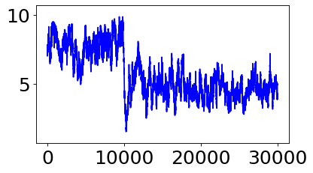
MEWMA
No
Data Set: $\{\left(x_{i}, y_{i}\right)\}_{i=1}^{m}$
Concept Drift?
Training
Remove unstable data
MEWMA
Yes
The data set has non-stationarity. A concept changes at #10000.

Slide 5
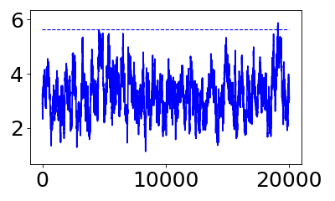
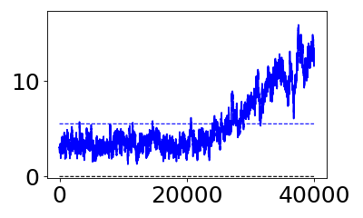
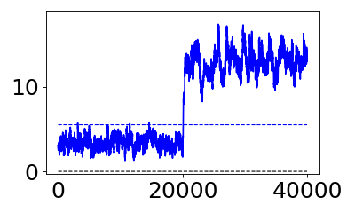
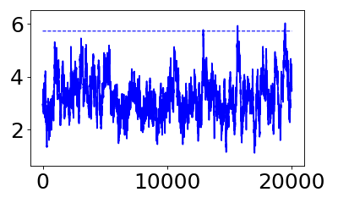




Training Data Set: $\{\left(x_{i}, y_{i}\right)\}_{i=1}^{n_{1}}$
Obtain CL
Training
Stationary Data Set: $\{\left(x_{i}, y_{i}\right)\}_{i=1}^{n}$
Model
Apply CL
Phase-I Data Set: $\{\left(x_{i}, y_{i}\right)\}_{i=n_{1}+1}^{n}$
Calculate CL
Monitoring
Phase-II Data Set: $\{\left({\tilde{x}}_{i}, {\tilde{y}}_{i}\right)\}_{i=1}^{\tilde{n} }$
Gradual
Abrupt
In-Control

Slide 6
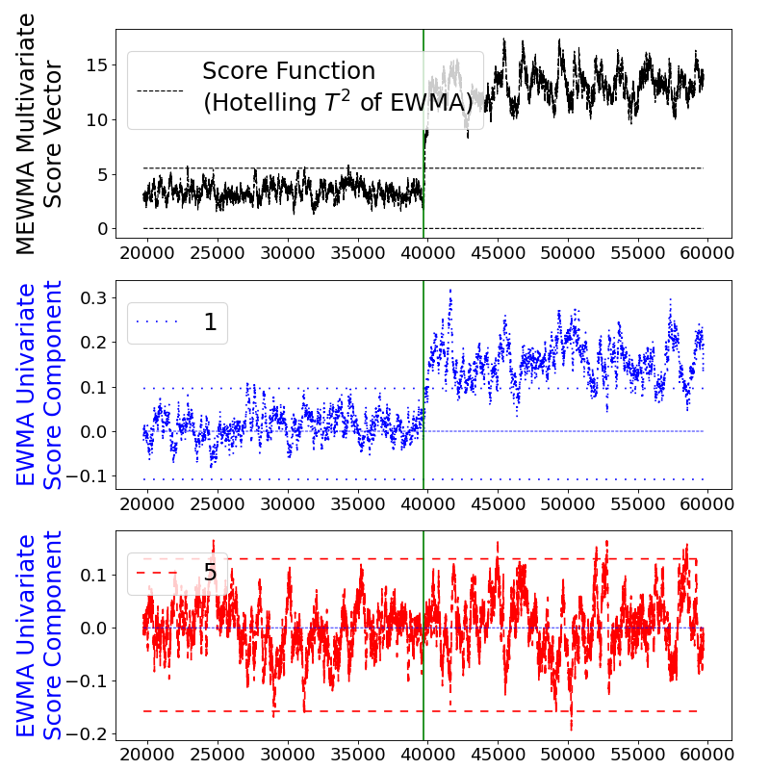
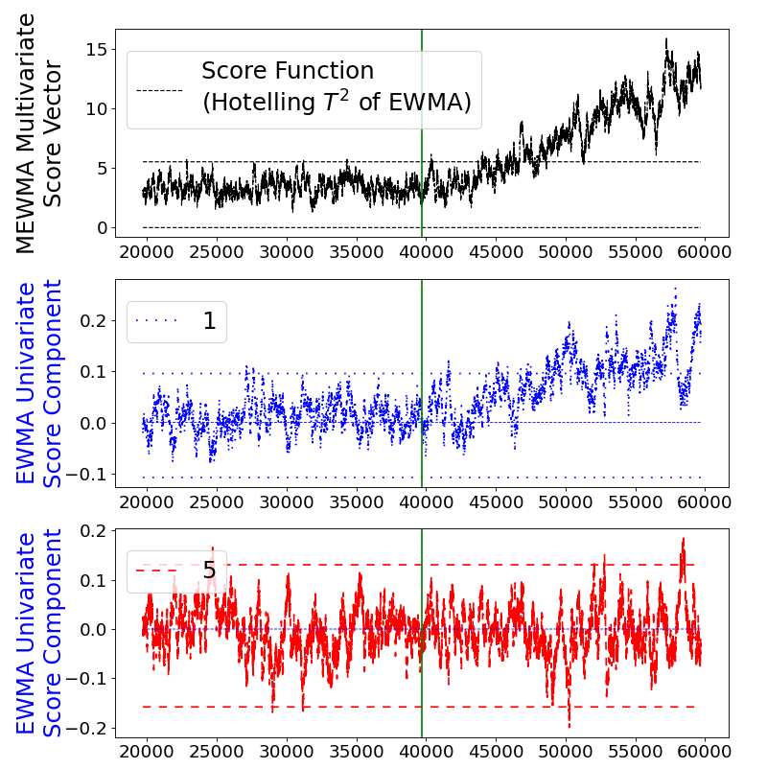
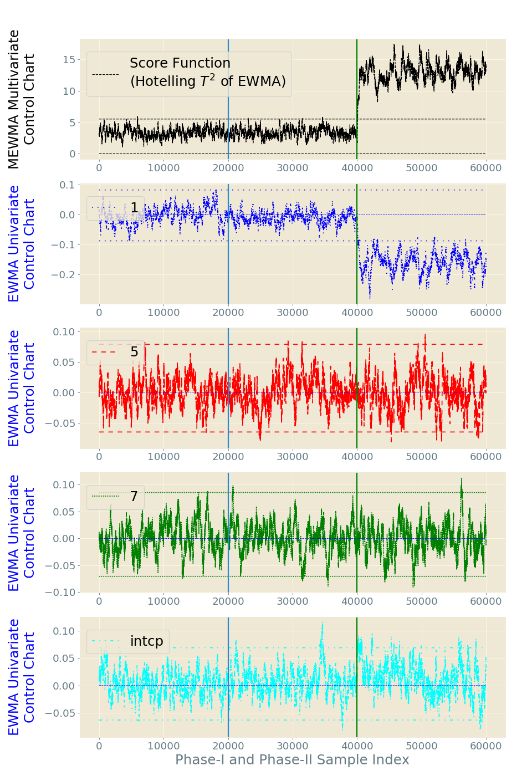
Diagnose the origin of concept drift

Slide 7
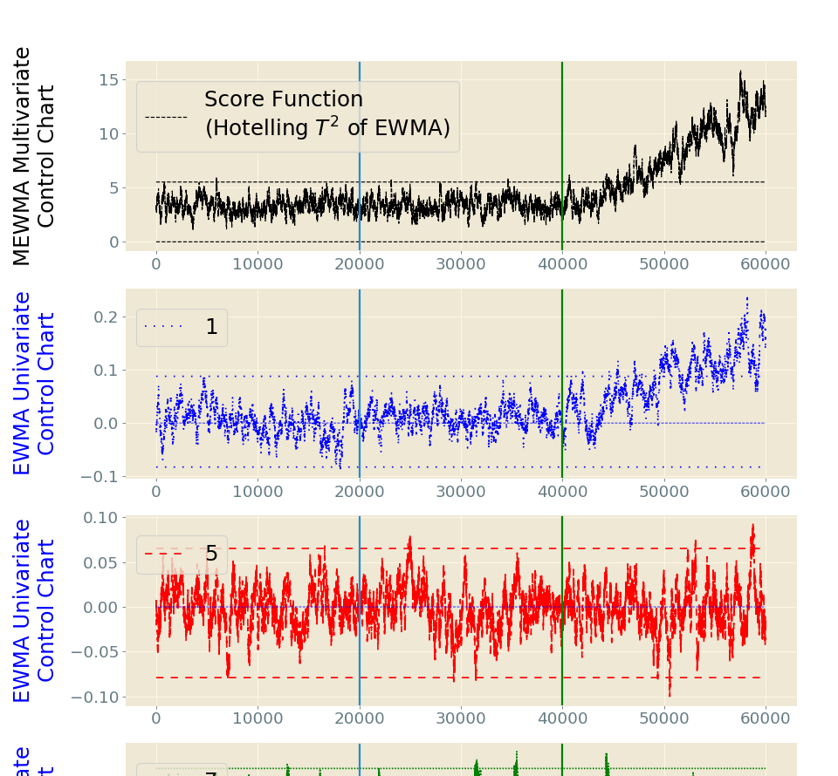
Diagnose the origin of concept drift

