Slide 1
HOTEL MANAGEMENT SYSTEM PROJECT GUIDE: Dr. Md IMRAN
Team no: 9
G V S Krishna hrithik – 245318733-019
S Lakshmidhar – 245318733-049
Yalla Satya Krishna Vamsee – 245318733-059

Slide 2
Contents:
Introduction and Importance
Existing System vs Proposed System
Tools Used
System Design
Conclusion of the Project

Slide 3
Introduction and Importance
Hotel Management System is a DESKTOP-BASED application that allows the hotel manager to handle all hotel activities ONLINE. Interactive GUI and the ability to manage various rooms, employees, drivers and customers make this system FLEXIBLE AND CONVENIENT.
The Purpose of the whole process is to ease the daily or regular activities of the Hotel Management into an AUTOMATIC COMPUTERIZED RETREIVABLE process.

Slide 4
MODULES
ADMIN
RECEPTIONIST

Slide 5
EXISTING SYSTEM
PROPOSED SYSTEM
Book Based
Most of the time spent in updating the books of record
Not suitable system for the computer era
Computerized
Hassle free method of updating the online records
Most aptly suited system for this era

Slide 6


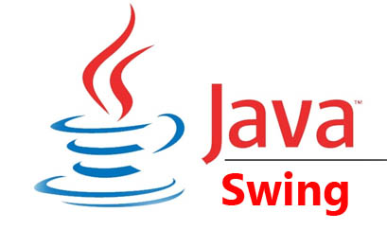
TOOLS USED
FRONTEND & GUI
DATABASE

Slide 7
SYSTEM REQUIREMENTS
OS: WINDOWS 10 or LINUX or MAC OS
PROCESSOR: INTEL or AMD(32/64BIT)
RAM: 2 GB or ABOVE
ROM: 100 GB or ABOVE
SOFTWARE:
JDK 8 or ABOVE
MYSQL
USER REQUIREMENTS
WINDOWS 10 or LINUX or MAC OS
Should know how to use the computer

Slide 8
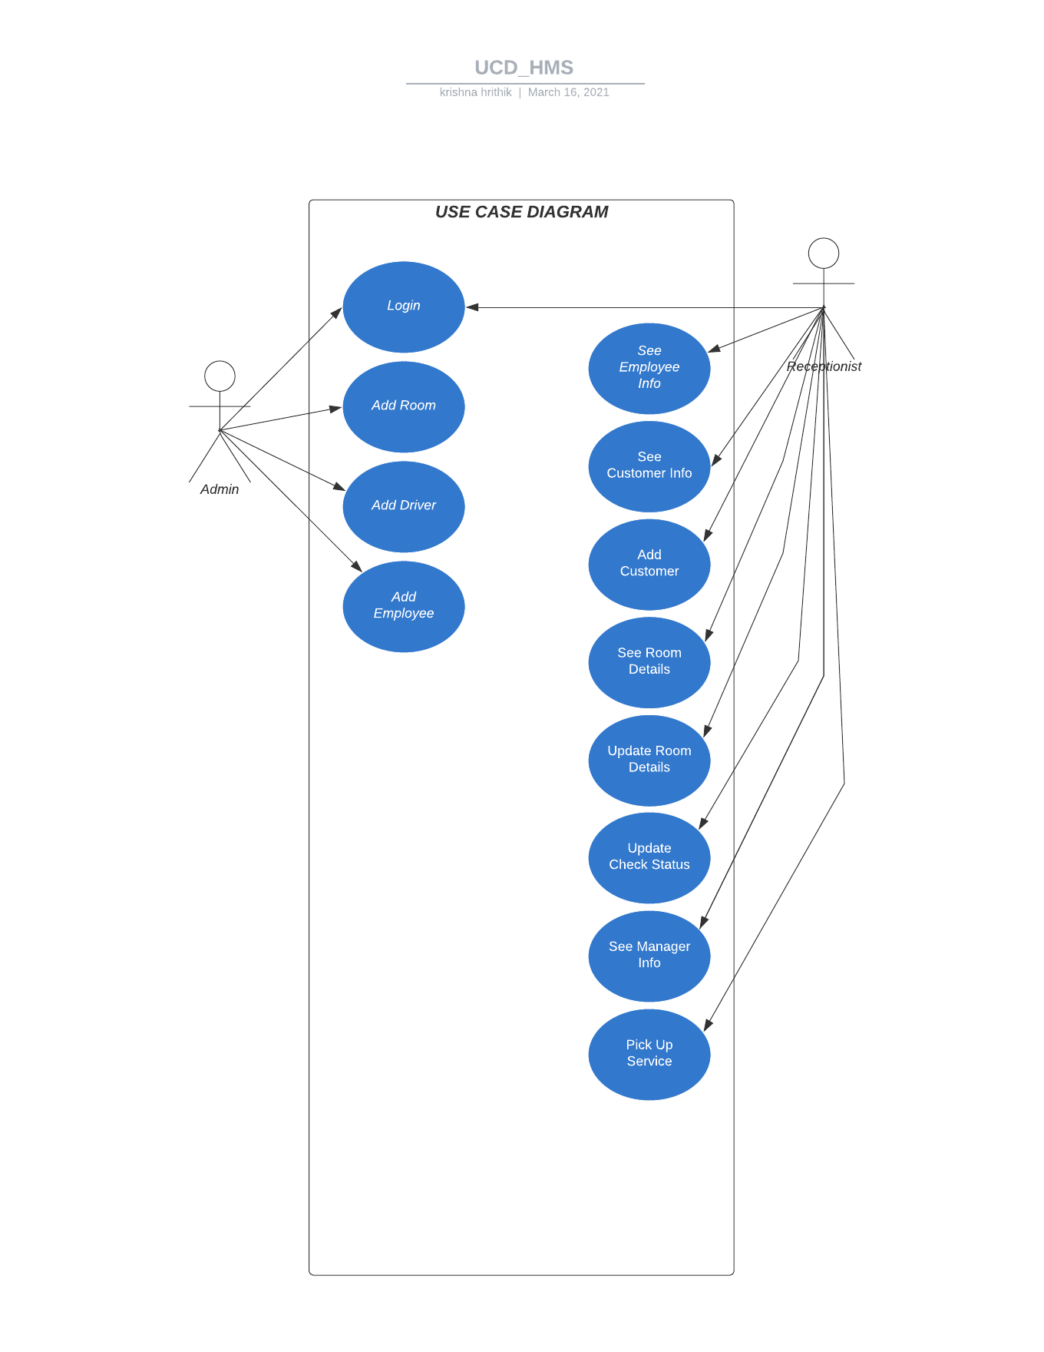
USE CASE DIAGRAM

Slide 9
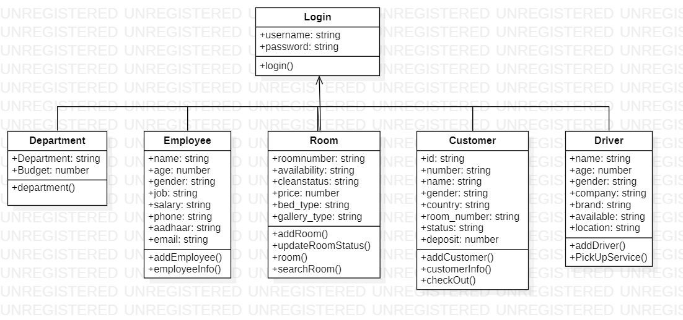
CLASS DIAGRAM

Slide 10
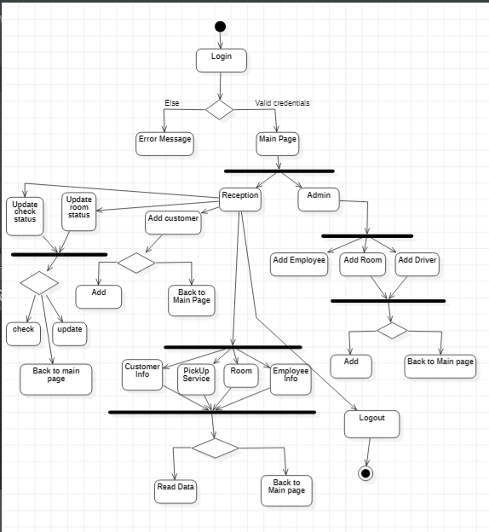
ACTIVITY DIAGRAM

Slide 11
ER DIAGRAM

Slide 12
COMPONENT DIAGRAM
LOGIN
HOTEL MANAGEMENT DATABASE
CUSTOMER
ROOM
DRIVER
EMPLOYEE
DEPARTMENT

Slide 13
CONCLUSION
Hotel Management System in short, is a minimalistic desktop application which was developed in order to make hotel management easy in many folds. However some desirable mentions are:
The first one is that customer, who should be treated as a king by businessmen, is handled in most of the aspects effectively from allotting a room to checking out of the room
The second important to be discussed is that people working for hotel are also being managed by adding them into database
Here, each department present in the hotel are being allocated with particular budget, are also stored in the database. Therefore, It helps hotel management officials to handle the key financial matters with matter of several clicks

