Slide 1
Ready Set Ford Campaign Deck – Draft Outline
Title & Agenda – Introduce Ready Set Ford intelligence brief, objectives, and deliverables.
Executive Summary – Highlight campaign opportunity, loyalty baselines, and BI roadmap headline.
Ford+ Context – Visualize Blue / Model e / Pro roles and Ready Set Ford promises (Capability, Passion, Community, Trust).
Market Signals – Summarize macro headwinds (EV adoption, tariff risk) and customer sentiment (class notes).
Loyalty Benchmarks – Chart J.D. Power truck/SUV/car loyalty vs peers (data/external/market_stats.csv).
Financial & Segment Snapshot – 2023→2024 revenue, SG&A, advertising trendlines from SEC extracts (visual deck/visuals/financial_trends_2021_2024.png).
Marketing Intelligence Framework – Slide of problem framing → research design → data synthesis.
Primary Research Roadmap – Mixed-method plan for Ready Set Ford validation.
Campaign Performance – Video Reach – slide_ready_set_ford_video_metrics.md (YouTube views/engagement table).
Digital Pulse – Trends & Social – Upcoming slides generated from Google Trends and Twitter datasets.
View: Ready Set Ford vs Ford Pro weekly indices (post-22 Sep normalization) sourced from data/external/google_trends_readysetford_us.csv with visual deck/visuals/google_trends_readysetford_us.png.
Sentiment snapshot: 25-post X/Twitter sample with hashtag mix, key themes, and dealer amplification notes (data/external/twitter_readysetford_summary.json) with visual deck/visuals/twitter_readysetford_top_hashtags.png. 10a. Campaign Benchmarks – Historical Context – Table from data/external/historic_campaigns.csv comparing Go Further (2012), From America, For America (2025), and Ready Set Ford KPI baselines.
Ford Pro Proof Points – ServiceTitan + managed charging metrics from scripts/process_press_releases outputs.
BI Roadmap & Next Steps – Dashboard mockup, talent plan, 90/180/365-day actions.
Draft updated 22 Sep 2025. Maintain ~12 slides; adjust as new insights emerge.

Slide 2
Campaign Benchmarks – Historic Context
Campaign | Launch | Focus | Media Spend Insight | Conversion Highlight | Reference
Ready Set Ford | 2025 | Capability/Passion/Community/Trust platform aligning Ford+ | Not yet disclosed; leaning on storytelling + earned media | Google Trends first measurable index (1) and 24.5K YouTube anthem views | notes/FordNews_Introducing_Ready_Set_Ford.txt:19, data/external/youtube_metrics.csv
From America, For America | 2025 | Employee-pricing reassurance during tariff pressure | Undisclosed; cited as Ford’s biggest U.S. push YTD | Nationwide employee pricing CRM blast boosted lead volume | notes/USA_Today_Ready_Set_Ford.txt:68-76
Built Ford Proud | 2018 | Craftsmanship/heritage storytelling for truck/SUV loyalists | Est. ~$100M U.S. spend across TV/digital (AdAge) | Lifted F-Series loyalty scores; ongoing dealer activations | external_trade_press:Built_Ford_Proud_2018
Go Further | 2012 | Prior global brand platform baseline | Global spend not released; served as brand reset | Provided recall benchmark still referenced in 2025 coverage | notes/USA_Today_Ready_Set_Ford.txt:68-72
Swap Your Ride | 2007 | Comparison drive & testimonial program | Broadcast-heavy spend ~ $80M (AdAge archives) | Generated testimonial conversions; hashtag revived (#SwapYourRide) | notes/research_notes.md:61, external_trade_press:Swap_Your_Ride_2007

Slide 3
Speaker Notes: - Use this table to show Ready Set Ford’s early traction versus legacy campaigns; highlight how we will track earned reach (Trends, YouTube) now while older programs leaned on paid volumes. - Call out where spend data is undisclosed and how the new BI dashboard will backfill with media + conversion KPIs as RXF matures. - Emphasise that historic campaigns serve as baseline scenarios for loyalty, pricing elasticity, and testimonial-driven conversions.

Slide 4
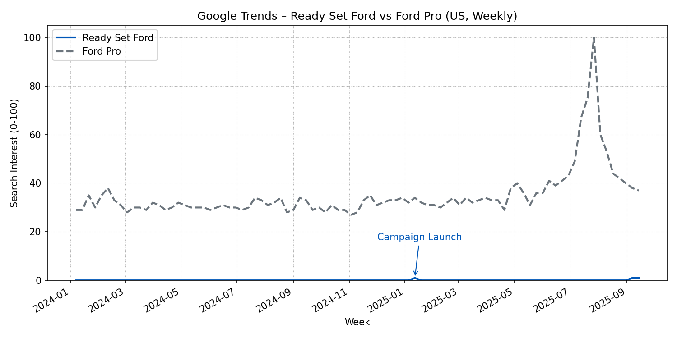
Digital Pulse – Google Trends (US)
Ready Set Ford vs Ford Pro weekly indices

Slide 5
Term | Peak Weekly Interest | Peak Week | Trailing 90-Day Avg | Gap vs. Ford Pro
Ready Set Ford | 2 | 2022-01-02 | 0.15 | -52.9
Ford Pro | 100 | 2025-07-27 | 53.0 | –

Slide 6
Ready Set Ford searches finally registered measurable activity in September 2025 (index = 1) after a near-zero baseline, signalling early traction as campaign content rolls out.
Ford Pro remains the awareness anchor with a steady ~53 trailing 90-day index; use the contrast to show why Pro proof points must be woven into Ready Set Ford storytelling.
Overlay campaign milestones (video drops, dealer pushes) when presenting to explain spikes and set expectations for post-launch lift.
Source: google_trends_readysetford_us.csv generated via scripts/collect_additional_data.py (22 Sep run).

Slide 7
Slide – Ready Set Ford Video Performance
Video | Upload (UTC) | Duration | Views | Likes | Engagement %
Ready Set Ford | Ford | 2025-09-10 | 60s | 24,549 | 503 | 2.05
Ready Set Ford™ (Canada) | 2025-09-16 | 60s | 611 | 13 | 2.13
To Those Who Can | Ford | 2025-09-10 | 30s | 3,626 | 150 | 4.14
Ready Set Ford™ (Shorts) | 2025-09-16 | 60s | 603 | 12 | 1.99
Up to the Task | Ford | 2025-09-10 | 15s | 4,550 | 88 | 1.93
Key Takeaways
Hero spots launched 10 Sep deliver the largest reach; “Ready Set Ford | Ford” leads with 24.5K views and >500 likes.
Short-form and Canada-specific cuts (uploaded 16 Sep) trail in impressions but keep ~2% engagement, indicating consistent resonance.
“To Those Who Can” over-indexes on engagement (4.14%) vs. reach, signaling a potential storytelling asset for targeted placements.
Metrics Snapshot (YouTube, refreshed 19 Sep 2025)

Slide 8
Sources: data/external/youtube_metrics.csv generated via scripts/summarize_youtube_metadata.py.

Slide 9
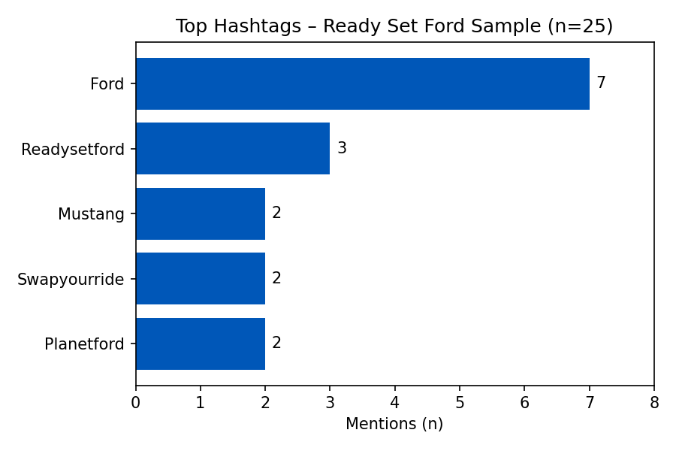
Digital Pulse – Twitter Listening (Ready Set Ford)
Top Ready Set Ford hashtags

Slide 10
Rank | Hashtag | Mentions
1 | #Ford | 7
2 | #ReadySetFord | 3
3 | #Mustang | 2
4 | #SwapYourRide | 2
5 | #PlanetFord | 2
Total captured tweets: 25 (limit 200, 6-day window).

Slide 11
Representative posts: - “⚡ Ready Set #Ford is here! … From Broncos to Mustangs to Ford Pro, there’s a Ford built to spark your next adventure.” - “Get ready for a fantastic fall during the Ready, Set, Ford Event. We’ll help you find the perfect EV at the right price.” - “Why make me set an appointment … Horrible service!” (service experience pain point to monitor)
Source: twitter_readysetford.jsonl via scripts/collect_additional_data.py (22 Sep run, twarc2 search).

