Slide 1
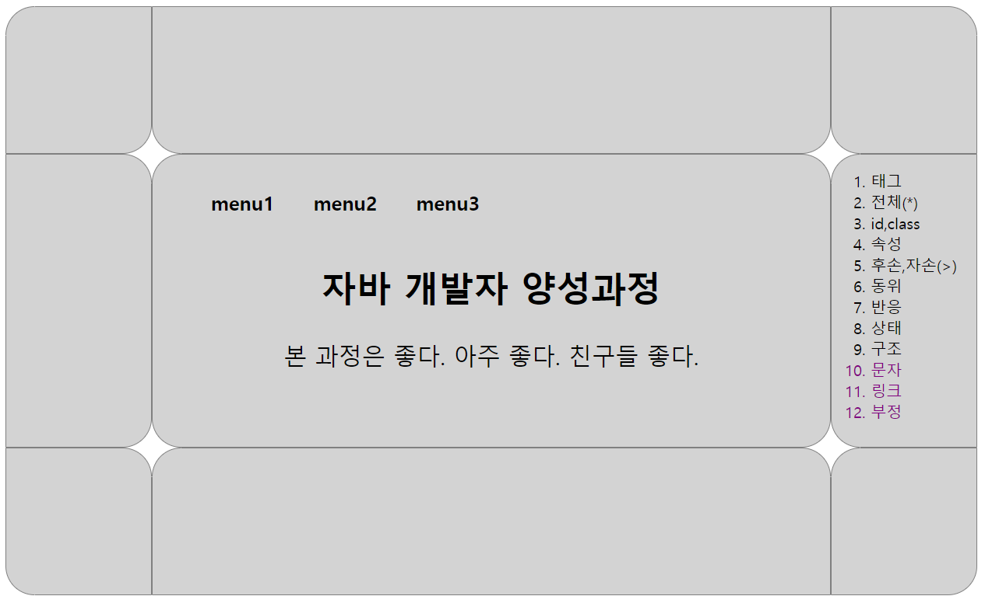
id=header
1000px
class=left
class=center
class=right
id=content
300px
class=left
class=center
class=right
id=footer
150px
694px
150px
class=left
class=center
class=right

