Slide 1
쇼핑몰 레이아웃

Slide 2
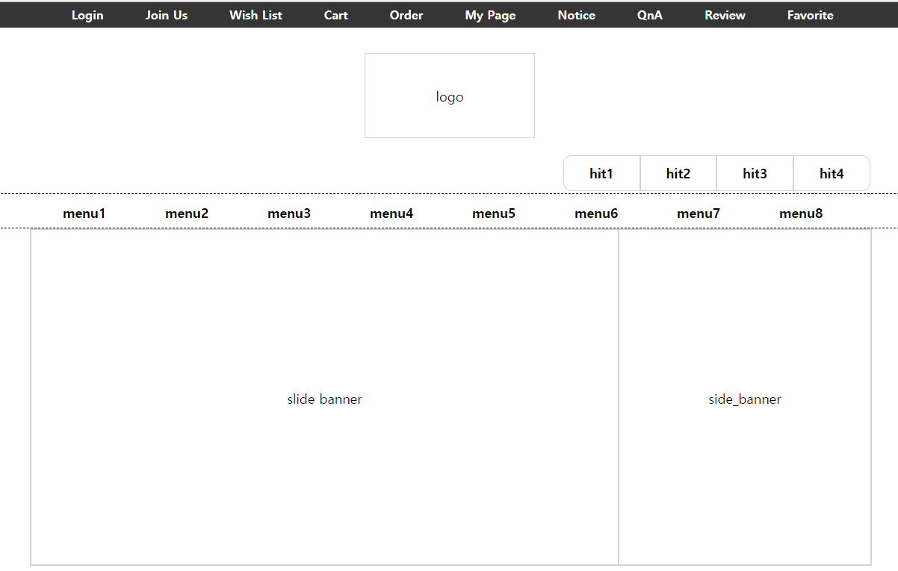
header = .gnb + .logo + .hitmenu + .lnb
30px
30px
400px
700px
300px
1000px
#content = .section1(.slide_banner + .side_banner)
+ .section2(.hit_product + .md_product)

Slide 3
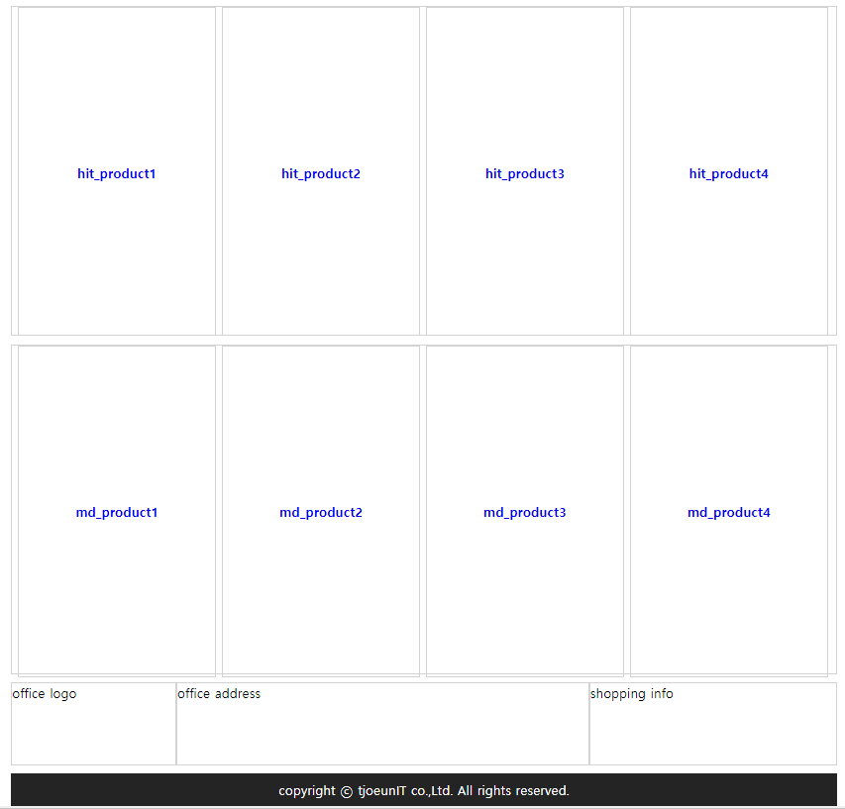
#content = .section1(.slide_banner + .side_banner)
+ .section2(.hit_product + .md_product)
7px
400px
10px
400px
7px
240px
footer = .office_logo + .office_address + .shopping_info + .copyright

Slide 4
Overflow:hidden;
float:left
float:left
float:left

Slide 5
검색 엔진 레이아웃

Slide 6
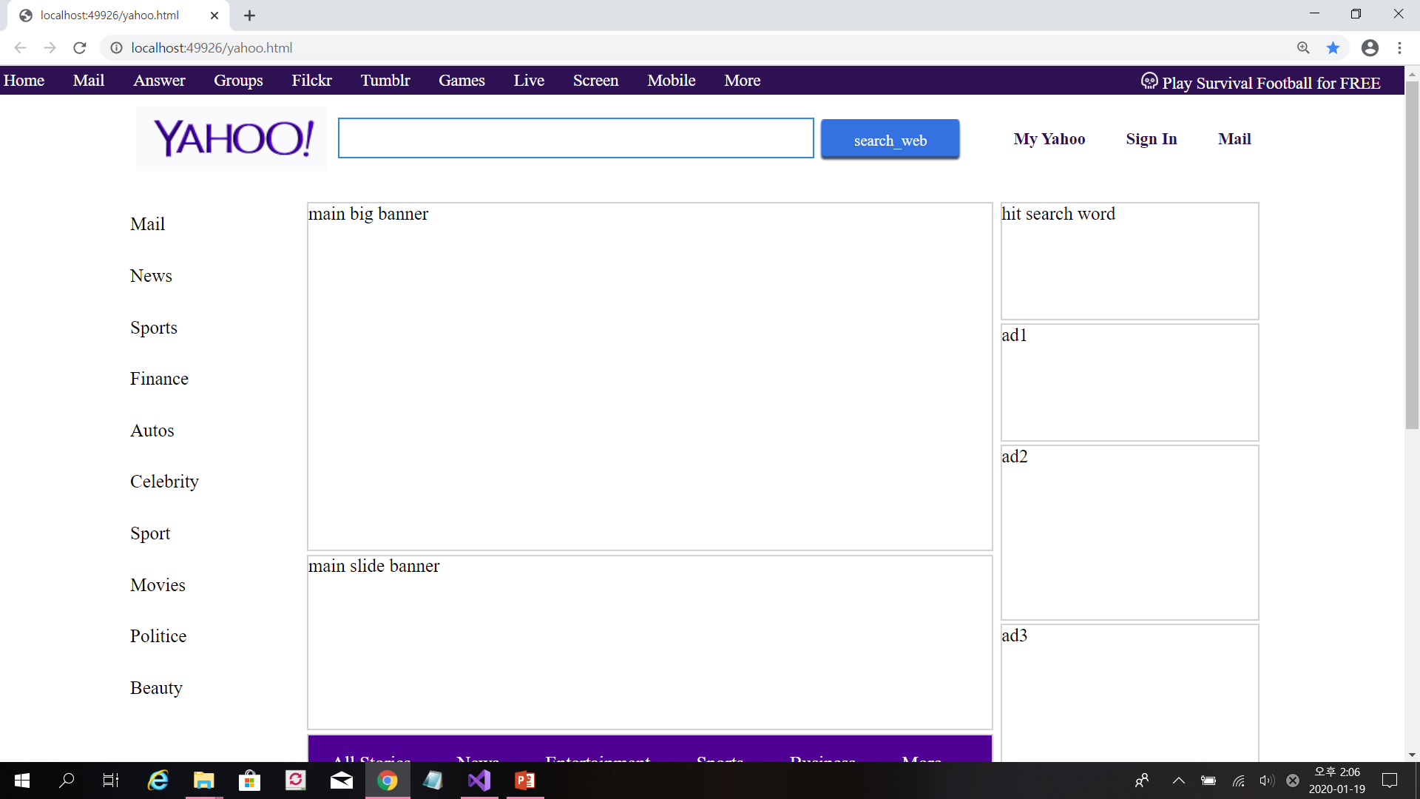
header = #header_nav(.gnb + .survivalFootball)
+ #header_info(.logo + .search + .service)
#2d1152
400px
20px
10px
#3488d9
.btn_search
155px
600px
100px
230px
3px
300px
100px
150px
#content = #main_menu + #main(div 7개)
+ #main_banner(div 5개)
150px
150px

Slide 7
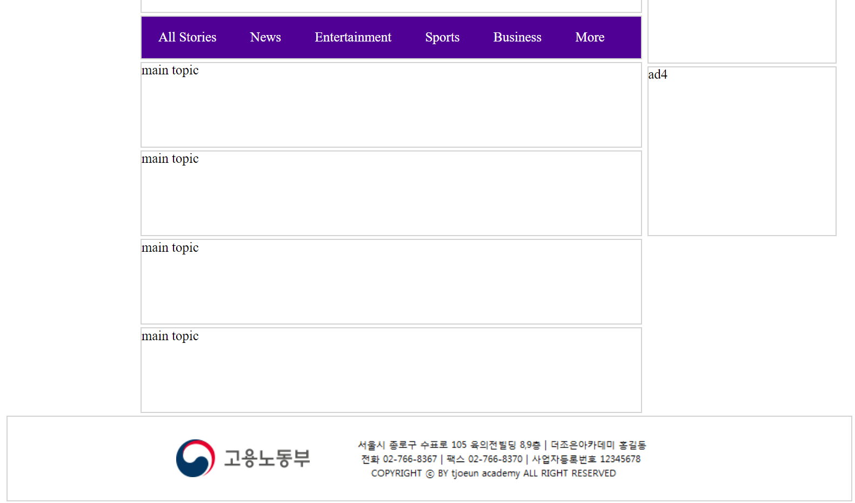
#500095
230px
50px
100px
200px
#content = #main_menu + #main(divS) + #main_banner
100px
100px
3px
100px
footer = ul > li >img
100px

