Slide 1
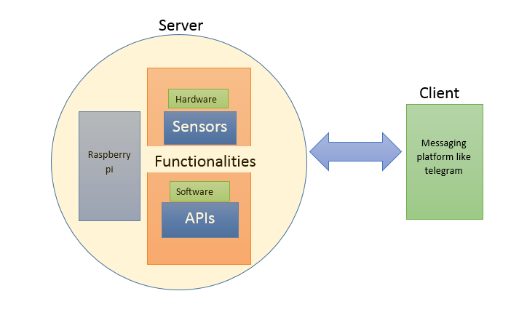
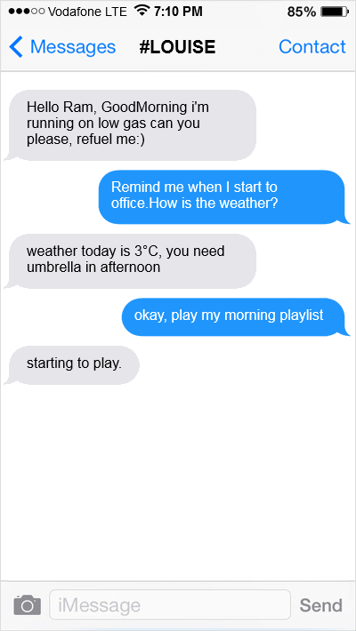


Motivation
Working
Motivation for this project are sensors and data acquisition.
Automobiles have different types of sensors for monitoring fuel, temperature, pressure, air quality etc.
If you are away from your car and want to know how much fuel is left…what you do????……...that’s where my project started!!! Called #Louise
Its works based on server and client model programmed in python
It works by checking the keywords in the sentence and executes the function around the keyword
Hello Ram, Good Morning I'm running on low gas can you please, refuel me :)
Advantages
Truly modular design simple to maintain code
Using simple syntax similar to human language
Extend functionalities on hardware by adding sensors and also on software by integrating with APIs like weather, translator etc.
Devices can talk! Devices can be your friends, can be your personal assistant
It can used in car as infotainment systems and home automation systems
What and How?
Louise is a programmable bot which can be used to achieve such a task in remote data acquisition.
It uses a ‘Existing’ messaging platform called telegram as client application and type a simple question to get the data.
Ask questions in Telegram Application:
What is the value of temperature sensor?
Play music, tell me a joke, take a picture.
How is the weather in Spain, Barcelona?
Translate, How are you?

