Slide 1

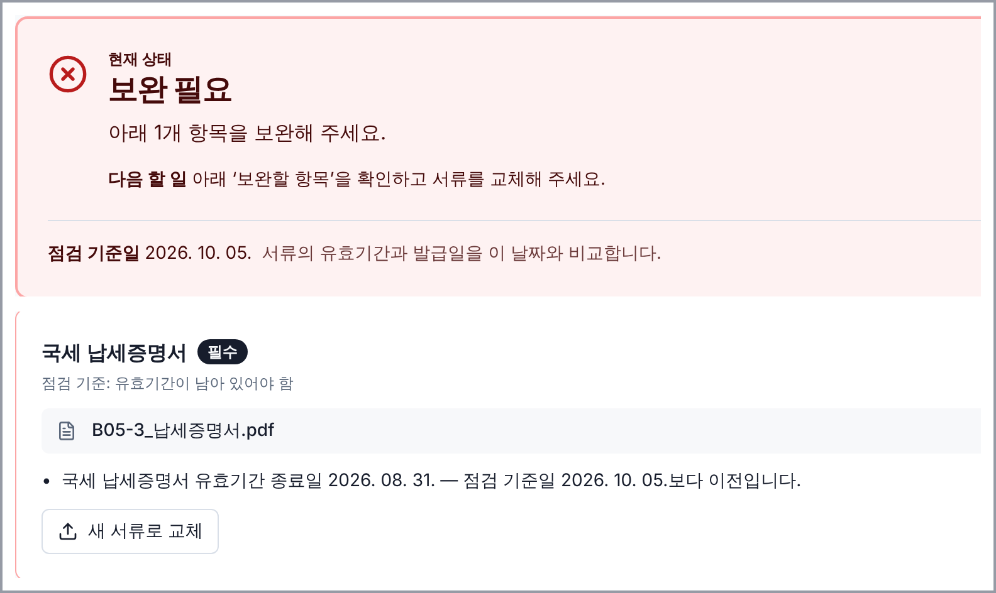
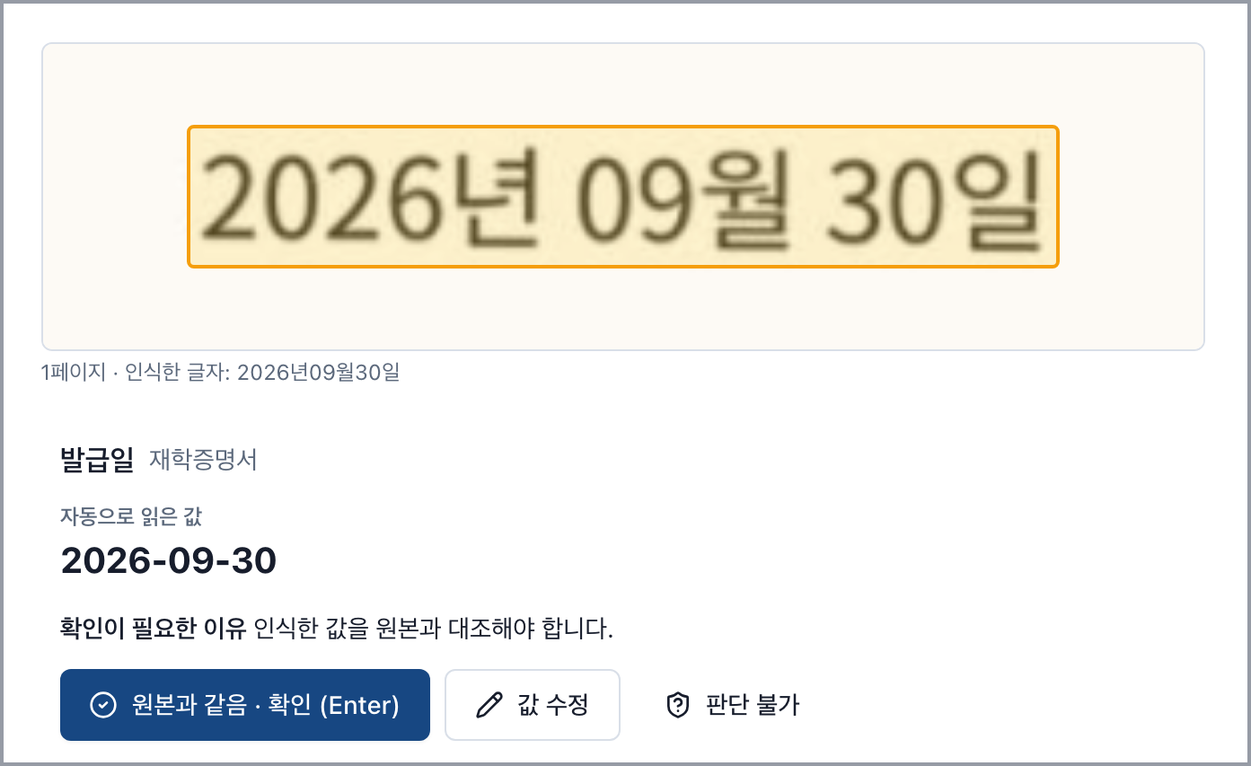
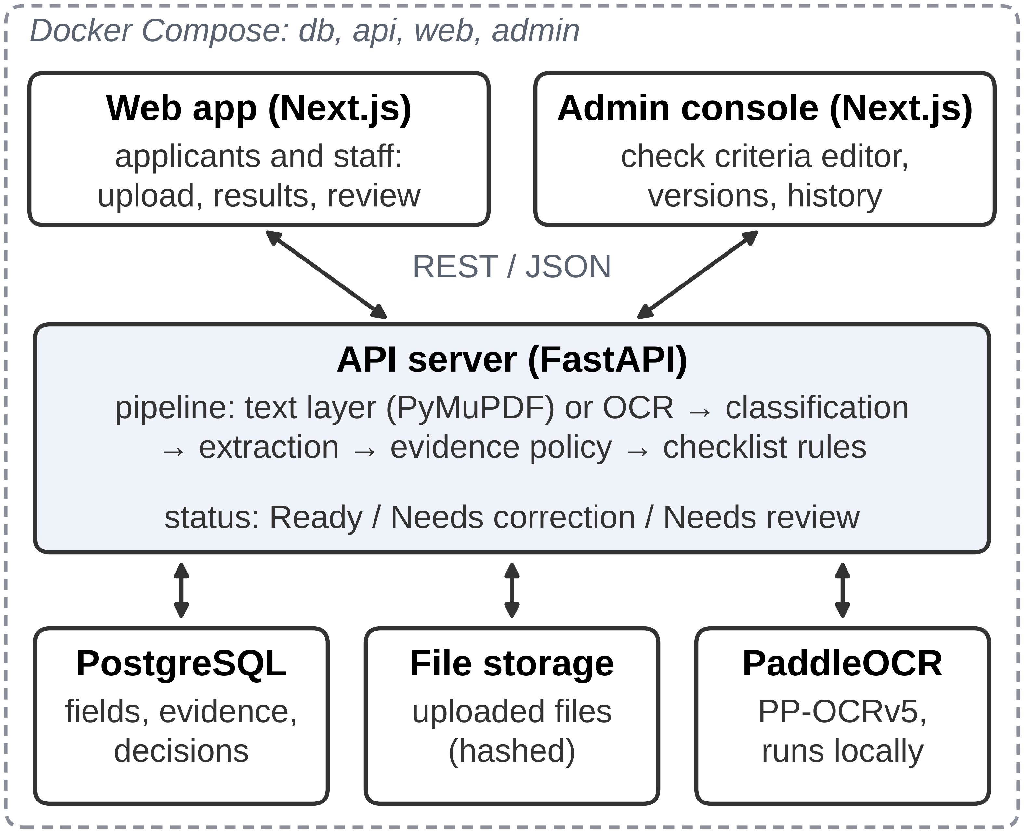
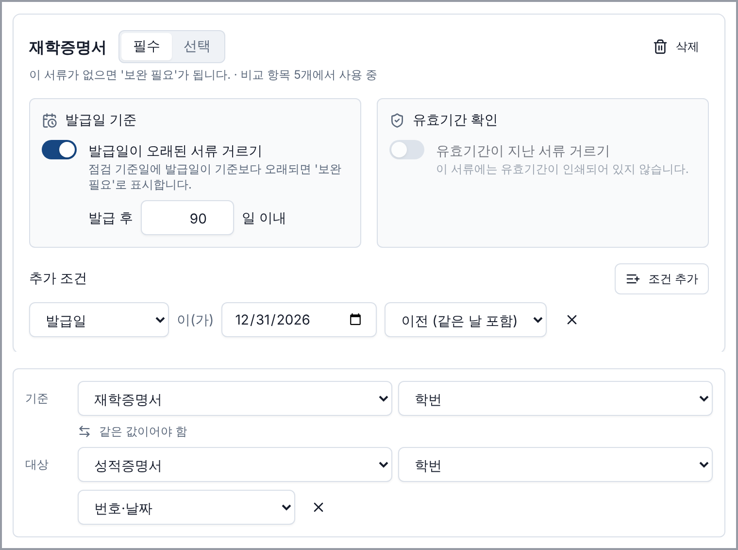
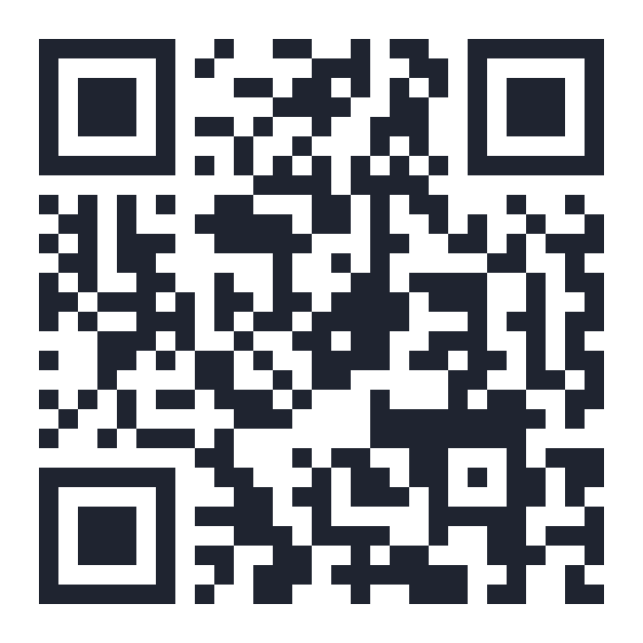
Safe Automation of Administrative Document Pre-Checks
through Cross-Document Verification
Munira Olimjonova¹, Khabibillo Gulomov¹, Hyunji Lee², Dongkyun Kim^{1,*}
¹School of Computer Science and Engineering, Kyungpook National University ²Flash21 Co., Ltd.
* Corresponding author khabibillo@knu.ac.kr
56 / 78
6.9 → 0.63
8.19 → 3.50
business submissions Ready with no staff review
items left for staff per business submission
items left for staff per student submission
1
Problem and goals
5
What users see
Staff check grant and scholarship certificates by hand. An expired certificate or another company's document can slip into the decision.
Goals: automate routine checks, never mark a submission Ready on a guess, let administrators change the rules without code, and explain every result.
2
How ADVS decides
ADVS reads each certificate (PDF text or OCR), extracts its fields and checks them against the rules. A value is accepted only when a separate source supports it; everything else goes to staff.
Value | Confirmed by
Business submission
Business registration no. | tax and insurance certificates; check digit
National tax validity | issue date + 30 days (by law)
Student submission
Name, birth date, issue date | same values on the transcript
GPA | GPA typed by the applicant
Applicant: status first, then each problem and how to fix it.
3
System architecture
Staff: confirm unsupported values next to the original, one key press.
Next.js · FastAPI · PostgreSQL · PaddleOCR (runs locally) · Docker Compose
Admin: required documents, issue-date age, validity and comparisons, with versions.
4
Validation
6
Conclusion and next steps
All 9 demonstration scenarios gave the expected result (complete, expired, mismatched, look-alike, missing, scanned).
889 back-end and 115 front-end automated tests.
Real certificates of one university and two companies as scans, photos and files: invalid submissions were never Ready.
ADVS automates routine document checks while keeping staff in control, and administrators adapt the rules without code. Next: staff accounts, electronic certificates, and more schools and companies.
Source code on GitHub
This research was supported by the MSIT, Korea, under the National Program for Excellence in SW (2021-0-01082) supervised by the IITP, and by the MSIT and NIPA through the Regional Industry SW Talent Development Infrastructure Program.

