Slide 1
How to speed up web application
by Khac Luan

Slide 2
Contents
Performance problems
Solves method
Tools

Slide 3
Method
Measure
Optimize only what's slow

Slide 4
Questions
Where is slow ?
How is it slow ?
Why is it slow ?

Slide 5
Performance problems
                ?

Slide 6
Performance problems
Images
CSS
Javascript
Download third party resources
Template
Codding
SQL
Network

Slide 7
Performance problems
Images
CSS
Javascript
Download third party resources
Template
Codding
SQL
Network

Slide 8
Images Solve
Use jpg if you can
Convert png to jpg when user upload.
Limit size
Specific width and height in HTML's img tag
Use inline base64 binary to HTML for small image
Use CSS instead of image.
Lazy loading images
Use Imagemagick to handle images.

Slide 9
Performance problems
Images
CSS
Javascript
Download third party resources
Template
Codding
SQL
Network

Slide 10
CSS Solve
Inheritance code
Compress CSS code (Minify CSS)
Remove unnecessary comments
Inline style (404.html, 500 ...)

Slide 11
Performance problems
Images
CSS
Javascript
Download third party resources
Template
Codding
SQL
Network

Slide 12
Javascript Solve
Code
Minify Code
Remove unnecessary comment
Inline script
Load external script at the bottom of page
Use async attributes
Use turbolinks

Slide 13
Performance problems
Images
CSS
Javascript
Download third party resources
Template
Codding
SQL
Network

Slide 14
Download third party resources
Server is died.
Server is so far
Server is low performances.

Slide 15
Performance problems
Images
CSS
Javascript
Download third party resources
Template
Codding
SQL
Network

Slide 16
Template
Show content has high priority
Choice a template engine better

Slide 17
Question
Should we use erb, slim or
haml template engine ?

Slide 18
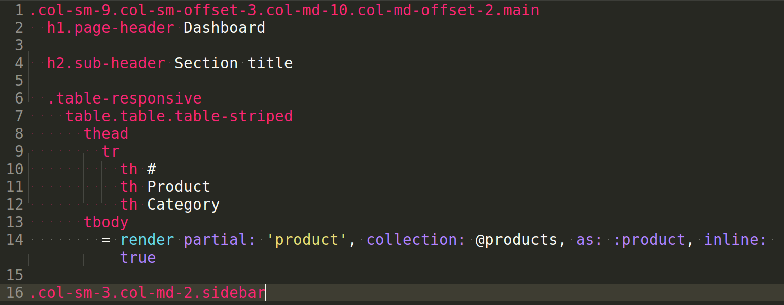
Slim

Slide 19
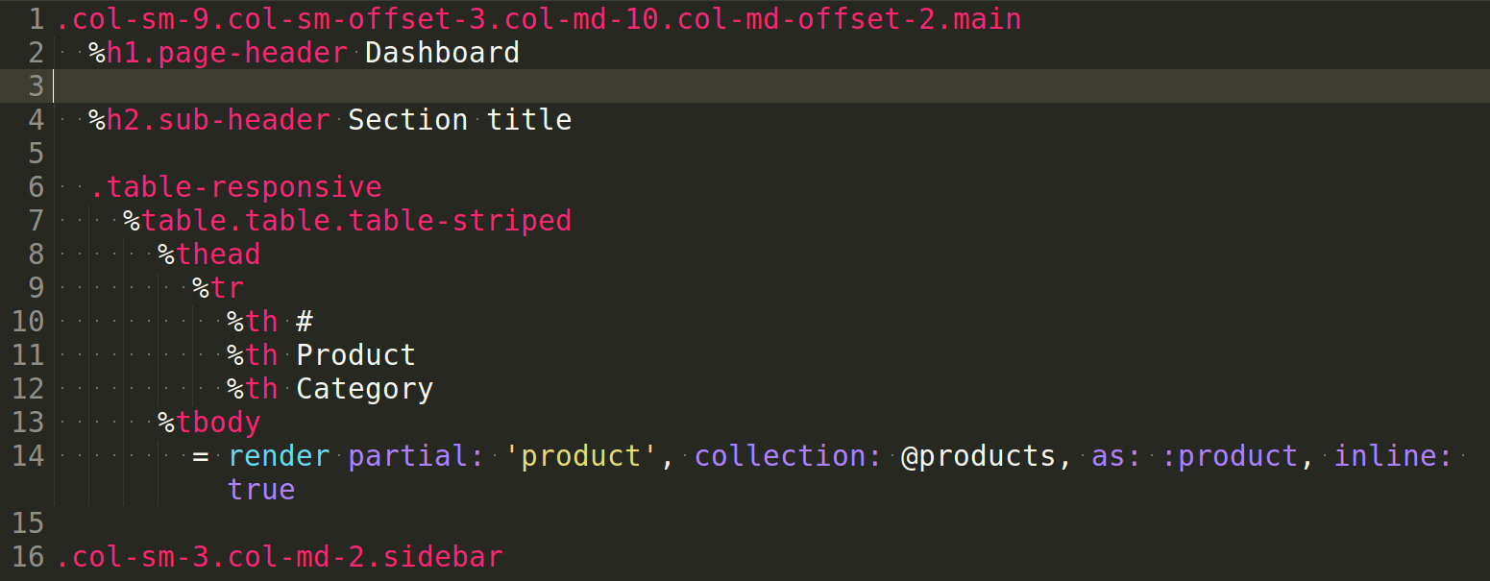
Haml

Slide 20
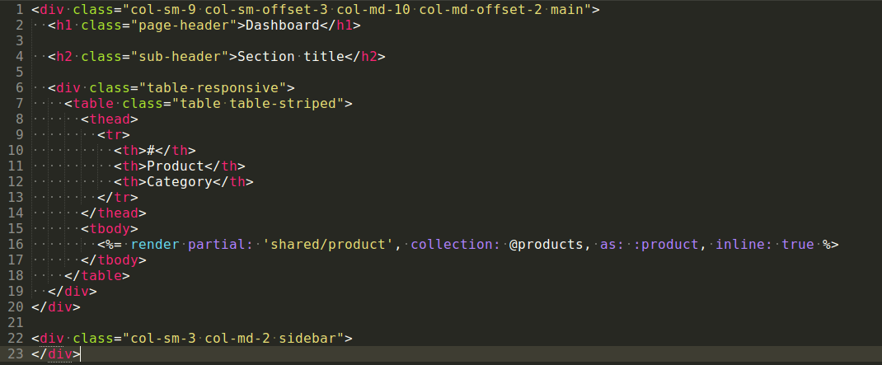
ERB

Slide 21
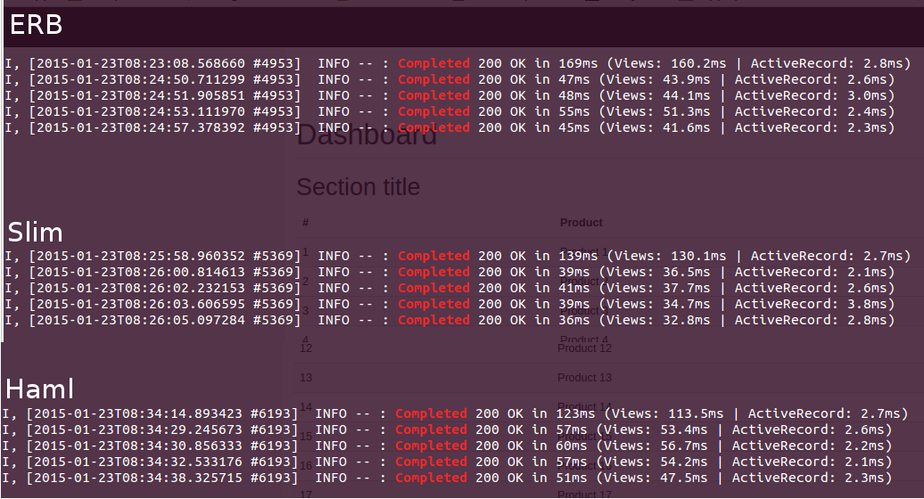
Let's benchmark
ERB : (169 + 47 + 48 + 55 + 45) / 5 = 72.8 ms
Slim : (139 + 39 + 41 + 39 + 36) / 5 = 58.8 ms
Haml : (123 + 57 + 60 + 57 + 51) / 5 = 69.6 ms

Slide 22
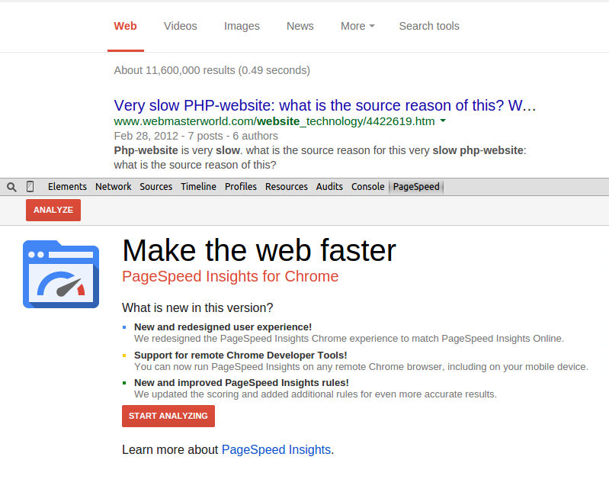
Google PageSpeed Tool

Slide 23
Performance problems
Images
CSS
Javascript
Download third party resources
Template
Codding
SQL
Network

Slide 24
Coding Ruby, Rails
Code review
Use background process (sidekiq , delayed_job, …) for long-running jobs.

Slide 25
Performance problems
Images
CSS
Javascript
Download third party resources
Template
Codding
SQL
Network

Slide 26
SQL
Index foreign key (don't add too many indexes - each one increases the DB size => reduces the performance of insert, update queries.
Eager-loading for N+1 queries
Use pluck method is fast.

Slide 27
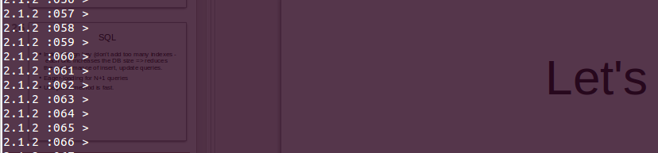
Let's benchmark

Slide 28
Performance problems
Images
CSS
Javascript
Download third party resources
Template
Codding
SQL
Network

Slide 29
Network
Cut cable
Low network , mobile network (2g, 3g)

Slide 30
Advance
Cache
E-tag

Slide 31
Tools
To measure use Benchmark
To analytics use Pagespeed , that is google plugin for chrome browser.

Slide 32
References
http://www.slideshare.net/smetana/performance-optimization-of-rails-applications
http://www.slideshare.net/snikch1/speed-up-rails-responses
http://sssslide.com/speakerdeck.com/a_matsuda/is-rails-slow

Slide 33
Thank you

