Slide 1
Khacluan,
Zigexn Ventura Co, LTD
Rspec testing

Slide 2
Content
Why do I write tests ?
TDD vs BDD
rspec style-guide
Setup rspec for rails application
Demo

Slide 3
Content
► Why do I write tests ?
TDD vs BDD
rspec style-guide
Setup rspec for rails application
Demo

Slide 4

WHY DO I WRITE TESTS ?

Slide 5

My code is perfect . Why do I write tests ?

Slide 6

Understood and happy

Slide 7
WHY DO WE WRITE TESTS ?
Guard against regressions
Gain confidence to change
Discover better designs

Slide 8
Content
Why do I write tests ?
►TDD vs BDD
rspec style-guide
Setup rspec for rails application
Demo

Slide 9
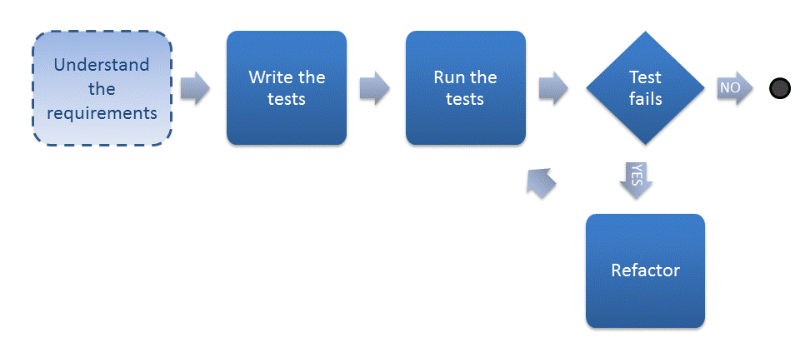
TDD

Slide 10

Difference between TDD vs Waterfall Model

Slide 11
TDD problem
Overload for developer
Acceptance Tester have no any role in TDD
developer must understand testing knowledge
► what thing to need to be test ?
► how many senarios are enough ?
► where is begin ?
► how to notice the failed test ?
.
.

Slide 12
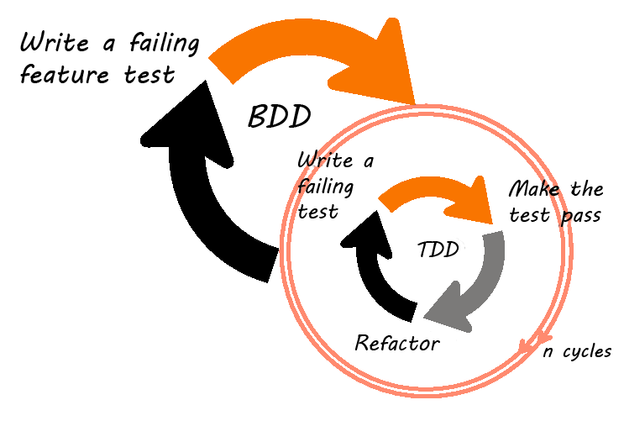
BDD

Slide 13
Content
Why do I write tests ?
TDD vs BDD
►Rspec style-guide
Setup rspec for rails application
Demo

Slide 14
Rspec style guide
https://github.com/reachlocal/rspec-style-guide

Slide 15
Content
Why do I write tests ?
TDD vs BDD
Rspec style-guide
►Setup rspec for rails application
Demo

Slide 16
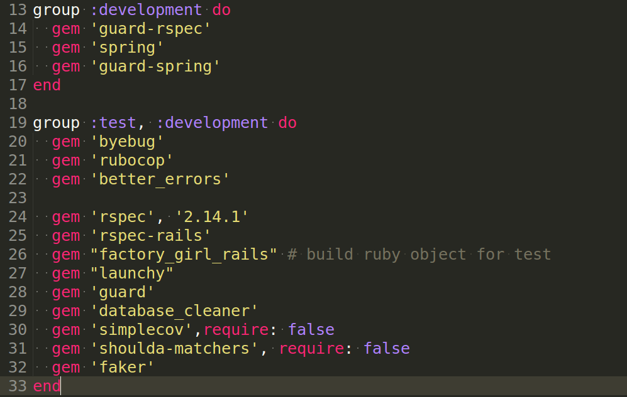
Setup Rspec

Slide 17
Setup Rspec
FactoryGirl or Fixtures ?

Slide 18
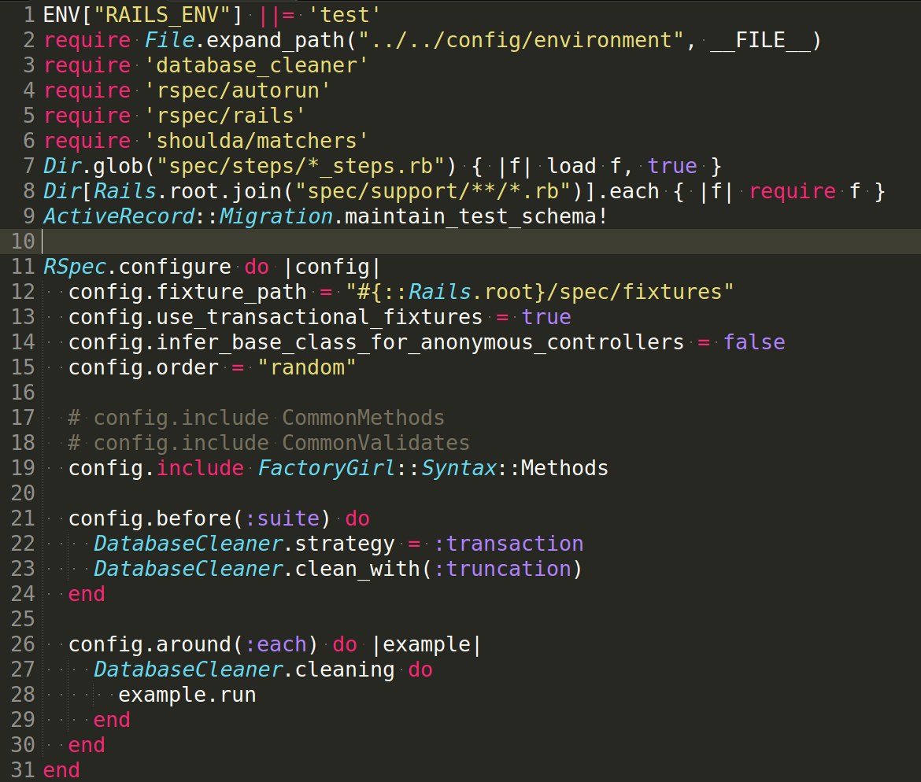
Setup Rspec

Slide 19
Let's demo

Slide 20
References
https://github.com/reachlocal/rspec-style-guide
https://github.com/abinoda/rspec-best-practices
http://blog.davidchelimsky.net/blog/2012/05/13/spec-smell-explicit-use-of-subject/

Slide 21
Have you any questions ?

Slide 22
Thanks for listening

