Slide 1
Process, Thread, Jobs

Slide 2
Content
What is process?
What is thread?
What is jobs?

Slide 3
What is process?
An executable program
Each process has an unique process id, environment variables, priority class and at least one thread of execution
A process is usually defined as an instance of a running program that consists of two components
Kernel object use to manage the process and keep statistical information
An address space contain all executable or dynamic link library

Slide 4
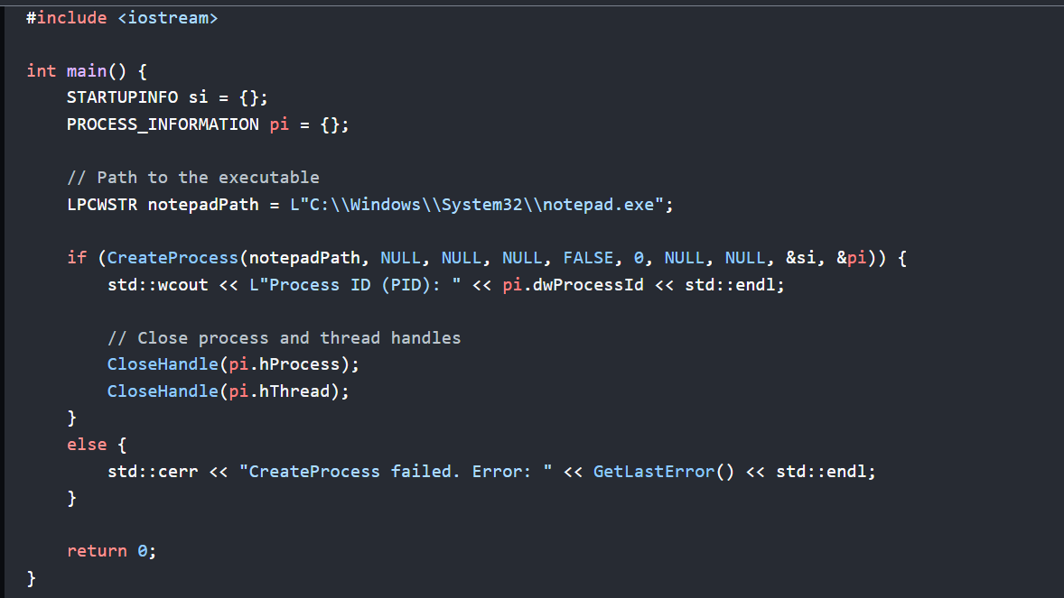
Creation of process

Slide 5
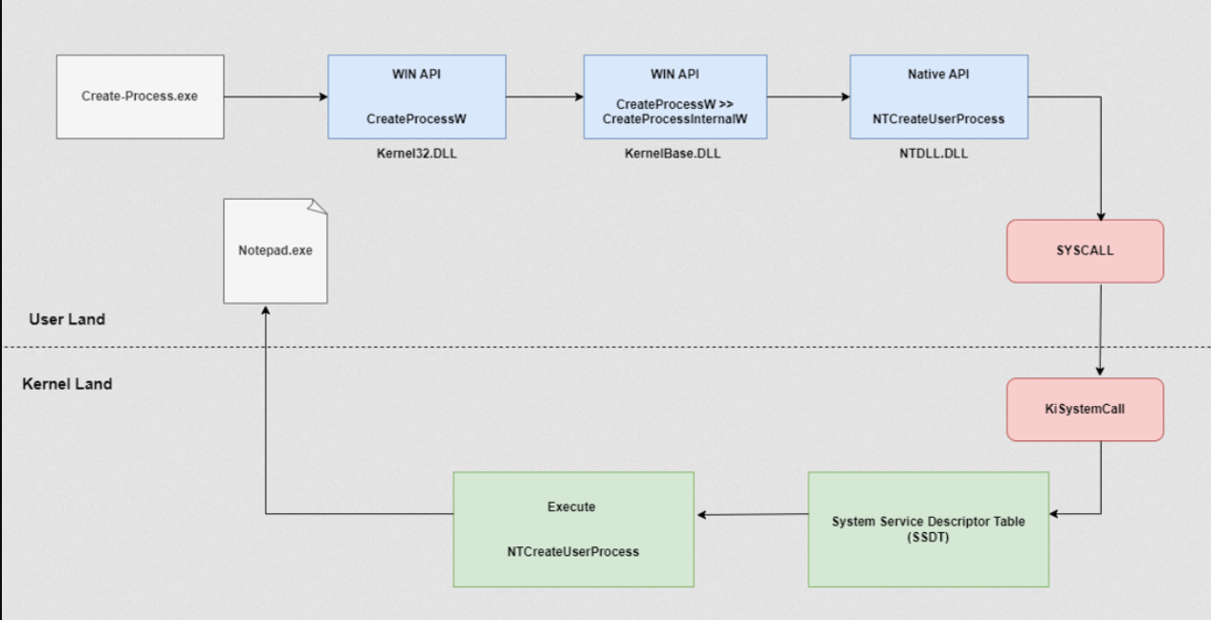
Creation of process

Slide 6
What is thread?
A unit of execution within a process
Thread within the same process share the same resources including memory space and file handles
Thread within a process can execute any part of the code that belong to the process
Without a thread, a process would not be able to run any code concurrently
There are kthread and ethread

Slide 7
Difference of kthread and ethread
Ethread (executive thread) create by user-mode
Created by CreateThread or CreateRemoteThread
Interact with kernel using system call
Kthread (kernel thread) create by kernel-mode
Handle various task such as I/O operations, resource management
Direct access to system/resources and hardware

Slide 8
What is a job?
A job is a complete unit of work under execution.
A job typically contains a group of related processes that perform specific task
Jobs allow for the management of system resources such as memory, cpu time or devices among the processed within the same job
Jobs can be used to control the startup, pause, resume, and termination of processes within them.

